Slide 1

A modular framework for working with VMs

Slide 2
Vagrant
Contents
Vagrant Overview
Getting up and Running
Configuring Vagrant boxes
Provisioning
Setting up a LAMP stack using Shell Scripts
Setting up a LAMP stack using Chef
Setting up a LAMP stack using Puppet
Setting up a LAMP stack using Ansible

Slide 3



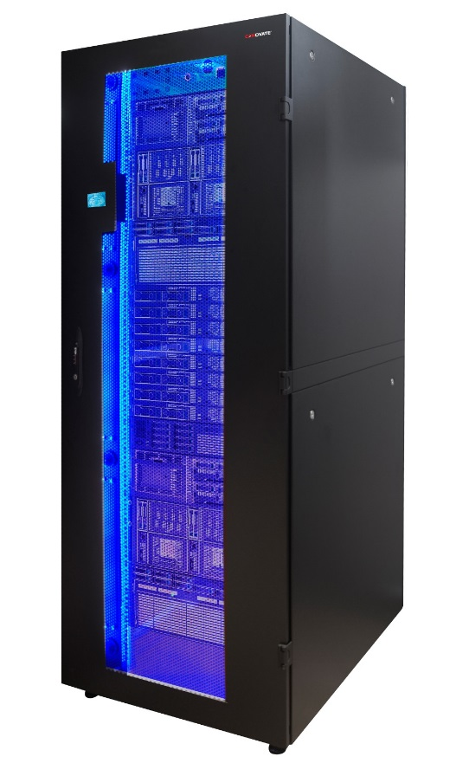








Vagrant Overview
Why Use Vagrant?
v 5.3
v 5.5
v 5.2
Production Environment
Developer A
Developer B

Slide 4



Vagrant Overview
Why Use Vagrant?
Production Environment
Developer A
Developer B

Slide 5
Vagrant Overview
Why Use Vagrant?
Create new VMs quickly and easily
Keep the number of VMs under control
Reproducibility
Identical environment in development and production
Portability
No more 4GB .ova files
Git clone and vagrant up
Notes:
Why Vagrant?
Vagrant provides easy to configure, reproducible, and portable work environments built on top of industry-standard technology and controlled by a single consistent workflow to help maximize the productivity and flexibility of you and your team.
To achieve its magic, Vagrant stands on the shoulders of giants. Machines are provisioned on top of VirtualBox, VMware, AWS, or any other provider. Then, industry-standard provisioning tools such as shell scripts, Chef, or Puppet, can be used to automatically install and configure software on the machine.

Slide 6
Vagrant Overview
What is Vagrant?
Written by Mitchell Hashimoto
an open-source software product for building and maintaining portable virtual development environments.
written in the Ruby language, but its ecosystem supports development in almost all major languages.
Vagrant uses "Provisioners" and "Providers" as building blocks to manage the development environments.
Notes:
Vagrant is an open-source software product for building and maintaining portable virtual development environments.^{[4]} The core idea behind its creation lies in the fact that the environment maintenance becomes increasingly difficult in a large project with multiple technical stacks. Vagrant manages all the necessary configurations for the developers in order to avoid the unnecessary maintenance and setup time, and increases development productivity. Vagrant is written in the Ruby language, but its ecosystem supports development in almost all major languages.

Slide 7
Vagrant Overview
Provisioners and Providers
Provisioners
”Provision” the VM
Provisioners are tools that allow users to customize the configuration of virtual environments.
Shared, repeatable config
Shell, Ansible, Chef, Puppet
Providers
Provide virtualization support
Magic VMs into existence
Providers are the services that Vagrant uses to set up and create virtual environments.
Local
(VirtualBox, VMWare, Docker)
Remote
(AWS, Digital Ocean, Openstack)
Shell Scripts
Ansible Playbooks
Puppet Modules
Chef recipes
Amazon EC2
DigitalOcean Droplet
Openstack
Nova
VirtualBox or VMWare
Local
Cloud
Notes:
Vagrant uses "Provisioners" and "Providers" as building blocks to manage the development environments. Provisioners are tools that allow users to customize the configuration of virtual environments. Puppet and Chef are the two most widely used provisioners in the Vagrant ecosystem.^{[9]} Providers are the services that Vagrant uses to set up and create virtual environments. Support for VirtualBox, Hyper-V, and Docker virtualization ships with Vagrant, while VMWare and AWS are supported via plugins.
Vagrant sits on top of virtualization software as a wrapper and helps the developer interact easily with the providers. It automates the configuration of virtual environments using Chef or Puppet, and the user does not have to directly use any other virtualization software. Machine and software requirements are written in a file called "Vagrantfile" to execute necessary steps in order to create a development-ready box. Box is a format and an extension ( .box) for Vagrant environments that is copied to another machine in order to replicate the same environment.

Slide 8
Vagrant Overview
Virtualization vs Containerization
Represents hardware-level virtualization
Heavyweight
Slow Provisioning
Limited Performance
Fully isolated and hence more secure
VIRTUAL MACHINES
CONTAINERS
Represents operating system virtualization
Lightweight
Real-time provisioning and scability
Native Performance
Process-level isolation and hence less secure
App
App
App
Guest OS
Guest OS
Guest OS
App
App
App
App
Hypervisor
Docker Engine
Host operating system
Host operating system
Host hardware
Host hardware
Notes:
Containerization -- also called container-based virtualization and application containerization -- is an OS-level virtualization method for deploying and running distributed applications without launching an entire VM for each application. Instead, multiple isolated systems, called containers, are run on a single control host and access a single kernel.
Because containers share the same OS kernel as the host, containers can be more efficient than VMs, which require separate OS instances.
Containers hold the components necessary to run the desired software, such as files, environment variables and libraries. The host OS also constrains the container's access to physical resources -- such as CPU and memory -- so a single container cannot consume all of a host's physical resources.
Advantages of containerization
Proponents of containerization point to gains in efficiency for memory, CPU and storage as key benefits of this approach, compared with traditional virtualization. Because containers do not have the overhead required by VMs -- separate OS instances -- it is possible to support many more containers on the same infrastructure. As such, containerization improves performance because there is just one OS taking care of hardware calls.
Disadvantages of containerization
A potential drawback of containerization is lack of isolation from the host OS. Because containers share a host OS, security threats have easier access to the entire system when compared with hypervisor-based virtualization. One approach to addressing this security concern has been to create containers from within an OS running on a VM. This approach ensures if a security breach occurs at the container level, the attacker can only gain access to that VM's OS, not other VMs or the physical host.
A Docker container is a software bucket comprising everything necessary to run the software independently. There can be multiple Docker containers in a single machine and containers are completely isolated from one another as well as from the host machine.
In other words, a Docker container includes a software component along with all of its dependencies (binaries, libraries, configuration files, scripts, jars, and so on). Therefore, the Docker containers could be fluently run on x64 Linux kernel supporting namespaces, control groups, and file systems, such as Another Union File System (AUFS). However, there are pragmatic workarounds for running Docker on other mainstream operating systems, such as Windows, Mac, and so on. The Docker container has its own process space and network interface. It can also run things as root, and have its own /sbin/init, which can be different from the host machines’.
In a nutshell, the Docker solution lets us quickly assemble composite, enterprise-scale, and business-critical applications. For doing this, we can use different and distributed software components: Containers eliminate the friction that comes with shipping code to distant locations. Docker also lets us test the code and then deploy it in production as fast as possible. The Docker solution primarily consists of the following components:
The Docker engine
The Docker Hub
The Docker engine is for enabling the realization of purpose-specific as well as generic Docker containers. The Docker Hub is a fast-growing repository of the Docker images that can be combined in different ways for producing publicly findable, network-accessible, and widely usable containers.
A hypervisor or virtual machine monitor (VMM) is computer software, firmware, or hardware, that creates and runs virtual machines. A computer on which a hypervisor runs one or more virtual machines is called a host machine, and each virtual machine is called a guest machine. The hypervisor presents the guest operating systems with a virtual operating platform and manages the execution of the guest operating systems. Multiple instances of a variety of operating systems may share the virtualized hardware resources: for example, Linux, Windows, and OS X instances can all run on a single physical x86 machine. This contrasts with operating-system-level virtualization, where all instances (usually called containers) must share a single kernel, though the guest operating systems can differ in user space, such as different Linux distributions with the same kernel.
However, virtualization technology has serious drawbacks, such as performance degradation due to the heavyweight nature of virtual machines(VM), the lack of application portability, slowness in provisioning of IT resources, and so on.
Containerization vs Virtualization
It is pertinent, and paramount to extract and expound the game-changing advantages of the Docker-inspired containerization movement over the widely used and fully matured virtualization paradigm. In the containerization paradigm, strategically sound optimizations have been accomplished through a few crucial and well-defined rationalizations and the insightful sharing of the compute resources. Some of the innate and hitherto underutilized capabilities of the Linux kernel have been rediscovered. These capabilities have been rewarded for bringing in much-wanted automation and acceleration, which will enable the fledgling containerization idea to reach greater heights in the days ahead, especially those of the cloud era.
Figure 2: Containerization vs Virtualization
The noteworthy business and technical advantages of these include the bare metal-scale performance, real-time scalability, higher availability, and so on. All the unwanted bulges and flab are being sagaciously eliminated to speed up the roll-out of hundreds of application containers in seconds and to reduce the time taken for marketing and valuing in a cost-effective fashion. The following diagram (figure 2) on the left-hand side depicts the virtualization aspect, whereas the diagram on the right-hand side vividly illustrates the simplifications that are being achieved in the containers.
The following table gives a direct comparison between virtual machines and containers:
Which one is better?
As always, it depends on your needs. If you just want to have a number of separate instances to run applications, a container environment often provides greater efficiency, both in managing the application environment, starting the application instances, and in resource consumption. Simple modification and deployment of application environments has been a design principle of container solutions like Docker and is entirely in the DevOps spirit (guess you just have been waiting for more buzzwords).
If you want to have best isolation of environments and come from a server virtualization perspective, then system virtualization may be more relevant: Noisy neighbours are much less of an issue than with containers. While many of the container folks currently focus on improving container isolation, virtual machine isolation is still superior. Coming from physical servers, virtual servers are a natural step, and an existing ecosystem around server management can often be applied to virtual servers, too.
On z systems, Linux has good scalability (to run containers), but z is the platform with an extremely efficient virtualization technology (to run virtual servers), and it is inherent in the entire system architecture. Without having measured it, combining the technologies is probably less painful on z Systems than on other platforms.

Slide 9
Vagrant Overview
Workflow
vagrant box add
Pull vagrant base box
Environment works?
vagrant ssh
Login into VM
vagrant init
Preparation
vagrant provision
Yes
vagrant up
Update Software
No
Test, Build Software
First Run
vagrant halt
vagrant suspend
vagrant destroy
Reconfigure
Remove VM
No
Shutdown VM
Hibernate VM
Remove VM
State?
Reconfigure
Yes

Slide 10
Vagrant Overview
Installation
Install VirtualBox
Windows hosts
OS X hosts
Linux distributions
Solaris hosts
Install Vagrant
MAC OS X : Universal (32 and 64-bit)
WINDOWS : Universal (32 and 64-bit)
DEBIAN : 32-bit | 64-bit
CENTOS : 32-bit | 64-bit

Slide 11
Getting up and Running
Minimal default setup
$ vagrant init centos/7
A `Vagrantfile` has been placed in this directory. You are now ready to `vagrant up` your first virtual environment! Please read the comments in the Vagrantfile as well as documentation on `vagrantup.com` for more information on using Vagrant.
==> default: Waiting for machine to boot. This may take a few minutes...
default: SSH address: 127.0.0.1:2200 default: SSH username: vagrant
default: SSH auth method: private key
default: Warning: Connection timeout. Retrying...
default:
default: Vagrant insecure key detected. Vagrant will automatically replace
default: this with a newly generated keypair for better security.
default:
default: Inserting generated public key within guest... default: Removing insecure key from the guest if it's present...
default: Key inserted! Disconnecting and reconnecting using new SSH key...
==> default: Machine booted and ready!
==> default: Checking for guest additions in VM...
default: No guest additions were detected on the base box for this VM! Guest
default: additions are required for forwarded ports, shared folders, host only
default: networking, and more. If SSH fails on this machine, please install
default: the guest additions and repackage the box to continue.
default:
default: This is not an error message; everything may continue to work properly,
default: in which case you may ignore this message.
==> default: Installing rsync to the VM...
==> default: Rsyncing folder: /home/bert/Downloads/test/ => /home/vagrant/sync
$ vagrant up
Bringing machine 'default' up with 'virtualbox' provider...
==> default: Box 'centos/7' could not be found. Attempting to find and install...
default: Box Provider: virtualbox
default: Box Version: >= 0
==> default: Loading metadata for box 'centos/7'
default: URL: https://atlas.hashicorp.com/centos/7
==> default: Adding box 'centos/7' (v1505.01) for provider: virtualbox
default: Downloading: https://atlas.hashicorp.com/centos/boxes/7/versions/1505.01/providers/virtualbox.box
==> default: Box download is resuming from prior download progress
==> default: Successfully added box 'centos/7' (v1505.01) for 'virtualbox'!
==> default: Importing base box 'centos/7'...
==> default: Matching MAC address for NAT networking...
==> default: Checking if box 'centos/7' is up to date...
==> default: Setting the name of the VM: test_default_1441636487571_53914
==> default: Fixed port collision for 22 => 2222. Now on port 2200.
==> default: Clearing any previously set network interfaces...
==> default: Preparing network interfaces based on configuration... default: Adapter 1: nat
==> default: Forwarding ports... default: 22 => 2200 (adapter 1)
==> default: Booting VM...
$ vagrant ssh
[vagrant@localhost ~]$ cat /etc/redhat-release CentOS Linux release 7.1.1503 (Core) [vagrant@localhost ~]$
Notes:
Vagrant init
creates a vagrantfile
Vagrant up
The base box is downloaded and stored locally
in ~/.vagrant.d/boxes/
A new VM is created and configured with the base box as template
The VM is booted
The box is provisioned
only the first time, must be done manually afterwards
Vagrant ssh
ssh into virtual machine

Slide 12
Configuring Vagrant boxes
Vagrantfile
Minimal Vagrantfile:
VAGRANTFILE_API_VERSION = '2'
Vagrant.configure(VAGRANTFILE_API_VERSION) do |config|
config.vm.box = 'centos/7'
end
Finding base boxes
Hosted by Hashicorp: https://atlas.hashicorp.com/
3rd party repository: http://vagrantbox.es/
Vagrantfile that specifies a custom base box:
$ vagrant box add --name centos71-nocm \ https://tinfbo2.hogent.be/pub/vm/centos71-nocm-1.0.16.box
$ vagrant init centos71-nocm
VAGRANTFILE_API_VERSION = '2'
Vagrant.configure(VAGRANTFILE_API_VERSION) do |config|
config.vm.box = 'centos71-nocm'
config.vm.box_url = 'https://tinfbo2.hogent.be/pub/vm/centos71-nocm-1.0.16.box'
end
Notes:
Vagrant init
creates a vagrantfile
Vagrant up
The base box is downloaded and stored locally
in ~/.vagrant.d/boxes/
A new VM is created and configured with the base box as template
The VM is booted
The box is provisioned
only the first time, must be done manually afterwards
Vagrant ssh
ssh into virtual machine

Slide 13
Configuring Vagrant boxes
Vagrantfile
Adding Network Address on Vagrant boxes:
VAGRANTFILE_API_VERSION = '2'
HOST_NAME = 'box001'
Vagrant.configure(VAGRANTFILE_API_VERSION) do |config|
config.vm.hostname = HOST_NAME
config.vm.box = 'centos/7'
config.vm.network :private_network, ip: '192.168.56.65', netmask: '255.255.255.0‘
end
Applying changes:
When you change the Vagrantfile, do:
$ vagrant reload
Or, if the change is profound:
$ vagrant destroy –f
$ vagrant up
Notes:
Vagrant init
creates a vagrantfile
Vagrant up
The base box is downloaded and stored locally
in ~/.vagrant.d/boxes/
A new VM is created and configured with the base box as template
The VM is booted
The box is provisioned
only the first time, must be done manually afterwards
Vagrant ssh
ssh into virtual machine

Slide 14
Configuring Vagrant boxes
Vagrantfile
Setup with multiple VMs:
VAGRANTFILE_API_VERSION = '2'
Vagrant.configure(VAGRANTFILE_API_VERSION) do |config|
config.vm.define 'box001' do |node|
node.vm.hostname = 'box001'
node.vm.box = 'centos/7'
node.vm.network :private_network, ip: '192.168.56.65', netmask: '255.255.255.0‘
node.vm.provider :virtualbox do |vb|
vb.name = 'box001'
end
end
config.vm.define 'box002' do |node|
node.vm.hostname = 'box002'
node.vm.box = 'centos/7'
node.vm.network :private_network, ip: '192.168.56.66', netmask: '255.255.255.0'
node.vm.provider :virtualbox do |vb|
vb.name = 'box002'
end
end
end
Notes:
Vagrant init
creates a vagrantfile
Vagrant up
The base box is downloaded and stored locally
in ~/.vagrant.d/boxes/
A new VM is created and configured with the base box as template
The VM is booted
The box is provisioned
only the first time, must be done manually afterwards
Vagrant ssh
ssh into virtual machine

Slide 15
Provisioning
Using Shell Scripts
Inline Scripts
Vagrant.configure("2") do |config|
config.vm.provision "shell", inline: "echo Hello, World"
end
Sample script for installing apache2
config.vm.provision "shell", inline: <<-SHELL
apt-get update
apt-get install -y apache2 vim
SHELL
External Scripts
Vagrant.configure("2") do |config|
config.vm.provision "shell", path: "script.sh"
end
Vagrant.configure("2") do |config|
config.vm.provision "shell", path: "https://example.com/provisioner.sh"
end
Notes:
Vagrant init
creates a vagrantfile
Vagrant up
The base box is downloaded and stored locally
in ~/.vagrant.d/boxes/
A new VM is created and configured with the base box as template
The VM is booted
The box is provisioned
only the first time, must be done manually afterwards
Vagrant ssh
ssh into virtual machine

Slide 16
Provisioning
Using Shell Scripts
Inline Scripts
Vagrant.configure("2") do |config|
config.vm.provision "shell", inline: "echo Hello, World"
end
Sample script for installing apache2
config.vm.provision "shell", inline: <<-SHELL
apt-get update
apt-get install -y apache2 vim
SHELL
External Scripts
Vagrant.configure("2") do |config|
config.vm.provision "shell", path: "script.sh"
end
Vagrant.configure("2") do |config|
config.vm.provision "shell", path: "https://example.com/provisioner.sh"
end
Notes:
Vagrant init
creates a vagrantfile
Vagrant up
The base box is downloaded and stored locally
in ~/.vagrant.d/boxes/
A new VM is created and configured with the base box as template
The VM is booted
The box is provisioned
only the first time, must be done manually afterwards
Vagrant ssh
ssh into virtual machine

Slide 17
Provisioning
Using Chef Solo
Sample Vagrantfile with Chef
Vagrant.configure("2") do |config|
config.vm.box = "precise32"
config.vm.box_url = http://files.vagrantup.com/precise32.box
config.vm.network :forwarded_port, guest: 80, host: 8888
config.vm.provision :chef_solo do |chef|
chef.add_recipe "apache2" chef.json = { :apache => { default_site_enabled => true } }
end
end
Notes:
Vagrant init
creates a vagrantfile
Vagrant up
The base box is downloaded and stored locally
in ~/.vagrant.d/boxes/
A new VM is created and configured with the base box as template
The VM is booted
The box is provisioned
only the first time, must be done manually afterwards
Vagrant ssh
ssh into virtual machine

Slide 18
Provisioning
Using Puppet
# /path/to/project/puppet/manifests/base.pp
class apache {
# Ensures Apache2 is installed
package { 'apache2':
name => 'apache2-mpm-prefork', # httpd if CentOS
ensure => installed,
}
# Ensures the Apache service is running
service { 'apache2':
ensure => 'apache2', # httpd if CentOS
ensure => running,
require => Package['apache2'],
}
}
# ...
include apache
Sample Vagrantfile with Puppet
Vagrant::Config.run do |config|
config.vm.box = "precise64"
config.vm.box_url = "http://files.vagrantup.com/precise64.box"
config.vm.provision :puppet do |puppet|
puppet.manifests_path = "puppet/manifests"
puppet.manifest_file = "base.pp"
end
end
Notes:
Vagrant init
creates a vagrantfile
Vagrant up
The base box is downloaded and stored locally
in ~/.vagrant.d/boxes/
A new VM is created and configured with the base box as template
The VM is booted
The box is provisioned
only the first time, must be done manually afterwards
Vagrant ssh
ssh into virtual machine

Slide 19
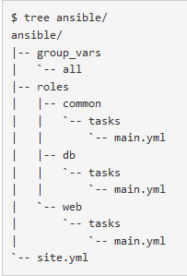
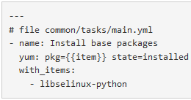
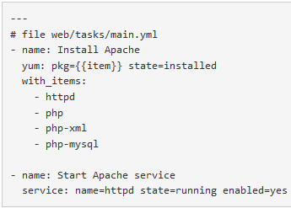
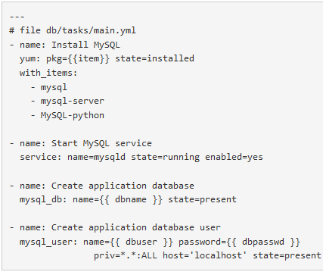
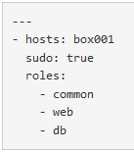
Provisioning
Using Ansible playbook
Sample Vagrantfile with Ansible
Project Structure:
Common Role
Web Role
VAGRANTFILE_API_VERSION = '2'
hosts = [ { name: 'box001', ip: '192.168.56.65' },
{ name: 'box002', ip: '192.168.56.66' } ]
Vagrant.configure(VAGRANTFILE_API_VERSION) do |config|
config.vm.box = 'centos/7'
hosts.each do |host|
config.vm.define host[:name] do |node|
node.vm.hostname = host[:name]
node.vm.network :private_network,
ip: host[:ip],
netmask: '255.255.255.0'
node.vm.synced_folder 'html', '/var/www/html‘
node.vm.provider :virtualbox do |vb|
vb.name = host[:name]
end
node.vm.provision 'ansible' do |ansible|
ansible.playbook = 'ansible/site.yml'
end
end
end
end
DB Role
site.yml
Notes:
Vagrant init
creates a vagrantfile
Vagrant up
The base box is downloaded and stored locally
in ~/.vagrant.d/boxes/
A new VM is created and configured with the base box as template
The VM is booted
The box is provisioned
only the first time, must be done manually afterwards
Vagrant ssh
ssh into virtual machine

