Slide 1
Git
1. v1.0

Slide 2
Loading
1. git init
2. checkout repos :
3. cd github/
git clone https://github.com/johnvl01/github

Slide 3
Creating github repos
git remote add origin https://github.com/johnvl01/github.git
# checking your remote :
# git remote -v
#origin https://github.com/johnvl01/github.git (fetch)
#origin https://github.com/johnvl01/github.git (push)
git push -u origin master

Slide 4
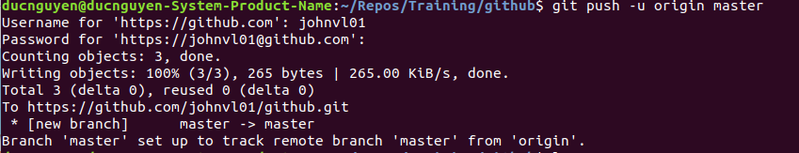

Slide 5
3.4 Remoing files
git rm is nto the oppostie of “ git add”
1. git rm -f
2. git rm –cache
Rm
3. rm
git add

Slide 6
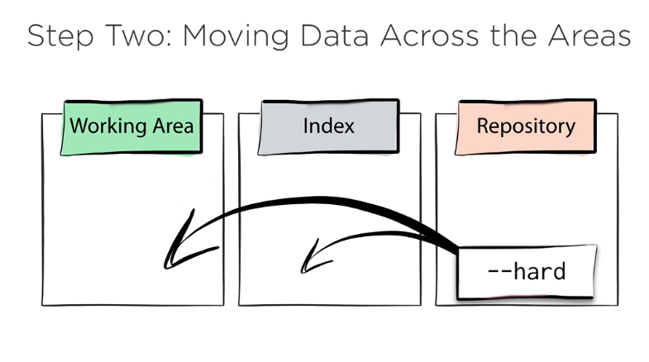
Reset
Reset moves the cureent branch from the Repository to the other areas.

Slide 7
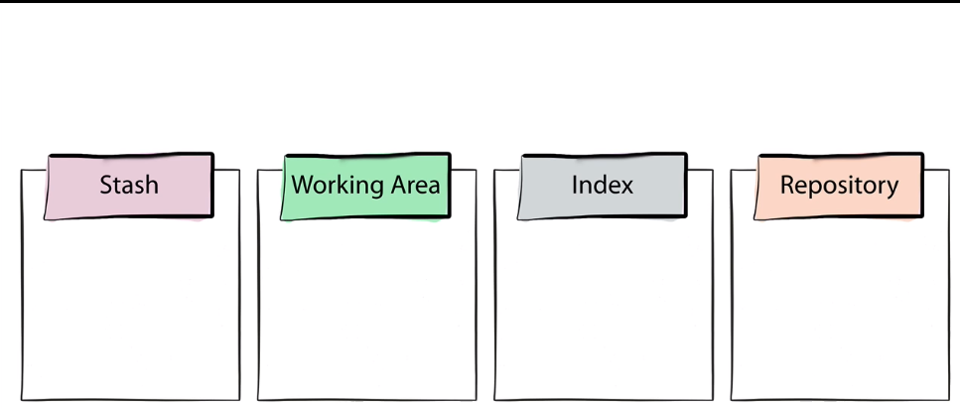
5. The Stash

Slide 8
5. The Stash
git stash –include-untracked
#save working dir and index state WIP of master .
Other commands :
1. git stash list
2. git stash clear # del stash .

Slide 9
5.3. working with paths
1. git add . # add all files
2. git reset HEAD --hard

Slide 10
6. History

Slide 11
6.2. Comit by any other name *
Explore :
git log --graph --decorate --oneline
git show
git show HEAD
git show HEAD^ ( parent of HEAD )
git show HEAD^^
or git show HEAD~2 ( go back )
HEAD~2^2 ?
HEAD@{“1 month ago”}

Slide 12
Git blame
Git diff HEAD HEAD~2

Slide 13
Browsing the log
1. git log --graph --decorate –oneline
2. git help log
3. git log --patch
4. git log --grep apples –oneline
5. git log -Gapples --patch

Slide 14
Chagin the latest commit
Git commit --amend

Slide 15
7.3 _Interactive Rebases *

Slide 16
8. workflow
git reflog HEAD

Slide 17
8.4_Constraints

Slide 18
8.5_We Need to Talk About GitFlow

