Slide 1
NOVATECH SOLUTIONS
Integrated workforce dashboard
FY2023 close · Board pack for FY2024–FY2026

Slide 2
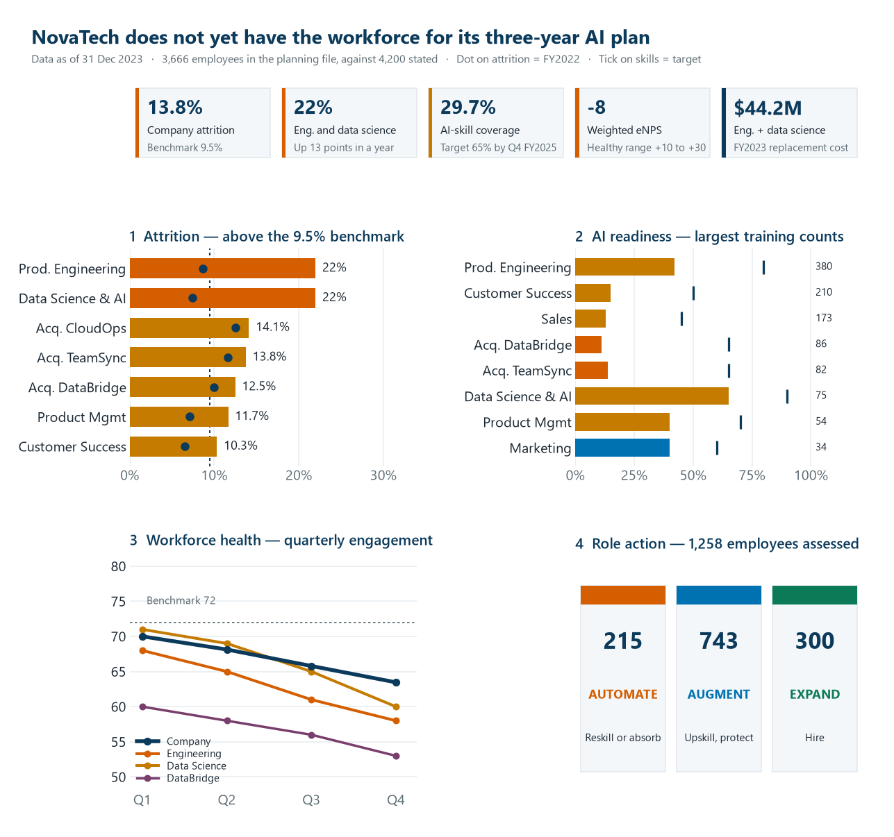

Slide 3
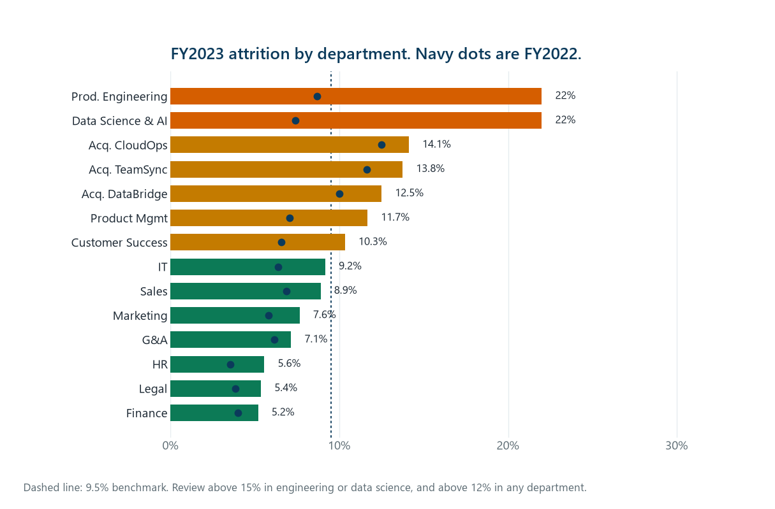

Slide 4
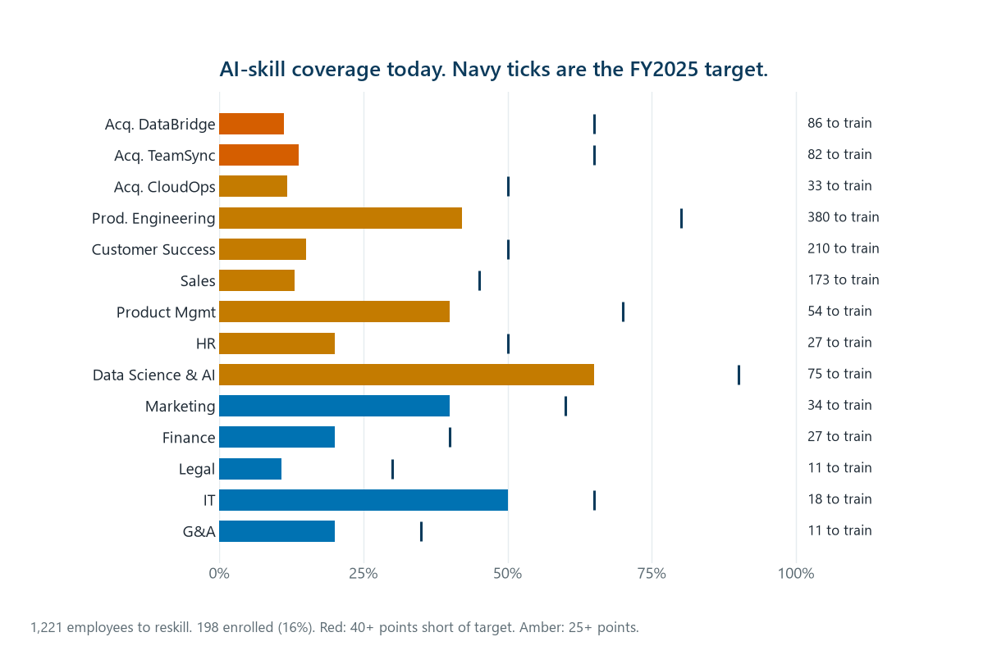

Slide 5
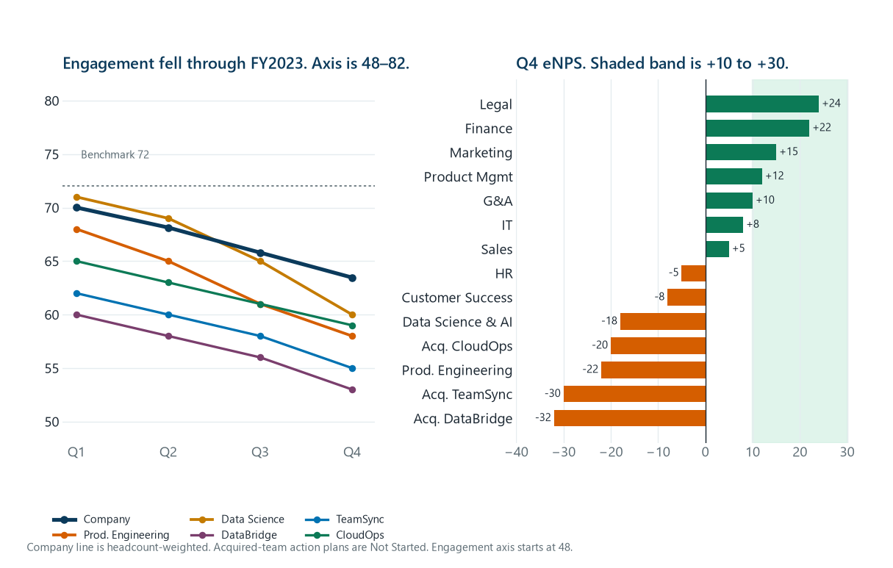

Slide 6


