Slide 1
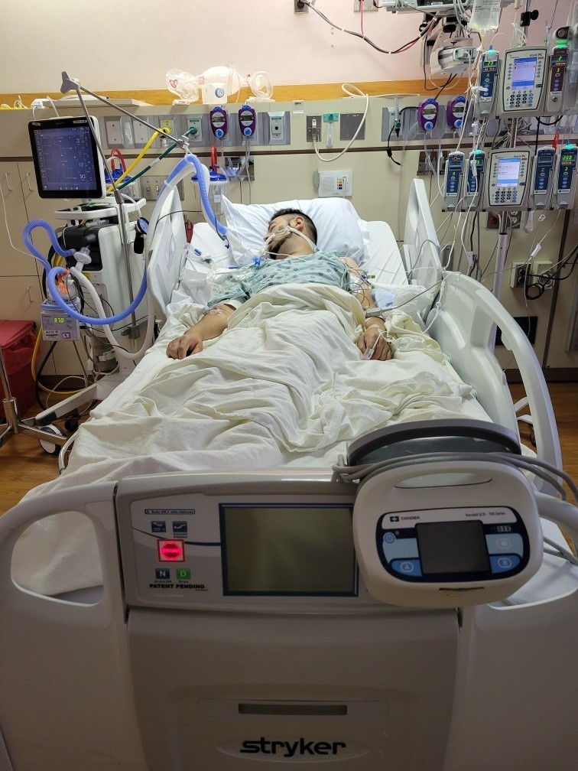

Interpretable Machine Learning Model to Predict and Influence Mortality of Patients with Heart Failure Warded in Intensive Care Unit
Wong chi keong john
3 jan 2022
General assembly
Data science immersive flex 2
Capstone project

Slide 2
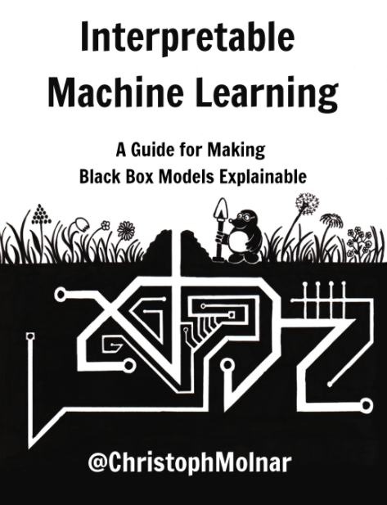
Data Science Process
Objective
Collect
Explore
Engineer feature
Build model
Conclude on objective
Deployment workflow
Develop interpretable machine learning model to predict and influence mortality of patients with heart failure warded in intensive care unit
Interpretable
“Interpretability is the degree to which a human can understand the cause of a decision.”
“Interpretability is the degree to which a human can consistently predict the model’s result”

Slide 3
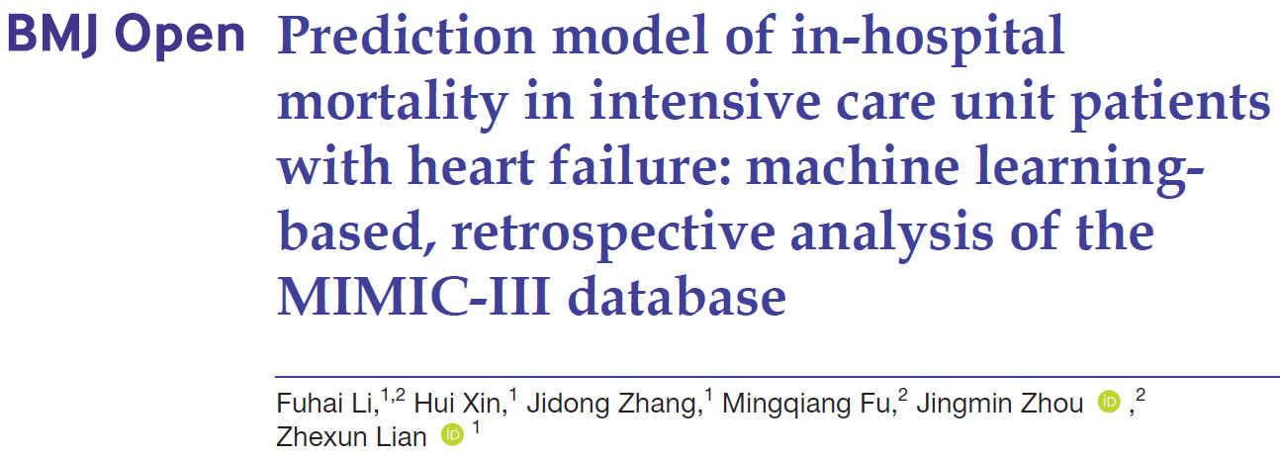
Data Science Process
Objective
Collect
Explore
Engineer feature
Build model
Conclude on objective
Deployment workflow
Data from Kaggle
https://www.kaggle.com/saurabhshahane/in-hospital-mortality-prediction
Paper from journal
https://bmjopen.bmj.com/content/11/7/e044779

Slide 4
Data Science Process
Objective
Collect
Explore
Engineer feature
Build model
Conclude on objective
Deployment workflow
Data frame size
51 variables × 1,177 cases
Variable type, category count, encoding
Missing
Duplicate
Imbalance
Multicollinearity

Slide 5
Data Science Process
Objective
Collect
Explore
Engineer feature
Build model
Conclude on objective
Deployment workflow
Data frame size
Variable type, category count, encoding
11 features ⇒ Categorical, binary, encoded in numeric
38 features ⇒ Continuous
Target ⇒ Categorical, binary, encoded in numeric
ID feature ⇒ Drop
Missing
Duplicate
Imbalance
Multicollinearity
No need one hot encoding

Slide 6
Data Science Process
Objective
Collect
Explore
Engineer feature
Build model
Conclude on objective
Deployment workflow
Data frame size
Variable type, category count, encoding
Missing
8 features have missing values from 12.2% to 25.0%
11 features have missing values from 0.1% to 3.1%
Target (“outcome”) has 1 missing value
Duplicate
Imbalance
Multicollinearity
Drop because too much to impute without affecting original probability distribution

Slide 7
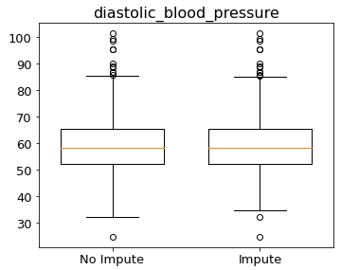
Data Science Process
Objective
Collect
Explore
Engineer feature
Build model
Conclude on objective
Deployment workflow
Data frame size
Variable type, category count, encoding
Missing
8 features have missing values from 12.2% to 25.0%
11 features have missing values from 0.1% to 3.1%
Target (“outcome”) has 1 missing value
Duplicate
Imbalance
Multicollinearity
Impute using KNNImputer with neighbouring samples = 5
Check original probability distribution not significantly affected (change in outliers, percentile and whiskers values)

Slide 8
Data Science Process
Objective
Collect
Explore
Engineer feature
Build model
Conclude on objective
Deployment workflow
Data frame size
Variable type, category count, encoding
Missing
8 features have missing values from 12.2% to 25.0%
11 features have missing values from 0.1% to 3.1%
Target (“outcome”) has 1 missing value
Duplicate
Imbalance
Multicollinearity
Drop missing case before train test split

Slide 9
Data Science Process
Objective
Collect
Explore
Engineer feature
Build model
Conclude on objective
Deployment workflow
Data frame size
Variable type, category count, encoding
Missing
Duplicate
No duplicate cases
Imbalance
Multicollinearity

Slide 10
Data Science Process
Objective
Collect
Explore
Engineer feature
Build model
Conclude on objective
Deployment workflow
Data frame size
Variable type, category count, encoding
Missing
Duplicate
Imbalance
Die (“1”) at 13.5%
Live (“0”) at 86.5%
Multicollinearity
Need to oversample minority category using SMOTE

Slide 11
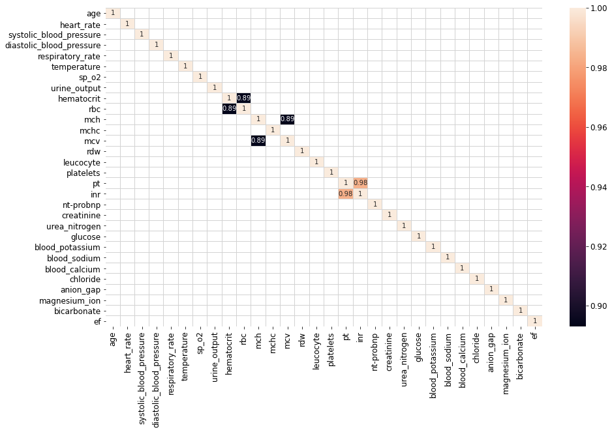
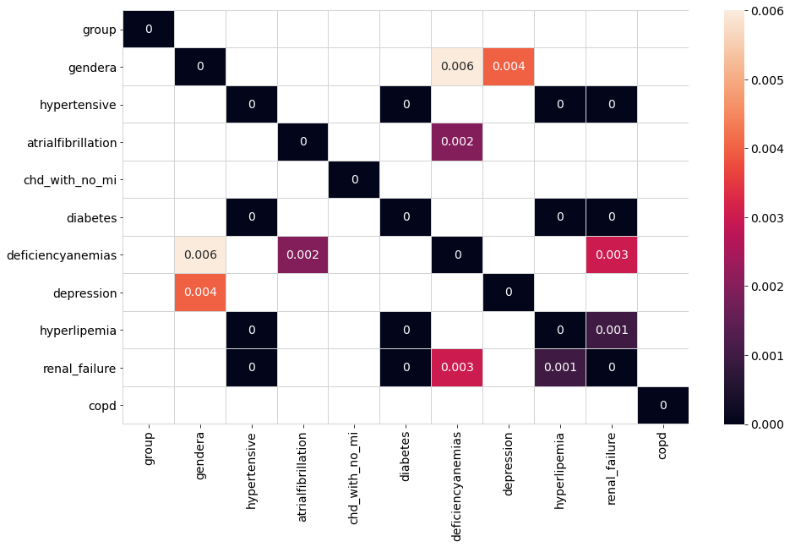
Data Science Process
Objective
Collect
Explore
Engineer feature
Build model
Conclude on objective
Deployment workflow
Data frame size
Variable type, category count, encoding
Missing
Duplicate
Imbalance
Multicollinearity
Need to regularise with L1 (LASSO) as many features are strongly correlated with each other
Pearson (continuous, more than R² ≥ 0.80)
Chi Square (categorical, less than p < 0.01)

Slide 12
Data Science Process
Objective
Collect
Explore
Engineer feature
Build model
Conclude on objective
Deployment workflow
Model requirement
Want high recall ⇒ TP ÷ ( TP + FN )
FN ⇒ Cannot save patient who will actually die
Balance with precision ⇒ TP ÷ ( TP + FP )
FP ⇒ Unnecessary extra resources spent on patient who will actually live
Few important features to facilitate interventions to change mortality
Smallest overfit

Slide 13
Data Science Process
Objective
Collect
Explore
Engineer feature
Build model
Conclude on objective
Deployment workflow
Model workflow
Mechanics of Pipeline and GridSearchCV to do manually for model in statsmodels.api
Data
**Train
Test
Train
15-fold cross validate
Validate
15-fold cross validate
Impute (fit, transform)
Oversample
Scale (fit, transform)
Instantiate, fit, *predict, evaluate recall
Impute (transform)
Scale (transform)
Predict, evaluate recall
Impute (transform)
Scale (transform)
Predict, evaluate recall
Train
**Same set
Impute (fit transform)
Oversample
Scale (fit, transform)
Instantiate, fit, *predict, evaluate recall
Small overfit
*Use impute (transform) and scale (transform) but not oversample for predict on train
Small overfit

Slide 14
Data Science Process
Objective
Collect
Explore
Engineer feature
Build model
Conclude on objective
Deployment workflow
Model performance
Impute
KNNImputer
Oversample
SMOTE
Scale
StandardScaler
Model
Explore different hyper-parameters for different models
Decision Boundary
Explore different decision boundary
Neighbouring samples = 5
Explore different sampling strategy
Prediction
Output = Category
Probability >= Decision Boundary
Category = 1 (Die)
Probability < Decision Boundary
Category = 0 (Live)
Prediction
Output = Probability
Same case
Different probability for different oversample and model
Different category for same decision boundary
Hence will explore together

Slide 15
Data Science Process
Objective
Collect
Explore
Engineer feature
Build model
Logistic Regression
K Nearest Neighbours
Neural Network
Conclude on objective
Deployment workflow
Logistic Regression with Regularisation (statsmodels.api)
Impute
KNNImputer
Oversample
SMOTE
Scale
StandardScaler
Model
Regularisation strength
Decision Boundary
Probability > 0.50, 0.35, 0.20 ⇒ Category = 1 (Die)
Neighbouring samples = 5
Sampling strategy = 0.70, 0.85, 1.00
L1 Alpha = 0 to 100
ss = 0.70
ss = 0.85
ss = 1.00
Highest recall
ss = 0.70
Smallest overfit from alpha = 40 to 60

Slide 16
Data Science Process
Objective
Collect
Explore
Engineer feature
Build model
Logistic Regression
K Nearest Neighbours
Neural Network
Conclude on objective
Deployment workflow
Logistic Regression with Regularisation (statsmodels.api)
Impute
KNNImputer
Oversample
SMOTE
Scale
StandardScaler
Model
Regularisation strength
Decision Boundary
Probability > 0.50, 0.35, 0.20 ⇒ Category = 1 (Die)
Neighbouring samples = 5
Sampling strategy = 0.70, 0.85, 1.00
L1 Alpha = 0 to 100
ss = 0.70
Highest precision
ss = 0.85
ss = 1.00
ss = 0.85 and 1.00
Smallest overfit

Slide 17
Data Science Process
Objective
Collect
Explore
Engineer feature
Build model
Logistic Regression
K Nearest Neighbours
Neural Network
Conclude on objective
Deployment workflow
Logistic Regression with Regularisation (statsmodels.api)
Impute
KNNImputer
Oversample
SMOTE
Scale
StandardScaler
Model
Regularisation strength
Decision Boundary
Probability > 0.50, 0.35, 0.20 ⇒ Category = 1 (Die)
Neighbouring samples = 5
Sampling strategy = 0.70, 0.85, 1.00
L1 Alpha = 0 to 100
db = 0.20
Highest recall
db = 0.35
db = 0.50
db = 0.20
Smallest overfit from alpha >= 50

Slide 18
Data Science Process
Objective
Collect
Explore
Engineer feature
Build model
Logistic Regression
K Nearest Neighbours
Neural Network
Conclude on objective
Deployment workflow
Logistic Regression with Regularisation (statsmodels.api)
Impute
KNNImputer
Oversample
SMOTE
Scale
StandardScaler
Model
Regularisation strength
Decision Boundary
Probability > 0.50, 0.35, 0.20 ⇒ Category = 1 (Die)
Neighbouring samples = 5
Sampling strategy = 0.70, 0.85, 1.00
L1 Alpha = 0 to 100
db = 0.20
db = 0.35
db = 0.50
Highest precision
db = 0.20
Smallest overfit

Slide 19
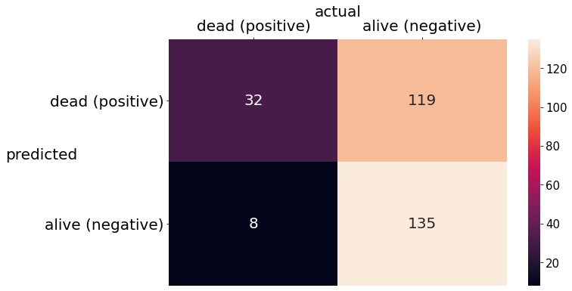
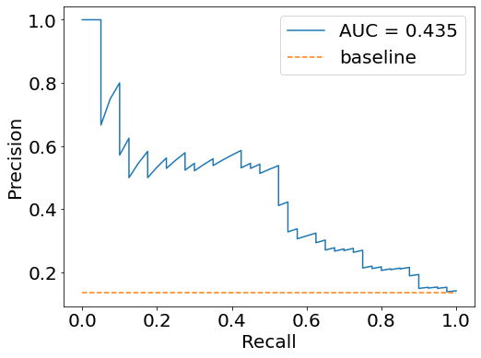
Data Science Process
Objective
Collect
Explore
Engineer feature
Build model
Logistic Regression
K Nearest Neighbours
Neural Network
Conclude on objective
Deployment workflow
Logistic Regression with Regularisation (statsmodels.api)
Impute
KNNImputer
Oversample
SMOTE
Scale
StandardScaler
Model
Regularisation strength
Decision Boundary
Probability > 0.35 ⇒ Category = 1 (Die) (balance overfit, recall, precision)
Neighbouring samples = 5
Sampling strategy = 0.85 (smallest overfit)
L1 Alpha = 50 simpler model but not too simple
Recall (overfit)
CV Train = 0.920
CV Validate = 0.875 (-4.85%)
Recall (overfit)
Train = 0.915
Test = 0.800 (-12.7%)
Precision (overfit)
Train = 0.226
Test = 0.212 (-6.09%)

Slide 20
Data Science Process
Objective
Collect
Explore
Engineer feature
Build model
Logistic Regression
K Nearest Neighbours
Neural Network
Conclude on objective
Deployment workflow
Pipeline (train=fit_transform, validate=transform)
KNNImpute
SMOTE
StandardScaler
Model
Decision Tree
Random Forest
Multinomial Naïve Bayes
K Nearest Neighbours
Support Vector Machine
Hyperparameter search settings
GridSearchCV (return train score, scoring = recall, 15-fold)
Fit
CV results
Train recall
Validate recall

Slide 21
Data Science Process
Objective
Collect
Explore
Engineer feature
Build model
Logistic Regression
K Nearest Neighbours
Neural Network
Conclude on objective
Deployment workflow
Model
Decision Tree
Random Forest
Multinomial Naïve Bayes
K Nearest Neighbours (best balanced performance in recall and overfit)
Support Vector Machine
Decision Tree
Random Forest
Support Vector
K Nearest Neighbours
Multinomial Naïve Bayes

Slide 22
Data Science Process
Objective
Collect
Explore
Engineer feature
Build model
Logistic Regression
K Nearest Neighbours
Neural Network
Conclude on objective
Deployment workflow
K Nearest Neighbours
Impute
KNNImputer
Oversample
SMOTE
Scale
StandardScaler
Model
Nearest neighbours = 100, 150, 200
Decision Boundary
Default in K Nearest Neighbours
Neighbouring samples = 5
Sampling strategy = 0.70, 0.85, 1.00
Weight = Uniform, Distance
Algorithm = Auto, Brute
P = 1, 2
Over | Train | Valid | Over
0.70 | 0.863 | 0.698 | -19.14%
0.85 | 0.915 | 0.792 | -13.42%
1.00 | 0.941 | 0.848 | -9.98%
NN | Train | Valid | Over
100 | 0.908 | 0.774 | -14.76%
150 | 0.907 | 0.780 | -13.99%
200 | 0.905 | 0.784 | -13.37%
p | Train | Valid | Over
p=1 | 0.865 | 0.688 | -20.49%
p=2 | 0.948 | 0.871 | -8.17%
Weight | Train | Valid | Over
Dist | 1.000 | 0.781 | -21.87%
Unif | 0.813 | 0.777 | -4.42%
Algo | Train | Valid | Over
auto | 0.907 | 0.779 | -14.04%
brute | 0.907 | 0.779 | -14.04%
Parameter and hyperparameters with smallest overfit indicated in blue

Slide 23
Data Science Process
Objective
Collect
Explore
Engineer feature
Build model
Logistic Regression
K Nearest Neighbours
Neural Network
Conclude on objective
Deployment workflow
K Nearest Neighbours
Impute
KNNImputer
Oversample
SMOTE
Scale
StandardScaler
Model
Nearest neighbours = 200 to 1200 (to refine further)
Decision Boundary
Default in K Nearest Neighbours
Neighbouring samples = 5
Sampling strategy = 1.00 (smallest overfit)
Weight = Uniform (smallest overfit)
Algorithm = Brute
P = 2 (smallest overfit)
More nearest neighbours, lower performance and smaller overfit

Slide 24
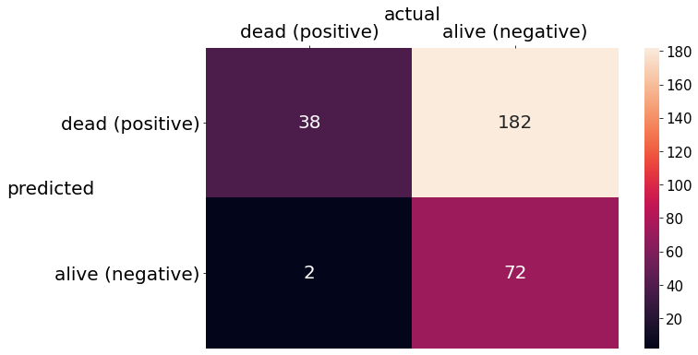
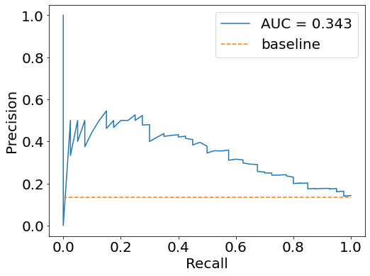
Data Science Process
Objective
Collect
Explore
Engineer feature
Build model
Logistic Regression
K Nearest Neighbours
Neural Network
Conclude on objective
Deployment workflow
K Nearest Neighbours
Impute
KNNImputer
Oversample
SMOTE
Scale
StandardScaler
Model
Nearest neighbours = 1000 (smallest overfit)
Decision Boundary
Default in K Nearest Neighbours
Neighbouring samples = 5
Sampling strategy = 1.00 (smallest overfit)
Weight = Uniform (smallest overfit)
Algorithm = Brute
P = 2 (smallest overfit)
LRR=32
LRR=119
LRR=8
LRR=135
Recall (overfit)
CV Train = 0.929
CV Validate = 0.917 (-1.29%)
Recall (overfit)
Train = 0.933
Test = 0.950 (1.85%)
Precision (overfit)
Train = 0.171
Test = 0.173 (1.15%)

Slide 25
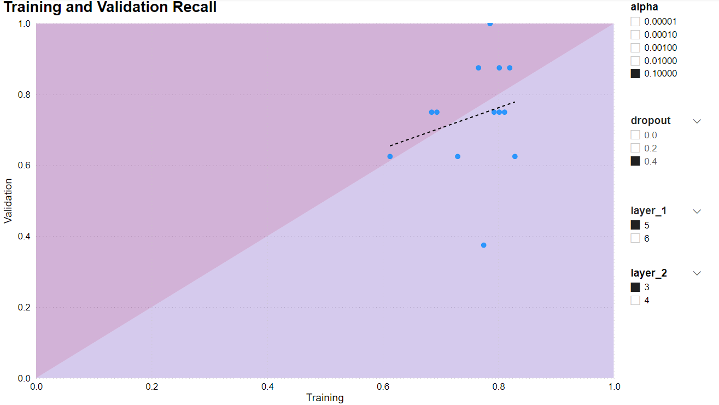
Data Science Process
Objective
Collect
Explore
Engineer feature
Build model
Logistic Regression
K Nearest Neighbours
Neural Network
Conclude on objective
Deployment workflow
Neural Network with Regularisation, Dropout Rate, Early Stopping
Impute
KNNImputer
Oversample
SMOTE
Scale
StandardScaler
Model
Layer 1 = 5, 6
Decision Boundary
0.4
Neighbouring samples = 5
Sampling strategy = 1.00
Layer 2 = 3, 4
Dropout = 0.0, 0.2, 0.4
L1 Alpha = 0.1, 0.01, 0.001, 0.001, 0.0001
Visualisation with Microsoft Power BI
Good balance of
* slope = 1
* small overfit
Best hyperparameters with
* layer1 = 5 neurons
* layer2 = 3 neurons
* dropout = 0.4
* L1 alpha = 0.1
Overfit Region

Slide 26
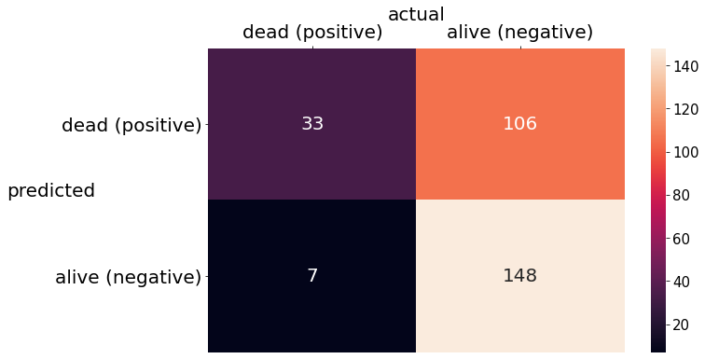
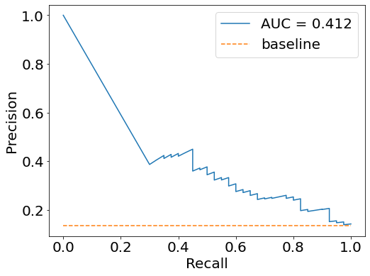
Data Science Process
Objective
Collect
Explore
Engineer feature
Build model
Logistic Regression
K Nearest Neighbours
Neural Network
Conclude on objective
Deployment workflow
Neural Network with Regularisation, Dropout Rate, Early Stopping
Impute
KNNImputer
Oversample
SMOTE
Scale
StandardScaler
Model
Layer 1 = 5
Decision Boundary
0.4
Neighbouring samples = 5
Sampling strategy = 1.00
Layer 2 = 3
Dropout = 0.4
Alpha = 0.1
LRR=32
LRR=119
KNN=38
KNN=182
LRR=8
LRR=135
KNN=2
KNN=72
Recall (overfit)
CV Train = 0.769
CV Validate = 0.742 (-3.54%)
Recall (overfit)
Train = 0.924
Test = 0.825 (-10.8%)
Precision (overfit)
Train = 0.264
Test = 0.237 (-10.0%)

Slide 27
Data Science Process
Objective
Collect
Explore
Engineer feature
Build model
Logistic Regression
K Nearest Neighbours
Neural Network
Conclude on objective
Deployment workflow
Develop interpretable machine learning model to predict and influence mortality of patients with heart failure warded in intensive care unit
Logistic Regression using statistical significance
Interpretable
Causes of death are understood
feature | std_coef | z | p
renal_failure | -0.3382 | -4.851 | 0
bicarbonate | -0.2817 | -3.114 | 0.002
blood_calcium | -0.2525 | -3.602 | 0.000
urine_output | -0.2168 | -3.133 | 0.002
deficiencyanemias | -0.1804 | -2.871 | 0.004
sp_o2 | -0.1459 | -2.245 | 0.025
heart_rate | 0.1387 | 2.031 | 0.042
leucocyte | 0.1719 | 2.298 | 0.022
atrialfibrillation | 0.1725 | 2.785 | 0.005
urea_nitrogen | 0.3728 | 4.485 | 0.000
renal_failure:
Categorical, Negative
Presence will reduce odds of dying compared to absence
bicarbonate:
Numeric, Negative
Higher value will reduce odds of dying
heart_rate:
Numeric, Positive
Higher value will increase odds of dying
atrialfibrillation:
Categorical, Positive
Presence will increase odds of dying compared to absence

Slide 28
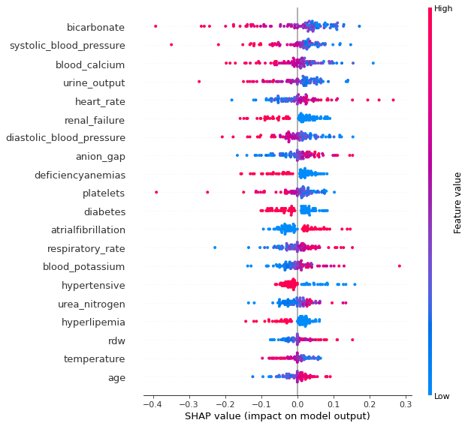
Data Science Process
Objective
Collect
Explore
Engineer feature
Build model
Logistic Regression
K Nearest Neighbours
Neural Network
Conclude on objective
Deployment workflow
Develop interpretable machine learning model to predict and influence mortality of patients with heart failure warded in intensive care unit
K Nearest Neighbours using Shapley values from SHAP
Interpretable
Causes of death are understood
bicarbonate (in agreement to before)
Numeric
Higher value (red) will reduce odds of dying (negative SHAP values)
heart_rate (in agreement to before)
Numeric
Higher value (red) will increase odds of dying (positive SHAP values)
renal_failure (in agreement to before)
Categorical
Higher value (presence) will reduce odds of dying (negative SHAP values)
atrialfibrillation (in agreement to before):
Categorical
Higher value (presence) will increase odds of dying (positive SHAP values)

Slide 29
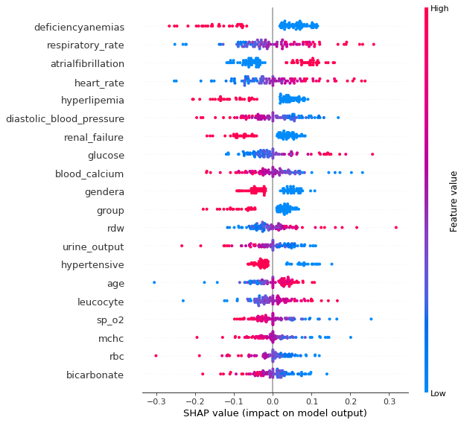
Data Science Process
Objective
Collect
Explore
Engineer feature
Build model
Logistic Regression
K Nearest Neighbours
Neural Network
Conclude on objective
Deployment workflow
Develop interpretable machine learning model to predict and influence mortality of patients with heart failure warded in intensive care unit
Neural Network using Shapley values from SHAP
Interpretable
Causes of death are understood
bicarbonate (in agreement to before)
Numeric
Higher value (red) will reduce odds of dying (negative SHAP values)
heart_rate (in agreement to before)
Numeric
Higher value (red) will increase odds of dying (positive SHAP values)
renal_failure (in agreement to before)
Categorical
Higher value (presence) will reduce odds of dying (negative SHAP values)
atrialfibrillation (in agreement to before)
Categorical
Higher value (presence) will increase odds of dying (positive SHAP values)

Slide 30
Data Science Process
Objective
Collect
Explore
Engineer feature
Build model
Logistic Regression
K Nearest Neighbours
Neural Network
Conclude on objective
Deployment workflow
Comparison of top important features in 3 machine learning models
BLUE: Presence in 3 models
Logistic Regression | K Nearest Neighbours | Neural Network
Renal_failure | Bicarbonate | Deficiencyanemias
Bicarbonate | Systolic_blood_pressure | Respiratory_rate
Blood_calcium | Blood_calcium | Atrialfibrillation
Urine_output | Urine_output | Heart_rate
Deficiencyanemias | Heart_rate | Hyperlipemia
Sp_o2 | Renal_failure | Diastolic_blood_pressure
Heart_rate | Diastolic_blood_pressure | Renal_failure
Leucocyte | Anion_gap | Glucose
Atrialfibrillation | Deficiencyanemias | Blood_calcium
Urea_nitrogen | Platelets | Gendera

Slide 31
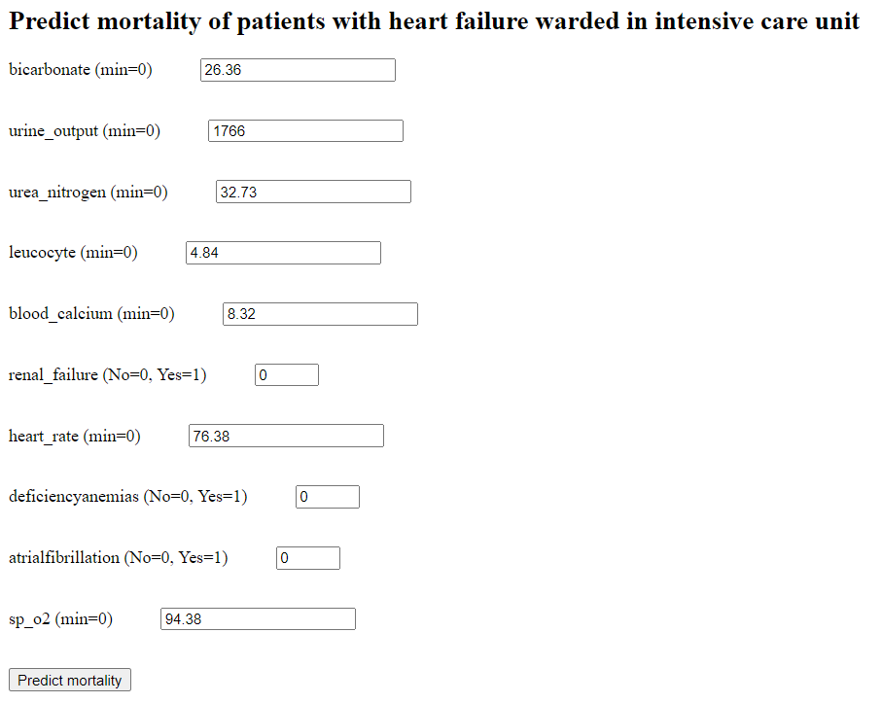
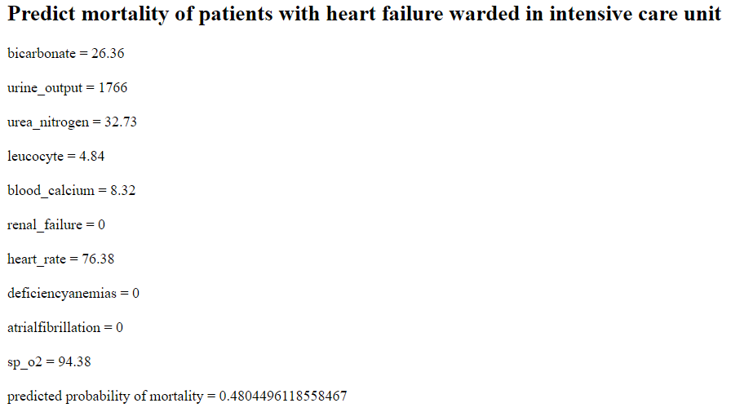

Data Science Process
Objective
Collect
Explore
Engineer feature
Build model
Logistic Regression
K Nearest Neighbours
Neural Network
Conclude on objective
Deployment workflow
Workflow to execute data science solution:
General ward
Repeat until discharge or death
Use important features to make interventions to change mortality status
Investigations
Emergency
Intensive Care Unit
Enter data in log reg model
Model predict mortality
Observations
Operating Theatre

Slide 32
Data Science Process
Objective
Collect
Explore
Engineer feature
Build model
Logistic Regression
K Nearest Neighbours
Neural Network
Conclude on objective
Deployment workflow
THE END

