Slide 1
Polymorphism
John Galindo
2020-04-14
CSC 326

Slide 2
What is Polymorphism?
Polymorphism is the concept of creating a single interface that works for multiple different data types
Core concept of object-oriented programming—lets you use a single method call for different kinds of object, tailoring the function definition to each object as needed
From the Greek roots poly (many) and morph (form)

Slide 3
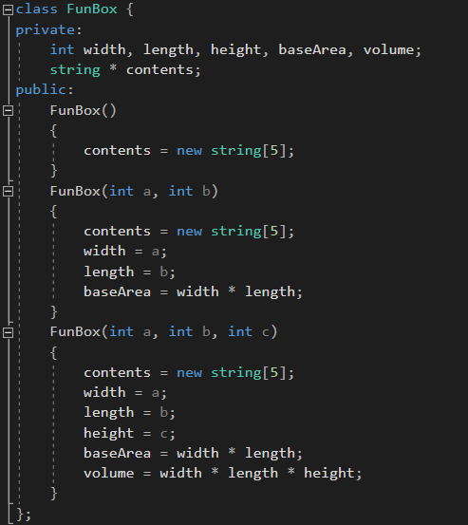
Function/Operator Overloading
Multiple functions are given the same name and are distinguished via their parameters by the compiler
Operator overloading is also a type of polymorphism

Slide 4
Base and Derivative Classes
Many of the object-oriented applications of polymorphism center around the use of inheritance, in which a derived class inherits the members of a base class. Multiple classes can inherit from the same base, and one class can derive from multiple bases. You can think of inheriting members from another class like importing functions from a library, with a few key differences like virtual functions.

Slide 5
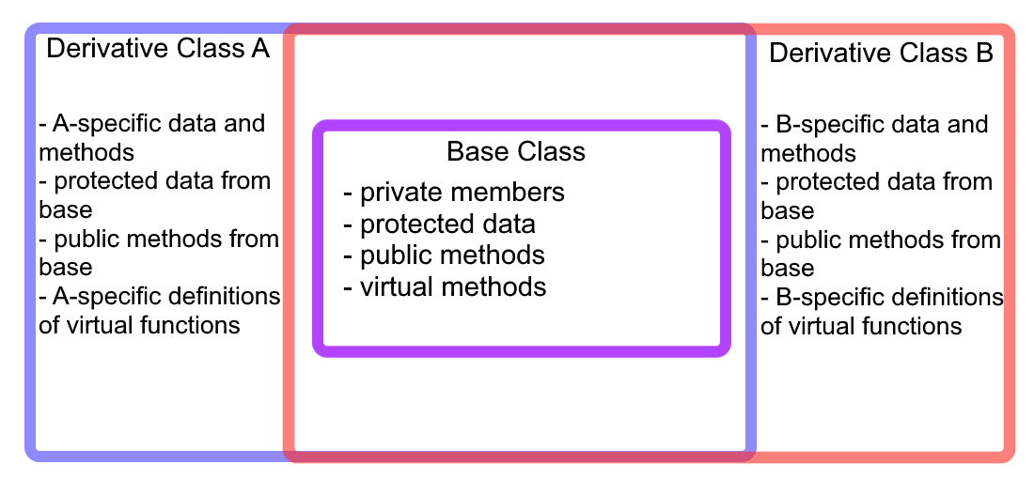
Base and Derivative Classes

Slide 6
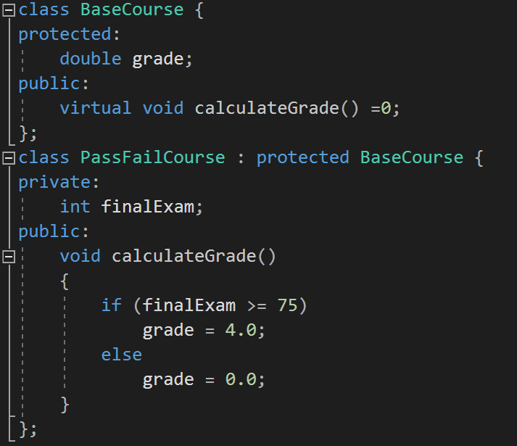
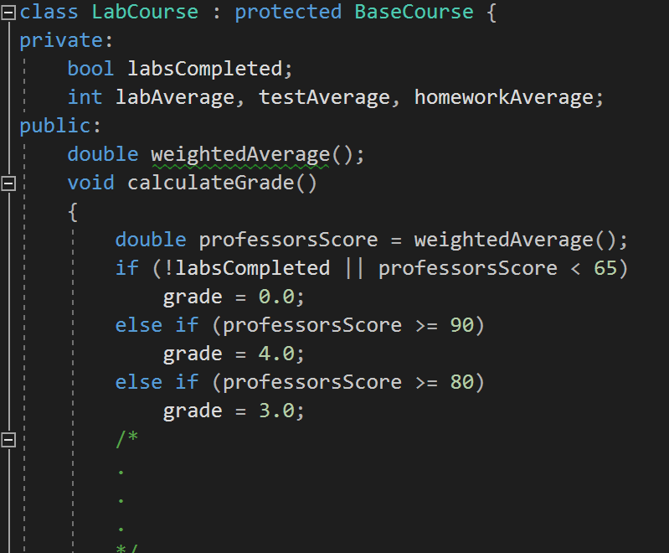
Base and Derivative Classes

Slide 7
Virtual Functions
Functions that can be redefined by a derived class
Does not need to be defined by the base class at all; typing ‘=0’ makes it a pure virtual function
Example: “virtual void printData() =0;”
You can redefine a function without the ‘virtual’ keyword, but it makes your life easier when dealing with pointers

Slide 8
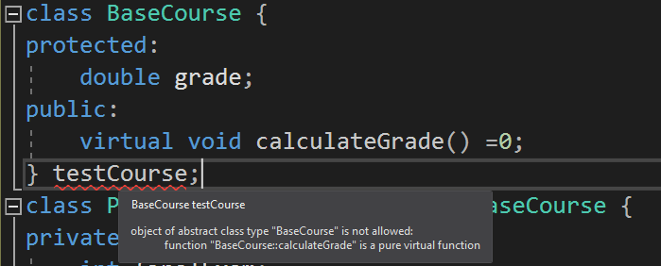
Abstract Base Classes
Class with at least one pure virtual function
Can no longer be used to directly declare objects, similar to templated classes in which the type hasn’t been specified

Slide 9
So what are they good for?
Pointers!
You can create classes that derive from an abstract base class, and then point to the base object within any of the derivative objects
This brings us back to polymorphism—rather than needing a unique pointer type for every class, abstract bases allow for a one-size-fits-all approach

Slide 10
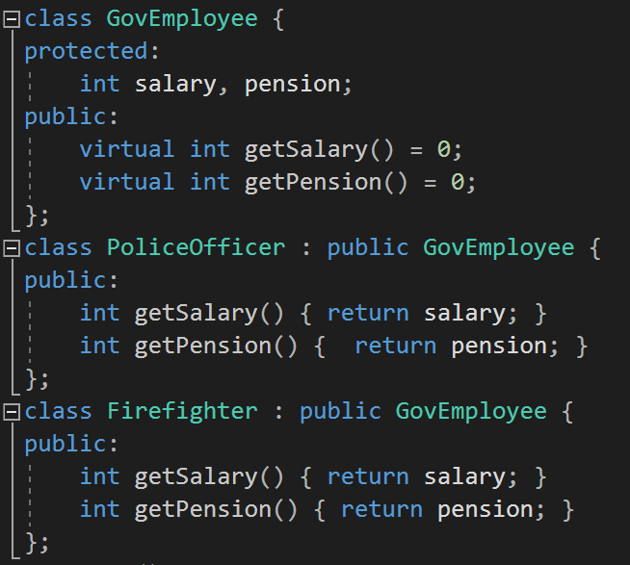
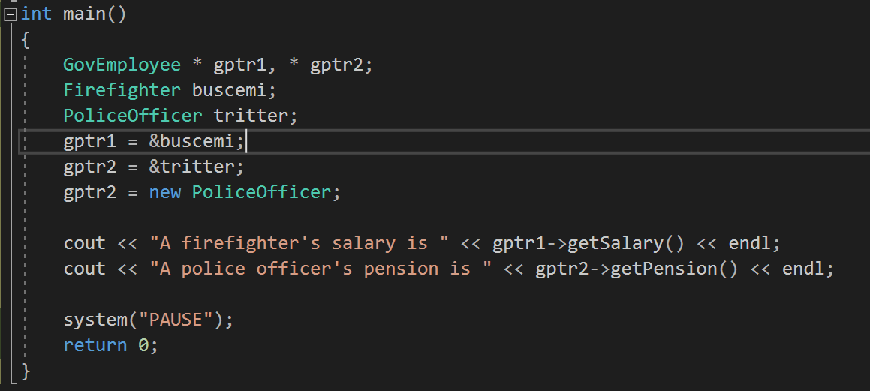
So what are they good for?

Slide 11
Why does this matter?
Scalability: Supporting new data types is easier if you have one protocol for everything.
Modularity: Problems are broken into parts to be tackled one-at-a-time: the interface is solved once and then works for all data types, common members are handled by a single base class, and so all that remains are novel virtual function implementations and other object-specific methods

Slide 12
Thank You!

