Slide 1

Meal Planner
By Jessica, Jack, Matthew

Slide 2
Abstract
The Meal Planner reduces the work and stress of finding ideas for meals and creating shopping lists. Automates and enhances the accuracy of creating a shopping list with the ingredients needed for a meal.
Manages a collection of recipes including instructions, ingredients and category. Keep track of items in the user's fridge. Manages the daily meal plans for each week. Generates a shopping list with ingredients in a meal plan that are not in the user’s fridge.

Slide 3
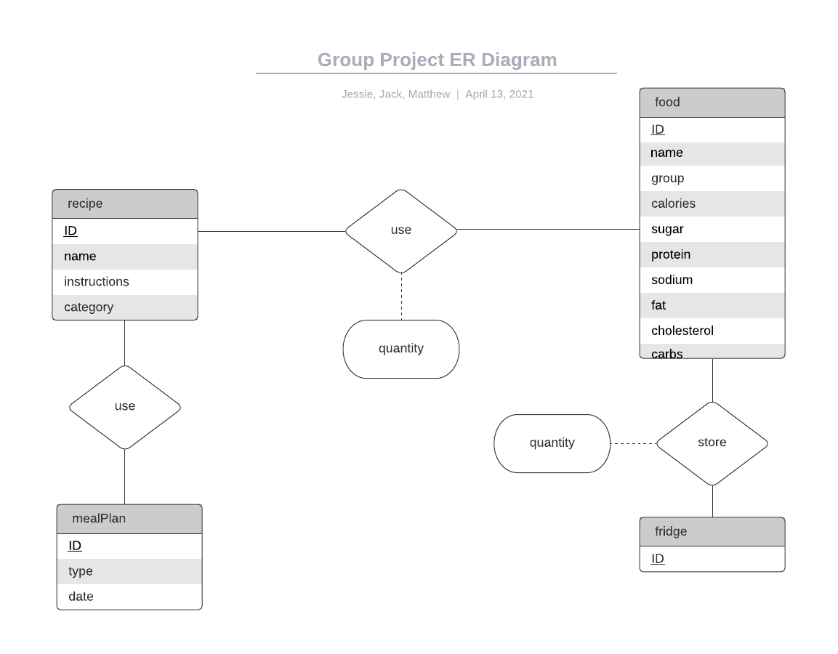
System Design

Slide 4
Relational Schema
recipe(ID, name, instructions, category)
mealPlan(ID, type, date)
fridge(ID)
food(ID, name, group, calories, sugar, protein, sodium, fat, cholesterol, carbs)
recipeMealPlan(recipeID, mealPlanID)
fridgeFood(fridgeID, foodID, quantity)
recipeFood(recipeID, foodID, quantity)

Slide 5
Functional dependencies
recipe: ID -> name, instructions, category
mealPlan: ID -> (type, date), (date, type) -> ID
fridge: N/A
food: ID -> name, group, calories, sugar, protein, sodium, fat, cholesterol, carbs
recipeMealPlan: N/A
fridgeFood: fridgeID, foodID -> quantity
recipeFood: recipeID, foodID -> quantity

Slide 6

Key Technical Techniques
Model-View-Controller architecture:
Used model-view-controller to increase scalability of the program.

Slide 7
Key Technical Techniques
Data source-delegate design pattern:
Used delegate and data source to communicate between the views and the view controllers.

Slide 8
Issues
Binding the model to the data shown on the view
Adjusting layout between Mac and Windows
Centering views in panels

Slide 9
What we learned
Creating effective model-view-controller architecture.
How to use Netbeans form editor
Properly making interfaces

