Slide 1

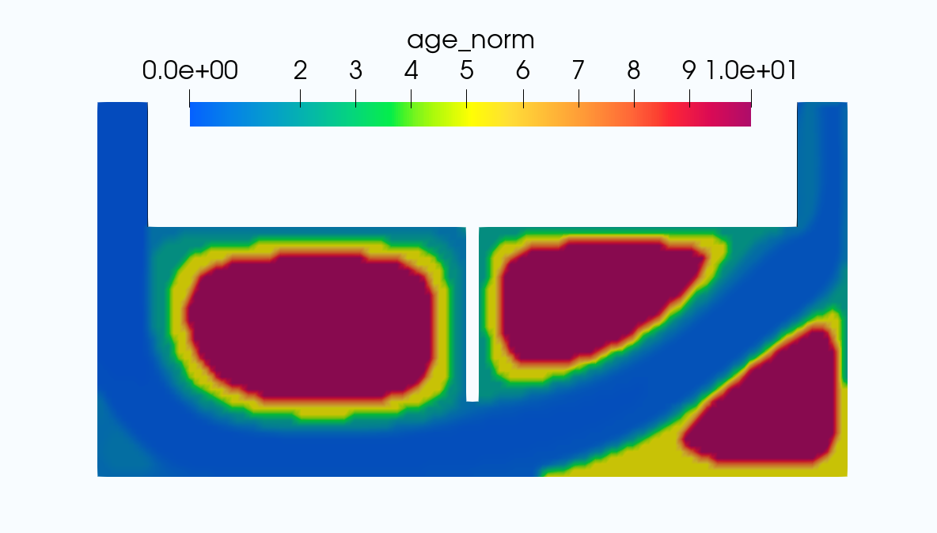
What
How
Traditionally:
Mesh
CFD / FVM Solver
Post-processor
Proposed:
GNN U-net
Post-processor
Mesh
Optimization Studies
Coronary artery simulations
Generate normalized age contours

