Slide 1
Going Places with ABC
Berkeley Logic Synthesis and Verification Group

Slide 2
Overview
Introduction
Logic networks
And-Inverter Graphs (AIGs)
Other aspect

Slide 3
Territory
System Specification
Verification
RTL
ABC
Logic synthesis
Technology mapping
Physical synthesis
Manufacturing

Slide 4
Destinations
Combinational synthesis
  traditional (SIS)
  AIG-based
  tech mapping
  equivalence checking
Sequential synthesis
  traditional (retiming)
  AIG-based
  tech mapping
  verification
    bounded
    unbounded
    based on synthesis

Slide 5
Means of Transportation
Netlist
  contains nets along with nodes, latches, and PI/PO terminals
  currently only used for I/O of networks to/from files
Logic network
  traditional logic network as in SIS; does not have nets
  nodes have SOP/BDD representation of local functions
AIG
  innovative network representation
  unifies synthesis, mapping, and equivalence checking
Sequential AIG
  a generalization of AIGs for sequential networks

Slide 6
Types of Fuel
SOPs
  Sum-Of-Products (two-level AND-OR representation) traditionally used to store node functions
  convenient for factoring but has a tendency to grow large
BDDs
  graph-based representation, canonical for a fixed variable ordering
  convenient for some applications but has a tendency to grow large
AND2s
  networks of two-input ANDs and inverters
  scalable, non-canonical representation
Gates
  primitives from the gate library assigned to the nodes by tech mapping

Slide 7
Allowed Combinations
Networks are composed of objects
  several network types are supported
Nodes are objects having logic function
  Several node functionality types are possible
Network type | Node functionality type
Netlist | SOP |  |  | Gates
Logic network | SOP | BDD |  | Gates
AIG |  |  | AND2
Seq AIG |  |  | AND2

Slide 8
Object Types
Net
  an object used in the netlist to denote connection among nodes
Node
  an object having a local logic function (e.g. ab+cd or AND2)
Latch
  a technology-independent D-flip-flops with an initial state
  all latches in a network should belong to the same clock domain
PIs/POs
  named network terminals w/o local logic function

Slide 9
Object Data Structure
struct Abc_Obj_t_ // 12 words
{
Abc_Ntk_t * pNtk; // host network
int Id; // object ID
unsigned Type : 3; // object type
unsigned fMarkA : 1; // multipurpose mark
unsigned fMarkB : 1; // multipurpose mark
unsigned fMarkC : 1; // multipurpose mark
unsigned fPhase : 1; // flag to mark the phase of a node (AIG)
unsigned fExor : 1; // marks a node that is a root of EXOR (AIG)
unsigned fCompl0 : 1; // complemented attribute of the first fanin (AIG)
unsigned fCompl1 : 1; // complemented attribute of the second fanin (AIG)
unsigned TravId : 10; // traversal ID
unsigned Level : 12; // level of the node
Vec_Int_t vFanins; // array of fanins
Vec_Int_t vFanouts; // array of fanouts
void * pData; // network specific data (SOP/BDD/gate,etc)
Abc_Obj_t * pNext; // next pointer in the hash table (AIG)
Abc_Obj_t * pCopy; // copy of this object
};

Slide 10
Overview
Introduction
Logic networks
And-Inverter Graphs (AIGs)
Other aspect

Slide 11
Logic Network
Similar to SIS network
  contains nodes, latches, PI/PO terminals
  adding, duplicating, removing nodes are similar
  nodes can have a logic function or a gate assigned
Differences
  after construction, finalizing steps are required
  internal node names are currently not stored
  node functionality can be a BDD

Slide 12
Constructing Logic Network
Typically a new network is created from an old network
  Abc_NtkStartFrom // copies PIs, POs, latches, etc
Objects can be added in any order
  Abc_NtkDupObj // duplicates an object
  Abc_NtkCreateNode // creates a new node
Object should be connected
  Abc_ObjAddFanin // adds fanin to an object
In the end, one or more finalizing functions may be called
  Abc_NtkFinalize // connects POs to nodes (unless done manually)
  Abc_NtkDupCioNamesTable // should be called always
  Abc_ManTimeDup // duplicates timing info if present
  Abc_NtkLogicMakeSimpleCos // often needed (e.g. converting from AIG)
  Abc_NtkMinimumBase // removes duplicated or vacuous fanins if present
  Abc_NtkReassignIds // restores topological ordering of nodes (AIGs only)

Slide 13
Overview
Introduction
Logic networks
And-Inverter Graphs (AIGs)
Other aspect

Slide 14
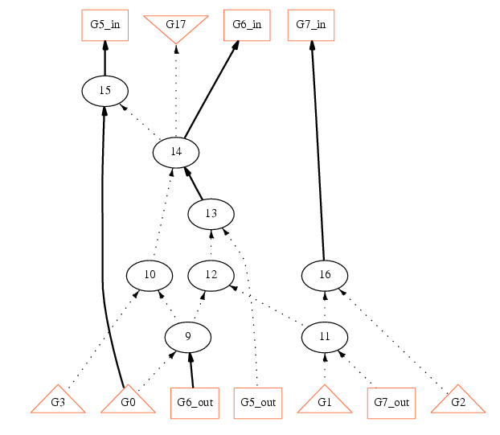
And-Inverter Graph

Slide 15
Requirements for AIGs in ABC
AIG is always stored in the structurally hashed form:
  two AND2s with the same fanins are merged
  the constants are propagated
  there is no single-input nodes (inverters/buffers)
Additionally, the following requirements are satisfied:
  there are no dangling nodes (nodes without fanouts are deleted)
  the level of each AND2 reflects the levels of its fanins
  the EXOR-status of each AND2 is up-to-date
  the nodes are stored in the topological order
  the constant 1 node has always number 0 in the object list

Slide 16
Manipulation of AIGs
AIGs are uniform, compact, and versatile
Computation based on AIG is fast and scalable
Deriving AIGs from logic networks is easy (strash)
  simple AIG conversion rules are used for gates
  algebraic factoring is used to convert large logic nodes
AIGs are the primary network representation in ABC
  required by tech-mappers and most of synthesis commands (balance, collapse, renode, rewrite, refactor, retime)
Extensively used in sequential synthesis
Manipulation is different compared to logic networks
  e.g. cannot duplicate or collapse nodes in an AIG

Slide 17
Operations Performed on AIG
Building new AND nodes
  Abc_AigAnd
Computing elementary Boolean functions
  Abc_AigOr, Abc_AigXor, etc
Replacing one node with another
  Abc_AigReplace
Propagating constants (computing cofactors)
  Abc_AigReplace
Structural hashing and other requirements are automatically enforced by the AIG manager

Slide 18
Overview
Introduction
Logic networks
And-Inverter Graphs (AIGs)
Other aspect
  Mapping information
  Timing information
  BDD representation
  SAT solvers
  FRAIG package
  Snapshots
  Sequential AIGs
  Visualizations

Slide 19
Using Mapping Information
Pointer to the library
  attached to pNtk->pManFunc of the network
Pointers to gates
  attached to pNode->pData of all internal nodes
What to do with the mapped network?
  print mapping statistics (print_stats)
  print gates used in the mapping (print_gates –l)
  print delay profile (print_level)
  sweep equivalent nodes without unmapping (fraig_sweep)
  write into a BLIF file (write_blif)
  replace gates by SOPs at all nodes (unmap)
  continue synthesis (network is unmapped automatically)

Slide 20
Using Timing Information
Timing info is stored in timing manager
Timing info of the network
  accepts arrival times of the PIs
  Abc_NtkDelayTrace (similar to SIS)
Timing info of the nodes
  Abc_NodeReadArrival, etc
Future work
  support of required times
  procedures to update timing incrementally (useful for resynthesis)
struct Abc_Time_t_
{
float Rise;
float Fall;
float Worst;
};

Slide 21
Using BDD Representation
CUDD by Fabio Somenzi is used for all BDD manipulation
Pointer to the BDD manager is in pNtk->pManFunc
Pointers to the local functions are in pNode->pData
Global functions can be computed by Abc_NtkGlobalBdds
  uses dynamic variable reordering
  handles the case when BDDs blow up
When constructing a new logic network, it is often convenient to use BDDs to represent local functions
  in the end, it is possible to convert to a logic network with SOPs by calling Abc_NtkBddToSop (or vice versa, by calling Abc_NtkSopToBdd)
There is no support for don’t-cares in the current version

Slide 22
Using SAT Solvers
Two networks can be transformed into a miter
  if the networks are sequential, the miter is a product machine, which can be unrolled for bounded equivalence checking (miter)
What to do with a combinational miter?
  print statistics (print_stats)
  convert into CNF for calling an external SAT solver (cnf)
    uses smart AIG-to-CNF conversion (due to Miroslav Velev)
  solve using brute-force SAT (sat)
    internally calls MiniSat-1.14 (by Niklas Eén, Niklas Sörensson)
  solve by merging equivalent nodes and applying SAT to the resulting miter (fraig –p)
    internally calls our version of MiniSat-1.12

Slide 23
Using FRAIG Package
Transforms AIG into a functionally reduced AIG (FRAIG)
Lossless synthesis
  several snapshots are converted into a network with choices (fraig_store, fraig_restore)
Sweeping logic networks
  detects and merges functionally equivalent nodes (fraig_sweep)
Equivalence checking
  simplifies and proves the miter to be 0, or finds a bug (fraig –p)

Slide 24
Using Snapshots
Motivation
  multiple snapshot reduce structural bias in tech mapping
Creation
  the current network (both logic network and AIG) can be recorded as a snapshot (fraig_store)
Storage
  all snapshots are stored in an internal AIG (different from the current network) while ABC is running
Use
  can be restored into the current network with choices (fraig_restore)
File I/O
  choice networks can be written into BLIF files (in which OR gate denote equivalence classes of nodes)
  reading choice networks efficiently can be done using fraig_trust

Slide 25
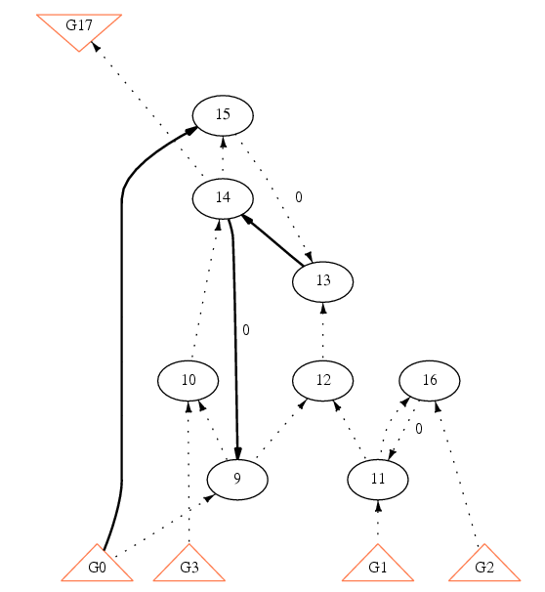
Using Sequential AIGs

Slide 26
Using Visualizations
Numerous printout commands are available
  print_exdc, print_factor, print_fanio, print_gates, print_io, print_latch, print_level, print_sharing, print_stats, etc
The following visualizations can be used
  local functions can shown as K-maps (print_kmap) (works well for up to 6 variables)
  local functions can be shown as BDDs (show_bdd)
  structure of logic networks (with mapping) (show_ntk)
  visualization of (sequential) AIGs (show_aig)

Slide 27
ABC Compared with Other Tools
Industrial
  well documented, fewer bugs
  too specialized, no source code, often costly
SIS
  traditionally very popular
  some data structures / algorithms are outdated, no sequential synthesis
VIS
  features Verilog input, implementation of BDD-based verification
  not meant for binary logic synthesis
MVSIS
  allows for multi-valued logic synthesis and finite automata manipulation
  complicated for experimental programming, not for binary synthesis

Slide 28
Conclusion
Reviewed basic concepts of ABC
Outlined basic programming principles
Updated programmer’s manual is online:
http://www.eecs.berkeley.edu/~alanmi/abc/programming.pdf

