Slide 1

Aircraft Risk Analysis & Business Recommendations
Low-Risk Aircraft for Strategic Investment
John Widno DORCY
June 15, 2025

Slide 2
Business Understanding
Objective:
The company is expanding into the aviation industry and needs data-driven insights to reduce risks in aircraft acquisition
Goal:
Determine the lowest-risk aircraft models for commercial and private operations.
Business Impact:
Informed decision-making to avoid costly aircraft with high incident rates.

Slide 3
Data Understanding
Data Sources:
National Transportation Safety Board -accident data from 1962 to 2023
about civil aviation accidents and incidents in the United States and
international waters.
Key Features:
Aircraft specifications (category,Make , Model)
Incident and accident reports
Operator information
Aircraft type, manufacturer, date, capacity, usage type
Number and severity of incidents
Operational detail

Slide 4
Data Challenges
Missing values
Inconsistent formats
Need for merging multiple datasets

Slide 5
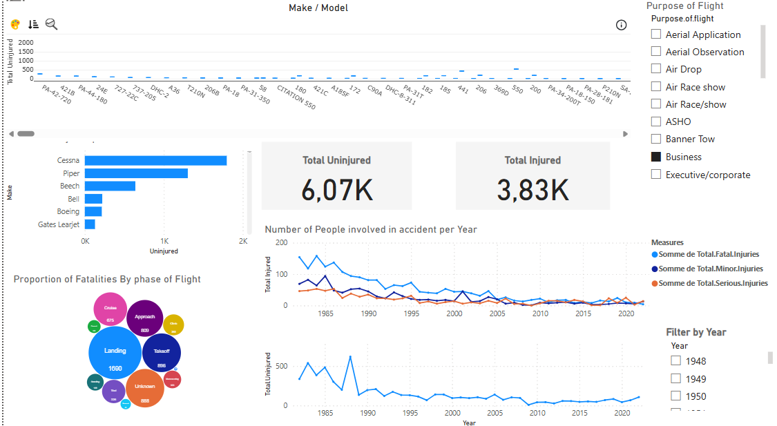
Data Challenges
Steps Taken:
Removed duplicates
Handled missing values with mean/mode or domain-specific logic
Standardized manufacturer names Severity, model numbers
Imputation Techniques:
imputation for numerical features (Number of injuries ,uninjuries, engine)
flagging for categorical fields
Unknow string feacture
Outcome:
Clean, unified dataset ready for analysis

Slide 6
Data Analysis
Risk Scoring Methodology:
Calculated incident rate per 1,000 flight hours
Adjusted for aircraft age and usage intensity
Insights:
Certain manufacturers had consistently lower incident rates
Newer aircraft models showed improved safety records
Visualization Preview:
Bar chart: Incident rate by aircraft model
Heatmap: Correlation between age and incident frequency

Slide 7
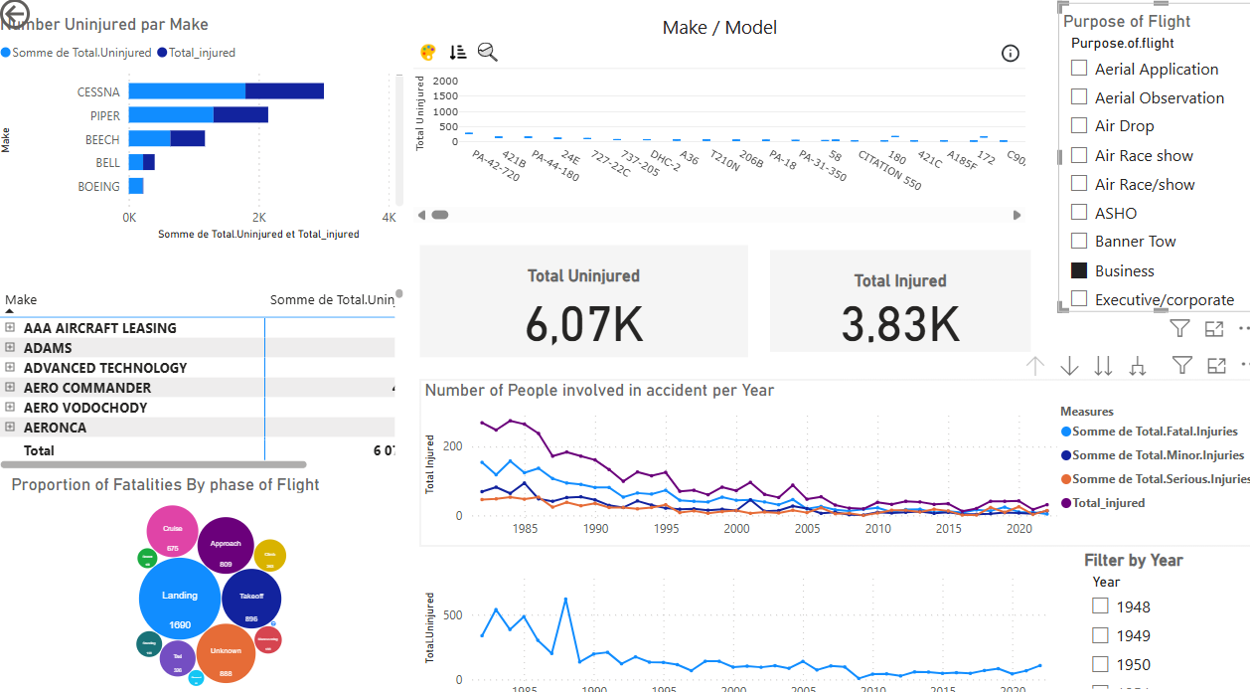
Data Analysis

Slide 8
Recommendations
Aircraft Models to the Company
Risk score for each aircraft model based on:
Number of incidents or accidents (normalized per flight pupose and Event year
Severity of incidents (Injured and Uninjured)
Usage purpose of flight
When calculated a normalized incident rate per
Business purpose flight, adjusted for Event year. Aircraft in recent years
were considered low-risk.”

Slide 9
Business Aircraft Risk Summary
Safest Models
Higher Risk Models
BOEING
newer models proven safety records
PIPER
BELL
BOEING
Based on the frequency and severity of incidents, we recommend considering aircraft such as the Aircraft below which show low incident rates and minimal injury severity.

Slide 10
Next Steps
We recommend starting with 1–2 of the safest aircraft for a pilot program. This allows the company to enter the market with minimal operational risk, while gathering real-world data on costs and performance.

Slide 11
Thank You
Contact Info:
John Widno Dorcy
+50938058388
LinkedIn: linkedin.com/in/john-widno-dorcy-19399a216
GitHub: github.com/johnwidno

