Slide 1
Microsoft SQL Server
Replication
Microsoft Data Integration Technologies
Replication Overview
Merge Replication
Questions & Answers
Example
John Huang

Slide 2

Microsoft Data Integration
--Build Distributed Systems--
Windows Communication Foundation(Indigo)
MSMQ(Microsoft Message Queuing)
SQL Server Service Broker
BizTalk
SSIS(SQL Server Integration Service)
Host Integration(Integrating with IBM )
Replication

Slide 3







Windows Communication Foundation
WCF is a set of .NET technologies for building and running connected system. It’s a new breed of communications infrastructure built around the Web service architecture.
Application
WCF
Application
Application
Other Web Services Platform
WCF
Direct communication between a windows application and another windows application.
Direct Web services communication between a windows application and an application built in other Web service platform.
Notes:
It implements communication services

Slide 4


MSMQ – Microsoft Message Queuing
MSMQ allows message exchange asynchronously and synchronously across networks and systems that may be temporarily offline. MSMQ provides guaranteed message delivery, efficient routing, security, and priority-based messaging.
Application
Application
MSMQ
MSMQ
When asynchronous communication is required between application.

Slide 5





SQL Server Service Broker
Service Broker is a built-in functionality in SQL Server 2005. It provides guaranteed message delivery between (or within SQL Servers) asynchronously.
Application
Application
SQL Server
SQL Server
Service Broker
Service Broker
Connecting logic built as stored procedures in one or more separate instance of SQL Server 2005

Slide 6














BizTalk
BizTalk is a server for building solutions for business process and integration. It sits in the middle of a group of applications and provides adapters for various communication mechanisms, including MSMQ, WCF, EDI…
Application
Application
Application
Other Web Services Platform
WCF
EDI
Orchestration
Application
Application
BizTalk
MSMQ
Other Communication Technologies
WCF
EDI
MSMQ
Others
Creating business process, addressing B2B integration, implementing integration process. Creating brokered application-to-application message-based integration…

Slide 7





SQL Server Integration Service
SSIS provides tools for combining data from diverse data source into a SQL Server database. It is an ETL service for SQL Server.
SQL Server
Other SQL Server
SSIS
Other DBMSs
Other Data Sources
Combining information from a group of operational databases into a data warehouse.
Transfer data from one DBMS to one or more other DBMSs
Loading data into SQL Server database from flat file, spreadsheets and other diverse data source.

Slide 8







Host Integration Server
Host Integration Server is a set of technologies focused on connecting to applications and data on IBM mainframes and mid-range system.
Application
Host Integration
DB2 or Other Data
z/OS
Application
Application
DB2 or Other Data
OS/400
Windows
Application
Web Sphere
Connecting windows system to IBM zSeries mainframes and iSeries mid-range systems.

Slide 9
Questions?

Slide 10










SQL Server Replication
SQL Server replication allows replicating data across two or more SQL Server databases.
SQL Server
SQL Server
Replication
Replication
Replication
Replication
Replication
SQL Server 1
SQL Server 2
SQL Server N
Deploy and collect data to/from other SQL Server Instance and other databases synchronously or asynchronously.
Load balance
Disaster Recovery
Notes:
http://msdn.microsoft.com/en-us/library/ms152567.aspx

Slide 11
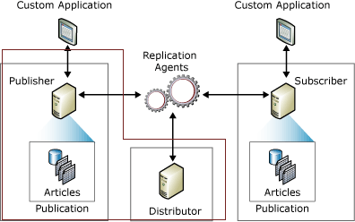
Model Overview
Components:
  Publisher , distributor and subscriber
  Replication agents
  Publication, Articles
  Push and Pull subscriptions

Slide 12
Publisher
Is a database instance that makes data available to other location through replication.
A publisher can have one or more publications.

Slide 13
Distributor
Is a database instance that acts as a store for replication specific data associated with one or more publisher.
Each publisher can only have one distributor.
Stores metadata, history data, and transactions.
In many cases, a single database instance hosts both publisher and distributor.

Slide 14
Replication Agents
Agent at Distributor(Push) or Subscriber (Pull)
  Distribution agent
    Used with snapshot replication and transactional replication.
    Apply snapshot for snapshot replication.
    Move transactions held in the distribution database to subscriber.
  Merge agent
    Used with merge replication only.
    Apply initial snapshot to subscriber and reconciles incremental data changes that occur.
    The Snapshot Agent is run typically under SQL Server Agent and can be administered directly using

Slide 15
Publication
Is a collection of articles, and an article is a grouping of data to be replicated.
An article can be an entire table, only certain columns (using a vertical filter), only certain rows (using a horizontal filter), or even a stored procedure (in some types of replication).
A publication can have multiple articles.

Slide 16
Articles
Tables & Views
Procedures
Functions

Slide 17
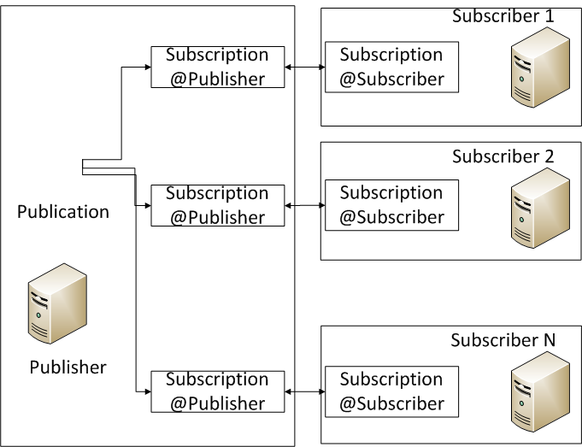

Subscription
A request for a copy of publication to be delivered to a subscriber.
Defines what publication will be received, where, and when.
Push: Replication agent running at distributor
Pull: Replication agent running at subscriber

Slide 18
Push Subscription
Replication agent runs and be managed at distributor. No request sends from subscriber. Easy to maintain.
The higher processor overhead at distributor does not affect performance.
Data will typically be synchronized continuously or on a frequently recurring schedule.
Most often used with snapshot and transactional replication.

Slide 19
Pull Subscription
Replication agent runs and be managed at subscriber.
Data will typically be synchronized on demand or on a schedule rather than continuously.
The publication has a large number of Subscribers, and/or it would be too resource-intensive to run all the agents at the Distributor.
Subscribers are autonomous, disconnected, and/or mobile. Subscribers will determine when they will connect and synchronize changes.
Most often used with merge replication.

Slide 20
Types of Replication
Snapshot Replication
Transactional Replication
Merge Replication

Slide 21
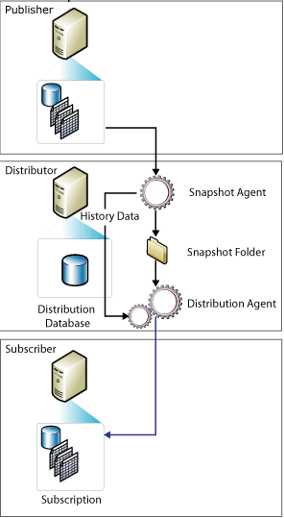
Snapshot Replication
Carried out by Snapshot Agent and Distribution Agent
  Snapshot Agent generates snapshot.
  Distribution agent delivers snapshot to subscribers(s).
One way replication.
Can deliver data table, procedures, functions…
Full refresh (recreates objects) at subscribers.
Data change infrequently
A large volume of changes occur.
Replicating small volumes of data
Accessible to have copies of data that are out of dates

Slide 22
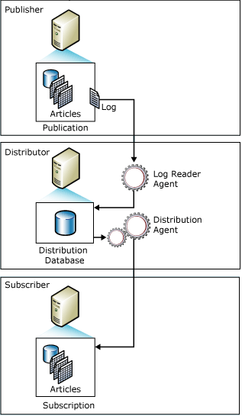
Transactional Replication
Carried out by Snapshot Agent, Log Reader Agent and Distribution Agent
  Snapshot Agent generates snapshot for initialization.
  Log Reader monitors transaction logs from published database and saves transactions to distribution database.
  Distribution agent delivers snapshot to subscribers(s) for initialization and the transactions saved in distribution database for incremental update at subscriber.
Incremental changes to be propagated as they occur.
Low latency between the time changes are made at the publisher and the changes arrive at the subscriber.
High volume of inserts, updates, and deletes.
Publisher or Subscriber is a non-SQL Server database, such as Oracle.
Issues and tricks:
  When database server run out of space, transaction logs may get corrupted and hence replication gets broken.
  When error occurs, Distribution agent will stop working. Database’s transaction log can not be truncated by any means.
  Initialization for big table
  Interface to Distribution Agent.

Slide 23
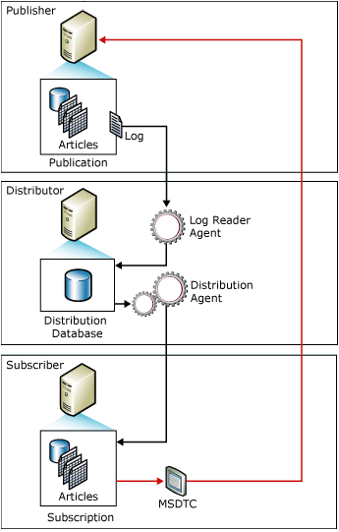
Updatable Subscription (1)
Immediate Updating
  Triggers are created with NOT FOR REPLICATION modifier at subscriber for each published tables.
  Procedures are created at publisher for modifying published tables at publisher
  Changes coming from Distribution agent will not fire up the trigger. Changes by user/application will be caught up by this trigger.
  Changes will be delivered to Publisher by the trigger through MSDTC and the procedures that created at publisher.
Need to build real time 2-way transactional replication.
Issues:
  When network is not available, changes could not be made at scriber.
  Changes will be rolled back when conflicts occur.
  Evil MSDTC gets involved.

Slide 24
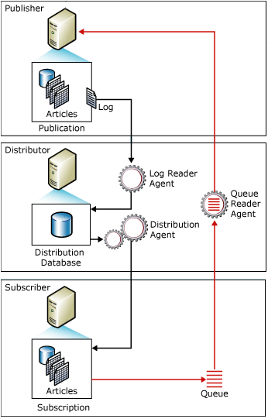
Updatable Subscription (2)
Queued Updating
  Triggers are created with NOT FOR REPLICATION modifier at subscriber for each published tables.
  Procedures are created at publisher for modifying published tables at publisher
  Changes coming from Distribution agent will not fire up the trigger. Changes by user/application will be caught up by this trigger and put into Msrepliction_queue table.
  Changes will be delivered to Publisher by Queue Reader Agent running at Distributor
Need to build near real time 2-way transactional replication.
Issues:
  Conflict policies.
    Publisher wins
    Publisher wins and the subscription is reinitialized
    Subscriber wins

Slide 25
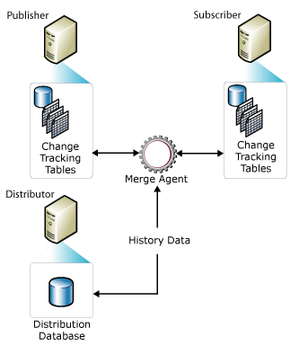
Merge Replication
Implemented by Snapshot Agent and Merge Agent
  Snapshot Agent generates snapshot for initializing subscriptions.
  Merge Agent delivers the changes among Publisher and Subscribers.
Multiple subscriber might update the same data at various times and propagate those changes to the publisher and other subscribers.
Each subscriber requires a different partition of data. Usually use system function SUSER_SNAME() and/or HOST_NAME().
Only replicate the latest change, no intermediate date state.

Slide 26
Filter
Vertical Partition
  Only replicate the columns needed
Horizontal Partition
  Simple Partition
    Use SUSER_SNAME(), HOST_NAME functions
      Where clause is used: where SubscriberName = Host_Name()
      Other condition can be added:
        where SubscriberName = Host_Name()
        Where SubscriberName = Host_Name() or SubscriberName is null
  Complex Partition
    Use SUSER_SNAME(), HOST_NAME functions within a subquery
      Where clause is used: where CustomerID in (select CustomerID from Customer_Subscriber where SubscriberName = Host_Name())
      Other condition can also be added: where CustomerID in (select CustomerID from Customer_Subscriber where SubscriberName = Host_Name()) or CreditScore < 2

Slide 27
Snapshot
Type of snapshot
  Regular Snapshot
  Dynamic Snapshot for publications which contains horizontally filtered articles
  Generic Snapshot for publications which contains horizontally filtered articles
Inside snapshot
  Table Schema, index, triggers and constraints.
  System tables and conflict tables.
  User data and meta data.
    User Data + Meta Data
      Regular Snapshot for the publications without filtered articles.
      Dynamic Snapshot
    Meta Data Only
      Regular Snapshot for the publications with filtered articles.
      Generic Snapshot

Slide 28
Initialization
Basic Concept
  Generate Snapshot(s).
  Apply Snapshot to subscriber
Apply a Snapshot
  Automatic
    Bulk copy meta data into system tables.
    Drop existing articles.
    Create existing articles.
    Bulk copy data into articles.
    Create index, triggers, and so on.
  None
    Bulk copy meta data into system tables.
    Check missing triggers and procedures

Slide 29
Initialization -- Continued
Newly created publication and subscribers
  Publication without horizontal filtered articles
    Generate Regular Snapshot.
    Deliver Snapshot to Subscriber.
    Apply Snapshot
  Publication with horizontal filtered articles
    Generate Regular Snapshot.
    Generate Dynamic Snapshot.
    Deliver Dynamic Snapshot to Subscriber
    Apply Snapshot

Slide 30
Initialization -- Continued
Rebuild replication without dropping tables at subscriber.
  Publication without horizontal filtered articles
    Change Sync Type to none.
    Generate Regular Snapshot.
    Deliver Snapshot to Subscriber.
    Apply Snapshot
  Publication with horizontal filtered articles
    Change Sync Type to none.
    Generate Regular Snapshot.
    Generate Generic Snapshot.
    Deliver Generic Snapshot to Subscriber
    Apply Snapshot

Slide 31
Conflict -- Detect
Column Level Tracking
  If changes are made on the same column in the same row at more than one replication node.
Row Level Tracking
  If changes are made on any columns in the same row at more than one replication node.
Logical Record Level Tracking
  If changes are made on any rows in the same logical record at more than one replication node.
    Customer -> Order -> Order Detail. It’s considered a conflict if customer A’s fields, its orders and its order details are modified at more than one replication node.
Update-update, Update-delete and Failed Change conflicts.
Retention Period

Slide 32
Conflict -- Resolve
Conflict Viewer
  Manually choose conflicts winner and loser.
Priority based, Built-in and customized resolver
  Priority based conflict resolver is often used in In publisher, re-publisher, subscriber structure.
  Microsoft COM-Based resolver
    Store procedure Resolver
    Download Only Resolver
    Subscriber Always Wins Conflict Resolver
    Minimum Conflict Resolver
  Customized
    Customized managed code.
    COM-Based.
Execute Business Logic During Merge Synchronization
  Microsoft.SqlServer.Replication.BusinessLogicSupport

Slide 33
Metadata Cleanup
Metadata
  MSmerge_contents
  Msmerge_tombstone
  Msmerge_genhistory
Meta data should NOT be growing forever.
  Retention period
Subscription expires if no communicate has been taking place within retention period.
  Reinitialize subscription

Slide 34
Questions?
No tough questions please

Slide 35
Q&A – Add an article
World keeps Changing…
Solution
  Add article.
  Generate Snapshot (have user data included)
    Do NOT reinitialized subscription!!!
  Apply snapshot
    Only newly added article will be applied to subscriber

Slide 36
Q&A – Add a column
Ideas keep Changing…
Solution – Simple!
  Add column through publication setup interface.
  Newly added column will be propagate to subscribers

Slide 37
Q&A – Remove a column or article
Business keeps Changing…
Solution – It sucks!
  Redo the publication!

Slide 38
Q&A – Meta data monster
Size of meta data
  Every insert, delete and update may generate at least one record in the meta data tables.
  It hits publisher’s performance
Solution
  Setup proper meta data retention period.
    Monitor size of meta data tables.
    Frequently rebuild or re-organize index for meta data tables.
  Avoid using full table update on published articles

Slide 39
Q&A – Reinforce Synchronization
Fake Update
  Applying fake update on a publisher or a subscriber can force data marked to be replicated.
    Data has not been updated on other side.
    Ensure there is no missing record on another side.

Slide 40
Q&A – Expired Subscription
When Subscription gets expired…
Solution
  Reinitialized subscription
    Set update before re-initialization
    Apply generic snapshot with none synchronization type + fake update.

Slide 41
Q&A –Restore Subscriber
Database corrupted at subscriber…
  Database at subscriber get corrupted at 2 PM.
  You only have a full backup from 2 AM.
  No Transaction log backup available.
Solution
  Restore the backup
    Data has been replicated to the publisher will be replicated back to subscriber
    Data has not been synchronized to publisher will be lost forever.

Slide 42
Q&A – Insert to subscriber without ….
Insert records to subscriber but don’t want it to be replicated to publisher…
Solution
  Start a transaction
  Insert the record
  Delete the meta data
  Commit the transaction

Slide 43
Q&A – Design
Get into wrong design…
  Master table and detail table
  Triggers in master table populating detail tables
  Replication triggers in both master table and detail tables
Solution
  Remove referential integrity @subscriber or publisher or both.
  Avoid getting involved into this situation.
  Change your design

Slide 44
Q&A – Time consuming conflict resolver
If your resolver is time consuming…
Solution
  Get conflict table name from sysmergearticles table
  Go through this table and resolve conflict
  Remove conflict record(s) from this table
Keep in mind
  The records might be REMOVED from both publisher and subscriber
  The information is sitting at conflict table
  Don’t abandon any conflict records
  Resolve conflict ASAP

Slide 45

Q&A – Server Swap
If you swap the server and start both servers…
  Server A get swapped to server B
  Server A is supposed to be destroyed but gets renamed to server C
  Server C gets started
Solution
????Why????
Don’t do that!!!

Slide 46
Questions?

Slide 47
Example – ABC Company
ABC Company is a financial services company which has more than 900 subscribers across North America, including branches, training centers and test subscribers. The systems now is built on SQL Server 2000 environment.
Requirements
  Data must be centralized at head office in Victoria. The main server should not be bogged down by replication processes.
  Branch database should only contain it’s own data. Unnecessary columns for branch business should not be replicated to stores.
  If customer registered at one store, the customer information should not be available at other stores. When customer goes to another store, the store should be aware of this customer.
  If customer went to one store, if he goes to the next store doing a transaction, this transaction must be available at the first store. Any changes happen to a customer, including address, transactions, phones and so on, it must be propagate to all the stores that customer had gone to.
  For the settings, if branch is not specified, deploy it to all branches. If branch is specified, synchronize it to that branch only

Slide 48
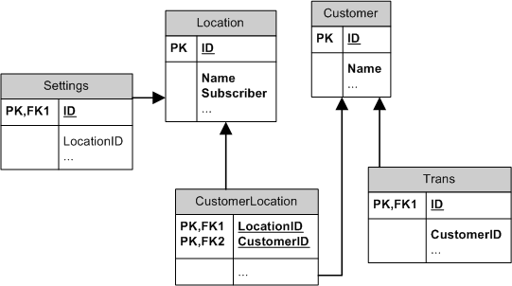
Tables

Slide 49










Structure
SQL Server
SQL Server
Replication
Replication
Horizontal Filter
Vertical Filter Only
Replication
Replication
Replication
SQL Server 1
SQL Server 2
SQL Server N

Slide 50
Filters
Customer
Select * Form Customer
Where CustomerID in (
Select CustomerID
    From CustomerLocation
    Where LocationID in (
Select ID From Location
Where Subscriber = Cast(HOST_NAME as varchar(20)))
)
Settings
Select * Form Settings
Where LocationID in (
Select ID From Location
Where Subscriber = Cast(HOST_NAME as varchar(20))
) OR LocationID IS NULL
Location
  No filter

Slide 51
Download Customer
Customer needs to be download to the branch when customer does a transaction in the store different from the branch he/she registered at.
  Begin a transaction at branch server
  Copy customer information and transactions from head office to branch.
  Remove records from meta data based on rowguid.
  Populate CustomerLocation table.
  Commit transaction

Slide 52

John Huang
Supervisor, Database administration & Business Intelligence
National Money Mart, Victoria
(250)412-6966 (Home)
John_wong_ca@hotmail.com
2008 Aug 16

