Slide 1
DetectRTL
Goal: Create a tool to automatically detect hardware vulnerabilities using static analysis on RTL code

Slide 2
Project Members
Group Members
  John Parks – parksjh@mail.uc.edu
Project Advisor
  Dr. Boyang Wang

Slide 3
Project Abstract
This project focuses on developing methodologies and tools for RTL-level secure coding to protect hardware designs from potential attacks. By detecting vulnerabilities at the Register Transfer Level (RTL), the project aims to mitigate potential vulnerabilities early in in the design process. Ultimately, this work contributes to building a static analysis tool that enhances hardware security and resilience against modern hardware-based attacks while maintaining performance and design efficiency

Slide 4
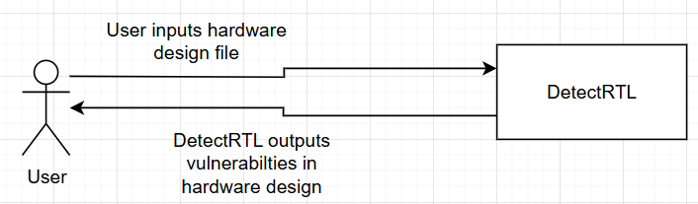
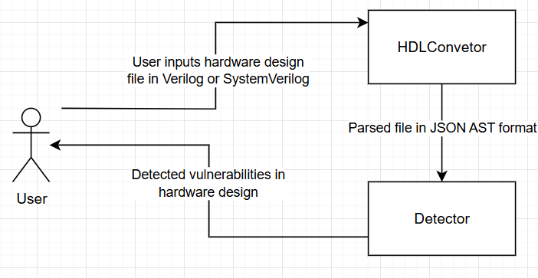
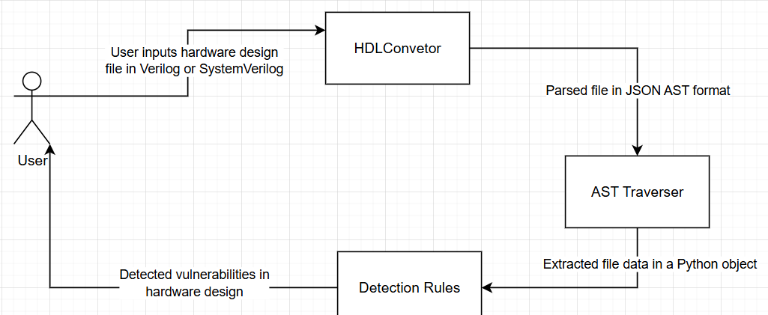
User Stores & Design Diagrams
As a hardware engineer, I want to check my design for insecure coding patterns so that I can prevent vulnerabilities early in the design process
As a security auditor, I want to automatically detect vulnerabilities in hardware designs so I can provide accurate security assessments
As a hardware verification engineer, I want to validate hardware designs are free of potential vulnerabilities so I can ensure hardware designs meet security requirements

Slide 5
Major Project Constraints
Ethical – Vulnerabilities in hardware designs raises ethical questions about reporting them
Security – Vulnerabilities are weaknesses that can be exploited so these vulnerabilities should not be shared with untrusted parties
Social – Improving the security of hardware benefits the community by protecting users from potential attacks

Slide 6
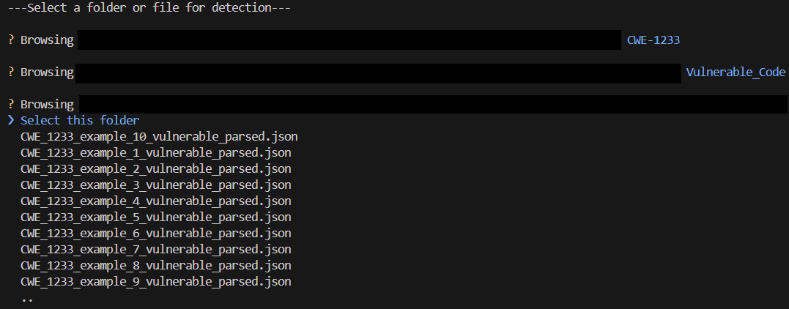
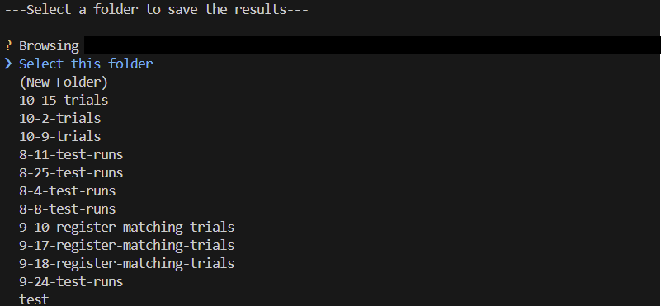
Project Progress
Currently I have detection algorithms for three CWEs
  CWE-226
  CWE-1233
  CWE-1245

Slide 7
Expected Accomplishments
Create a tool that scans RTL code for vulnerabilities associated to CWEs
Write a final report that summarizes my findings

Slide 8
Division of Work (Major Milestones)
Initial research and select relevant CWEs for detection - John
Dataset collection and creation - John
Implementation of detection methods - John
Weekly reports - John
Final research paper - John

Slide 9
Expected Demo at Expo
At the Expo I will the demo the tool on Verilog or SystemVerilog hardware design files to show how vulnerabilities are detected and reported.

