Slide 1
PickyRTL

Slide 2
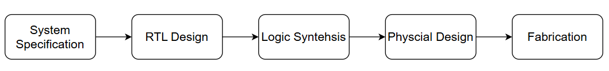
Project Background
Research Project Title: RTL-level Secure Coding against Hardware Attacks
The main goal is to implement detection algorithms for CWEs
Register Transfer Level (RTL)
Part of the hardware design process
Is a hardware description abstraction
Defines digital circuit behavior in terms of data flow between registers
Is written in a Hardware Description Language (HDL)
Verilog, SystemVerilog, VHDL
Notes:
Combinational = pure function of inputs (no clock, no memory) (outside of always)
Sequential = depends on history (uses clock, has registers) (always @(posedge clk) begin)
Why RTL? – Human-readable, which enables static analysis, catching weaknesses earlier, is easier and less costly to fix
System specification – architectural requirements
RTL – coding the chip design, describes data movement and logic operations between registers, what the circuit does
Logic synthesis – gates and netlists, simulation of code and analysis of timing/functionality
Physical design – layout of the chip
Fabrication - silicon

Slide 3

What is CWE?
Stands for Common Weakness Enumeration
List of common hardware and software weakness types
Weakness – a condition that under certain circumstances, could contribute to the introduction of vulnerabilities
Selected 4 CWEs for static analysis detection
CWE-1245
CWE-1233
CWE-226
CWE-1431
Notes:
Vulnerability – an exploitable flaw that can be exploited in a deployed system
The CWEs were selected based on their ability to be detected through static analysis and their relevance in the 2021 MIHW list and 2025 MIHW list
Provides a standardized framework for identifying, categorizing, and preventing security issues during development
It is maintained by MITRE corporation

Slide 4
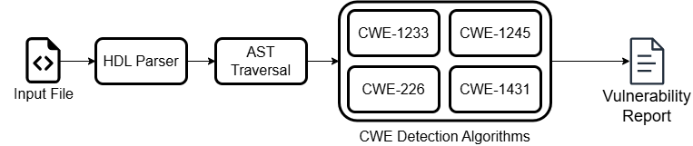
Detection Overview
Notes:
Parse HDL files with HDL convertor into a JSON AST format
Then we extract relevant data (FSM, cryptographic modules, security critical registers) from the AST
Then we run through the detection algorithms and receive a vulnerability report

Slide 5
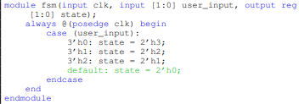
CWE-1245: Improper Finite State Machines (FSMs) in Hardware Logic
FSMs are commonly used in hardware logic for secure data operations, security state, and other functionality
Vulnerable Patterns
Deadlocks
Unreachable states
Incomplete state coverage
Consequences
System could enter a deadlocked state
Bypass security authentication
Unpredictable system behavior
Detection
Incomplete state coverage?
Unreachable states?
Deadlock states?
Notes:
The patterns can lead to consequences. The example shows an FSM with incomplete state coverage. The state variable ‘user_input’ has 4 possible values because it is 2 bits long. There are originally only 3 defined states. If ‘user_input’ had a value of 2’h3 the system would enter an unpredictable state and could possibly be exploited
Could be exploited through fault injection attacks
2 – 2 bit width
H – hexadecimal
3 - value

Slide 6

CWE-1233: Security Sensitive Hardware Controls with Missing Lock Bit Protection
Lock Bit – A hardware mechanism that prevents modification of registers after they have been set
Security-critical registers should be protected with lock bits
Consequences
Security policies could be bypassed if access controls are modified
Keys could be overwritten
Detection
Identify the lock bit
Gather security-critical registers
Are assignments made to the registers unprotected?
Notes:
Security-critical registers – boot configurations, control settings, debug interface controls, keys
The example shows a key in some cryptographic module that should be protected with lock bit, but is not.

Slide 7
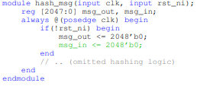
CWE-226: Sensitive Information in Resource Not Removed Before Reuse
Registers often store sensitive information such as cryptographic keys, authentication tokens, etc.
If the registers aren’t cleared after being used, the data persists and can be accessed by subsequent operations
Consequences
Cryptographic key leakage to unauthorized process
Sensitive data could be accessed by untrusted parties
Detection
Identify the reset signal
Gather registers that need to be reset
Are the registers properly reset?
Notes:
The example shows a hashing module where the input message is not cleared. If this is not cleared then the unhashed input message will remain on that register and could be accessed by an untrusted party/process

Slide 8

CWE-1431: Driving Intermediate Cryptographic State/Results to Hardware Module Outputs
Cryptographic modules often involve intermediate results between rounds of encryption
These results should remain internal and not be exposed to output ports
Consequences
Intermediate results could be observed by untrusted parties through side channel attacks
Detection
Identify the cryptographic module output
Find any registers containing intermediate results
Are intermediate results assigned to the module output before checking if the result is valid?
Notes:
Intermediate results can give attackers a chance to decipher the original message
The result in the example should not be driven to the data_o output before the result is actually valid

Slide 9
Questions?

