Slide 1
Dependency Injection, Unit Testing and Mocking
Developing Testable, maintainable, high-quality code

Slide 2
Agenda
Why
How (fictitious MyPizza.com code example)
Show and tell (Compliance implementation)
Discussion
Takeaways
Have a good understanding of the benefits of dependency injection, unit testing and mocking

Slide 3

MyPizza.com Startup
In the first sprint, developers got the initial pizza order web and phone app working
They wrote an automated test, but it is slow and unreliable; the test also accidentally sent out an email and charged a real credit card
Many bugs have been discovered as the front end wasn’t ready until late in the sprint and all testing was manual
There are many enhancements planned, and the team would like to improve the code maintainability and quality

Slide 4
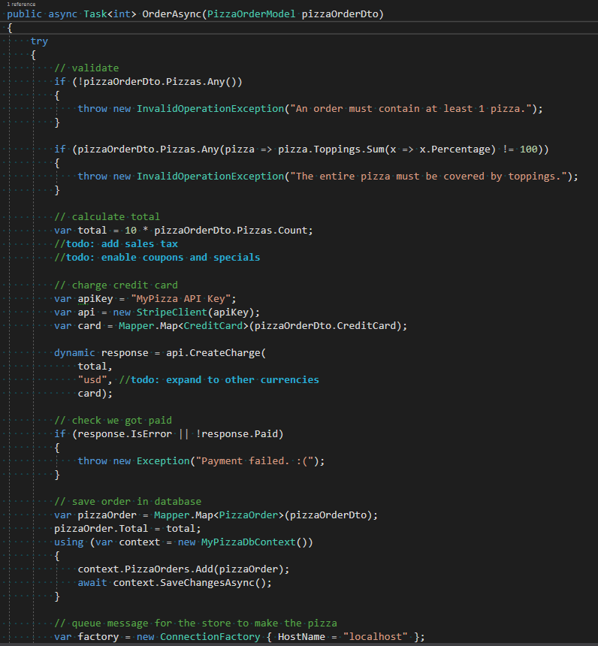
Sprint 1 Code
Tightly coupled dependencies on concrete implementations
Can’t unit test it
Too many responsibilities
The order method already has too many lines of code and is going to get even longer

Slide 5
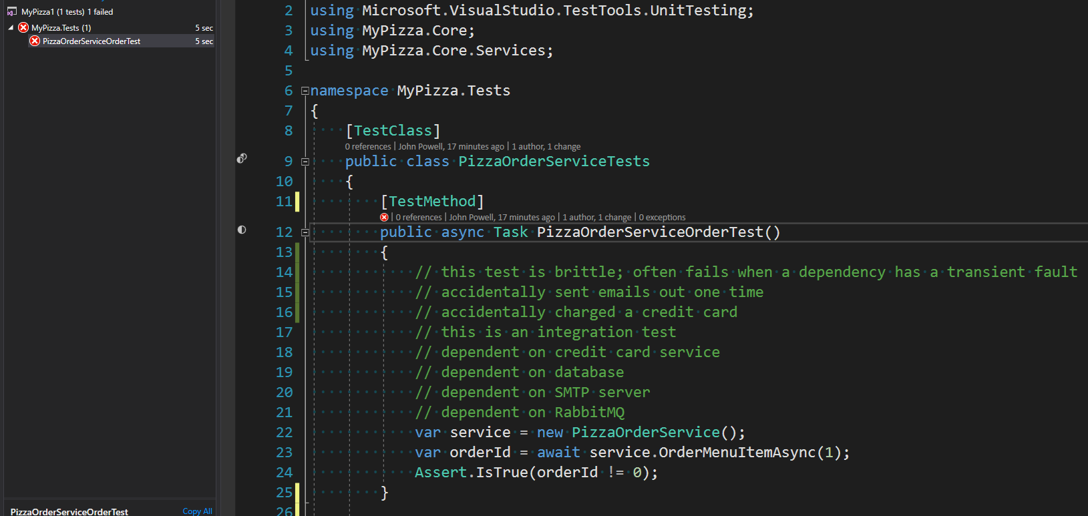
Sprint 1 Tests
Tests are too slow (5 seconds for 1 test) will compound over time
No control over dependencies
Randomly fail

Slide 6
Plan to Improve the Code
Design for Testability. Design classes to depend on interfaces rather than concrete implementations, e.g. IPaymentService, ILoggingService. Single Responsibility Principle helps
Inject Dependencies. Do not “new up” or create static dependencies in classes. Dependencies instead get “injected” by passing them into a class constructor, property or method
Dependency Injection Containers. Eases the pain of creating all the dependencies by injecting them for you
Isolate Dependencies in Unit Tests. Only test the unit of work (e.g. PizzaOrderService), not it’s dependencies. This can be done with fakes and/or mocks

Slide 7
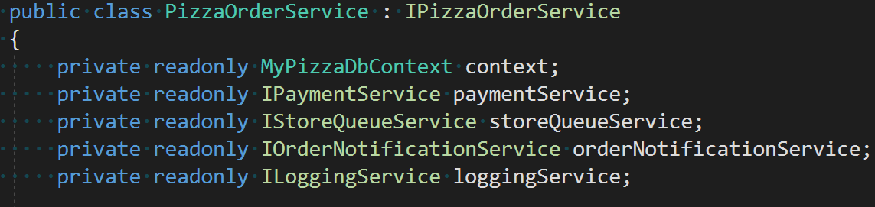
Step 1: Design for Testability
Refactor concrete implementations into interfaces (use Single Responsibility Principle)
Remove static references
Modify existing code to depend on interfaces

Slide 8
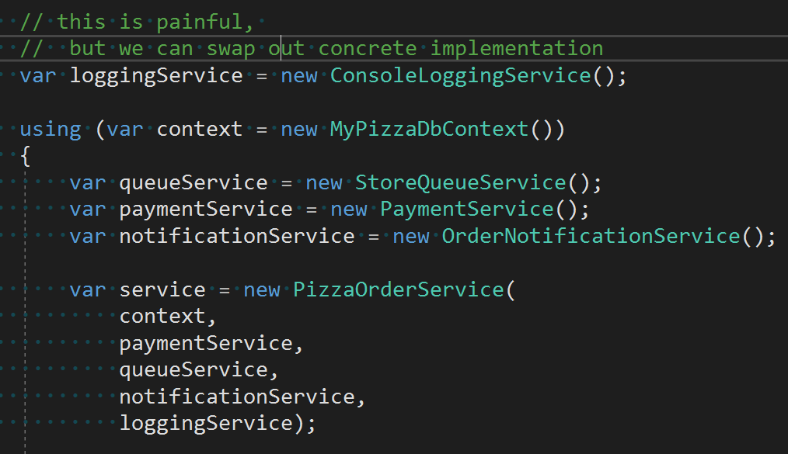
Step 2: Inject Dependencies
Instead of “newing” up objects or using static references, pass dependencies to the class
Enables swapping concrete implementation
But..
Painful to create all the dependencies when you want an object
Repeated code, not DRY

Slide 9
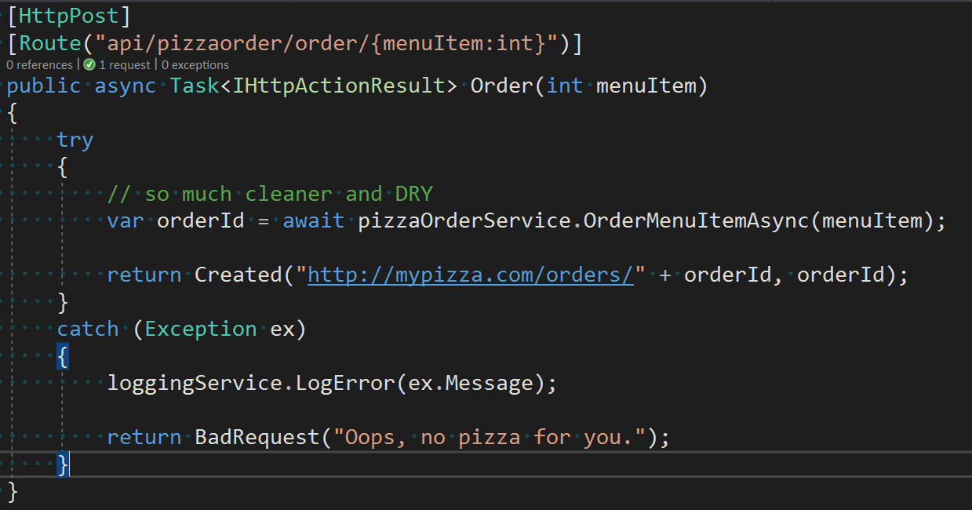
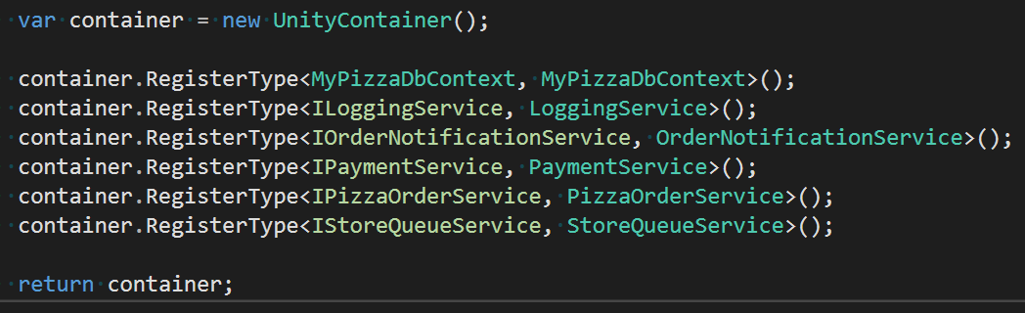

Step 3: DI Container
Introduce a DI container like Unity
Configure dependency mappings in a single place at startup (code or config file)
Refactor existing code to take dependencies in the constructor (or properties/methods)

Slide 10
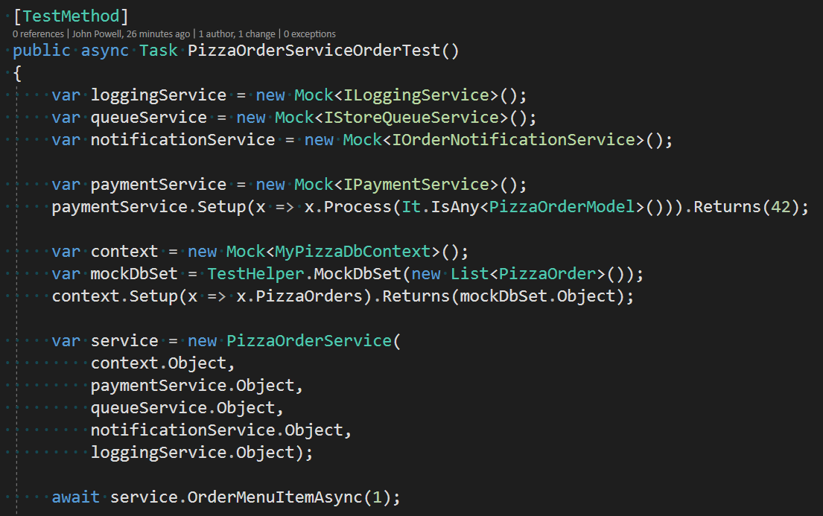
Step 4: Isolate Dependencies in Unit Tests
Unit Tests and Integration Test in separate projects
Use isolation framework like Moq and/or fakes
Unit Tests part of CI build to ensure unit tests are maintained
Integration Tests part of nightly build because they are still important

Slide 11
Closer Look at Unit and Integration Tests
Unit Test
Has full control of the code under test and does not use real dependencies
Integration Test
Does not have full control of the code under test and uses real dependencies
Both are important, but must be independent.

Slide 12
Good Unit Tests
Automated
Fast
Reliable
Consistent
Have full control of unit under test
Run independently of other tests
Don’t change things between runs
Can be run by anyone on the team

Slide 13
Good Practices
Write unit tests while developing the code (fresh in your mind)
Have a team unit test coverage target (70% is common)
When a bug is discovered, start by writing a unit test
Run unit tests with CI build (so they are maintained)
Run integration tests with daily build (to test it all works together)

Slide 14
Summary
Less bugs
Ensure the back end is correct without waiting for the front end or using external tool to manually test
Refactor code with confidence you didn’t break anything
Cleaner, more maintainable code
Ability to swap concrete implementation
Working documentation how to use your code

Slide 15
Show and Tell

Slide 16
Questions and Discussion
Apply these concepts to new development
Refactor existing code over time

