Slide 1
Dependency Injection, Unit Testing and Mocking
Developing Testable, maintainable, high-quality code

Slide 2
Agenda
Why
How (fictitious MyPizza.com code example)
Show and tell (Compliance implementation)
Discussion
Takeaways
Have a good understanding of the benefits of dependency injection, unit testing and mocking

Slide 3

MyPizza.com Startup
In the first sprint, developers got the initial pizza order web and phone app working
They wrote an automated test, but it is slow and unreliable; the test also accidentally sent out emails one time
Many bugs have been discovered as the front end wasn’t ready until late in the sprint and all testing was manual
There are many enhancements planned, and the team would like to improve the code maintainability and quality

Slide 4
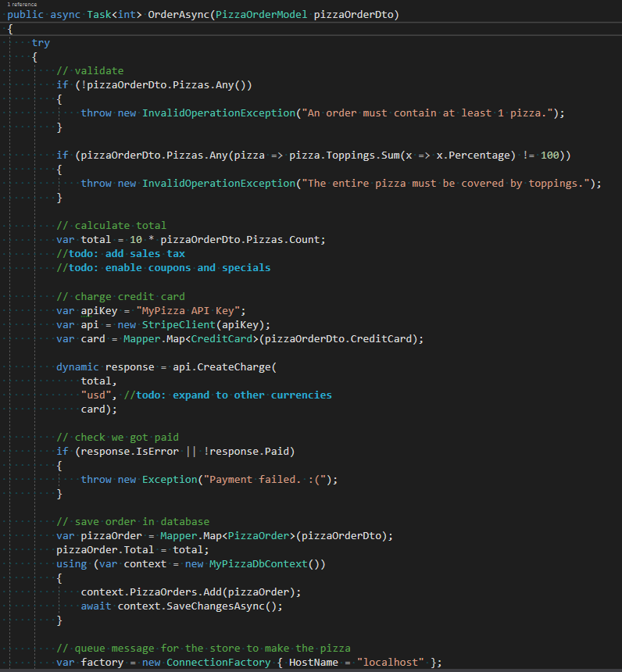
Sprint 1 Code
Tightly coupled dependencies on concrete implementations
Can’t unit test it
Too many responsibilities
The order method already has too many lines of code and is going to get even longer

Slide 5
Plan to Improve the Code
Design for Testability. Design classes to depend on interfaces rather than concrete implementations, e.g. IPaymentService, ILoggingService. Single Responsibility Principle helps
Inject Dependencies. Do not “new up” or create static dependencies in classes. Dependencies instead get “injected” by passing them into a class constructor, property or method
Dependency Injection Containers. Eases the pain of creating all the dependencies by injecting them for you
Isolate Dependencies in Unit Tests. Only test the unit of work (e.g. PizzaOrderService), not it’s dependencies. This can be done with fakes and/or mocks

Slide 6
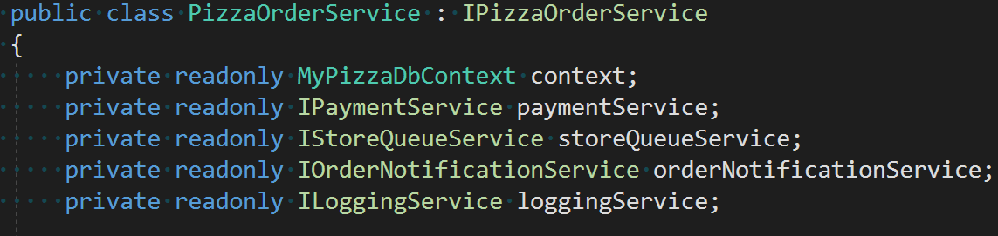
Step 1: Design for Testability
Refactor concrete implementations into interfaces (use Single Responsibility Principle)
Identify static references
Modify existing code to depend on interfaces

Slide 7
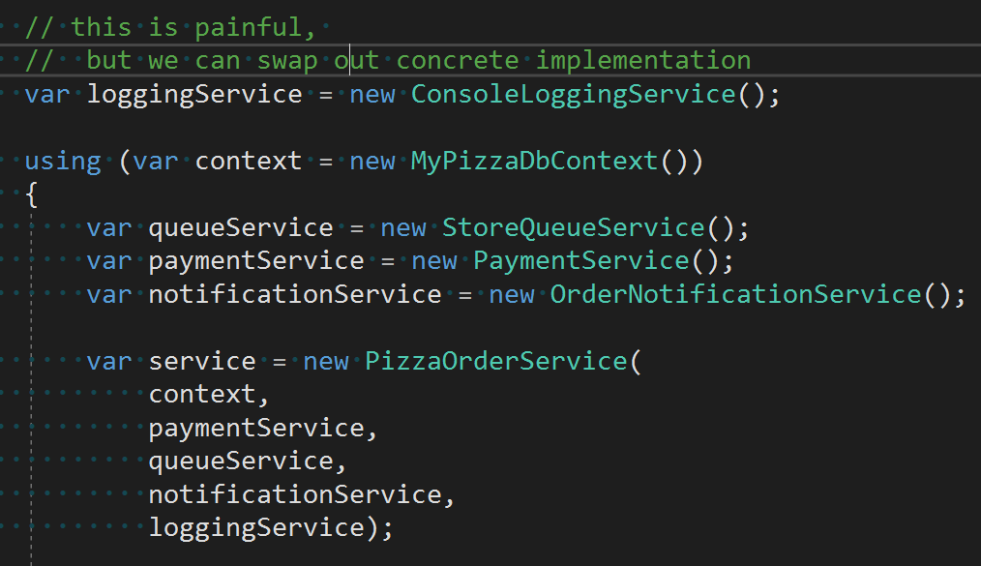
Step 2: Inject Dependencies
Instead of “newing” up objects or using static references, pass dependencies to the class
Enables swapping concrete implementation
But..
Painful to create all the dependencies when you want an object
Repeated code, not DRY

Slide 8
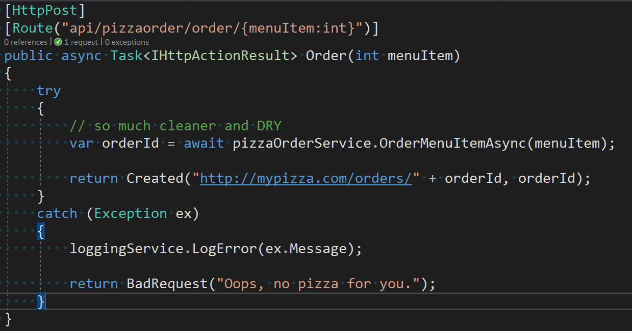
Step 3: DI Container
Introduce a DI container like Unity
Configure default dependency mappings in a single place at startup
Refactor existing code to take dependencies in the constructor

Slide 9
Step 4: Isolate Dependencies in Unit Tests
Unit Tests and Integration Test in separate projects
Use isolation framework like Moq and/or fakes
Unit Tests part of CI build to ensure unit tests are maintained
Integration Tests part of nightly build because they are still important

Slide 10
Closer Look at Unit and Integration Tests
Unit Test
Has full control of the code under test and does not use real dependencies
Integration Test
Does not have full control of the code under test and uses real dependencies
Both are important, but must be independent.

Slide 11
Good Unit Tests
Automated
Fast
Reliable and consistent
Have full control of unit under test
Run independently of other tests
Doesn’t change anything between runs
Run automatically when code is changed
Anyone on the team can run them

Slide 12
Summary
Less bugs
Ensure the back end is correct without waiting for the front end or using external tool to manually test
Refactor code with confidence you didn’t break something
Cleaner, more maintainable code
Ability to swap concrete implementation
Working documentation how to use the unit

Slide 13
Show and Tell

Slide 14
Discussion
Apply these concepts to new development
Refactor existing code over time

