Slide 1
Intro to Human-Centered Data Science Final Project Presentation
Data-driven analysis surrounding women-run WHD, FIR, and the perception of policing.
Created by: John Preston

Slide 2
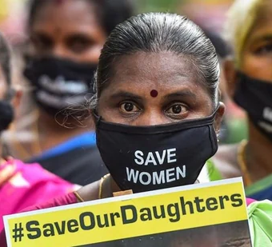

Overview & Background of Data
Over the last few weeks, we have discussed numerous cases and expanded on the ethical implications of those cases.
As a Data Scientist, we can do our part by articulating data in a way that will save and impact lives.
Our data for this project stems from a policing reform experiment in India. The focus was on GBV.
It was one of the largest controlled trials, with 180 police stations serving 24.4 million people.

Slide 3
Objective
--- To evaluate the impact of specialized police initiatives, demographic influences, and community engagement factors on improving the accessibility, effectiveness, and trustworthiness of law enforcement in addressing gender-based violence. ---

Slide 4
Dataframes and variables used in this project
Admin_long Dataframe
Police_full
Dataframe
Police_baseline
Dataframe
Citizen_full
Dataframe
Variables:
treatment
fir_bywomen_count
b_helpful
b_visit & e_visit
b_pol_handling & e_pol_handling
month
b_effective & e_effective
gender & member_gender

Slide 5
Question 1 & Motivation
Q1: How does the implementation of a women-run help desk impact the number of first information reports filed by women?
M1:
This question aims to understand the impact of specialized support services like women-run help desk and the reporting behavior of women. Understanding the correlation helps us determine if the resources are working as they should or if there are any gaps that should be reviewed.

Slide 6
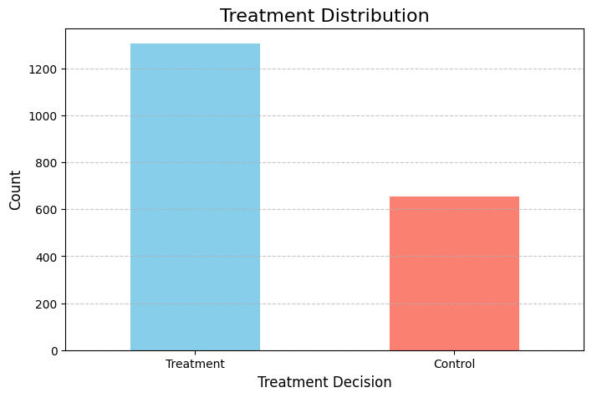
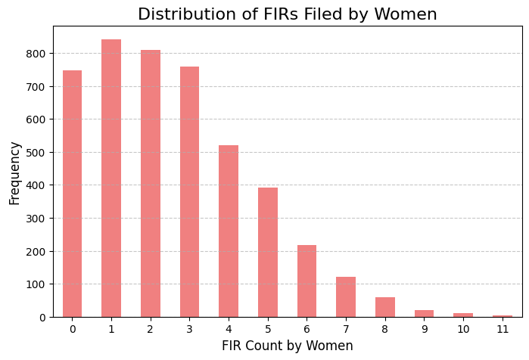
What does this data show us? How can we dive deeper into this data to find a correlation?

Slide 7
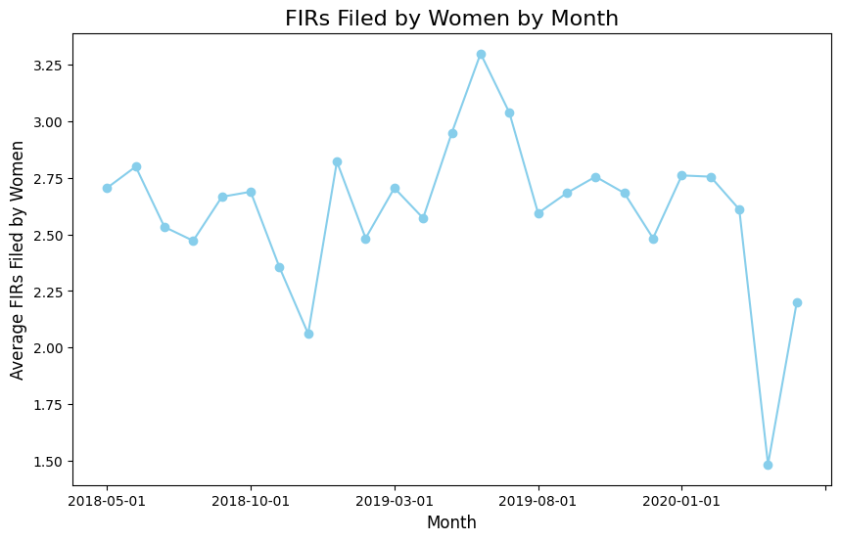
11,730
Total Count

Slide 8
Question 2 & Motivation
Q2: What demographic factors influence perceptions of police effectiveness in handling cases related to women?
M2:
Investigating the demographic factors that shape the perception of police effectiveness when addressing gender-based violence can help shine the spotlight on any biases and trainings that may be needed.

Slide 9
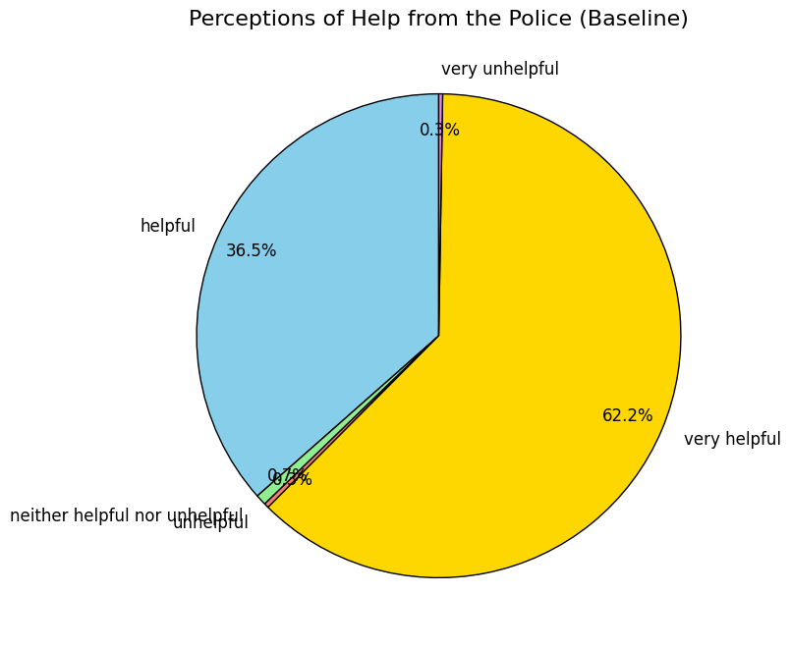
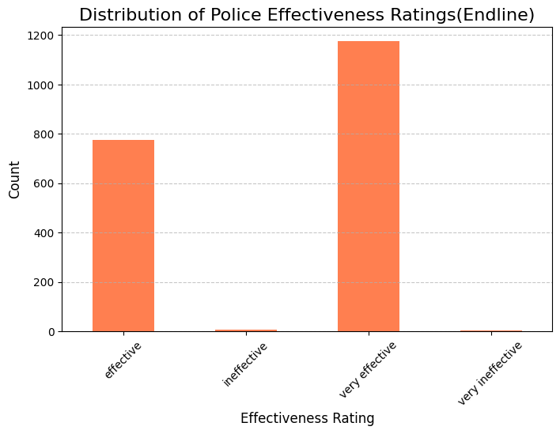
What does this data show us?

Slide 10
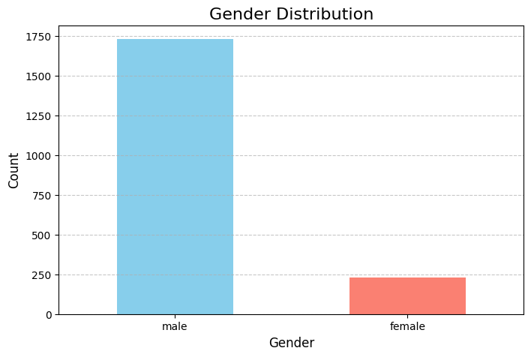
Who’s
gender?
This data was pulled from the Police_full dataframe. How can we use this information accurately?

Slide 11
Question 3 & Motivation
Q3: What factors predict the likelihood of a citizen visiting a police station based on survey data?
M3:
By understanding predictors of whether citizens will visit police stations can help us identity any barriers that hinder access to police services. With information like this, departments can develop and target outreach programs to build community engagement.

Slide 12
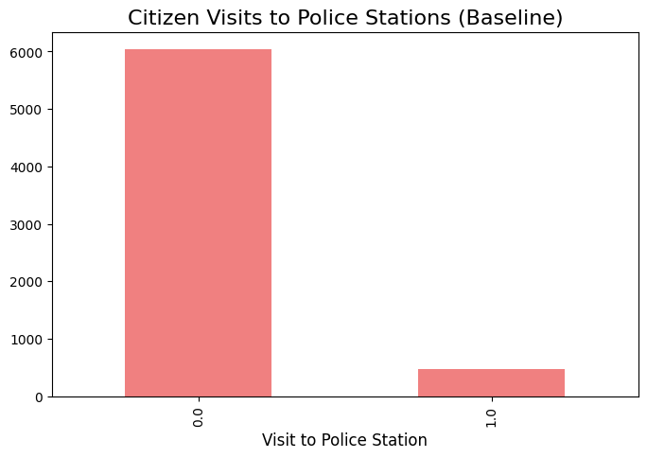
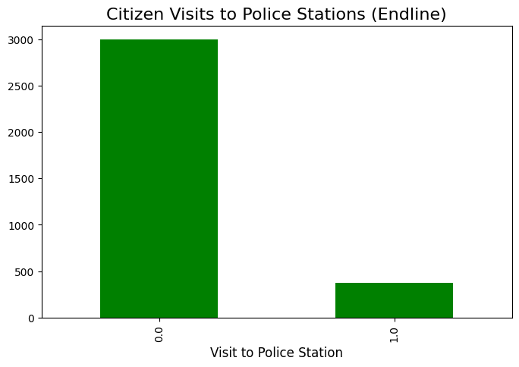
What does this data show us?

Slide 13
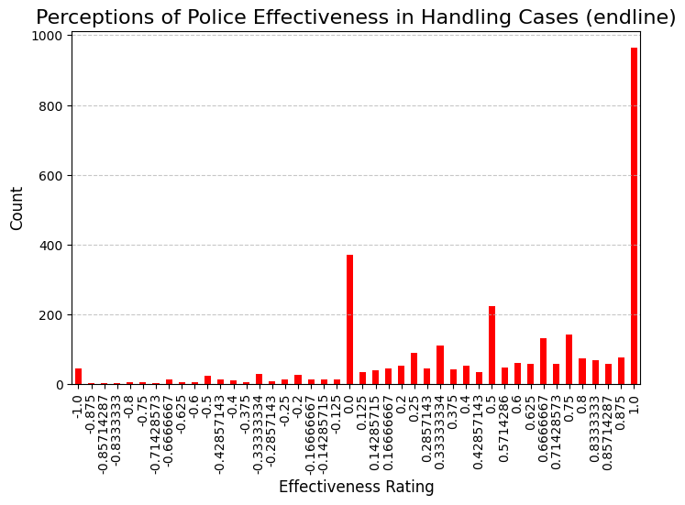
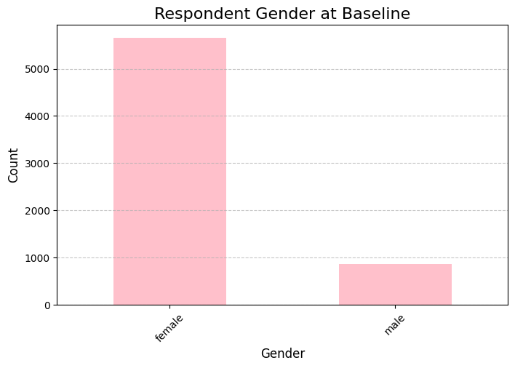
This data was pulled from the household level. Although some of the data is skeptical, we can see that the largest amount of responses came from women.

Slide 14
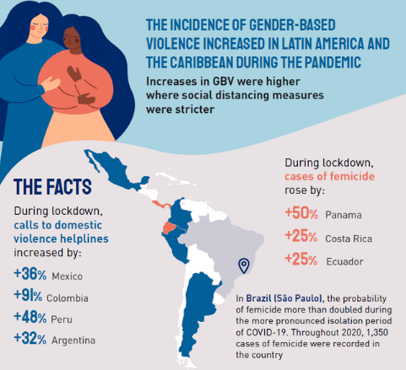
Conclusion & remarks
Overall, there could be some correlation between variables within the data frames; however, I would need to take a deeper dive.
If we could obtain more clarity of the variables, we could merge the data better for more accuracy in our EDA.
It may seem like there is a negative perception of the police; however, from the data provided, the perception shows to be very helpful, and their efforts are very effective for the most part.
I would love to see a similar trial take place focused on GBV and the 2020 Pandemic.

