Slide 1
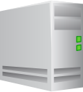
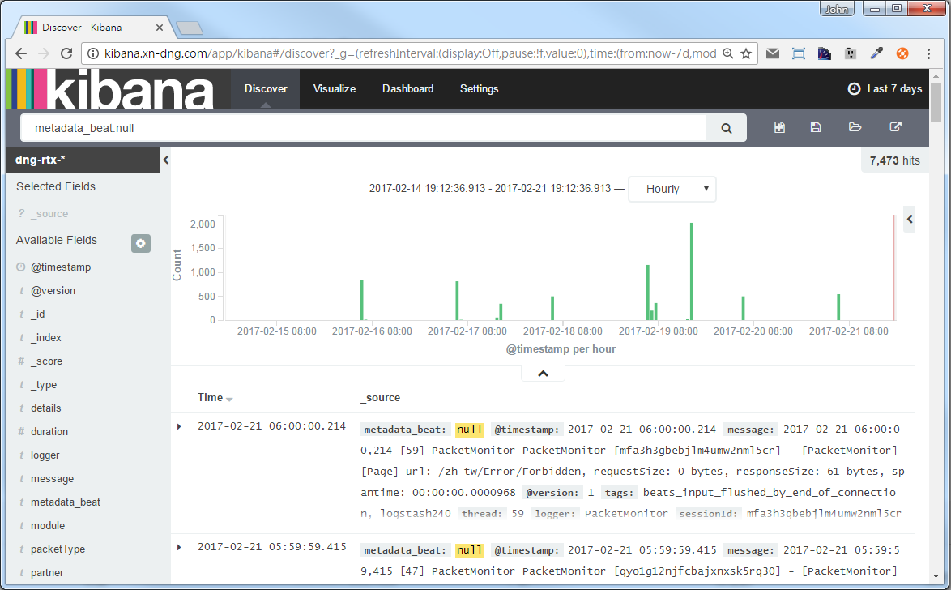
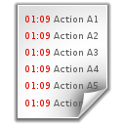


blog.johnwu.cc
Parsing log
Time: 2017-02-21 18:38:37.893
Type: Info
Message: XXXXXXXXX
Host: 10.0.0.1
…
Query
Send custom fields
Data
Logstash
Elasticsearch
Kibana
Data
Query
Send log
Filebeat
Server

Slide 2


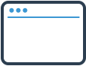


blog.johnwu.cc
Session: 1 exists
Session: 1
Request - 2
Request - 1
Response
Clone
Website A
Session: 1
Session: 1
Session: 1 Not exists
Request Session
Session: 1
User
Response
Redis
Request - 3
Get Session
Website B

Slide 3
blog.johnwu.cc
Session: 1
Request Session
Request - 2
Request - 1
Response
Get Session
Save Session
Website A
Session: 1
Session: 1
Session: 1
Request Session
Session: 1
User
Response
Redis
Request - 3
Get Session
Website B

Slide 4
blog.johnwu.cc
First
Middleware
Second
Middleware
Third
Middleware
Action
Request
{
// Logic
next();
// Logic
}
{
// Logic
next();
// Logic
}
{
// Logic
next();
// Logic
}
{
// Logic
}
Response

Slide 5
blog.johnwu.cc
Routing
Action
Routing Attribute
Request
Request
Router Middleware

Slide 6


XXXXXXXXXXXXXXX
XXXXXXXXXXXXXXX
XXXXXXXXXXXXXXX
XXXXXXXXXXXXXXX
XXXXXXXXXXXXXXX
XXXXXXXXXXXXXXX
XXXXXXXXXXXXXXX
XXXXXXXXXXXXXXX

Slide 7

Start
Keep
More of
Stop
Less of

Slide 8
Concern
Influence
Control

Slide 9
Liked
Learned
Lacked
Longed For

Slide 10
TypeScript
(Component)
Interpolation
HTML
(Template)
Property Binding
Event Binding
Two-way Data Binding

Slide 11
blog.johnwu.cc
Action
Request
Model Binding
Authorization Filters
Middleware
Resource Filters
Action Filters
Response
Result Filters
Response
Exception Filters
Throw
Exception

Slide 12
Exception
Middleware
Other
Middleware
Resource Filter
Result Filter
Exception Filter
Action Filter
Action

Slide 13
blog.johnwu.cc
Services Container
1st Request
Controller
DI: A , B , C
Singleton
Pool
C
A
View
DI: A , B , C
Scoped
Pool
C
B
2nd Request
Controller
DI: A , B , C
C
Scoped
Pool
View
DI: A , B , C
B
C

Slide 14
MyComponent
AppModule
FirstModule
Providers
Providers
MyComponent
FirstComponent
SampleService
SampleService
JavaScript
AppModule
FirstModule
AppModule
Service
Singleton
Service
SampleComponent
Controller
Service
Module Service
Import
SharedModule
SecondModule
SharedModule
Service
SampleComponent
Controller
Service
Module Service
SharedModule
Import
SharedModule
Service
ThirdModule
Import
SampleComponent
SharedModule
Controller
Service
Module Service
SharedModule
Service

Slide 15
Mad
Sad
Glad

Slide 16


Slide 17
DAL
(Data Access Layer)
BLL
(Business Logic Layer)
Entities
MyWebsite

Slide 18
Constructor
OneTime
SetUp
SetUp
Test
OneTime
TearDown
Dispose
TearDown

Slide 19
blog.johnwu.cc
Global Action Filter
Request
First
Action
Third
Action
Request
Ignore Global
Action Filter
Special
Action
Second
Action
Other
Action

Slide 20
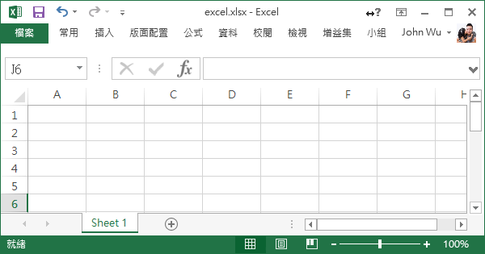
Workbook
SheetData
Worksheet
Sheet
Sheets

Slide 21
blog.johnwu.cc
Action
Request
HTTP Module 1
HTTP Handlers
HTTP Module 2
HTTP Module n
Action Filters
Respose

Slide 22
Module A
Module B
Module C
Module D
Module E
Module F
Application
Website

Slide 23
Example (DLL)
Example (DLL)
Example (DLL)
ExampleApp (EXE)
ExampleApp (EXE)

Slide 24
Request
Request
Users
External Systems
Users
Request
Presentation Layer
Presentation Layer
Component
Component
Components
Business Layer
Service Layer
Component
Component
Component
Component
Data Layer
Business Layer
Component
Component
Component
Component
Database
External Services
Data Layer
Component
Component
Database
External Services

Slide 25



Domain.dll
Website
WebService
BusinessLayer.dll
DataLayer.dll

Slide 26
Host
Build Stage
Publish Stage
/
build/
doc/
scripts/
src/
XXXX.Domain/
XXXX.WebPortal/
ClientApp/
node_modules/
package.json
test/
XXXX.IntegrationTest/
XXXX.UnitTest/
XXXX.sln
/src
/publish
/app
XXXX.Domain/
XXXX.WebPortal/
ClientApp/
node_modules/
package.json
*.dll
(publish files)
*.dll
(publish files)

Slide 27
Host
Build Stage - dotnet
Build Stage - npm
/
build/
doc/
scripts/
src/
XXXX.Domain/
XXXX.WebPortal/
ClientApp/
node_modules/
package.json
test/
XXXX.IntegrationTest/
XXXX.UnitTest/
XXXX.sln
/src
/publish
/src
/publish/wwwroot
XXXX.Domain/
XXXX.WebPortal/
ClientApp/
node_modules/
package.json
XXXX.Domain/
XXXX.WebPortal/
ClientApp/
node_modules/
package.json
*.dll
(publish files)
js/*.js
css/*.css (front-end files)
Publish Stage
/app /app/wwwroot
*.dll
(publish files)
js/*.js
css/*.css (front-end files)

Slide 28

Nginx
ASP.NET Core Application
http://demo.johnwu.cc
http://example.johnwu.cc
https://demo.johnwu.cc
HTTP
Kestrel Web Server
Port: 5000
HttpContext
Internet
Application Code
(Startup.cs , …)

Slide 29




Development
Environment
Production
Environment
Internet
Developers
Servers
Cleanroom

Slide 30


Development Environment
Production Environment
Docker
Publish Registry
2. Push
Docker
Private Registry
sha 2
Third-party DLL
sha 1
Base Image
3. Pull
Servers
1. Push
sha 2
Third-party DLL
sha 3
Project DLL
sha 1
Base Image
7. Pull
sha 2
Third-party DLL
4. Retag & Push
sha 3
Project DLL
sha 1
Base Image
5. Pull
sha 2
Third-party DLL
sha 2
Third-party DLL
sha 3
Project DLL
sha 1
Base Image
sha 1
Base Image
sha 2
Third-party DLL
sha 1
Base Image
sha 3
Project DLL
sha 2
Third-party DLL
Docker
Private Registry
sha 1
Base Image
6. Retag & Push
Cleanroom
sha 3
Project DLL

