Slide 1
Refactoring Assistants
John Businge
john.businge@unlv.edu

Slide 2
Refactoring: change the internal structure of a code without compromising its external behaviour
Refactorings can be looked at in two ways:
How to identify refactoring targets
How to detect applied refactorings
Notes:
Although in the labs will shall look at both, the final project will make use of number (2).

Slide 3
How to identify refactoring targets
“I wrote the original edition in 2000 when Refactoring was a little-known technique.” – Martin Fowler
Refactoring is a very common practice that helps developers to complete maintenance tasks (i.e., implement new features and fix bugs) and eliminate various design and code smells
There are more than 80 types of refactorings
Some of the common refactorings:
Moving a class, renaming an attribute, extracting a method

Slide 4
Strategic Refactoring
Strategic Refactoring is to apply refactoring for a particular design reason/goal
Support a new feature/correction
Solving a specific design problem
“Refactor to Understand” (OORP, p.127)
In this Reengineering Course, refactoring without reason/goal is meaningless.
Please remember the pattern “Keep it Simple” (OORP, p.37) when planning refactoring activities.

Slide 5
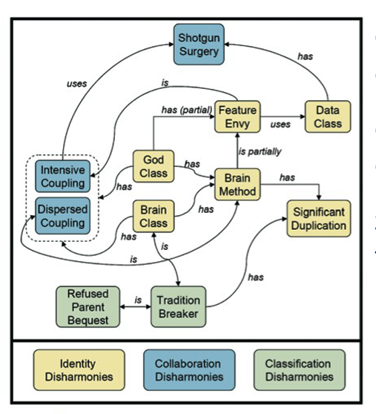
Bad/Code Smells
Code smells are the result of inexperience multiplied by tight deadlines, mismanagement, and nasty shortcuts taken during the development process.
Code smells are a prime candidate for refactoring
SonarQube is a nice tool for Smell detection
In CodeScene, Only the paid version shows Smells
Disharmonies and their correlations
Notes:
God Class – Performs too much work on its own and centralizes the intelligence of a system. Reduces reusability, understanding, and maintainability of a class or subsystem.
Feature Envy – Method that is more interested in the data of others classes than its own class. The method may be misplaced and should be moved to another class.
Data Class – Dumb data holders without complex functionality, but other classes strongly rely on them
Brain Method – Centralizes the functionality of a class, and it is often hard to maintain and understand. Is long, has excessive branching, and deep nesting, and uses many local and instance variables
Intensive Coupling – A single client method is strongly coupled with only a few provider classes

Slide 6
Code Smell Example: God Class
A God Class is a class that is big on size and/or responsibilities, controlling too many objects.
Refactoring solution: Extract/Split Class
It is often possible to “split” a god class into two or more classes with a more clear and logical design
Notes:
God Class – Performs too much work on its own and centralizes the intelligence of a system. Reduces reusability, understanding, and maintainability of a class or subsystem.

Slide 7
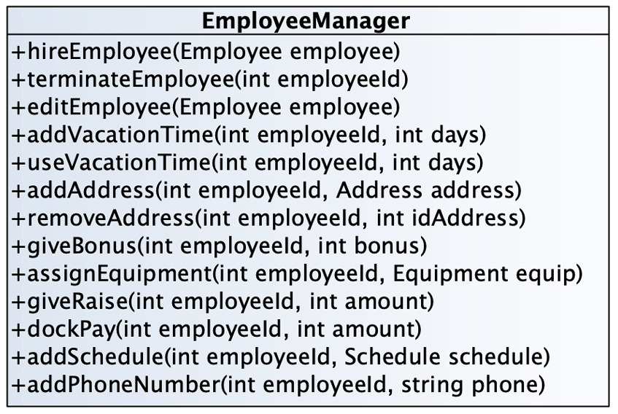
Code Smell Example: God Class
Notes:
This problem is difficult because:
By assuming too many responsibilities, a god class monopolizes control of an application. Evolution of the application is difficult because nearly every change touches this class, and affects multiple responsibilities.
It is difficult to understand the different abstractions that are intermixed in a god class. Most of the data of the multiple abstractions are accessed from different places.
Identifying where to change a feature without impacting the other functionality or other objects in the system is difficult. Moreover, changes in other objects are likely to impact the god class, thus hampering the evolution of the system.
It is nearly impossible to change a part of the behavior of a god class in a black-box way.

Slide 8
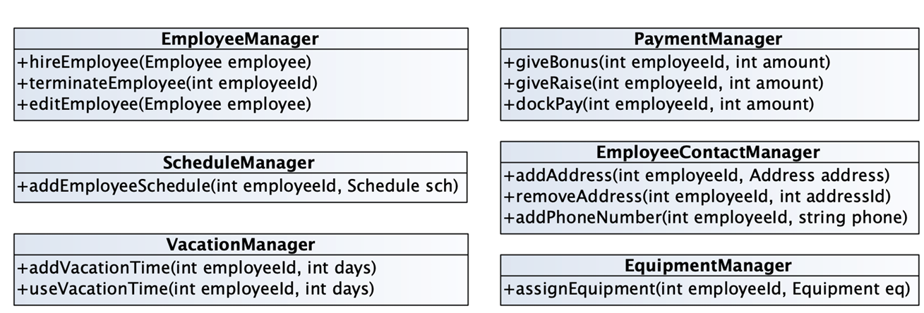
Code Smell Example: God Class
Notes:
Incrementally redistribute the responsibilities of the god class either to its collaborating classes or to new classes that are pulled out the god class.

Slide 9
Guidelines on How to Refactor
Identify where (and when) to refactor
Consider which refactoring(s) to apply
Assure behavior preservation on the refactored artifact
Perform the refactoring(s)
Assess the effect of the refactoring on quality
Maintain the system’s consistency among the refactored code and other software artifacts

Slide 10
How to detect Applied Refactorings
Refactoring is noise in evolution analysis
Bug-inducing analysis (SZZ): flag refactoring edits as bug-introducing changes
Tracing requirements to code: miss traceability links due to refactoring
Regression testing: unnecessary execution of tests for refactored code with no behavioral changes
Code review/merging: refactoring edits tangled with the actual changes intended by developers
Notes:
Despite the benefits, in some contexts, refactoring is perceived as change noise, which makes it difficult in the completion of various software evolution-related tasks.

Slide 11
There are many refactoring detection tools
Demeyer et al. [OOPSLA’00]
UMLDiff + JDevAn [Xing & Stroulia ASE’05]
RefactoringCrawler [Dig et al. ECOOP’06]
Weißgerber and Diehl [ASE’06]
Ref-Finder [Kim et al. ICSM’10, FSE’10]
RefDiff [Silva & Valente, MSR’17]
RefactoringMiner (SOA tool) [Tsantalis et al. TSE’20]
(RefactoringMiner has the highest average precision (99.6%) and recall (94%) among all competitive tools)
Notes:
For this reason, many refactoring-aware techniques have been developed to merge branches, detect bug-introducing changes, adapt client software to the library and framework updates, select regression tests, and assist code review,] in the presence of refactoring operations.

Slide 12
RefactoringMiner – Detecting refactorings in commits
A library/API written in Java that can detect refactorings applied in the history of a Java project.
https://github.com/tsantalis/RefactoringMiner

Slide 13
RefactoringMiner approach in a nutshell
AST-based statement matching algorithm
Input: code fragments T1 from parent commit and T2 from child commit
Output:
M set of matched statement pairs
UT1 set of unmatched statements from T1
UT2 set of unmatched statements from T2
Code changes due to refactoring mechanics: abstraction, argumentization
Code changes due to overlapping refactorings or bug fixes: syntax-aware AST node replacements

Slide 14
private static Address[] createAddresses(int count) {
Address[] addresses = new Address[count];
for (int i = 0; i < count; i++) {
try {
addresses[i] =
new Address("127.0.0.1", PORTS.incrementAndGet());
}
catch (UnknownHostException e) {
e.printStackTrace();
}
}
return addresses;
}
private static Address[] createAddresses(int count) {
Address[] addresses = new Address[count];
for (int i = 0; i < count; i++) {
try {
addresses[i] =
new Address("127.0.0.1", PORTS.incrementAndGet());
}
catch (UnknownHostException e) {
e.printStackTrace();
}
}
return addresses;
}
Before
After
Extract Method detection rule

Slide 15
private static Address[] createAddresses(int count) {
Address[] addresses = new Address[count];
for (int i = 0; i < count; i++) {
try {
addresses[i] =
new Address("127.0.0.1", PORTS.incrementAndGet());
}
catch (UnknownHostException e) {
e.printStackTrace();
}
}
return addresses;
}
private static List<Address> createAddresses(int count) {
List<Address> addresses = new ArrayList<Address>(count);
for (int i = 0; i < count; i++) {
try {
addresses[i] =
new Address("127.0.0.1", PORTS.incrementAndGet());
}
catch (UnknownHostException e) {
e.printStackTrace();
}
}
return addresses;
}
Before
After
Extract Method detection rule

Slide 16
private static Address[] createAddresses(int count) {
Address[] addresses = new Address[count];
for (int i = 0; i < count; i++) {
try {
addresses[i] =
new Address("127.0.0.1", PORTS.incrementAndGet());
}
catch (UnknownHostException e) {
e.printStackTrace();
}
}
return addresses;
}
private static List<Address> createAddresses(AtomicInteger ports, int count){
List<Address> addresses = new ArrayList<Address>(count);
for (int i = 0; i < count; i++) {
try {
addresses[i] =
new Address("127.0.0.1", ports.incrementAndGet());
}
catch (UnknownHostException e) {
e.printStackTrace();
}
}
return addresses;
}
Before
After
Extract Method detection rule

Slide 17
private static Address[] createAddresses(int count) {
Address[] addresses = new Address[count];
for (int i = 0; i < count; i++) {
try {
addresses[i] =
new Address("127.0.0.1", PORTS.incrementAndGet());
}
catch (UnknownHostException e) {
e.printStackTrace();
}
}
return addresses;
}
private static List<Address> createAddresses(AtomicInteger ports, int count){
List<Address> addresses = new ArrayList<Address>(count);
for (int i = 0; i < count; i++) {
try {
addresses[i] =
new Address("127.0.0.1", ports.incrementAndGet());
}
catch (UnknownHostException e) {
e.printStackTrace();
}
}
return addresses;
}
Before
After
Extract Method detection rule

Slide 18
private static Address[] createAddresses(int count) {
Address[] addresses = new Address[count];
for (int i = 0; i < count; i++) {
try {
addresses[i] =
new Address("127.0.0.1", PORTS.incrementAndGet());
}
catch (UnknownHostException e) {
e.printStackTrace();
}
}
return addresses;
}
private static List<Address> createAddresses(AtomicInteger ports, int count){
List<Address> addresses = new ArrayList<Address>(count);
for (int i = 0; i < count; i++) {
}
return addresses;
}
try {
addresses[i] =
new Address("127.0.0.1", ports.incrementAndGet());
}
catch (UnknownHostException e) {
e.printStackTrace();
}
Before
After
Extract Method detection rule

Slide 19
private static Address[] createAddresses(int count) {
Address[] addresses = new Address[count];
for (int i = 0; i < count; i++) {
try {
addresses[i] =
new Address("127.0.0.1", PORTS.incrementAndGet());
}
catch (UnknownHostException e) {
e.printStackTrace();
}
}
return addresses;
}
private static List<Address> createAddresses(AtomicInteger ports, int count){
List<Address> addresses = new ArrayList<Address>(count);
for (int i = 0; i < count; i++) {
addresses.add(createAddress("127.0.0.1", ports.incrementAndGet()));
}
return addresses;
}
protected static Address createAddress(String host, int port) {
try {
return new Address(host, port);
}
catch (UnknownHostException e) {
e.printStackTrace();
}
return null;
}
Before
After
Extract Method detection rule

Slide 20
private static Address[] createAddresses(int count) {
Address[] addresses = new Address[count];
for (int i = 0; i < count; i++) {
try {
addresses[i] =
new Address("127.0.0.1", PORTS.incrementAndGet());
}
catch (UnknownHostException e) {
e.printStackTrace();
}
}
return addresses;
}
private static List<Address> createAddresses(AtomicInteger ports, int count){
List<Address> addresses = new ArrayList<Address>(count);
for (int i = 0; i < count; i++) {
addresses.add(createAddress("127.0.0.1", ports.incrementAndGet()));
}
return addresses;
}
protected static Address createAddress(String host, int port) {
try {
return new Address(host, port);
}
catch (UnknownHostException e) {
e.printStackTrace();
}
return null;
}
(1) Abstraction
# appears as a return statement in the extracted method.
Before
After
Extract Method detection rule
Notes:
Abstraction: Some refactoring operations, such as EXTRACT and INLINE METHOD, often introduce or eliminate return statements when a method is extracted or inlined, respectively.
For example, new Address(host, port) appears as a return statement in the extracted method.

Slide 21
private static Address[] createAddresses(int count) {
Address[] addresses = new Address[count];
for (int i = 0; i < count; i++) {
try {
addresses[i] =
new Address("127.0.0.1", PORTS.incrementAndGet());
}
catch (UnknownHostException e) {
e.printStackTrace();
}
}
return addresses;
}
private static List<Address> createAddresses(AtomicInteger ports, int count){
List<Address> addresses = new ArrayList<Address>(count);
for (int i = 0; i < count; i++) {
addresses.add(createAddress("127.0.0.1", ports.incrementAndGet()));
}
return addresses;
}
protected static Address createAddress(String host, int port) {
try {
return new Address(host, port);
}
catch (UnknownHostException e) {
e.printStackTrace();
}
return null;
}
(2) Argumentization
Before
After
Extract Method detection rule
Notes:
Some refactoring operations may replace expressions with parameters and vice-versa.
For example, arguments are replaced with parameters in the extracted method. (i.e., 127.0.0.1” and ports.incrementAndGet() are replaced with host and port

Slide 22
private static Address[] createAddresses(int count) {
Address[] addresses = new Address[count];
for (int i = 0; i < count; i++) {
try {
addresses[i] =
new Address("127.0.0.1", PORTS.incrementAndGet());
}
catch (UnknownHostException e) {
e.printStackTrace();
}
}
return addresses;
}
private static List<Address> createAddresses(AtomicInteger ports, int count){
List<Address> addresses = new ArrayList<Address>(count);
for (int i = 0; i < count; i++) {
addresses.add(createAddress("127.0.0.1", ports.incrementAndGet()));
}
return addresses;
}
protected static Address createAddress(String host, int port) {
try {
return new Address("127.0.0.1", ports.incrementAndGet());
}
catch (UnknownHostException e) {
e.printStackTrace();
}
return null;
}
(2) Argumentization
Before
After
Extract Method detection rule
Notes:
Argumentization is the process of replacing parameter names with the corresponding arguments in the code after refactoring.
The figure shows an example of argumentization, where parameter names host and port are replaced with arguments "127.0.0.1” and ports.incrementAndGet(), respectively, in statement.

Slide 23
private static Address[] createAddresses(int count) {
Address[] addresses = new Address[count];
for (int i = 0; i < count; i++) {
try {
addresses[i] =
new Address("127.0.0.1", PORTS.incrementAndGet());
}
catch (UnknownHostException e) {
e.printStackTrace();
}
}
return addresses;
}
private static List<Address> createAddresses(AtomicInteger ports, int count){
List<Address> addresses = new ArrayList<Address>(count);
for (int i = 0; i < count; i++) {
addresses.add(createAddress("127.0.0.1", ports.incrementAndGet()));
}
return addresses;
}
protected static Address createAddress(String host, int port) {
try {
return new Address("127.0.0.1", ports.incrementAndGet());
}
catch (UnknownHostException e) {
e.printStackTrace();
}
return null;
}
(3) AST Node Replacements
Before
After
Extract Method detection rule
Notes:
Replaces the parameters with static fields from the before to help in matching the statements

Slide 24
private static Address[] createAddresses(int count) {
Address[] addresses = new Address[count];
for (int i = 0; i < count; i++) {
try {
addresses[i] =
new Address("127.0.0.1", PORTS.incrementAndGet());
}
catch (UnknownHostException e) {
e.printStackTrace();
}
}
return addresses;
}
private static List<Address> createAddresses(AtomicInteger ports, int count){
List<Address> addresses = new ArrayList<Address>(count);
for (int i = 0; i < count; i++) {
addresses.add(createAddress("127.0.0.1", ports.incrementAndGet()));
}
return addresses;
}
protected static Address createAddress(String host, int port) {
try {
return new Address("127.0.0.1", PORTS.incrementAndGet());
}
catch (UnknownHostException e) {
e.printStackTrace();
}
return null;
}
Before
After
Extract Method detection rule

Slide 25
private static Address[] createAddresses(int count) {
Address[] addresses = new Address[count];
for (int i = 0; i < count; i++) {
try {
addresses[i] =
new Address("127.0.0.1", PORTS.incrementAndGet());
}
catch (UnknownHostException e) {
e.printStackTrace();
}
}
return addresses;
}
private static List<Address> createAddresses(AtomicInteger ports, int count){
List<Address> addresses = new ArrayList<Address>(count);
for (int i = 0; i < count; i++) {
addresses.add(createAddress("127.0.0.1", ports.incrementAndGet()));
}
return addresses;
}
protected static Address createAddress(String host, int port) {
try {
return new Address("127.0.0.1", PORTS.incrementAndGet());
}
catch (UnknownHostException e) {
e.printStackTrace();
}
return null;
}
textual similarity = 100%
Before
After
Extract Method detection rule

Slide 26
private static Address[] createAddresses(int count) {
Address[] addresses = new Address[count];
for (int i = 0; i < count; i++) {
try {
addresses[i] =
new Address("127.0.0.1", PORTS.incrementAndGet());
}
catch (UnknownHostException e) {
e.printStackTrace();
}
}
return addresses;
}
private static List<Address> createAddresses(AtomicInteger ports, int count){
List<Address> addresses = new ArrayList<Address>(count);
for (int i = 0; i < count; i++) {
addresses.add(createAddress("127.0.0.1", ports.incrementAndGet()));
}
return addresses;
}
A
1
B
2
C
D
3
E
F
G
9
protected static Address createAddress(String host, int port) {
try {
return new Address("127.0.0.1", PORTS.incrementAndGet());
}
catch (UnknownHostException e) {
e.printStackTrace();
}
return null;
}
M = {(C, 4) (D, 5) (E, 6) (F, 7)}
UT1 = {A, B, G}
UT2 = {8}
4
5
6
7
Before
After
8
Extract Method detection rule
Notes:
By applying abstraction and argumentization, the original statements D and 5 in the Figure are transformed to:
new Address("127.0.0.1", PORTS.incrementAndGet())
new Address("127.0.0.1",ports.incrementAndGet()),
respectively, and thus can be identically matched by replacing static field PORTS with parameter ports.

Slide 27
Extract Method detection rule
(M, UT1, UT2) = statement-matching(createAddresses, createAddress)
M = {(C, 4) (D, 5) (E, 6) (F, 7)} UT1 ={A, B, G} UT2 = {8}
createAddress is a newly added method in child commit ✓
createAddresses in parent commit does not call createAddress ✓
createAddresses in child commit calls createAddress ✓
|M| > |UT2| ✓
⇒ createAddress has been extracted from createAddresses

Slide 28
The Project
Intermediate Report
What refactorings are you planning to implement in the project
Reasons why the refactorings are important for your goal
Describe the planned refactoring activities
Final Report
Same as the intermediate Report, but the refactorings must be “completed” by then
Commits relating to the refactorings should be clearly labelled.

