Slide 1
Designing Software Systems for Collaborative Development
Dr. John Businge
john.businge@unlv.edu

Slide 2
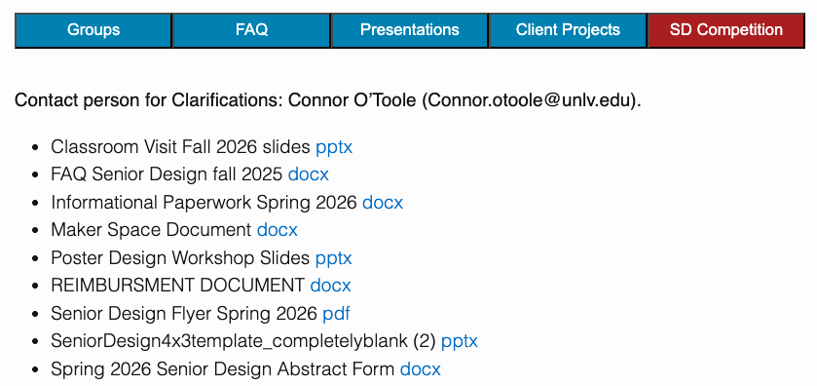
Announcements
Grading Lab 1
Submit your DP I 02/20 on Canvas and pin the Google doc on Discord
Focus on DP II and III – Its both team and individual
  Individual 60%
  Team 40%
Navigating Client Challenges
Reimbursement up to $750
Notes:
I know early stages can feel messy. That’s normal.
What’s not normal is staying blocked.

Slide 3
Announcements - Business Collaboration Opportunity
Partner Course
BGES 302: Growing Business Organizations
Dr. Huston Pullen (College of Business)
What You Get
  • Business students as advisors
  • Market validation perspective
  • Help refining value proposition
  • Stronger final presentation
Your Commitment
  • ~2 meetings total this semester
  • 45–60 minutes each
  • Professional collaboration
I will submit your team for pairing by 02/18/2026.

Slide 4
Learning Objectives
By the end of today, you can:
Explain how design controls the cost of change — coupling and cohesion.
Decide whether a change needs a class diagram, a sequence diagram, or both.
Write a pull request that reads as a design increment, not just code.
Judge a project’s design maturity and move it toward intentional, PR-level design.
Design is the bridge between messy reality and stable collaboration.

Slide 5
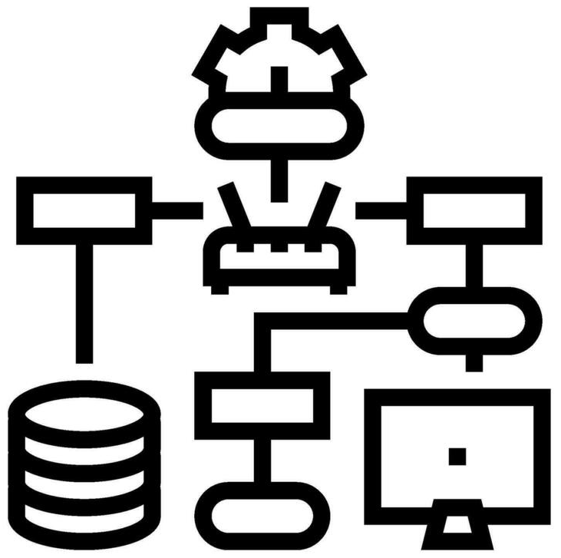
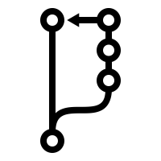
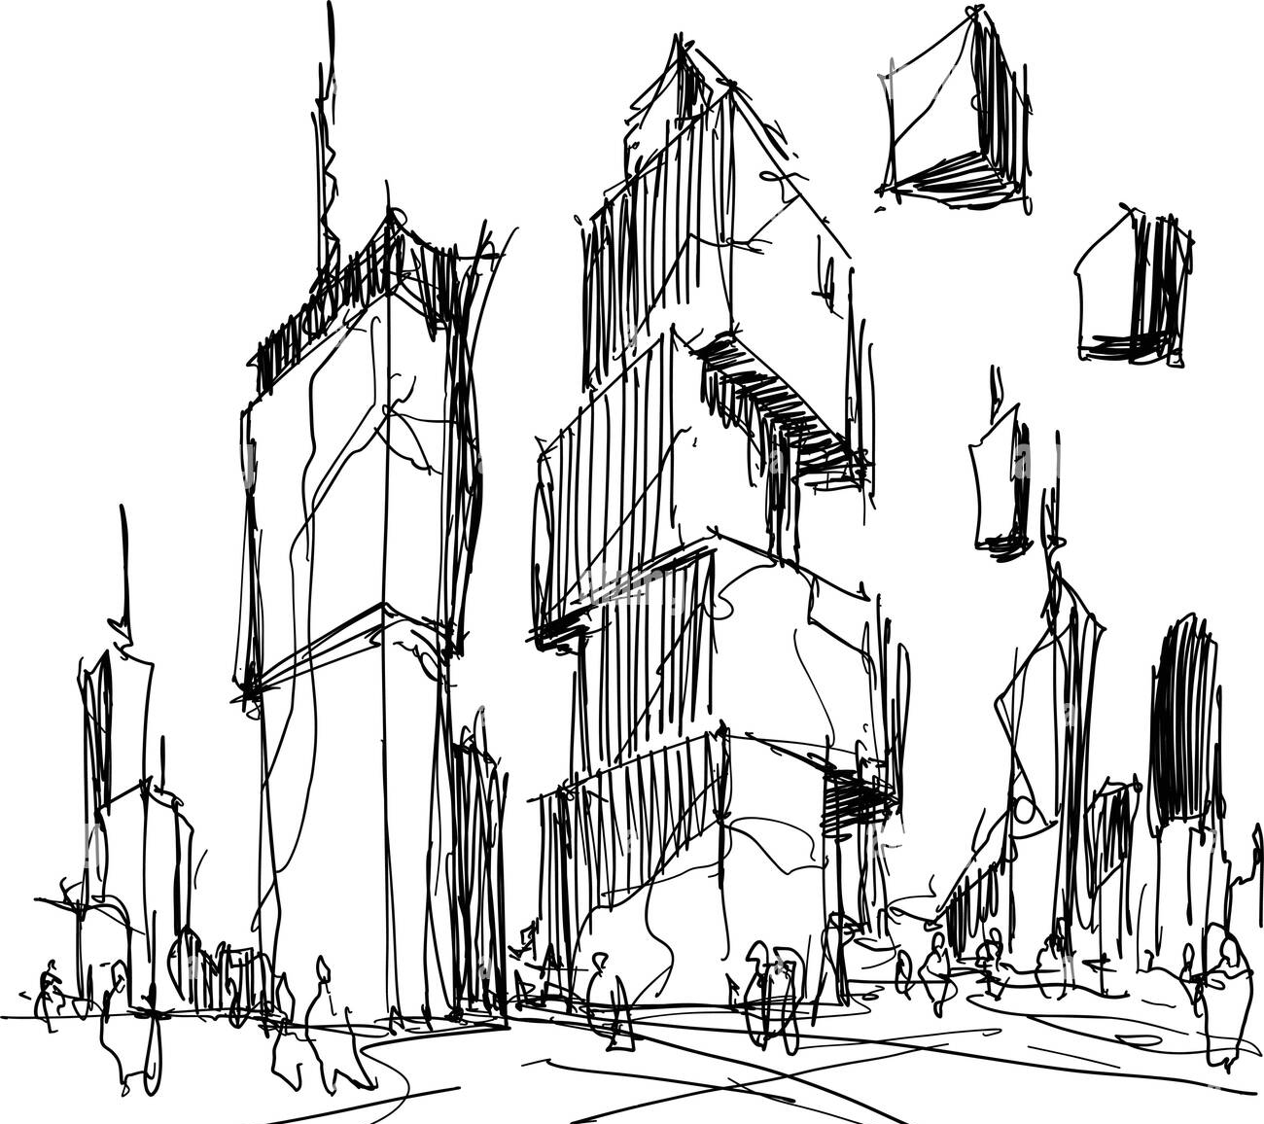
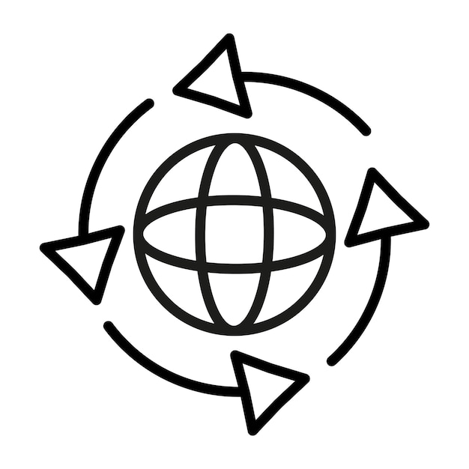
From Requirements to Pull Requests
Real World
Implementation + PR + CI
Domain Model - DPI
Design Model - DPII
CI reduces integration conflict
Reduces conceptual conflict
Reduces structural conflict
The real world is ambiguous. Software must bring structure to ambiguity.
Failure happens because you skip Domain clarity or Design clarity.
Design is the bridge between messy reality and stable collaboration.
Notes:
The real world is ambiguous. Software must bring structure to ambiguity.
Domain modeling is about understanding the problem — not solving it yet. Core concepts
Identify core concepts (Book, User, Loan, Street, TrafficLight, etc.)
Focus on what exists
No implementation details
Now we move from understanding to engineering. This is the transition from conceptual clarity to structural clarity.
Define concepts, responsibilities, and interfaces
Implementation + PR + CI
Code follows design
Each PR implements a design slice
CI validates design assumptions
Review checks alignment with design

Slide 6
The Path from Requirements to Merge
Architectural Baseline - DPI
Controlled Evolution - DPII
Problem
Refined Class Diagrams
Requirements
Sequence Diagrams
Use Cases
Feature Implementation
Domain Model
Pull Request
Initial Class Diagrams
CI + Coverage
High-level Architecture
Merge

Slide 7
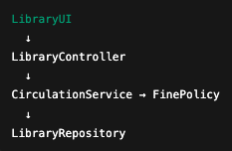

Design Is About Controlling Change
What will change most often in this system?
If I add a new feature, how many classes must I modify?
Does this design make testing easy?
Can this system evolve through small pull requests?
GOOD DESIGN (Layered)
Book overdue feature
BAD DESIGN (Tangled)
One change spreads everywhere (high coupling).
  Overdue feature changes 6 classes
One change stays local (low coupling)
  Changes 1 or 2 classes
Tangled design → large PRs → fragile CI
Layered design → small PRs → stable CI
Notes:
Now that we’ve seen how requirements turn into pull requests, the real question is:
How do we design so that change doesn’t destroy our system?
In bad design, responsibilities blur, so adding a feature touches everything.
In good design, a feature maps to 1–2 responsibilities, which maps to a small PR.

Slide 8
The Vocabulary of Good Design
Four ideas the rest of this lecture uses:
Coupling — how much one class depends on others. Low coupling keeps a change local.
Cohesion — how focused a class is. High cohesion means the class has one clear job.
Single Responsibility (SRP) — a class should have exactly one reason to change.
Responsibility assignment — give each behavior to the class that owns the data (Street owns its traffic loop).
Name the principle, and every design review gets easier.

Slide 9
Design before You Code
Before Opening a Pull Request, Ask:
What requirement / issue does this PR address?
What type of PR is this?
  Feature
  Refactor
  Test-only
  CI / Config
  Documentation
Am I changing structure (classes, responsibilities)?
Am I changing behavior (interactions between objects)?
Is this change localized to a coherent part of the system?
Do I need to update a diagram or design artifact?
If architecture changes, the design must reflect it.
Notes:
In bad design, responsibilities blur, so adding a feature touches everything.
In good design, a feature maps to 1–2 responsibilities, which maps to a small PR.

Slide 10
Match the Diagram to the Change
STRUCTURAL CHANGE
→ Update Class Diagram
Examples:
Add FinePolicy
Split LibraryService into two services
Introduce new interface
Change relationships between classes
Question to ask:
  Am I changing the structure of the system?
BEHAVIORAL CHANGE
→ Draw / Update Sequence Diagram
Examples:
Add new borrow flow
Add return-with-fine flow
Add reservation approval process
Question to ask:
  Am I changing how objects interact?
Major architectural change → Update both diagrams
Notes:
In bad design, responsibilities blur, so adding a feature touches everything.
In good design, a feature maps to 1–2 responsibilities, which maps to a small PR.

Slide 11
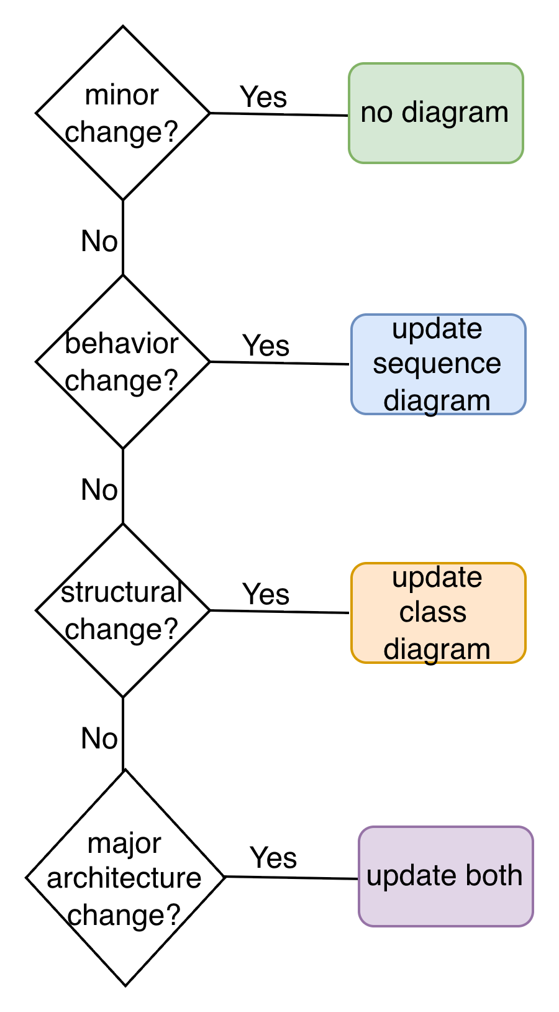
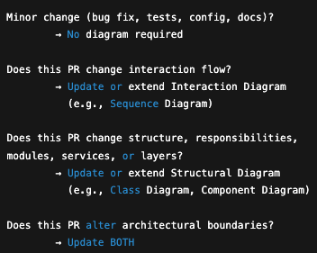
Make the Design Change Visible First
Design changes must be visible before code changes

Slide 12
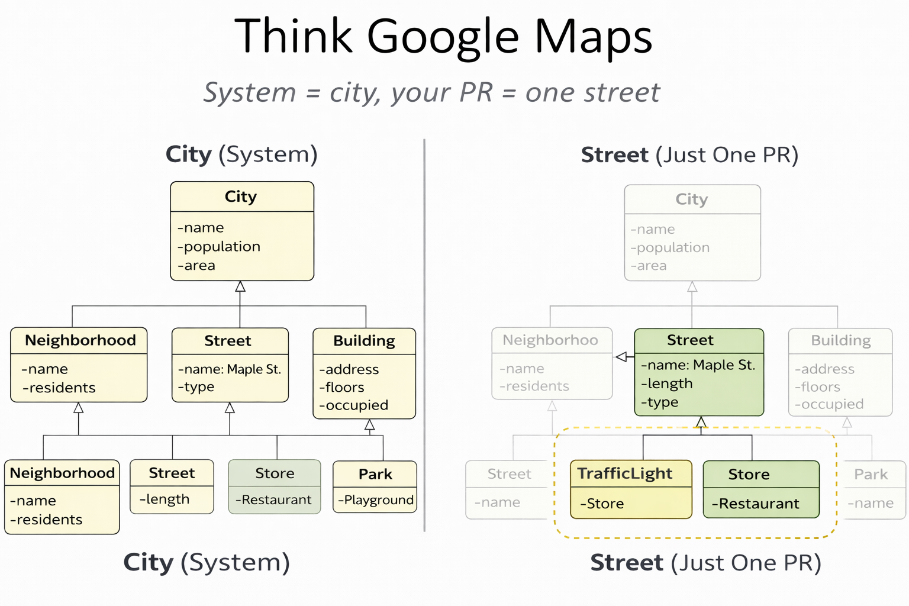
Think of Google Maps
System = City
Your PR = One Street
You do NOT redraw the entire system.
You show only the part your PR changes - but it must clearly fit back into the whole.

Slide 13
Example PR: Add Traffic Light Support
Linked Issue: Issue #42 – Add Traffic Light Support to Streets
PR Title: Add TrafficLight support to Street model
PR Description: This PR introduces traffic light functionality to streets to support dynamic traffic control and future traffic system features.
Design evidence (What Changes in the System):
Structural Change → Class Diagram
New class: TrafficLight
New relationship: Street 1 → * TrafficLight
Behavioral Change → Sequence Diagram
Controller → Street → TrafficLight
New interaction: advanceState()
Requirement (What Must Be True After Merge):
The system must support traffic lights on streets.
Each Street can have multiple Traffic Lights.
Traffic Lights must:
  Have a location (latitude, longitude)
  Have a status (RED, YELLOW, GREEN)
  Be changeable dynamically
Before writing code, we make the design change visible.

Slide 14
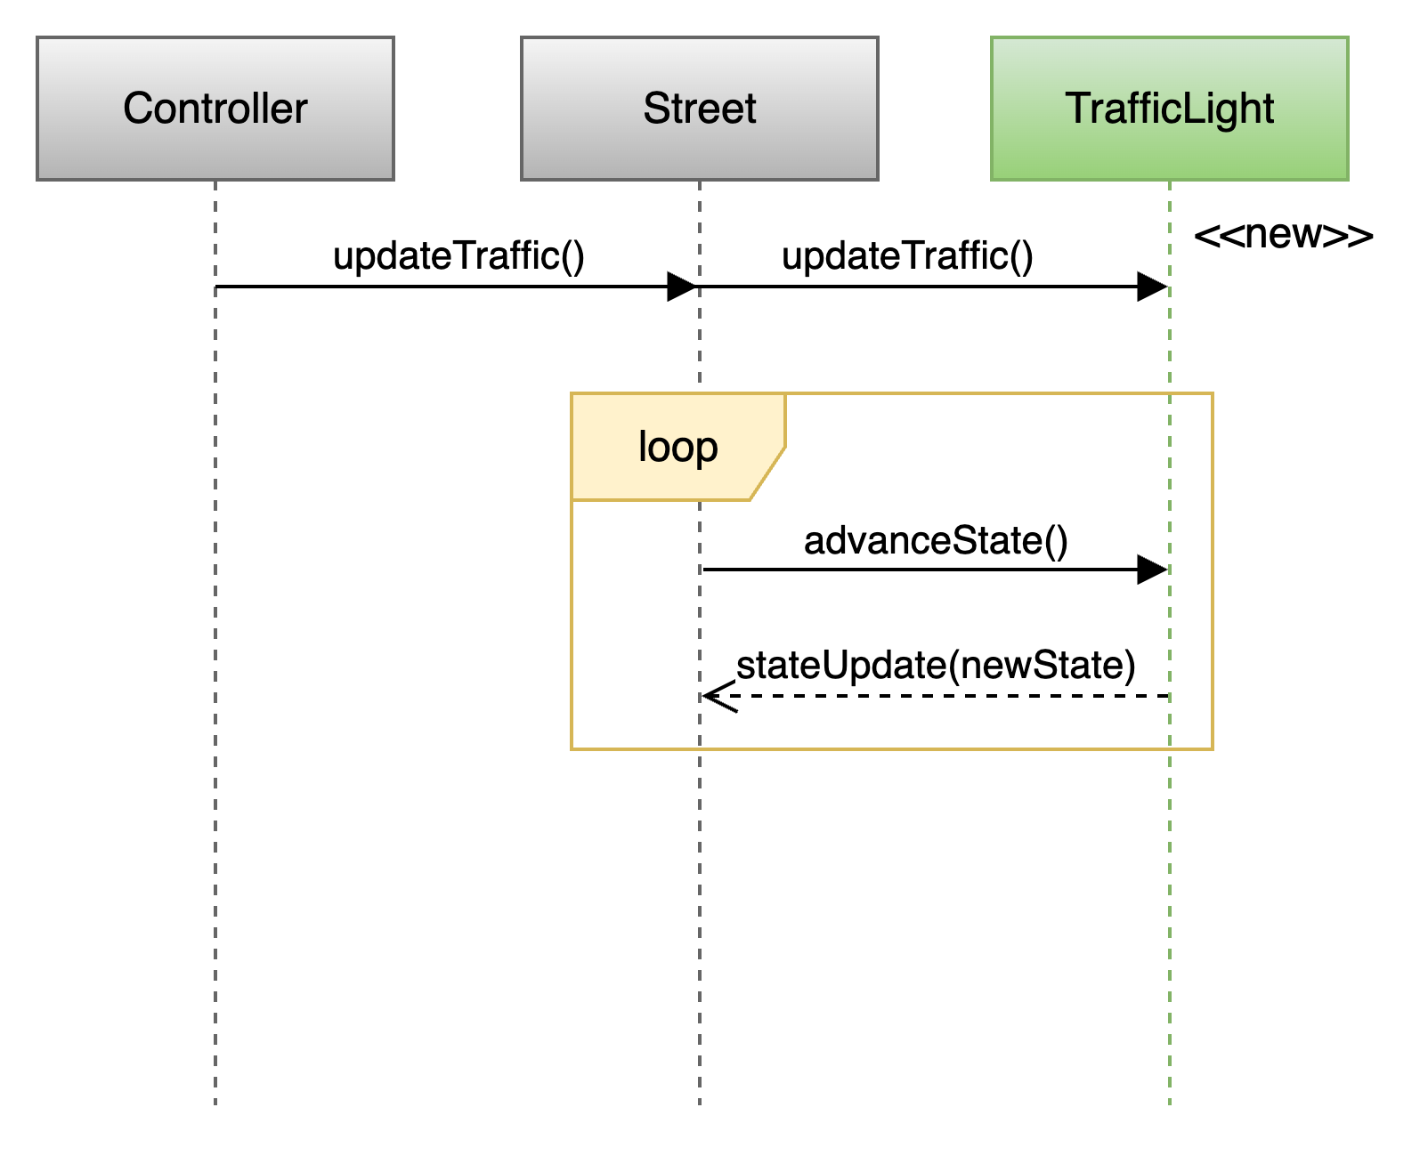
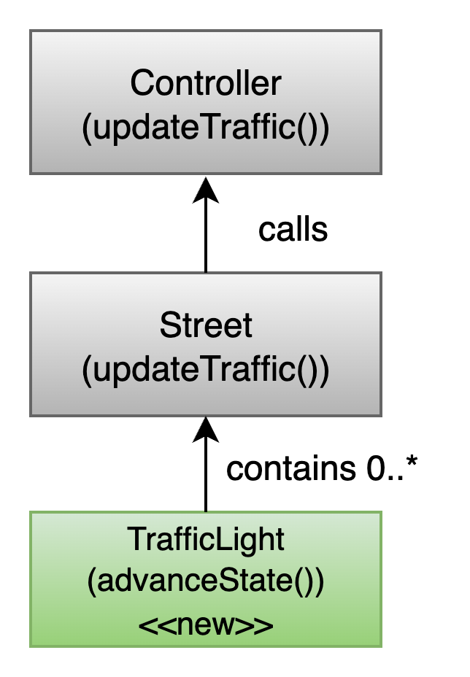
Traffic Light PR: Structural + Behavioral Changes
Sequence Diagram
Class Diagram
Structural Changes:
Added class TrafficLight
Street now contains 0..* TrafficLight
Controller unchanged
Controller → Street : updateTraffic()
The Controller starts the process. It tells the Street: update your traffic.
Street → TrafficLight : advanceState()
Inside updateTraffic(), the Street loops through each TrafficLight it contains.
TrafficLight receives advanceState().
RED → GREEN → YELLOW → RED
Notes:
The Controller starts the process. It tells the Street: update your traffic.
Inside updateTraffic(), the Street loops through each TrafficLight it contains.”

Slide 15
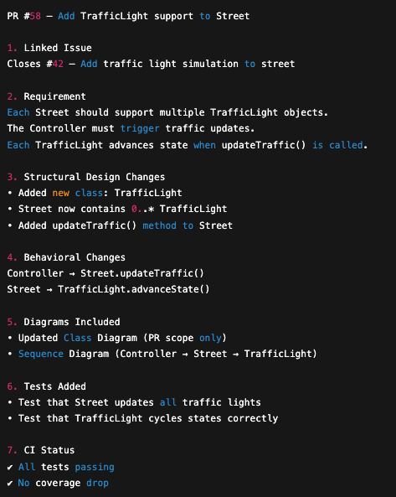
The PR Explains What Changed — and Why
This PR explains WHAT changed and WHY — before anyone reads the code.
Notes:
The Controller starts the process. It tells the Street: update your traffic.
Inside updateTraffic(), the Street loops through each TrafficLight it contains.”

Slide 16
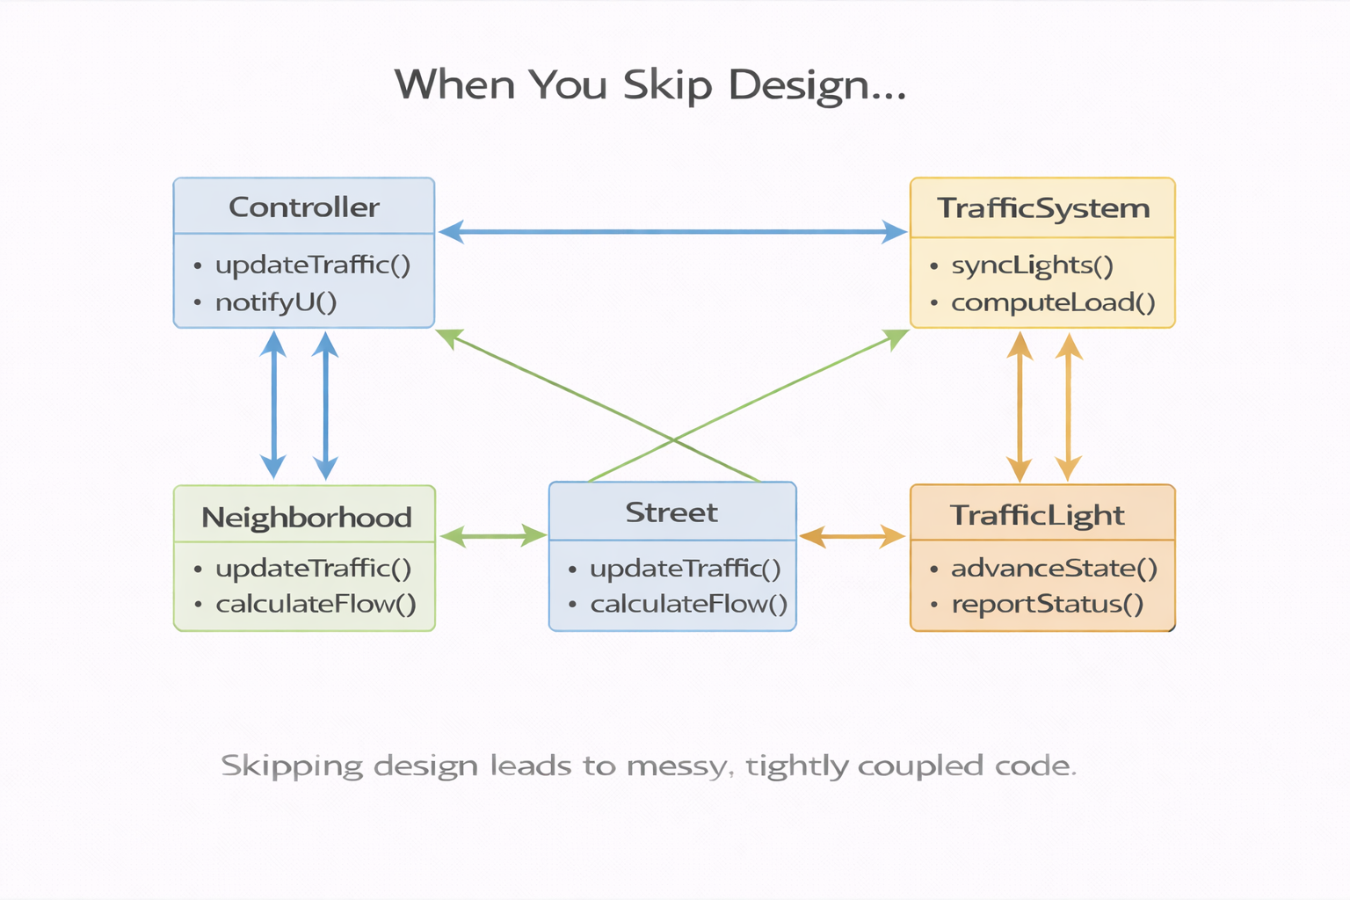
What Happens When You Skip Design?
Messy/Tangled design
When You Skip Design…
You don’t modify one street.
You accidentally modify:
• the street
• the neighborhood
• the traffic system
• the city boundary
Now your PR:
• touches unrelated classes
• breaks existing behavior
• increases merge conflicts
• destabilizes CI
No diagram
No clear boundary
“We’ll figure it out in code”
Notes:
The Controller starts the process. It tells the Street: update your traffic.
Inside updateTraffic(), the Street loops through each TrafficLight it contains.”

Slide 17
Design Maturity in Senior Projects
There are four levels of design maturity in software projects.
🟡 Level 3 — Intentional PR Design
Every meaningful PR:
Evaluates structural impact
Evaluates behavioral impact
Updates the correct diagram
Senior Design Target
🔴 Level 1 — Reactive
Code first.
Diagram after (if at all).
🟢 Level 4 — Architectural Stewardship
Architecture evolves intentionally:
Refactor proactively
Protect boundaries
Reduce coupling
Improve design over time
Senior engineers and architects do in industry.
🟠 Level 2 — Selective
Design only major features.
Small PRs skip design.

Slide 18
From Diagram to Java Files and Methods
Class Diagram
Sequence Diagram
Street
Controller Street TrafficLight
TrafficLight
becomes
becomes
controller.updateTraffic()
Street.java (class Street)
street.updateTraffic()
TrafficLight.java (class TrafficLight)
trafficLight.advanceState()
Methods defined:
Street.updateTraffic()
TrafficLight.advanceState()

Slide 19

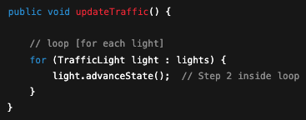
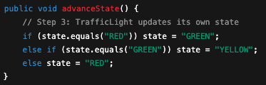
Diagram → Code: The Three Classes in Order
class Controller
class Street
1
2
3
class TrafficLight

Slide 20
Implementation Must Realize the Design
In our TrafficLight example:
Controller only calls Street
Street owns the loop
TrafficLight changes its own state
If Code Ignores Design
Responsibilities shift accidentally
Classes grow “God methods” (breaks SRP)
PR scope expands
Review confusion
Tests don’t match architecture
CI failures increase
If Code Follows Design
Changes stay localized (Street owns loop)
Each class has one responsibility (SRP)
PR remains small and focused
Tests map cleanly to methods
CI remains stable
Design → Code → Tests → CI → Stable Main
Skipping design breaks the chain.

Slide 21
A Pull Request Is a Design Increment
A good PR includes:
Linked issue (clear requirement). What problem are we solving?
Clear PR Title (what change is being introduced)
PR Description explaining why the change is needed
Design Evidence
  Updated Class Diagram (if structure changed)
  Updated Sequence Diagram (if behavior changed)
  Explanation of what part of the system is affected
Focused Implementation
  Small, localized change
  Only related files modified
  No “drive-by” edits
  Responsibilities respected (no God methods)
Verification
  Tests added or updated
  All tests passing
  CI pipeline green
  No coverage regression
PR = Requirement + Design + Implementation + Validation

Slide 22
CI Is Architecture Protection
Small, well-designed PRs lead to:
→ Easier review
→ Faster CI feedback
→ Fewer conflicts
→ Stable main branch
Large, design-less PRs lead to:
→ Review confusion
→ CI failures
→ Rework
→ Architecture drift

Slide 23
The Collaborative Engineering Control Loop
Design controls change.
PRs implement design.
CI protects architecture.
Senior Design goal: Intentional architecture evolution.

Slide 24
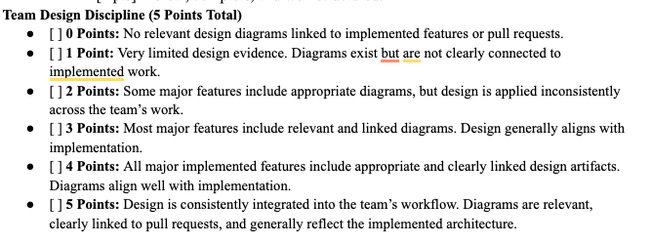
How Your Design Discipline Is Graded
Design Portfolios II & III — link every major feature’s diagrams to its PR.

