Slide 1
Mining Software Repositories
John Businge

Slide 2
References

Slide 3
More References

Slide 4
Acknowledgement
Ahmed E. Hassan
Queen’s University
www.cs.queensu.ca/~ahmed
ahmed@cs.queensu.ca
Tao Xie
North Carolina State University
www.csc.ncsu.edu/faculty/xie
xie@csc.ncsu.edu
Bram Adams
Polytechnique Montréal, Canada
http://mcis.polymtl.ca/index.html
lab.mcis@gmail.com
With updates by John Businge from the University of Nevada Las Vegas

Slide 5
Lecture Goals
Learn about:
After the lecture and lab, you should be able to:
Classic and notable research and researchers in mining SE data
Retrieve software evolution data from Git and GitHub
Data mining and data processing techniques and how to apply them to SE data
Trace a pull request to its commits and merge commit
Mine repository history to understand a software change
Risks in using SE data due to noise and incompleteness
Use repository evidence to support a reengineering task
Notes:
Use this revised goals slide in place of the current Lecture Goals slide.,The first column preserves the broader MSR goals. The second column makes the project connection explicit.,Emphasize that the goal is not to become experts in GraphQL. The goal is to retrieve and interpret repository evidence that supports reengineering.

Slide 6
Why mine SE data?
SE data can be used to:
  Gain empirically-based understanding of software development
  Predict, plan, and understand various aspects of a project
  Support future development and project management activities

Slide 7
How is SE Data generated?

Slide 8
What is MSR?
Transforming static record keeping SE into active data
Making SE data actionable by uncovering patterns and trends
Git
Bugzilla
Mailing
Lists
Code Repos
Execution Traces

Slide 9
MSR researchers analyze and cross-link repositories
New bug report
Estimate fix effort
Suggest experts and fix!

Slide 10
Study Outline
Part I: What can we learn from SE data?
  A sample of notable findings for different SE data types
Part II: How can we mine SE data?
  Understand the structure of SE data

Slide 11
MSR studies – Bugs – Part I
Using imports to predict Bugs

Slide 12
MSR studies - Bugs
Do not program on Friday ;-)

Slide 13
MSR studies – Sentiment Analysis
Anger vs. Joy
How they stack up?
PHP, Object-C, and C# are net positive
Java, Shell, and C are fairly even while VimL is just bad news.
[Doll and Grigorik, 2012]

Slide 14
MSR studies – Sentiment Analysis

Slide 15
MSR studies – Programming languages
Programming language relations
A Ruby programmers is very likely to know Javascript, while a Perl programmer is not
Java is a popular programming language but stands primarily alone
https://github.com/mjwillson/ProgLangVisualise

Slide 16
MSR studies – Changes by programmers
Programming language relations
[Zimmermann et al., 2005]
Mining Version Histories to Guide Software Changes
After the programmer has made some changes to the source (above), ROSE suggests locations (below) where, in similar transactions in the past, further changes were made
Suggests and predicts likely changes
Prevents errors due to imcoplete changes

Slide 17
How can we mine SE Data – Part II
Repositories of Repositories
April 2019
28 Millinon repositories
10 Million Users
Feb 2026:
180M developers
630M repositories
4.3M AI projects
April 2019
28K projects
January 2020:
430K repositories
3.7 Million Users

Slide 18

How can we mine SE Data form GitHub

Slide 19
From a Pull Request to the Merge Commit
Given an Apache Kafka pull request, how do we identify the commit to integrate?
Pull Request
PR metadata
and history
Merge commit
identified
Commit SHA
recorded
Integrate into
LinkedIn Kafka
Assigned Apache Kafka PR
Title • state • commits
changed files • discussion
Identify the merge commit
that represents the merged change
Record the SHA
and inspect the commit
Use the commit as the
integration candidate
How you obtain the evidence is your choice:
Git • GitHub UI • REST API • GraphQL API • Scripts
Goal: systematically recover the repository information needed for integration.
Notes:
Place this after the current GraphQL slide.,This is the minimum repository-mining task students should understand before the project begins.,Start with the assigned Apache Kafka PR, determine how it was merged, identify the merge commit, record the SHA, and inspect the change.,GraphQL is optional. Git, the GitHub UI, REST, GraphQL, or scripts are all acceptable. The important point is systematic recovery of evidence.

Slide 20
How can we mine SE Data
Easiest to obtain local copy (distributed version control!), and has distinction between authors and committers, but … branches can be pain to analyse

Slide 21
How can we mine SE Data
Access to millions of Git-based projects via GitHub

Slide 22
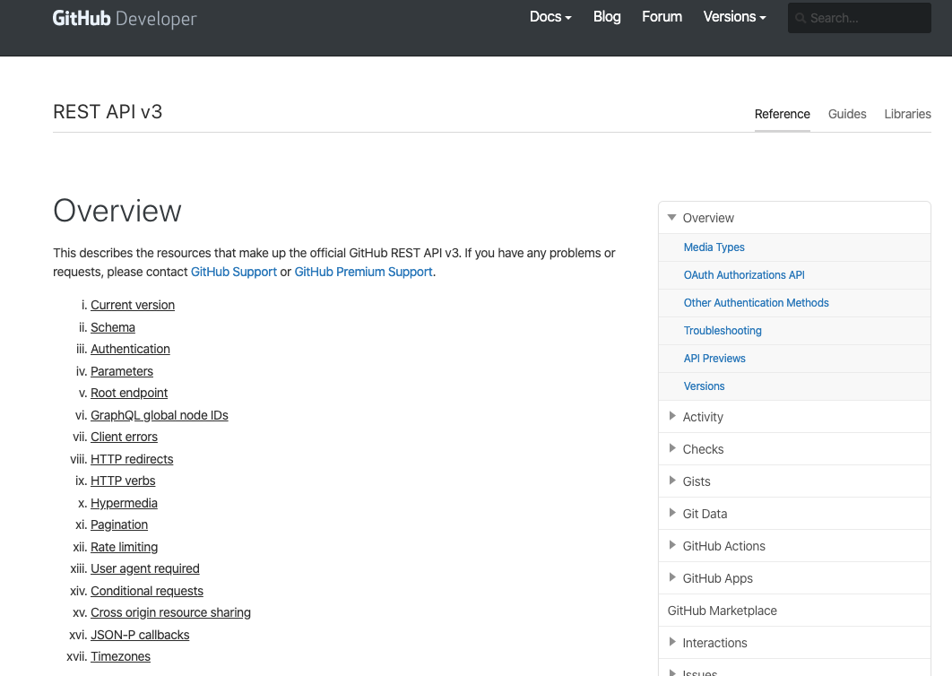
How can we mine GitHub Data
How can we obtain GitHub data?

Slide 23
How can we mine GitHub Data
There are rate-limit issues!
You are only allowed only a limited number of GitHub requests per hour
How can we obtain GitHub data?

Slide 24
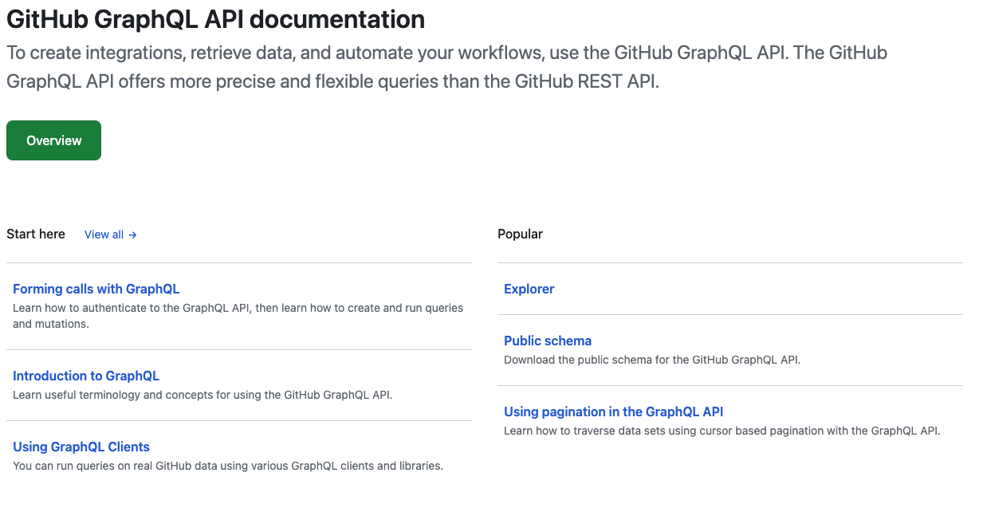
How can we mine GitHub Data
There are rate-limit issues!
Use GraphQL API
Rate limit is less of an issue
How can we obtain GitHub data?

Slide 25
What Can We Mine for the Project?
A commit SHA is only the beginning
What was the purpose of the change?
PR
Example evidence
PR #16221
✓ merged
Changed files
• LeaderElection.java
• KafkaMetrics.java
• LeaderElectionTest.java
Commits
• implementation
• refactor
• merge commit
COMMITS
Which commits belong to the PR?
FILES
Which files, classes, and methods changed?
TESTS
Were tests added or modified?
HISTORY
How did the relevant code evolve?
VARIANTS
How has the target diverged from the source?
Use repository history as evidence for understanding the change, not only for locating it.
Notes:
The project does not require students to turn every item on this slide into a separate analysis. Use it to show what repository mining can contribute. At minimum, they need the information required by the project. The broader point is that repository history can also help explain the change and the divergence between Apache Kafka and LinkedIn Kafka.
[Sources]
- https://johnxu21.github.io/teaching/Software-Reengineering/project/
[/Sources]

Slide 26
How the Labs Fit Together
MINE
UNDERSTAND
ADAPT
INTEGRATE
VALIDATE
Repository History
Design & Evolution
Refactorings
Apply Change
Build & Test
Identify PR and merge commit
Recover design
Account for refactorings
git cherry-pick
Build successfully
Examine commits and changed files
Locate affected components
Use RePatch when needed
Resolve conflicts
Run tests
Analyze history and divergence
Understand source-target differences
Manual adaptation when necessary
Adapt change to target variant
Check coverage and resulting design
The labs are parts of one reengineering workflow.
Notes:
Use this as the closing slide before students begin the project next week.,Repository mining provides historical evidence. Design recovery helps students understand where the change fits. Refactoring analysis helps explain structural divergence. Integration applies the change. Testing and coverage validate the result.,Closing message: From this point forward, CodeScene, RefactoringMiner, RePatch, testing, and repository mining are not separate labs. They are techniques available to solve one reengineering problem.

