Slide 1
LLMs in Pull Request Workflows: Outcomes, Integration, and Professional Discipline
Prepared by: John Businge
john.businge@unlv.edu

Slide 2
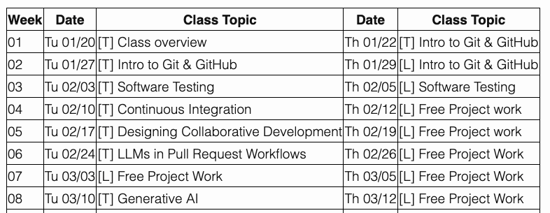
Announcements
Grades for Lab 1 and 2 by the end of this week
Start working on DP II

Slide 3
Why Generative AI Matters in Software Engineering
Adoption & Industry
87% of GitHub developers use GenAI tools.
Tools like Copilot and ChatGPT are embedded in workflows.
AI-assisted PRs are now common in open-source projects.
The Problem
Unstructured use → overreliance.
Blind trust in AI output.
Reduced accountability
Weak integration discipline
The issue is not whether to use GenAI — it is how to use it professionally.
What does professional GenAI usage look like inside a pull request?
Notes:
Generative AI is no longer experimental in software engineering.
Tools like ChatGPT and GitHub Copilot are already embedded in professional workflows.
Recent industry surveys show that the majority of developers rely on GenAI tools in some capacity.
So the question is not whether you will encounter AI in your career.
You already are — or will very soon.

Slide 4
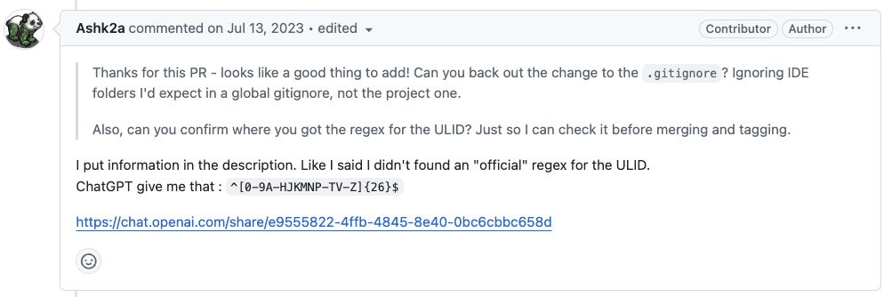
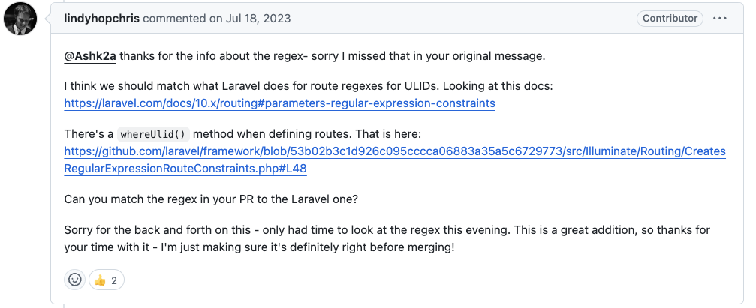
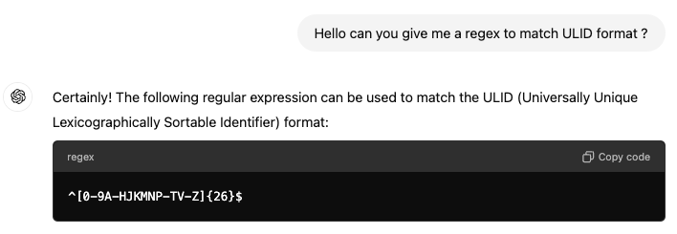
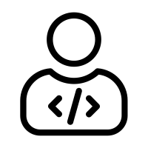
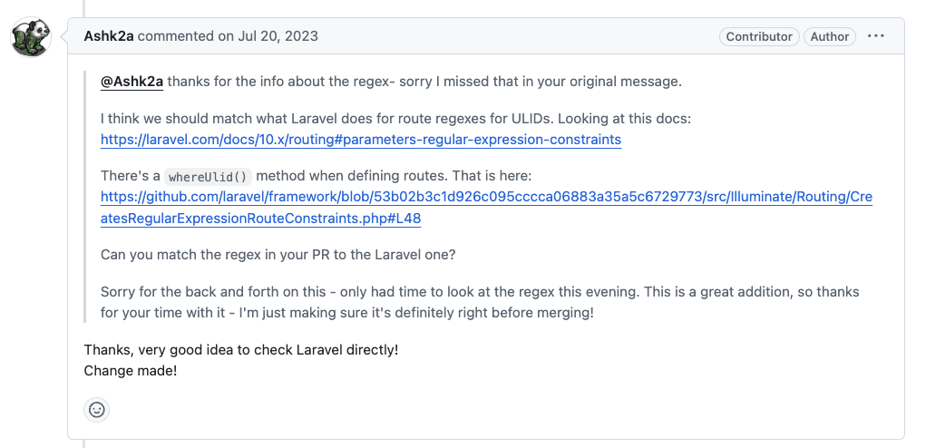
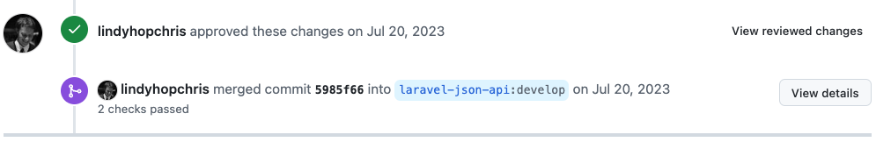
Generative AI in Pull Request Workflows (From Patch Suggestion to Merge Decision)
PR author
GenAI is part of PR workflows.
AI can suggest patches — but humans decide integration.
Professional use requires traceability, testing, and justification.
maintainer
Refined Code (After ChatGPT’s Suggestion)
Notes:
What you’re looking at here is a real pull request. A reviewer asked ChatGPT for a regex to match ULIDs. ChatGPT provided something that looked correct.
Walk Through - What Actually Happened
1) ChatGPT conversation and suggestion, 2) Maintainer checks official docs, 3) They refine the regex. 4) Code is updated. 5) Tests pass. 6) PR is approved and merged.
Verification., Justification, Collaborative refinement, Traceability. That is professional AI use.
In this course, GenAI use only counts if it leaves evidence. If I cannot see verification, justification, refinement, and traceability in your PR — then you are not using AI professionally.

Slide 5
Generative AI in Pull Request Workflows (From Patch Suggestion to Merge Decision)
PR author
Justification
The author explains the reasoning and updates code accordingly.
Verification
Maintainer checks official Laravel docs.
Collaborative Refinement
Back-and-forth discussion improves the solution.
Traceability
conversation link is included
reasoning is documented in the PR thread.
refined change is visible in commit history.
maintainer
Refined Code (After ChatGPT’s Suggestion)
When AI is used in a PR, professional practice requires verification, refinement, and traceability.
Notes:
This example shows what professional AI-assisted development looks like in practice. Let’s extract the principles behind why this patch was mergeable.
Verification - In this case, the maintainer did not assume the ChatGPT suggestion was correct. They checked the official Laravel documentation.
Justification - Notice the developer explains the reasoning and updates the code accordingly. They do not say: “ChatGPT told me this.” They say: “I checked Laravel directly. Change made.” – That’s shows ownership. AI assists. Humans decide.
Collaborative Refinement - This was not a one-shot merge. There was back-and-forth discussion. The maintainer questioned. The developer refined. The solution improved.
Traceability - The AI usage is visible. The reasoning is auditable. Future maintainers can reconstruct context. The refined change appears in commit history.

Slide 6
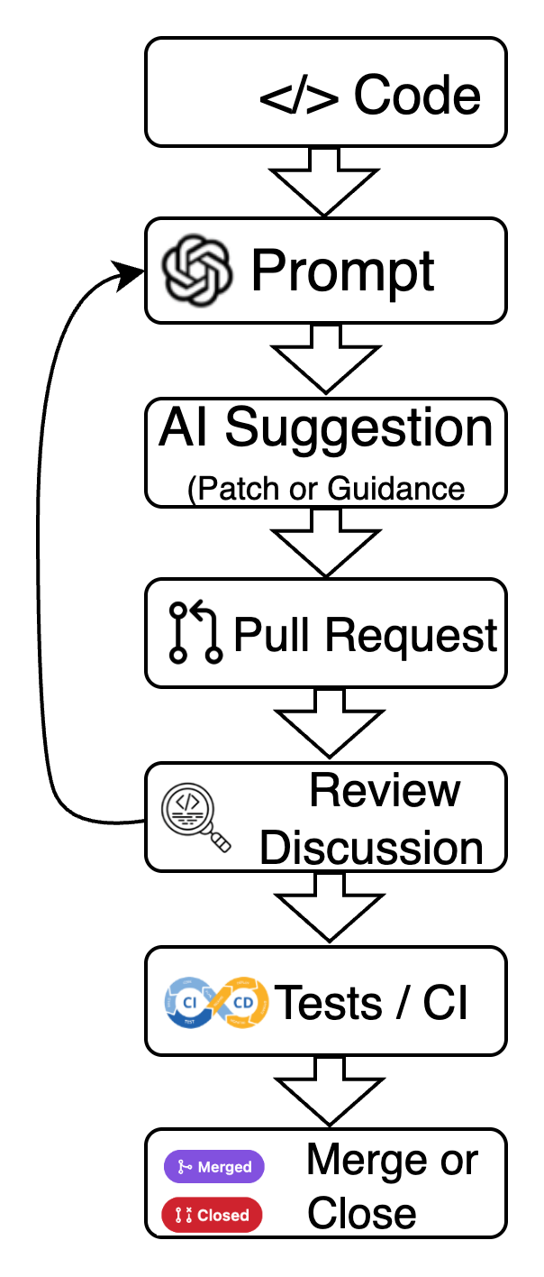
The AI-Assisted PR Feedback Loop
Failure can occur due to:
Poor prompt specification
Context misalignment
Inadequate justification
Test / CI failure
Architectural violation
Contribution policy non-compliance
So in theory, AI output enters this feedback-controlled workflow.
But what actually happens in practice?
Notes:
What we just saw in the example is not unique.
It follows a pattern.
When AI is used in development, it enters a control loop.
It starts with a prompt.
That produces a suggestion — sometimes code, sometimes guidance.
That suggestion enters a pull request.
From there, the team evaluates it.
Reviewers question it. Tests validate it. CI enforces constraints.
And then one of two things happens:
It is merged.
Or it is closed.

Slide 7
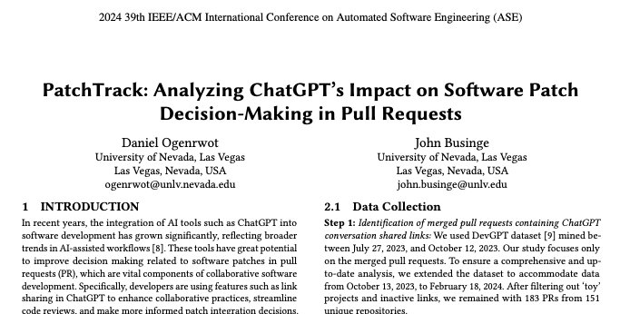

Observed Outcomes of AI-Assisted PRs (Empirical Analysis of Real-World AI-Assisted PRs)
Outcomes After the Feedback-Controlled PR Evaluation
PA – Patch Adopted
AI-generated code integrated (often partially refined)
PN – Patch Not Adopted
Suggestion did not appear in the integrated code
NE – No Executable Patch
AI provided guidance, not code
CL – Closed
The PR itself was closed without merge
Notes:
Importantly, these categories reflect In our empirical study of AI-assisted pull requests, we observed four distinct integration outcomes. These outcomes emerged after what we call a feedback-controlled PR evaluation process — meaning the AI suggestion goes through normal GitHub review, discussion, and refinement before a final decision is made.
integration behavior — not correctness in isolation.
The first category is PA — Patch Adopted. This means the AI-generated code was integrated into the final merged version. This tells us something important: AI suggestions are rarely merged verbatim — human judgment dominates integration.
The second category is PN — Patch Not Adopted. In these cases, the AI provided executable code, and the pull request continued through normal review. However, when we compared the AI suggestion to the final merged code, we found that the suggested patch did not structurally appear in the integrated version.
The third category is NE — No Executable Patch. In these cases, the AI did not provide code but instead offered guidance, explanations, or design suggestions. These interactions still influenced development decisions, but no concrete patch could be structurally compared to the final code.
The final category is CL — Closed. These pull requests were closed without merging, often due to process or contextual misalignment.
Now that we’ve defined these four outcome classes, the next important question is: How did we determine whether a patch was actually adopted or not?

Slide 8
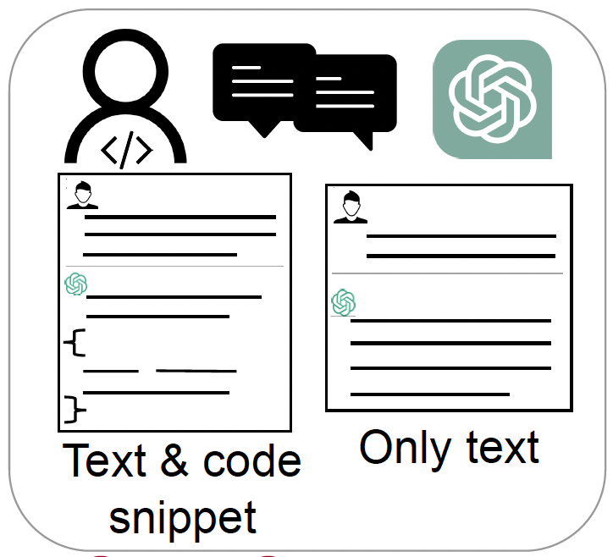
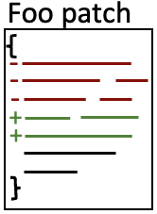
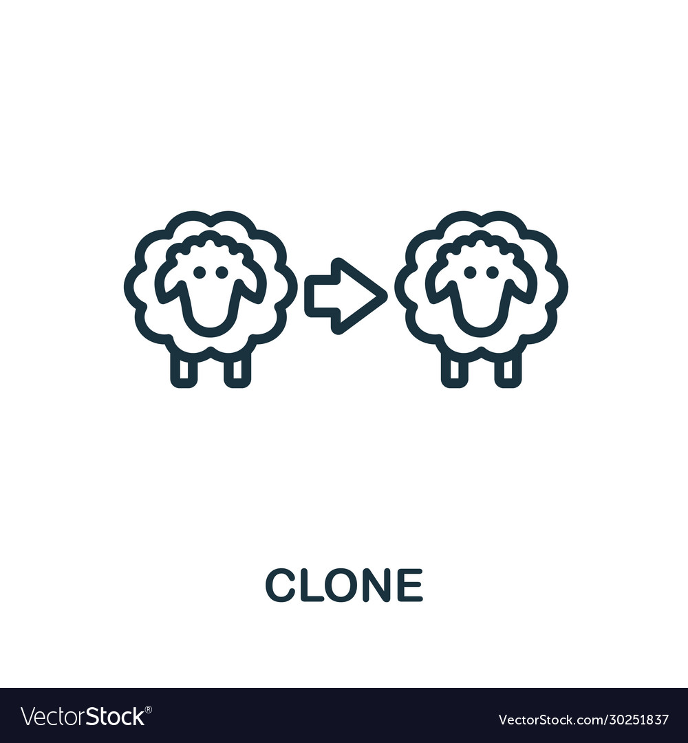
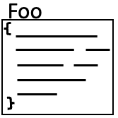

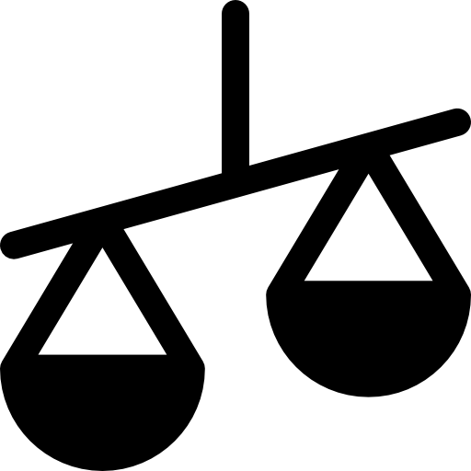
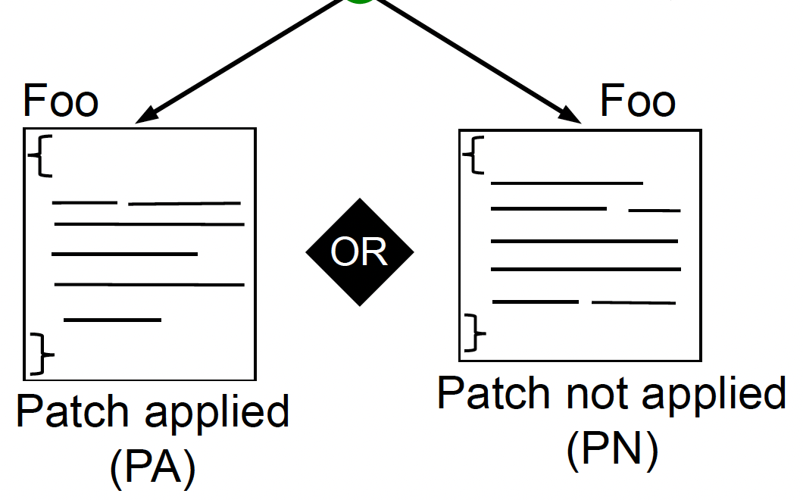
How We Determined Patch Adoption
Merged PRs
Patch Applied (PA)
Patch not Applied (PN)
No existing patch (NE)
Closed PR (CL)
PatchTracker - clone detection tool
branch
Pull request
Patch not Applied
Patch Applied
Notes:
- First, we extract the AI-generated patch from the PR discussion.
- Next, we compare it to the final merged code.
- We use clone detection to identify structural similarity.
- If the suggested patch — fully or partially — appears in the final code, we classify it as PA.
- If no structural similarity exists, it becomes PN.
If no executable patch was suggested, it is NE.
If the PR was closed without being merged, then we classify it as CL

Slide 9
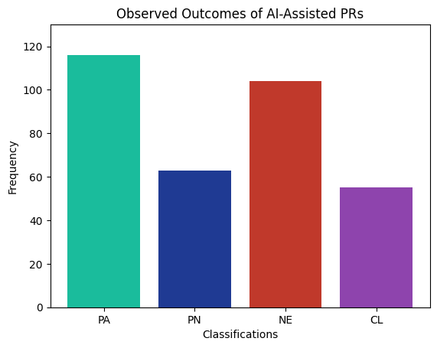
Empirical Snapshot: How Often Does AI Code Get Integrated?
Dataset Overview
338 pull requests
From 255 unique GitHub repositories
PRs where developers shared ChatGPT conversation links
Included both merged and closed PRs
Let’s now examine each of these outcomes more carefully, starting with PA.
Notes:
This slide gives an empirical snapshot of real-world PRs where developers explicitly shared ChatGPT conversation links. We analyzed 338 PRs across 255 GitHub repositories, including both merged and closed PRs.
The important takeaway here is that AI assistance does not produce a single predictable result. Some suggestions are adopted, some are not integrated, some interactions are guidance-only, and some PRs are closed due to contextual or process factors.
In other words, AI participation in PR workflows produces multiple distinct integration outcomes — and each one reflects a different type of developer interaction.

Slide 10

How Much of an Adopted AI Patch Is Preserved?
PA Cases only (n=116)
% of AI-generated lines preserved in the final merged code
PN cases excluded (no structural preservation)
Median preservation ≈ 25%
Adoption ≠ Verbatim Integration Most AI patches are substantially revised before merge.
Percentage of AI-generated lines preserved in PA (Patch Adopted) pull requests
Notes:
This analysis focuses only on PA cases — situations where the AI-generated patch is structurally present in the final merged code.
For each adopted patch, we compute the percentage of AI-generated lines preserved.
The median preservation rate is about 25%.
This means that even when AI patches are adopted, they are rarely merged verbatim. They are typically adapted to fit architecture, style conventions, and project constraints.
Now let’s look more closely at what Patch Adopted actually looks like in practice.

Slide 11
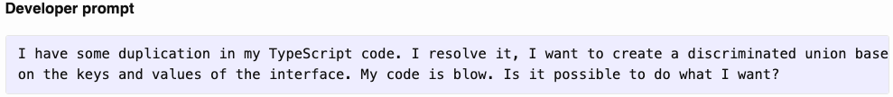
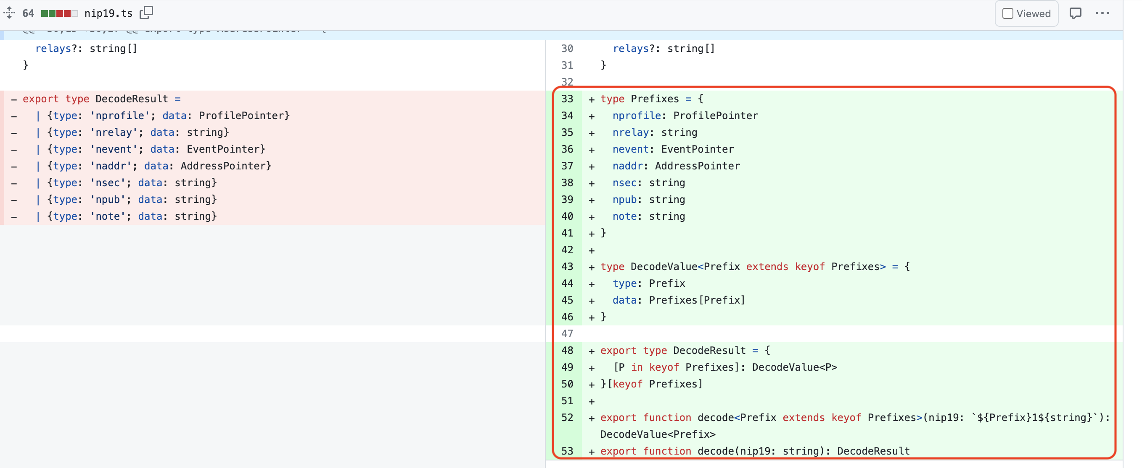
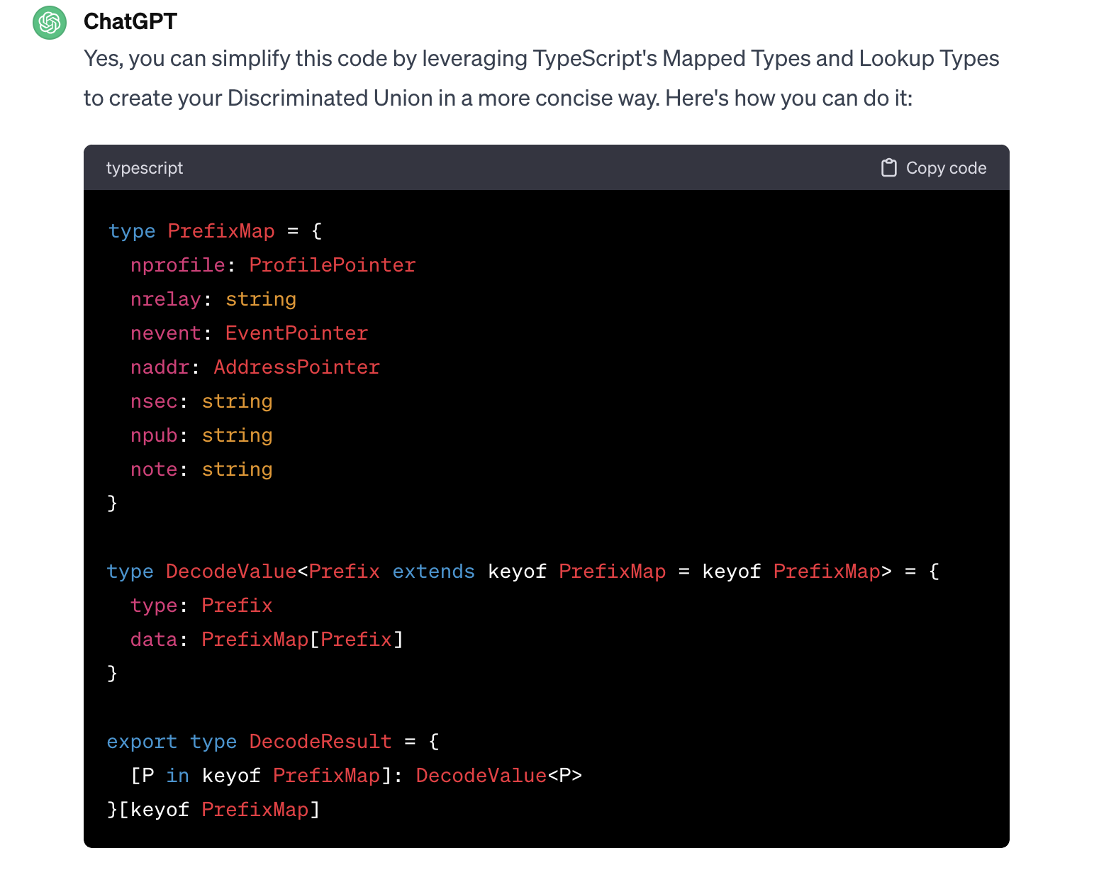
PA Example: Code Refactoring
PrefixMap != Prefixes
AI suggestion was integrated, but variable names and structure were adjusted to fit project conventions.
Notes:
This is a PA case involving refactoring to reduce duplication. The AI suggested restructuring the type definitions using a discriminated union pattern.
When we compare the AI suggestion to the final merged code, we see structural similarity — but not verbatim integration.
Variable names were adjusted. The structure was cleaned. The final implementation aligns with project conventions.

Slide 12

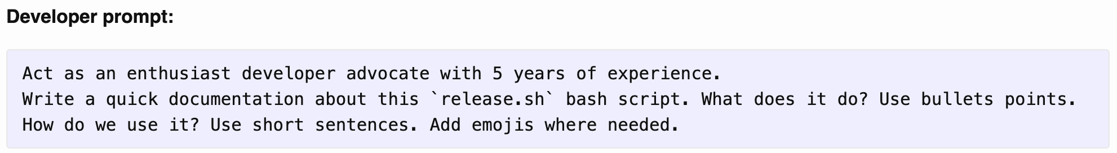
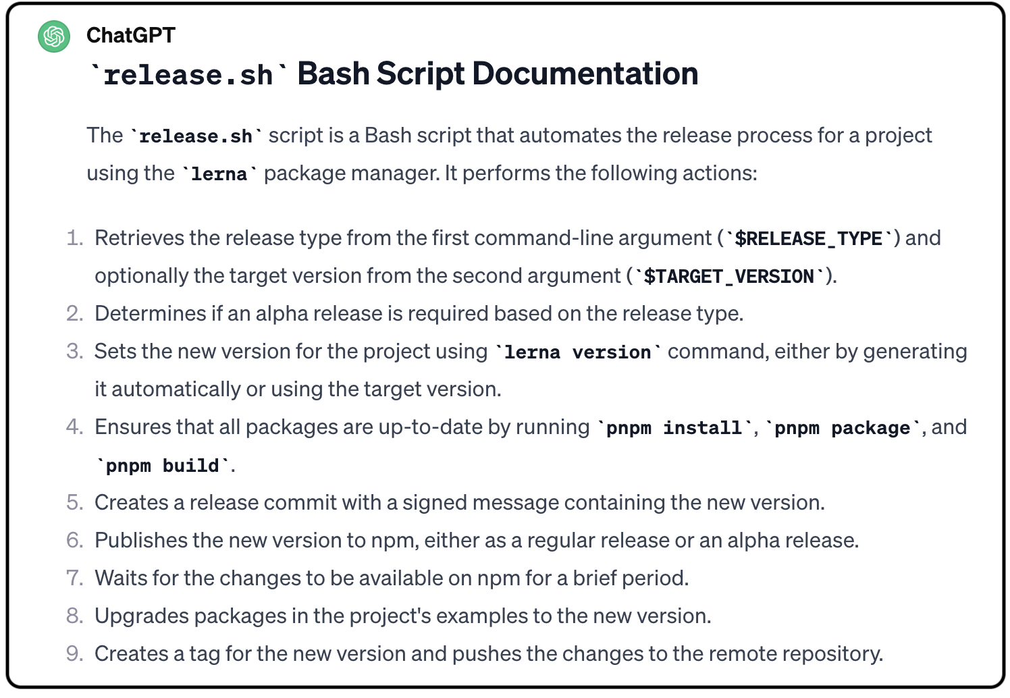
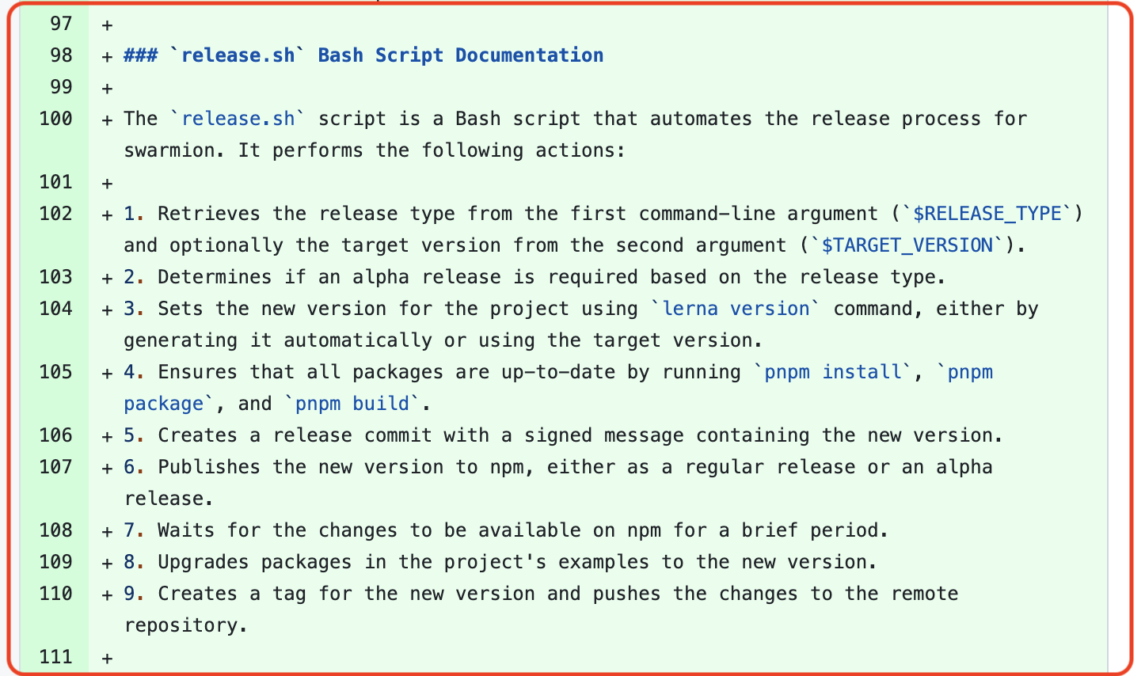
PA Example: Documentation Enhancement
AI-generated documentation was integrated after review and minor refinement.
AI support extends beyond code — documentation patches are often adopted with light editing.
Notes:
This example shows a documentation task. The developer asked ChatGPT to summarize a Bash release script.
The generated documentation was integrated with minimal modification.
This contrasts with refactoring cases, where structural changes are more extensive.
It reminds us that AI adoption varies by task type — complexity matters.

Slide 13
Understanding Why Patches Are Not Adopted (PN)
To understand PN cases, we conducted a structured qualitative analysis:
Summarized developer–AI conversations
Examined PR discussions and review feedback
Identified recurring themes explaining non-integration
PN reflects reasoning patterns — not failure of AI correctness.

Slide 14
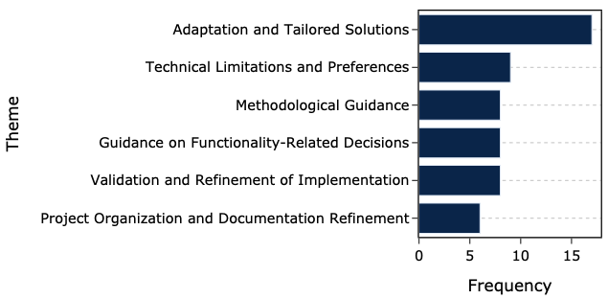
Patch Not Applied (PN)
Developers adapted AI suggestions rather than merging verbatim
Guidance adopted; implementation reworked
AI helped improve or verify an already existing implementation.
Many PN cases reflect contextual misalignment — not incorrect code.
Notes:
Let’s now examine Patch Not Applied (PN) cases. In these situations, the AI provided an executable patch, but when we compared it to the final merged code, the suggested patch did not structurally appear.
Importantly, PN does not mean the pull request was closed. The PR may still have been merged — but the AI-generated patch itself was not integrated.
The most common theme was Adaptation and Tailored Solutions. Developers used the AI suggestion as inspiration, but reworked the implementation to better fit project constraints.
The second common pattern involved Methodological Guidance. The AI influenced the approach or strategy, but not the final code structure.
Another recurring theme was Validation and Refinement. Developers used the AI to confirm, improve, or verify an existing implementation rather than directly applying the patch.

Slide 15
PN Example – Adaptation & Tailored Solutions
PR Author
Repo maintainer
AI influenced the solution conceptually, but the maintainer did not structurally preserve the patch.
Conceptual influence ≠ structural preservation
Refined Code (After ChatGPT’s Suggestion)
https://github.com/laravel-json-api/core/pull/12
https://chatgpt.com/share/e9555822-4ffb-4845-8e40-0bc6cbbc658d
Notes:
In this case, ChatGPT suggested a regular expression for ULID validation.
During review, the maintainer suggested aligning with Laravel’s conventions.
The developer adjusted the solution accordingly.
The final merged code differs structurally from the AI suggestion.
This is classified as PN because the AI patch itself is not preserved — even though it influenced the final solution.

Slide 16
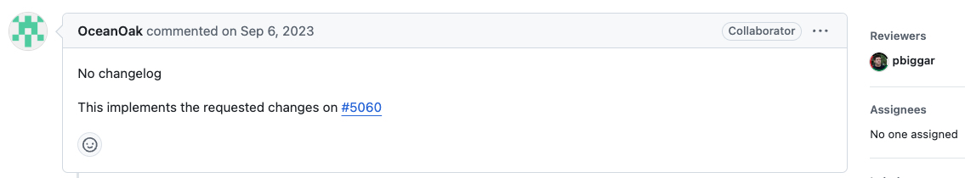
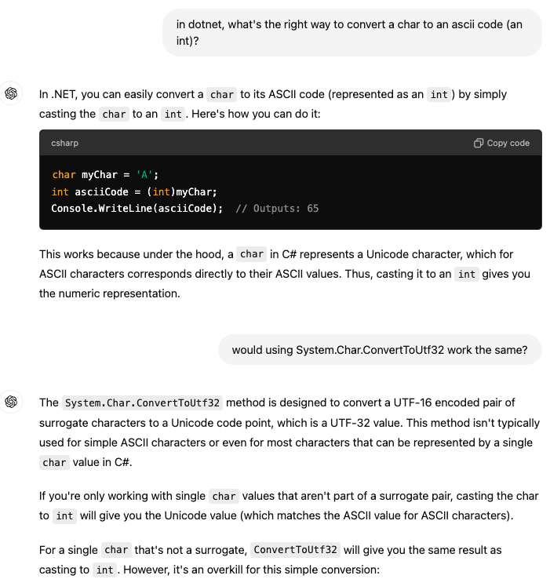
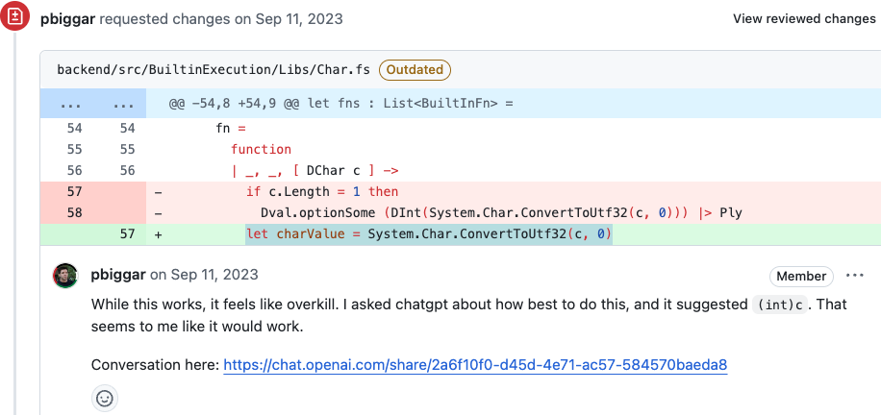
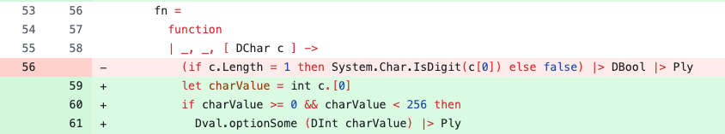
PN Example – Methodological Guidance
PR Author
AI suggested a better approach; the maintainer rewrote the implementation.
Repo maintainer
Initial Code (Before ChatGPT's Suggestion)
Replaced
Refined Code (After ChatGPT’s Suggestion)
This example shows how AI can streamline thinking, even when its patch is not directly integrated.
https://github.com/darklang/dark/pull/5063
https://chatgpt.com/share/2a6f10f0-d45d-4e71-ac57-584570baeda8
Notes:
In this example, the reviewer asked ChatGPT about converting a character to its ASCII code in .NET. ChatGPT suggested using System.Char.ConvertToUtf32 as a cleaner way to handle the conversion.
The original implementation used a more manual or verbose approach.
During code review, feedback indicated that the existing logic was overly complex, and the AI-suggested method provided a simpler and more efficient alternative.
However, the maintainer did not merge the AI snippet directly. Instead, they rewrote the implementation using the improved approach, integrating it properly into the existing structure.
Because the AI-generated patch itself does not appear structurally in the final merged code, this is classified as PN.
In this case, ChatGPT functioned as a methodological advisor. It influenced how the problem was solved, but the final implementation was written and adapted by the developer.
This example shows how AI can streamline thinking, even when its patch is not directly integrated.

Slide 17
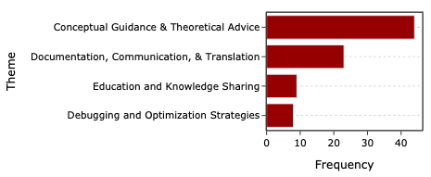
None Existing Patch (NE)
Conceptual guidance; no executable patch.
Concept explanation; no code contribution.
Not all AI impact in PR workflows is patch-based.
Notes:
We’ve now looked at PN cases, where the AI provided a patch but it was not structurally integrated. Let’s contrast that with NE — No Executable Patch cases. In NE cases, the AI does not provide a concrete patch at all.
This graph summarizes the thematic distribution of NE interactions. Each bar represents a category of conversations where developers used ChatGPT, but the interaction did not result in a specific code patch. Instead, these exchanges were guidance-oriented.
The dominant theme is Conceptual Guidance & Theoretical Advice. These are conversations about programming concepts, design principles, optimization strategies, or best practices — without a concrete patch being proposed.

Slide 18
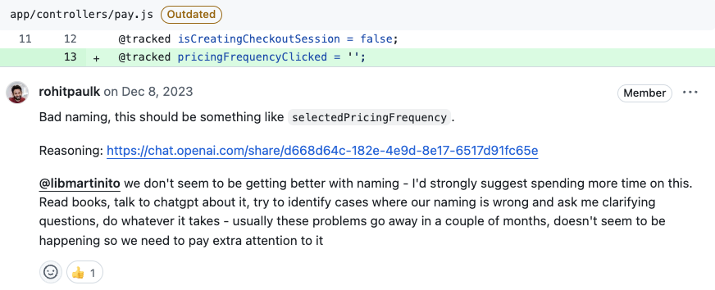
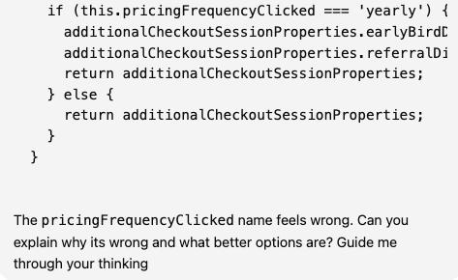
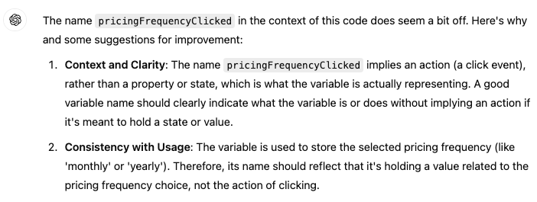
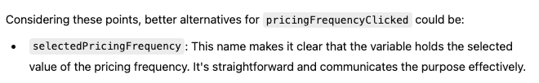
NE Example – Conceptual Guidance (Naming Refinement)
PR Author / repo maintainer
Conceptual guidance — no patch proposed - AI suggested clearer variable naming to improve readability. No structural patch was evaluated.
Initial Code (Before ChatGPT's Suggestion)
Refined Code (After ChatGPT’s Suggestion)
AI influenced code clarity without generating a mergeable patch.
https://github.com/codecrafters-io/frontend/pull/1061
https://chatgpt.com/share/d668d64c-182e-4e9d-8e17-6517d91fc65e
Notes:
In this pull request, the developer asked ChatGPT whether a variable name was appropriate and how it could be improved.
ChatGPT did not generate a code diff intended for direct integration. Instead, it suggested alternative naming options and explained why they might improve readability and clarity.
The developer then manually renamed the variable in their local code.
There was no executable patch produced by ChatGPT that could be structurally compared to the final merged version.
Because there was no concrete AI-generated patch to evaluate using clone detection, this case is classified as NE — No Existing Patch.
The influence here is cognitive — ChatGPT shaped the developer’s reasoning — but not structural in terms of mergeable code.

Slide 19
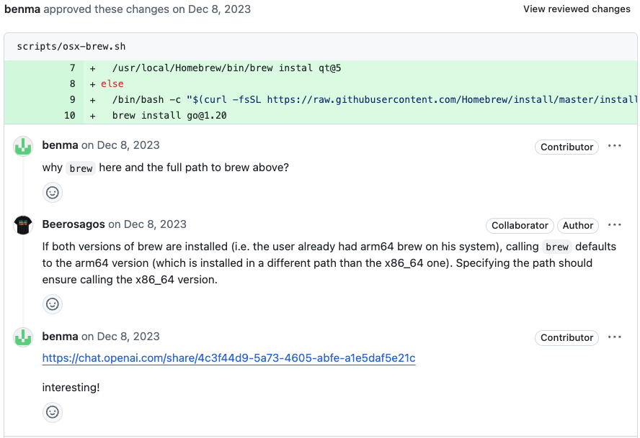
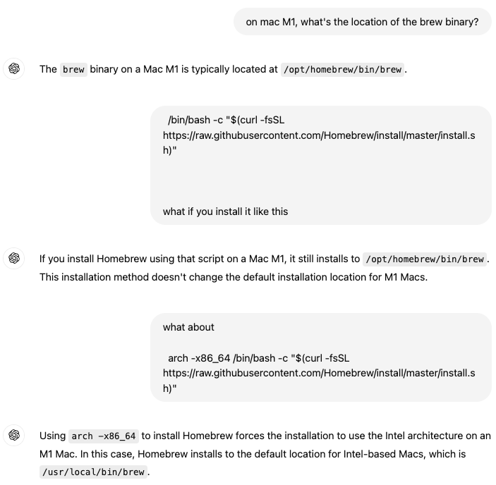
NE Example 2 — Education & Knowledge Sharing
PR Author
Educational clarification — architecture understanding.
Installation of different architectures (arm64 vs. x86_64)
AI supported system understanding without contributing executable code.
https://github.com/BitBoxSwiss/bitbox-wallet-app/pull/2415
https://chatgpt.com/share/4c3f44d9-5a73-4605-abfe-a1e5daf5e21c
Notes:
In this case, the developer asked about Homebrew behavior across architectures.
ChatGPT explained how arm64 and x86_64 differ on Mac M1 systems.
No patch was generated.
The AI helped the developer understand environment configuration.
Again — this is learning support, not patch contribution.

Slide 20
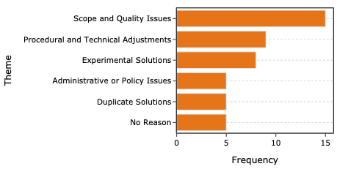
Pull Request Closed (CL)
Scope misalignment; solution diverges from PR intent.
Process violations; CI or workflow constraints unmet.
Closure often reflects process misalignment, not incorrect code.
Notes:
In many CL cases, the AI-generated solution technically works — but it expands beyond the original issue or diverges from project expectations. Reviewers may comment that the solution is out of scope. The PR is closed not because the code is wrong — but because it doesn’t match the intended contribution. Solving the problem is not enough. You must solve the right problem.
In other cases, the patch fails CI checks, lacks tests, breaks formatting rules, or conflicts with architectural guidelines. The issue isn’t correctness — it’s workflow discipline. The PR stalls and eventually gets closed. Code must satisfy process constraints — testing, CI, contribution standards.
CL cases show that mergeability depends on context, scope, and process — not just technical validity.

Slide 21
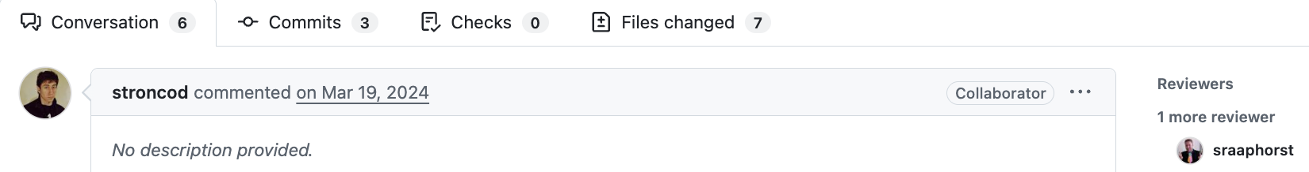
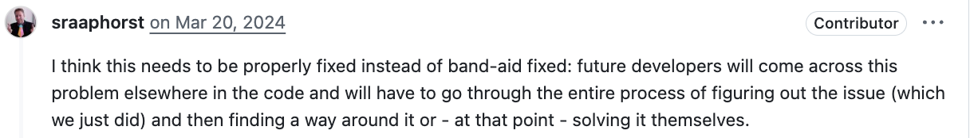
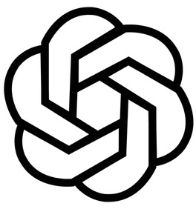


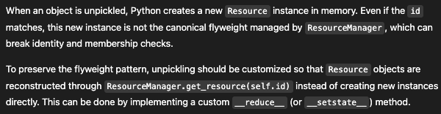

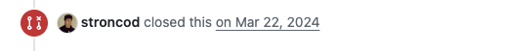
CL Example: Scope and Quality Issues
Architectural Misalignment — Local Fix vs. Architectural Consistency
Is [r.id for r in resources]
recreated for each check?
Yes. Precompute a set instead.
Why does a pickled and unpickled Resource break identity, and how can we preserve the flyweight instance during unpickling?
AI-informed review surfaced the architectural issue; the structural fix was not implemented — PR closed.
https://github.com/gemini-hlsw/scheduler/pull/428
Notes:
This is the core change that triggered the review discussion. The PR changes this to compare IDs instead (resource.id in [r.id for r in resources]), which works around equality issues. This looks like a fix — but it shifts from object identity to string comparison.
Now we see the reviewer, @sraaphorst, stepping in. He immediately says this needs to be “properly fixed instead of band-aid fixed.”
At this point, the reviewer references ChatGPT. He asks whether the list [r.id for r in resources] is recreated on every check. ChatGPT confirms that it is inefficient and suggests precomputing a set. So AI is helping validate performance concerns — and even aligns with the reviewer’s thinking.
Notice that the reviewer actually links the ChatGPT conversation directly in the PR. This shows AI being used transparently in the review process.
The reviewer encounters uncertainty about unpickling and resource identity. They go to ChatGPT to understand why a pickled and unpickled Resource breaks flyweight identity. AI explains that unpickling creates a new instance and suggests routing reconstruction through ResourceManager.
The reviewer shares the ChatGPT conversation in the PR, bringing the AI reasoning directly into the review. The discussion shifts from a local membership fix to preserving the flyweight invariant by customizing unpickling through ResourceManager. Shift from local fix → architectural consistency.
After this architectural discussion, the PR author closes the PR unmerged. This suggests that the proposed patch did not implement the deeper structural change discussed. The issue required a broader redesign rather than a localized fix.
The original issue was that membership checks were failing after pickling and unpickling Resource objects.
The PR author fixed it by comparing IDs instead of objects.
ChatGPT even suggested optimizing the ID check using a set.
But the reviewer identified the real issue: the flyweight pattern was being violated during unpickling.
Instead of patching comparisons, the system should guarantee canonical Resource identity through ResourceManager.
Because the solution addressed the symptom rather than the architectural cause, the PR was closed unmerged.
This is a perfect example of AI providing locally correct advice that doesn’t align with long-term architectural constraints.

Slide 22
AI in PR Workflows — Four Distinct Roles
🟢 PA — Code contributor
AI-generated code integrated (verbatim or adapted).
AI directly contributes executable code.
🔵 NE — Educational clarifier
AI provides clarification, explanation, or system understanding.
AI supports learning without producing a patch.
🟡 PN — Conceptual advisor
AI suggestion influences reasoning, but code is reworked.
Conceptual influence without structural preservation.
🔴 CL — Architectural catalyst
AI-informed review surfaces deeper architectural issues.
AI clarifies invariants; structural fix not implemented.
AI participation extends beyond patch production.
Both authors and reviewers initiate AI use.
Professional judgment mediates AI integration.
Technical validity does not guarantee integration.
AI can elevate review quality — even when patches aren’t adopted.
AI enters PR workflows as a collaborative reasoning partner, but integration is governed by architectural discipline.
Notes:
PA - Here we see cases where AI-generated code is directly integrated — either verbatim or slightly adapted. In these cases, AI functions as a code contributor.
PN - Here the AI suggestion influences the developer’s reasoning, but the final code is reworked. The idea is adopted, but the structure is not preserved.
NE - In these cases, AI does not produce executable code. Instead, it provides clarification, explanation, or system understanding.
CL - Here AI-informed review surfaces deeper architectural issues. The proposed patch addresses a symptom, but architectural consistency governs the outcome.
AI plays multiple roles in PR workflows—used by both authors and reviewers—and its integration is governed by engineering judgment rather than technical correctness alone.
AI enters pull request workflows as a collaborative reasoning partner — but integration is ultimately governed by architectural discipline. That is what shapes outcomes.

Slide 23
Why We Study GenAI in This Course
This material comes from ongoing research in my lab.
We analyze real pull requests where AI was used in industry.
GenAI tools are now embedded in professional software workflows.
Senior engineers are expected to use AI responsibly — not blindly.
You are not required to use GenAI. But if you use it, you are expected to use it professionally.

Slide 24
Professional Use of GenAI
If you chose to use GenAI in your project:
Demonstrate understanding of the final code.
Explain key design decisions in your PR.
Justify non-trivial changes.
Add tests for AI-assisted logic.
Be prepared to defend your implementation in review.
Unexplained code is poor engineering — regardless of who wrote it.

Slide 25
What We Evaluate in Pull Requests
PR description clarity.
Commit discipline.
Review depth.
Test coverage.
Architectural reasoning.
Quality of integration decisions
We evaluate how thoughtfully tools are used — not whether they are used.

