Slide 1
Designing Software Systems for Collaborative Development
Dr. John Businge
john.businge@unlv.edu

Slide 2
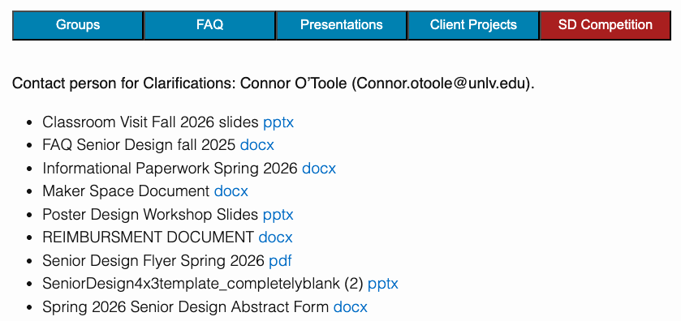
Announcements
Grading Lab 1
Submit your DP I 02/20 on Canvas and pin the Google doc on Discord
Focus on DP II and III – Its both team and individual
Individual 60%
Team 40%
Navigating Client Challenges
Reimbursement up to $750
Notes:
I know early stages can feel messy. That’s normal.
What’s not normal is staying blocked.

Slide 3
Announcements - Business Collaboration Opportunity
Partner Course
BGES 302: Growing Business Organizations Dr. Huston Pullen (College of Business)
What You Get
• Business students as advisors • Market validation perspective • Help refining value proposition • Stronger final presentation
Your Commitment
• ~2 meetings total this semester • 45–60 minutes each • Professional collaboration
I will submit your team for pairing by 02/18/2026.

Slide 4
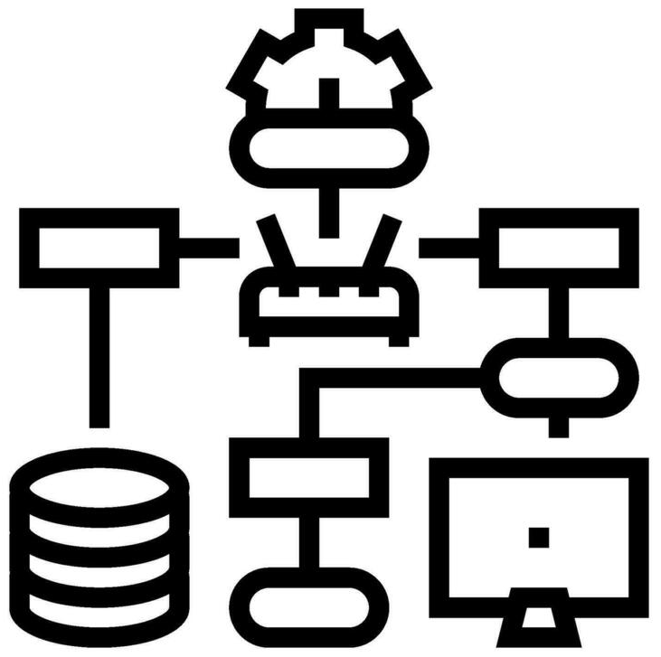
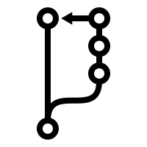
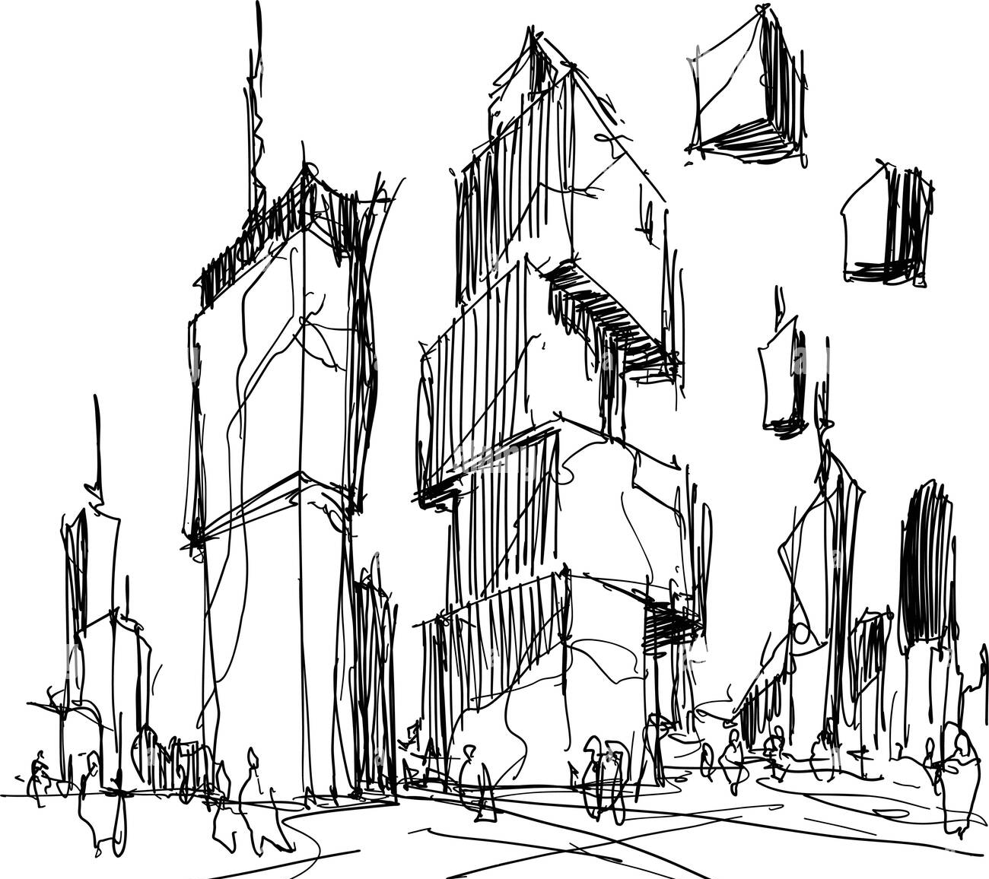
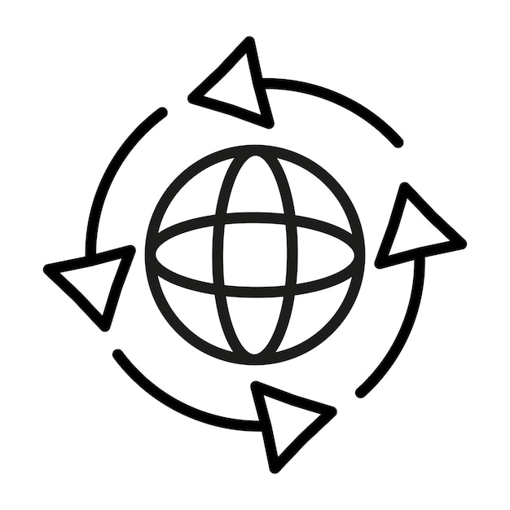
From Requirements to Pull Requests
Real World
Implementation + PR + CI
Domain Model - DPI
Design Model - DPII
CI reduces integration conflict
Reduces conceptual conflict
Reduces structural conflict
The real world is ambiguous. Software must bring structure to ambiguity.
Failure happens because you skip Domain clarity or Design clarity.
Design is the bridge between messy reality and stable collaboration.
Notes:
The real world is ambiguous. Software must bring structure to ambiguity.
Domain modeling is about understanding the problem — not solving it yet. Core concepts
Identify core concepts (Book, User, Loan, Street, TrafficLight, etc.)
Focus on what exists
No implementation details
Now we move from understanding to engineering. This is the transition from conceptual clarity to structural clarity.
Define concepts, responsibilities, and interfaces
Implementation + PR + CI
Code follows design
Each PR implements a design slice
CI validates design assumptions
Review checks alignment with design

Slide 5
From Requirements to Pull Requests
Architectural Baseline - DPI
Controlled Evolution - DPII
Problem
Refined Class Diagrams
Requirements
Sequence Diagrams
Use Cases
Feature Implementation
Domain Model
Pull Request
Initial Class Diagrams
CI + Coverage
High-level Architecture
Merge

Slide 6
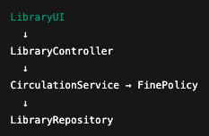

Design Is About Controlling Change
What will change most often in this system?
If I add a new feature, how many classes must I modify?
Does this design make testing easy?
Can this system evolve through small pull requests?
GOOD DESIGN (Layered)
Book overdue feature
BAD DESIGN (Tangled)
One change spreads everywhere.
Overdue feature changes 6 classes
One Change stays local
Changes 1 or 2 classes
Tangled design → large PRs → fragile CI
Layered design → small PRs → stable CI
Notes:
Now that we’ve seen how requirements turn into pull requests, the real question is: How do we design so that change doesn’t destroy our system?
In bad design, responsibilities blur, so adding a feature touches everything.
In good design, a feature maps to 1–2 responsibilities, which maps to a small PR.

Slide 7
Design before You Code
Before Opening a Pull Request, Ask:
What requirement / issue does this PR address?
What type of PR is this?
Feature
Refactor
Test-only
CI / Config
Documentation
Am I changing structure (classes, responsibilities)?
Am I changing behavior (interactions between objects)?
Is this change localized to a coherent part of the system?
Do I need to update a diagram or design artifact?
If architecture changes, the design must reflect it.
Notes:
In bad design, responsibilities blur, so adding a feature touches everything.
In good design, a feature maps to 1–2 responsibilities, which maps to a small PR.

Slide 8
Which Diagram Do I Need Before My PR?
STRUCTURAL CHANGE
→ Update Class Diagram
Examples:
Add FinePolicy
Split LibraryService into two services
Introduce new interface
Change relationships between classes
Question to ask:
Am I changing the structure of the system?
BEHAVIORAL CHANGE
→ Draw / Update Sequence Diagram
Examples:
Add new borrow flow
Add return-with-fine flow
Add reservation approval process
Question to ask:
Am I changing how objects interact?
Major architectural change → Update both diagrams
Notes:
In bad design, responsibilities blur, so adding a feature touches everything.
In good design, a feature maps to 1–2 responsibilities, which maps to a small PR.

Slide 9
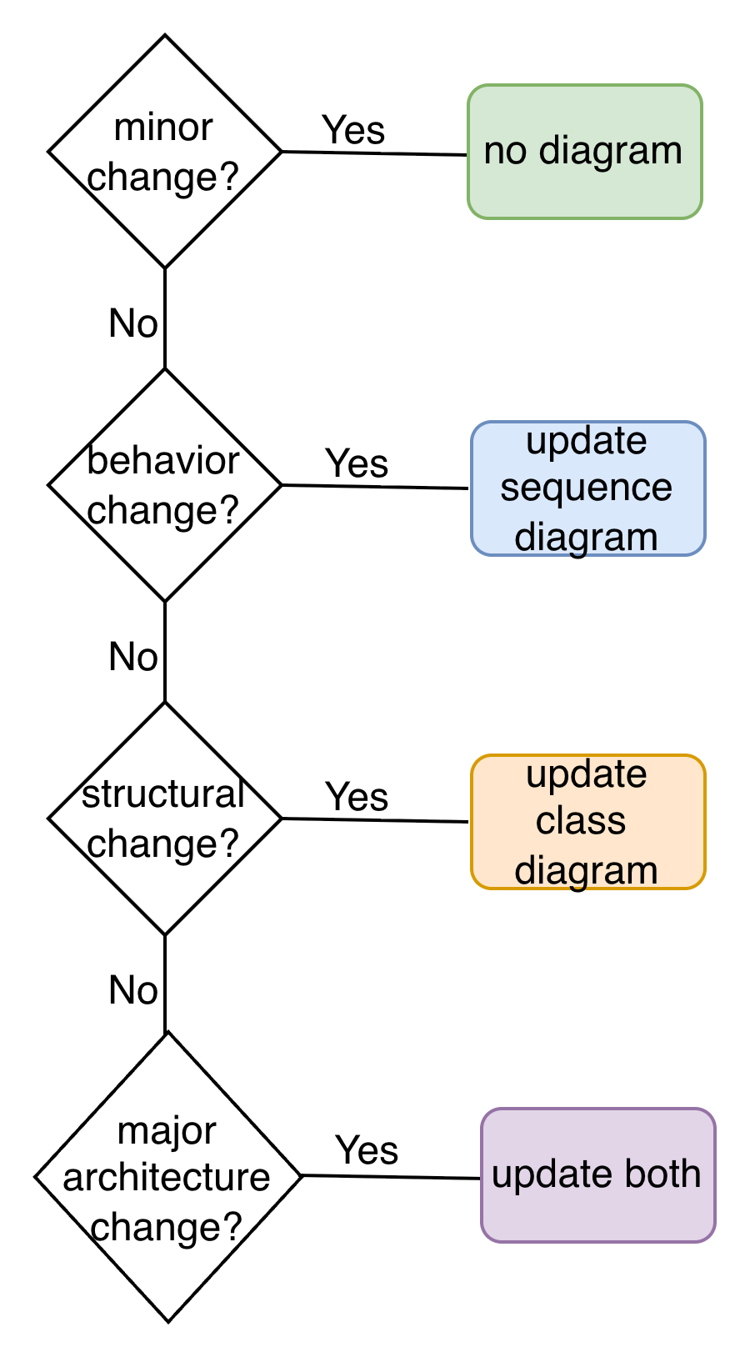
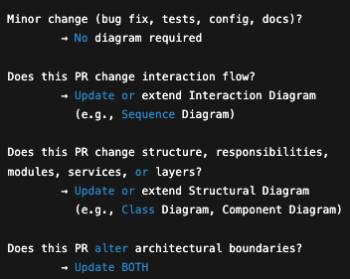
Which Diagram Do I Need Before My PR?
Design changes must be visible before code changes

Slide 10
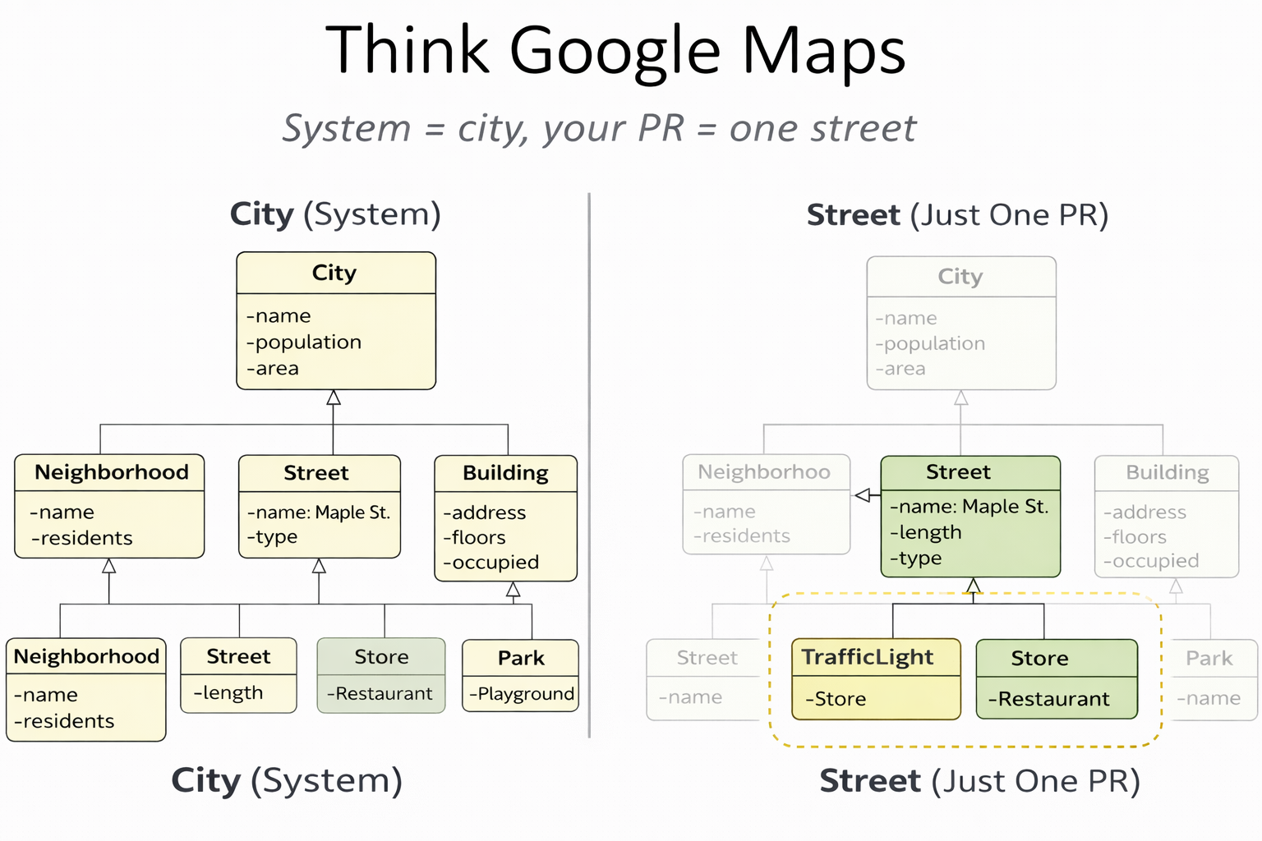
Think of Google Maps
System = City
Your PR = One Street
You do NOT redraw the entire system. You show only the part your PR changes - but it must clearly fit back into the whole.

Slide 11
Example PR: Add Traffic Light Support
Linked Issue: Issue #42 – Add Traffic Light Support to Streets
PR Title: Add TrafficLight support to Street model
PR Description: This PR introduces traffic light functionality to streets to support dynamic traffic control and future traffic system features.
Design evidence (What Changes in the System):
Structural Change → Class Diagram
New class: TrafficLight
New relationship: Street 1 → * TrafficLight
Behavioral Change → Sequence Diagram
Controller → Street → TrafficLight
New interaction: advanceState()
Requirement (What Must Be True After Merge):
The system must support traffic lights on streets.
Each Street can have multiple Traffic Lights.
Traffic Lights must:
Have a location (latitude, longitude)
Have a status (RED, YELLOW, GREEN)
Be changeable dynamically
Before writing code, we make the design change visible.

Slide 12
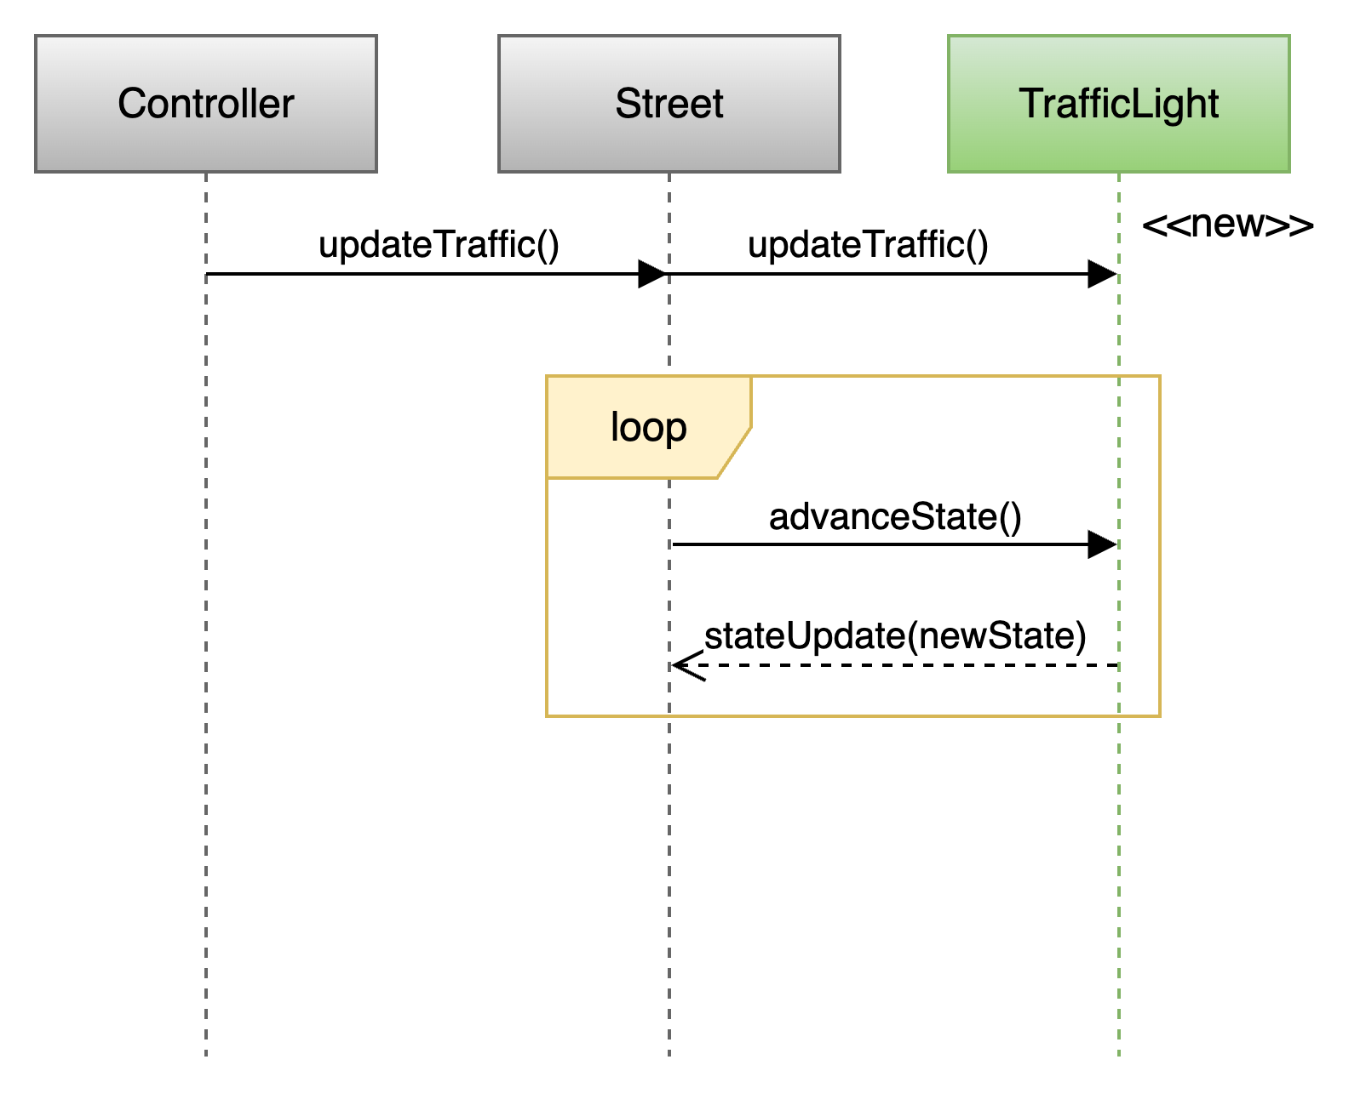
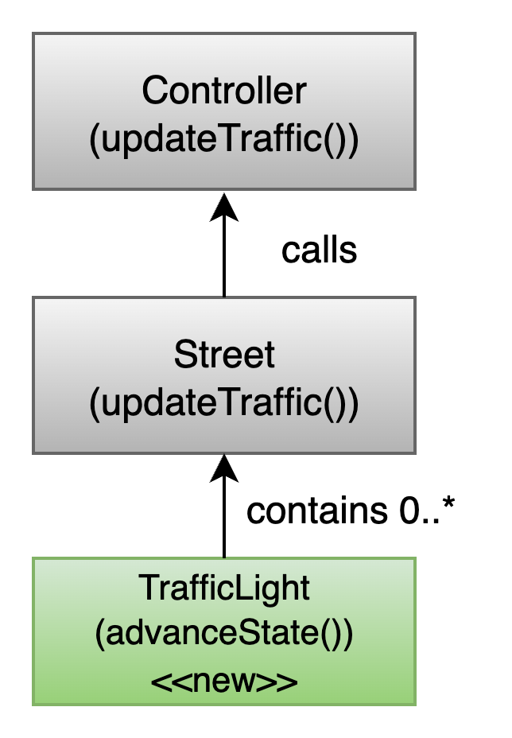
Example PR: Add Traffic Light Support
Sequence Diagram
Class Diagram
Structural Changes:
Added class TrafficLight
Street now contains 0..* TrafficLight
Controller unchanged
Controller → Street : updateTraffic()
The Controller starts the process. It tells the Street: update your traffic.
Street → TrafficLight : advanceState()
Inside updateTraffic(), the Street loops through each TrafficLight it contains.
TrafficLight receives advanceState().
RED → GREEN → YELLOW → RED
Notes:
The Controller starts the process. It tells the Street: update your traffic.
Inside updateTraffic(), the Street loops through each TrafficLight it contains.”

Slide 13
Anatomy of a Well-Designed PR
PR must contain:
• Linked issue • Clear requirement description • Relevant diagram(s) • Small, focused change • Tests • Passing CI • No coverage drop
What This Looks Like in Practice:
PR title
Requirement paragraph
Design summary
Diagram reference
Tests
CI green
A PR is a design proposal — not just a code submission.
Notes:
The Controller starts the process. It tells the Street: update your traffic.
Inside updateTraffic(), the Street loops through each TrafficLight it contains.”

Slide 14
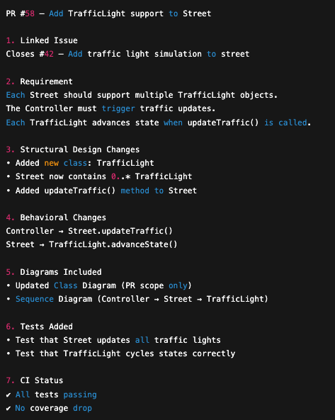
Example PR: Add Traffic Lights to a Street
This PR explains WHAT changed and WHY — before anyone reads the code.
Notes:
The Controller starts the process. It tells the Street: update your traffic.
Inside updateTraffic(), the Street loops through each TrafficLight it contains.”

Slide 15
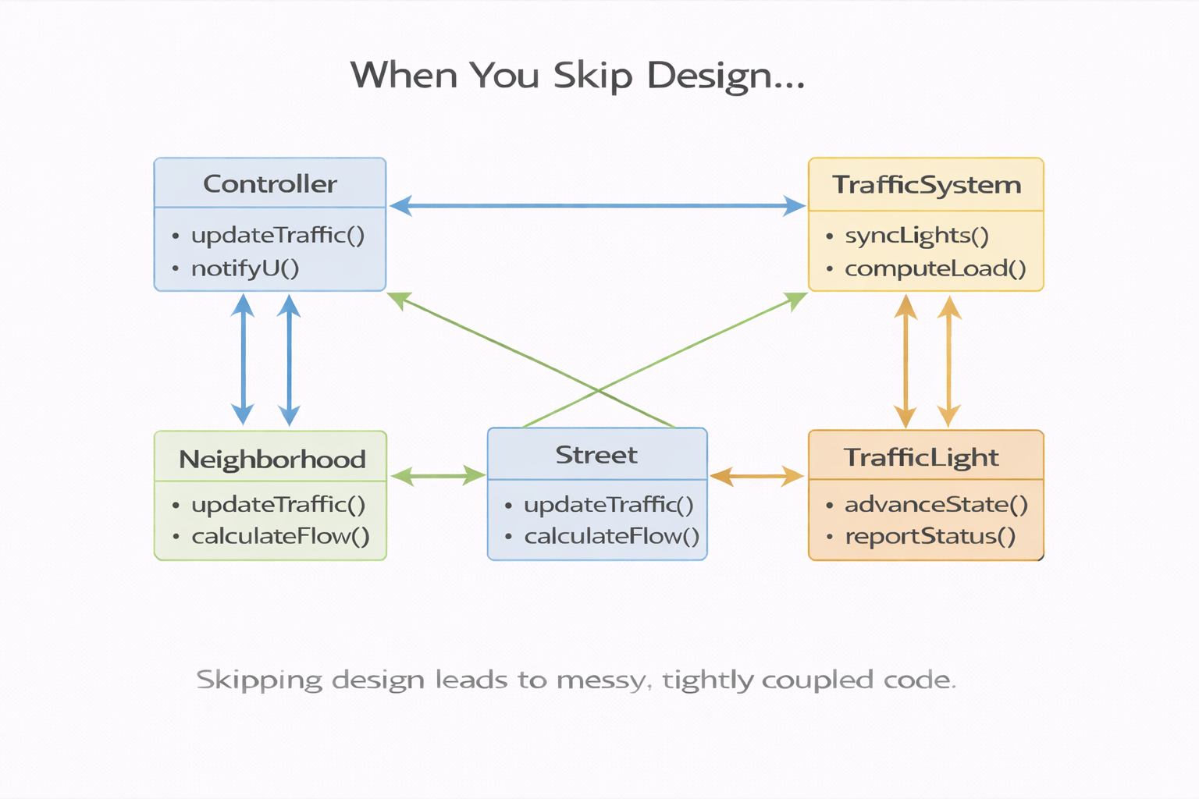
What Happens When You Skip Design?
Messy/Tangled deign
When You Skip Design…
You don’t modify one street.
You accidentally modify: • the street • the neighborhood • the traffic system • the city boundary
Now your PR: • touches unrelated classes • breaks existing behavior • increases merge conflicts • destabilizes CI
No diagram
No clear boundary
“We’ll figure it out in code”
Notes:
The Controller starts the process. It tells the Street: update your traffic.
Inside updateTraffic(), the Street loops through each TrafficLight it contains.”

Slide 16
Design Maturity in Senior Projects
There are four levels of design maturity in software projects.
🟡 Level 3 — Intentional PR Design
Every meaningful PR:
Evaluates structural impact
Evaluates behavioral impact
Updates the correct diagram
Senior Design Target
🔴 Level 1 — Reactive
Code first.
Diagram after (if at all).
🟢 Level 4 — Architectural Stewardship
Architecture evolves intentionally:
Refactor proactively
Protect boundaries
Reduce coupling
Improve design over time
Senior engineers and architects do in industry.
🟠 Level 2 — Selective
Design only major features.
Small PRs skip design.

Slide 17
From Diagram to Implementation
Class Diagram
Sequence Diagram
Street
Controller Street TrafficLight
TrafficLight
becomes
becomes
controller.updateTraffic()
Street.java (class Street)
street.updateTraffic()
Traffic_light.java (class TrafficLight)
trafficLight.advanceState()
Methods defined:
Street.updateTraffic()
TrafficLight.advanceState()

Slide 18

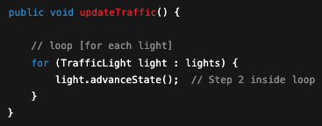
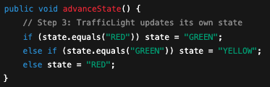
From Diagram to Implementation
class Controller
class Street
1
2
3
class TrafficLight

Slide 19
Implementation Must Realize the Design
In our TrafficLight example:
Controller only calls Street
Street owns the loop
TrafficLight changes its own state
If Code Ignores Design
Responsibilities shift accidentally
Classes grow “God methods”
PR scope expands
Review confusion
Tests don’t match architecture
CI failures increase
If Code Follows Design
Changes stay localized (Street owns loop)
Each class has one responsibility
PR remains small and focused
Tests map cleanly to methods
CI remains stable
Design → Code → Tests → CI → Stable Main
Skipping design breaks the chain.

Slide 20
A Pull Request Is a Design Increment
A good PR includes:
Linked issue (clear requirement). What problem are we solving?
Clear PR Title (what change is being introduced)
PR Description explaining why the change is needed
Design Evidence
Updated Class Diagram (if structure changed)
Updated Sequence Diagram (if behavior changed)
Explanation of what part of the system is affected
Focused Implementation
Small, localized change
Only related files modified
No “drive-by” edits
Responsibilities respected (no God methods)
Verification
Tests added or updated
All tests passing
CI pipeline green
No coverage regression
PR = Requirement + Design + Implementation + Validation

Slide 21
CI Is Architecture Protection
Small, well-designed PRs lead to:
→ Easier review → Faster CI feedback → Fewer conflicts → Stable main branch
Large, design-less PRs lead to:
→ Review confusion → CI failures → Rework → Architecture drift

Slide 22
The Collaborative Engineering Control Loop
Design controls change.
PRs implement design.
CI protects architecture.
Senior Design goal: Intentional architecture evolution.

Slide 23
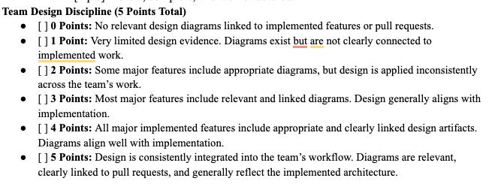
Project
For Design Portfolio II and III

