Slide 1
Designing Software Systems for Collaborative Development
Dr. John Businge
john.businge@unlv.edu

Slide 2
Announcements
Today is our last in-person meeting
We will meet again as a class during the trial presentation
The Discord communication and meeting minutes are both assessed
Lab 2 is dues 9/18
Submit your DP I 09/25 on Canvas and pin the Google doc on Discord
Focus on DP II and III – Its both team and individual
  Individual 60%
  Team 40%
Notes:
I know early stages can feel messy. That’s normal.
What’s not normal is staying blocked.

Slide 3
Project expectations
Individual contributions account for up to 60% of the project assessment. The team component accounts for 40%.
Each student completes at least six meaningful project pull requests during the semester.
Each project pull request requires at least two teammate approvals and passing CI checks before merge.
DP II and DP III each require at least one individual pull request supported by a relevant design diagram.
Issues, pull requests, reviews, tests, diagrams, and repository activity provide evidence of individual work.
2
Notes:
I know early stages can feel messy. That’s normal.
What’s not normal is staying blocked.

Slide 4
Today’s focus
Connect requirements, design decisions, implementation, tests, and CI.
Choose a class diagram for structural changes and a sequence diagram for interaction changes.
Keep each pull request focused on one coherent design and implementation increment.
Review whether the diagram, code, and tests describe the same system behavior.
Make design changes visible and reviewable before they reach the main branch.
3

Slide 5
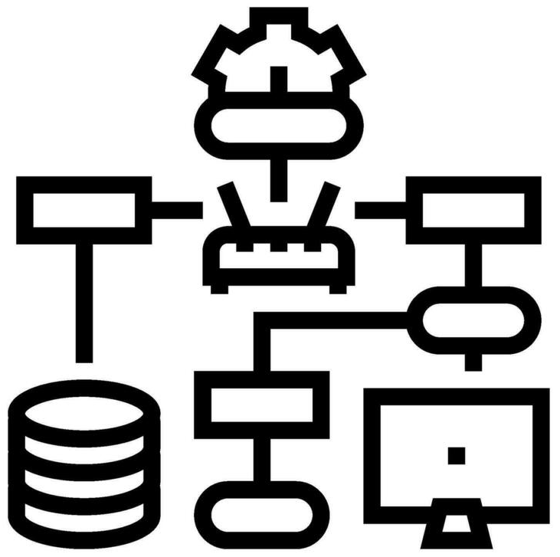
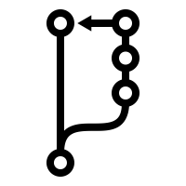
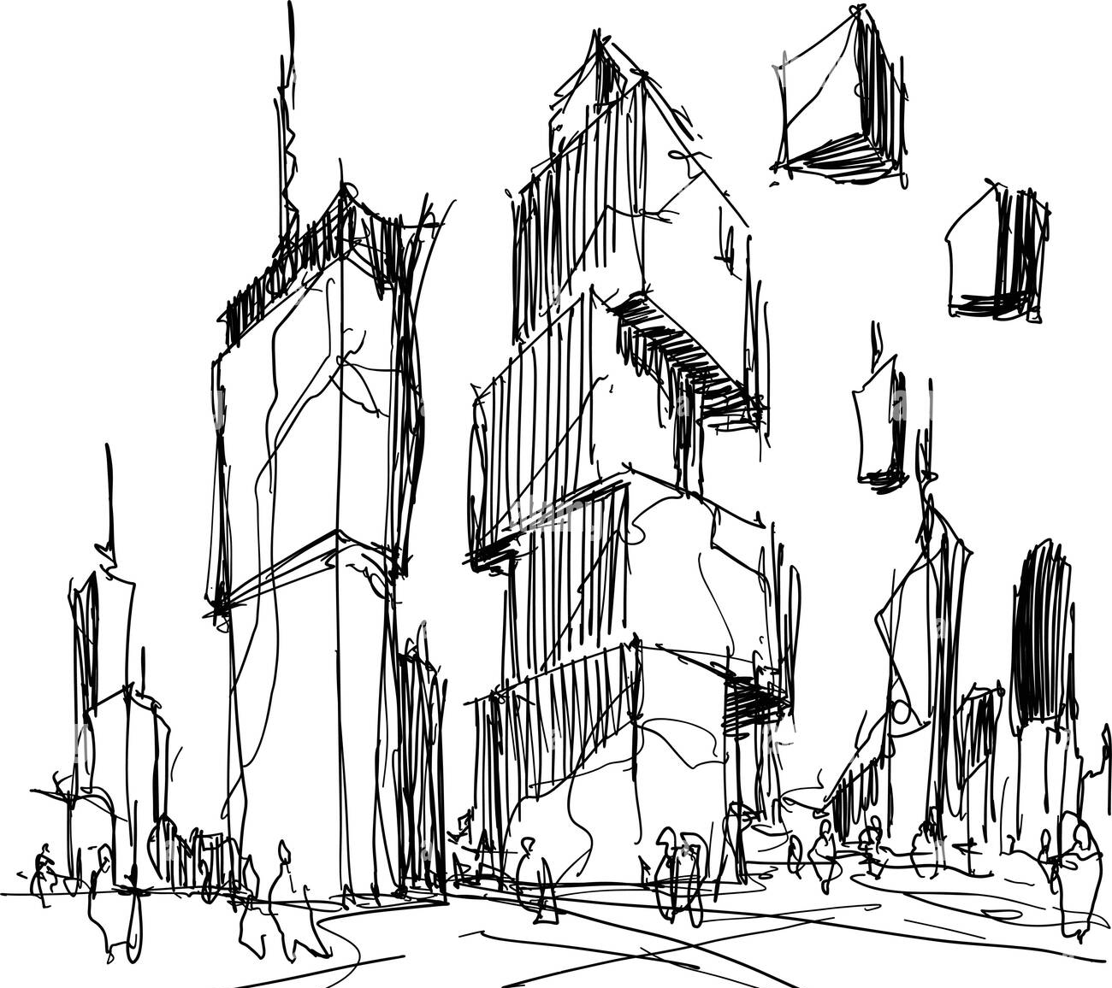
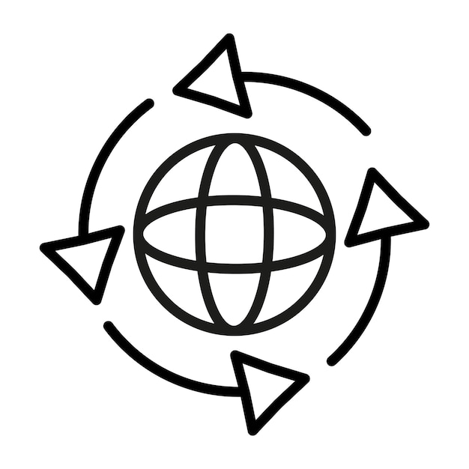
Design is the bridge from messy reality to stable collaboration
Real World
Implementation + PR + CI
Domain Model - DPI
Design Model - DPII
CI reduces integration conflict
Reduces conceptual conflict
Reduces structural conflict
The real world is ambiguous. Software must bring structure to ambiguity.
Failure happens because you skip Domain clarity or Design clarity.
Design is the bridge between messy reality and stable collaboration.
Notes:
The real world is ambiguous. Software must bring structure to ambiguity.
Domain modeling is about understanding the problem — not solving it yet. Core concepts
Identify core concepts (Book, User, Loan, Street, TrafficLight, etc.)
Focus on what exists
No implementation details
Now we move from understanding to engineering. This is the transition from conceptual clarity to structural clarity.
Define concepts, responsibilities, and interfaces
Implementation + PR + CI
Code follows design
Each PR implements a design slice
CI validates design assumptions
Review checks alignment with design

Slide 6
Every feature travels the same path: requirements → design → PR → merge
Architectural Baseline - DPI
Controlled Evolution - DPII
Problem
Refined Class Diagrams
Requirements
Sequence Diagrams
Use Cases
Feature Implementation
Domain Model
Pull Request
Initial Class Diagrams
CI + Coverage
High-level Architecture
Merge
Notes:
Contrast the two columns. DP I establishes an architectural baseline rather than a finished design. DP II refines that baseline as features are implemented. Point out that diagrams should evolve when evidence from implementation reveals a better design.

Slide 7
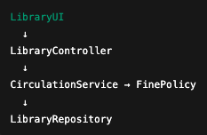

Design Is About Controlling Change
What will change most often in this system?
If I add a new feature, how many classes must I modify?
Does this design make testing easy?
Can this system evolve through small pull requests?
GOOD DESIGN (Layered)
Book overdue feature
BAD DESIGN (Tangled)
One change spreads everywhere.
  Overdue feature changes 6 classes
One Change stays local
  Changes 1 or 2 classes
Tangled design → large PRs → fragile CI
Layered design → small PRs → stable CI
Notes:
Now that we’ve seen how requirements turn into pull requests, the real question is:
How do we design so that change doesn’t destroy our system?
In bad design, responsibilities blur, so adding a feature touches everything.
In good design, a feature maps to 1–2 responsibilities, which maps to a small PR.

Slide 8
The Vocabulary of Good Design
Four ideas the rest of this lecture uses:
Coupling — how much one class depends on others. Low coupling keeps a change local.
Cohesion — how focused a class is. High cohesion means the class has one clear job.
Single Responsibility (SRP) — a class should have exactly one reason to change.
Responsibility assignment — give each behavior to the class that owns the data (Street owns its traffic loop).
Name the principle, and every design review gets easier.

Slide 9
Design before You Code
Before Opening a Pull Request, Ask:
What requirement / issue does this PR address?
What type of PR is this?
  Feature
  Refactor
  Test-only
  CI / Config
  Documentation
Am I changing structure (classes, responsibilities)?
Am I changing behavior (interactions between objects)?
Is this change localized to a coherent part of the system?
Do I need to update a diagram or design artifact?
If architecture changes, the design must reflect it.
Notes:
In bad design, responsibilities blur, so adding a feature touches everything.
In good design, a feature maps to 1–2 responsibilities, which maps to a small PR.

Slide 10
Choose the Diagram That Matches the Change
Update the design artifact affected by the Pull Request.
STRUCTURAL CHANGE
BEHAVIORAL CHANGE
CLASS DIAGRAM
SEQUENCE DIAGRAM
LibraryService
FinePolicy
Member
LibraryService
FinePolicy
uses
returnBook()
▶
+ borrowBook()
+ returnBook()
+ calculateFine()
+ isOverdue()
calculateFine()
▶
◀
fineAmount
Classes • responsibilities • relationships
Interactions • message order
Did classes, responsibilities, or relationships change?
Did object interactions or message order change?
Update the class diagram
Update the sequence diagram
If both structure and behavior change, update both diagrams.
Notes:
Use the class diagram when the PR changes the static structure: classes, responsibilities, interfaces, or relationships.
Use the sequence diagram when the PR changes how objects collaborate or the order of messages in a workflow.
A change can affect both. In that case, update both diagrams, but do not require a diagram update when the design has not changed.

Slide 11
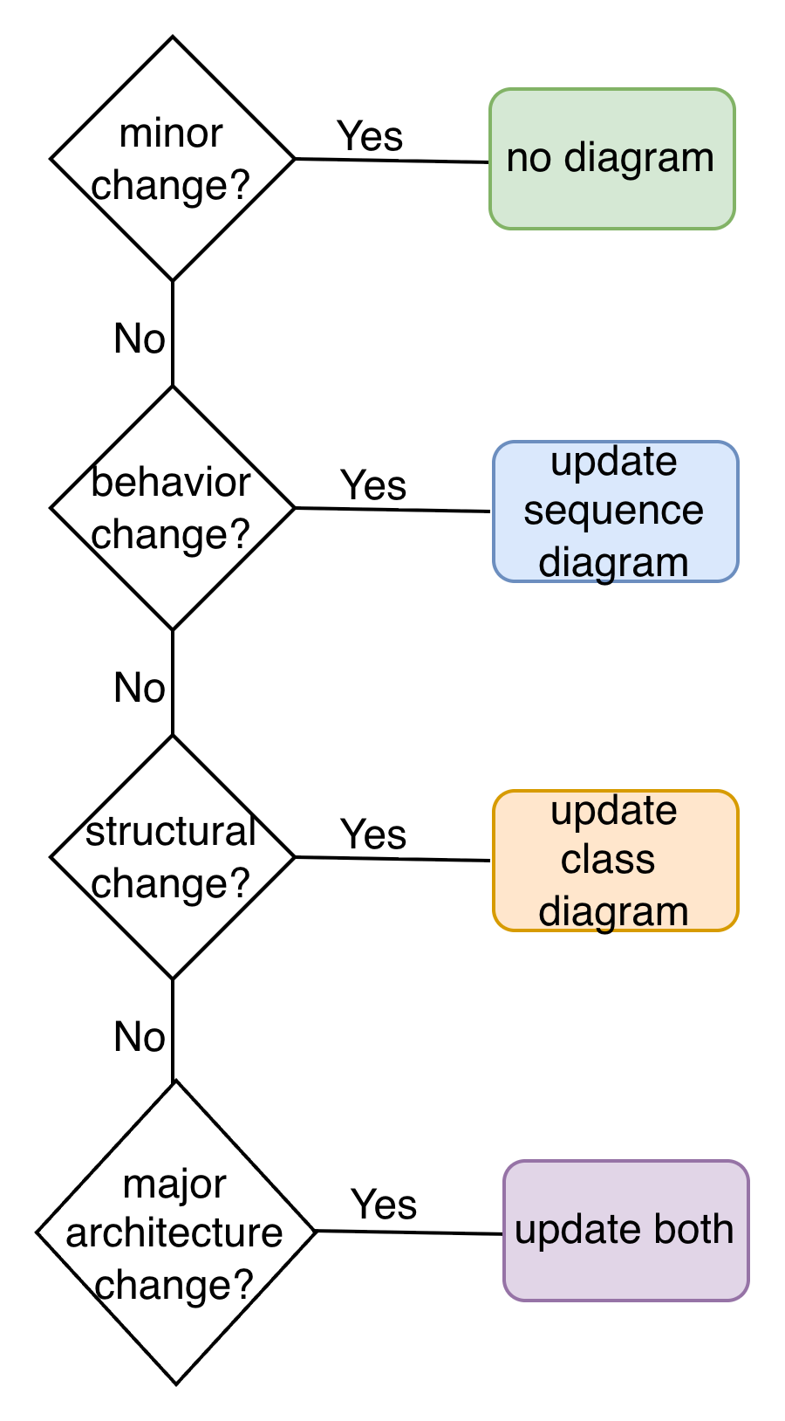
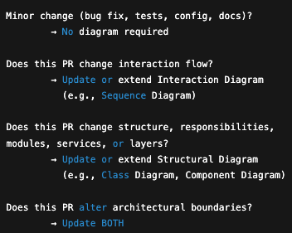
Make the design change visible before the code change
Design changes must be visible before code changes

Slide 12
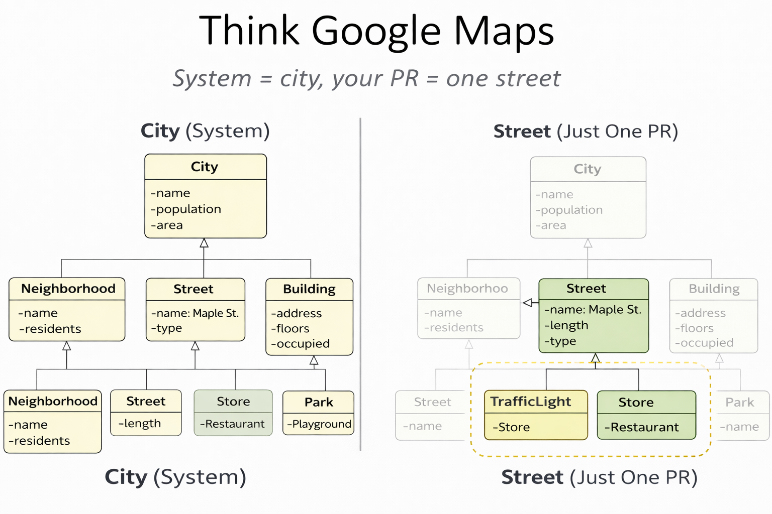
Your PR changes one street, not the whole city
System = City
Your PR = One Street
You do NOT redraw the entire system
. You show only the part your PR changes - but it must clearly fit back into the whole.

Slide 13
Example PR: Add Traffic Light Support
Linked Issue: Issue #42 – Add Traffic Light Support to Streets
PR Title: Add TrafficLight support to Street model
PR Description: This PR introduces traffic light functionality to streets to support dynamic traffic control and future traffic system features.
Design evidence (What Changes in the System):
Structural Change → Class Diagram
New class: TrafficLight
New relationship: Street 1 → * TrafficLight
Behavioral Change → Sequence Diagram
Controller → Street → TrafficLight
New interaction: advanceState()
Requirement (What Must Be True After Merge):
The system must support traffic lights on streets.
Each Street can have multiple Traffic Lights.
Traffic Lights must:
  Have a location (latitude, longitude)
  Have a status (RED, YELLOW, GREEN)
  Be changeable dynamically
Before writing code, we make the design change visible.

Slide 14
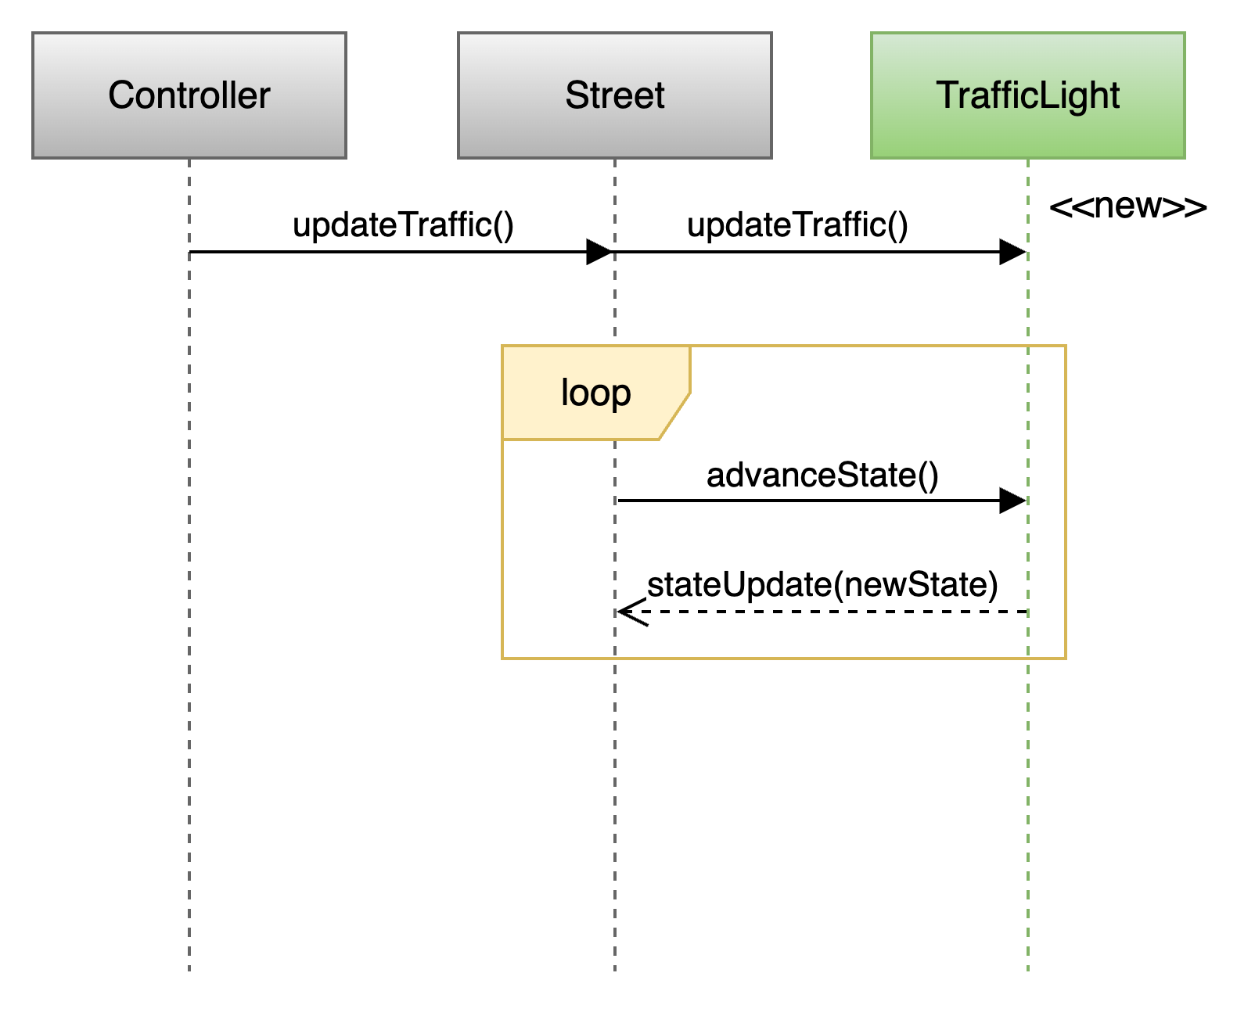
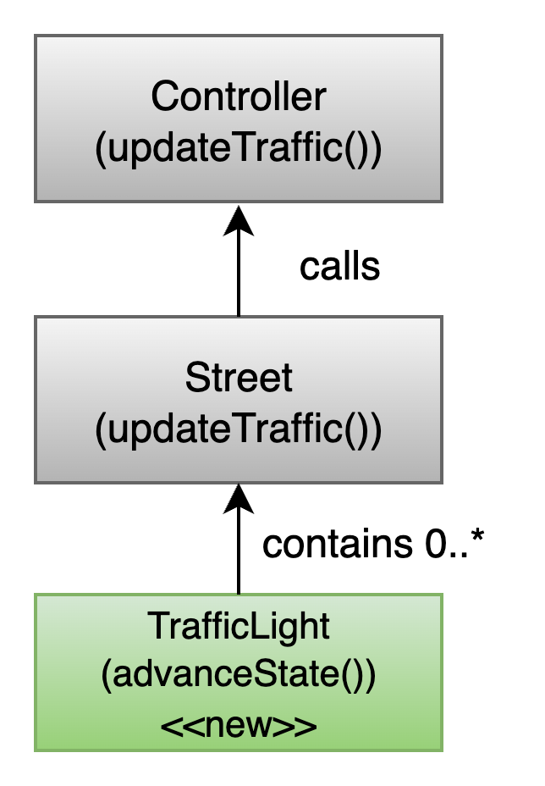
Traffic-light PR: the structural and behavioral changes
Sequence Diagram
Class Diagram
Structural Changes:
Added class TrafficLight
Street now contains 0..* TrafficLight
Controller unchanged
Controller → Street : updateTraffic()
The Controller starts the process. It tells the Street: update your traffic.
Street → TrafficLight : advanceState()
Inside updateTraffic(), the Street loops through each TrafficLight it contains.
TrafficLight receives advanceState().
RED → GREEN → YELLOW → RED
Notes:
The Controller starts the process. It tells the Street: update your traffic.
Inside updateTraffic(), the Street loops through each TrafficLight it contains.”

Slide 15
Issue and pull request traceability
Example: add traffic lights to a street
ISSUE #42
PULL REQUEST #58
Add traffic-light support to Street
Add TrafficLight support to Street
Focused
branch
Problem
Closes #42
A Street has no model for its traffic lights or their state changes.
What changed
• Added TrafficLight.
• Street owns 0..* lights.
• Controller calls Street.updateTraffic().
Acceptance criteria
1. Street supports multiple TrafficLight objects.
2. Controller can trigger a traffic update.
3. Each light advances state when updated.
4. Existing behavior remains unchanged.
Design
Code
Tests
Verification evidence
• Design diagrams updated.
• Acceptance criteria covered by tests.
• Two peer approvals and passing CI.
No coverage drop
ISSUE: defines what must be true before implementation begins
PR: explains what changed and how the team verified it
Reviewers compare the PR evidence with the acceptance criteria in the linked issue.
Notes:
Begin on the left. In the lab, students created the issue before opening a branch or writing code. The issue identifies the problem and states the acceptance criteria. It should describe what the completed change must accomplish without prescribing every implementation detail.
Use the traffic-light example to distinguish requirements from implementation. The issue requires a Street to support multiple traffic lights, permits the Controller to trigger an update, requires each light to advance its state, and protects existing behavior. These statements give the author and reviewers a shared definition of completion.
Move to the center. The student creates a focused branch linked to the issue. The branch contains the design work, implementation, and tests. If the change affects structure or interactions, the student updates the relevant class or sequence diagram before or while implementing the change.
Move to the right only after the change is ready for review. The pull request uses a title that corresponds to the issue and includes ‘Closes #42’ so GitHub maintains traceability and closes the issue when the team merges the PR.
The pull request explains what changed in the design and implementation. It also supplies verification evidence. In this example, the team updated the diagrams, tested the acceptance criteria, obtained two peer approvals, and passed the required CI checks.
Emphasize the review question at the bottom: does the evidence in the pull request demonstrate every acceptance criterion in the issue? Reviewers should not approve a PR merely because the code looks reasonable or CI passes.
The issue and pull request serve different purposes. The issue defines the expected outcome before implementation. The pull request documents the completed change and the evidence that it satisfies the issue.

Slide 16
Consequences of skipping design
A change intended for one class can spread when responsibilities and boundaries remain unclear.
Without a clear design boundary
The pull request becomes harder to control
Controller
1
Scope expands
The PR touches classes that the issue did not clearly require.
Intended change
Street
Neighborhood
Traffic system
2
Regression risk increases
Changes outside the intended boundary can break existing behavior.
City boundary
3
Integration becomes harder
Review takes longer, conflicts increase, and CI failures become harder to diagnose.
The implementation now reaches beyond the scope implied by the issue.
Before coding, define the smallest design boundary that can satisfy the issue.
Notes:
Use the traffic-light feature as the example. The issue asks the team to add traffic lights to a Street. The intended center of change is therefore the Street and the new TrafficLight responsibility.
The left side shows what can happen when the team begins coding without first deciding where the responsibility belongs. Logic can spread into the Controller, Neighborhood, TrafficSystem, or even broader system boundaries.
Changing several classes is not automatically wrong. The problem occurs when the team cannot explain why each affected class must change or how those changes follow from the design.
Connect this to the issue workflow from the Git and GitHub lab. The issue and its acceptance criteria establish the intended scope. Before implementation, the team should identify the responsible class and update the relevant class or sequence diagram when structure or interactions change.
On the right, explain the practical consequences. First, the pull request grows beyond the issue. Second, touching unrelated responsibilities increases the chance of regressions. Third, a larger change becomes harder to review and integrate. Merge conflicts may increase, and CI failures can become harder to diagnose because the PR changes several behaviors at once.
When reviewing a PR, ask whether every modified file is necessary to satisfy the linked issue. If the relationship is unclear, the author should refine the design, split the work, or explain the dependency.
Conclude with the statement at the bottom. The goal is not to force every change into one class. The goal is to identify the smallest coherent design boundary that satisfies the issue and keeps the PR reviewable.

Slide 17
From Diagram to Java: Files & Methods
Class Diagram
Sequence Diagram
Street
Controller Street TrafficLight
TrafficLight
becomes
becomes
controller.updateTraffic()
Street.java (class Street)
street.updateTraffic()
TrafficLight.java (class TrafficLight)
Methods defined:
Street.updateTraffic()
TrafficLight.advanceState()
trafficLight.advanceState()

Slide 18

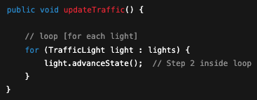
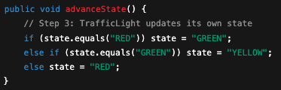
From Diagram to Code: Three Classes in Order
class Controller
class Street
1
2
3
class TrafficLight

Slide 19
A Pull Request Is a Design Increment
One PR should carry one change from intent to evidence.
ONE TRACEABLE CHANGE
1
ISSUE
2
DESIGN
3
CHANGE
4
EVIDENCE
→
→
→
Acceptance criteria
Impact + diagrams
Focused code + tests
CI + peer review
PR title + description: WHAT changed? WHY is it needed?
MERGE GATE
Two approvals • required checks pass • no coverage regression
Notes:
Treat the PR as one coherent change. Link the issue and acceptance criteria, then explain what changes and why.
Assess structural and behavioral impact. Update a class or sequence diagram when the design changes. Keep the implementation focused and include tests tied to the acceptance criteria.
The PR supplies the evidence: passing CI, maintained coverage, and two peer approvals before merge.

Slide 20
Design maturity in senior projects
Four levels of practice, from writing code first to improving the architecture.
Senior Design Target
4
Architectural
stewardship
PROJECT FOCUS
3
Intentional
Builds on Level 3:
Each meaningful PR:
2
Selective
Issue and acceptance
criteria
Refactor proactively.
Design for
major features.
Structural and
behavioral impact
Protect boundaries.
1
Reactive
Reduce coupling.
Diagram update when
the design changes
Code first.
Small changes
often skip design.
Improve the design
as the system evolves.
Design later,
if at all.
Tests, approvals,
and passing CI
Architectural stewardship means deliberately improving the design over time.
Notes:
Use these levels as a teaching framework. Reveal the steps in order, then emphasize Level 4 as the project focus.
Reactive means code first. Selective means design mainly for major changes. Intentional means considering design impact in each PR and updating diagrams when needed.
Architectural stewardship builds on that workflow by refactoring deliberately, protecting boundaries, and reducing coupling as the project evolves.

Slide 21
Design-supported pull requests in DP II and DP III
Each student completes at least one qualifying pull request in DP II and one additional qualifying pull request in DP III.
DP II
DP III
At least one meaningful individual PR.
A linked issue with clear acceptance criteria.
A relevant class, sequence, or architecture diagram created or updated.
Implementation or tests that realize the documented design.
The author addresses feedback from the assigned reviewers.
At least one additional meaningful individual PR.
The diagram reflects the implementation after the change.
Tests cover the affected behavior and all required CI checks pass.
The author addresses feedback from the assigned reviewers.
Both PRs require at least two teammate approvals before merge and count toward the semester minimum of six meaningful project PRs.
23

Slide 22
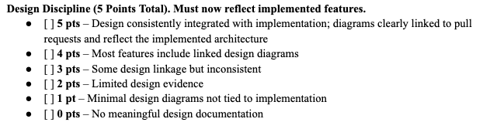
How Your Design Discipline Is Graded
Design Portfolios II & III — every major feature needs diagrams linked to its PR.

