Slide 1
Software Integration
John Businge
john.businge@unlv.edu

Slide 2
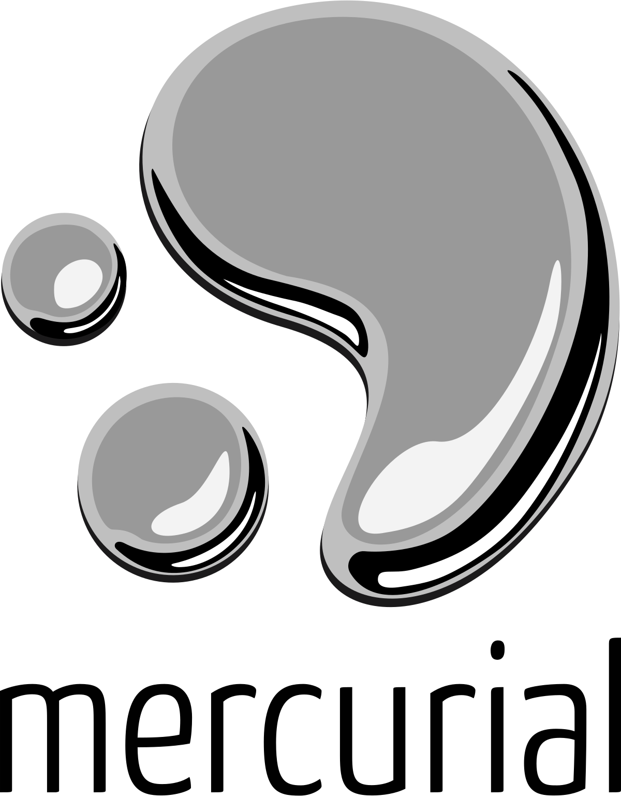
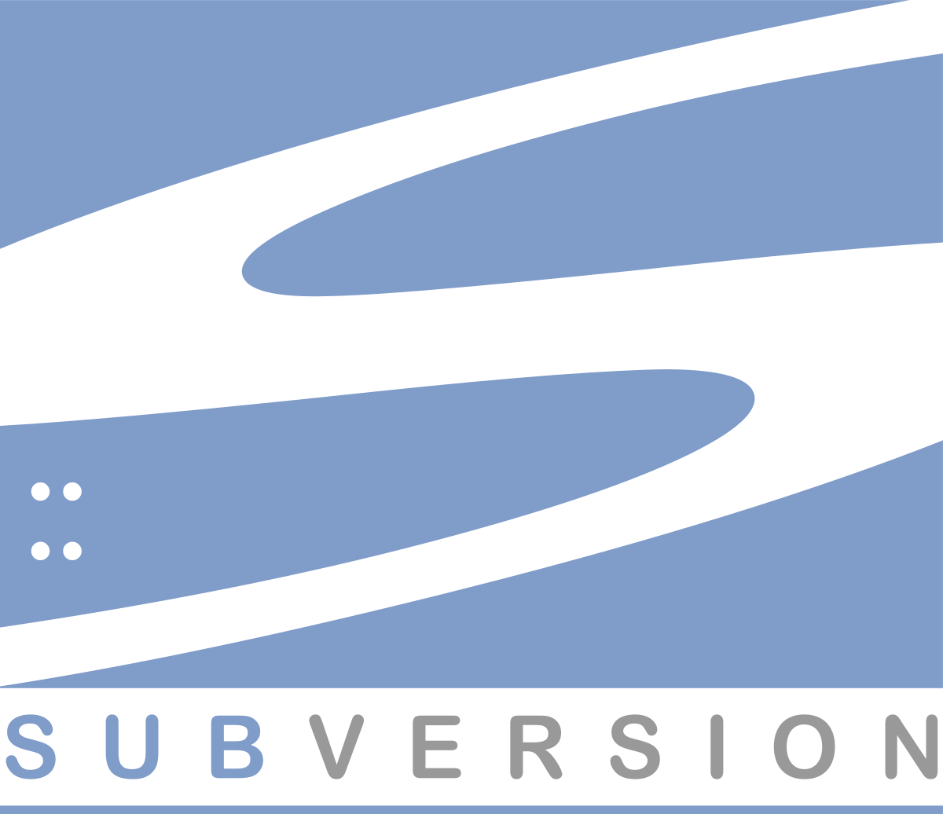
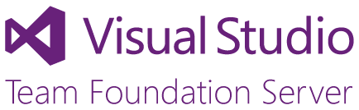

Version Control Systems
Keep track of the software development history
Became popular with the rise of distributed software development
Offer practices that facilitate collaborative software development
Offer practices that facilitate collaborative software development
Notes:
A fundamental way that developers manage change is through version control systems.
As you know, they help developers track changes to code, allowing them to revert, merge, fork, and clone projects in a way that is traceable and reliable.

Slide 3
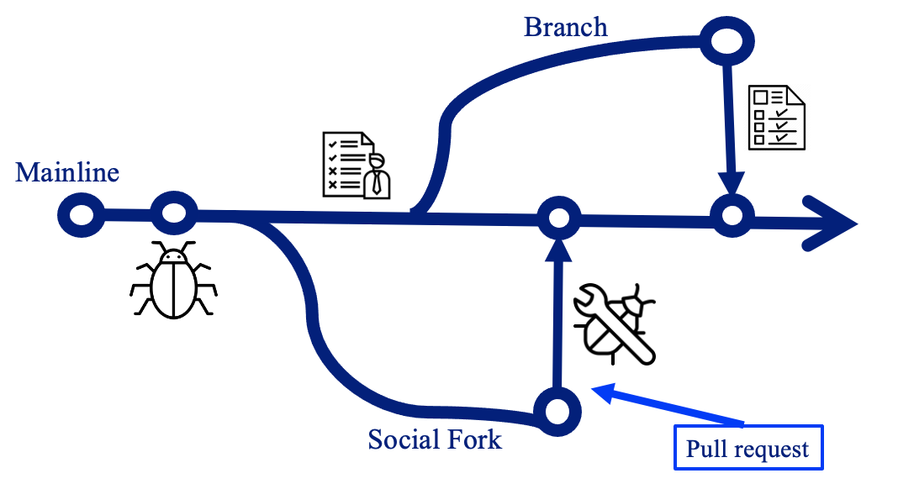
Branching/Forking
A branch is an instance of the source code
Developers create multiple branches and apply their changes in parallel
Reasons for branching: isolating development work, bug fixes, releases, etc.

Slide 4
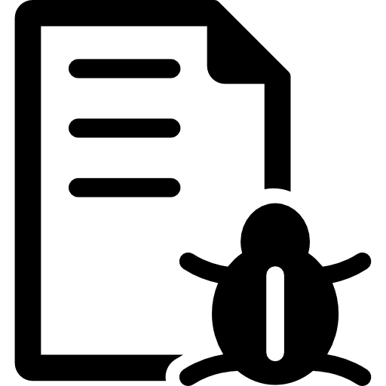
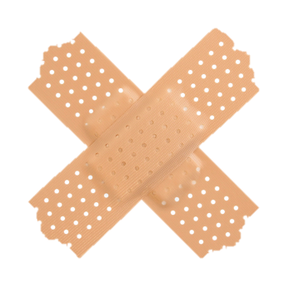
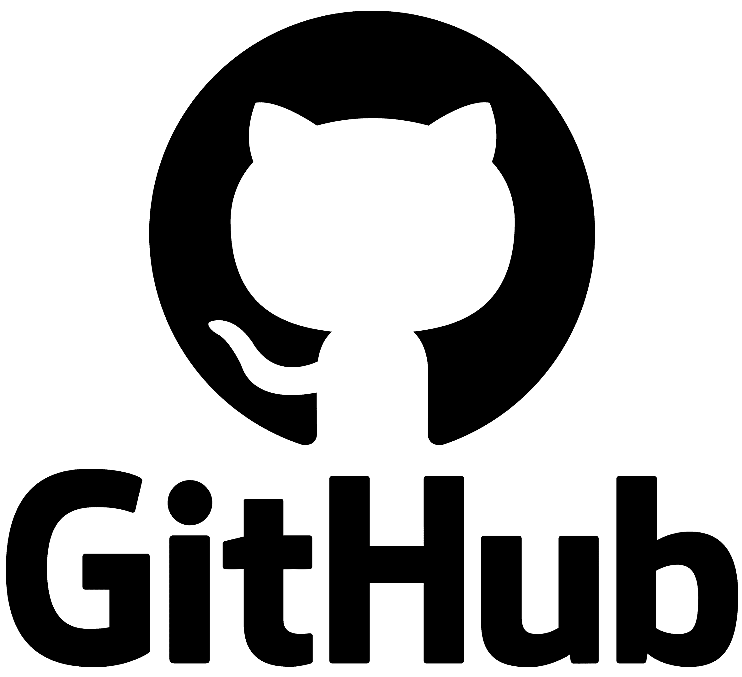
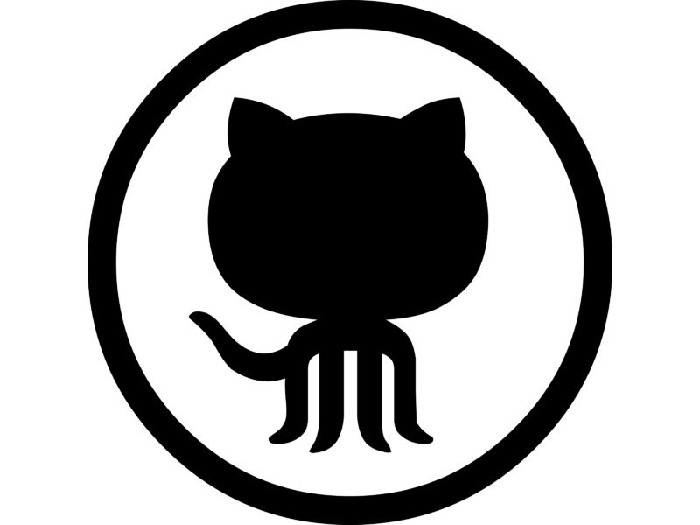
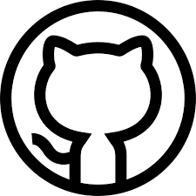
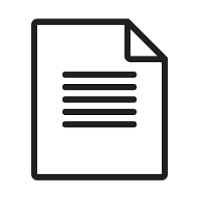
Causes of Merge Conflicts
foo
foo
social fork
current_date
fork_date
divergence_date
Pull request
variant1
(source)
Inherited commits
PR merge_commit
Synchronized commits
Unique commits
target git_head
variant2
(target)
foo
foo
foo
foo
Split
case
Missed
opportunity
Effort duplication
Uninteresting
P.K Ramkisoen, J. Businge, et. al. PaReco: patched clones and missed patches among the divergent variants of a software family, FSE, 2022.
Notes:
Using an illustration, let me explain the context of our problem. (the numbers represent the clicks you will be making)
Let’s say we have variant1 on Github with three revisions.
A different developer sees variant1, and they want to use it as a starting point to build variant2. They fork, and therefore they would inherit all the revisions of variant1.
Between the fork_date and the divergence date, the two variants pull from each other updates and synchronize commits. At this point, the two variants are even.
Between the divergence_date and the current_date, for some reason, the two variants stop synchronizing commits. Each variant has got commits not present in the other (unique commits)
Let us assume that a bug was found at this commit. The developer created a social fork or a bug-fixing-branch, patched the bug, and then integrated the patch back into variant1.
At the git_head of the target variant, four scenarios are possible:
Foo has been patched by the developer in variant2 – effort duplication
Foo is still buggy - missed opportunity
Foo has both buggy and patched lines – split case
Foo is changed beyond comparison of V1.foo and V2.foo – uninteresting.

Slide 5
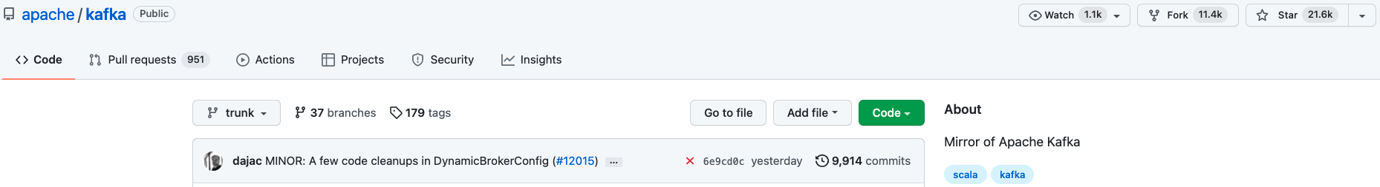
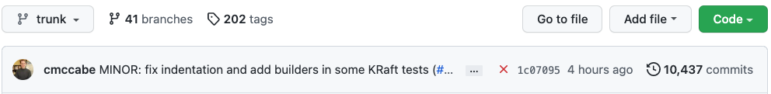
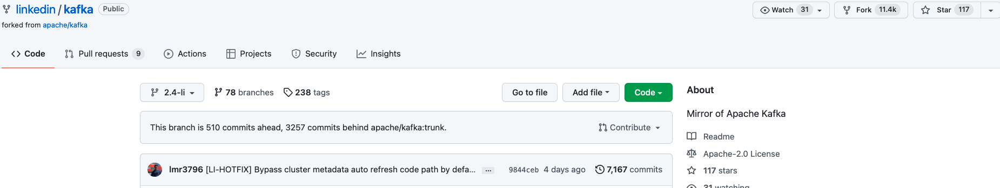
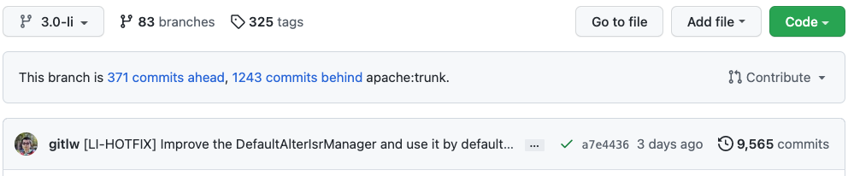
Concrete Example
Current_date 2022-10-07
linkedin
unique commits
apache
unique commits
Very active
This is the version of Kafka running at LinkedIn.
Notes:
Let me use a concrete example on GitHub, that we also have in our dataset.
The divergent pair apache/kafka and linked/kafka are hosted on Github. Linked in is a version of kafka running at linked (in fact, this is our most favorite example)
As you can see, linkedin is a fork of apache
Linked in is ahead of apache by 371 commits and behind apache by 1,243. In other words, linked and apache has 371 and 1,243 unique, respectively.
The variants are pretty very active. Their git_head commits were med 3 days and 4 hours ago, respectively.

Slide 6
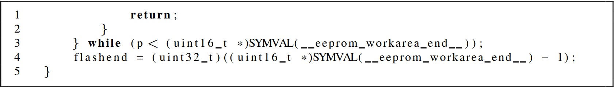
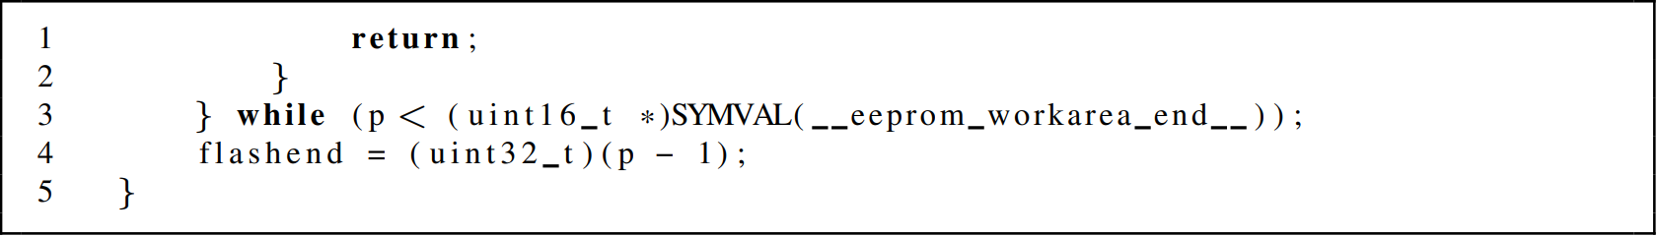
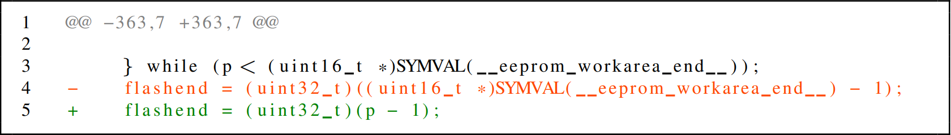

Concrete Example: Missed Opportunity
Buggy code from source – apache/kafka
Buggy line
Patched code from source – apache/kafka
Patched line
Diff for patch in source – apache/kafka
Hunk
File from target git_head – linkedin/kafka
Buggy line
Notes:
Concrete MO from kafka

Slide 7
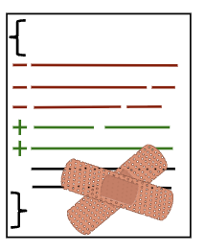
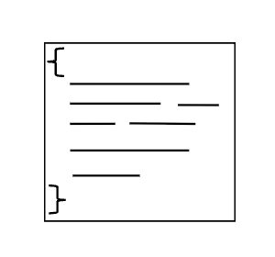
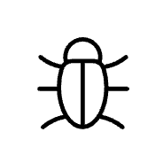
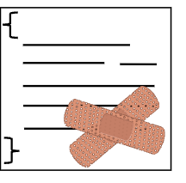


Causes of Merge Conflicts
Foo.java
patched
Bug fixing branch
Foo.java
pull request
merge commit
Fork date
Divergent date
Source Variant
Shared commits common codebase
Synchronized commits
Unique commits
cherry-pick and apply to target
Target Variant
Foo.java
Foo.java
Foo.java
Still buggy
git_head commit before cherry-pick
Failure
(merge conflict)
Success
(cleanly applied)
D. Ogenrwot and J. Businge. Refactoring-Aware Patch Integration Across Structurally Divergent Java Forks, SCAM 2025
Notes:
Picture two variants that start in sync, then split at a divergence point. After that, each evolves on its own. A developer fixes a bug in Foo.java on the source side—very likely the same bug exists in the target—but there’s no direct way to transfer that fix. In practice, we try git cherry-pick onto the target’s git_head. That works only when the change is purely textual. It breaks the moment the target has refactorings or even small independent edits—like renamed methods, moved classes, or tweaked signatures—because the patch’s assumptions no longer hold. The punchline: success depends on structural consistency between the source’s merge commit and the target’s current state.”
Figure 1 shows patch integration between two variants that initially share a synchronized history but diverge at a specific point (divergence_date). After this point, both vari- ants evolve independently and no longer share synchronized commits. Suppose a developer identifies and fixes a bug in Foo.java, a file present in both source and target variants, by submitting a pull request in the source repository. Although the same bug likely exists in the target variant, there is no direct mechanism to transfer the patch. Developers often use Git’s cherry-pick to apply the source commit to the target’s git_head, with two possible outcomes:
(i) The patch applies cleanly if the change involves simple textual edits.
(ii) The patch fails if structural changes in the target, such as refactorings or reorganizations, conflict with the assump- tions of the patch.
Even small independent edits can cause patch failures due to mismatches in method signatures, class structures, or identifier names.

Slide 8
Causes of Merge Conflicts
Task: apply a bug‑fix patch from a source variant to a target variant that has drifted
Structural drift breaks textual correspondence → conflicts or failed cherry‑picks
Typical sources of drift:
Rename/Move/Inline/Extract
Parameter renames or reordering
Package/class reshuffling
Notes:
Notes: We phrase as variant‑to‑variant asymmetric patch transfer…..
Structural and semantic divergence poses a major barrier
to patch propagation. As variants undergo refactoring, such
as method renaming, class movement, or interface modifica-
tion [14]–[16], syntactic similarity with the source deterio-
rates. Tools like Git cherry-pick, which rely on textual
alignment, often fail when entities have been reorganized or
renamed [15], [16].
structural and semantic divergence over time complicates the reuse of upstream patches such as bug fixes or enhancements.
Tools like Git cherry-pick, which rely on textual alignment, often fail when entities have been reorganized or renamed

Slide 9
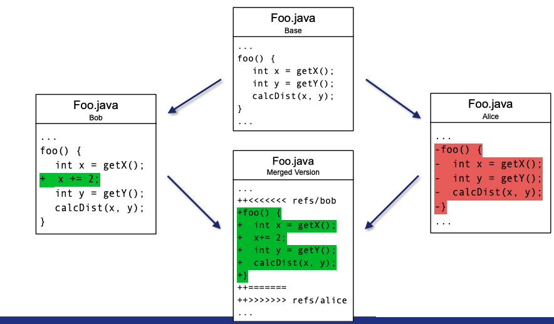
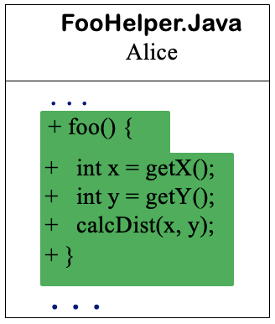
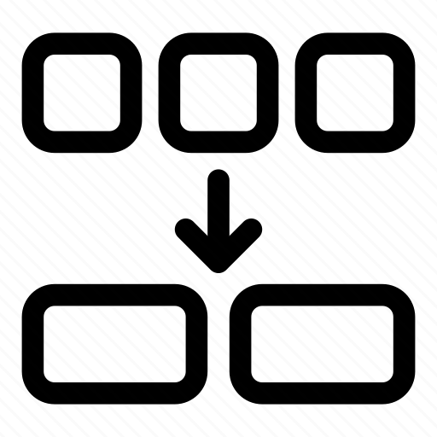
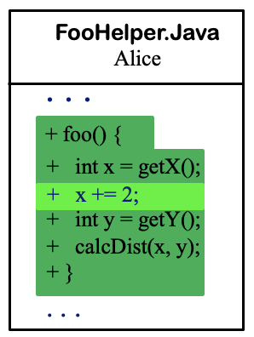
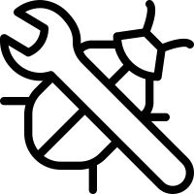
Merge Conflicts - Illustration
Alice
Fork date
Divergent date
Source Variant
Shared commits common codebase
Synchronized commits
Unique commits
cherry-pick and apply to target
Target Variant
Bob
Bob
Notes:
Alice moves function foo() from Foo.java to FooHelper.java, while Bob adds the line x + = 2; to foo’s implementation in its original place in Foo.java. The figure shows the resulting conflict in Foo.java, when Bob tries to merge his code with Alice. As shown, the resulting conflict in Foo.java shows that the whole function is deleted in one branch, but modified in the other; the number of conflicting lines reported is also large (the size of the whole function foo). Given that Bob is not aware that he needs to look at FooHelper.java to understand what happened, he would mistakenly think that this is a complex conflict that would take him lots of time to understand and resolve. In reality, the conflict is actually simple: Alice moved the function (a refactoring operation) while Bob added an extra piece of code to it. A simple resolution would be to add the extra piece of code to the new location of the function.

Slide 10
Refactoring Aware Operation-Based Merging
Detect conflicting regions
Detect evolutionary changes
Detect Refactorings
Detect involved refactorings in the conflicting region

Slide 11
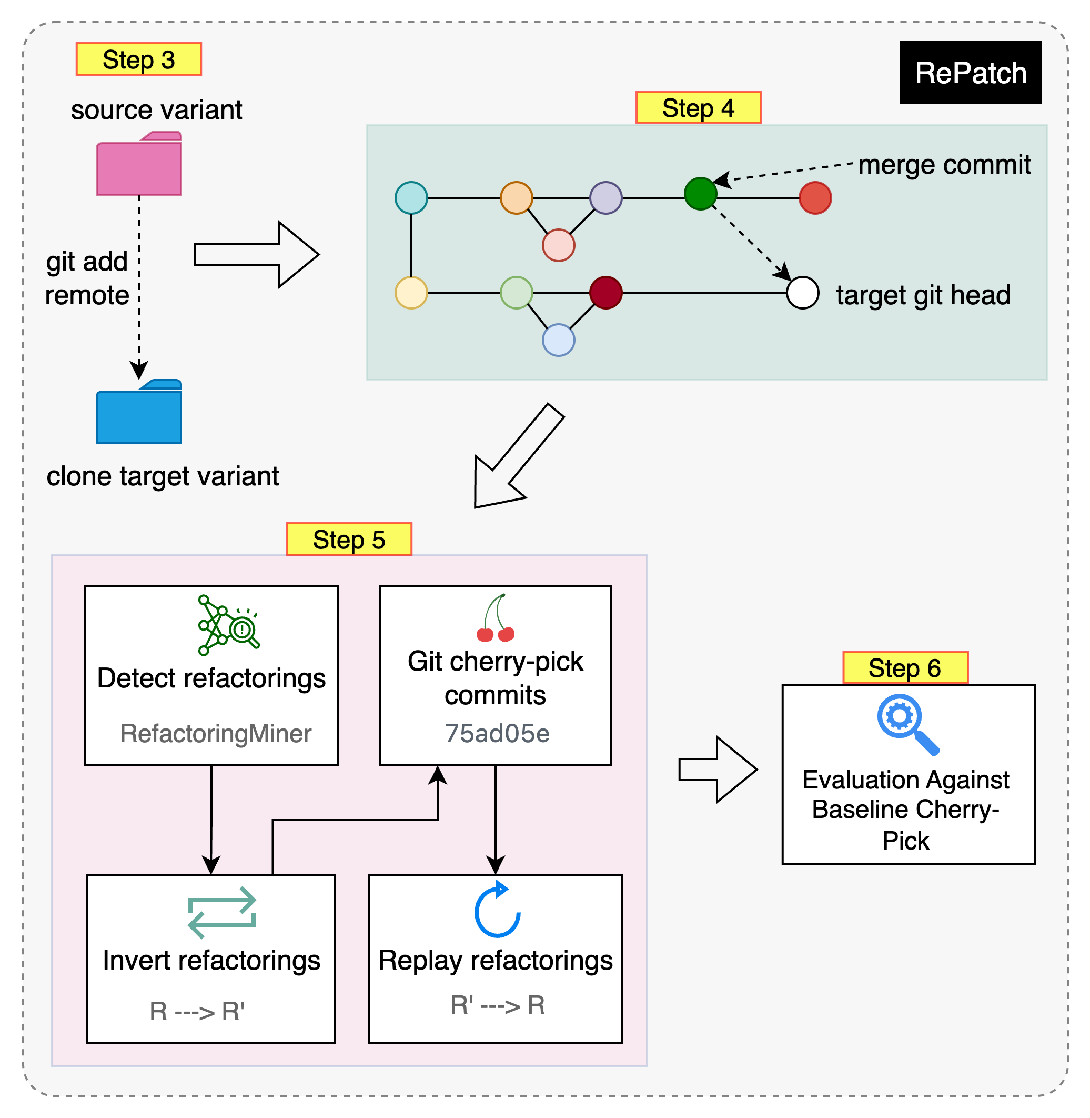
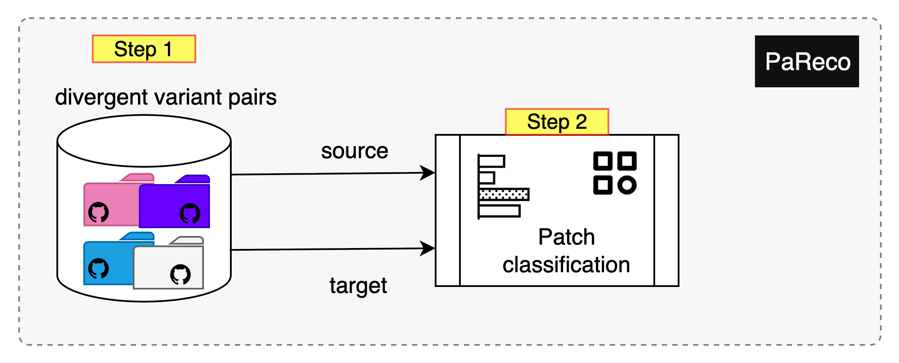
RePatch (Invert → Apply → Replay)
MO Cases
Notes:
Start from PaReco variant‑pair corpus; re‑filter to active as of May 15, 2025.
Focus on Java to leverage refactoring tooling.
14 divergent variant pairs, 478 bug‑fix PRs (merge commits) as integration units.
Notes: Clarify "Missed Opportunities" = bug‑fix present in source, absent/partial in target.
A refactoring‑aware patch integration system for asymmetric (cross‑fork) settings.
Extends RefMerge ideas to commit‑level patch transfer.
Integrates with RefactoringMiner for detection; uses a conflict matrix to order transformations.
1. Identify Missed Opportunities (PaReco).
2. Link repos & cherry‑pick the merge commit (baseline).
3. Detect refactorings in source & target.
4. Invert refactorings to re‑align context.
5. Apply patch → Replay refactorings.
6. Compare to baseline (conflicts, success).
Notes: Visually annotate invert → apply → replay.

Slide 12
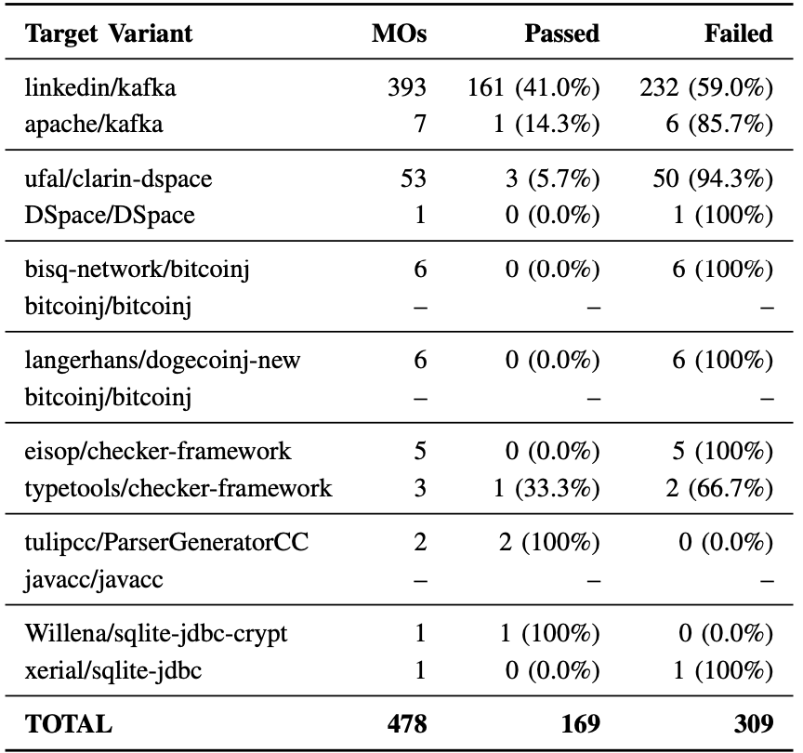
Results – Baseline Outcomes (Git)
RQ1: How often do source variant bug-fix patches fail to apply cleanly to target variants using Git’s cherry-pick?
Cherry‑pick fails in 64.4% of the 478 patches (overall)
Median failure rate across targets: 85.7%
Several projects show 94–100% failure under baseline cherry‑pick
Notes:
Summary of RQ1 Results: The results of RQ1 demonstrate that traditional syntax-based patch integration mechanisms, such as Git’s cherry-pick, are inadequate for reliably propagating bug-fix patches across structurally diverged software variants. High failure rates across multiple projects reflect the compounding effects of semantic drift, architectural changes, and uncoordinated evolution.

Slide 13
Results – Effect of RePatch
RQ3: Can a refactoring-aware integration approach reduce merge conflicts and increase the success rate of applying patches across divergent variants?
On previously failing cases (n≈292 after constraints):
Reduces file‑level conflicts in 53.1% of cases; increases in 1.4%
Reduces line‑level conflicts in 53.8% of cases; increases in 3.4%
Successfully integrates 52.8% of the previously failing patches
Notes:
Summary of RQ3 Results: Out of 292 previously failing patch applications, RePatch reduced file-level merge conflicts in 53.1% of cases and line-level conflicts in 53.8%. In contrast, it introduced new conflicts in only 1.4% and 3.4%, respectively. Overall, RePatch successfully integrated 155 of the 292 failed patches, achieving a resolution rate of 52.8%. These findings show that refactoring-aware integration can substantially improve patch applicability while reducing manual effort and semantic misalignment associated with structural divergence.

Slide 14
Testing After Patch Integration
Why: Ensure the patch works correctly in the target repo, not just that it merged
Focus: Changed hunks + immediate collaborators
Patterns (OORP):
Tests: Your Life Insurance (p.149) – protect against regressions
Grow Your Test Base Incrementally (p.159) – add only tests around the patch
Write Tests to Understand (p.179) – clarify intended behavior
Practical Steps:
Identify patch behavior
Add/adjust unit or integration test
Run suite → confirm all green

Slide 15
The Project
You will use RePatch with the git cherry-pick
You will employ the same approach of mining git logs to extract interesting data for the project.
Let us go to the Lab.

