Slide 1
Software Product Design and Development I
Dr. John Businge
John.businge@unlv.edu
TA: Daniel Ogenrwot
ogenrwot@unlv.nevada.edu
Notes:
Good afternoon dear All
Welcome to the class Software Product Design and Development I.
My name is Dr. John Businge and the professor responsible for this class. I am so exited to be taking you in this class
Attendance is not compulsory. However, it would be nice if you attend you can influence what we are going to discuss and how we are going to discuss it
This class will be physical

Slide 2
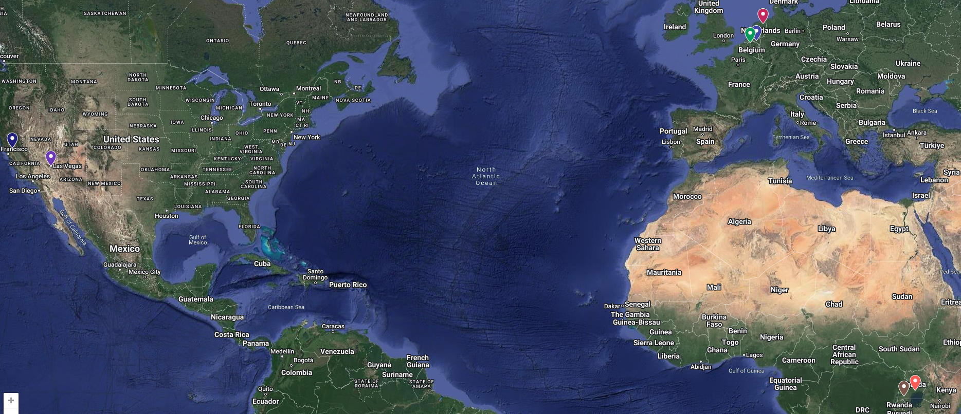
My Journey to UNLV
Notes:
First let me give you a brief about myself

Slide 3
Administration
Background Information survey.
Go to - https://johnxu21.github.io/teaching/CS472/
My Lab - https://unlv-evol.github.io/
Notes:
Let us discuss the boreing stuff about administation.

Slide 4
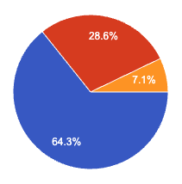
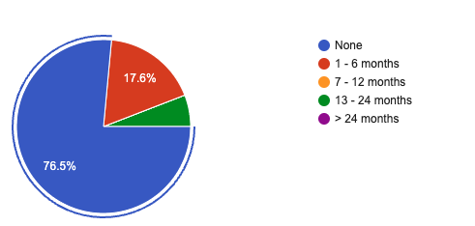
How many months of industry software development experience did you have before the beginning of class 472/672?
Spring 2026
Fall 2025
Notes:
This is the 4th time I am teaching this course.
What this means is that I am still a student of this class and learning to improve in my mistakes.
But at the same time, it is a great opportunity for you to influence how this course is going to look like.
In case you have feedback, please do not wait until the end of the course; Kindy give me the feedback as we go on. If it means giving it to me privately/anonymously, I will be more than happy to receive feedback
This is all I had for the administration. Before I can continue, are there any questions?

Slide 5
Course Goal: Build High-Quality Software Collaboratively
Collaborate as a Team
1
Work effectively with teammates who bring different skills and responsibilities.
Coordinate and Verify Contributions
2
Use GitHub, code reviews, testing, and CI to coordinate work and verify changes.
Design for Shared Development
3
Design software that team members can develop, integrate, and maintain together.
Throughout the course, you will apply these practices to deliver a working MVP.

Slide 6
Course Learning Roadmap
Each stage prepares you to contribute more effectively to the team project.
1
Git and GitHub
Coordinate work through issues, branches, pull requests, reviews, and merges.
2
Software Testing and CI
Write tests and use automated checks to protect software quality.
3
Collaborative Software Design
Use architecture and clear interfaces to support parallel development and integration.
4
Team Project
Apply these practices together to develop, evaluate, and deliver a working MVP.
Instruction → Practice → Application in the team project

Slide 7
One Collaborative Engineering Loop
We will use the following workflow for each meaningful project change.
1
→
2
→
3
→
4
→
5
→
6
ISSUE
DESIGN
BUILD
TEST
REVIEW
MERGE
Define change
Plan impact
Branch + code
Verify behavior
PR + CI
Integrate
MERGE ↻ NEXT ISSUE
Repeat the loop for each meaningful project change.

Slide 8
Teams, Iterative Development, and Design Portfolios
DP I
→
DP II
→
DP III
PLAN THE MVP
BUILD AND TEST
INTEGRATE AND DELIVER
Scope • requirements • architecture
≥3 substantive PRs
≥3 evidence-based reviews
≥3 substantive PRs
≥3 evidence-based reviews
Individual contribution across DP II and DP III
Each member: ≥6 PRs • ≥6 reviews | Quality and relevance matter - not only the count.

Slide 9
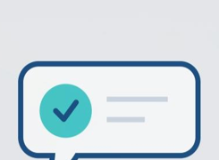
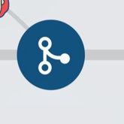

What Is a Minimum Viable Product?
The smallest usable version that addresses a core user need and can be meaningfully evaluated.
For this course, an MVP must satisfy three conditions:
VALUABLE
USABLE
TESTABLE
Addresses an important user need.
Works as an integrated, end-to-end solution.
Produces evidence and feedback for improvement.
Minimum scope—not minimum quality.
Notes:
An MVP is not simply the smallest amount of code a team can produce. It is the smallest version of the product that delivers a useful outcome for a real user or client.
For this course, an MVP must satisfy three conditions.
[Click 1 — Valuable]
First, it must be valuable. It should address an important user or client need. A feature is not valuable merely because it was technically interesting to implement. Ask: Does this solve a real problem for the intended user?
[Click 2 — Usable]
Second, it must be usable. The selected features should work together as an integrated, end-to-end solution. A collection of disconnected screens, isolated components, or unfinished features is not yet a usable MVP. A user should be able to complete at least one meaningful workflow.
[Click 3 — Testable]
Third, it must be testable. The team should be able to evaluate whether the MVP works and whether it meets the intended need. Evidence may come from functional tests, CI results, a working demonstration, and feedback from users or the client. The purpose is to identify what works, what does not, and what should be improved.
[Click 4 — Minimum scope, not minimum quality]
Finally, “minimum” refers to the scope, not the quality. You may deliver fewer features, but the features you select should be integrated, tested, and professionally implemented.
The team should agree on the MVP scope with the client. Feedback may refine priorities and implementation decisions, but substantial scope changes should be discussed and documented with both the client and the instructor.

Slide 10






Build the MVP Through Usable Increments
Example: student assignment portal (a Canvas-like workflow)
COMPONENTS ONLY
→
→
Data store
Service API
Basic interface
Necessary components—but not yet a complete user outcome.
USABLE INCREMENTS
→
→
INCREMENT 1
INCREMENT 2
INCREMENT 3
View assignment
+ due date
Submit work
+ confirmation
Instructor review
+ feedback
Each increment works, provides value, and guides the next decision.
Notes:
Consider a student assignment portal similar to Canvas.
[Click 1 — Components] A database, an API, and an interface are necessary. However, completing these components separately does not yet give the student a useful outcome.
[Click 2 — Components-only message] The student still cannot complete a meaningful task. This is why we should not define progress only by technical layers or the amount of code produced.
[Click 3 — Usable increments] Instead, build the system through usable increments. First, students can view an assignment and its due date. Next, they can submit their work and receive confirmation. Then, the instructor can review the submission and return feedback. Each increment completes a real workflow and extends the previous one.
[Click 4 — Final message] This connects to our MVP definition: each increment provides value, works end to end, and can be tested and evaluated. What matters is not merely completing components, but delivering working outcomes that guide the next decision.

Slide 11
Choose Your Project Pathway
3 teams • 2 pathways • 1 informed decision
CLIENT-SPONSORED PROJECT
TEAM-PROPOSED PROJECT
1
2
Review the client’s precondition report.
Define a meaningful problem and intended users.
Assess the scope, starting point, and constraints.
Prepare the team’s precondition report.
Collaborate with the client throughout development.
Obtain instructor approval before development.
Choose based on the problem, feasibility, and team fit—not only the technology.
Notes:
Students may choose the available client-sponsored project or propose a project of their own.
Before choosing the client project, review its precondition report. It should explain the problem, intended users, existing software and documentation, expected MVP, technology, access requirements, client availability, dependencies, and known risks.
A team-proposed project must complete an equivalent precondition report so that its scope and feasibility can be evaluated using the same standard.
A team-proposed project should identify meaningful intended users and a way to obtain feedback. It is not simply permission to build any preferred technology.
The purpose of the report is to support an informed commitment before the team begins development.

Slide 12
Why Student-Designed Projects Matter
They build ownership, product judgment, and technical leadership.
1
2
3
OWN THE PROBLEM
SHAPE THE PRODUCT
LEAD THE ENGINEERING
Choose a problem the team understands and genuinely wants to solve.
Define the users, requirements, priorities, and an achievable MVP.
Make, justify, and validate the important technical decisions as a team.
Success = a real need + a working product + evidence from users
Notes:
Client projects provide external needs and constraints. Student-designed projects offer a different but equally valuable experience: the team becomes both the product owner and the engineering team.
[Click 1] First, the team owns the problem. Choose something meaningful—not simply an application that is easy to build.
[Click 2] Next, shape the product. Identify real users, prepare the precondition report, define the requirements, and agree on an achievable MVP.
[Click 3] Finally, lead the engineering. The team must make and justify the design, implementation, testing, and integration decisions.
[Click 4] Both project types are judged by the same standard: a valuable, usable, tested product supported by evidence from real users. The difference is where the initial problem and constraints come from.

Slide 13
Why Client Projects Matter
They add authentic needs, constraints, and accountability to the engineering work.
1
2
3
REAL NEEDS
REAL CONSTRAINTS
REAL COLLABORATION
Build for an actual organization and its users.
Work within existing systems, access limits, and deadlines.
Clarify expectations, communicate progress, and respond to feedback.
Success = a working product + a professional client relationship
Notes:
A client project introduces the realities that are difficult to reproduce in a purely classroom-defined assignment.
The team must understand a real problem, negotiate an achievable MVP, and work within the client’s technical and organizational constraints.
Students must communicate professionally: ask clarifying questions, document decisions, report progress, manage access or confidentiality requirements, and respond constructively to feedback.
The client is a stakeholder, not the team’s project manager. Students remain responsible for planning, technical decisions, testing, documentation, and delivery.
A technically functioning system is not sufficient if the team fails to communicate, disregards agreed requirements, or leaves the client unable to use or maintain the result.

Slide 14
Teamwork Challenges Become Project Risks
Recognize these patterns early—before they affect integration and delivery.
1
2
3
4
UNEVEN PARTICIPATION
UNCLEAR OWNERSHIP
LATE INTEGRATION
SILENT PROBLEMS
A few members carry most of the work.
Tasks and dependencies are not clearly assigned.
Changes collide near the deadline.
Risks remain hidden until recovery is difficult.
Make work, ownership, dependencies, and risks visible early.
Notes:
Team difficulties become engineering risks when they remain invisible.
Uneven participation can overload a few students and leave other members without sufficient evidence of contribution.
Unclear ownership leads to duplicated work, missed dependencies, and tasks that everyone assumes someone else will complete.
Late integration produces larger conflicts, rushed reviews, inadequate testing, and unstable demonstrations.
Silent problems include technical blockers, unavailable teammates, client delays, and scope concerns that are reported only when little recovery time remains.
Use issues, assignments, pull requests, reviews, meetings, and written decisions to make the team’s actual state visible.

Slide 15
Do Not Block the Team
Collaborative work depends on timely contributions and timely reviews.
1
2
3
BE READY EARLY
REVIEW PROMPTLY
REASSIGN—DON’T WAIT
Open a complete, review-ready PR at least 24 hours before the deadline.
Complete assigned reviews early enough for authors to respond.
Request another reviewer or review another available PR.
Different timelines, same responsibility
Labs: PR ready ≥24 hours early • Projects: ≥1 meaningful PR each week
GitHub timestamps protect students who are ready on time.
Be ready, communicate, and keep the workflow moving.
Notes:
This policy applies to the Git and GitHub lab, the Testing and CI lab, and the team project.
A review-ready pull request contains the required work, links to its issue, and is not marked as a draft.
The author should open the pull request at least 24 hours before the assignment deadline so that review feedback can be addressed.
Round-robin assignments identify the initial reviewer, not the only possible reviewer.
If the assigned reviewer is unavailable, the author should request another teammate. If the assigned author has no review-ready pull request, the reviewer should review another available pull request.
Notify the instructor or TA before the deadline if no teammate is available.
A student who is ready on time and makes a reasonable effort to obtain a review will not be penalized for another student’s delay. GitHub timestamps provide evidence.
Students who submit late remain responsible for obtaining the required review. Teammates are not required to delay completed work to accommodate a late contribution.

Slide 16
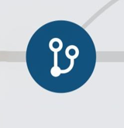
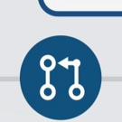

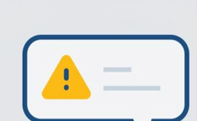
Git and GitHub: A Shared Path from Task to Merge
The workflow makes ownership, progress, and review visible.
ISSUE
BRANCH + COMMITS
PULL REQUEST
REVIEW + MERGE
→
→
→
Agree on the task
and ownership
Develop a focused
change
Explain the change
and request review
Improve it before
it reaches main
The repository becomes the record of collaboration
Issues, commits, PRs, reviews, and merges show how the team worked.
Notes:
Preview the visible path from task definition to reviewed work on main.
Students use the workflow in the lab and later in the team project.
[Sources]
- User-provided Git-and-GitHub.pdf.
- User-provided Git workflow icon examples.

Slide 17
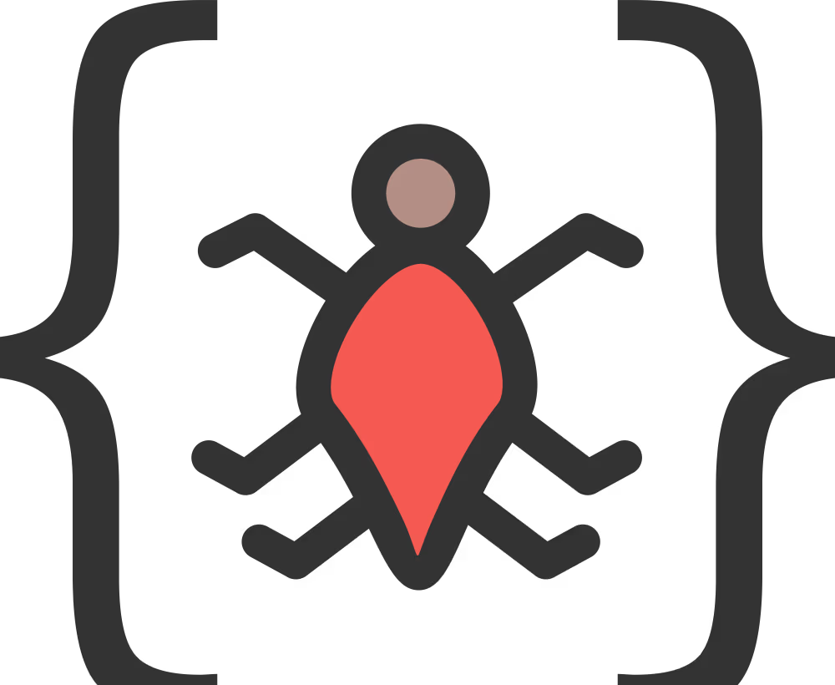
Testing and CI: Three Questions Before We Merge
Each practice provides a different kind of evidence.
DOES IT WORK?
Write tests for expected behavior and important edge cases.
WHAT IS UNTESTED?
Use coverage to find important code the tests do not exercise.
WILL IT STAY CHECKED?
Use CI to run tests and quality checks on every pull request.
A green pipeline supports review
It provides fast feedback, but it does not replace thoughtful review.
Notes:
Tests check behavior; coverage identifies unexercised code; CI automates agreed checks.
Coverage is evidence, not a guarantee of test quality.
[Sources]
- User-provided CS472 - Software Testing.pdf.
- User-provided CS472 - CI - Using GitHub Actions - Setting up workflow.pdf.
- User-provided software testing icon examples.

Slide 18
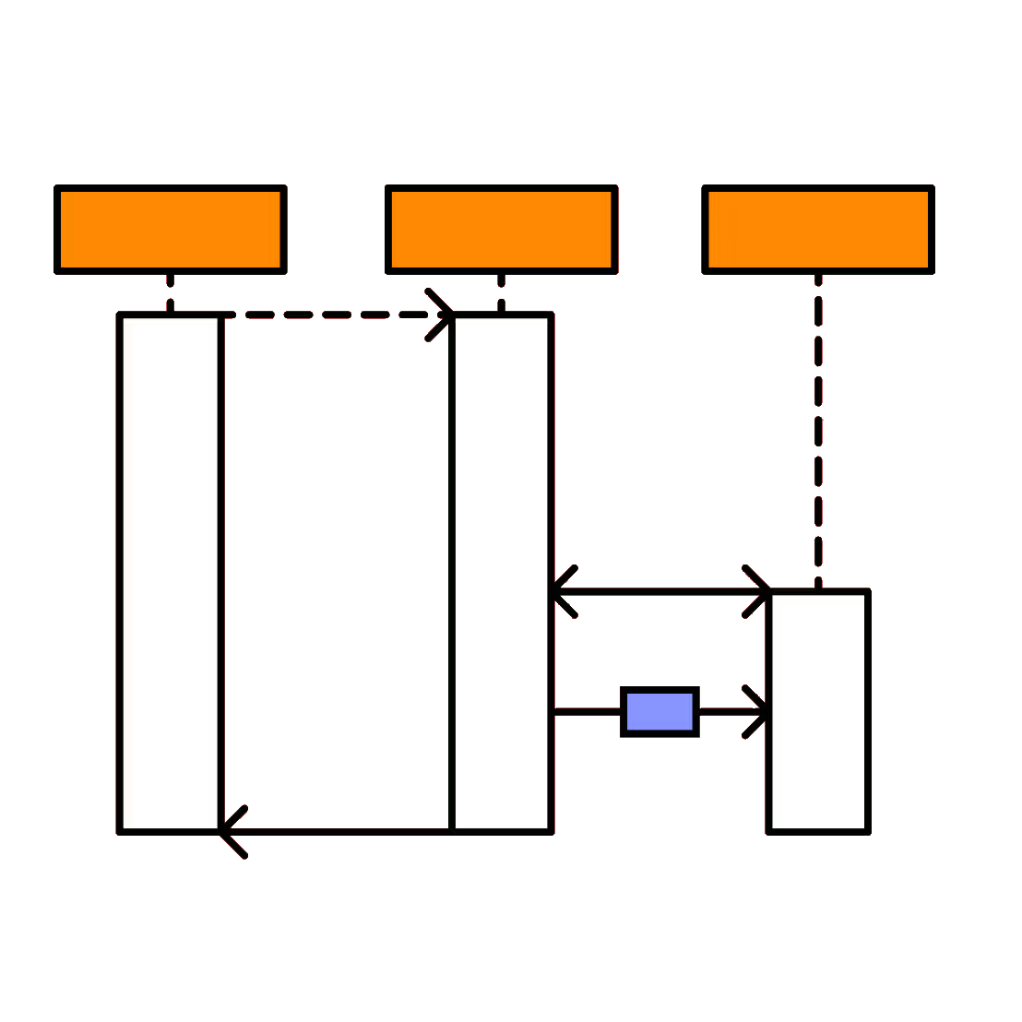
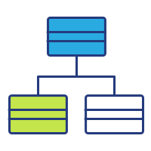
Collaborative Design: Decide What the Change Affects
Use only the design evidence needed to explain the contribution.
STRUCTURE
BEHAVIOR
Are classes, responsibilities, or relationships changing?
Are interactions between objects changing?
Update the relevant class diagram.
Update the relevant sequence diagram.
The PR connects design to implementation
Show the affected part of the system—not the entire system.
Notes:
Structural changes normally need class-diagram evidence; behavioral changes normally need sequence-diagram evidence.
Students should show only the part of the system affected by the PR.
[Sources]
- User-provided OOD-V2.pptx.
- User-provided class and sequence diagram icon examples.

Slide 19
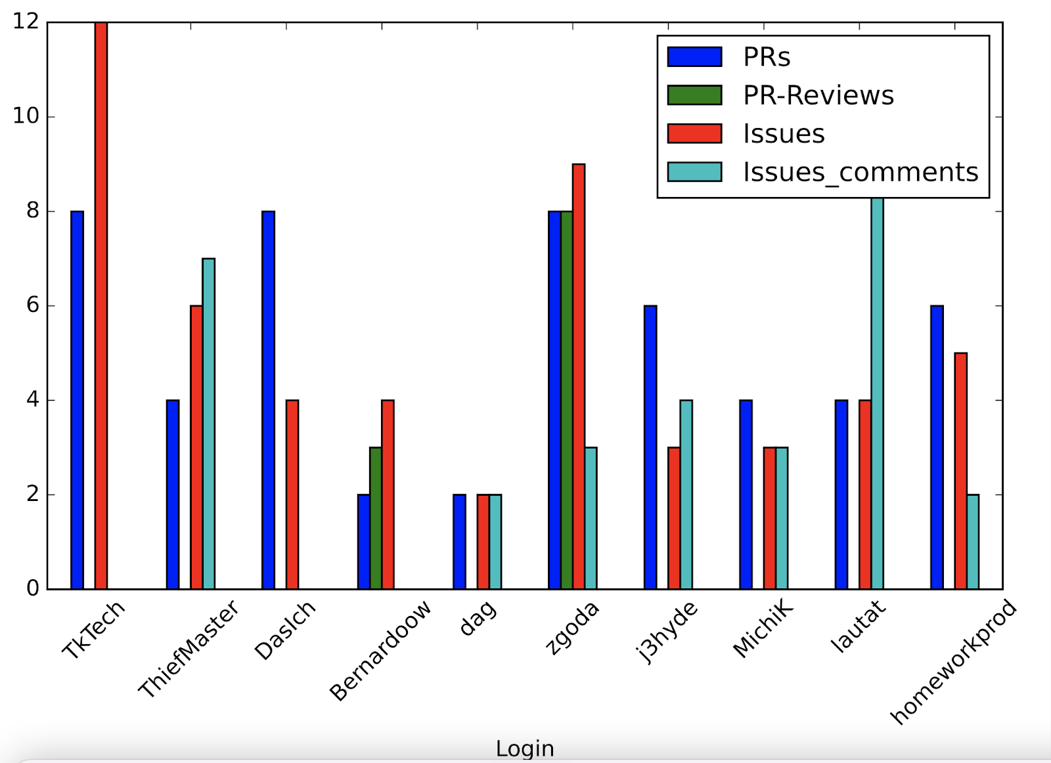
Assessment

Slide 20
A list of previous projects by students
https://github.com/orgs/UNLV-CS472-672/repositories?type=all

Slide 21


