Slide 1


Software Reengineering CS 789
John Businge
http://scg.unibe.ch/download/oorp/
Notes:
PUT SLIDE ON while people are entering the room
INTRODUCE MYSELF
…
INTRODUCE co-authors
…
INTRODUCE YOURSELVES
How many people have reengineered an OO System ? A non OO system migrated to an old one? How many of you expect to reengineer in the near future? How large was it? 100KLOC – 500KLOC – 1MLOC
How many have experience with C - C++ - Java - Smalltalk ---> NO PROGRAMMING EXPERIENCE?
How many people understand UML class diagrams --> DO NOT UNDERSTAND UML
How many people know REFACTORING? Who knows what EXTRACT METHOD is? (Can you explain that to me ?)

Slide 2

2nd
Time
Notes:
This is the first time I am teaching this course.
What this means is that there will be some problems since I am still learning
But at the same time, it is a great opportunity for you to influence how this course is going to look like. Your influence is extremely valuable in terms of what we are talking about and how we are talking about it, also in the years to come.
In case you have feedback, please do not wait until the end of the course; Kindy give me the feedback as we go on. If it means giving it to me privately/anonymously, I will be more than happy to receive feedback

Slide 3
Overview of the Class
https://johnxu21.github.io/teaching/Software-Reengineering/?
My Lab Research - https://unlv-evol.github.io/

Slide 4

Schedule
1. Introduction
Software changes and that requires planning
2. Reverse Engineering
How to understand your code
3. Visualization
Scalable approach
4. Restructuring
How to Refactor Your Code
5. Dynamic Analysis (& Testing)
To be really certain
5. Code Integration
How to resolve conflicts
7. Mining Software Repositories
Learn from the past
8. Conclusion
Notes:
Here is the overall time schedule that we PLAN for this afternoon/morning.
However, we want to CUSTOMISE this a bit depending on your INTEREST
How many of you want to CONVINCE THEIR MANAGERS/COLLEAGUES that their system should be re-engineered?
How many of you have REGRESSION TESTS in place? How adequate is your TEST PROCEDURE?
How many of you have INFERIOR OBJECT-ORIENTED DESIGN sneaking in their code ?
How many of you have submitted a PULL REQUEST to any system?

Slide 5
Goals
We will try to convince you:
Programs change!
Reverse engineering, forward engineering and reengineering are essential activities in the lifecycle of any successful software system. (And especially OO ones!)
There is a large set of lightweight tools and techniques to help you with reengineering.
Despite these tools and techniques, people must do job and they represent the most valuable resource.
Notes:
For this presentation, we set out some goals
We want to convince you that because of various reasons. WE WILL LEARN ABOUT WHY PROGRAMS CHANGE
In fact, we want to go one step further, and we will even try to convince you that REENGINEERING (and REVERSE ENGINEERING) are essential activities, hence essential skills that should be taught to professional software engineers.
[WHICH BRINGS US TO THE 3RD BULLET] If you accept that it is an essential skill, you should be able to collect some PRINCIPLES, TECHNIQUES, METHODOLOGY and TOOLS to support practitioners. Moreover, you should be able to collect it in such a form that can be TAUGHT TO STUDENTS AND PROFESSIONALS. That’s precisely what OOP book tells about. And today, we’re going to pick a few of these techniques and
While doing this will emphasize two points
A) reengineering a project may seam difficult at first, however, there is a large set of LIGHTWEIGHT TOOLS and TECHNIQUES
B) Despite these tools and techniques, PEOPLE MUST DO THE JOB and they represent the most valuable resource.

Slide 6

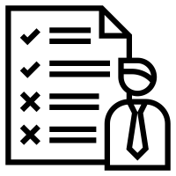


Program Change
Branch
Mainline
Social Fork
Pull request
Notes:
Programs change. You find bugs, and you fix them. You discover a new requirement, and you add a feature.
[TALK ABOUT THE PICTURE] HERE IS A SIMPLE ILLUSTRATION OF A PROGRAM CHANGE.
A requirement changes because users demand it; you revise a feature.
The simple fact about programs is that they’re rarely stable but rather constantly changing, living artifacts that shift as much as our social worlds shift.
The apps on our phones are constantly being updated to improve our experiences, while the websites we visit potentially change every time we visit them, without us noticing.

Slide 7
Software Maintenance - Cost
Relative Cost
of Fixing Mistakes
Relative Maintenance Effort
Between 50% and 75% of global effort is spent on “maintenance” !
x 200
x 20
x 10
Solution ?
Better requirements engineering?
Better software methods & tools (database schemas, CASE-tools, objects, components, …)?
x 5
x 1
requirement
coding
delivery
design
testing
Notes:
MANAGGING CHANGE is a problem, here are some numbers to illustrate how SEVERE THE PROBLEM IS
Several empirical surveys dating from the SEVENTIES AND EIGHTIES have shown that MORE THAN HALF OF THE TOTAL SOFTWARE BUDGET is spent during maintenance. (point to TOP LEFT CORNER).
These observations are typically explained by means of a diagram looking like this (POINT TO RIGHT)
The idea is that maintenance is seen as fixing mistakes and the LONGER YOU WAIT with fixing those mistakes, the MORE COSTLY it becomes
Actually, if you look at the kind of PROGRESS we made in software engineering TECHNOLOGY, you can see that we actually tried to tackle this phenomenon.
A) First of all, we invested a lot in better REQUIREMENTS ENGINEERING, to make sure that we discover potential “mistakes” much earlier. If you look at USE-CASES and CRC-Cards, for instance, to whole idea is to separate the STABLE requirements from the UNSTABLE ones, focussing on the STABLE ones, and as such try to prevent that we will have to fix things afterwards.
B) Also, we invested a lot in BETTER TOOLS AND TECHNIQUES so that it becomes easier to change software artefacts once they are in the field. Modern Relational Databases for instance, allow you to modify the schema of a database while it is up and running, plug-and-play components allow you to download new versions over the internet
SO WHAT DID THIS GAIN US ? Well, let’s study the impact of both a little bit further.

Slide 8
Continuous Development
data from [Lien78a]
17.4% Corrective
(fixing reported errors)
60.3% Perfective
(new functionality)
18.2% Adaptive
(new platforms or OS)
4.1% Other
The bulk of the maintenance cost is due to new functionality
⇒ even with better requirements, it is hard to predict new functions
Notes:
Well, better requirements engineering indeed helped to identify stable ground in the muddle of CHANGING REQUIREMENTS.
Unfortunately, an empirical survey done by Lientz and Swanson revealed that the majority of changes requested have to do with EXTRA FUNCTIONALITY.
That’s why modern requirements engineering tries to define SCENARIOs FOR FUTURE EXTENSIONS so that the designers can accommodate their designs. That’s why we try to define good DOMAIN MODELS, so that most of the changes will fit our design.
Unfortunately, no matter how good our requirements engineering, we will never be able TO PREDICT THE FUTURE
Therefore, there will always be changes that DO NOT FIT OUR ORIGINAL DESIGN, and depending on our problem domain this may be quite a lot.
By the way, that’s one of the reasons why AGILE DEVELOPMENT METHODS are so popular nowadays. They observed that for certain problem domains you cannot make good predictions about the 60% perfective maintenance here (POINT TO SLIDE). When that’s the case, its useless to invest in a good design because you don’t know which variation points to build into your design. Half of the time, you will guess wrong and then you lose twice – once for creating a variation point you didn’t use, and once for extending the design with a new variation point.

Slide 9
Lehman's Laws
A classic study by Lehman and Belady [Lehm85a] identified several “laws” of system change.
Continuing change
A program that is used in a real-world environment must change, or become progressively less useful in that environment.
Increasing complexity
As a program evolves, it becomes more complex, and extra resources are needed to preserve and simplify its structure.
Those laws are still applicable…
Notes:
The big conclusion we can derive from this as that we are STUCK
The worst thing that can happen to a software system is that IT ACTUALLY GETS USED.
Because if your system is used, USERS WILL ASK YOU TO ADAPT
And because end-users are VERY CREATIVE in finding new ways of using your software, you will end up adding features which were never expected
And because you did not expect it, adding these will PROBABLY DESTROY YOUR INITIAL GOOD DESIGN
This observation isn't new. Already in the early 80's, Manny Lehman observed the way the IBM Operating system 760 evolved
… and derived 7 LAWS OF SOFTWARE EVOLUTION
Two of them are particularly RELEVANT IN A REENGINEERING CONTEXT
… (READ SLIDE)
Since then, these laws have been validated against a number of INDUSTRIAL CASES
and shown that they are STILL APPLICABLE
… however, open source development seems to be able to ESCAPE THE EXTRA COMPLEXITY, probably because they spend the extra resources to simplify the structure.

Slide 10
The Reengineering Life-Cycle
(0) requirement
analysis
Requirements
(2) problem
detection
(3) problem
resolution
Designs
people centric
lightweight
New Feature
(1) model
capture
Code
(4) program transformation
Notes:
To tackle these problems, you need some kind of GENERIC REENGINEERING PROCESS
Here is the one that we propose, WHICH WE WILL USE TROUGHOUT THIS TALK
Note that you should see this as a way to describe the various activities that take place during a project, but not necessarily a STRICT ORDER ON when these activities must take place.
(0) Requirement analysis: analyse on WHICH PARTS OF YOUR REQUIREMENTS HAVE TO BE CHANGED – feature or patch?
Model capture: REVERSE ENGINEER from the source-code into a MORE ABSTRACT FORM, typically some form of a design model. How abstract depends on the kind of problem you want to solve.
problem detection: IDENTIFY DESIGN PROBLEMS in that abstract model
problem resolution: PROPOSE AN ALTERNATIVE DESIGN that will solve the identified problem
program transformations: MAKE THE NECESSARY CHANGES TO THE CODE, so that it adheres to the new design YET PRESERVES ALL THE REQUIED FUNCTIONALITY Here TESTING will play an important role
In the REMAINDER OF THE TALK, we will use this picture to ILLUSTRATE WHERE the various techniques and tools FIT IN.
While doing that, we will emphasize the role of THE HUMAN IN THE LOOP, because we believe that reengineering is a very PEOPLE CENTRIC activity.
Also, we will show some lightweight techniques and tools, because we experienced that you can achieve quite a lot with rather inexpensive technology.

Slide 11
A Map of Reengineering Patterns
Tests: Your Life Insurance
Detailed Model Capture
Migration Strategies
Initial Understanding
Detecting Duplicated Code
Redistribute Responsibilities
First Contact
Organized according to Reengineering lifecycle
Transform Conditionals to Polymorphism
Setting Direction
Notes:
The patterns in this book are organized according to the reengineering lifecycle presented earlier.
The figure is an overview of how the chapters in this book are represented as clusters of patterns along the lifecycle. The diagram suggests that the patterns may be applied in sequence.
Though this may well be the case, in practice you are more likely to iterate between reverse engineering and reengineering tasks.
It may be a useful way to keep track of the different software engineering activities and their relationships, even though we know that they are not carried out sequentially but iteratively.
1. For example, Setting Direction contains several patterns to help you determine where to focus your reengineering efforts and make sure you stay on track.
2. First Contact: consists of a set of patterns that may be useful when you encounter a legacy system for the first time.
3. Initial Understanding helps you to develop a first simple model of a legacy system, mainly in the form of class diagrams.
4. Detailed Model Capture helps you to develop a more detailed model of a particular component of the system.

Slide 12

2. Reverse Engineering
What and Why
First Contact
Interview during Demo
Initial Understanding

Slide 13
What and Why ?
Definition
Reverse Engineering is the process of analysing a subject system
to identify the system’s components and their interrelationships and
create representations of the system in another form or at a higher level of abstraction. — Chikofsky & Cross, ’90
Motivation
Understanding other people’s code
(cfr. newcomers in the team, code reviewing,
original developers left, ...)
Generating UML diagrams is NOT reverse engineering
... but it is a valuable support tool

Slide 14
The Reengineering Life-Cycle
(0) requirement
analysis
Requirements
(2) problem
detection
(3) problem
resolution
(0) req. analysis
(1) model capture
issues
scale
speed
accuracy
politics
Designs
(1) model
capture
New Feature
Code
(4) program transformation

Slide 15
First Contact
feasibility assessment
(one week time)
System experts
Talk with developers
Talk with
end users
Chat with the Maintainers
Interview during Demo
Talk about it
Software System
Verify what you hear
Read it
Read about it
Compile it
Read All the Code
in One Hour
Skim the Documentation
Do a Mock Installation

Slide 16
Interview during Demo
Problem: What are the typical usage scenarios?
Solution: Ask the user!
... however
Which user ?
Users complain
What should you ask ?
Solution: interview during demo
select several users
demo puts a user in a positive mindset
demo steers the interview

Slide 17
Initial Understanding
Top down
Recover design
Speculate about Design
software
visualisation
understand ⇒
higher-level model
ITERATION
Analyze the Persistent Data
Study the Exceptional Entities
Recover database
Identify problems
Bottom up

Slide 18
3. Software Visualization
Introduction
The Reengineering life-cycle
Examples
Lightweight Approaches
tooling

Slide 19
The Reengineering Life-cycle
(0) requirement
analysis
Requirements
(2) problem
detection
(3) problem
resolution
Designs
(2) problem detection
issues
Tool support
Scalability
Efficiency
(1) model
capture
New Feature
Code
(4) program transformation
Notes:
If tools lack support → you can’t apply them widely.
If they don’t scale → they collapse on real-world systems.
If they’re inefficient - fast → nobody uses them in iterative cycles.

Slide 20
UML Diagrams
(Mostly) Simple and Standard Way to present an abstract visualization of a system
UML defines 14 diagrams
Useful to plan and design the reengineering project
You will be using UML diagrams to show the system before and after the change

Slide 21
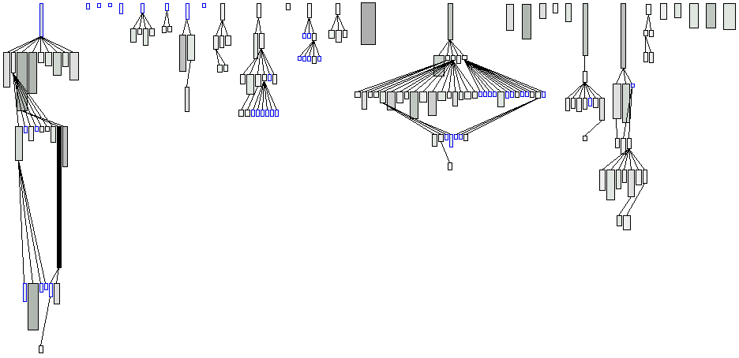
System Complexity View
Nodes: Classes
Edges: Inheritance Relationships
Width: Number of attributes
Height: Number of methods
Color: Number of lines of code
Notes:
First of them is the system complexity view
There are some red flags

Slide 22
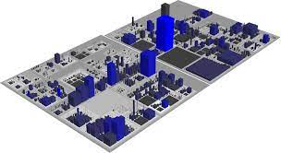
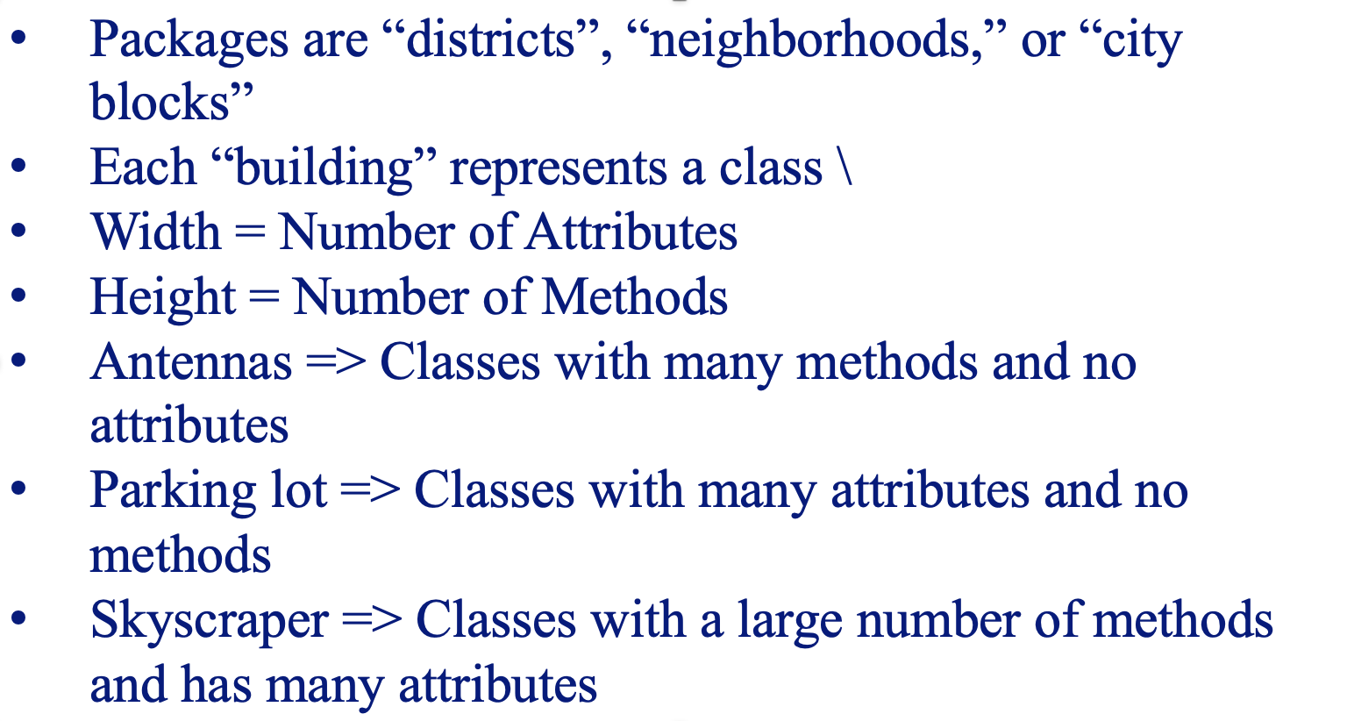
Code City
CodeCity is a visualization concept for source code.
The source code is shown as an interactive 3D city.
Notes:
Explanation of the blocks on the next slide

Slide 23
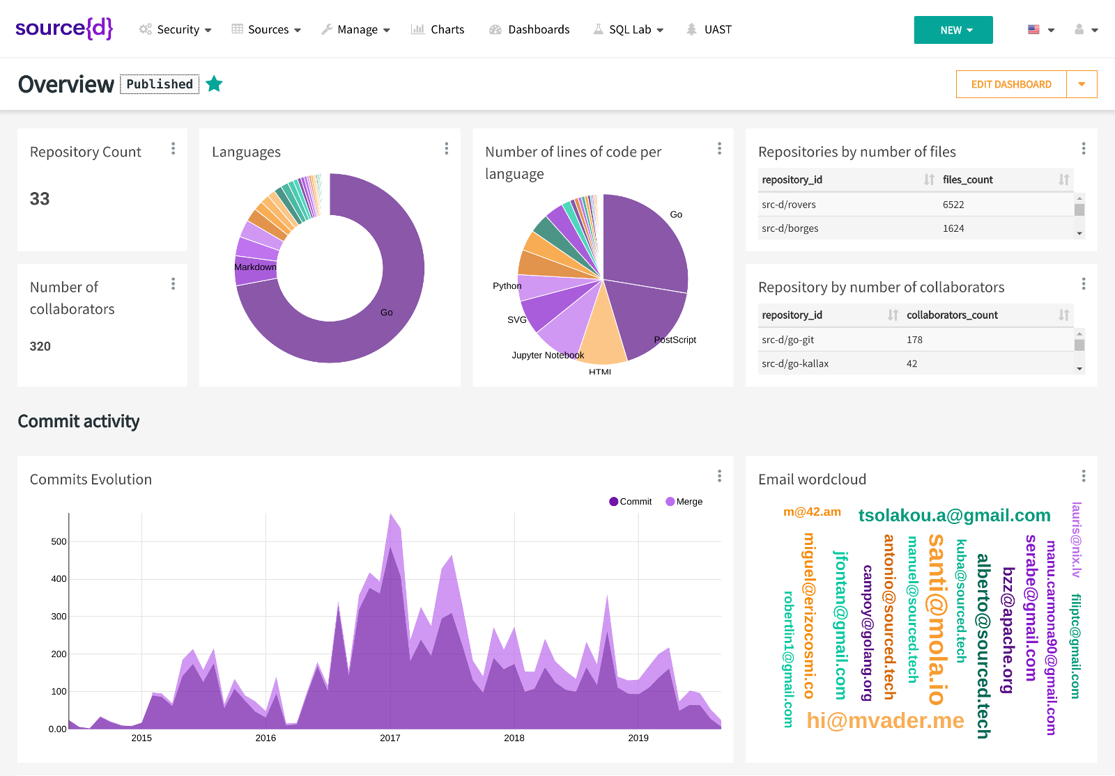
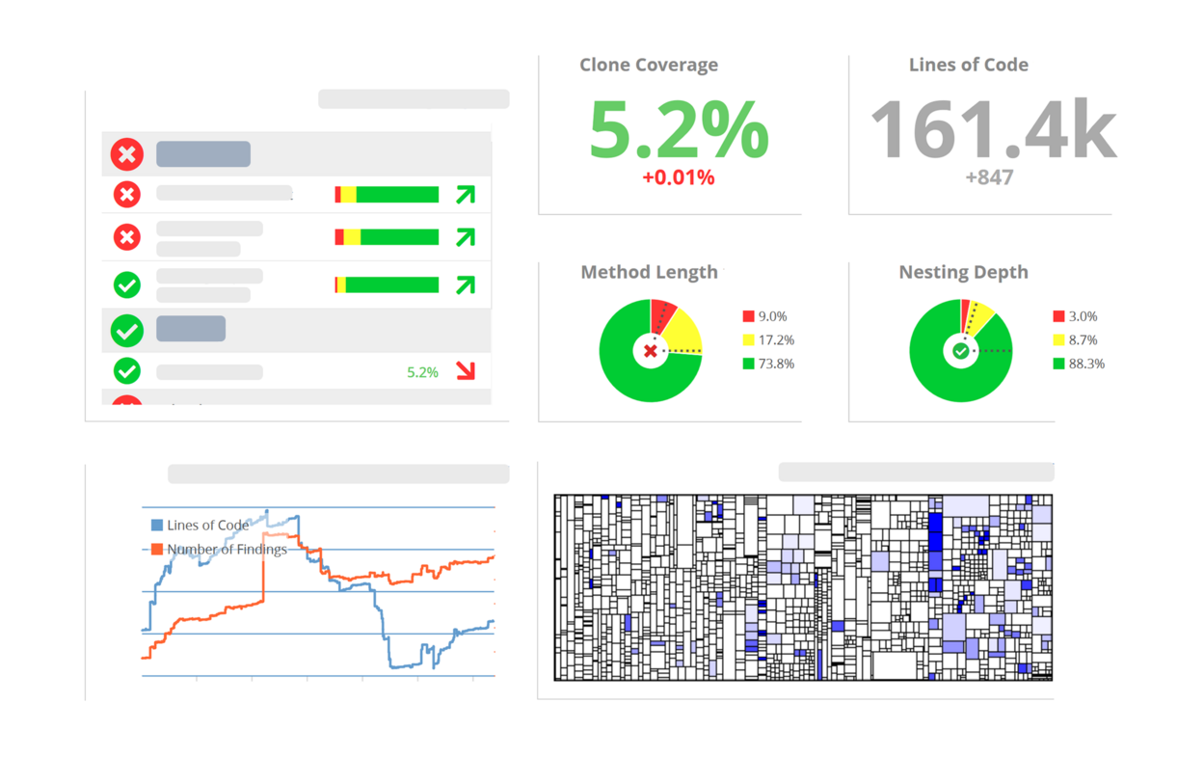
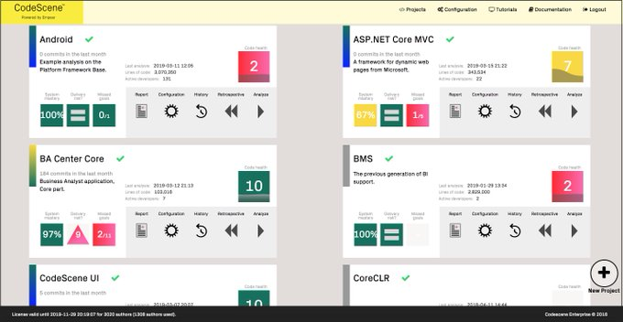
State of the Art Tooling
1. source{d}
https://sourced.tech
https://github.com/src-d/engine
2. teamscale
https://www.cqse.eu/
https://github.com/cqse
3. codescene
https://codescene.io
https://github.com/empear-analytics

Slide 24
4. Restructuring
Identifying refactoring targets
Redistribute Responsibilities
Move Behaviour Close to Data
Eliminate Navigation Code
Split up God Class
Empirical Validation
Identifying refactorings in code
Refactoring-aware techniques
Notes:
REFACTORING is a very common practice that helps developers to complete maintenance tasks (i.e., implement new features and fix bugs), and eliminate various design and code smells
Despite the benefits, in some contexts, refactoring is perceived as change noise, which makes more difficult the completion of various software evolution related tasks.
For instance, refactoring operations can cause merge conflicts when merging development branches
cause breaking changes to clients of libraries and frameworks
cause unnecessary test executions for behavior-preserving changes

Slide 25
The Reengineering Life-cycle
(0) requirement
analysis
Requirements
(2) problem
detection
(3) problem
resolution
Designs
(3) problem resolution
Issues
Correctness
Maintainability
Risk of regression
Consistency
Effort vs payoff
(1) model
capture
New Feature
Code
(4) program transformation
Notes:
Correctness – ensuring that fixes and restructurings do not break existing functionality.
Maintainability – balancing short-term fixes with long-term code health.
Consistency – avoiding divergence between design and implementation, or across multiple forks/variants.
Risk of regression – resolving problems without introducing new bugs elsewhere.
Effort vs. payoff – not all problems are equally worth solving; prioritization matters.

Slide 26
Redistribute Responsibilities
Identifying Refactoring Targets
Monster client of data containers
Chains of
data containers
Split Up God Class
Eliminate Navigation Code
Data containers
Move Behaviour Close to Data
Notes:
This cluster deals with problems of misplaced responsibilities.
The two extreme cases are
Data containers, classes that are nothing but glorified data structures and have almost no identifiable responsibilities, and
God classes, procedural monsters that assume too many responsibilities.

Slide 27
Split Up God Class
Problem: Break a class which monopolizes control?
Solution: Incrementally eliminate navigation code
Detection:
measuring size
class names containing Manager, System, Root, Controller
the class that all maintainers are avoiding
How:
move behaviour close to data + eliminate navigation code
remove or deprecate façade
However:
If God Class is stable, then don't split ⇒ shield client classes from the god class
Notes:
A god class may be recognized in various ways:
a single huge class treats many other classes as data structures.
a “root” class or other huge class has a name containing words like “System”, “Subsystem”, “Manager”, “Driver”, or “Controller”.
changes to the system always result in changes to the same class.
changes to the class are extremely difficult because you cannot identify which parts of the class they affect.
reusing the class is nearly impossible because it covers too many design concerns.

Slide 28
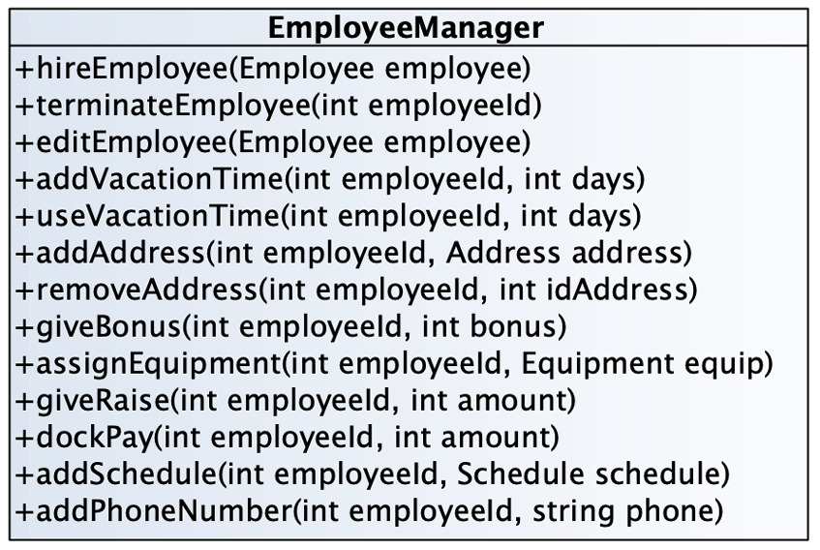
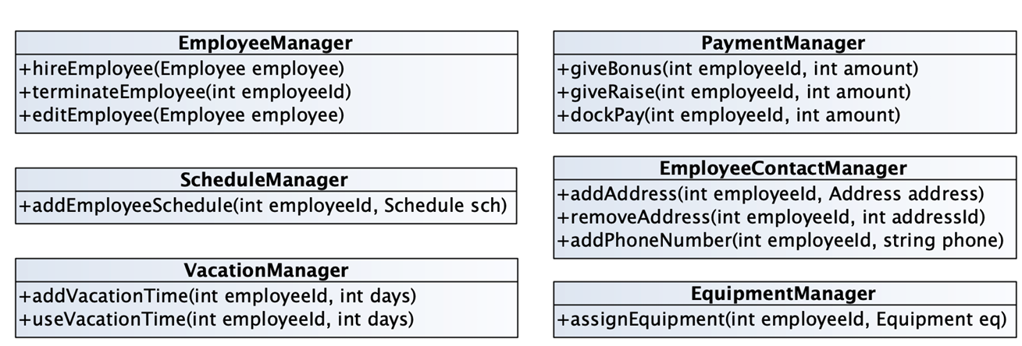
Split Up God Class
Notes:
This problem is difficult because:
By assuming too many responsibilities, a god class monopolizes control of an application. Evolution of the application is difficult because nearly every change touches this class, and affects multiple responsibilities.
It is difficult to understand the different abstractions that are intermixed in a god class. Most of the data of the multiple abstractions are accessed from different places.
Identifying where to change a feature without impacting the other functionality or other objects in the system is difficult. Moreover, changes in other objects are likely to impact the god class, thus hampering the evolution of the system.
It is nearly impossible to change a part of the behavior of a god class in a black-box way.

Slide 29
6. Dynamic Analysis (& Testing)
Key Concept Identification
Unit testing
Test coverage
Mutation testing
Notes:
I Will introduce some key concepts

Slide 30
Introduction
Dynamic Analysis verifies properties of a system during execution
Testing Analysis is one example of Dynamic Analysis
Unit tests, integration tests, system tests, and acceptance tests use dynamic testing
Notes:
In the dynamic analysis, we verify properties during the execution of the system. There are many forms of dynamic analysis. One of them is testing

Slide 31
Testing
Tests are your life insurance! (OORP, p. 149)
Tests are essential to assure the quality of refactoring activities.
Write Tests to Enable Evolution (OORP, p.153)
Good tests can find bugs on your artifact
Tests can also detect unwanted behavior
You can also write tests to understand a part of a system (OORP, p.179)

Slide 32
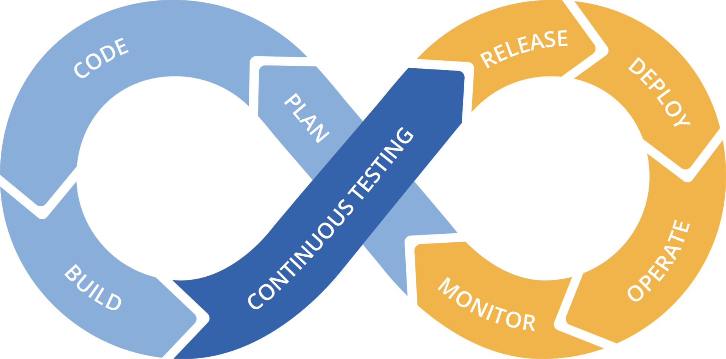
Regression Testing
A type of change-related testing to detect whether defects have been introduced or uncovered in unchanged areas of the software.

Slide 33
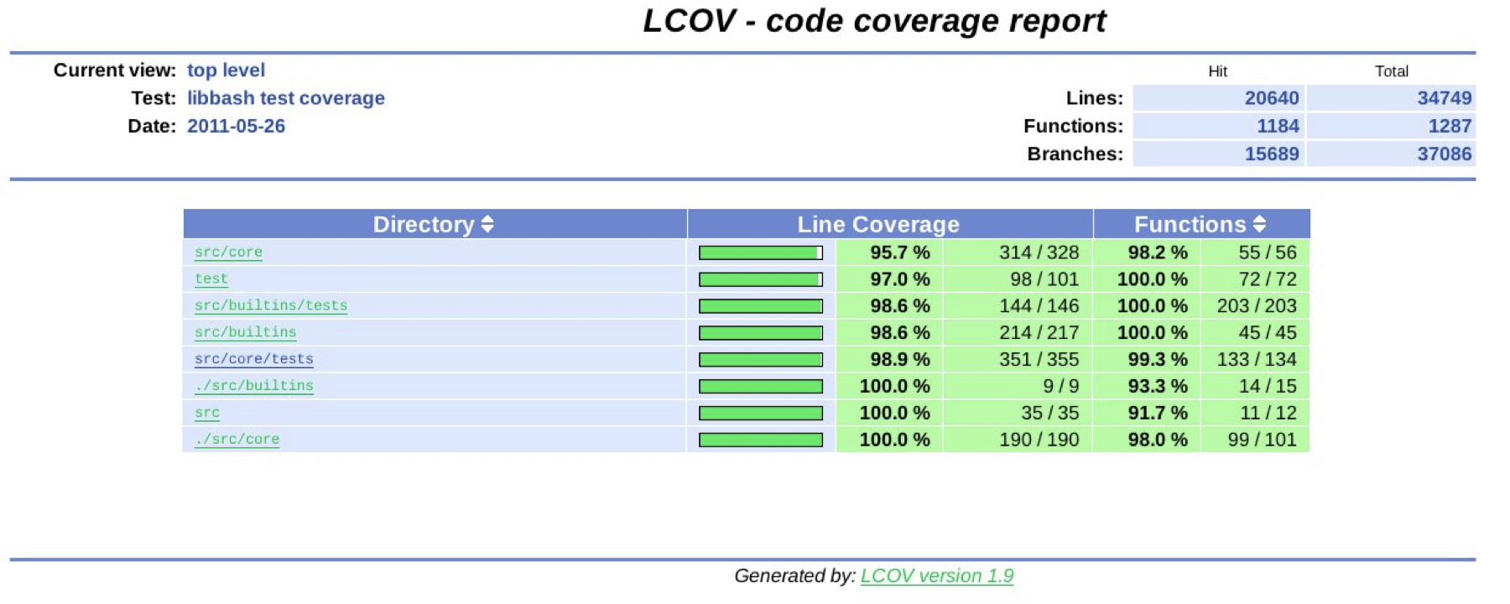
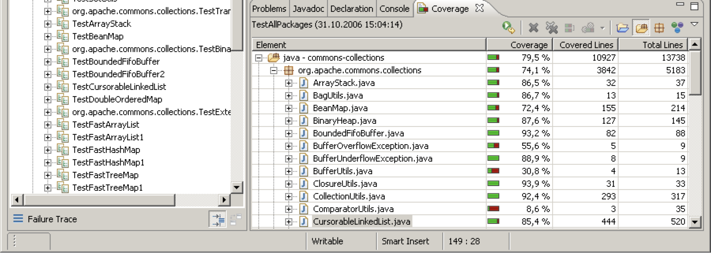
Coverage
Are the areas under change sufficiently covered by the current test suite?
Compare coverage reports before and after refactoring!

Slide 34
5. Code integration
Version Control Systems
Branching
Merging/integration
Merge conflicts

Slide 35
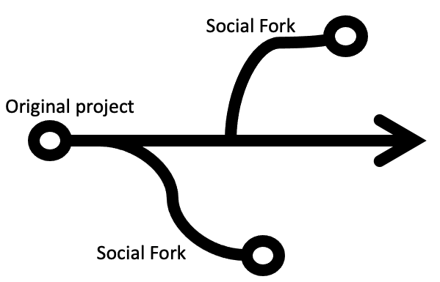
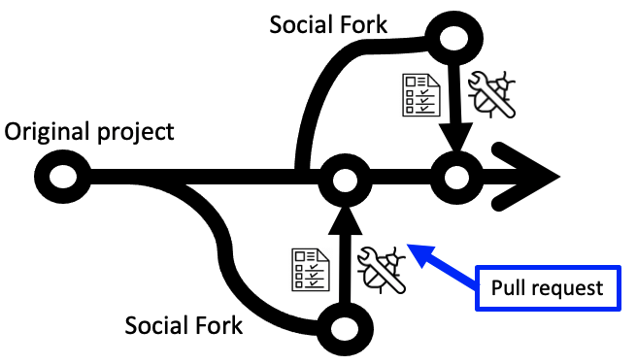
The Reengineering Life-Cycle
(0) requirement
analysis
Requirements
(2) problem
detection
(0) Clone&nwn
(3) problem
resolution
Designs
(4) Code Integration
issues
Conflicting changes
New Feature
(1) model
capture
(4) integration
Code
(4) program transformation
Notes:
The book was published in 2002. If there were publishing new editions, I would suggest two additions
Brancing
Code integration

Slide 36
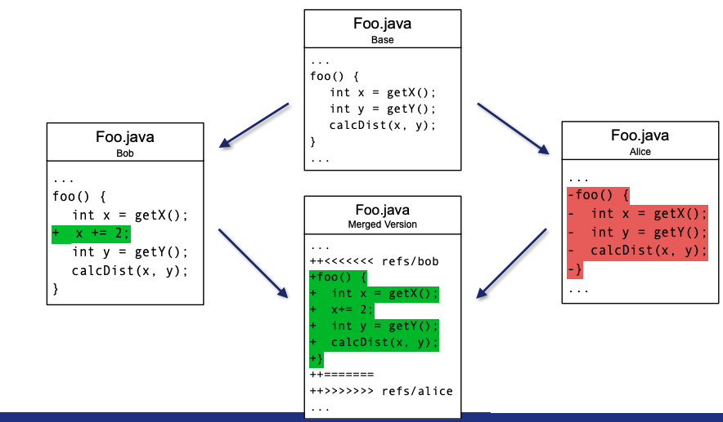
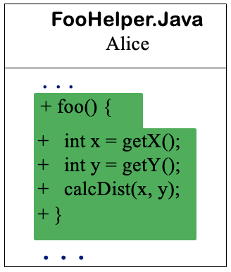
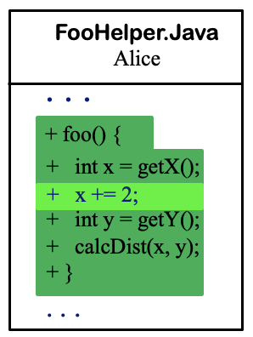

Code Integration
Bob
Mainline
Bob
Alice
The key lesson is that the size of a textual conflict does not always reflect its conceptual complexity. Understanding the intent behind each change makes the conflict easier to resolve.
Notes:
Both Alice and Bob begin with foo() in Foo.java. Alice refactors the code by moving the method to FooHelper.java. Meanwhile, Bob modifies the original method in Foo.java by adding x += 2;.
When their changes are integrated, Git sees that Alice deleted the method from Foo.java while Bob modified it there. Because Git compares lines rather than understanding the refactoring, it reports what appears to be a large conflict involving the entire method.
The conflict looks complex, but its underlying cause is simple: one developer moved the method while another edited it. The appropriate resolution is to preserve Alice’s move and apply Bob’s added statement to foo() in FooHelper.java. The team should then verify affected references and run the tests.
The key lesson is that the size of a textual conflict does not always reflect its conceptual complexity. Understanding the intent behind each change makes the conflict easier to resolve.

Slide 37
Refactoring-Aware Techniques
Many refactoring-aware techniques:
IntelliMerge & Refmerge – merge branches
APIDiff – adapt client software to library and framework updates
RePatch - Ogenrwot and Businge (SCAM 2025)
All developed in the presence of refactoring operations.
Notes:
Some tooling to help with refactoring

Slide 38
Code Integration
Compare Code Mechanically (OORP, p.227)
Begins with mechanical comparison of patches across repositories
Detecting Duplicated Code (OORP, p.223)
Identifying a reusable patch between branches is a duplicate detection problem
Most Valuable First (OORP, p.29)
Not every patch can or should be integrated.
Write Tests to Understand (OORP, p.179)
When the intent of an integrated patch is unclear, write a focused test to document and explore its behavior.
Tests: Your Life Insurance (OORP, p.149)
After integration, run or extend tests to ensure functional behavior holds in the target.

Slide 39

7. Mining Software Repositories (MSR)
What are software repositories?
Why should we mine Software repositories?
What are some of the data sources of software engineering data?
What are some of the existing tools we can use to mine software engineering data
What can we learn from MSR

Slide 40
The Reengineering Life-Cycle
(0) requirement
analysis
Requirements
(2) problem
detection
(3) problem
resolution
Designs
(5) Mining Software
Repositories
issues
Mining the history
Who did what
(1) model
capture
New Feature
(4) integration
Code
(4) program transformation

Slide 41
What is a Software Repository?
Artifacts produced and archived during software development
Technical artifacts
Social artifacts

Slide 42


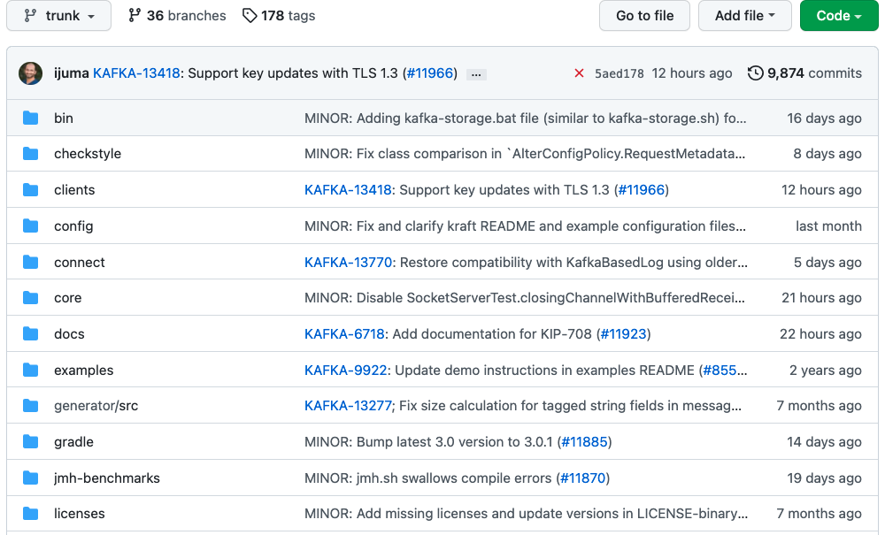



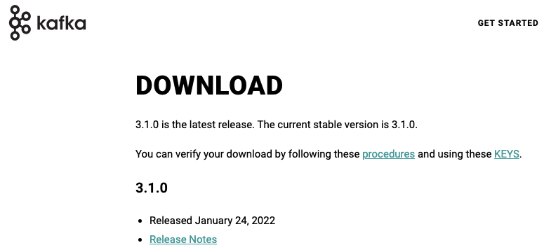
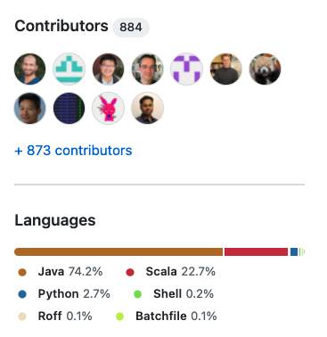
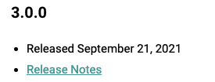
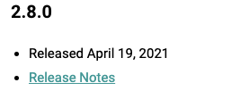
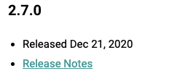
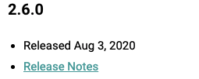
What is a Software Repository?
1.7k
Apache Kafka is a distributed event store and stream-processing platform
Notes:
Technical like source code artifacts like refactorings, updates, e.t.c

Slide 43
Why should we mine Software repositories?
The goal … is to improve software engineering practices by uncovering interesting and actionable information about software systems and projects using the vast amounts of software data
- If the data analysis in not carefully designed and executed, it can lead to invalid conclusions
+ Understand software development process
+ Support and/or improve the maintenance of software systems
+ Exploit knowledge in planning the future development
Notes:
Be careful about the data you have mained

Slide 44
What are some of the data sources of software engineering data?
This list is not exhaustive.
Qn. What are some of the additional software engineering data sources that can be mained?
Notes:
If you take an example of a mobile app,
The client will produce data regarding the requirements
Programmer will write code and commit in in a version control system

Slide 45
What are some of the existing tools we can use to mine software engineering data?
PyDriller
A Python framework that helps developers in analyzing Git repositories. With PyDriller you can easily extract information about commits, developers, modified files, diffs, and source code.
RepoDriller
A Java framework that helps developers on mining software repositories. With it, you can easily extract information from any Git repository, such as commits, developers, modifications, diffs, and source codes, and quickly export CSV files.
Build your own tool/script
Sometimes/ most of the times, you have to build your own tool or script to mine your own data
Notes:
Keep in mind that the information fetched is actually what you need. Depending on your goal, the tools might not give you what you want.

Slide 46
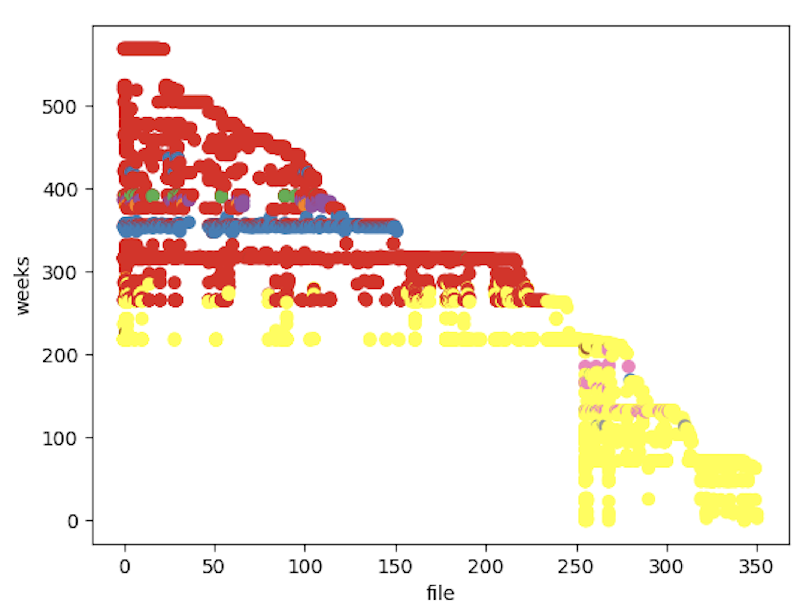
Developers who touched files

Slide 47
7. Mining Software Repositories (MSR)
Learn from the Past (p.143) – This pattern explicitly recommends reconstructing and analyzing past changes (using metrics, VCS history, etc.) to understand how the system evolved.
Compare Code Mechanically (p.227) – Supports automated mining through diffs, metrics, and tooling before manual interpretation. Key for large-scale history analysis.
Detecting Duplicated Code (p.223) – Identifies recurring fragments or reused fixes across repository history. Useful for spotting redundant effort or clone evolution.
Study the Exceptional Entities (p.107) – Focuses on outliers (files with high churn, ownership concentration, or bug frequency). Repository mining surfaces such hotspots clearly.

Slide 48
9. Conclusion
1. Introduction
Software changes and that requires planning
2. Reverse Engineering
How to understand your code
3. Visualization
Understanding large systems
4. Restructuring
How to Refactor Your Code
6. Dynamic Analysis (& Testing)
To be really certain
6 . Code Integration
How to resolve conflicts
7. Mining Software Repositories
Learn from the past

Slide 49


