Slide 1
Software Integration
John Businge
john.businge@unlv.edu

Slide 2
Software Evolves Through Changes
Version control records the evolution of a software system over time.
Each commit captures a change and preserves how the current system came to be.
+ feature
fix()
rename
test ✓
v2.0
Initial code
Feature
Bug fix
Refactoring
Tests
Release
Current
What changed?
When did it change?
How did we get here?
Commits preserve features, fixes, and refactorings.
History orders changes and identifies versions.
Relationships among commits explain the current codebase.
2
Notes:
Software is not static. Developers continuously add features, fix bugs, refactor code, and release new versions. Version control gives us a history of that evolution. Each commit is not just a snapshot; it tells us what changed and how the current codebase came to be.
The important point for this lecture is that this history does not always remain a single straight line. Development can branch, and separate lines can begin evolving independently. That takes us to the next slide.
[Sources]
- Course framing based on the instructor-provided Version Control Systems slide.
[/Sources]

Slide 3
One Codebase Can Evolve Along Different Paths
Branches and forks share a common origin, but they can accumulate different changes over time.
COMMON HISTORY
Development path A
branch / fork
Different changes
→ divergence
Development path B
Independent evolution can produce different features, bug fixes, and refactorings in each line.
3
Notes:
A version-control history does not have to remain linear. At some point, developers may create a branch or a fork. Initially, both lines share the same history and therefore the same code.
After the split, however, developers can make changes independently. Path A may receive one bug fix or refactoring, while Path B receives a different feature or restructuring. The longer they evolve independently, the more their code can diverge.
This is the key transition to the next slide: when these independently evolving lines represent related versions of the same system, we can think of them as software variants. We are especially interested in what happens when a useful change exists in one variant but not in another.
[Sources]
- Course framing based on the instructor-provided Branching/Forking and Software Variants slides.
[/Sources]

Slide 4
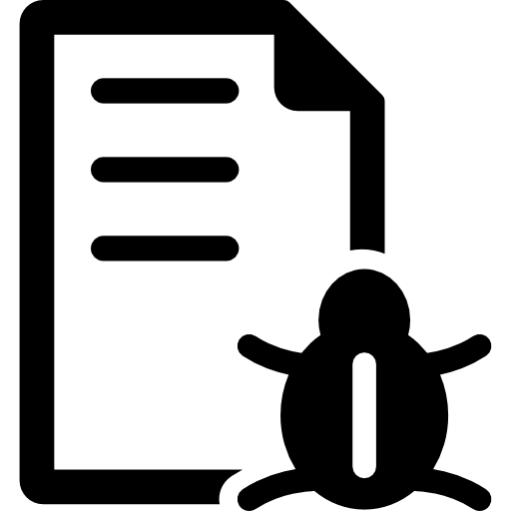
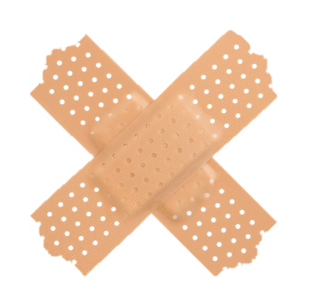
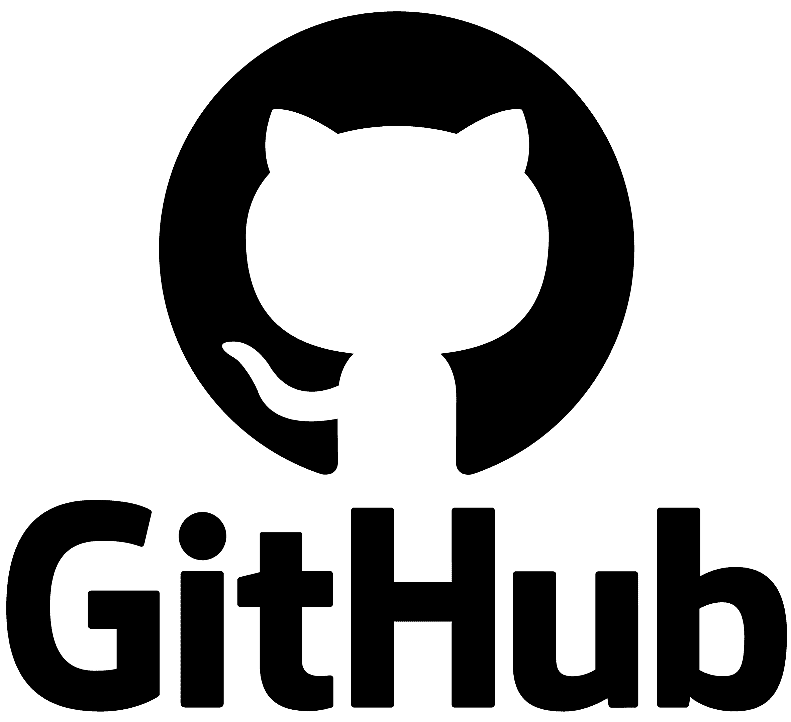
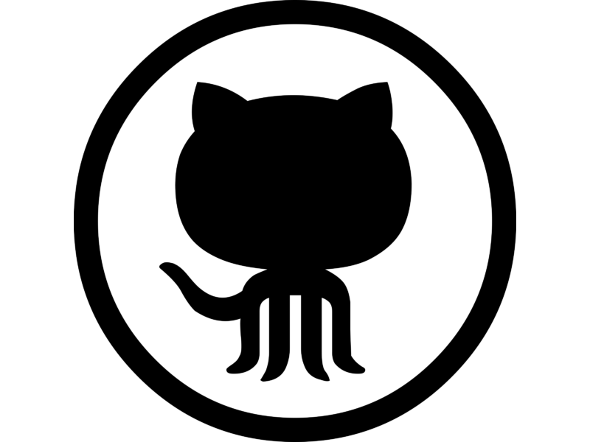
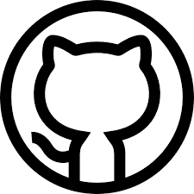
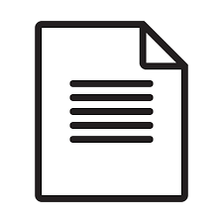
From Forks to Divergent Software Variants
foo
foo
social fork
current_date
fork_date
divergence_date
Pull request
variant1
(source)
Inherited commits
PR merge_commit
Synchronized commits
Unique commits
target git_head
variant2
(target)
foo
foo
foo
foo
Split
case
Missed
opportunity
Effort duplication
Uninteresting
P.K Ramkisoen, J. Businge, et. al. PaReco: patched clones and missed patches among the divergent variants of a software family, FSE, 2022.
Notes:
Using an illustration, let me explain the context of our problem. (the numbers represent the clicks you will be making)
Let’s say we have variant1 on Github with three revisions.
A different developer sees variant1, and they want to use it as a starting point to build variant2. They fork, and therefore they would inherit all the revisions of variant1.
Between the fork_date and the divergence date, the two variants pull from each other updates and synchronize commits. At this point, the two variants are even.
Between the divergence_date and the current_date, for some reason, the two variants stop synchronizing commits. Each variant has got commits not present in the other (unique commits)
Let us assume that a bug was found at this commit. The developer created a social fork or a bug-fixing-branch, patched the bug, and then integrated the patch back into variant1.
At the git_head of the target variant, four scenarios are possible:
Foo has been patched by the developer in variant2 – effort duplication
Foo is still buggy - missed opportunity
Foo has both buggy and patched lines – split case
Foo is changed beyond comparison of V1.foo and V2.foo – uninteresting.

Slide 5
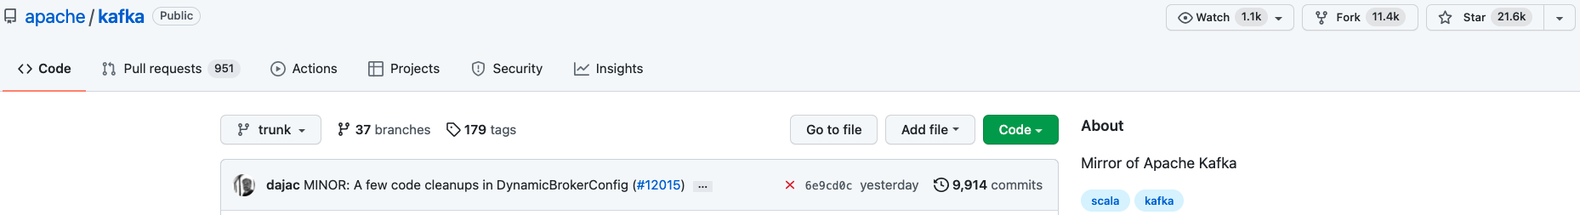
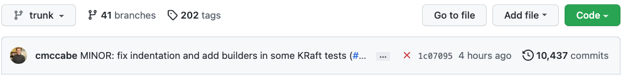
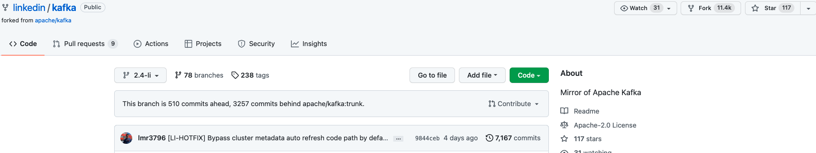
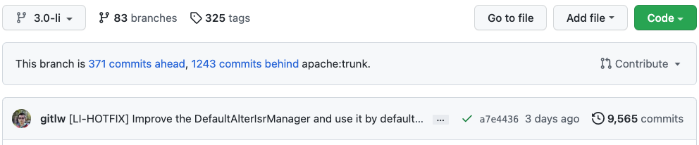
A Real-World Variant: LinkedIn's Fork of Apache Kafka
Current_date 2022-10-07
linkedin
unique commits
apache
unique commits
Very active
This is the version of Kafka running at LinkedIn.
Notes:
Let me use a concrete example on GitHub, that we also have in our dataset.
The divergent pair apache/kafka and linked/kafka are hosted on Github. Linked in is a version of kafka running at linked (in fact, this is our most favorite example)
As you can see, linkedin is a fork of apache
Linked in is ahead of apache by 371 commits and behind apache by 1,243. In other words, linked and apache has 371 and 1,243 unique, respectively.
The variants are pretty very active. Their git_head commits were med 3 days and 4 hours ago, respectively.

Slide 6
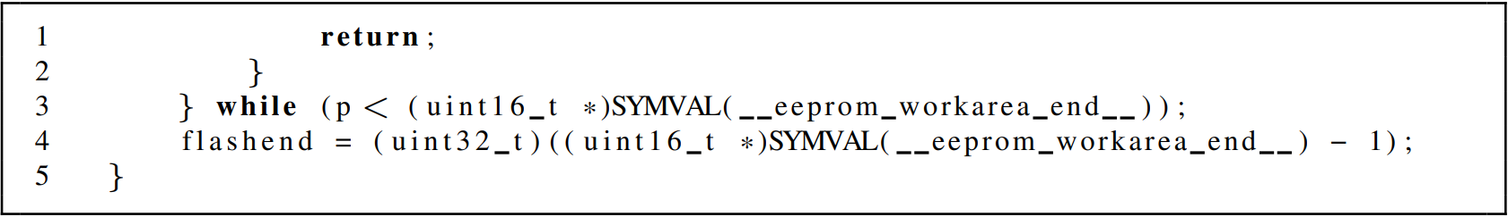
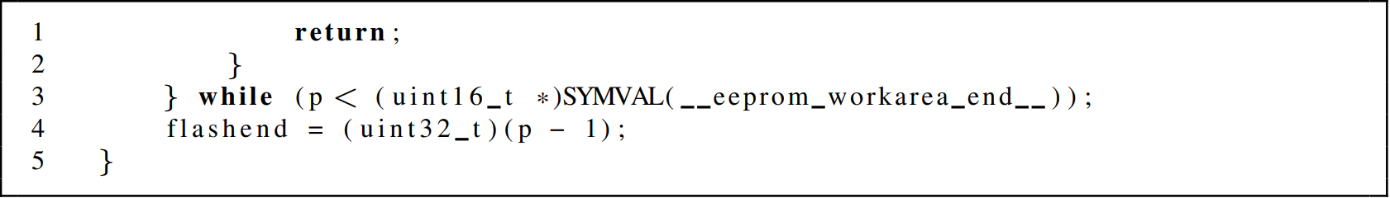
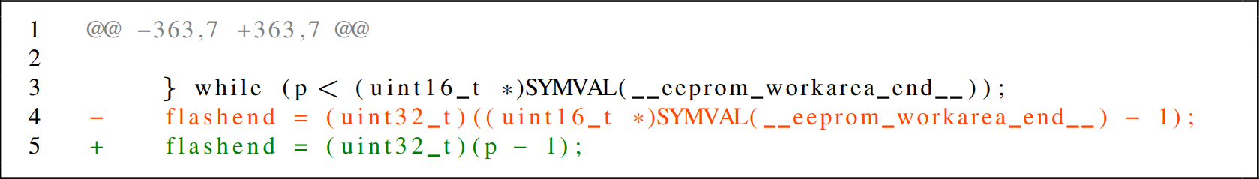

Concrete Example:
Missed Opportunity
Buggy code from source – apache/kafka
Buggy line
Patched code from source – apache/kafka
Patched line
Diff for patch in source – apache/kafka
Hunk
File from target git_head – linkedin/kafka
Buggy line
Notes:
Concrete MO from kafka

Slide 7
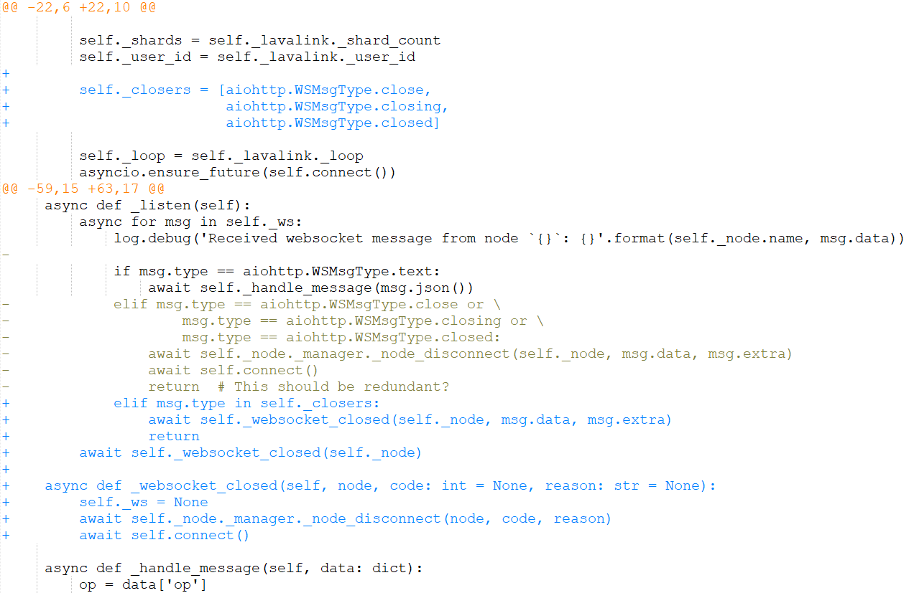
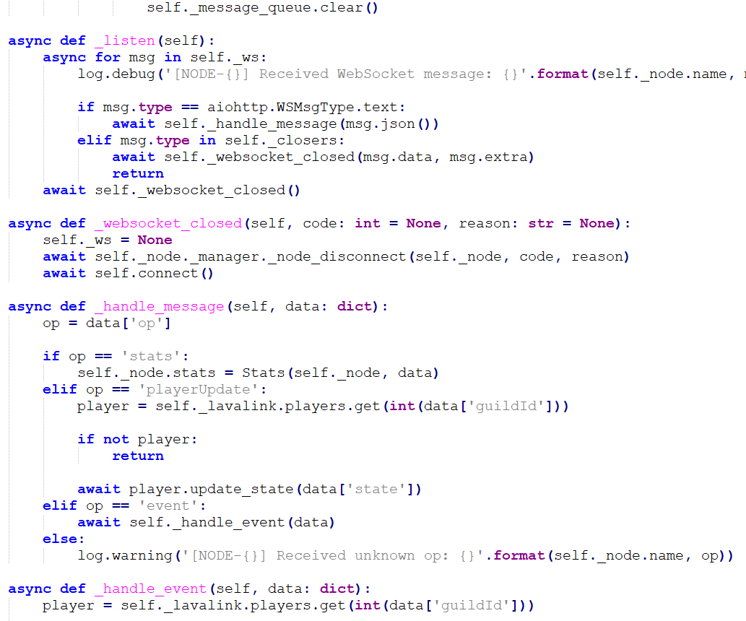
Complex Example 1
Diff for patch in upstream
Latest_commit snippet from divergent fork
1
Effort Duplication
2

Slide 8
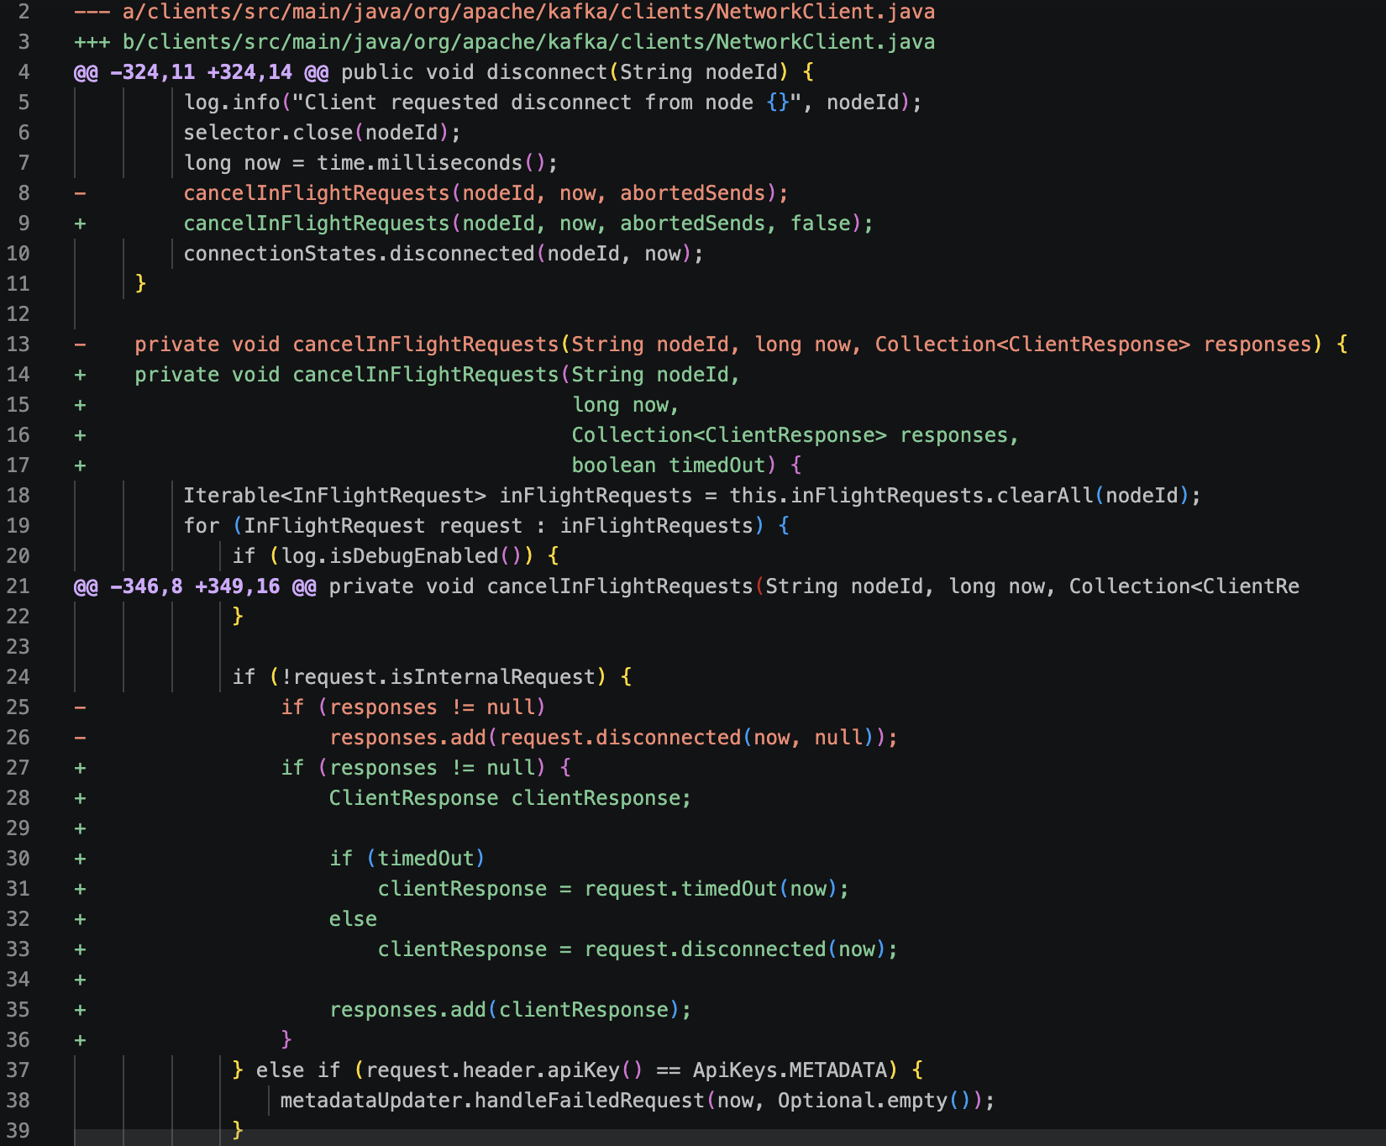
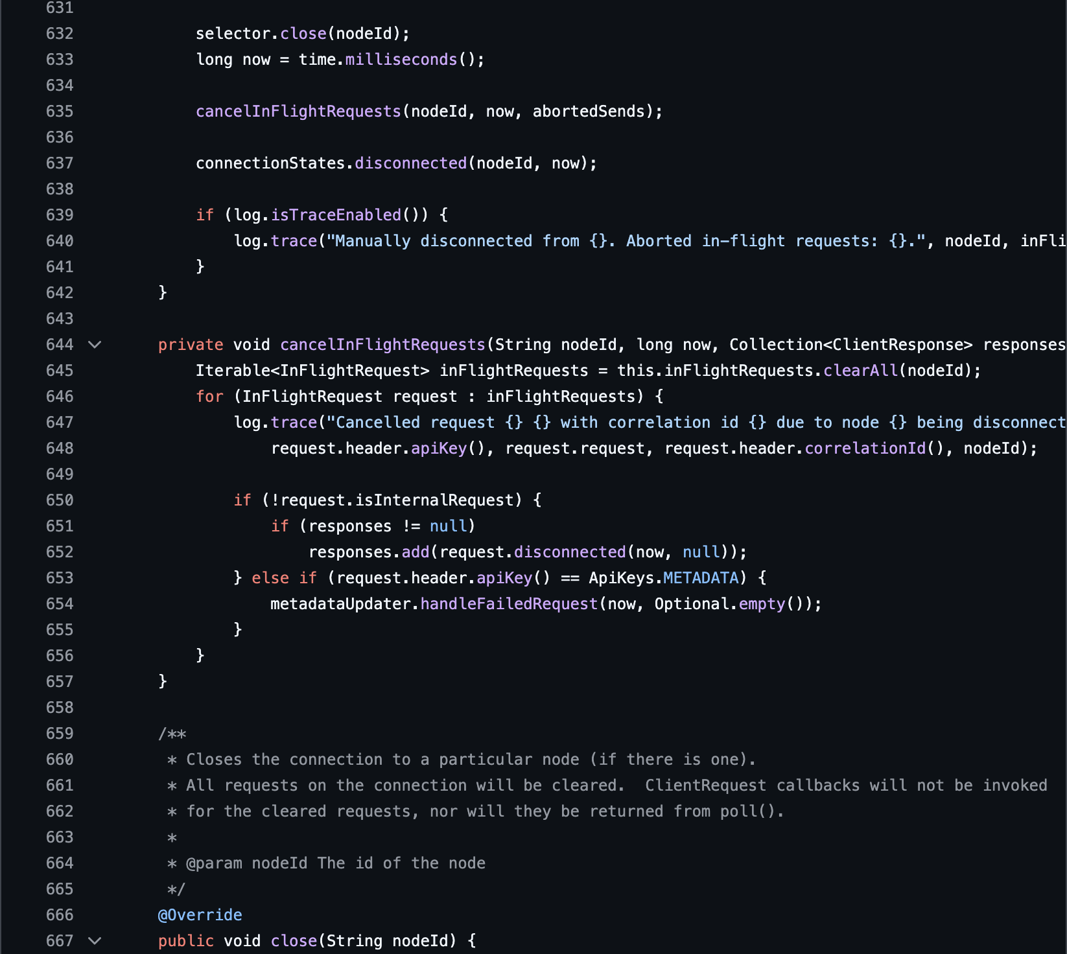
Complex Example 2
Diff for patch in upstream
Latest_commit snippet from divergent fork
1
Missed Opportunity
2

Slide 9
From Manual Inspection to Automated Detection
Simple MOs may be recognizable by inspection. As patches and variants become larger and more complex, identifying them manually becomes difficult.
1
PaReco
2
GACPD
3
MOVis
Detect missed opportunities
Generalize detection
Visualize and inspect changes
Finds patches present in one variant that may be missing from a divergent variant.
Extends detection across programming languages and more complex code changes.
Shows the patch alongside corresponding code in the divergent variant so developers can inspect the evidence.
Research progression: detect the MO → generalize detection → help developers understand the evidence
Notes:
In the earlier example, the missed opportunity was small enough that we could recognize it with our own eyes. But the complex example shows why that does not scale. A real patch may contain multiple hunks, many changed lines, and potentially changes across several files. Manually searching a divergent variant for the corresponding code becomes difficult.
This is one of the problems we have been working on in my research lab. We started with PaReco, which identifies missed patching opportunities between divergent variants. We then developed GACPD to generalize MO detection across programming languages and more complex code changes. Detection alone is not enough, however. Once an MO is identified, a developer still needs to understand the evidence. That motivated MOVis, which visualizes the patch and the corresponding code in the divergent variant.
Let me show you what that looks like.

Slide 10
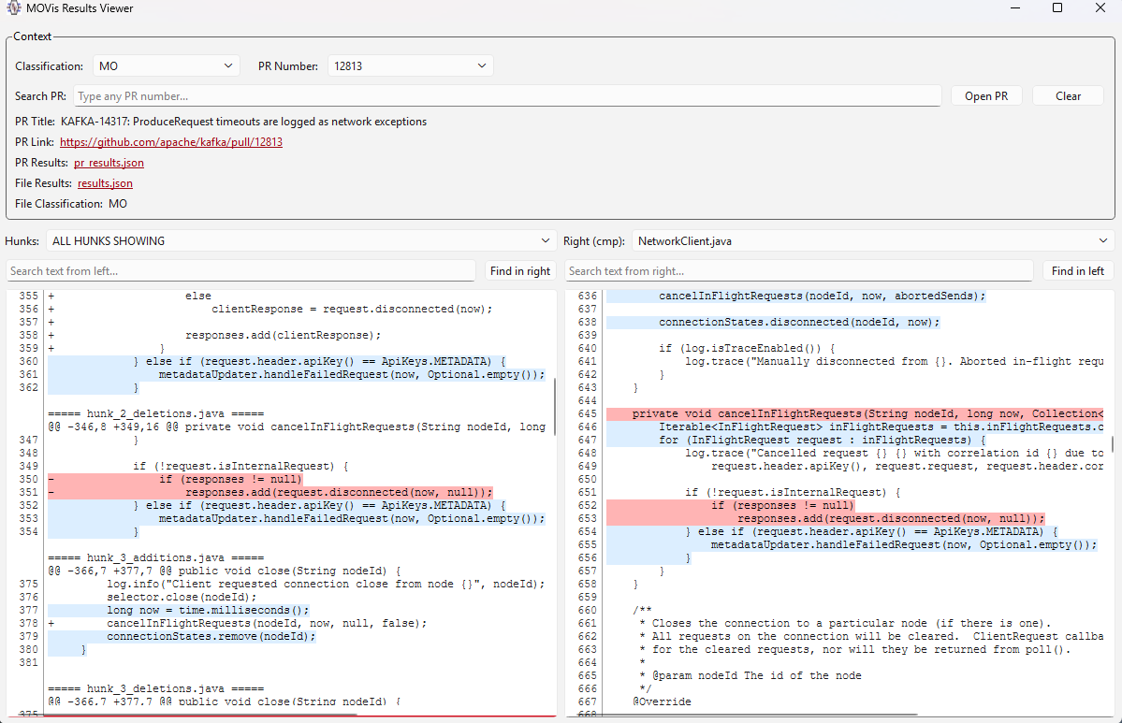
MOVis: inspecting the evidence
Detection finds a candidate; visualization helps developers decide whether the patch is really missing, duplicated, or partially present.
Read the view in
three passes
1
Context
PR number, title, classification, and result files.
2
Source patch
Changed hunks from the upstream patch.
3
Divergent fork
Corresponding target code shown beside the patch.
Goal: move from detection to developer understanding.
MOVis helps inspect why a candidate matters, not just whether a tool reported it.
Notes:
This is the slide where I show MOVis after explaining that simple missed opportunities can be identified with our eyes, but complex cases become difficult.
Start by telling students that detection is only the first step. A tool may tell us that a patch looks missing, duplicated, or partially present, but a developer still needs to inspect the evidence.
Walk through the screen in three passes. First, point to the context area at the top: the classification, PR number, PR title, and result files. Second, point to the left pane: this is the patch hunk from the source or upstream side. Third, point to the right pane: this is the corresponding code in the divergent fork.
Emphasize that MOVis is useful when the case has many hunks or files. Instead of manually jumping between GitHub, diff files, and target repository files, the tool organizes the evidence side by side.
Transition to the demo or discussion by saying: Now we can use this view to reason about whether the patch is really missing, already duplicated, or only partially integrated.

Slide 11
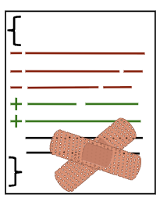
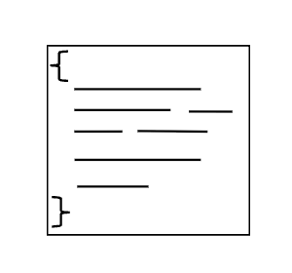
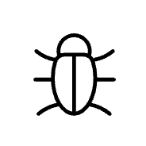
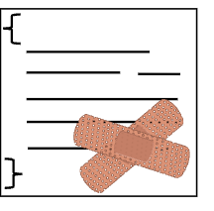


Finding the Missing Patch Is Only the First Step
We know what patch we need, but applying it may fail.
Foo.java
patched
Bug fixing branch
Foo.java
pull request
merge commit
Fork date
Divergent date
Source Variant
Shared commits common codebase
Synchronized commits
Unique commits
cherry-pick and apply to target
Target Variant
Foo.java
Foo.java
Foo.java
Still buggy
git_head commit before cherry-pick
Failure
(merge conflict)
Success
(cleanly applied)
D. Ogenrwot and J. Businge. Refactoring-Aware Patch Integration Across Structurally Divergent Java Forks, SCAM 2025
Notes:
Picture two variants that start in sync, then split at a divergence point. After that, each evolves on its own. A developer fixes a bug in Foo.java on the source side—very likely the same bug exists in the target—but there’s no direct way to transfer that fix. In practice, we try git cherry-pick onto the target’s git_head. That works only when the change is purely textual. It breaks the moment the target has refactorings or even small independent edits—like renamed methods, moved classes, or tweaked signatures—because the patch’s assumptions no longer hold. The punchline: success depends on structural consistency between the source’s merge commit and the target’s current state.”
Figure 1 shows patch integration between two variants that initially share a synchronized history but diverge at a specific point (divergence_date). After this point, both vari- ants evolve independently and no longer share synchronized commits. Suppose a developer identifies and fixes a bug in Foo.java, a file present in both source and target variants, by submitting a pull request in the source repository. Although the same bug likely exists in the target variant, there is no direct mechanism to transfer the patch. Developers often use Git’s cherry-pick to apply the source commit to the target’s git_head, with two possible outcomes:
(i) The patch applies cleanly if the change involves simple textual edits.
(ii) The patch fails if structural changes in the target, such as refactorings or reorganizations, conflict with the assump- tions of the patch.
Even small independent edits can cause patch failures due to mismatches in method signatures, class structures, or identifier names.

Slide 12
Why Patches Fail to Integrate Cleanly
Apply a bug‑fix patch from a source variant to a target variant that has drifted
Structural drift breaks textual correspondence → patch integration may fail
Typical sources of drift:
Rename/Move/Inline/Extract
Parameter renames or reordering
Package/class reshuffling
Notes:
Notes: We phrase as variant‑to‑variant asymmetric patch transfer…..
Structural and semantic divergence poses a major barrier
to patch propagation. As variants undergo refactoring, such
as method renaming, class movement, or interface modifica-
tion [14]–[16], syntactic similarity with the source deterio-
rates. Tools like Git cherry-pick, which rely on textual
alignment, often fail when entities have been reorganized or
renamed [15], [16].
structural and semantic divergence over time complicates the reuse of upstream patches such as bug fixes or enhancements.
Tools like Git cherry-pick, which rely on textual alignment, often fail when entities have been reorganized or renamed

Slide 13
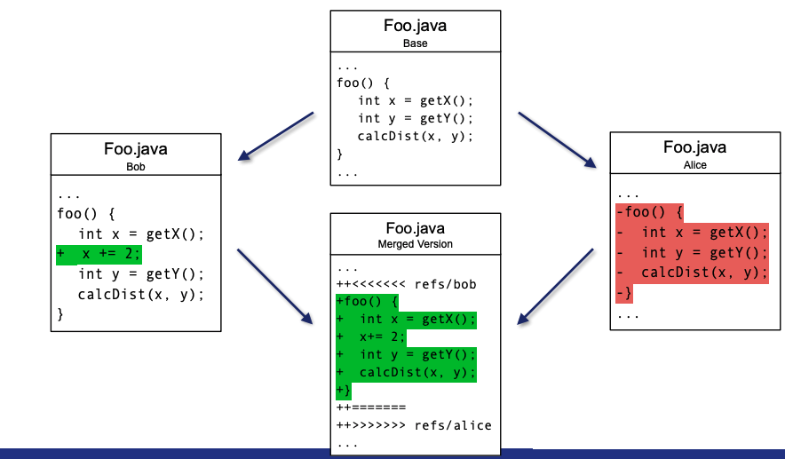
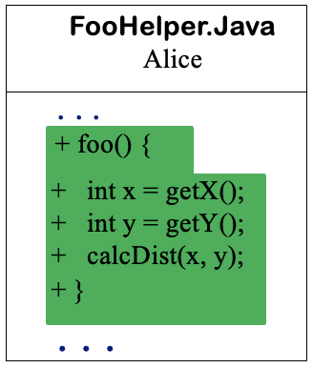
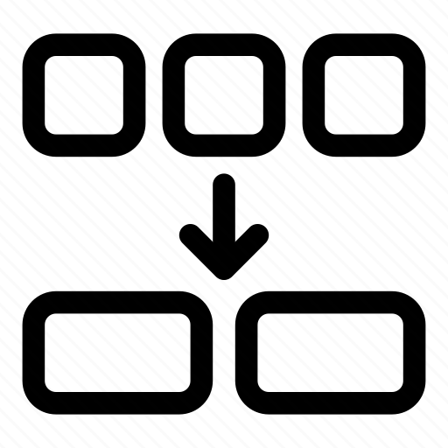
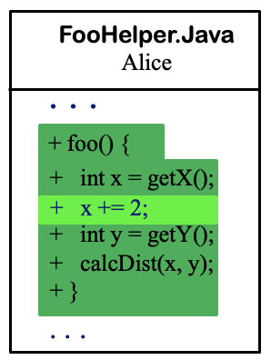
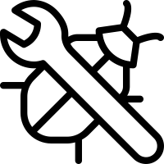
How Refactoring Creates Merge Conflicts
Alice
Fork date
Divergent date
Source Variant
Shared commits common codebase
Synchronized commits
Unique commits
cherry-pick and apply to target
Target Variant
Bob
Bob
Notes:
Let us look at a concrete example of how structural drift can create a merge conflict. Alice and Bob begin with the same codebase. After the variants diverge, they independently modify the same code.
On Alice's side, she performs a refactoring. She moves foo() from Foo.java to FooHelper.java. Notice that the behavior has not necessarily changed. The code has simply been reorganized.
Meanwhile, on Bob's side, Bob modifies foo() in its original location in Foo.java. In this example, he adds the line x += 2.
Now suppose we want to bring Bob's change into Alice's variant. We try to cherry-pick the change.
Git sees a problem. Bob's patch says: modify foo() in Foo.java. But in Alice's version, foo() is no longer there. From Git's textual perspective, Alice deleted the method while Bob modified it. So Git reports a merge conflict.
But look at what actually happened. This is not necessarily a difficult semantic conflict. Alice moved the method, while Bob modified it. If we understand the refactoring, the resolution is straightforward: apply Bob's change to foo() in its new location, FooHelper.java.
This illustrates an important limitation of traditional textual integration. The conflict may look complex textually, even when the underlying change is conceptually simple.
So, what if our integration tool could recognize the refactoring before trying to apply the patch?

Slide 14
Refactoring-Aware Merging
Use code history and refactorings to explain conflicts before resolving them.
1
Locate Conflict
2
Trace Evolution
3
Detect Refactorings
4
Explain Conflict
foo()
helper()
PATCH
×
NEW
LOCATION
divergence
×
MOVE / RENAME
Identify the code region where patch integration fails.
Follow the source and target histories around the conflicting code.
Recognize structural changes such as Move, Rename, Extract, or Inline.
Determine which refactoring changed the location or shape expected by the patch.
Key idea: the conflict is textual, but its cause may be structural.
Notes:
In the previous example, Git reported a conflict because it could not see that Alice had moved foo() from Foo.java to FooHelper.java. A refactoring-aware approach adds structural knowledge to the integration process.
First, locate the region where the patch fails to apply. Second, trace the evolution of that code in the source and target variants using their commit histories. Third, detect refactorings such as Move Method, Rename Method, Extract Method, or Inline Method. Finally, connect the detected refactoring to the conflict. If we know that foo() was moved rather than deleted, we can understand where Bob's modification should be applied.
The key idea is that the conflict may be textual, while the cause is structural.
Animation suggestion: reveal the four cards one at a time from left to right. Keep each card's icon and text together as one animation.
[Sources]
- User-provided course slides and examples in the current conversation.
[/Sources]

Slide 15
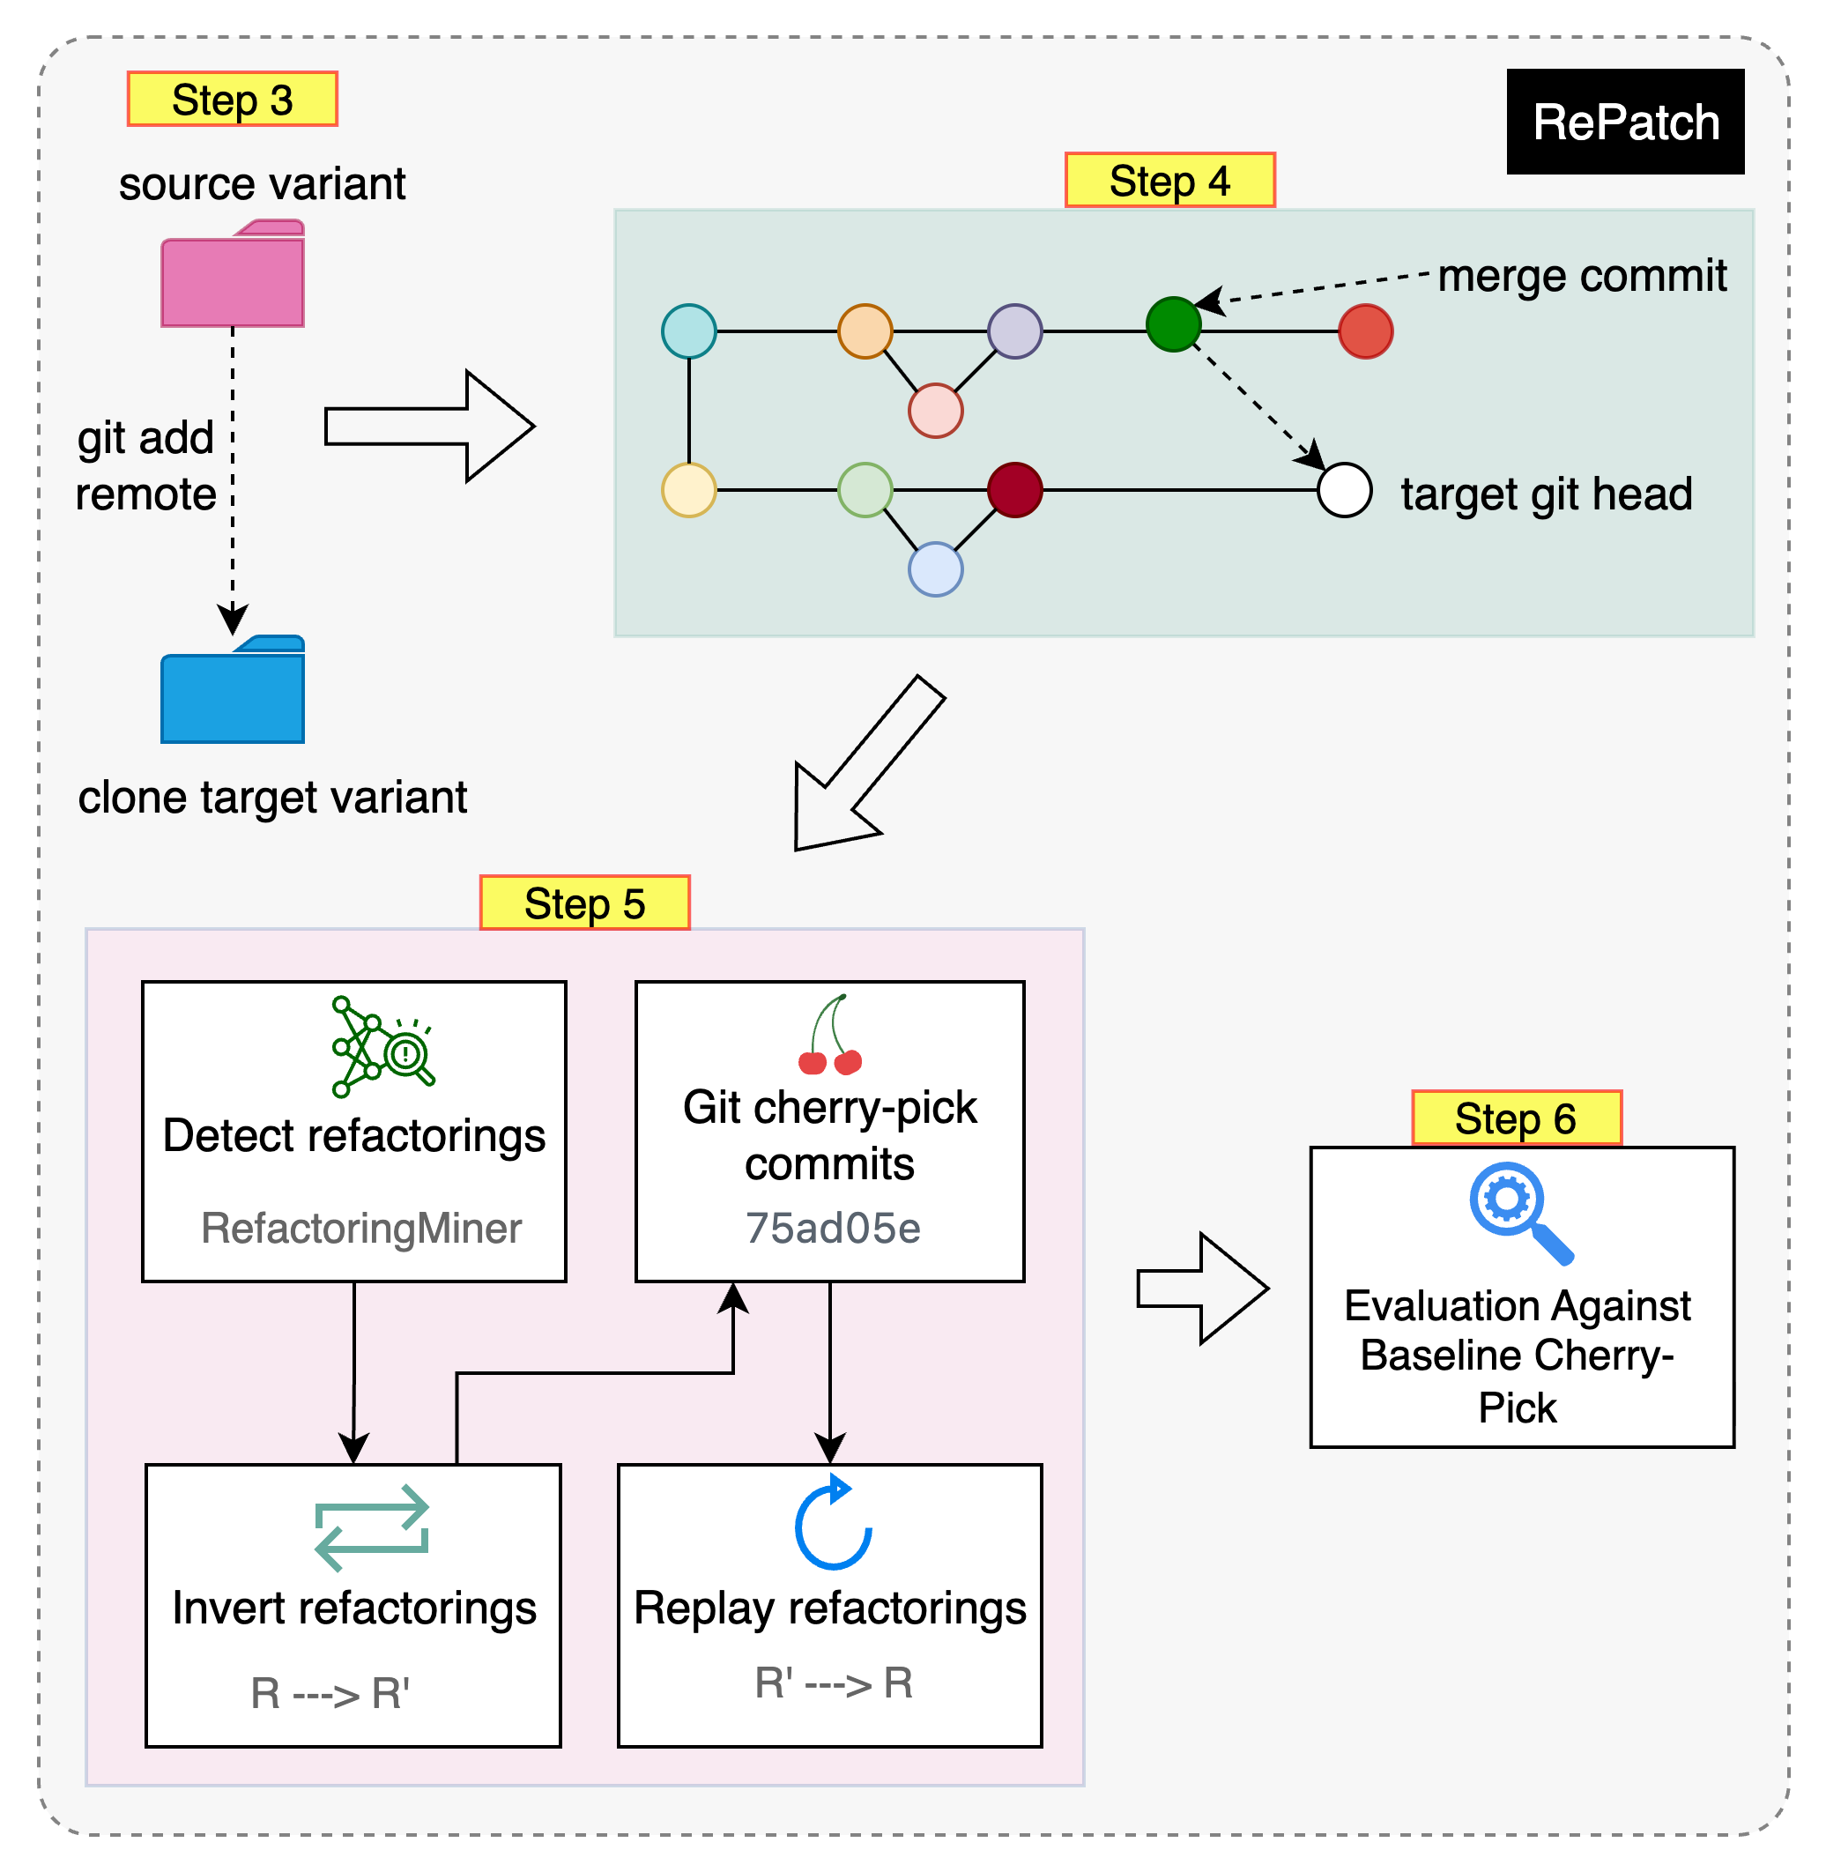
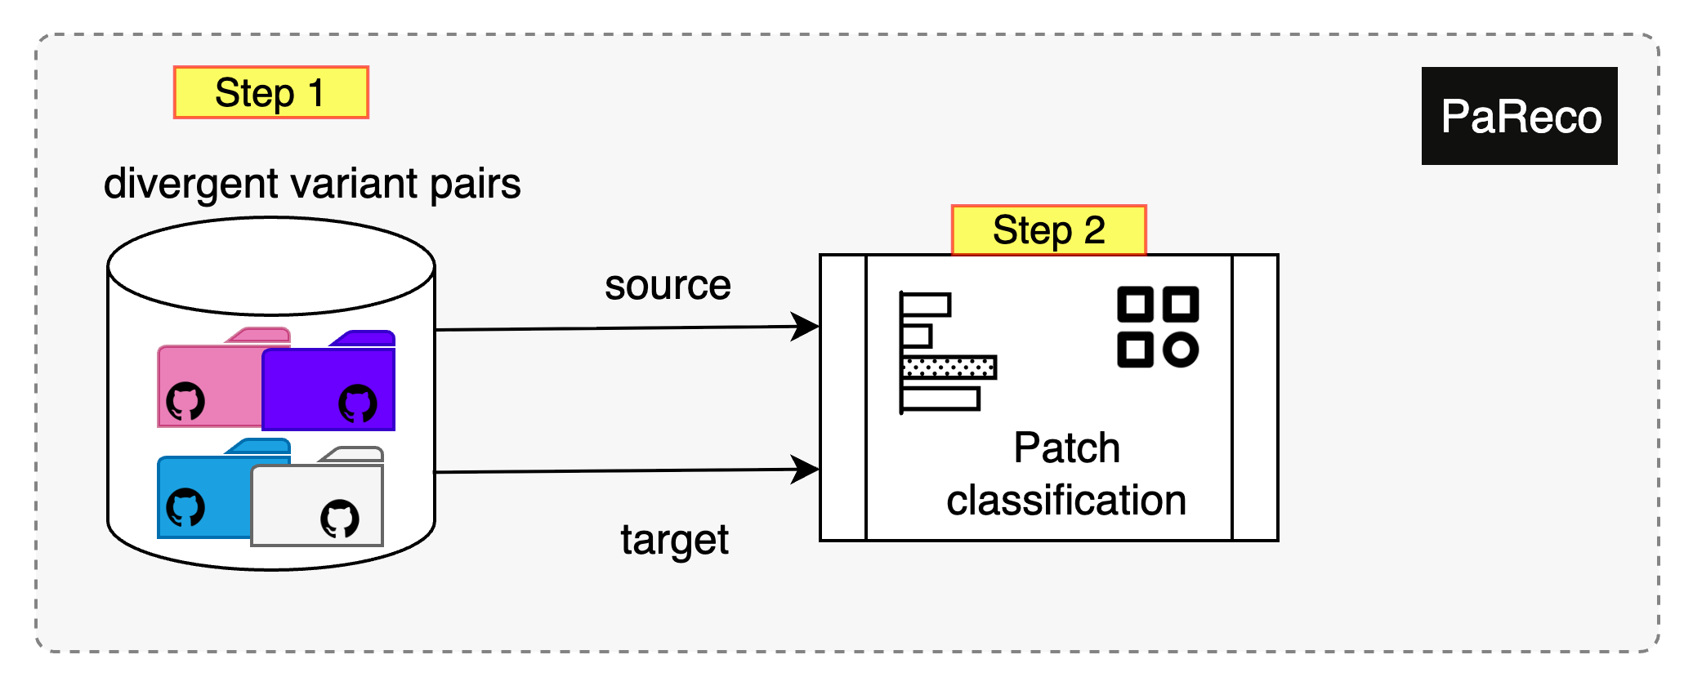
RePatch: Refactoring-Aware Patch Integration
RePatch: Refactoring-Aware Patch Integration
Invert refactorings → apply the patch → replay refactorings
MO Cases
Notes:
Start from PaReco variant‑pair corpus; re‑filter to active as of May 15, 2025.
Focus on Java to leverage refactoring tooling.
14 divergent variant pairs, 478 bug‑fix PRs (merge commits) as integration units.
Notes: Clarify "Missed Opportunities" = bug‑fix present in source, absent/partial in target.
A refactoring‑aware patch integration system for asymmetric (cross‑fork) settings.
Extends RefMerge ideas to commit‑level patch transfer.
Integrates with RefactoringMiner for detection; uses a conflict matrix to order transformations.
1. Identify Missed Opportunities (PaReco).
2. Link repos & cherry‑pick the merge commit (baseline).
3. Detect refactorings in source & target.
4. Invert refactorings to re‑align context.
5. Apply patch → Replay refactorings.
6. Compare to baseline (conflicts, success).
Notes: Visually annotate invert → apply → replay.

Slide 16
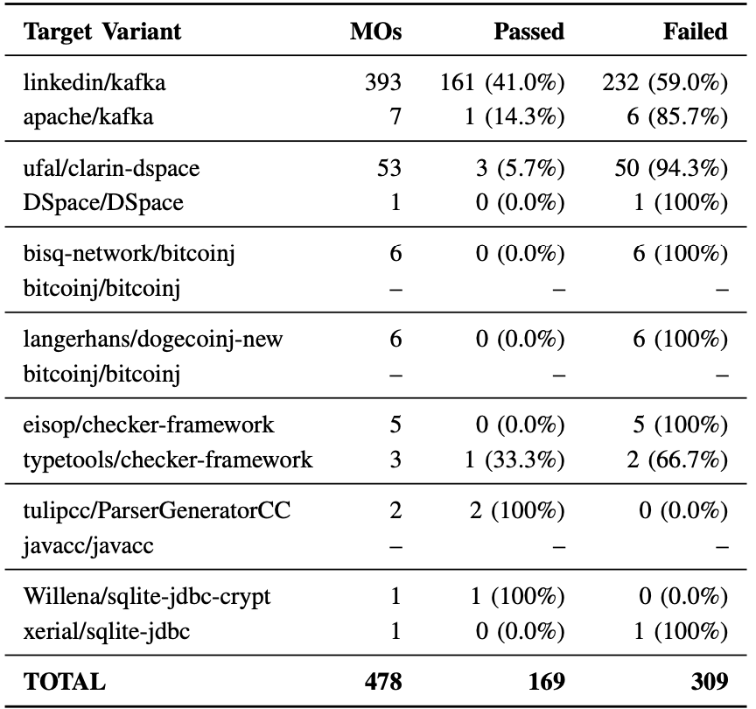
Git Cherry-Pick Frequently Fails Across Divergent Variants
RQ1: How often do source variant bug-fix patches fail to apply cleanly to target variants using Git’s cherry-pick?
Cherry‑pick fails in 64.4% of the 478 patches (overall)
Median failure rate across targets: 85.7%
Several projects show 94–100% failure under baseline cherry‑pick
Notes:
Summary of RQ1 Results: The results of RQ1 demonstrate that traditional syntax-based patch integration mechanisms, such as Git’s cherry-pick, are inadequate for reliably propagating bug-fix patches across structurally diverged software variants. High failure rates across multiple projects reflect the compounding effects of semantic drift, architectural changes, and uncoordinated evolution.

Slide 17
RePatch Recovers More Than Half of Failed Patches
RQ3: Can a refactoring-aware integration approach reduce merge conflicts and increase the success rate of applying patches across divergent variants?
On previously failing cases (n≈292 after constraints):
Reduces file‑level conflicts in 53.1% of cases; increases in 1.4%
Reduces line‑level conflicts in 53.8% of cases; increases in 3.4%
Successfully integrates 52.8% of the previously failing patches
Notes:
Summary of RQ3 Results: Out of 292 previously failing patch applications, RePatch reduced file-level merge conflicts in 53.1% of cases and line-level conflicts in 53.8%. In contrast, it introduced new conflicts in only 1.4% and 3.4%, respectively. Overall, RePatch successfully integrated 155 of the 292 failed patches, achieving a resolution rate of 52.8%. These findings show that refactoring-aware integration can substantially improve patch applicability while reducing manual effort and semantic misalignment associated with structural divergence.

Slide 18
A Clean Merge Does Not Guarantee a Correct Patch
Conflict resolution only tells us the patch can be applied. We still need evidence behaves correctly.
1
Integrated Patch
2
Build Project
3
Targeted Tests
4
Regression Suite
5
Validated Integration
→
→
→
→
Patch is applied to the target repository.
Compile/build the target after integration.
Test the changed behavior and nearby collaborators.
Run the existing suite to detect regressions.
Accept only when build and tests provide evidence.
A patch may merge and still fail to build, fail its intended behavior, or regress existing tests.
Integration is complete only after the patch is applied, builds successfully, and passes appropriate tests.
OORP patterns that guide validation
Tests: Your Life Insurance
Grow Your Test Base Incrementally
Write Tests to Understand
(p.149) Protect against regressions
(p.159) Add focused tests around the patch
(p.179) Clarify the intended behavior
Notes:
RePatch can resolve a merge conflict, but that does not prove that the resulting program is correct. A syntactically successful integration can still fail to compile, violate the intended behavior of the patch, or introduce regressions elsewhere in the target variant.
So after integration we need validation. First, build the target project. Then add or adjust focused unit or integration tests around the changed behavior and its immediate collaborators. Finally, run the existing regression suite. Only then do we have stronger evidence that the patch was integrated correctly.
This connects directly to the OORP testing patterns. Tests: Your Life Insurance emphasizes protection against regressions. Grow Your Test Base Incrementally tells us to add focused tests as we change the system. Write Tests to Understand is useful when we need to clarify the intended behavior of the code we are integrating.
The key message is: a clean merge is necessary, but it is not sufficient.
[Sources]
- Object-Oriented Reengineering Patterns (OORP), patterns and page references supplied in the course slide: Tests: Your Life Insurance (p.149); Grow Your Test Base Incrementally (p.159); Write Tests to Understand (p.179).
[/Sources]

Slide 19
The Project
You will use RePatch with the git cherry-pick
You will employ the same approach of mining git logs to extract interesting data for the project.
Let us go to the Lab.

