Slide 1
Dynamic Analysis: Testing
John Businge
john.businge@unlv.edu

Slide 2
Introduction
Dynamic Analysis verifies properties of a system during execution/runtime.
Testing Analysis is one example of Dynamic Analysis
  Unit tests, integration tests, system tests, and acceptance tests use dynamic testing
Notes:
Another example is using a debugger.
The different testing techniques like Unit tests, Integration tests, system tests, and acceptance tests use dynamic testing.

Slide 3
Testing in the Book
Tests are your life insurance! (OORP, p. 149)
Tests are essential to assuring the quality of refactoring/code change activities.
Write Tests to Enable Evolution (OORP, p.153)
  Good tests can find bugs in your artifact
  Tests can also detect unwanted behavior
You can also write tests to understand a part of a system (OORP, p.179)
Test the Interface, Not the implementation (OORP, p.171). This is essentially Black-box testing.
Notes:
There are many parts in the book related to testing. The first one I like very much is “Tests are your life assurance!”
Black-box testing is a method of software testing that examines the functionality of an application without peering into its internal structures or workings.
This test method can be applied virtually to every level of software testing: unit, integration, system and acceptance.

Slide 4
Unit Testing
In this session, we focus on Unit Testing.
  Unit testing focuses on the smallest testable parts of an application called units (e.g., a class method or function)
There are other types of testing (Integration, Performance, Security, etc.)
It does not mean that Unit Testing is more important, but those are the tests we can more easily automatize and benefit from tool support.
Notes:
In this lab, we are going to focus on unit testing
In unit testing, the focus is on the smallest testable parts of an application, called units (an example is a method)

Slide 5
Quality of a Test Suite
How do you know if your unit test cases are good enough?
Are they really testing the application?
When do we stop testing?
Solution: Test Coverage!

Slide 6
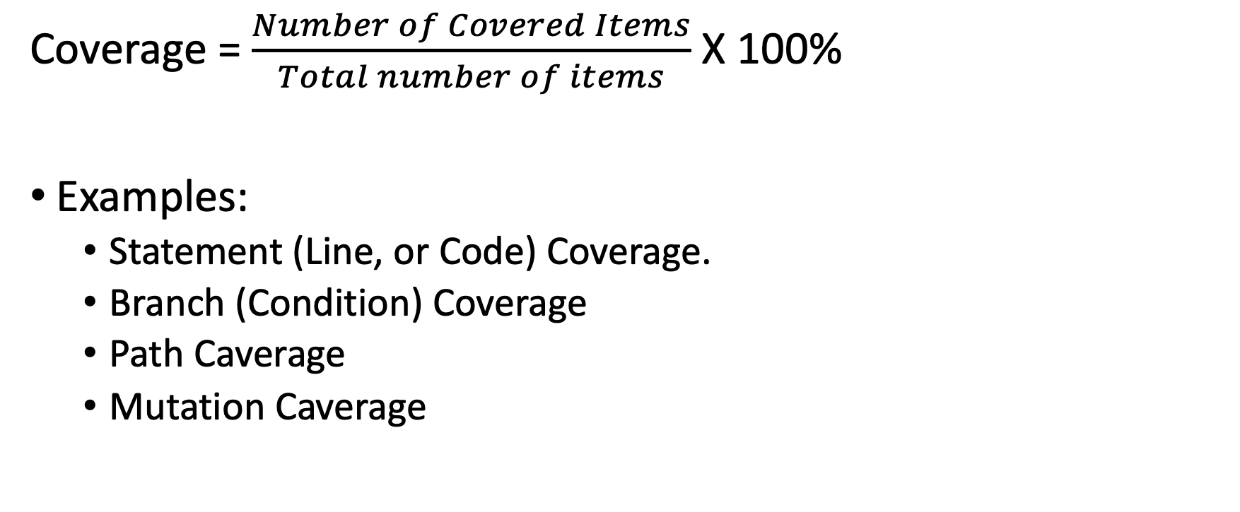
Test Coverage
Coverage = $\frac{Number of Covered Items}{Total number of items}$ X 100%
Examples:
  Statement (Line, or Code) Coverage.
  Branch (Condition) Coverage
  Path Caverage
  Mutation Caverage
Notes:
Coverage tells us how much of the code our tests are actually exercising.
Coverage isn’t just a number — it’s about confidence in testing

Slide 7
One function contains three independent decisions
THREE BOOLEAN DECISIONS
int foo(int input, bool b1, bool b2, bool b3) {
int x = input;
int y = 0;
if (b1) x++;
if (b2) x--;
if (b3) y = x;
return y;
}
b1
true: increment x
false: leave x unchanged
b2
true: decrement x
false: leave x unchanged
b3
true: copy x into y
false: leave y as 0
Each decision can be true or false, creating different execution paths.
Notes:
This function accepts an integer and three Boolean inputs.
Each Boolean controls a separate decision. When true, its associated statement executes; when false, that statement is skipped.
Because each decision can be true or false, different combinations create different execution paths.”

Slide 8
Line coverage shows which executable lines ran
Test: foo(0, false, true, true) == −1
1
int x = input;
✓
COVERAGE RESULT
2
int y = 0;
✓
3
if (b1)
✓
8 of 9
4
x++;
×
5
if (b2)
✓
88.9% line coverage
6
x--;
✓
7
if (b3)
✓
8
y = x;
✓
Missed: x++;
9
return y;
✓
because b1 is false
Line coverage reveals unexecuted code—not whether every decision was tested both ways
Notes:
We begin with one test in which b1 is false while b2 and b3 are true.
The test executes these eight lines. Because b1 is false, the statement x++ is skipped.
Using this executable-line count, eight of nine lines run, giving 88.9% line coverage. Line coverage identifies unexecuted code, but it does not show whether every decision was tested both ways.

Slide 9
Line coverage shows which executable lines ran
Test: foo(0, true, true, true) == 0
1
int x = input;
✓
COVERAGE RESULT
2
int y = 0;
✓
3
if (b1)
✓
9 of 9
4
x++;
✓
5
if (b2)
✓
100% line coverage
6
x--;
✓
7
if (b3)
✓
8
y = x;
✓
9
return y;
✓

Slide 10
100% Line Coverage Can Still Mean 50% Branch Coverage
The same test satisfies line coverage but exercises only one outcome of each decision.
Test: foo(0, true, true, true) == 0
FUNCTION UNDER TEST
BRANCH OUTCOMES
LINE COVERAGE
int foo(int input, bool b1, bool b2, bool b3) {
int x = input;
int y = 0;
if (b1) x++;
if (b2) x--;
if (b3) y = x;
return y;
}
Decision
True
False
100%
b1
Covered
Not covered
BRANCH COVERAGE
50%
b2
Covered
Not covered
3 of 6
b3
Covered
Not covered
branch outcomes
3 decisions × 2 outcomes = 6 branches
Every line ran, but none of the false outcomes was tested.
Notes:
This test produced 100% line coverage because every executable line ran.
Branch coverage asks a different question. Each of the three decisions has a true and a false outcome, giving six branch outcomes in total.
The test makes b1, b2, and b3 true. It covers three true outcomes but none of the false outcomes, so branch coverage is 3 of 6, or 50%.

Slide 11
A Second Test Covers the Missing Branches
Branch coverage reaches 100% only after every decision evaluates both true and false.
Test 1: foo(0, true, true, true) == 0
Test 2: foo(0, false, false, false) == 0
FUNCTION UNDER TEST
BRANCH OUTCOMES
LINE COVERAGE
int foo(int input, bool b1, bool b2, bool b3) {
int x = input;
int y = 0;
if (b1) x++;
if (b2) x--;
if (b3) y = x;
return y;
}
Decision
True
False
100%
b1
Test 1
Test 2
BRANCH COVERAGE
100%
b2
Test 1
Test 2
6 of 6
b3
Test 1
Test 2
branch outcomes
3 decisions × 2 outcomes = 6 branches
Together, the two tests exercise both outcomes of every decision.
Notes:
The first test covers the true outcome of b1, b2, and b3. The second test covers the false outcome of all three decisions.
Together, the tests cover all six branch outcomes, so branch coverage reaches 100%.
This example shows why achieving 100% line coverage does not guarantee 100% branch coverage. Branch coverage often requires additional tests.

Slide 12
Three Binary Decisions Create Eight Execution Paths
Each decision doubles the number of complete outcome combinations.
2 × 2 × 2 = 2³ = 8 paths
b1
T
F
b2
b2
T
F
T
F
b3
b3
b3
b3
T
F
T
F
T
F
T
F
TTT
TTF
TFT
TFF
FTT
FTF
FFT
FFF
A path records the outcome of b1, then b2, then b3.
Notes:
A path records the complete sequence of outcomes through the function. Here, each path contains the outcomes of b1, b2, and b3.
Because the three Boolean inputs are independent, all eight combinations are feasible: two outcomes raised to three decisions.

Slide 13
Path Coverage Considers Complete Outcome Combinations
The position of each value corresponds to b1, b2, and b3.
TTT
TTF
TFT
TFF
b1
b2
b3
b1
b2
b3
b1
b2
b3
b1
b2
b3
T
T
T
T
T
F
T
F
T
T
F
F
FTT
FTF
FFT
FFF
b1
b2
b3
b1
b2
b3
b1
b2
b3
b1
b2
b3
F
T
T
F
T
F
F
F
T
F
F
F
Path coverage measures combinations, not isolated branch outcomes.
Notes:
Read each path from left to right as the outcomes of b1, b2, and b3.
Branch coverage checks whether each individual decision has been true and false. Path coverage checks which complete combinations have been exercised.

Slide 14
The Same Tests Produce Different Coverage Results
The two tests cover every line and every branch, but only two complete paths.
Path: TTT
Test 1: foo(0, true, true, true) == 0
Test 2: foo(0, false, false, false) == 0
Path: FFF
LINE COVERAGE
BRANCH COVERAGE
PATH COVERAGE
100%
100%
25%
9 of 9 lines
6 of 6 outcomes
2 of 8 paths
100% branch coverage exercises only 25% of the feasible paths.
Complete path coverage becomes impractical as decisions and loops multiply.
Notes:
These are the same two tests used to achieve 100% branch coverage. They execute all nine lines and both outcomes of every decision.
However, they exercise only the TTT and FFF paths. Six feasible combinations remain untested, so path coverage is 2 of 8, or 25%.
This example has no loops and all combinations are feasible. In larger programs, path counts grow quickly, some paths may be infeasible, and loops can create an unbounded number of paths.

Slide 15
Good testing starts with choosing the right test data
A short feedback loop supports frequent, confident changes.
1
2
3
SLOW
Long wait
Change code
Run unit tests
Act on feedback
Small edit or refactoring
Locally or through CI
Fix quickly or continue
Tests get
postponed
Keep the unit-test suite fast enough to run repeatedly during development.
Notes:
Developers continually make small changes to the code—adding functionality, fixing defects, or refactoring existing code.
After making a change, developers should be able to run the unit tests immediately. Because these tests are focused and isolated, they should provide feedback quickly.
Quick feedback allows developers to fix a failure while the change is still fresh in their minds. If the tests pass, they can confidently continue working.
Feedback interrupts development and Tests may be postponed

Slide 16
We cannot test every possible input value
Example: a bank-interest function may accept any account balance.
REPRESENTATIVE TEST CASES
POSSIBLE INPUT VALUES
Select systematically
−$2,000
overdraft behavior
$2,500
first interest tier
negative
many valid balances
very large
$7,500
second interest tier
$15,000
highest interest tier
Testing every value is impossible.
A manageable starting set—not random samples
Equivalence partitioning
Boundary-value analysis
Choose values from behaviors that should differ.
Then test values near each rule change.
Notes:
The circles represent possible account-balance values accepted by the function. Because the range is extremely large, we cannot test every possible balance.
We therefore select inputs systematically rather than randomly. These four values form a manageable starting set because each represents a different interest-rule behavior.
Equivalence partitioning helps us identify the different behavior classes and choose a representative from each one. Boundary-value analysis then adds tests around the points where the behavior changes. The next two slides examine these techniques using the same example.

Slide 17
Equivalence partitioning samples each behavior class
Example: a bank applies different interest rules to different account balances.
Balance < $0
$0–$5,000
$5,000–$10,000
Balance > $10,000
4% overdraft penalty
0.5% interest
1% interest
2% interest
✓
✓
✓
✓
−$2,000
$2,500
$7,500
$15,000
Start with one representative value from every class that should behave differently.
Notes:
On the previous slide, we selected four representative test cases. This slide explains how we identified them.
Equivalence partitioning divides the possible inputs into classes that should produce meaningfully different behavior. In this example, the applicable interest rule changes across these four balance ranges.
Instead of testing every balance, we begin with one representative value from each class. Negative two thousand dollars represents the overdraft class; the other three values represent the three interest classes.
The assumption is that values within the same class should be processed similarly. This does not prove that every value in the class is correct, but it gives us a systematic and manageable starting set.
Equivalence partitioning helps us cover the different categories of behavior without testing every possible input. However, the representative values are located safely inside their classes. Defects often occur near the points where one class changes into another. We therefore examine those boundaries next.

Slide 18
Boundary-value analysis tests where behavior changes
Defects often hide immediately below, at, or above a boundary.
$0
$5,000
$10,000
just below
at
just above
○
●
○
○
●
○
○
●
○
−1
0
1
4,999
5,000
5,001
9,999
10,000
10,001
Partitions cover the categories; boundary tests probe the transitions between them.
Notes:
The previous slide tested one value from inside each equivalence class. Boundary-value analysis focuses instead on the transitions between those classes.
In this example, the behavior changes at zero dollars, five thousand dollars, and ten thousand dollars. These are therefore the boundaries we need to examine carefully.
For each boundary, we test a value immediately below it, the boundary itself, and a value immediately above it.
At five thousand dollars, for example, we test 4,999, 5,000, and 5,001. These cases verify that the implementation changes behavior at exactly the correct point—not one value too early or too late.
These examples assume balances are represented in whole dollars. If the system accepts cents, we should use the smallest meaningful increment, such as 4,999 dollars and 99 cents, 5,000 dollars, and 5,000 dollars and 1 cent.
The two techniques are complementary. Equivalence partitioning covers the different categories of behavior, while boundary-value analysis tests the risky transitions between them. Together, they produce a small but systematic set of high-value test cases.

Slide 19
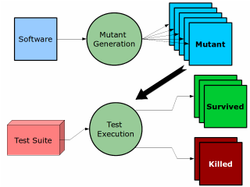


Mutation Testing
Mutation Testing
A test suite should detect small, deliberate changes to the program.
if(x == y) – Original
if (x != y) – Mutant
if( x > y) – Mutant
if(x < y) – Mutant
if(x >= y) – Mutant
1 Original
2 Generate mutant
Mutant
3 Run the tests
if (a && b)
Change one operator
if (a || b)
Use the same test suite
KILLED
SURVIVED
At least one test fails.
All tests still pass.
A mutant in software testing is a deliberate, small change (fault) introduced into a program’s source code to check whether the existing test suite can detect it.
Formal Definition: A mutant is the modified version of the program created by applying a mutation operator (like changing == to !=, + to -, or && to ||).
If your tests fail when run against the mutant → ✅ the mutant is killed (good test suite).
If your tests still pass → ❌ the mutant survives (weak test suite, it missed a fault).
What a surviving mutant means
The tests may be missing an important case. The mutant may also be behaviorally equivalent to the original program.
Notes:
Mutation testing makes a small, deliberate change and reruns the same tests. A failed test kills the mutant. If every test still passes, the mutant survives. A surviving mutant may expose a missing test, but equivalent mutants are also possible.

Slide 20

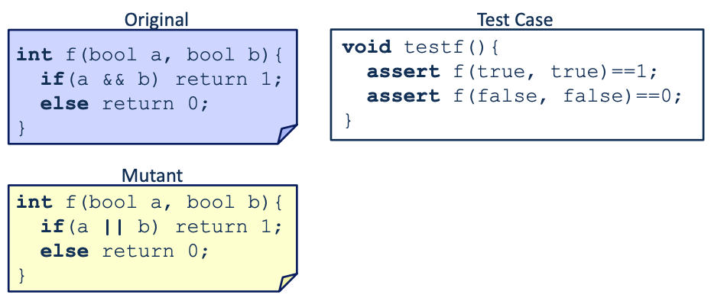
Mutation Testing: Small Example
Existing Tests Do Not Distinguish the Mutant
The current assertions produce the same result for both programs.
ORIGINAL
CURRENT TESTS
if (a && b) return 1;
else return 0;
assert f(true, true) == 1;
assert f(false, false) == 0;
INPUT
ORIGINAL
MUTANT
MUTANT
true, true
false, false
1
0
1
0
if (a || b) return 1;
else return 0;
Mutant Survives the Test Case
No assertion fails
Result: the mutant survives
Notes:
Run the two existing assertions against both versions. Both programs return the same values for these inputs, so neither assertion fails. The tests therefore allow the mutant to survive.

Slide 21
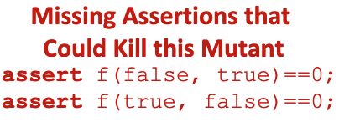
Mutation Testing: Small Example
A Distinguishing Test Kills the Mutant
Use an input for which the original and mutant behave differently.
ORIGINAL
ADD EITHER TEST
if (a && b) return 1;
else return 0;
assert f(false, true) == 0;
assert f(true, false) == 0;
INPUT
ORIGINAL
MUTANT
MUTANT
false, true
true, false
0
0
1
1
if (a || b) return 1;
else return 0;
The new assertion fails on the mutant
Result: the mutant is killed
Original would give 0.
Mutant would give 1.
That’s the bug!
Notes:
Either mixed input distinguishes AND from OR. The original returns zero, but the mutant returns one. The added assertion fails on the mutant, so the test kills it. One of these tests is enough for this mutant.

Slide 22
Mutation Coverage
Mutation Score
Structural coverage and mutation testing answer different questions.
Assess how good your test cases are at catching faults by introducing defects into the source code.
More reliable metric to validate test suite effectiveness.
In recent years, mutation testing has been more prominent in academia and less in industry.
LINE, BRANCH, AND PATH COVERAGE
MUTATION TESTING
Which code and control-flow outcomes executed?
Would the tests detect a small behavioral change?
MUTATION SCORE
killed mutants ÷ non-equivalent mutants × 100%
Notes:
Line, branch, and path coverage tell us what executed. Mutation testing asks whether the tests can detect a small behavioral change. Compute the score over non-equivalent mutants. Interpret survivors carefully because some represent missing tests while others preserve behavior.

Slide 23
Testing Coverage for the Project
It is required to show coverage for your Project (in both the Intermediate and the Final Report)
  At least Branch Coverage is better.
  You should show the chosen coverage before the refactoring/change and after (where hopefully you also added new tests).
Changes should not regress in the project.
But if your project has very low coverage, you better have a good explanation for that.
Focus on increasing the coverage for the system parts that will be affected by your refactoring/change.

