Slide 1
Git and GitHub
Dr. John Businge
john.businge@unlv.edu
Notes:
Good afternoon dear all! Welcome to the second lesson of this class.
In this class we shall be looking at Git and GitHub tools.

Slide 2
Learning Objectives
By the end of this lecture, you should be able to:
Explain why teams use version control.
Describe the Git workflow from local changes to a remote branch.
Explain how branches support parallel development.
Describe how issues, pull requests, and reviews coordinate team contributions.
Explain how teams protect main and control the integration of changes.
Apply this workflow in the Git and GitHub lab.

Slide 3
Why Git and GitHub Matter to a Team
Git records how a project changes over time.
Developers can work in parallel without placing unfinished work on main.
Branches isolate work; pull requests make proposed changes visible.
Issues, reviews, and commit history create a shared record of responsibilities and decisions.

Slide 4
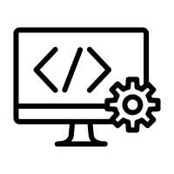

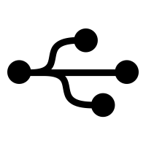


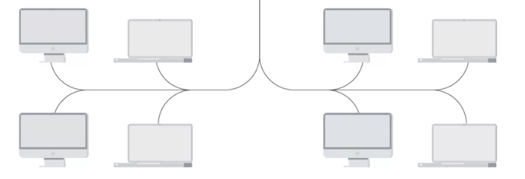


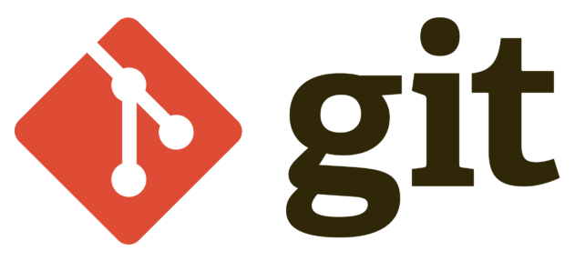
Git & GitHub - version Control
V1
VCS
V2
rollback
Project Files
Code
Tests
Documentation
Configuration
Software project development
Notes:
Let us dive in and learn about Git and GitHub.
When you are developing a software project, you manage a tone of files. These files include documentation, code, configurations
Imagine you are involved in maintaining a software project deployed on a network. You introduce a new feature in the project, test it and roll it out. After that, you realize that half of the clients are broken. This implies that the feature was not properly tested. You may be tempted to provide a a quick fix, but in most cases the quick fix will not provide the solution to the problem.
To avoid these headaches, you can use a version control system to easily roll back your code to the previous version. Since you know that this version was working correctly before the change was made, it would be safe to go back to that one until you had time to fix the code, run some tests, and make sure everything works correctly for all machine models. By releasing code only after properly testing, you avoid having to push quick-fix after quick-fix.
In this class we shall look one of the popular VCS called git.

Slide 5
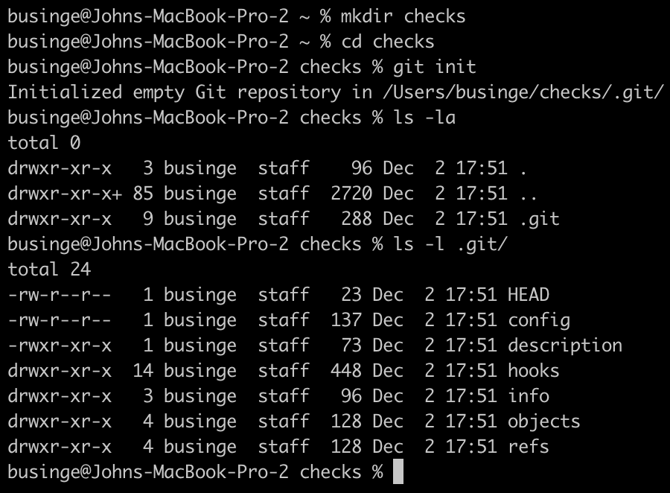
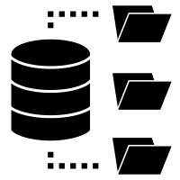
Working with Git
There are two ways to start working with a git repository:
git init - creating a repository from scratch
git clone - a repository already exists somewhere else on a remote site
Run
Empty working tree/directory
Git directory
Git history/changes
Bunch of files
Notes:
Let us now look at how we can work with Git
For now let us start with ‘git init’ and look at git clone later.
Git init – When we run git init, an empty working directory returned.
We will also have a “.git directory”, which we see as a database for your Git project that stores the changes and the change history.

Slide 6
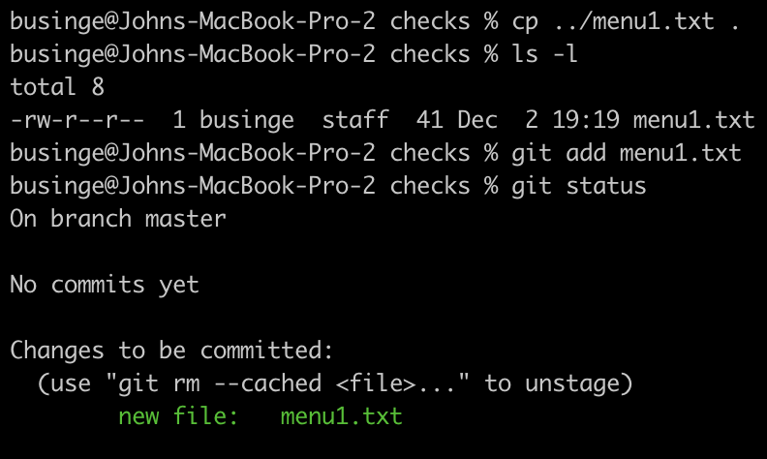

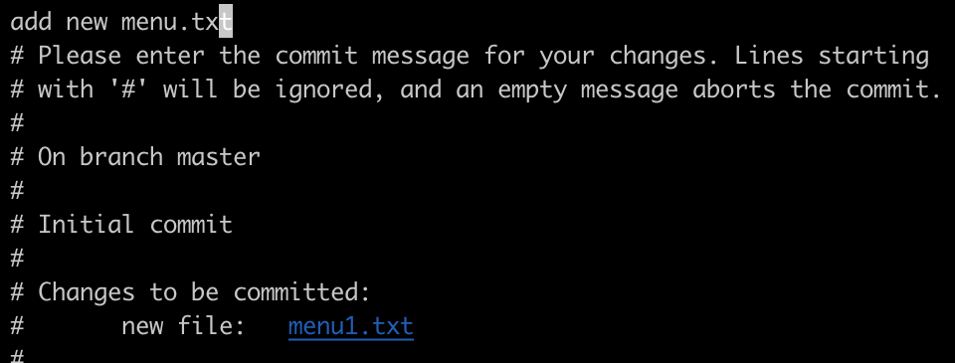
Working with Git
Working directory – add menu1.txt
The Git WorkFlow
Working Directory
Staging Area
.git directory
Modify WD
git add menu1.txt
git commit
changes
Notes:
1. Let us copy the file menu1.txt into our previously created empty working directory. After adding it, this file will be in the working tree, but untracked by git since it has not been added to the .git directory.
2. To track it, we should run the command git add <filename>. We see that our new file is marked to be committed, this means that our change is currently in the staging area.
3. To get it committed into the .git directory, we run the git commit command. When we run this command, we tell Git that we want to save our changes. It opens a text editor where we can enter a commit message.
We'll dive deep into writing good commit messages later.
4. This is called the “Git Workflow”

Slide 7
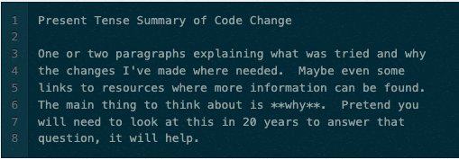
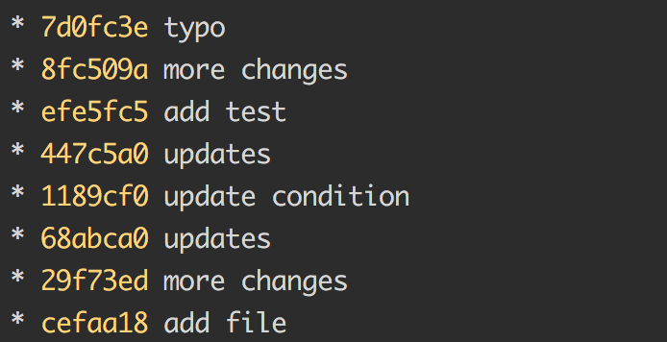
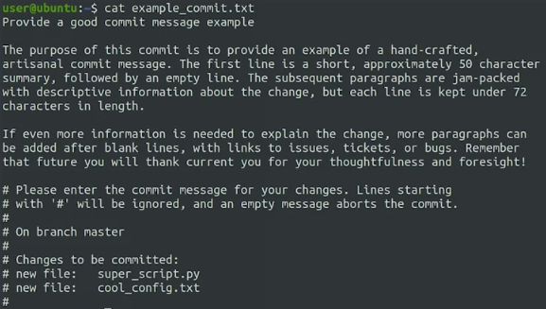
What makes a good commit message?
https://www.freecodecamp.org/news/a-beginners-guide-to-git-how-to-write-a-good-commit-message/
http://benfalk.com/blog/2015/10/20/commits-that-matter/
Short Commit Message
Under 50 characters
Detailed Commit Message
One or more paragraphs, if needed
Lines kept under 72 characters
https://initialcommit.com/blog/git-commit-messages-best-practices
Notes:
So, what is a good commit message?
Sometimes it can be tempting to just write something short like update, change or fix as the description of our commit messages. Don't do it. It's super frustrating to go back to repositories history and discover that there's not enough context to understand what was changed and why.
It takes only a few more seconds to write a better description. This can be invaluable down the line.
Following these guidelines can help make your commit message really useful, and the investment of work now will really pay off later. Writing a clear, informative commit message is important when using a VCS and working in a team.
Future, you or others who might read the commit message, later on, will really appreciate the contextual information as they try and figure out some of the parts of the code or configuration
2. Short commit message
3. Detailed commit message.

Slide 8
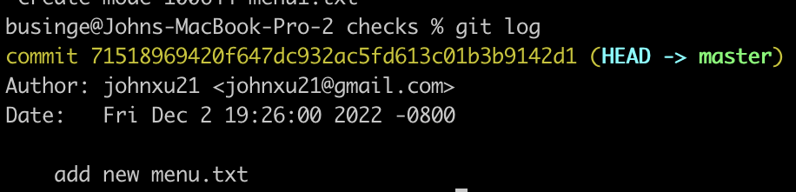
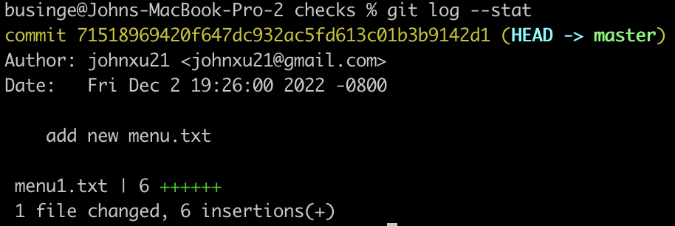
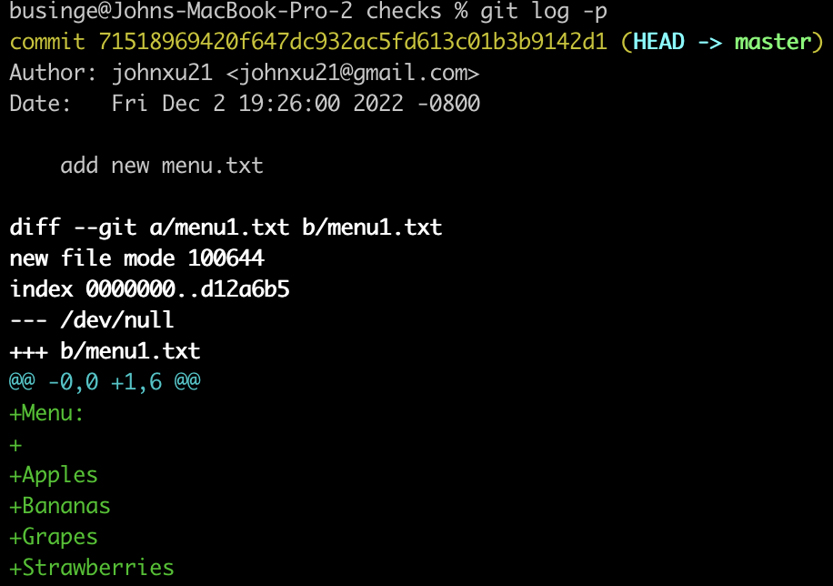
Getting More Information About Our Changes
git log
git log
git log – p
git log --stat
git show <commit-ID>
git log --stat
git log -p
menu1.txt
Menu:
Apples
Bananas
Grapes
Strawberries
Recall that we have one commit in our git repository
Notes:
Now, let us look at Getting More Information About Our Changes
These commands are very useful to track changes of your commits: git log, –p, --stat, and git show.
1. Recall that we have one commit in our git repository having one file <Menu1.text>
2. When we run git log will list all the commits and their details
3. Git log –p will show you the commits and details of their patches
4. Git –stat will return the statistics
5. Git show - shows details of a commit and its patch

Slide 9




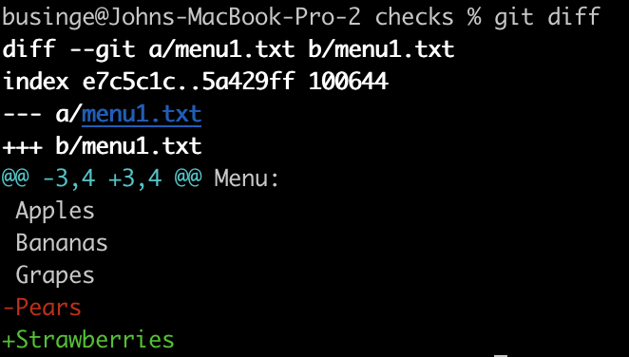


Getting More Information About Our Changes
git log
git log – p
git log --stat
git show <commit-ID>
Changes
Staged/
committed
menu1.txt
menu1.txt
Menu1:
Apples
Bananas
Oranges
Pears
Menu1:
Apples
Bananas
Oranges
Strawberry Pears
git diff (changes not yet staged)
changes
Unstaged changes
Commits
Next commit?
Involving Use-case
Notes:
These commands we have looked at work on changes that have either been staged or committed
Sometimes it can take a while before you can commit your changes, especially when you are working on an involving use case. Before committing it, you need to make sure that it works correctly. Check that all the test cases are covered and so on and so on. So while doing this you find bugs in your code that you need to fix. It's only natural that by the time you get to the commit step you don't really remember everything you changed.
To help us keep track git gives us the “git diff” command.
Let's make a new change to our script and then try this command out.

Slide 10
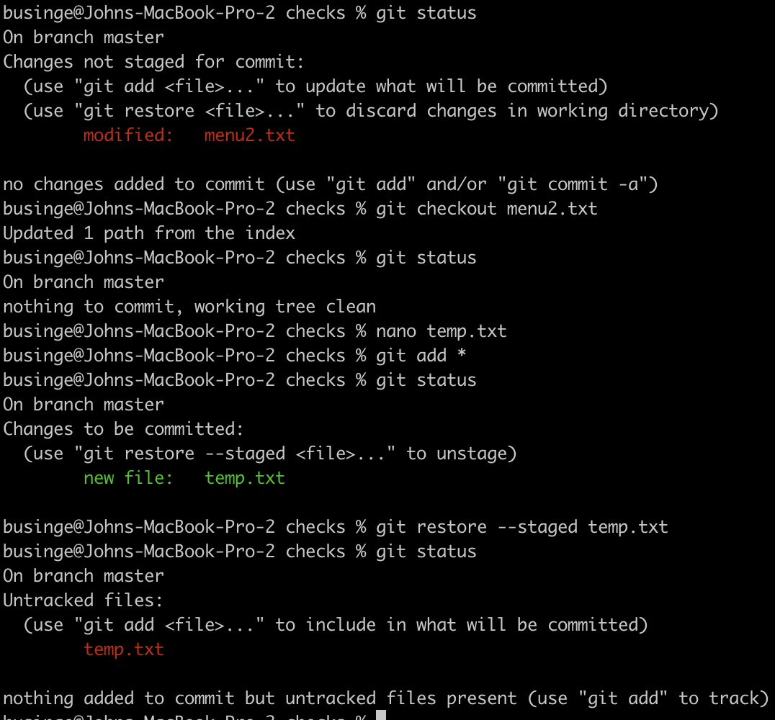
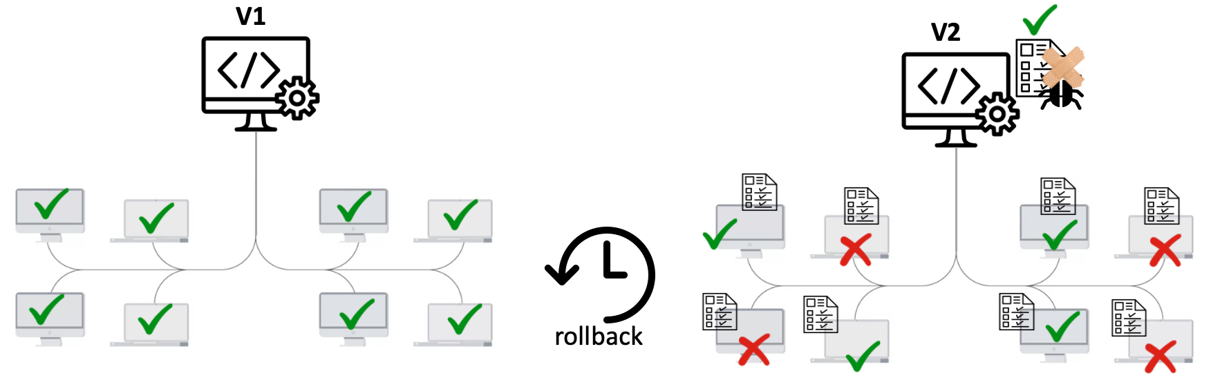
Undoing Changes
git checkout/restore (reverting unstaged changes)
git reset/restore (reverting staged changes)
menu2.txt
menu2.txt
temp.txt
Menu:
Apples
Bananas
Grapes
Strawberries
Menu:
Apples
Bananas
Grapes
Strawberries
Menu Temp:
Pears
Not to be tracked
meant not to be tracked
Green->tracked
Red->untracked
Notes:
Now let us look at another aspect of git – undoing changes
At the beginning of this class we discussed about the possibility of rolling back changes to an earlier version so that we can fix a stubborn bug. There's a bunch of different techniques available depending on which changes we need to undo.
One of these commands is git checkout/restore (it is used to undo untracked changes). Back to our running example—menu2.txt, assuming we delete banana and we realise that it was done out of error. Of course this is a trivial example, but in practice you might make many changes spanning many files.
Reverting untracked changes: git checkout/restore
Then run git status. We can see that menu.txt is untracked and also git gives us suggestions on what to do
We then run git checkout followed by git status. We can see that working tree is not clean
The next command is git reset/restore (Reverting staged changes. Let us asume that we created a new file called temp.txt that is meant not to be tracked.
We accidentally add it to the staging area
Git gives us a suggestion on what we can do with the tracked file
We run git restore to untrack the temp.txt

Slide 11
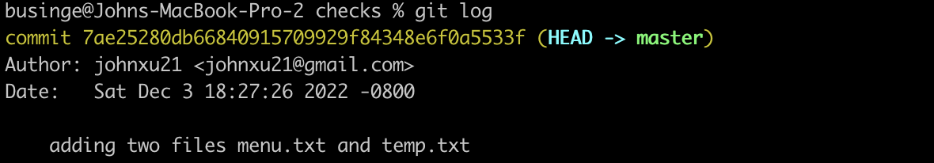
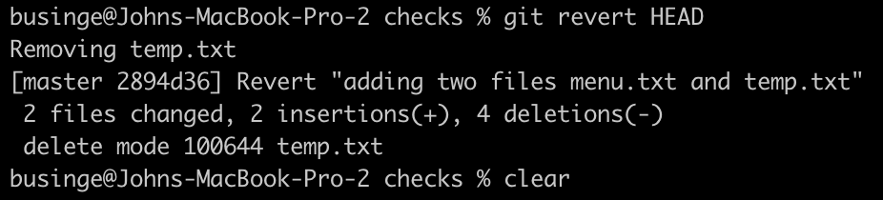
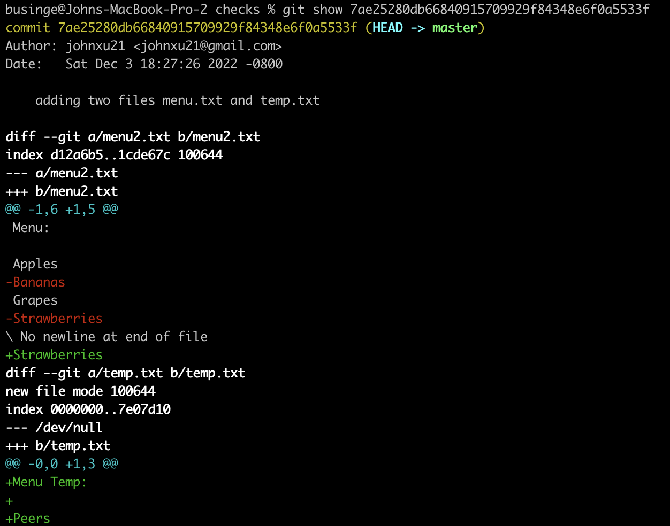
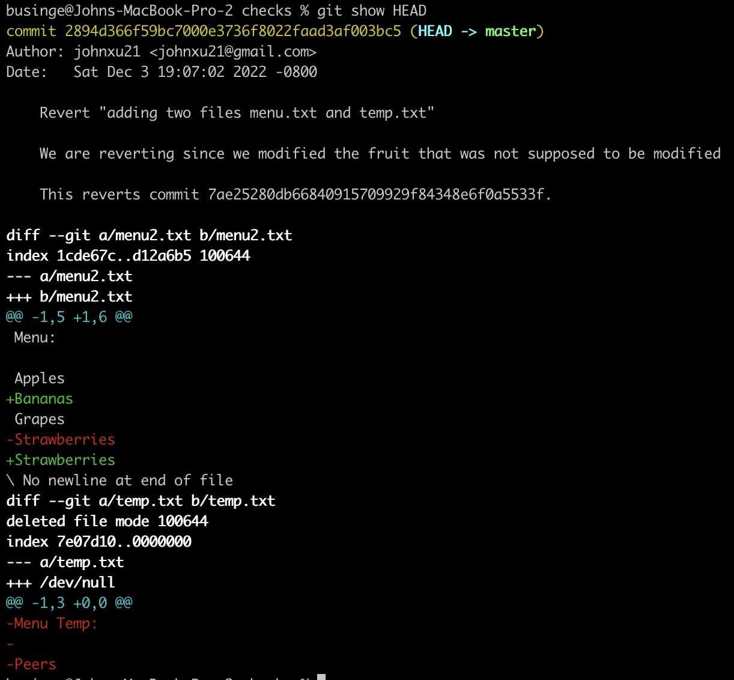

Undoing Changes - Rolbacks
git checkout/restore (reverting unstaged changes)
git reset/restore (reverting staged changes)
git revert commit (undoing committed changes)
Inverse of the commit command
menu2.txt
menu2.txt
temp.txt
Menu:
Apples
Bananas
Grapes
Strawberries
Menu:
Apples
Bananas
Grapes
Strawberries
Menu Temp:
Pears
Commited 2 files
Notes:
The next command is: git revert commit (undoing committed changes). The output of the command is the “inverse of the committed commit”
Fixing your work before you commit is good. But what happens if it's already been snapshotted by Git (already committed)?
Git revert HEAD will help us produce the inverse of the committed changes

Slide 12
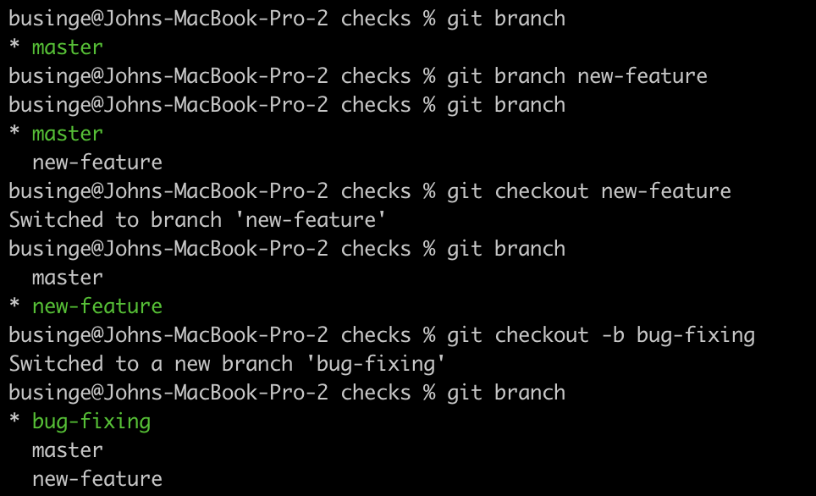


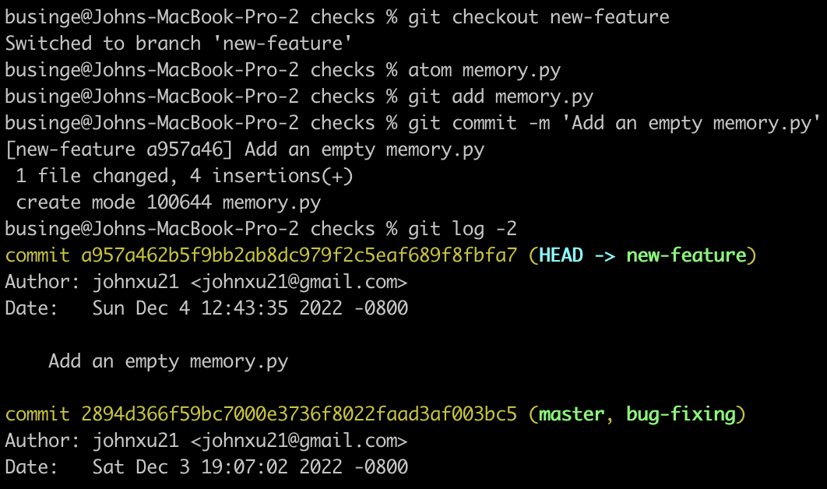
Branching and Merging
Feature branch
Master/main branch
bugfix branch
Branches are an important part of the Git workflow.
What is a branch?
A branch represents an independent line of development in a project.
Branching is a common practice in software development.
Notes:
Branches are an important part of the Git workflow. What is a branch? A branch represents an independent line of development in a project. Branching is a common practice in software development.
Developers create branches to develop features or create patches and merge the changes back into the main branch when they are fully developed.
Creating a branch and switching to it immediately is a pretty common task. So common that git gives us a useful shortcut to create a new branch and to switch to it in a single command. We can use the <git checkout -b new branch> to do this.
Let us add a file in the new-feature called memory.py and commit it. When we call git log -2 we see that the new-feature is at the HEAD. While master and bug-fixing branches are pointing to an earlier snapshot of the project

Slide 13

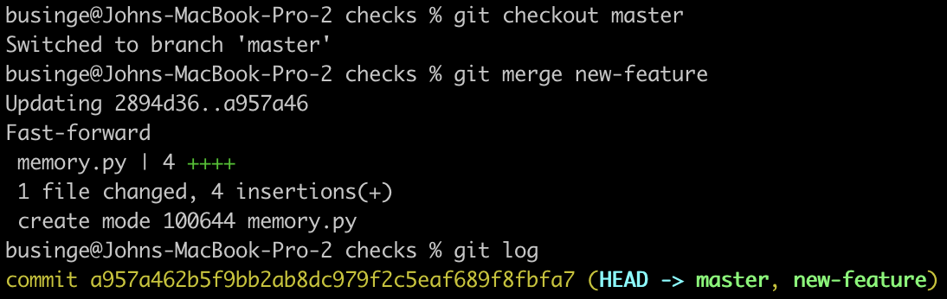
Branching and Merging
master
Feature branch
master head
new-feature
Master/main branch
Integrating the feature
new-feature head
Merge Algorithms
Fast-forward – not diverged
Three-way merge - diverged
bugfix branch
master
Fast-forward
Linear history
new-feature
new-feature head
master head
After Fast-forward merge
Notes:
We have looked at how we can create branches and also commit changes to those branches. Remember that the branch is meant to experiment a feature/bug fix and when fully developed we integrate the feature or bugfix into the main/master branch
Now let us see how we can integrate/merge the developed feature into the main branch.
First we checkout master and then merge new-branch
There are two types of merge algorithms:
Let us first look at the fast-forward – The merge we just performed is an example of a fast-forward merge. This kind of merge occurs when all the commits in the checked out branch are also in the branch that's being merged.
If this is the case, we can say that the commit history of both branches doesn't diverge. In these cases, all Git has to do is update the pointers of the branches to the same commit, and no actual merging needs to take place.

Slide 14
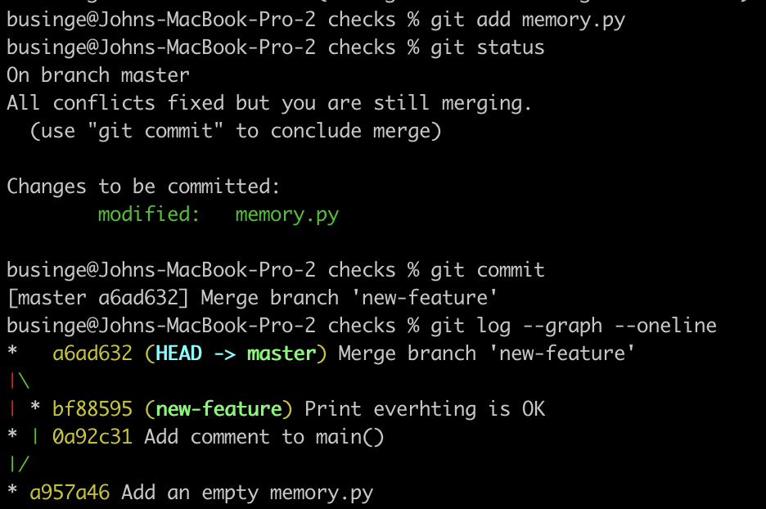
Branching and Merging
master
Feature branch
new-feature
master head
Master/main branch
new-feature head
Three-way merge
Merge Algorithms
Fast-forward – not diverged
Three-way merge - diverged
bugfix branch
master
Three-way merge
Split history
new-feature
master head
new-feature head
master head
After Three-way merge
Notes:
On the other hand, a three-way merge is performed when the history of the merging branches has diverged in some way, and there isn't a nice linear path to combine them via fast-forwarding. This happens when a commit is made on one branch after the point when both branches split.
In our case, this could have happened if we made a commit on the master branch after creating the other branches.
Git will tie the branch histories together when this occurs with a new commit. And merge the snapshots at the two branch tips with the most recent common ancestor, the commit before the divergence.
The problem with three way merges is that because of the split history, it's hard for one to debug when an issue is found in our code, and we need to understand where the problem was introduced.
If instead the changes are made on the same part of the same file, Git won't know how to merge those changes, and the attempt will result in a merge conflict.
Git rebase - by changing the base where our commits split from the branch history, we can replay the new commits on top of the new base. This allows Git to do a fast forward merge and keep history linear.
We run the command git rebase, followed by the branch that we want to set as the new base. When we do this, Git will try to replay our commits after the latest commit in that branch.

Slide 15
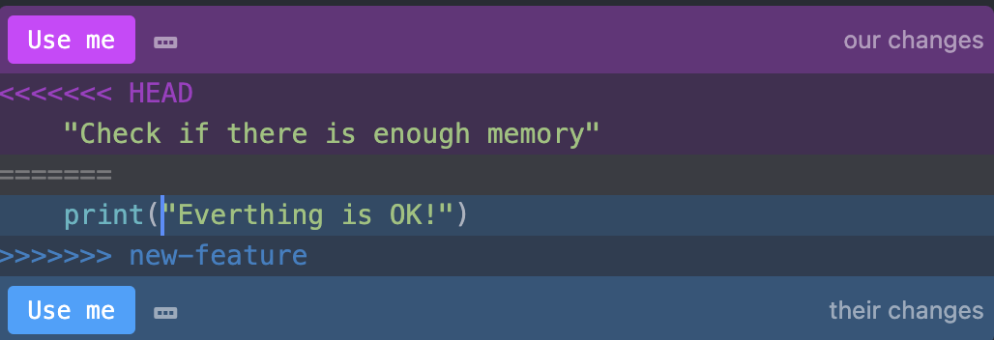
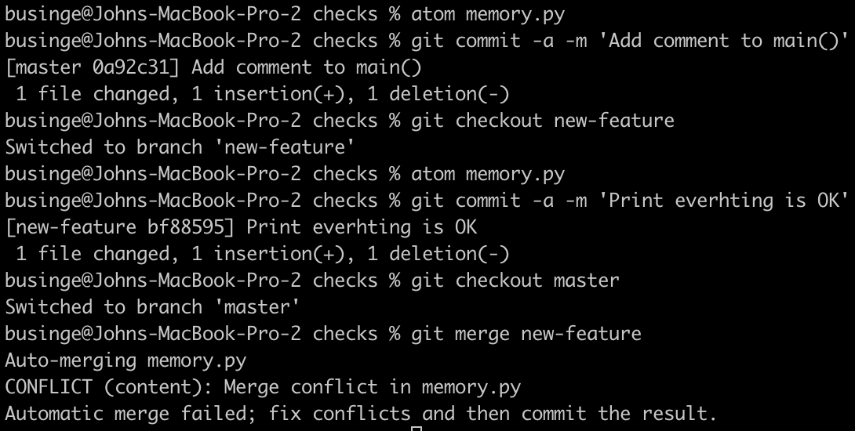
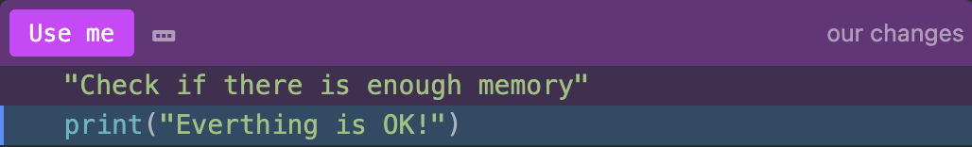
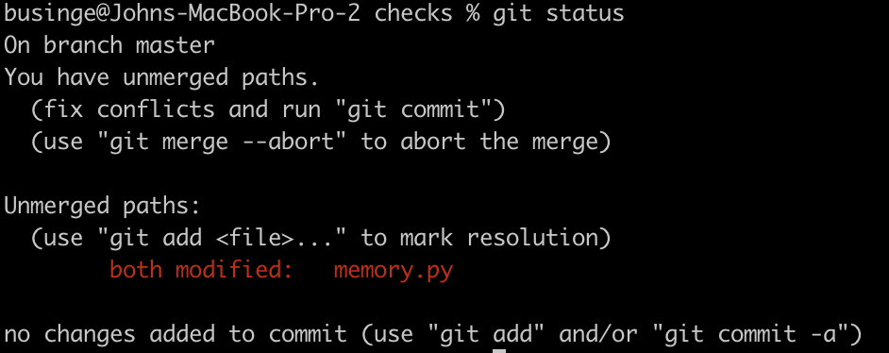
Merge Conflicts
memory.py (at master)
Keep both
Notes:
When we make edits to the same part of the same file, a merge will result in a merge conflict. Normally, Git can automatically merge files for us. But when we have a merge conflict, it will need a little help to figure out what to do.
I edited the "memory.py" file in the master branch and replaced the "pass" statement with a comment about what the main function should do.
Let us checkout new-feature and edit memory.py
When we call git merge, we can see that our changes are untracked
The unmerged content of the file in the new-feature branch is the call to the print function. It's up to us to decide which one to keep or if we should change the file's contents altogether.
We’ll keep both statements in this case and delete the merger markers.
To see what the commit history looks like now, we'll use a couple of handy options to the git log command; --graph for seeing the commits as a graph, and --oneline to only see one line per commit. This format helps us better understand the history of our commits and how merges have occurred. We can see the new commit that was added and also the two separate commits that we merged. One coming from the main branch and the other two coming from the "new-feature" branch. We can also see that master is pointing to the merge commit but new-feature is still pointing to the previous one.

Slide 16




Intro to GitHub
Remote repository
hosting
Notes:
In earlier slides, we called out that Git is a distributed version control system. Distributed means that each developer has a copy of the whole repository on their local machine.
GitHub is a remote repository hosting service for Git.
GitHub is a web-based Git repository hosting service. On top of the version control functionality of Git, GitHub includes extra features like bug tracking, wikis, and task management. GitHub lets us share and access repositories on the web and copy or clone them to our local computers so we can work on them. GitHub is a popular choice with a robust feature set, but there are others. Other services that provide similar functionality are BitBucket and GitLab.

Slide 17
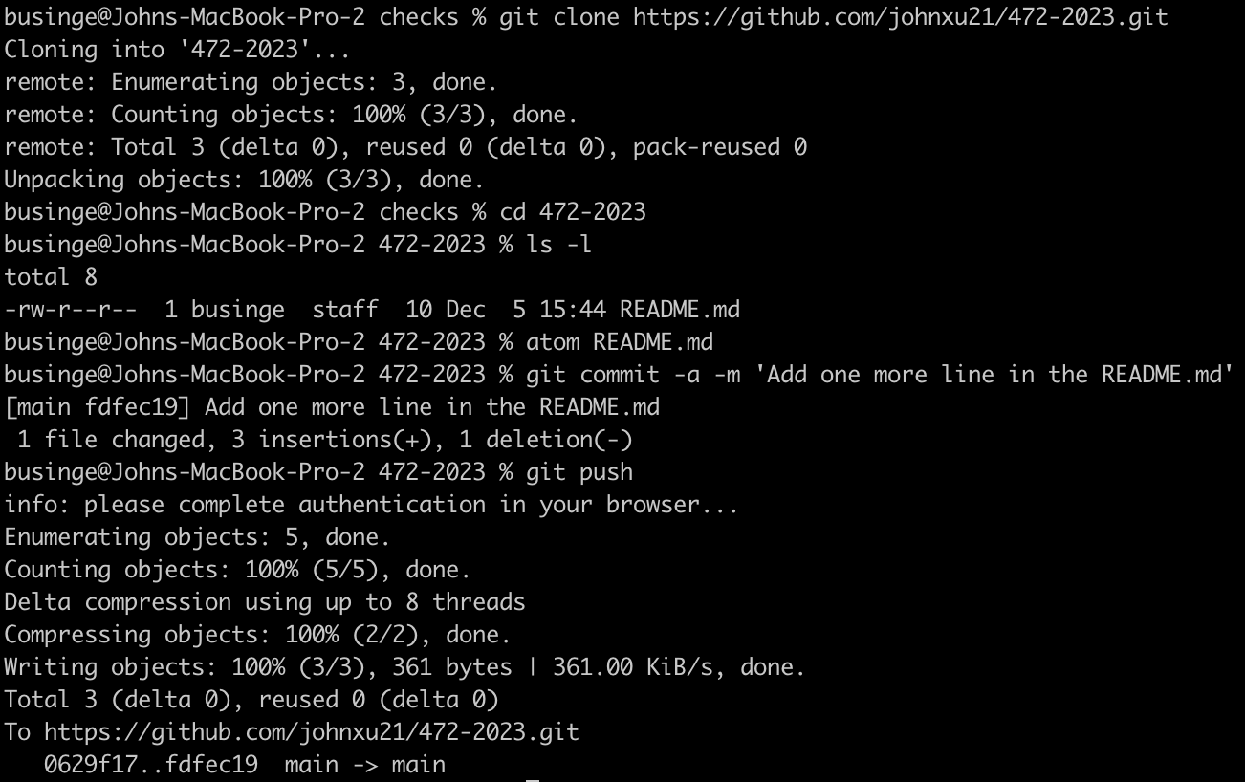
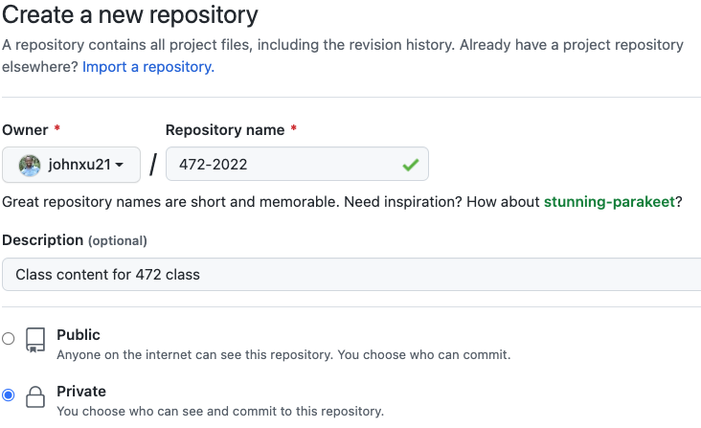
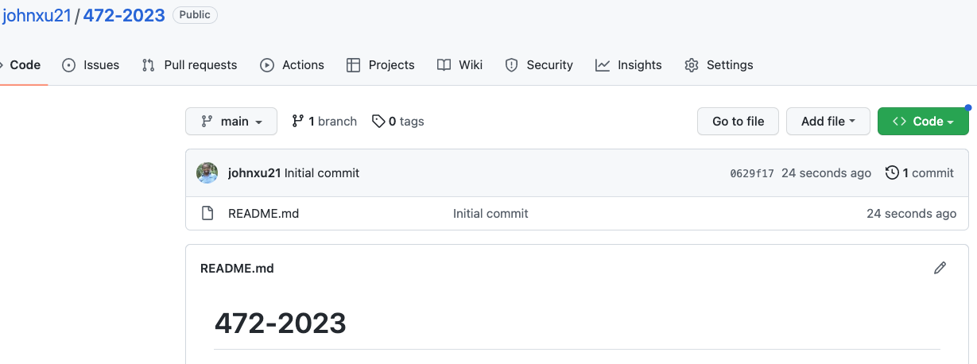
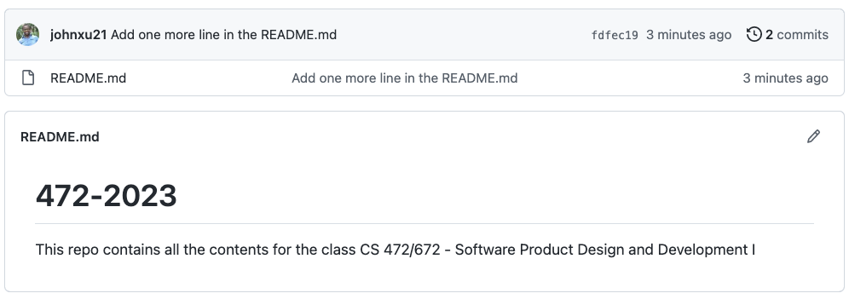
Interacting with GitHub
git init
git clone
472-2023
Notes:
Recall that we stated that there are two ways of creating a local git repository
First, let us create a remote repository on GitHub
Next, let us clone the remote repository onto our local computer
Then let us modify the README.md to make it more descriptive
Commit and push the remote repository

Slide 18
One Repository for the Whole Team
All team members clone the same team repository.
The main branch represents the integrated and stable project.
Each task is completed on a separate branch.
Unfinished work remains off main.
Branch protection prevents uncontrolled integration.

Slide 19
The Team Contribution Workflow
Issue → Synchronize fork → Branch → Focused commits → Push → Pull request → Review → Revision → Merge
The issue defines the expected result and identifies the contributor.
The team member synchronizes their fork with the upstream team repository.
A branch in the member’s fork isolates the implementation.
Focused commits provide a clear and reviewable history.
The pull request proposes integrating the contribution into the upstream repository.
Review and revision occur before the maintainers merge the contribution into main.

Slide 20
Pull Requests Control Integration
A pull request should identify the related issue.
The author explains what changed and how it was tested.
A teammate reviews the contribution against the issue and project requirements.
The author responds to comments and updates the same branch.
The change is merged only after approval and required checks.

Slide 21
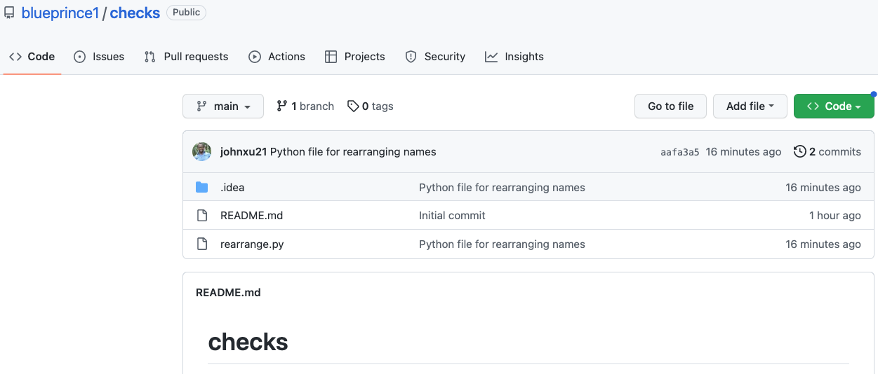
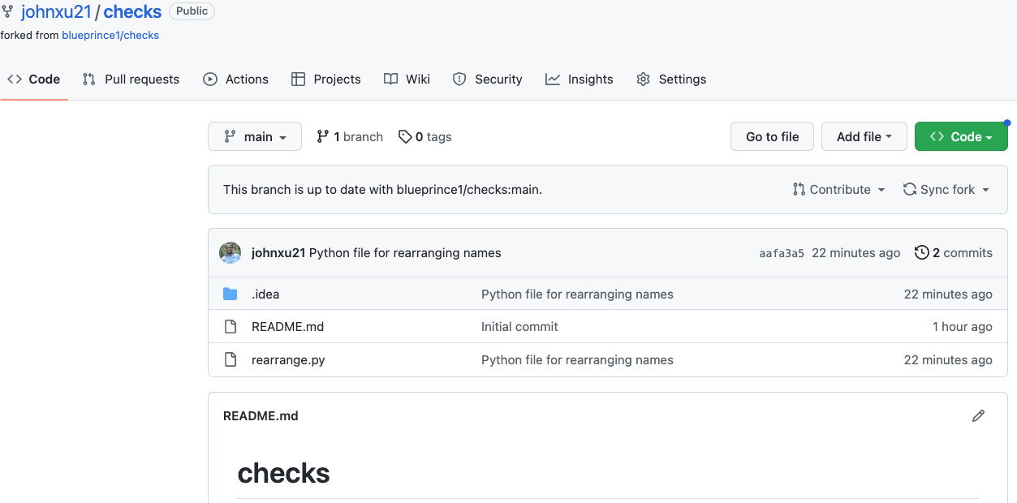
Collaboration on GitHub - Pull request – Fork Workflow
Notes:
Let us assume that our colleague Blueprince has created a checks repo to rearrange names and we want to contribute to it.
I decide to create a fork so that I can own the repo and contribute.
See how it shows that it's a forked repo by stating the original repo under the name.

Slide 22
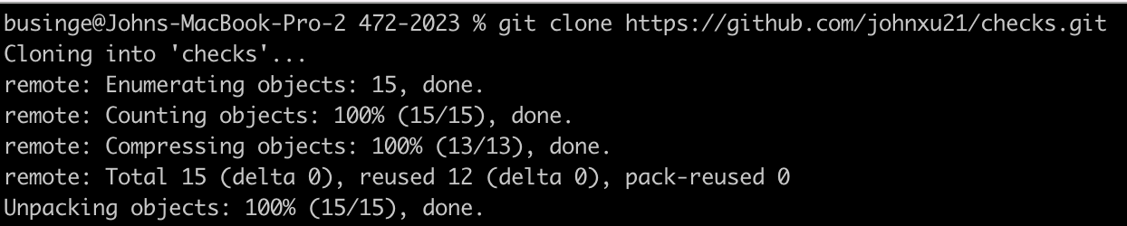
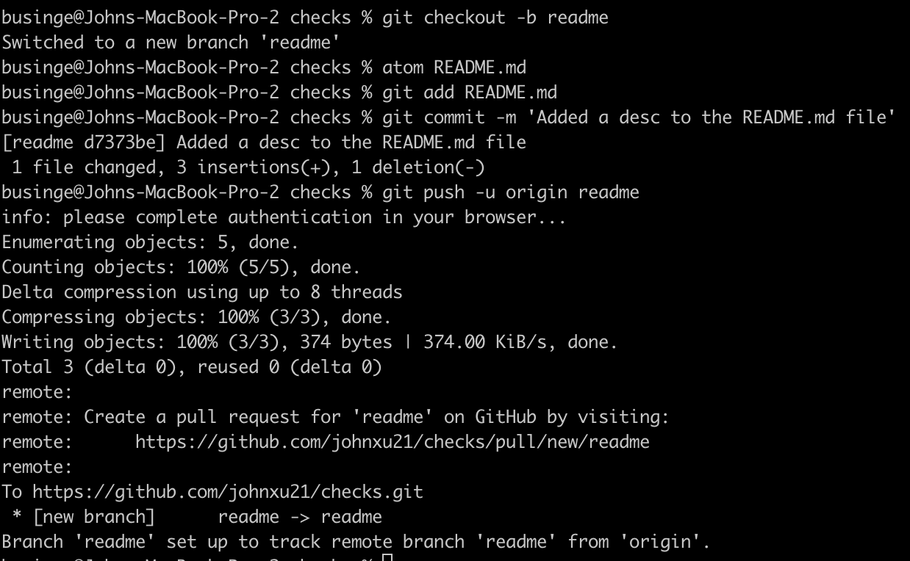
Collaboration on GitHub - Pull request – Fork Workflow
Create local branch
Create remote branch -> push
Notes:
After creating the fork, I clone the fork so that I can have a local repository to experiment with my changes.
We can now start editing the README.md file. The MD extension indicates that we're using markdown, which is a lightweight markup language. We can use it to write plain text files that are then formatted following some simple rules. In this case, we'll start with a title with the module's name and a brief description that says it's used to rearrange names.
Now, to push the change to our forked repo, we need to create the corresponding remote branch. Do you remember the command for that? Yes. It's git push - u origin add -readme.
So when we push the change to the new branch, we got a message that we can create a pull request if we want to. We'll do that in a minute.

Slide 23
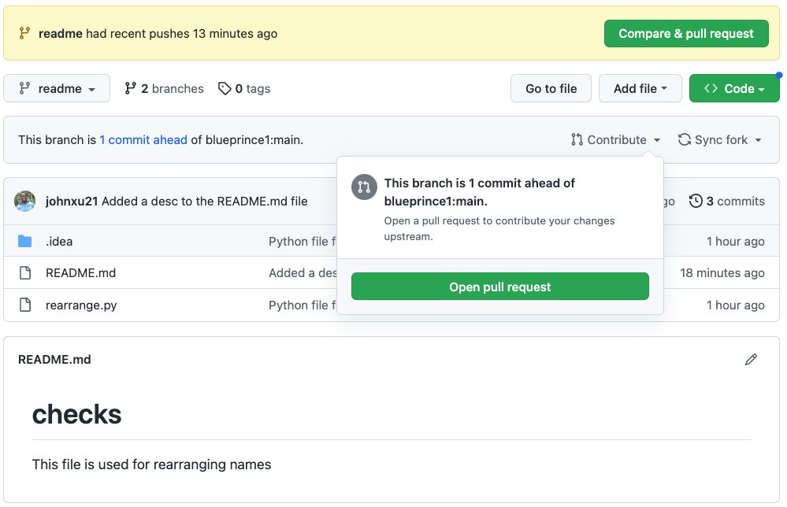
Collaboration on GitHub - Pull request – Fork Workflow
A pull request is a commit or series of commits that you send to the owner of the repository so that they incorporate it into their tree.
Notes:
First, let's check out how our file looks when rendered.
GitHub tells us that our branch is ahead of the original repositories main branch by one commit, which is the commit we just made. We have to select the readme branch
We can start our pull requests by clicking on the Pull Request link.
A pull request is a commit or series of commits that you send to the owner of the repository so that they incorporate it into their tree.

Slide 24
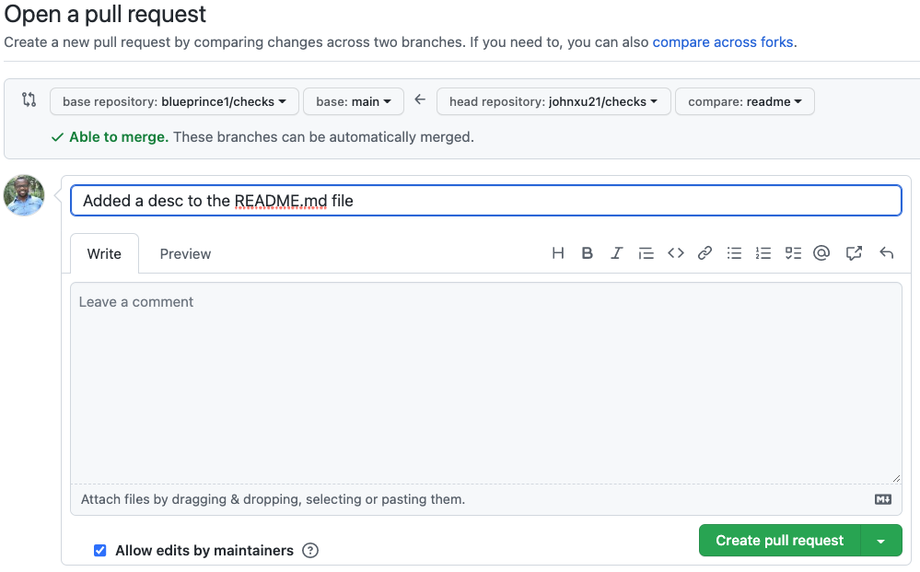
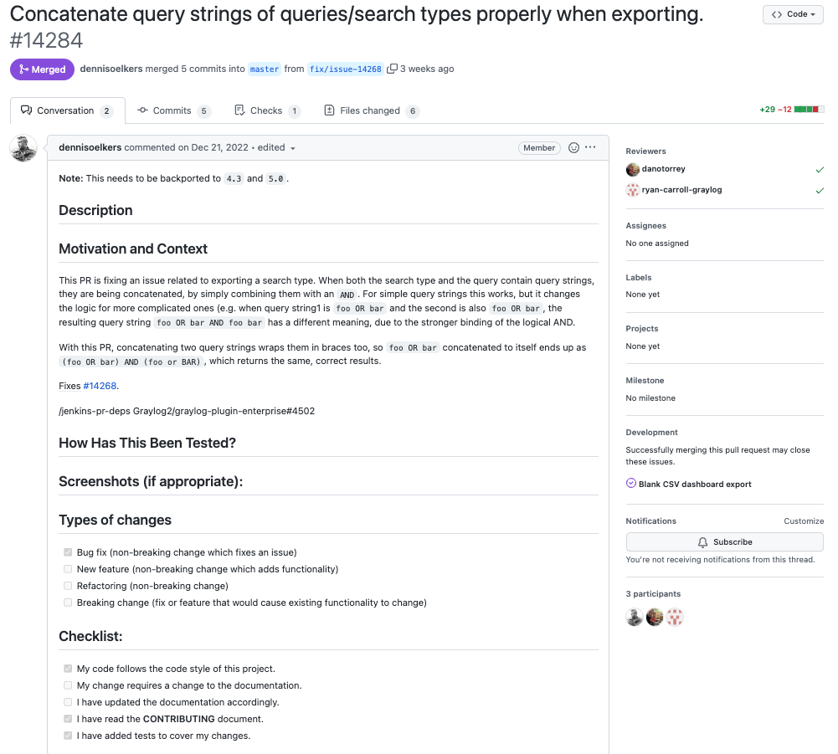
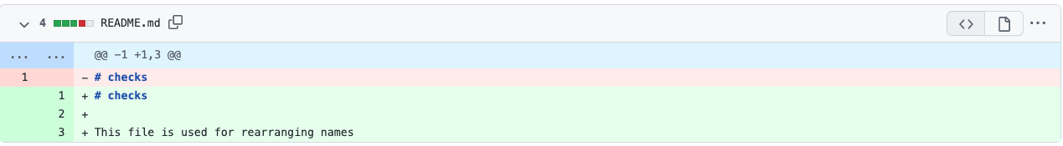
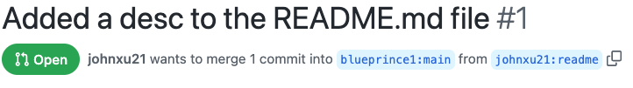
Collaboration on GitHub - Pull request – Fork Workflow
Added a description to the README.md that was missing in the project
Notes:
Before creating a pull request, it's always important to check that the code will merge successfully. GitHub tells us that our change can be automatically merged, which is great news.
As we mentioned before, we should use this to explain why we're creating this pull request. This lets the person that will approve the change understand why they should merge the change into the main tree. Are we fixing a bug? This is a new feature to let the project support more use cases. How will the project benefit from including our change? Whatever info might be useful to the approver, record it here. We can also use this box to explain how the change was tested.
So we'll just say we're adding a README file that was missing for the project.
We should also check that the change we're sending looks correct. It's always a good idea to double-check that we're sending the right change. To do that, let's look at the diff that appears at the bottom of the page.
The number next to the name of our pull request is the identifier that's used in GitHub to track issues and pull requests. We can use this identifying number to access this pull request anytime we need it.

Slide 25
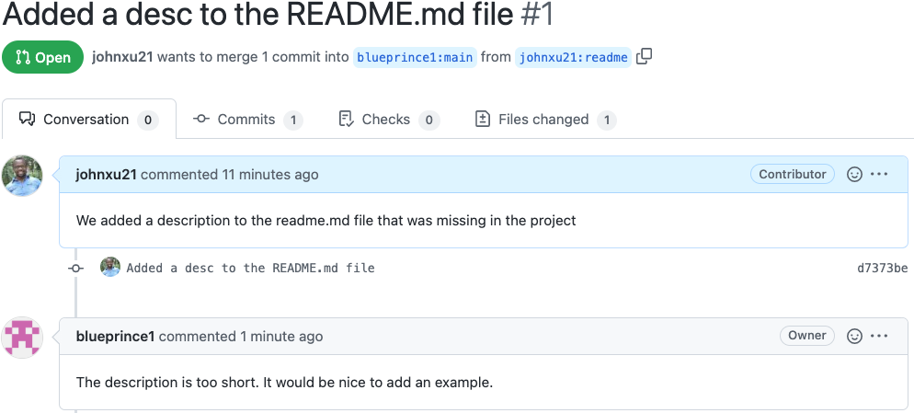
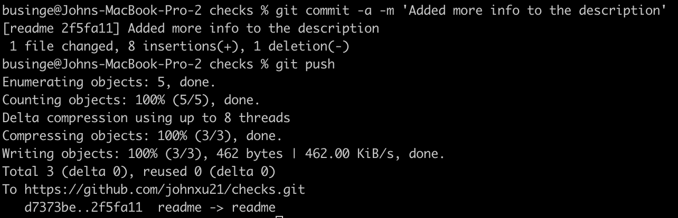
Updating an Existing Pull Request
Notes:
We got a comment saying that our README was too short and they'd like us to add an example. To address this comment, will add more details to our file. We'll start by explaining that the function rearranges LastName, FirstName into FirstName LastName and then we'll add an example. We'll say that calling rearrange name with Turing, Alan as a parameter, will return Alan Turing.

Slide 26
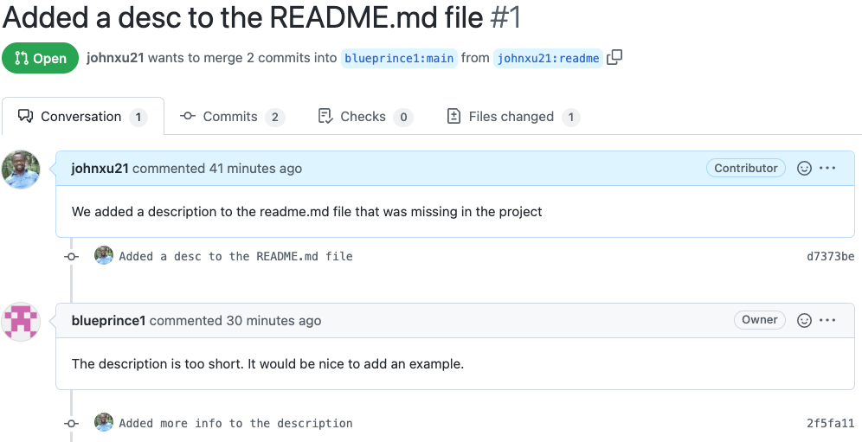
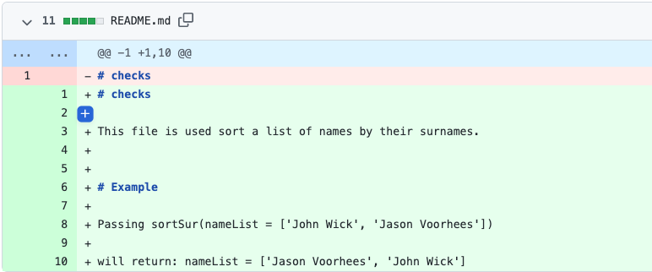
Updating an Existing Pull Request
Some projects may ask you to have only one commit in your pull requests
Notes:
Now that we've pushed our change back to the repo, let's check our pull request in GitHub. In the Commit's tab, we can see our two commits.
Our commit now shows up as a part of the same pull request. It's important to notice here that we just pushed our commit to the same branch as before and GitHub automatically added it to the pull request. If we wanted to create a separate pull request, we would need to create a new branch instead. If we go to the Files Change tab, we can see all files affected by the pull request, no matter which commit they were changed in. Whenever we look at the diff generated by a commit or a chain of commits, GitHub will show a color diff for the changes that we've made.
It will use green for new lines and red for lines that were deleted. If only a part of the line changed, it will highlight that specific part of the line. In this case, it's a new file, so all the lines are additions. Check out how we see only one file even when there are two separate commits.
Some projects may ask you to have only one commit in your pull requests, other projects may ask you to rebase against the latest master branch when your pull request is ready to be merged back into the main tree.

Slide 27
Best Practices for Collaboration
It's a good idea to always synchronize your branches before starting any work on your own.
Avoid having very large changes that modify a lot of different things.
When working on a big change, it makes sense to have a separate feature branch.
To make the final merge of the feature branch easier, it makes sense to regularly merge changes made on the master branch back onto the feature branch.
Avoid rebasing on public repository
https://help.github.com/en/github/collaborating-with-issues-and-pull-requests/about-merge-conflicts
https://help.github.com/en/github/collaborating-with-issues-and-pull-requests/resolving-a-merge-conflict-using-the-command-line

Slide 28
Code Reviews
Code review (sometimes referred to as peer review) is a software quality assurance activity in which one or several people check a program mainly by viewing and reading parts of its source code, and they do so after implementation or as an interruption of implementation.
At least one of the persons must not be the code's author.
The persons performing the checking, excluding the author, are called "reviewers".
Documentation
Configurations
Code
Design Diagrams
Notes:
Last week we looked at a range of concepts about Git commands and how we can use them. We also looked at GitHub and collaboration
Today we are going to look at more concepts on Github and collaboration

Slide 29
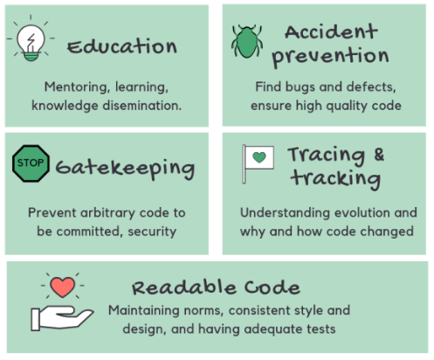

Why do we need to perform code reviews?
Forgetting to add tests
Unclear names
Code issues
Forgetting to handle a specific condition
Requirements
Programming language Style Guide
The code has passed all tests
Test Coverage (>90)
Code is well Documented
Passed CI
Design Diagrams
One thing to always remember, code reviews are not about us being good or bad coders, they're about making our code better.
Notes:
Why do we need to perform code reviews?
Common code issues are unclear names that makes the code hard to understand. Forgetting to add a test or forgetting to handle a specific condition.
Today, some open-source projects and lots of companies require code reviews for everybody. This isn't because they don't trust them, but because they want the highest quality code. And code reviews are how they get there. One thing to always remember, code reviews are not about us being good or bad coders, they're about making our code better. And not only that specific review, but in general.

Slide 30
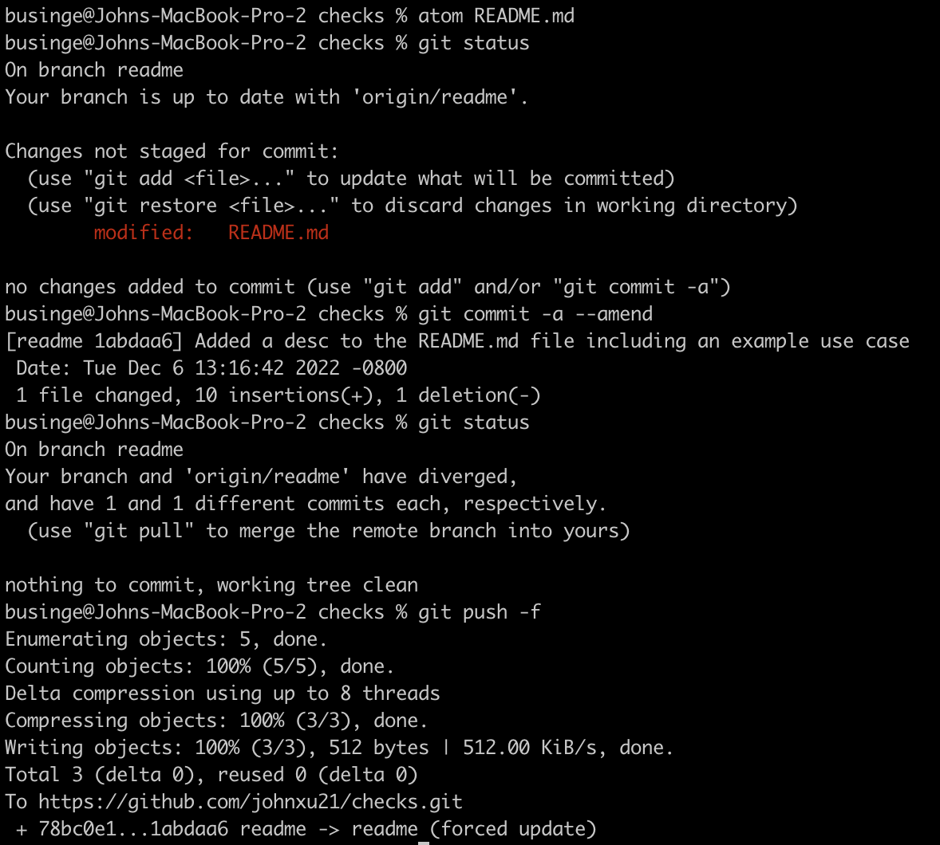
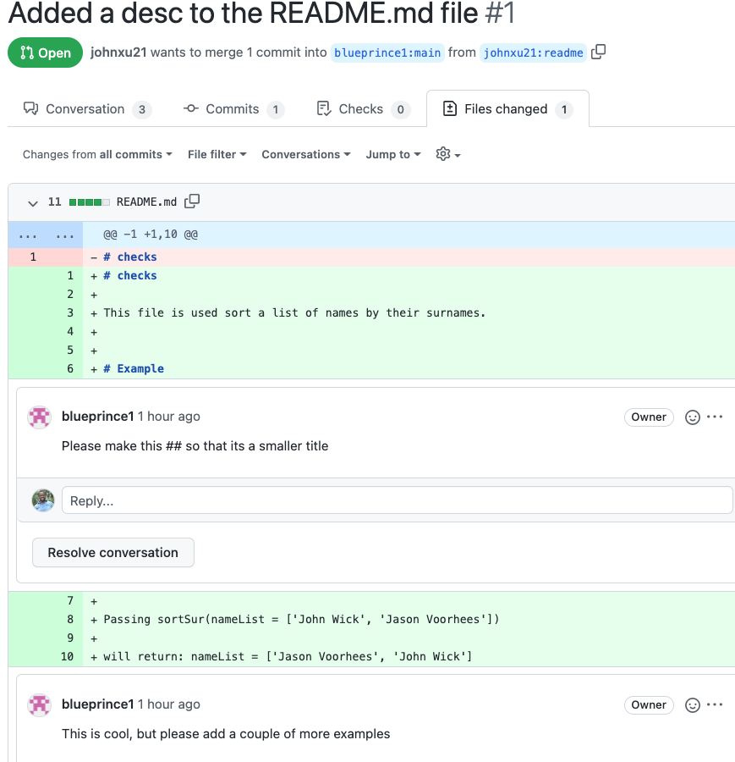
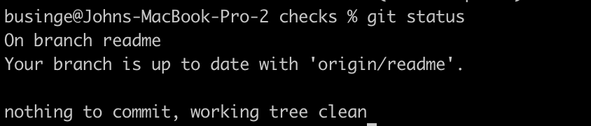
Code Reviews on GitHub
Notes:
Remember, a while back in the slides, we created a pull request that added a read me file. Conveniently, our colleague just replied with a few comments. Let's have a look.
We open up Readme.md and fix the issues
Since we want this change to be a part of the previous commit, we'll call
git commit --amend (reverting committed changes)
“git commit -a – amend”, which will edit the original commit.
“git push -f”

Slide 31


Code Reviews on GitHub
The comment has been resolved. Please take another look.
The comment has been resolved. Please take another look.
Notes:
Ignore the outdated. It simply means that we have added a new comment

Slide 32

Code Reviews on GitHub
Markdown Language

Slide 33




Merging PRs – Branch Protection Rules
Project
Notes:
It is important to set checks to avoid merging garbage into the main repository

Slide 34

Integrating PRs
Project

Slide 35
Managing Team Projects
Good planning and communication key managing team projects
Documenting what you do and why you do it becomes even more important; otherwise, you'll spend most of your time answering everybody else questions.
The basic form of this is writing clear code with good comments and documentation for those functions.
If you are a project maintainer, you must promptly reply to pull requests and not let them stagnate.
When coordinating who does what and when a common strategy for active software projects is to use an issue tracker.

Slide 36







Tracking Issues
Simon
Pull
Ramos
Push
Remote Repository
Subway Project
Pull
Pull
Pull
Push
Push
Push
Sam
Alice
Bob
Local Repository
Local Repository
Local Repository
Notes:
In the project you will be working in groups of 10 students. You decide to start coding without careful planning
Instead of dividing the task into smaller pieces and assigning them to different people, you just randomly started working on some part of the infrastructure.
The result would probably be total chaos, with different pieces of software that won't work well together, and lots of gaps that nobody worked on.

Slide 37


Issue Template
Feature request
Bug report
https://github.com/hubtype/botonic/tree/master-lts/.github/ISSUE_TEMPLATE

Slide 38


Issue Tracker - GitHub
Issues
Feature requests
Bugs to fix
New tests to add
Notes:
That's when a tool like an issue tracker or bug tracker can help us coordinate our work better. An issue tracker tells us the tasks that need to be done, the state they're in and who's working on them.
The system also let's us add comments to the issue, these comments can be super helpful. They can give us more details about the problem, explain a way to solve it, or detail how to test if it's been solved. Issue trackers aren't just useful for people actively working on projects.
Having a clear visible list of the pending work, lets new contributors figure out how to help and where to jump in.
So, if you're hosting your project there, it can be very handy to track work on your project. Like the problems to solve, the features to add and the use cases to include it, let's check it out.

Slide 39




Tracking Issues - GitHub
Pull Request
Issue
Title
Detailed description
Keyword #Issue_No
In the project, it is required that you link the Issues to the Pull requests
More Description later – As comments
Notes:
The issues should have a title
Description: When writing in issues description, it's a good idea to include all the information that we have about the problem or missing feature and any ideas on how to solve it. And if new information comes up later on, it can be added as additional comments on the same issue. Great, we're now ready to submit the new issue.
The issue was assigned to a developer who fixed it

Slide 40

Project – Pull requests and reviews requirements
Markdown Language
Requirements
Programming language Style Guide
The code has passed all tests
Test Coverage (>90)
Code is well Documented
Passed CI
Design Diagrams
PR and issues are linked

Slide 41
Workflow in the Lab
Issue → Synchronize fork → Branch → Focused commits → Push → Pull request → Review → Revision → Merge

Slide 42


Slide 43
Project Evaluation
Project Evaluation

