Slide 1
Dynamic Analysis: Testing
John Businge
john.businge@unlv.edu

Slide 2
Introduction
Dynamic Analysis verifies properties of a system during execution/runtime.
Testing Analysis is one example of Dynamic Analysis
Unit tests, integration tests, system tests, and acceptance tests use dynamic testing
Notes:
Another example is using a debugger.
The different testing techniques like Unit tests, Integration tests, system tests, and acceptance tests use dynamic testing.

Slide 3
Testing in the Book
Tests are your life insurance! (OORP, p. 149)
Tests are essential to assuring the quality of refactoring/code change activities.
Write Tests to Enable Evolution (OORP, p.153)
Good tests can find bugs in your artifact
Tests can also detect unwanted behavior
You can also write tests to understand a part of a system (OORP, p.179)
Test the Interface, Not the implementation (OORP, p.171). This is essentially Black-box testing.
Notes:
There are many parts in the book related to testing. The first one I like very much is “Tests are your life assurance!”
Black-box testing is a method of software testing that examines the functionality of an application without peering into its internal structures or workings.
This test method can be applied virtually to every level of software testing: unit, integration, system and acceptance.

Slide 4
Unit Testing
In this session, we focus on Unit Testing.
Unit testing focuses on the smallest testable parts of an application called units (e.g., a class method or function)
There are other types of testing (Integration, Performance, Security, etc.)
It does not mean that Unit Testing is more important, but those are the tests we can more easily automatize and benefit from tool support.
Notes:
In this lab, we are going to focus on unit testing
In unit testing, the focus is on the smallest testable parts of an application, called units (an example is a method)

Slide 5
Quality of a Test Suite
How do you know if your unit test cases are good enough?
Are they really testing the application?
When do we stop testing?
Solution: Test Coverage!

Slide 6
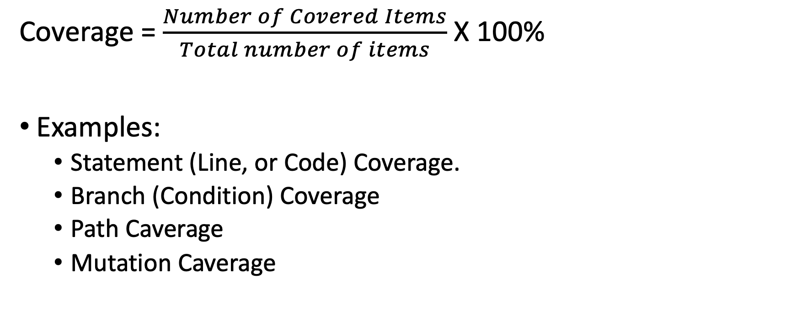
Test Coverage
Coverage = $\frac{Number of Covered Items}{Total number of items}$ X 100%
Examples:
Statement (Line, or Code) Coverage.
Branch (Condition) Coverage
Path Caverage
Mutation Caverage
Notes:
Coverage tells us how much of the code our tests are actually exercising.
Coverage isn’t just a number — it’s about confidence in testing

Slide 7
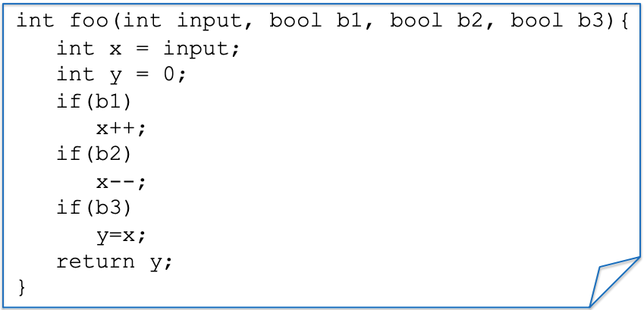
Example: a function to test
Notes:
We have a simple function foo with inputs - > input, 3 booleans b1, b2, b3
We also have three if statements that manipulate the input

Slide 8
Statement/Line/Code Coverage
Test Case(s)
ASSERT foo(0, true, true, true) == 0;
Notes:
Suppose we have a test case trying to assert if I call this function foo with

Slide 9
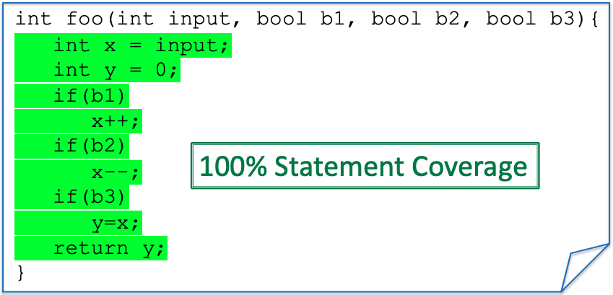
Statement/Line/Code Coverage
Test Case(s)
ASSERT foo(0, true, true, true) == 0;
Notes:
Statement/Line/Code Coverage
This is the simplest form of coverage: checks if each line of code was executed by tests.
Limitation: 100% line coverage doesn’t mean you tested all behaviors.
It is useful but shallow — a line may run without truly checking logic.

Slide 10

Statement/Line/Code Coverage
Test Case(s)
ASSERT foo(0, true,, true, true) == -1;
false
$\frac{8}{9}$ x100% = 88.9%
x++;
Notes:
Line coverage is the most basic metric—good for ensuring all code runs, but insufficient for catching hidden logic errors

Slide 11
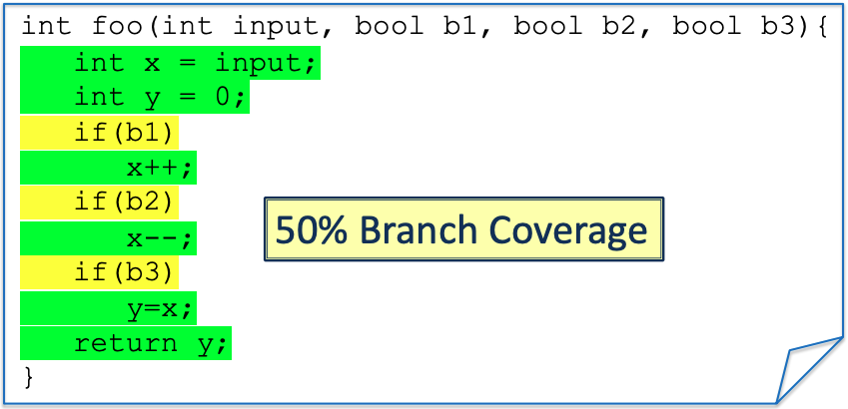
Branch/Condition Coverage
Test Case(s)
ASSERT foo(0, true, true, true) == 0;
Notes:
Branch/Condition Coverage
Goes deeper: checks if each branch of an if/else or condition is executed.
Example: one test covers the true branch, but you also need one for the false branch.
Branch coverage ensures decision-making logic is exercised, not just code paths

Slide 12
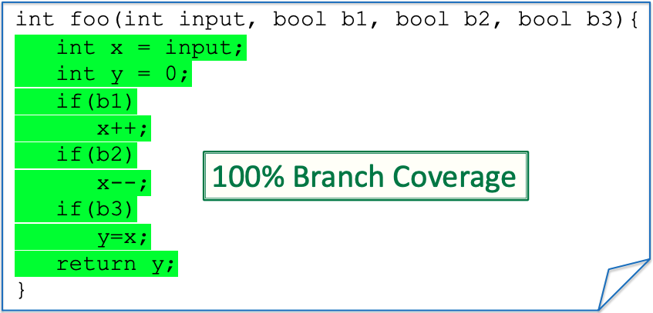
Branch/Condition Coverage
New Test
Test Case(s)
ASSERT foo(0, true, true, true) == 0;
Assert foo(0,false, false, false) == 0;

Slide 13
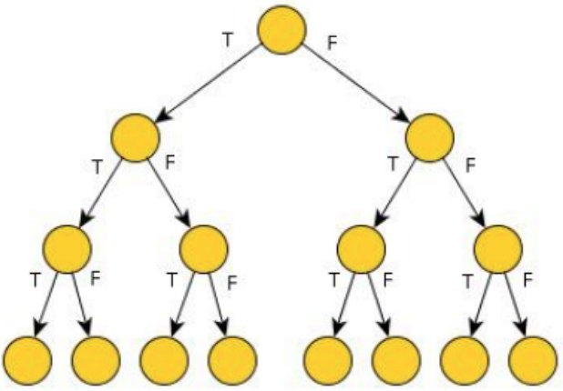
Path Coverage
Paths for three “if” each can be either true (T) or false (F)
8-Paths
Notes:
Path Coverage
Considers all possible execution paths through code (combinations of branches).
For n decisions, possible paths grow exponentially (2ⁿ).
Example: 3 ifs → 8 paths, but most tests only cover a fraction.
Path coverage is powerful but often impractical beyond small functions. Good for showing limits of exhaustive testing

Slide 14

Path Coverage
Test Case(s)
ASSERT foo(0, true, true, true) == 0;
ASSERT foo(0,false, false, false) == 0;
25% Path Coverage
Notes:
As you can see, conditionals (and loops) make path coverage hard. We need to write a lot of tests
We get an exponential number of paths on the number of conditionals tests.
This is going to be very costly to test, but on the other hand, it could be that a bug is hidden in one of the paths
We need path coverage to find certain bugs

Slide 15
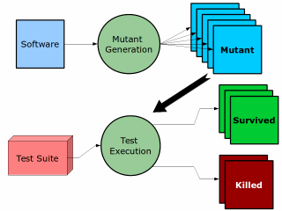
Mutation Testing
if(x == y) – Original
if (x != y) – Mutant
if( x > y) – Mutant
if(x < y) – Mutant
if(x >= y) – Mutant
A mutant in software testing is a deliberate, small change (fault) introduced into a program’s source code to check whether the existing test suite can detect it.
Formal Definition: A mutant is the modified version of the program created by applying a mutation operator (like changing == to !=, + to -, or && to ||).
If your tests fail when run against the mutant → ✅ the mutant is killed (good test suite).
If your tests still pass → ❌ the mutant survives (weak test suite, it missed a fault).
Notes:
Mutation Testing
Idea: deliberately inject small changes (mutants) into code (e.g., flip == to !=).
If your tests catch the change (test fails), the mutant is killed.
If the test passes, the mutant survives → your test suite is weak.
Mutation testing is a stronger metric than coverage because it checks if tests detect behavioral faults
If your tests fail when run against the mutant → ✅ the mutant is killed (good test suite).
If your tests still pass → ❌ the mutant survives (weak test suite, it missed a fault).

Slide 16

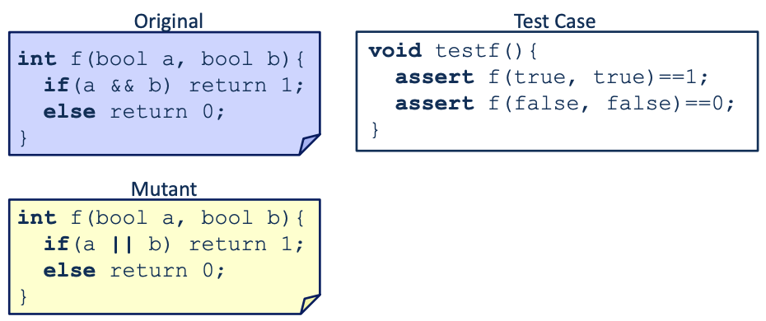
Mutation Testing: Small Example
Mutant Survives the Test Case
Notes:
Mutation Testing
Idea: deliberately inject small changes (mutants) into code (e.g., flip == to !=).
If your tests catch the change (test fails), the mutant is killed.
If the test passes, the mutant survives → your test suite is weak.
Mutation testing is a stronger metric than coverage because it checks if tests detect behavioral faults

Slide 17
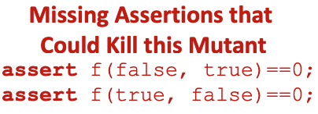
Mutation Testing: Small Example
Original would give 0.
Mutant would give 1.
That’s the bug!
Notes:
Why the mutant survives
Case 1: (true, true)
Original → 1
Mutant → 1 ✅ Both pass
Case 2: (false, false)
Original → 0
Mutant → 0 ✅ Both pass
No test checks (true, false) or (false, true).
Original would give 0.
Mutant would give 1.
That’s the bug!

Slide 18
Mutation Coverage
Assess how good your test cases are at catching faults by introducing defects into the source code.
More reliable metric to validate test suite effectiveness.
In recent years, mutation testing has been more prominent in academia and less in industry.

Slide 19
Testing Coverage for the Project
It is required to show coverage for your Project (in both the Intermediate and the Final Report)
At least Branch Coverage is better.
You should show the chosen coverage before the refactoring/change and after (where hopefully you also added new tests).
There is no set coverage limit to reach for the project.
But if your project has very low coverage, you better have a good explanation for that.
Focus on increasing the coverage for the system parts that will be affected by your refactoring/change.

