Slide 1










Phonebook
Internal Use
Copyright © MediaTek Inc. All rights reserved.

Slide 2
Outline
Introduction
Phonebook Menu
Data structure & Nvram
Application
Q & A

Slide 3
Architecture
MMI
PHB
AT
L4C
L4PHB
NVRAM
SIM
Storage

Slide 4
Introduction (MMI PHB)
Phonebook is an app for user to add, edit, delete, copy, move contact to nvram or SIM.
Support caller group, caller pic, caller ringtone, caller video
Support vCard sending via SMS, MMS, BT, IrDA and saving to file
Have name, number, home number, work number, fax number, company name, VoIP URI, IMPS id, address, URL, note fields
Provide the interface for other apps to select phb contacts to send SMS, MMS, email,…

Slide 5
Introduction (L4PHB)
Startup, read, write, delete phb
Manage ADN, FDN, BDN, MSISDN
Handle the approve of dialing out number (ECC and FDN)
FDN: Fixed dialing numbers
AND: Abbreviated dialing numbers
MSISDN: Mobile station ISDN
BDN: barred dialing numbers
ECC：Emergency Number
Notes:
Abbreviated:缩写

Slide 6
PhoneBook Introduction
Phonebookmain.c
Phonebooksearch.c
Initialization/restart
Build lookup table
Main menu
Phonebook list menu
Common utility
Name index sorting
Search by name
Quick search
Phonebooksettings.c
Phonebookoperatesingle.c
Memory status
Preferred storage
Optional field on/off setting
My vcard setting
View entry
Add entry
Edit entry
Delete entry
Copy entry
Move entry
Duplicate entry
Image handling in file sys
Phonebookcallergroup.c
Call group data setting
Call group member list
Build inline selection list
Phonebookoperatemass.c
Copy all
Delete al
At command
Common operation utilities
PhonebookStubsToOthers.c
Interface for call
Interface for SMS
Interface for MMS
Interface for email
Common name/number lookup table
Common convert utilities
Phonebookextranumber.c
Owner number
Service dial number
Emergency number
Copyright © MediaTek Inc. All rights reserved.

Slide 7
Outline
Introduction
Phonebook Menu
Data structure & Nvram
Application
Q & A

Slide 8
PhoneBook Introduction
A Phonebook Record
  All required field will be read from SIM and NVRAM through L4 at the boot-up time and store in SRAM
  Optional field will be read from NVRAM at the boot-up time when needed
  Optional ID will be read into a data structure when needed
  All phone numbers(Mobile, Home, Office, Fax) will be populated into a lookup table for reference of call log or other app
SIM
Name
Required
Number
Field
Home Number
Company Name
Optional
Email
Field
NVRAM
Office Number
Fax Number
Birthday
Picture
Video
Optional
Ring Tone
ID
Caller Group
Copyright © MediaTek Inc. All rights reserved.
Notes:
Optional field:
Home Number； Company Number； Email Address； Office Number； Fax Number；
Birthday；
Associate Picture； Associste Video； Caller Group
void mmi_phb_op_update_field_flag( U16 store_index, S8 *number, S8 *home, S8 *office, S8 *fax, S8 *email, BOOL is_new)

Slide 9
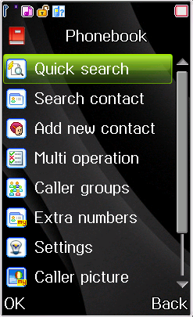
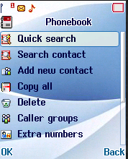
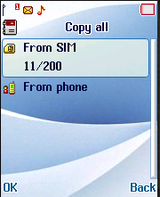
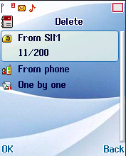
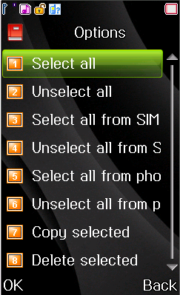
PhoneBook Introduction
Main menu
  Display all entries sorted according to Unicode
  Search by Name
  Controled by fields
  & name or number is essential
  Multi copy and multi delete
Copyright © MediaTek Inc. All rights reserved.
Notes:
Delete和copy all与
Multi operater不能并存，只有一个存在，靠宏__MMI_PHB_MULTI_OPERATION__来控制
这个宏打开需要在mmi_features_switch.h里
__MMI_PHB_GENERIC_MULTI_SELECT__是用作多选，如从sms进phb选姓名

Slide 10
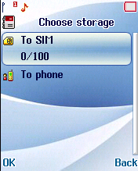
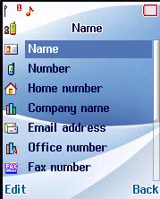
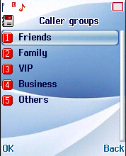
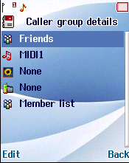
Phonebook Menu (2/5)
Add new contact -> add to SIM and phone
Caller group -> support 5 caller groups, every contact could only belongs to one caller group, user can set up name, picture, ring tone, video and add members from phonebook list for each caller group
——Priority: Video>ringtone + picture>default
Notes:
5 caller groups 可以修改MAX_PB_CALLER_GROUPS变化

Slide 11
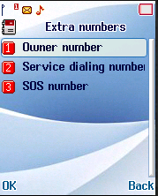
PhoneBook Introduction
Extra Numbers
  Owner Number, Service Dial Number, and Emergency Number.
  Owner Number (SIM : read / write)
    User can set up his own number here, this number can be displayed in idle screen
  Service Dial Number (SIM : read only)
    Service dial number is provided by network service provider
  Emergency Number (SIM: read only
  / NVRAM: read/write)
    Emergency number can be specify by
    user(NVRAM) and by service provider(SIM).
    User can modify emergency
    number store in NVRAM
    Emergency number in SIM is read only
Copyright © MediaTek Inc. All rights reserved.
Notes:
Emergency Number ：112，911，999
Ower munber是本机号码，编辑后可以显示在idle
SDN是服务号码，是需要特定的sim卡支持的，不常见
Sos可以通过宏__MMI_PHB_SOS_NUM_EDIT__来决定是否可以edit

Slide 12


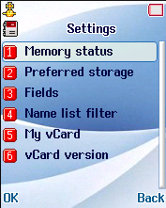
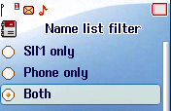
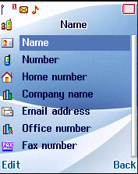
PhoneBook Introduction
Memory Status:
  User can check SIM and phone memory usage here
Preferred Storage:
  Change focus on sim or phone each time when user operate a phonebook entry(add, delete…)
Fields Setting:
  Next page
Name List Filter:
  Setting which storage of entry can be seen
VCard:
VCard Version:
  2.1；3.0
Copyright © MediaTek Inc. All rights reserved.
Notes:
2.1和3.0 的區別是什麽？？

Slide 13
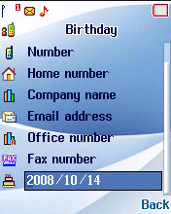
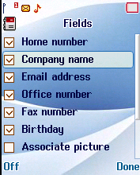
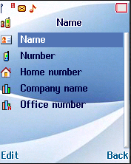
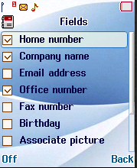
PhoneBook Introduction
Fields Setting:
  user can set which field is well needed when add or edit by turn on / off certain field.
  This setting has no effect on Vcard setting.
Copyright © MediaTek Inc. All rights reserved.

Slide 14
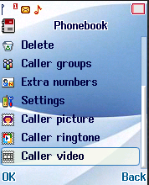
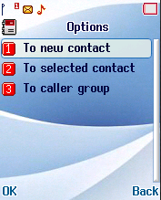
Phonebook menu (5/5)
Select a picture for certain entry or group
Select a ring tone for certain entry or group
Select a video for one entry or group
  Priority:
  contact > caller group > user profile

Slide 15
Outline
Introduction
Phonebook Menu
Data structure & Nvram
Application
Q & A

Slide 16
Data struct (constant)
Short name | Value | Long name
MAX_PS_NAME_LENGTH | 32 / 62
MAX_PS_NUMBER_LENGTH | 41
MAX_ENTRIES_IN_LIST | 15 | Max entries retrieve from L4
MAX_SIM_PASSWD_LEN | 9
MAX_PB_SIM_ENTRIES | 250 | Max entry sore in SIM
MAX_PB_PHONE_ENTRIES | 1000 | Max entry store in NVRAM
MAX_PB_ENTRIES | MAX_PB_SIM_ENTRIES + MAX_PB_PHONE_ENTRIES | Maximum entry of whole phonebook
MAX_PB_FIELDS | MMI_PHB_FIELD_TOTAL + MMI_PHB_EXTRA_FIELD_TOTAL | Max fields of each entry
MAX_PB_MANDATORY_FIELDS | 2 | Max mandatory fields of each entry
MAX_PB_VIEW_FIELDS | MMI_PHB_FIELD_TOTAL - MAX_PB_MANDATORY_FIELDS | Max optional fields of each entry
PHB_SIM_ENTRY
  The max number of PHB entry supported for PHB in sim by ME
PHB_PHONE_ENTRY
  The max number of PHB entry supported by ME.
Notes:
MAX_PS_NAME_LENGTH转换编码时使用，多2个结束符，MAX_PS_NUMBER_LENGTH protocol stack size
MAX_PB_NAME_LENGTH每一笔记录名字的长度

Slide 17
Data struct (constant)
MAX_PB_PICTURES_TAGS | 30 | Max associate picture number
MAX_PB_OWNER_NUMBERS | 4 | Max entry of owner number
MAX_PB_NAME_LENGTH | 30 / 60 | Max name length of each entry
MAX_PB_NUMBER_LENGTH | 40 | Max number length of each entry
MAX_PB_EMAIL_LENGTH | 60 | Max email length of each entry
MAX_PB_COMPANY_LENGTH | 20 | Max company name length of each entry
MAX_GRP_NAME_LENGTH | 20 | Max caller group name length
MAX_SEARCH_NAME_LENGTH | 10 | Max search string length
MAX_PB_CALLER_GROUPS | 5 | Max caller group entry number
MAX_CALLER_GRP_ITEMS | 6/7 | Max caller group filed
CALLER_GROUPS_RECORD_SIZE | 260 | Caller group size store in NVRAM
OPTIONAL_IDS_RECORD_SIZE | 510 | Optional ID field size store in NVRAM for 85 entries.
OPTIONAL_IDS_RECORD_TOTAL | 85 | Number of entries of phonebook optional Ids store in one NVRAM record.
OPTIONAL_FIELDS_RECORD_SIZE | 229 | Optional filed size store in NVRAM.
Notes:
typedef struct{
kal_uint16 pictureTagID;
kal_uint16 ringToneID;
kal_uint8 callerGroupID;} PHB_OPTIONAL_IDS_STRUCT;

Slide 18
Data struct (constant)
INVALID_NUMBER | 10000000 | A large number used to invalidate number store in number lookup table.
ALPHA_LIST_LENGTH | 26 | Begin index of each alphabet
MAX_PB_RING_TONES | 60 | Max associate ring tone number
MAX_PB_ALERT_TYPES | 5 | Max associate alert type number
MAX_PB_LED_PATTERNS | 6 | Max associate led pattern number
PHB_NOTIFY_TIMEOUT | UI_POPUP_NOTIFYDU RATION_TIME | Time duration for popup message
MAX_SIM_ENTRIES | 20 | Max number of Service List, FDN, and BDN entry store in SIM
MAX_NAME_LEN_FSB_LIST | 30 | Max name field of FDN and BDN
MAX_NUMBER_LEN_FSB_LIST | 40 | Max number field of FDN and BDN
MAX_SIM_SOS_ENTRIES | 5 | Max number of SOS entry store in SIM.
MAX_NVRAM_SOS_ENTRIES | 5 | Max number of SOS entry sore in Phone.
NVRAM_SOS_RECORD_SIZE | 86 | SOS record size store in NVRAM
MMI_PHB_DRV | MMI_PUBLIC_DRV | Hard disk store drive for associate picture
MMI_PHB_IMAGE_FOLDER | FMGR_DEFAULT_FO LDER_PHBIMAGES | Folder for associate picture.
MMI_PHB_VIDEO_DATA_FILE | FMGR_DEFAULT_FI LE_PHBVIDEO | Folder for associate video
MMI_PHB_MAX_PATH_LENGTH | 64*ENCODING_LENG TH | Max path length for phonebook associate picture.
Notes:
ALPHA_LIST_LENGTH from A to Z

Slide 19
Data struct (constant)
MMI_PHB_ENTRY_FIELD_NAME | 0x01 | Field flag filter for name
MMI_PHB_ENTRY_FIELD_NUMBER | 0x02 | Field flag filter for number
MMI_PHB_ENTRY_FIELD_HOME | 0x04 | Field flag filter for home number
MMI_PHB_ENTRY_FIELD_OFFICE | 0x08 | Field flag filter for office number
MMI_PHB_ENTRY_FIELD_FAX | 0x10 | Field flag filter for fax number
MMI_PHB_ENTRY_FIELD_ALL_NUMBER | 0x1E
MMI_PHB_ENTRY_FIELD_EMAIL | 0x20 | Field flag filter for email address
MMI_PHB_ENTRY_FIELD_COMPANY | 0x40 | Field flag filter for company name
MMI_PHB_ENTRY_FIELD_ANRA | 0x04 | Field flag filter for home number
MMI_PHB_ENTRY_FIELD_ANRB | 0x08 | Field flag filter for office number
MMI_PHB_ENTRY_FIELD_ANRC | 0x10 | Field flag filter for fax number
MMI_PHB_BDAY_MIN_YEAR_INT | 1900 | Min year
MMI_PHB_BDAY_MAX_YEAR_INT | 2030 | Max yea
MMI_PHB_BDAY_YEAR_STR | L”0000” | Empty
MMI_PHB_BDAY_MON_STR | L”00” | Empty
MMI_PHB_BDAY_DAY_STR | L”00” | Empty

Slide 20
Data struct (enum)
Short name | Long name
MMI_PHB_LIST_VIEW | Phonebook list view type enum
MMI_PHB_CHARSET_ENUM | String encoding type enum
MMI_PHB_STORAGE_LOCATION | Entry storage position enum
MMI_CSMCC_ADDR_TYPE | Phonebook number type enum
MMI_PHB_TYPE | Phonebook entry type enum
MMI_PHB_CAUSE_ENUM | Error Cause type enum when retrieve from L4
MMI_PHB_UPDATE_ENUM | AT command update type enum
MMI_PHB_ENTER_LOCATION_ENUM | Location of enter phonebook from other application
MMI_PHB_ENTRY_UPDATE_ENUM | Phonebook alpha list update type enum.
mmi_phb_image_location_enum | Associate picture location enum
mmi_phb_receive_resource_enum | Receive resource type
mmi_phb_multi_operation_enum | Multi operation type
mmi_phb_sync_vcard_enum | Sync operation type
mmi_phb_sync_error_enum | Sync operation error type
mmi_phb_add_from_others_error_enum | For other app
MMI_PHB_NUMBERS | All numbers belong to one entry
SCREENID_LIST_PHONE_BOOK | Screen ID
STRINGID_LIST_PHONE_BOOK | String ID
IMAGEID_LIST_PHONE_BOOK | Image ID
Notes:
DD_APP_Phonebook.pdf

Slide 21
Data struct (enum)
Short name | Long time
MMI_PHB_SORT_METHOD_ENUM | Phonebook entry sort type
MMI_PHB_OP_ENUM | Single operation tpye
MMI_PHB_VCARD_VERSION_ENUM | vCard type
MMI_PHB_USIM_WRITE_ERROR_ENUM | The error info of usim
MMI_PHB_USIM_READY_STAGE_ENUM | The ready stage of usim

Slide 22
Data Structure (struct)
1. PHB_OPTIONAL_IDS_STRUCT
kal_uint16 | pictureTagID
kal_uint16 | ringToneID
kal_uint8 | callerGroupID
This structure is used for each phonebook entry stored in nvram.
If defined__MMI_CALLERGROUP_IN_SIM__
It is also used for ADN stored in sim

Slide 23
Data structure (struct)
2. PHB_OPTIONAL_FIELDS_STRUCT
U8 | homeNumber[MAX_PB_NUMBER_LENGTH + 1 + 1]
U8 | companyName[(MAX_PB_COMPANY_LENGTH + 1) *ENCODING_LENGTH]
U8 | emailAddress[MAX_PB_EMAIL_LENGTH + 1]
U8 | officeNumber[MAX_PB_NUMBER_LENGTH + 1 + 1]
U8 | faxNumber[MAX_PB_NUMBER_LENGTH + 1 + 1]
This structure is used for each phonebook entry store in NVRAM

Slide 24
Data structure (struct)
3. PHB_CALLER_GROUP_STRUCT
kal_uint8 | groupName[(MAX_GRP_NAME_LENGTH + 1) *ENCODING_LENGTH]
kal_uint16 | ringToneID
kal_uint16 | pictureTagID
kal_uint16 | LEDPatternID
kal_uint16 | VideoID
kal_uint8 | alertType
kal_uint8 | is_modified
This structure is to store information for each caller group
“is_modified” identify groupName is changed or not.

Slide 25
Data structure (struct)
4. MMI_PHB_NAME_STRUCT
U8 | name_length
U8 | name_dcs
U8 | name[(MAX_PB_NAME_LENGTH + 1) *ENCODING_LENGTH]
This structure is for name field of an entry in phonebook
5. MMI_PHB_NUMBER_STRUCT
U8 | tpye
U8 | length
U8 | number[(MAX_PB_NUMBER_LENGTH + 1 + 1) *ENCODING_LENGTH]
This structure is for number field of BDN, FDN, MSISDN, SDN, ECC

Slide 26
Data structure (struct)
6. MMI_PHB_NUMBER_BCD_STRUCT
U8 | type
U8 | length
U8 | Number[(MAX_PB_NUMBER_LENGTH + 1) / 2]
This structure is for number field of an entry
7. MMI_PHB_ENTRY_BCD_STRUCT
MMI_PHB_NUMBER_BCD_STRUCT | tel
MMI_PHB_NAME_STRUCT | alpha_id
U8 | field
U8 | dummy
This structure is used to store phonebook entry.
Use BCD number structure to save space

Slide 27
Data structure (struct)
8. MMI_PHB_ENTRY_STRUCT
U8 | storage
U8 | type
U16 | index
U16 | record_index
MMI_PHB_NUMBER_STRUCT | tel
MMI_PHB_NAME_STRUCT | alpha_id
This structure is for entry of BDN , FDN, MSISDN, SDN,
ECC

Slide 28
Data structure (struct)
9. MMI_OWNER_NUMBER_STRUCT
U8 | name[(MAX_PB_NAME_LENGTH + 1) *ENCODING_LENGTH]
U8 | number[(MAX_PB_NUMBER_LENGTH + 1 + 1) *ENCODING_LENGTH]
This structure is for store owner number
10. MMI_PHB_LOOKUP_NODE_STRUCT
U16 | store_index
U32 | number
This structure is used to store numbers for fast number matching

Slide 29
Data structure (struct)
11. MMI_SOS_NUMBER_STRUCT
U8 | type
U8 | length
U8 | number[(MAX_PB_NUMBER_LENGTH + 1 + 1)*ENCODING_LENGTH]
This structure is for store ECC number
12. MMI_PHB_BDAY_STRUCT
U16 | bYear
U8 | bMonth
U8 | bDay
This structure is used for BirthDay field

Slide 30
Data structure (struct)
15. PHB_INFO_FIELDS_STRUCT
U8 | title[(MAX_PB_TITLE_LENGTH + 1) *ENCODING_LENGTH]
U8 | url[MAX_PB_URL_LENGTH + 1]
U8 | address[(MAX_PB_ADDRESS_LENGTH + 1) *ENCODING_LENGTH]
U8 | note[(MAX_PB_NOTE_LENGTH + 1) *ENCODING_LENGTH]
This struct is for entry detail field
16. MMI_PHB_EMAIL_STRUCT
U8 | email_length
U8 | email_address[MAX_PB_EMAIL_LENGTH + 1]
This structure is for email sort or usim email field

Slide 31
PHB Related NVRAM LID(1/2)
NVRAM_EF_PHB_LID
NVRAM_EF_PHB_LN_ENTRY_LID
NVRAM_EF_PHONEBOOK_SOS_LID
NVRAM_EF_PHONEBOOK_SPEEDDIAL_LID
NVRAM_EF_PHB_IDS_LID
  pictureTagID, ringToneID, callgroupID
NVRAM_EF_PHB_FIELDS_LID
  HomeNumber, companyName, emailAddress, officeNumber, faxNumber
NVRAM_EF_PHB_SETTINGS_LID
  View field
NVRAM_EF_PHB_CALLER_GROUPS_LID
NVRAM_EF_PHB_VCARD_LID
NVRAM_EF_PHB_COMPARE_DIGIT_LID

Slide 32
PHB Related NVRAM LID(2/2)
NVRAM_EF_PHB_INFO_LID
  Used for vcard, contain title, url, address, note
NVRAM_EF_PHB_VOIP_LID
….
….
Note：reference “common_nvram_editor_data_item.h” file

Slide 33
Outline
Introduction
Phonebook Menu
Data structure & Nvram
Application
Q & A

Slide 34
Startup(1/2)
MMI
L4C
NVRAM
mmi_phb_ind_startup_begin()
PRT_PHB_STARTUP_BEGIN_IND
Init phb data
mmi_phb_ind_startup_read()
PRT_PHB_STARTUP_READ_IND
PRT_PHB_STARTUP_READ_NEXT_REQ
……repeat
mmi_phb_ind_startup_finish()
PRT_PHB_STARTUP_FINISH_IND
NVRAM_EF_PHB_SETTINGS_LID
NVRAM_PHB_STORAGE_LOCATION
NVRAM_EF_PHB_CALLER_GROUPS_LID
NVRAM_PHB_NAME_LIST_FILTER
Get data from nvram
Sort name index
Start 500ms timer to wait for reaching idle
After reaching idle,
PhbGetSpeedDialInfo_Ext
NVRAM_EF_PHONEBOOK_SPEEDDIAL_LID
Set Phb status is ready
Init lookup table

Slide 35
Startup(2/2)
startup
Begin
_
read
LOCAL
_
PARA
_
HDR
LOCAL
_
PARA
_
HDR
Startup
_
finish
kal
_
uint
16
sim
_
max
_
num
;
PRT
_
PHB
_
START
l
4
c
_
phb
_
entries
_
struct
phb
_
entries
[
1
]
;
kal
_
uint
16
phb
_
max
_
num
;
UP
_
BEGIN
_
IND
PRT
_
PHB
_
STARTUP
_
READ
_
IND
kal
_
uint
8
access
_
id
;
kal
_
uint
8
phb
_
len
;
PRT
_
PHB
_
STARTU
kal
_
uint
8
fdn
_
len
;
P
_
FINISH
_
IND
kal
_
uint
8
bdn
_
len
;
g
_
phb
_
cntx
.
phb
_
ready
=
FALSE
;
Reset counter
PRT
_
PHB
_
STARTUP
_
READ
_
N
kal
_
uint
8
owner
_
len
;
g
_
phb
_
cntx
.
sim
_
used
=
0
;
EXT
_
REQ
NVRAM
_
EF
_
PHB
_
SETTINGS
_
LID
g
_
phb
_
cntx
.
phone
_
used
=
0
;
yes
LocalPtr
-
no
Update g
_
phb
_
cntx data
NVRAM
_
PHB
_
STORAGE
_
LOCATION
PhoneBookEntryCount
=
0
;
>
phb
_
entries
[
0
].
phb
_
entry
[
0
].
storage
==
NVRAM
_
PHB
_
NAME
_
LIST
_
FILTER
g
_
phb
_
cntx
.
lookup
_
table
_
count
=
0
;
MMI
_
SIM
NVRAM
_
PHB
_
VCARD
_
VERSION
g
_
phb
_
cntx
.
populate
_
count
=
0
;
Get
_
data
_
from
_
nvram
NVRAM
_
EF
_
PHB
_
CALLER
_
GROUPS
_
LID
g
_
phb
_
cntx
.
sim
_
used
++
;
Get store
_
index
i
<
LocalPtr
-
>
phb
_
entries
[
0
].
num
_
of
_
entry
gSecuritySetupContext
FdlStatus
Read
_
entry
no
yes
yes
Read
_
entry
.
no
Read
_
fdn
_
list
Read name
Read name
and number
and number
Maybe hang a
mmi
_
phb
_
sort
_
build
_
name
_
index
moment
Set phonebook
[
store
_
index
].
field
Set phonebook
[
store
_
index
].
field
mmi_bootup_is_sim_valid
Set g
_
phb
_
name
_
index
[]
yes
no
Set g
_
phb
_
name
_
index
[]
Read
_
speedDial
Set g
_
phb
_
cntx
.
phb
_
ready
=
TRUE
Set g_phb_name_index
Build
_
lookup
_
table
Notes:
mmi_phb_ind_startup_finish：

Slide 36
g_phb_name_index
g_phb_name_index[300]
SIM
Store index
0
1
2
….
199
200
201
202
….
299
Phone
Record index
1
2
3
….
200
1
2
3
….
100
g_phb_name_index[300]
g_phb_name_index[300]
0
1
2
3
4
…..
201
202
….
299
Sort by name
201
2
0
200
1
PhoneBook
0
1
2
3
4
…..
200
201
….
299
Notes:
Record index：L4 index从1开始
Store index：存储index，ME在前，sim在后面从0开始

Slide 37
Name sort
Sort
_
name
_
index
mmi_phb_sort_build_name_index
  PINYIN SORT
  If not support PINYIN SORT, Use ENCODING SORT
  mmi_phb_sort_name_fast_quicksort(left, right, compare)
    Entry Number > 4 : Quick Sort 平均时间复杂度为O(nlgn)
      mmi_phb_sort_name_quicksort(left, right, compare)
    Entry Number <= 4 : Insertion Sort 平均时间复杂度为O(n2)
      mmi_phb_sort_name_insertionsort(left, right, compare)
no
phonebookEntryCount
>
1
yes
Compare function
Fast
_
quick
_
sort
quicksort
4
insertionsort
算法介绍
Notes:
Encoding sort: 所有的名字都会转换成UCS的编码，然后大于4个就用快速排序，小于4个就用插入排序
所以排列的效果是英文的会按照顺序排在中文名字之前，因为英文转成UCS2都是0x00AA一定比中文UCS2小
Pinyin sort: 在startup read entry的时候就会去判断开PINYIN sort没有，开了就会将第一个字符（非ascii）的拼音spelling转到g_phb_name_pinyin_index[]中，转的长度为MMI_PHB_SORT_LENGTH
排序时将转后的拼音spelling相互比，或是与ascii的UCS2比较来排序

Slide 38
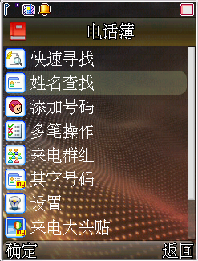
Name binary search
mmi_phb_search_name_binary_search(S32 low, S32 high, S8 *ucs2_name)
g_phb_name_index[300]
0
1
2
3
4
…..
201
202
….
299
PhoneBook
0
1
2
3
4
…..
201
202
….
299
Notes:
姓名查找是找最新的，用的是折半查找的算法，找最相近的，所以输入需要查找的字符就算phb中没有完全匹配的也会返回最接近的，跟快速查到一定会找到一样的否则不返回不同

Slide 39
Quick Search Flow
User input character
in list screen
mmi_phb_quick_search_find_entry
If not make search
cache, make it
compare the
first character
Loop for all entries
Candidate?
N
input string
length == 1?
compare the
first character
Get the name string
Y
string length > 1?
Check the input string is
the name subset?
N
N
Candidate?
Y
Y
Add to PointerList
N
Y
More?
N
Notes:
在进入真正的查找页面前会调用mmi_phb_quick_search_make_cache来将所有entry第一个字符的相应编码存入g_phb_qsearch_cache中以便快速查找
有多个需要查找的字符，是在第一个找到后才去比后面的，比的时候才会把整个name转成pinyin(开pinyin sort的话)

Slide 40
Lookup table
For each number field in phonebook entry (mobile number, home number, office number ..), it will be populated to a sorted lookup table for quick access when there's an incoming call.
Before the number saved to lookup table, it will be removed the extension number and converted to a 4bytes integer. For example:
The whole number list will be sorted by quick sort algorithm with increasing order for number field.
Original number | Convert 7 digits | Convert 9 digits
0918123456 | 8123456 | 918123456
26598088p1111 | 6598088 | 26598088

Slide 41
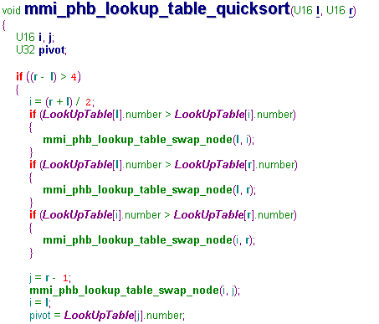
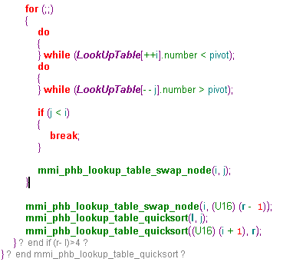
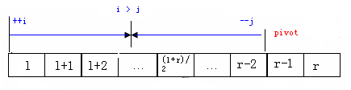
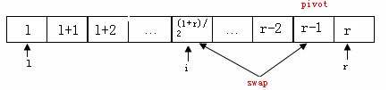
Build lookup table(1/2)
Building lookup table uses quick sort and insert sort

Slide 42
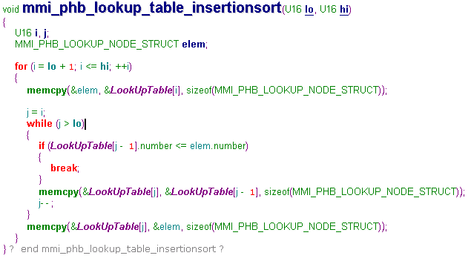
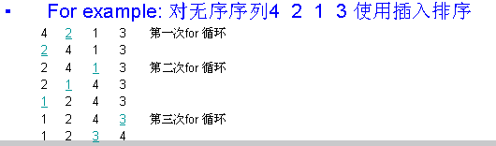
Build lookup table(2/2)

Slide 43
Lookup table
mmi_phb_lookup_table_search
Call Num | Store_Index0
 | Store_Index1
 | …
 | Store_IndexN
Fax Num | Store_Index0
 | Store_Index1
Home Num | Store_Index0
 | Store_Index1
Office Num | Store_Index0
 | Store_Index1
tel0 | alpha_id0 | field0 | dummy0
… | … | … | …
telN | alpha_idN | fieldN | dummyN
Compare
Number
PhoneBook
Search fax/home/office number
Copyright © MediaTek Inc. All rights reserved.

Slide 44
Add new contact(1/3)
MMI
L4 Controller
NVRAM
mmi_phb_entry_op_add_entry()
User input Data
mmi_phb_op_add_pre_save()
Check if all field empty
PRT_PHB_SET_ENTRY_REQ
mmi_phb_op_add_entry_req
PRT_PHB_SET_ENTRY_RSP
mmi_phb_op_add_entry_rsp
NVRAM_EF_PHB_FIELDS_LID
Write optional field to NVRAM
Increase lookup table
Sort lookup table
Update phonebook list index

Slide 45
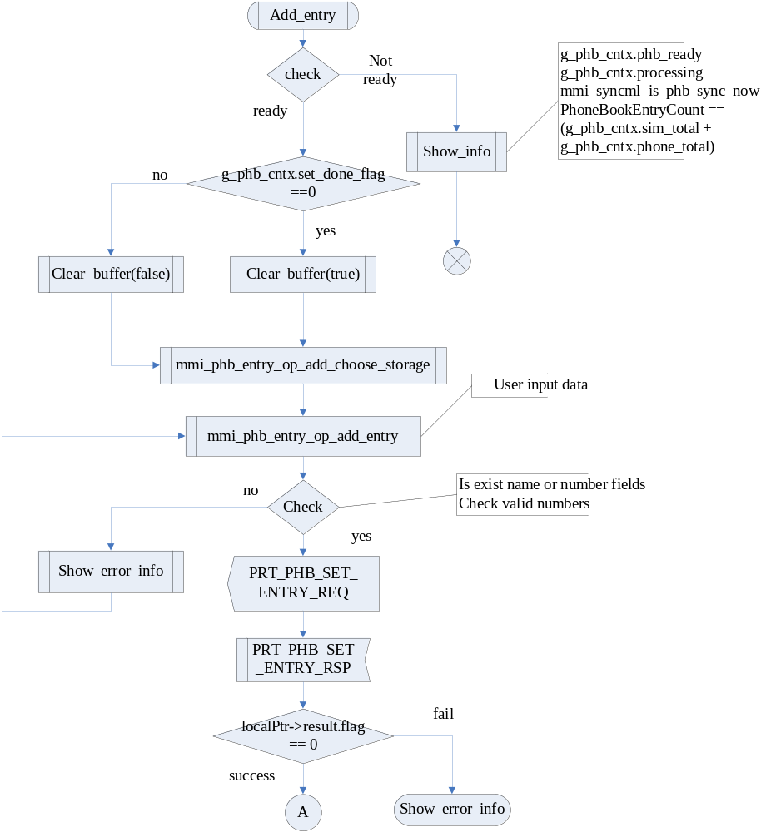
Add new contact(2/3)
Notes:
if (g_phb_cntx.set_done_flag) /* save number from idle screen shouldn't clear the phNumber */
即有其他app如idle下增加电话本entry的话不memset phNumber

Slide 46
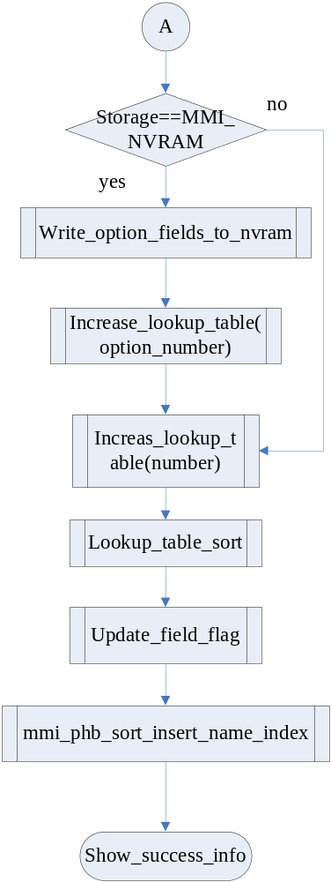
Add new contact (3/3)

Slide 47
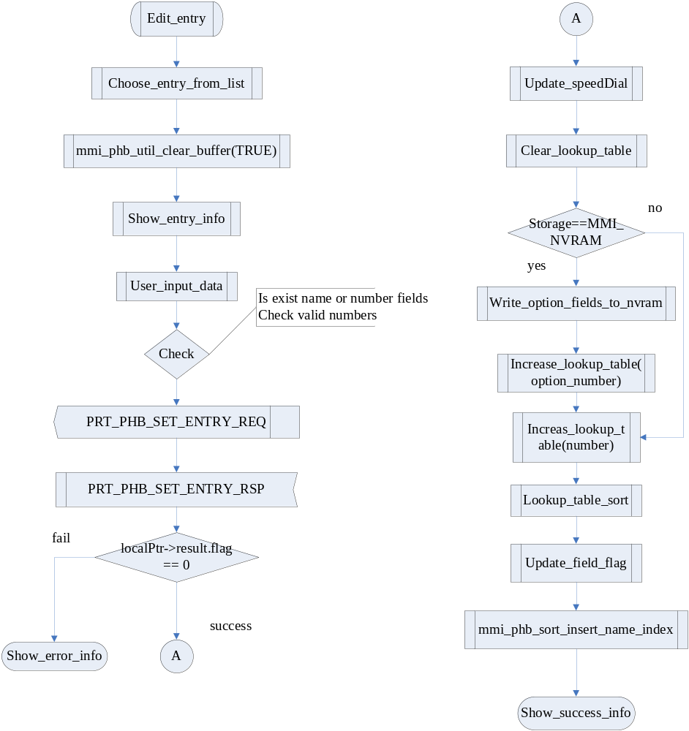
Edit contact

Slide 48
Delete contact(1/2)
MMI
L4 Controller
NVRAM
User delete an entry
PRT_PHB_DEL_ENTRY_REQ
mmi_phb_op_delete_entry_req
PRT_PHB_DEL_ENTRY_RSP
mmi_phb_op_delete_entry_rsp
NVRAM_EF_PHONEBOOK_SPEEDDIAL_LID
PhbUpdateSpeedDial
NVRAM_EF_PHB_FIELDS_LID
Clear option field
Remove lookup table entry
Remove phonebook list index

Slide 49
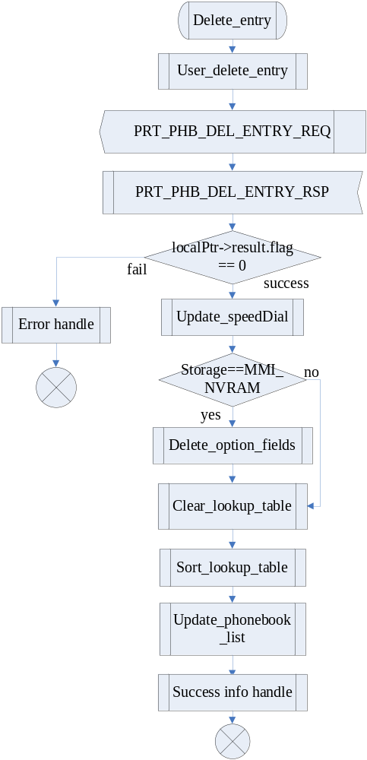
Delete contact(2/2)

Slide 50
Thank you!
Q&A
Copyright © MediaTek Inc. All rights reserved.

