Slide 1
EVENT

Slide 2
1.1Concept of queues
Each task has a queue associated with it. Any task, which has to pass event to a task will,direct that event to the queue associated with that task. So L4/NS writes events to MMI queue and the MMI task reads from this queue. Similarly, MMI task writes to the L4/NS queue and L4/NS read from this queue

Slide 3
Design Overview
1.1Concept of queues
1.2Role of Framework
1.3Classification of Events

Slide 4
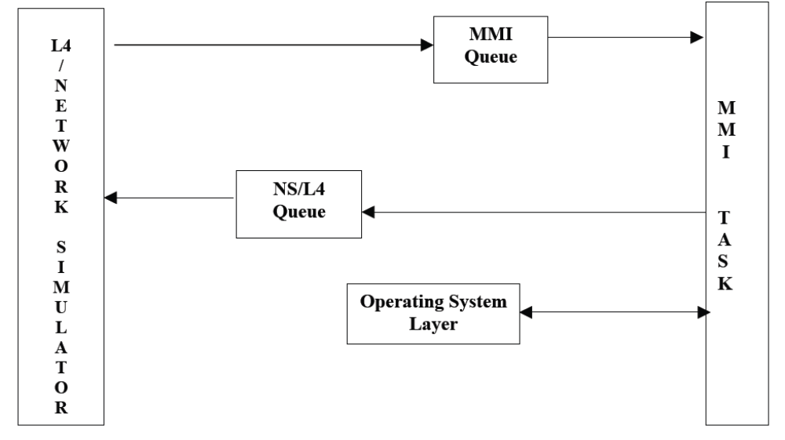
1.1Concept of queues

Slide 5
1.2Role of Framework
An Event-Handler layer (part of framework) sits in between external events and applications. This layer exposes APIs to applications to attach the incoming external events to specific routines. When an external event comes in the MMI queue, the framework makes application function callback mapped for that event.
Similarly, when application has to generate an event for an external entity, it makes a call to the framework layer for passing message to L4 queue. Framework writes the message to the L4 queue from where the L4 task reads the message.

Slide 6
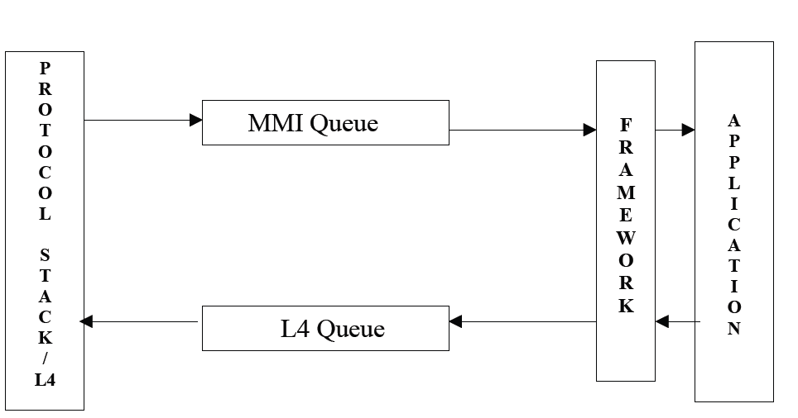
1.2Role of Framework

Slide 7
1.3Classification of Events
Events are of four types:
1. Keyboard Events
2. Protocol Events
3. Timer Events
4. Highlight Events

Slide 8
1.3.1Keyboard Events
Keyboard events are generated on key usage by user. In the current Pluto implementation, these events are passed on to MMI task by L4 task only. Key events are of four types:
  1. Key event Down.
  2. Key event Up.
  3. Key event Long press.
  4. Key event Repeat.
Framework provides APIs for the following functions to the application:
  - Set key handler for particular key
  - Set Key handler for group of keys
  - Execute current key handler for key press event
  - Clear key handlers for particular key
  - Clear key handlers for all keys
  - Special handling for Power and End Key

Slide 9
1.3.2Protocol Events
Protocol events are used for the communication between underlying layer and the MMI task.
  For example,INCOMING_CALL_EVENT is generated by L4 in case of an incoming call and CALL_ACCEPT_EVENT is generated by MMI application for L4 if user chooses to accept that call.
Framework provides APIs for the following functions to the application for handling protocol events:
  Send protocol event.
  Set protocol event handler.
  Execute Current protocol event handler.
  Clear handler for specific protocol event.
  Clear all protocol event handlers

Slide 10
1.3.3Timer Events
Events are used to notify starting or stopping a timer to the underlying layer. The notification of a timer expiry also comes as an event. Framework provides wrappers for the following functions:
  Start a timer
  Stop a Timer
On timer expiry, the framework makes an application function callback to a function, which is given as an argument while starting the timer.

Slide 11
1.3.4Highlight Events
Highlight events are internal events generated by framework when a particular menu item is highlighted. Applications use these events to perform functions like hint display, mapping of keys and changing labels of soft keys. Highlight handler functions are registered as callback functions by the application for menu items. Framework provides
APIs for the following functions to the application for handling protocol events:
  Set highlight handler.
  Execute current highlight handler.
  Clear highlight handler.
  Clear all highlight handlers

Slide 12
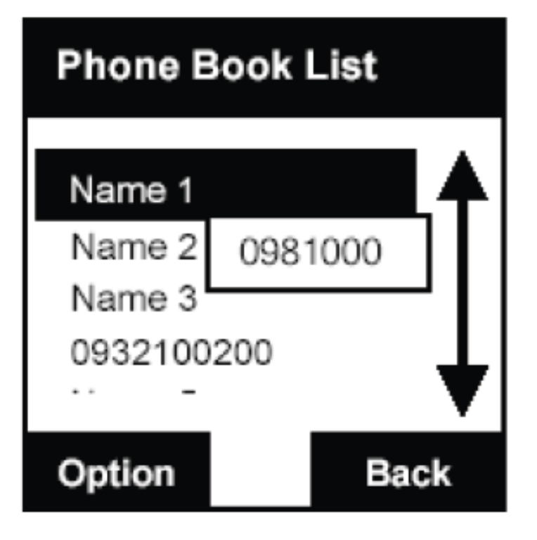
1.4Hint Handlers
Framework provides a mechanism for displaying hints for menu items. As the userhighlights a menu-item, a hint text is displayed just at the bottom of the menu-item.

Slide 13
1.4 Hint Handlers
Applications can register hint handlers with the framework. These hint-handler functions are called just before category screen function is called to display the screen. Hint handler functions are used to populate the global data structure with the hint strings. This mechanism ensures the movablity of hint itmes along with the menu items through the customization tool.
Framework provides APIs for the following functions to the application for handling protocol events:
  Set Hint handler.
  ConstructHintsList – function to populate a global array with hint
  strings for a menu
  Clear hint handler.
  Clear all highlight handlers.

Slide 14
Function Flow

Slide 15
2.1Protocol Event Handlers

Slide 16
Setting a Protocol Event Handler
Framework uses a global array protocolEventHandler[] to store the events and their corresponding handler-functions. Whenever an application calls SetProtocolEventHandler(Cback,eventID), an entry is made in this array with the eventID and cback function

Slide 17
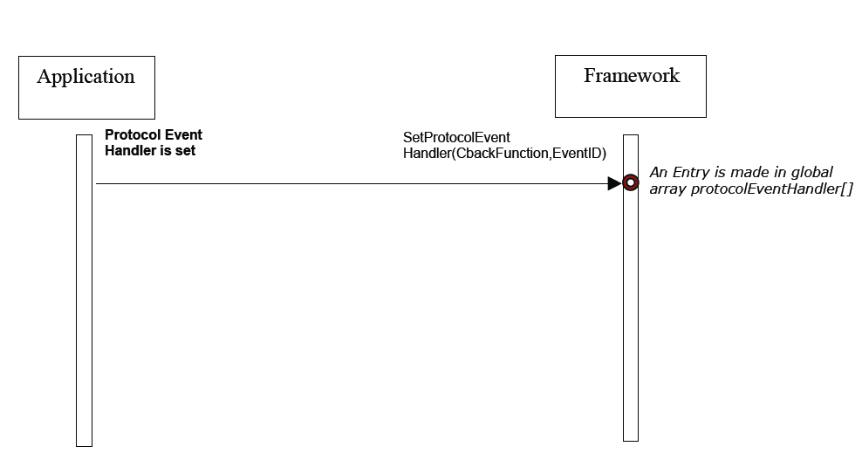
Setting a Protocol Event Handler

Slide 18
Protocol Event Call-back
MMI_task function waits for messages on MMI queue. Whenever a message is received, ProtocolEventHandler() is called which in turn calls ExecuteCurrProtocolHandler(). This function checks protocolEventHandler array to find an entry with corresponding eventID. If an entry is found, the corresponding cBack function is called, otherwise the event is ignored.

Slide 19
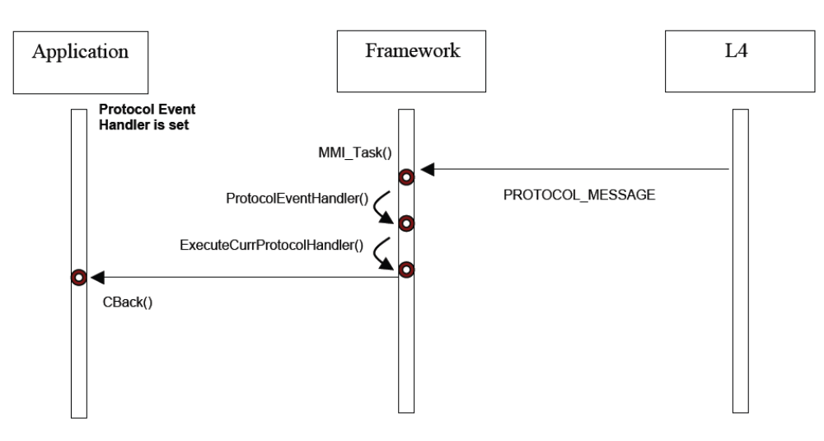
Protocol Event Call-back

Slide 20
Key Event Handlers

Slide 21
Setting a Key Event Handler
Framework uses a global array currKeyFuncPtrs [] to store the events and their corresponding handler-functions. Whenever an application calls SetKeyHandler (Cback,Keycode,KeyType), an entry is made in this array with the KeyCode,KeyType and cback function.

Slide 22
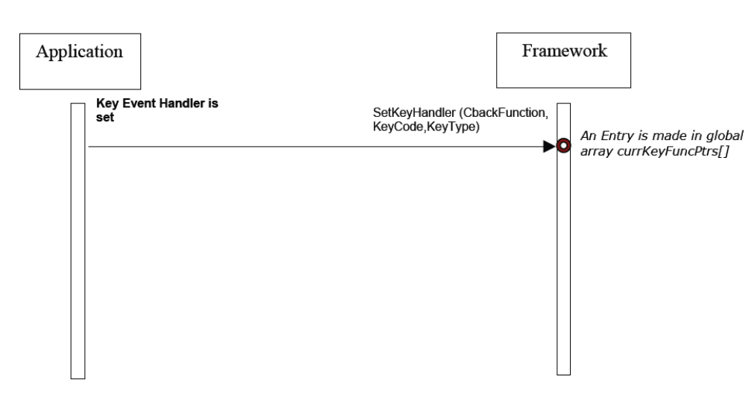
Setting a Key Event Handler

Slide 23
Key Event Call-back
L4KeyHandle function is set as the protocol handler for event KEY_EVENT. This key event comes as a protocol event from L4. So, whenever this event comes, L4KeyHandle function is called as the Cback. This function checks the KeyCode and Keytype in the message and calls the corresponding Cback function set in the array currKeyFuncPtrs[].If the KeyCode is not present or the Cback function is NULL, the key-event is ignored.

Slide 24
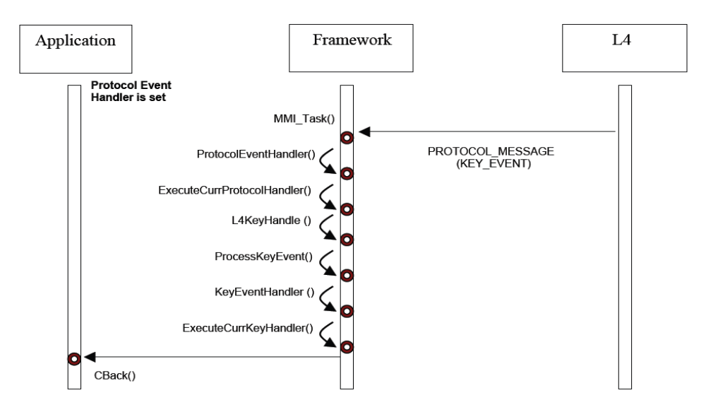
Key Event Call-back

Slide 25
Data Structures
This structure keeps the information about the functions to be called on asynchronous events.
typedef struct {
U16 eventID; //for timer & hardware events
PsFuncPtr entryFuncPtr;
} PseventInfo;
This array keeps the keyhandler function pointers for all the keys.
FuncPtr currKeyFuncPtrs[MAX_KEY_CODE][MAX_KEY_TYPE]
This structure contains the highlight-handler function pointers for menu items.
typedef struct {
FuncPtrShort hintFuncPtr;
FuncPtr entryFuncPtr;
} hiliteInfo;
U8 hintData[MAX_SUB_MENUS][MAX_SUB_MENU_HINT_SIZE]
This array is used by the category screens to read hint strings.

Slide 26
Major Procedures(Exported)
void InitFramework(void);
void ExecuteCurrKeyHandler(S16 keyCode, S16 keyType);
void ExecuteCurrProtocolHandler(U16 eventID,void* MsgStruct);
void ExecuteCurrExitHandler(void);
void ExecuteCurrSubLcdExitHandler(void);
void ExecuteCurrHiliteHandler(S32 hiliteid);
void SetKeyHandler(FuncPtr funcPtr, U16 keyCode, U16 keyType);
FuncPtr GetKeyHandler(U16 keyCode, U16 keyType);
void SetGroupKeyHandler(FuncPtr funcPtr, PU16 keyCodes, U8 len,U16 keyType);
void ClearKeyHandler(U16 keyCode, U16 keyType);
void ClearAllKeyHandler(void);
void PowerAndEndKeyHandler(void);
void SetProtocolEventHandler(PsFuncPtr funcPtr, U16 eventID);

Slide 27
Major Procedures(Exported)
void StartTimer(U16 timerid, U32 delay, FuncPtr funcPtr);
void StopTimer(U16 timerid);
void DeInitFramework(void);
void DeInitAllApplications(void);
void DeInitInsertApp(void);
void DisplayPopup(U8 * string, U16 imageId, U8 imageOnBottom, U32 popupDuration,U8 toneId);
void ConstructHintsList(U16 currParentID, U8 **hintArray);
void SetHintHandler(U16 itemid, FuncPtrShort hintFuncPtr);
void ClearHintHandler(U16 itemid);

Slide 28
History 1#
Database containing snapshots of screen
Implemented as a non default LIFO
Structure of history node
  Screen ID – of screen to be saved
  Entry Function Pointer – to redraw the screen
  Input Buffer – to save running text data for this screen
  GUI Buffer – to save UI related information for this screen

Slide 29
History 2#
History API
  Add Node to History
  Delete ‘N’ nodes in history
  Go back ‘N’ nodes in history
  Retrieve history for a screen
  Retrieve input buffer for screen
  Dump History for debugging
  Initialize history

Slide 30
History 3#
Subtle facts about history
  Is implemented as stack
  First screen saved after boot up is never removed
  New Nodes are added to the head of history

