Slide 1
RetainIT
Manisha Biswas
ID:- abhishek.nandy81@gmail.com
PassCode :-ICIC8020

Slide 2
PS:-How do we retain customers and add new one
Solution targeted for retail customers as well as admins who manage the account
Innovative ways to retain the customers and give a unified experience
Bridging the gap between customers and the ICICIBank with intelligent system powered by IBM Watson services
Showing offers and details according to users need

Slide 3
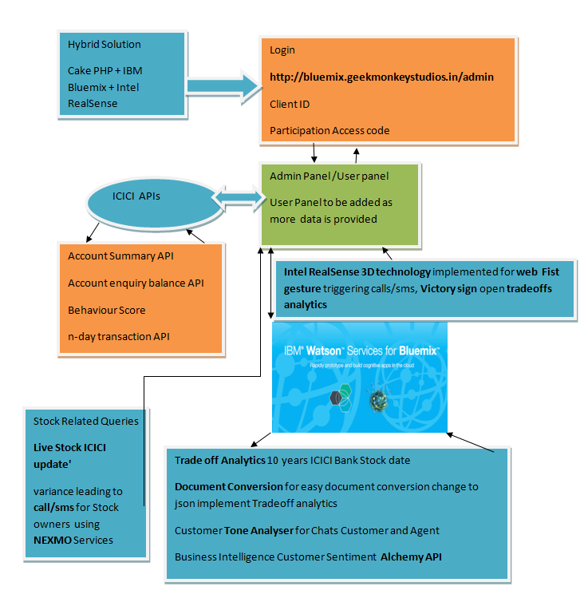
The project Flow

Slide 4
List of functionalities
Login using Client ID and passcode,leads you to admin page
Login:- http://bluemix.geekmonkeystudios.in/admin
User Name:-abhishek.nandy81@gmail.com
Password :- ICIC8020
Using ICICI Bank Apis first get Accounts Summary, then using Account enquiry Balance API shows the balance for the user,Behaviourial API allows to see if is eligible for Loans or not.N-day (10 days)transaction API establishes transaction history for a user.

Slide 5
List of functionalities contd..
Using IBM Bluemix Watson services
Trade Off Analytics:- uses 10 years ICICI Bank stock data and do analysis on that data give desired results
Document Conversion allows you convert a document into JSON that can be easily implemented to do trade off analytics
Customer Service Tone Analyzer:- allows steady analysis of customer/agent chat with Sentiments/emotion values.
Business Intelligence and Customer Sentiment:- This allows users to know the market pulse from internet how is the pulse of ICICI bank for a period of time using News API from Alchemy(API calls just goes out of limit because of a free key)
Stock Related Data & messages:- Shows live stock update of ICICI bank for registered users owning ICICIBank we make a call/sms when there is increase/decrease of share price used dummy number now(for call our friend’s number added) he receives a call now can be extended to various services in portal powered by Nexmo(https://www.nexmo.com/).
Lastly we have used Intel RealSense technology for web using the camera to fire call/sms when we show gestures Like Fist gesture will make a call/sms ,Victory sign opens trade off analytics(http://www.intel.com/content/www/us/en/architecture-and-technology/realsense-overview.html) we are working on emotion detection for users to give offers.

Slide 6
How the solution is different
User experience is governed by power of AI of Watson services that gives a very good experience to users
Analysing important data gives us ways to interact with customers more engaging
Giving latest updates via sms/phone calls makes more interesting as this figures/flows are generated from Watson Services.
Gesture recognition for touchless experience for users adding another dimension to the app
We are working on emotion detection mechanism with Watson services so that we provide offers according to the mood or capture a variance looking at user data. It uses Intel RealSense

Slide 7
Underlying technology
We have used Hybrid Solution using Cake PHP to build it and mixed IBM Bluemix Watson services for the application flow(trade off analytics, document conversion, tone analyser, alchemy API) Gesture Recognition(Intel RealSense).For making calls we have used Nexmo and ICICI Bank APIs.We made it in a windows system can be easily converted to IBM Bluemix platform(used manisha.biswas@india.com for Bluemix access)
ICICI Apis used
Account Summary API
Account enquiry balance API
Behaviour Score
n-day transaction API

Slide 8
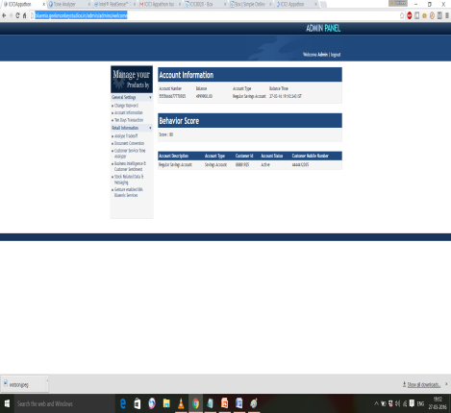
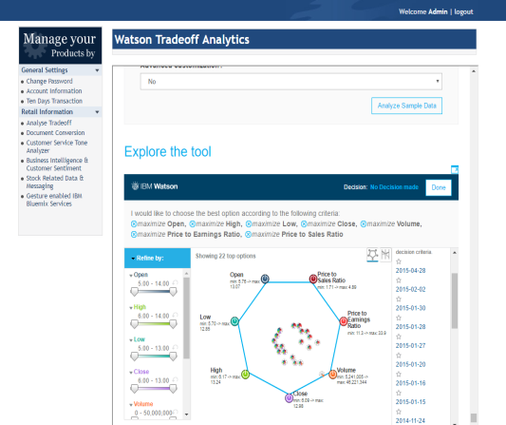
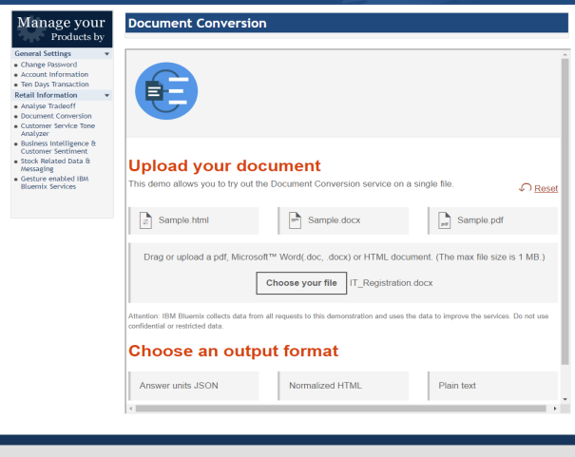
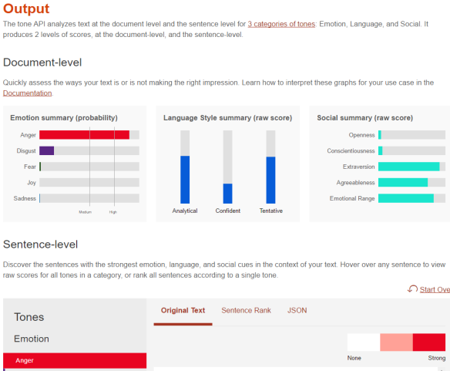
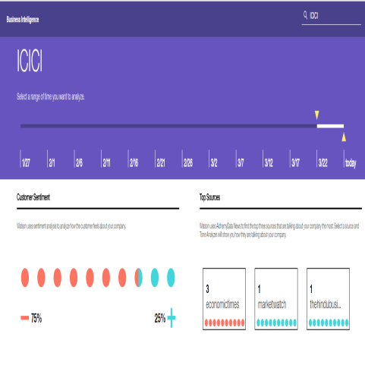
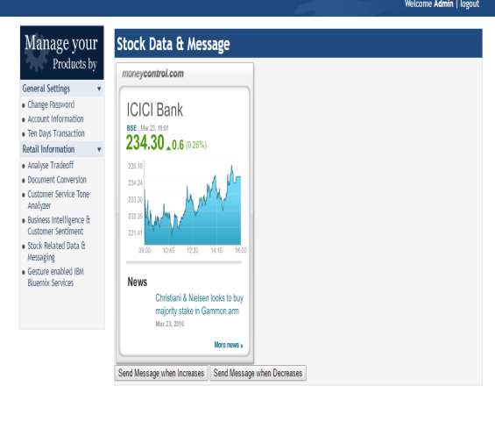
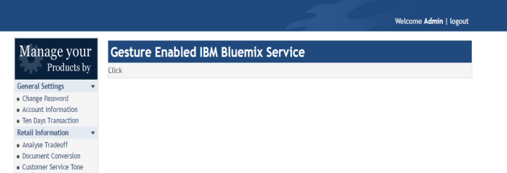
App Screenshots

