Slide 1

Welcome to Data Science Online Bootcamp
Know more about Decision Trees

Slide 2

Learning Objectives
Decision Trees

Slide 3
Some Important Updates
Some updates have been made to the code from yesterday’s session, please download the updated code below: https://github.com/dphi-official/First_ML_Model

Slide 4
Understanding Decision Trees
The following video explains clearly what a decision is and how it works with bunch of live examples.
Alongside it will talk about some mathematical aspects such as gini impurity. It would be good to understand them in long run, though you may not want to overwhelm yourself with too many jargons at the moment.

Slide 5
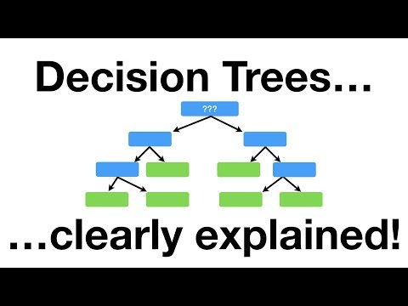
Understanding Decision Trees

Slide 6
Decision Tree Resources
A simple non-technical explanation of decision tree: https://towardsdatascience.com/a-beginners-guide-to-decision-tree-classification-6d3209353ea
A comprehensive article on decision trees that talks about optimisation criteria, pros and cons etc: https://www.datacamp.com/community/tutorials/decision-tree-classification-python

Slide 7
Decision Tree Resources
Optional reading, to understanding several aspects of decision trees: https://medium.com/greyatom/decision-trees-a-simple-way-to-visualize-a-decision-dc506a403aeb

Slide 8
Let’s do some practice
Now that we know how to build a simple decision tree model on one of the datasets that we used previously (dataset details are given in the next slide)
Objective: Imagine you were hired as a Data Scientist/Analyst by the Central Police Office of Metropolitan areas and your job is now to create a predictive model for crime_rate. For now, let’s focus on building a simple decision tree.

Slide 9
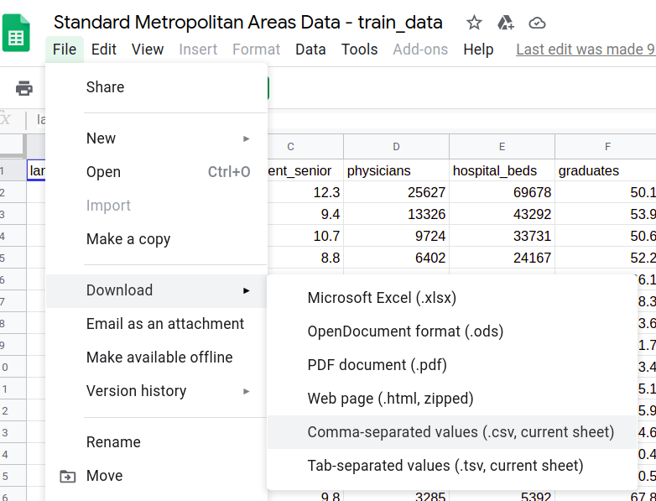
Dataset
In this exercise, we’ll be exploring the Standard Metropolitan Areas Dataset in depth.
Link to the Dataset: https://bit.ly/SMA_Dataset
Download the dataset
as a CSV file.

Slide 10
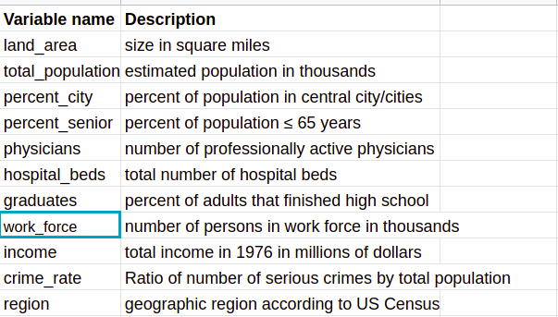
Dataset Description
It contains data of 99 standard metropolitan areas in the US. The data set provides information on 10 variables for each area for the period 1976-1977. The areas have been divided into 4 geographic regions: 1=North-East, 2=North-Central, 3=South, 4=West. The variables provided are listed in the table below:

Slide 11
Hints
This is a regression problem as the outcome variable is continuous. Hence, you need to use a Regressor instead of classifier in the below lines of code. A reference example of regressor problem can be found here.
from sklearn.tree import DecisionTreeClassifier
model = DecisionTreeClassifier()
model.fit(X_train, y_train)

Slide 12
What next?
If you were able to build a model then don’t forget to share it here with fellow learners:
https://dphibootcamp.slack.com/archives/C014J5W1KUG
You surely deserve a praise for your first Machine Learning Model!

Slide 13
Download link to slides
Download here: https://docs.google.com/presentation/d/1BCwLdFQqFLHR2-7APyoWh5u1b6Jo3wq17nj-8s2H_mg/edit?usp=sharing

Slide 14
That’s it for the day. Thank you!
Feel free to post any queries in the #help channel on Slack

