Slide 1

TrailGraph
Business Plan & Market Positioning
The graph-native, memory-powered trip planner for all U.S. public lands
Bootstrapped consumer freemium · NPS · State · USFS · BLM · Confidential draft, June 2026

Slide 2




Planning a public-lands trip is fragmented and unforgiving
Every leading tool solves one slice — and forgets you between trips
Fragmented tools & agencies
The reservation scramble
One trip spans trails, campsites, routes, permits & conditions across NPS, state, USFS and BLM — stitched across a dozen apps and tabs.
Reservable sites open on a 6-month window and summer dates “fill within seconds.” Timed-entry permits sell out in minutes.
Generic AI with no memory
The backcountry is offline
New AI planners answer one prompt and forget you — they don’t know your rig length, accessibility needs, or trip history.
Cell service dies exactly where help is needed — at the trailhead and campsite — yet most AI assistants are cloud-only.

Slide 3
A vast, growing, AI-receptive market
Outdoor recreation is a $1.3T economy — and trip planning is going AI-first
$1.3T
331.9M
56M / $61B
~80%
outdoor rec output
(2.4% of GDP, 5.2M jobs)
NPS visits in 2024
(a record)
Americans camped / spent
in 2024
of U.S. travelers now
use AI to plan trips
$3.4B → 11% CAGR
global travel-planner app market
$2.8B → $15.5B
AI-powered travel app market by 2032 (23.8% CAGR)
Sources: BEA 2024; NPS 2024; KOA 2024; market.us; QYResearch.

Slide 4
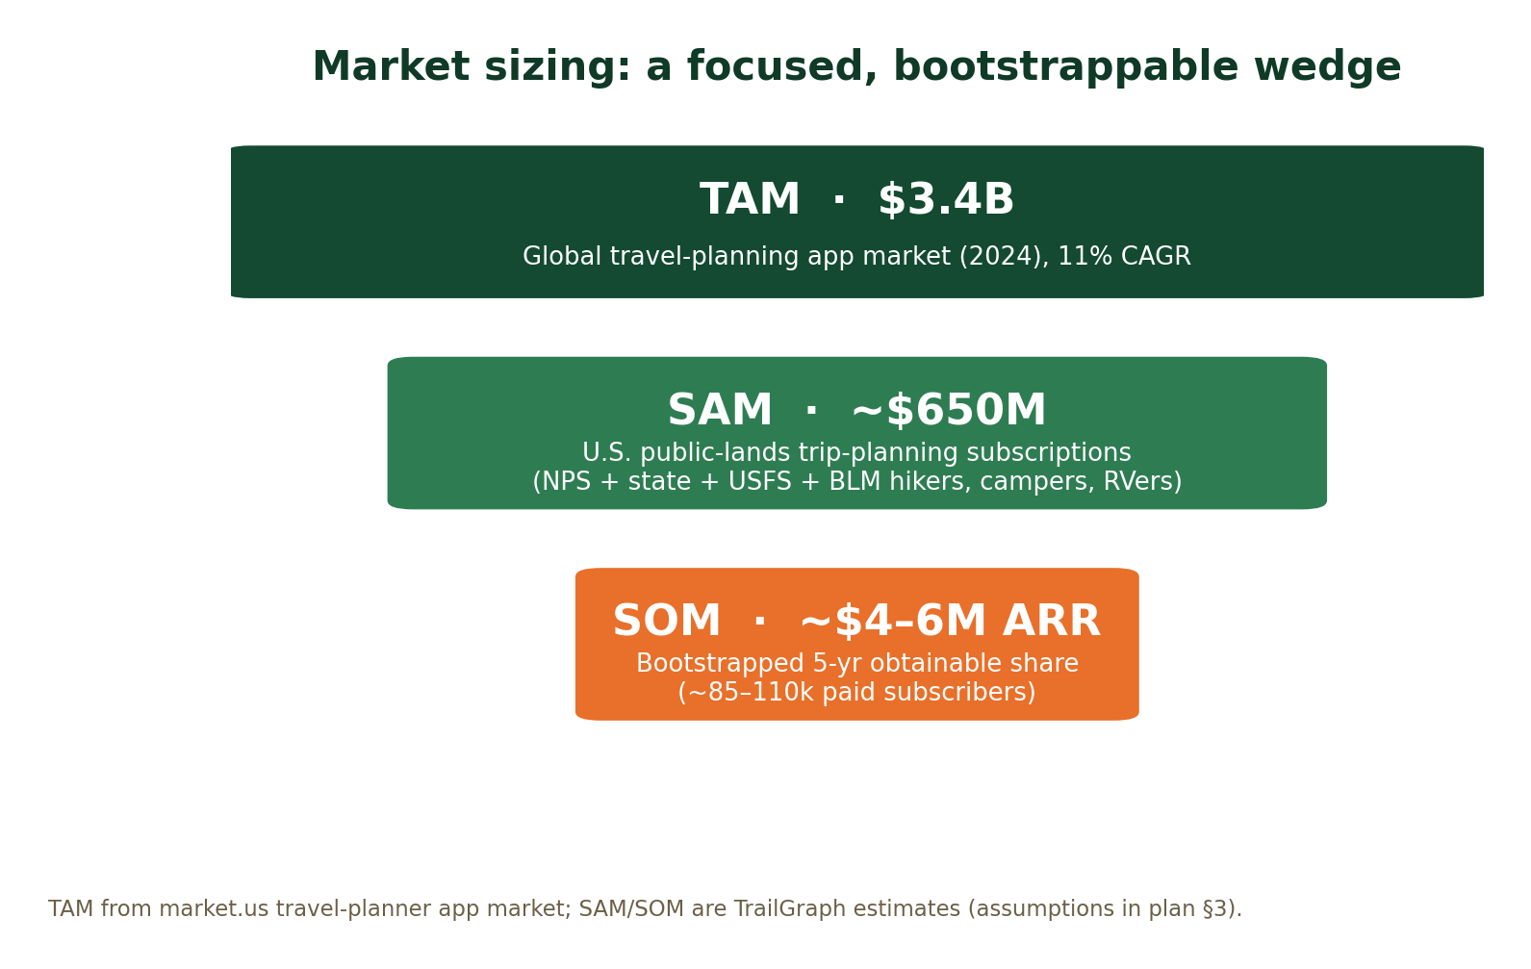
A focused, bootstrappable wedge
Conservative, defensible sizing — not top-down hype
TAM
$3.4B
Global travel-planner app market
SAM
~$650M
U.S. public-lands trip-planning subscriptions
SOM
~$4–6M ARR
Bootstrapped 5-yr obtainable (~85–110k paid)

Slide 5
The market is proven — but every leader is single-purpose
Incumbents validate willingness to pay; none combine breadth + memory-native AI
Player | Focus | $/yr | Strength → the gap
AllTrails | Trails | ~$36 | 60M users, ~$150M ARR, best trail catalog → trails only; no camping, routing or memory
The Dyrt | Camping | $36–60 | 1M+ reviews, offline + alerts → camping-centric; thin trails/itinerary; no AI memory
Wanderlog | Itineraries | ~$40 | Great collaborative itineraries + AI → thin public-lands data; stateless AI
Roadtrippers | Road trips / RV | $36–60 | Route discovery + RV routing → route-centric; no availability alerting or memory
Gaia GPS / onX | Offline maps | $30–100 | Best offline topo & GPS → maps, not planning; no agent or reservations
NPS / Recreation.gov | Info & booking | Free | Authoritative + booking rails → utility, not a planner; federal-only, no AI

Slide 6
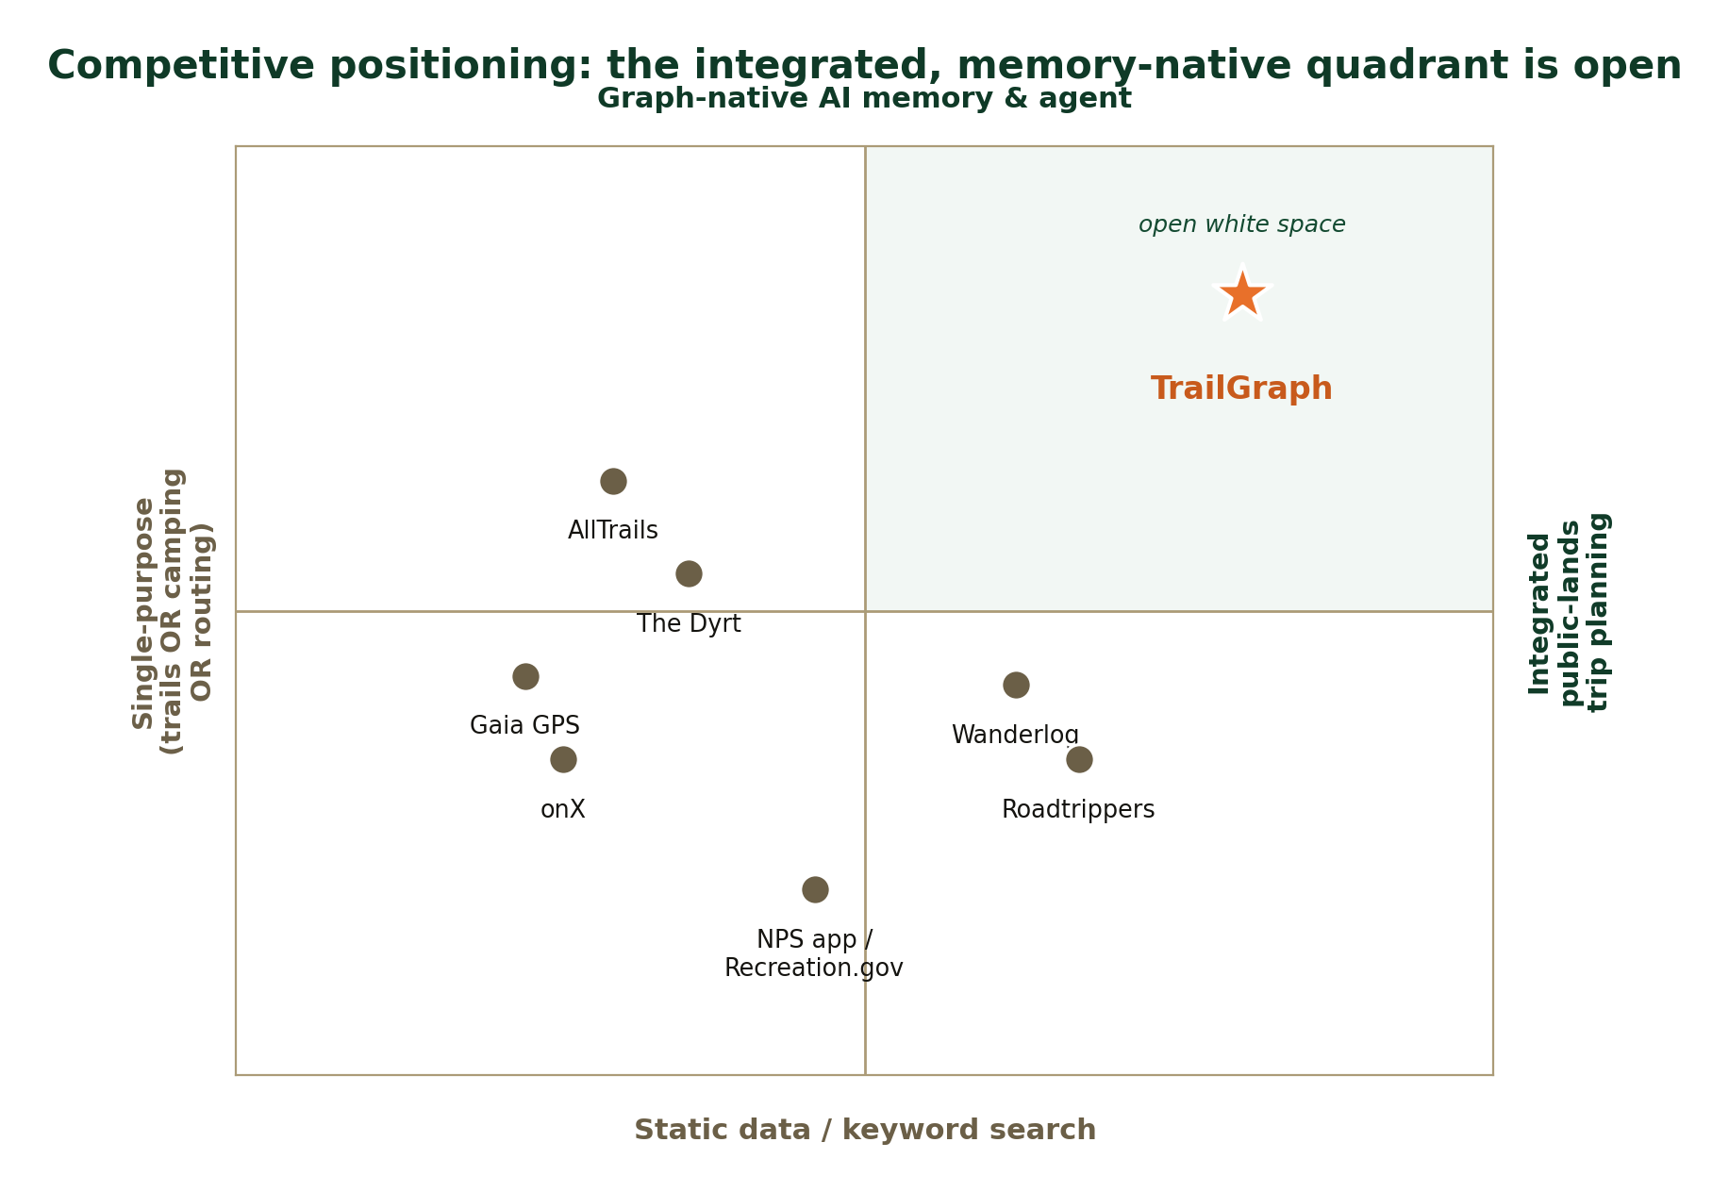
The integrated, memory-native quadrant is open
TrailGraph’s wedge — and a compounding data + memory moat
Breadth that defines a category
Whole-trip planning across NPS, state, USFS & BLM — no incumbent spans all four.
Memory that compounds
The graph + cross-trip memory get smarter with every user; single-purpose rivals can’t bolt it on.
Offline AI nobody else has
An on-device ranger that works without signal — the backcountry’s missing tool.
Priced in the band
Pro at ~$39 vs. an established $30–60 willingness to pay.

Slide 7


Built, and what the business needs next
The national-parks core proves the architecture; breadth + monetization come next
Shipped today
To build for the plan
Explorable national-park graph
AI ranger with graph-native memory (preferences & constraints injected every turn)
Trip planner + route drawing + GPX / calendar export
Interactive map & graph explorer
Learn module (decomposed NPS lesson plans)
Multi-agency data pipeline — trails + campgrounds across NPS/state/USFS/BLM
Real trails & activities — length, elevation, difficulty; activity-first
Availability + Camp Watch — live search + cancellation alerts
Mobile + offline AI ranger — the premium differentiator
Subscription billing & entitlements — trials, tiers, referrals
Affiliate / booking funnel — revenue without processing payments

Slide 8

The differentiator: an offline AI ranger
Itinerary intelligence that works when the signal doesn’t — no competitor offers it
Works in dead zones
Downloaded maps, trips and an on-device/edge model answer “what’s the next campsite with availability?” with zero bars.
Remembers you, on device
Your rig, accessibility needs and trip history travel with you — privately — even offline.
The reason to go Pro+
A concrete, daily-value upgrade that maps & itinerary apps can’t match — and the highest-ARPU segment (RVers, overlanders) needs most.

Slide 9



Pricing: a freemium ladder
Free drives discovery & SEO; Pro unlocks power; Family/Overlander captures the highest spenders
Free
Pro
Family / Overlander
$0
~$39/yr
~$69/yr
Browsers & first-timers
Active hikers & campers
Households, RVers, overlanders
AI ranger (limited)
Browse parks, trails, camps
1 saved trip · 1 Camp Watch
Ads-free, community
Unlimited ranger + trips
Offline maps + trips
Offline AI ranger
Unlimited Camp Watch alerts
Conditions alerts, GPX/field briefs
Everything in Pro
Up to 5 members
RV/rig-aware routing & site fit
Dispersed / free-camping layer
Faster alert scan cadence

Slide 10
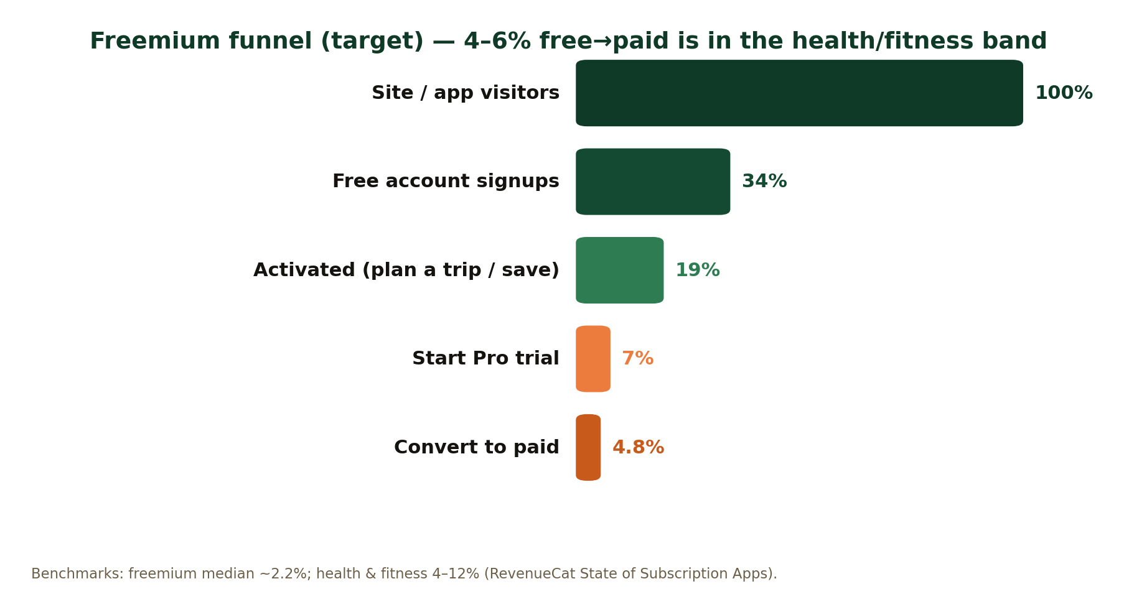




Go-to-market: capital-efficient & compounding
CAC-light channels that the graph + content architecture is built for
Content & SEO engine
The graph auto-generates interlinked park/trail/campground pages — programmatic SEO against high-intent queries.
Reservation-race wedge
“Get alerted when a sold-out site opens” — a sharp, shareable hook with built-in urgency.
Community & UGC
Reviews, trip reports & saved trips deepen the graph and the moat while lowering content cost.
Target freemium funnel — 4–6% free→paid is within the health-&-fitness band (RevenueCat).
Seasonal & partnerships
Time pushes to planning season + 6-month booking windows; gateway towns, gear/RV brands, creators.

Slide 11
Financial model — bootstrapped base case
Subscription-led, profitable around Year 3, no outside capital
$4.9M
total revenue by Year 5
~84k
paid subscribers by Y5
~Y3
profitable, bootstrapped
~$45
blended ARPU
Base case: organic + content-led growth, 3.5→6% conversion, lean team. Upside (paid CAC, B2B, global) excluded.

Slide 12
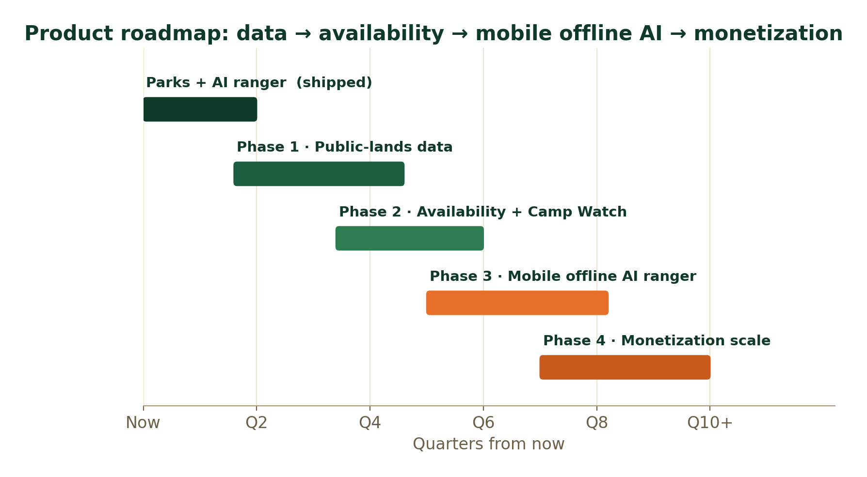
Roadmap: data → availability → mobile offline AI → scale
Each phase is independently shippable
Public-lands data
trails + campgrounds, multi-agency
1
Availability + Camp Watch
live search + cancellation alerts
2
Mobile + offline AI ranger
the premium differentiator
3
Monetization scale
tiers, affiliate/booking, data
4

Slide 13

Why TrailGraph wins
The only integrated, memory-native, offline-capable planner for U.S. public lands
Open quadrant — integrated breadth + graph-native memory + offline AI — unoccupied by incumbents
Compounding moat — the graph & cross-trip memory get harder to catch with every user and data source
Bootstrapped to ~$4.9M — ~84k paid subscribers by Year 5, profitable by ~Year 3, no outside capital
TrailGraph · the trip planner that remembers

