Slide 1
GRAPHS × OPEN KNOWLEDGE FORMAT
From Markdown to
Knowledge Graph
Ingesting Google's Open Knowledge Format into Neo4j — and making it earn its keep with GraphRAG
OKF spec v0.2
Neo4j 2025.x
neo4j-graphrag 1.18
Will Lyon · github.com/johnymontana/neo4j-okf
Notes:
Setup (60s): Two threads meet in this talk. Google shipped OKF — an open spec that formalizes the 'LLM wiki' pattern: organizational knowledge as markdown + YAML frontmatter, designed to be written and maintained by agents as much as by people. And we have Neo4j, which is where knowledge shaped like a graph wants to live. Thesis: an OKF bundle IS a graph, serialized as files — materialize it in Neo4j and you get governance queries and grounded retrieval that neither the files nor a vector store can do. Everything shown is in the repo: parser, ingestion, notebook, this deck.

Slide 2
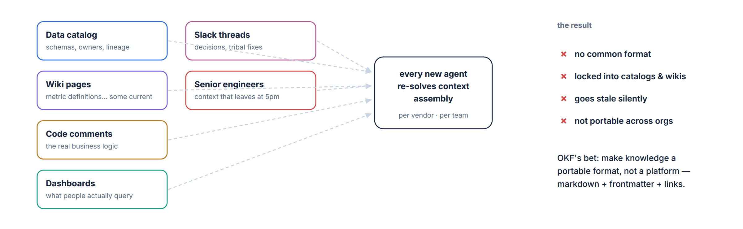
PART I · THE FORMAT
Why Google shipped a knowledge format at all
the knowledge agents need exists — as five different exhausts
OKF × Neo4j
2
Notes:
90s: The context agents need — table semantics, metric definitions, runbooks, deprecations — exists, but as exhaust across five systems, each with its own API and none portable. Every agent team rebuilds context assembly; every vendor sells you their proprietary catalog. OKF's bet, per Google's own framing: knowledge should be a FORMAT, not a platform. Files you can cat, diff, git-clone. Note their observation that agents are often better wiki maintainers than humans — they don't get bored or forget cross-references. That's why trust metadata becomes load-bearing: when agents write most of the corpus you need provenance machinery, which is exactly what v0.2 added.

Slide 3
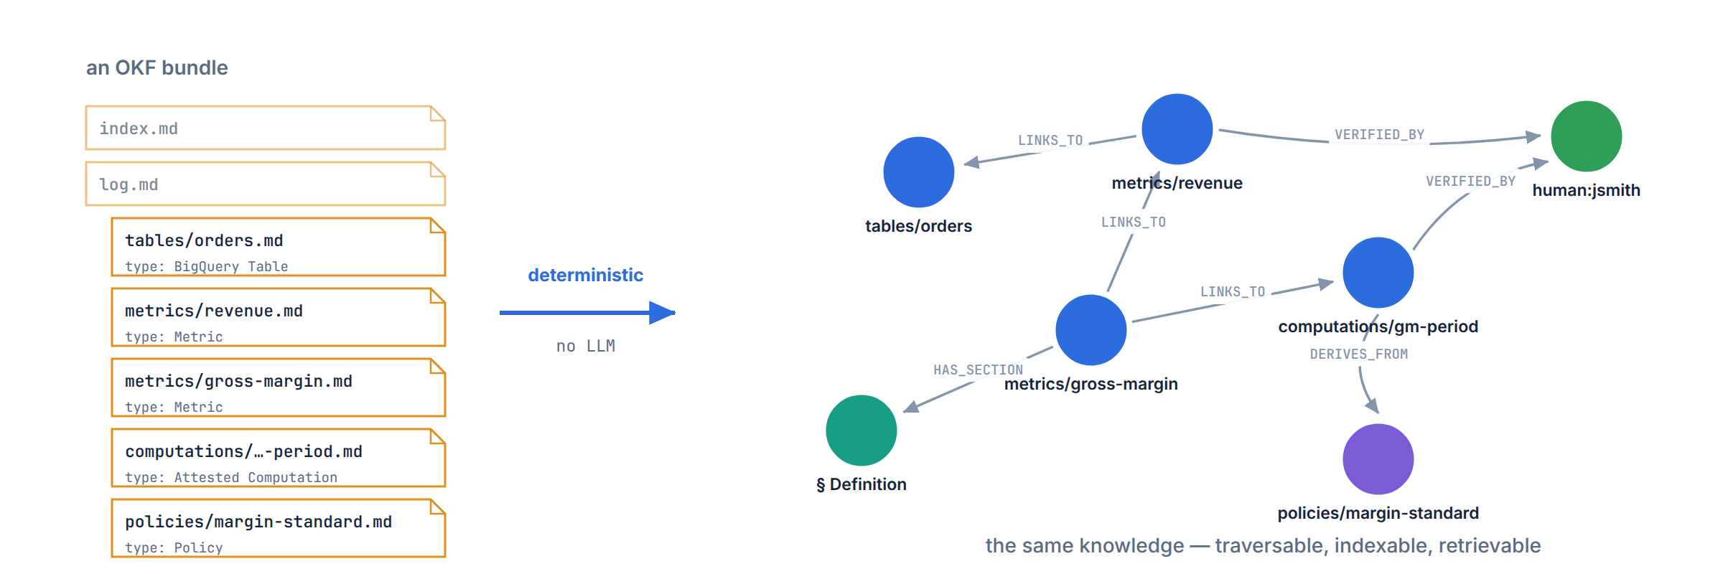
PART I · THE FORMAT
The whole talk in one picture
files in git → deterministic parse → property graph → Cypher + GraphRAG
OKF × Neo4j
3
Notes:
30s: Left — an OKF bundle: markdown files with frontmatter, cross-linked. Right — the same bytes as a labeled property graph: concepts, sections, actors, sources. The arrow in the middle is boring on purpose: no LLM, no inference, just parsing structure that's already there. That boringness is a feature — ingestion is reproducible and cheap, and we save the model calls for retrieval time where they buy something.

Slide 4
PART I · THE FORMAT
OKF in five facts
github.com/GoogleCloudPlatform/knowledge-catalog · Apache-2.0 · spec v0.2
1
A bundle is a directory of markdown files — that's the whole runtime
Concepts (tables, metrics, playbooks, policies…) as files; ship via git, tarball, or a subdir.
2
One required key: type — everything else is optional families
No schema registry, no central authority. Consumers MUST tolerate unknown types and keys.
3
Path = identity · markdown links = relationships
metrics/gross-margin.md is the id; links carry meaning in surrounding prose. Broken links are legal: not-yet-written knowledge.
4
v0.2 makes trust first-class: sources, generated / verified, status, stale_after
Built for corpora that agents maintain — provenance, trust tiers, freshness, attested computations.
5
Format, not platform — producers and consumers swap independently
Reference producer agent + static graph viewer ship with the repo; GCP Knowledge Catalog ingests OKF.
OKF × Neo4j
4
Notes:
75s: Orient the audience on the spec itself. Emphasize the conformance posture — it's aggressively permissive (MUST NOT reject unknown types, keys, broken links) which matters for us as consumers: our ingester must be permissive too. And flag fact 4: v0.2's trust families are the interesting part for a graph audience — they're literally edge data waiting for a graph. The samples in the repo: GA4, Stack Overflow, Bitcoin, and acme_retail which we'll use throughout — it exercises every v0.2 feature.

Slide 5
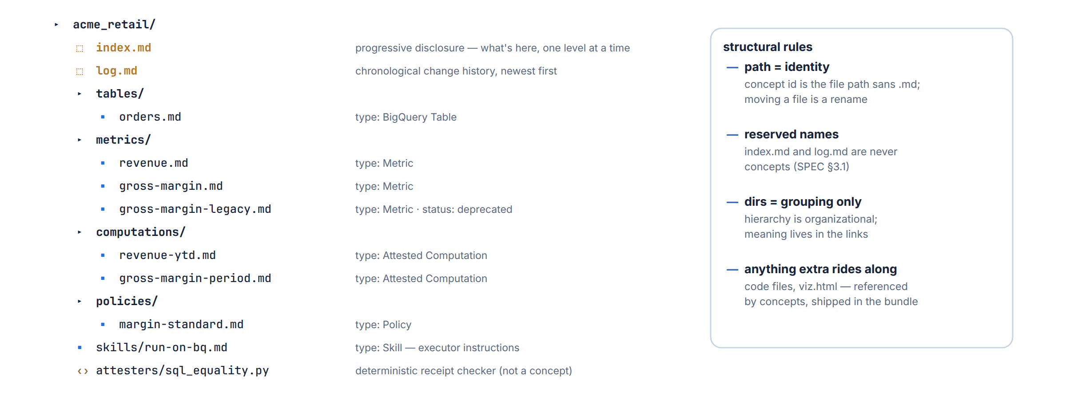
PART I · THE FORMAT
Anatomy of a bundle
unit of distribution: a git repo, a tarball, a subdirectory — files all the way down
OKF × Neo4j
5
Notes:
60s: The acme_retail sample: tables, metrics, computations, policies, plus executor skills and attester code. Reserved names: index.md (progressive disclosure — an agent can navigate one level at a time instead of slurping the whole tree into context) and log.md (chronological history). Note gross-margin-legacy sitting there with status: deprecated — the spec says keep it for reproducibility. Remember that file; it's the landmine the GraphRAG demo steps on later.

Slide 6
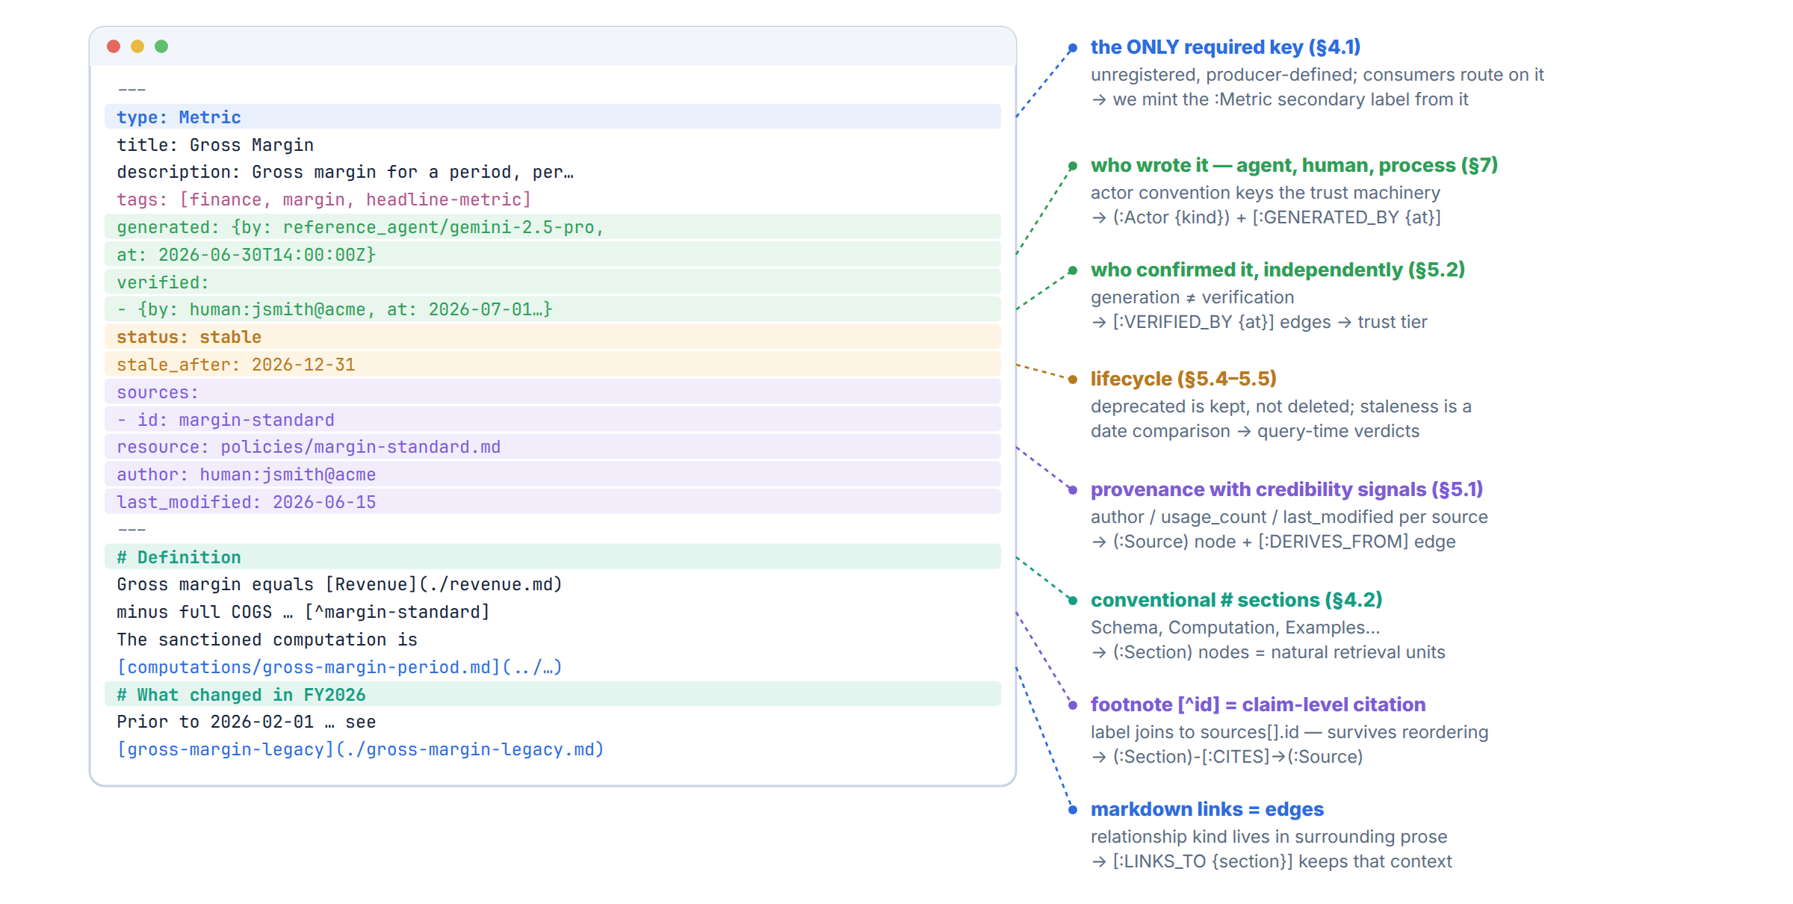
PART I · THE FORMAT
Anatomy of a concept
metrics/gross-margin.md, dissected — every family is optional except type
OKF × Neo4j
6
Notes:
90s: One real file, dissected. Frontmatter: type is the only required key — we'll mint Neo4j secondary labels from it. generated vs verified is the key split: who wrote it need not be who confirmed it, and the actor convention (human: / process: / producer-version) is what trust tiers key off. sources carry per-source credibility signals — author, usage_count, last_modified — signals, not scores; scoring is the consumer's job. Body: conventional h1 sections, links whose meaning lives in prose, and footnotes keyed to sources[].id giving CLAIM-level attribution that survives agents rewriting the doc. Every callout on the right names the graph element it becomes.

Slide 7
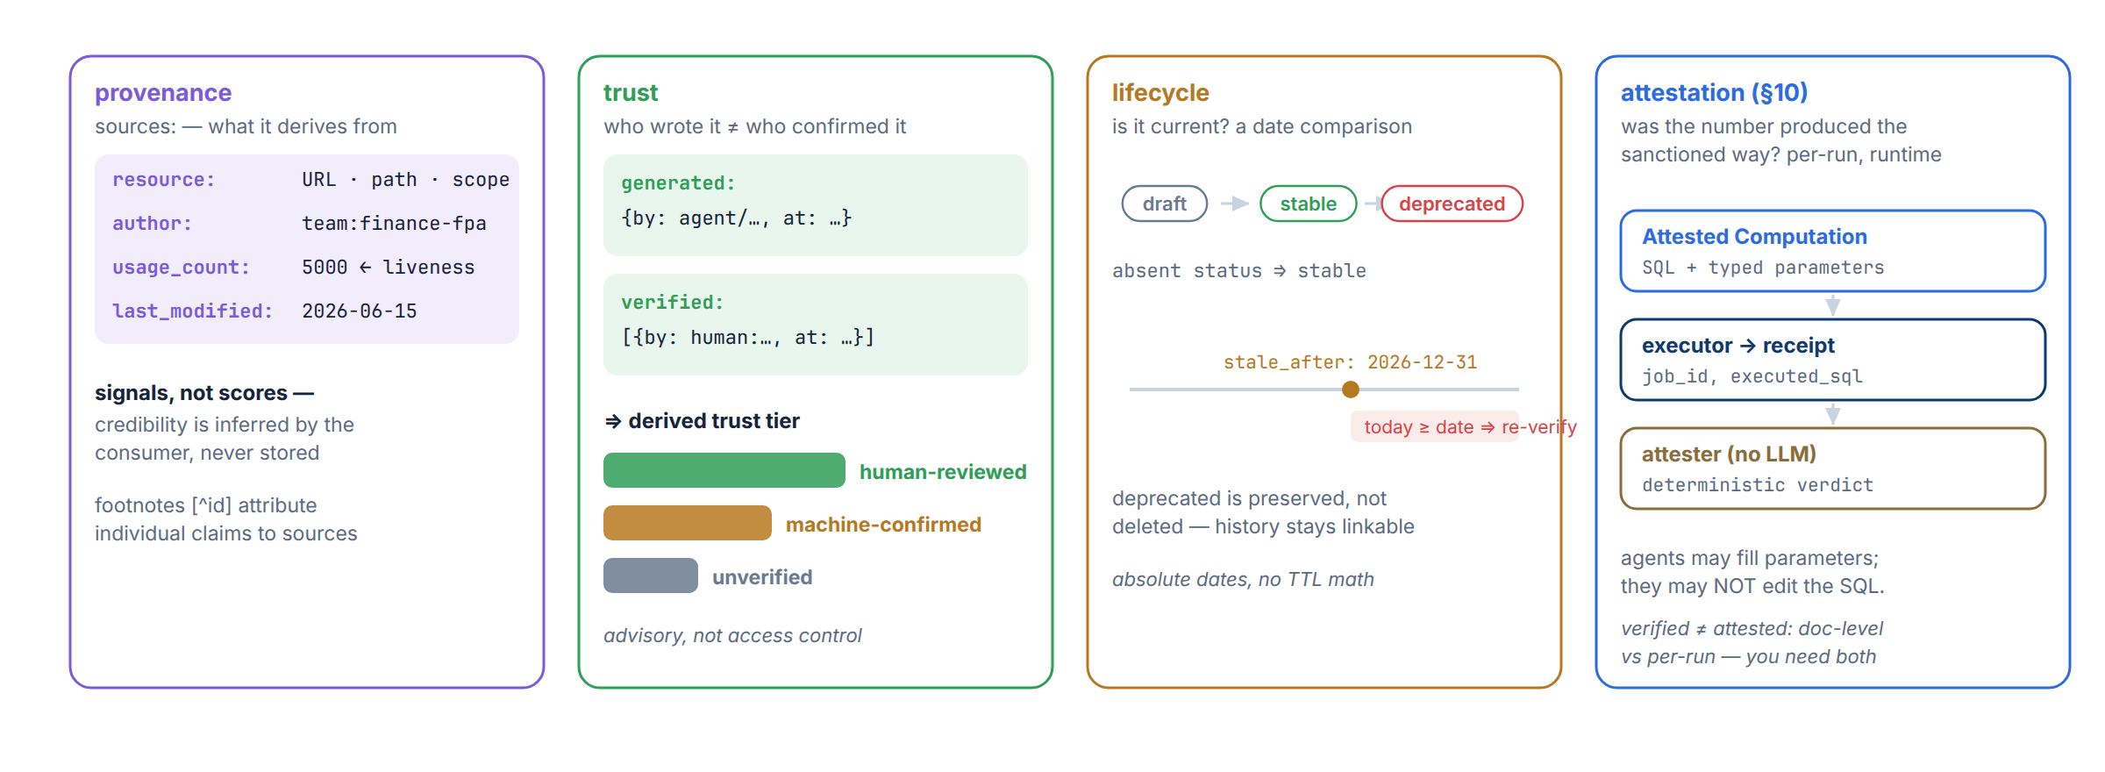
PART I · THE FORMAT
The v0.2 trust machine
four optional frontmatter families — absence is meaningful, never fatal (SPEC §5, §10)
OKF × Neo4j
7
Notes:
90s: Four families. Provenance: sources + objective signals; credibility is inferred at consumption, deliberately not stored. Trust: generated/verified split, three derived tiers — and absence is meaningful: unverified is a legitimate, visible state, never a parse error. Lifecycle: absolute dates (stale_after), so staleness is a date comparison, not TTL math against read-time. Attestation is the deep one: a sanctioned computation is its own concept — typed parameters, an executor that returns a receipt (job_id + executed_sql), an attester that's deterministic code, no LLM. Agents may bind parameters; they may not author SQL. verified ≠ attested: doc-level vs per-run. You need both.

Slide 8
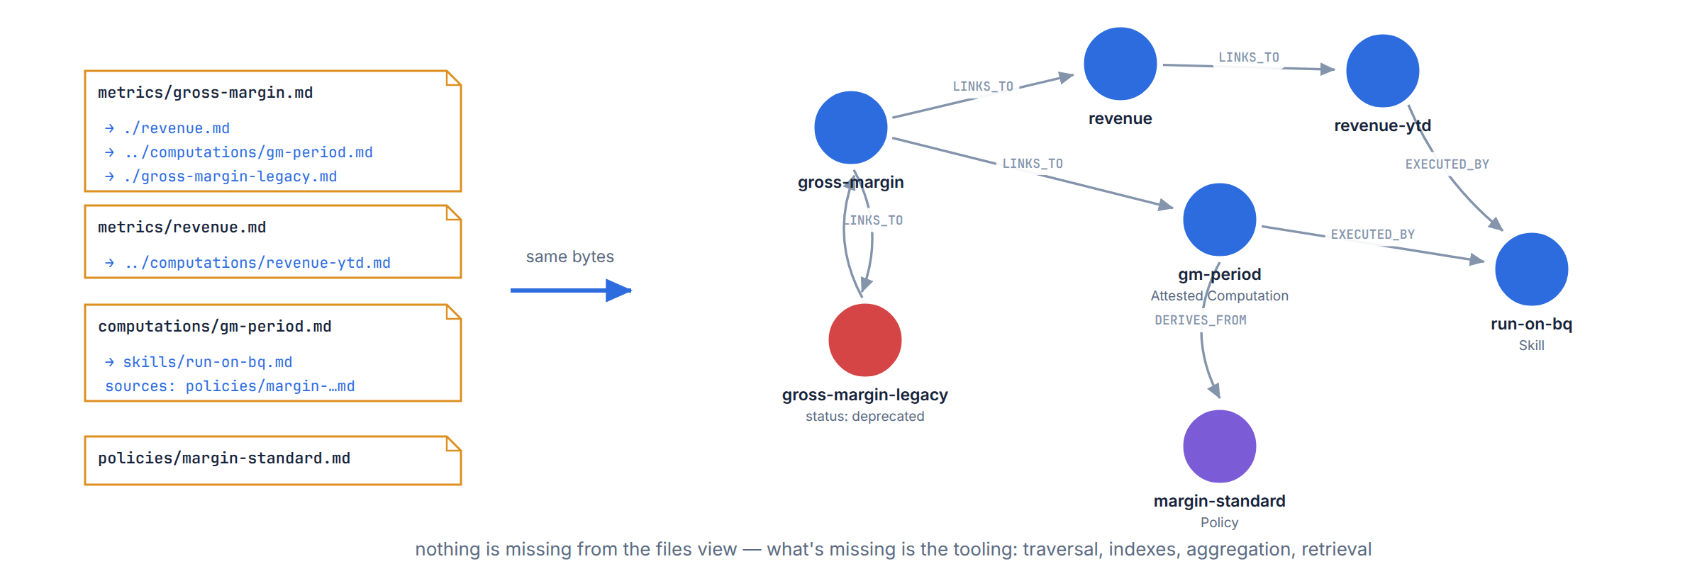
PART II · INTO NEO4J
A bundle is already a graph
Google's own framing: “graph-shaped, not just tree-shaped” — every bundle even ships a static viz.html
OKF × Neo4j
8
Notes:
45s: Pivot slide. Path = node identity, links = edges, frontmatter = properties, directory tree = one grouping dimension. Google says it themselves: graph-shaped, not just tree-shaped — they even ship a static viz.html with every bundle. So the interesting question isn't WHETHER this is a graph; it's what tooling you get once you admit it is one.

Slide 9
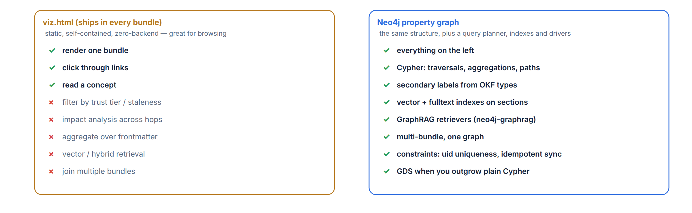
PART II · INTO NEO4J
Why materialize it in a database
viz.html browses one bundle beautifully — everything on the right is a database job
OKF × Neo4j
9
Notes:
45s: Nothing against viz.html — static, self-contained, great for browsing one bundle. But it can't answer questions: filter by trust tier, staleness reports, impact analysis across hops, aggregation over frontmatter, similarity retrieval, joining multiple bundles into one estate view. Those are database jobs. Everything on the right comes from ~400 lines of parser + plain Cypher MERGE — no APOC, no plugins — plus the neo4j-graphrag package for indexes and retrievers.

Slide 10
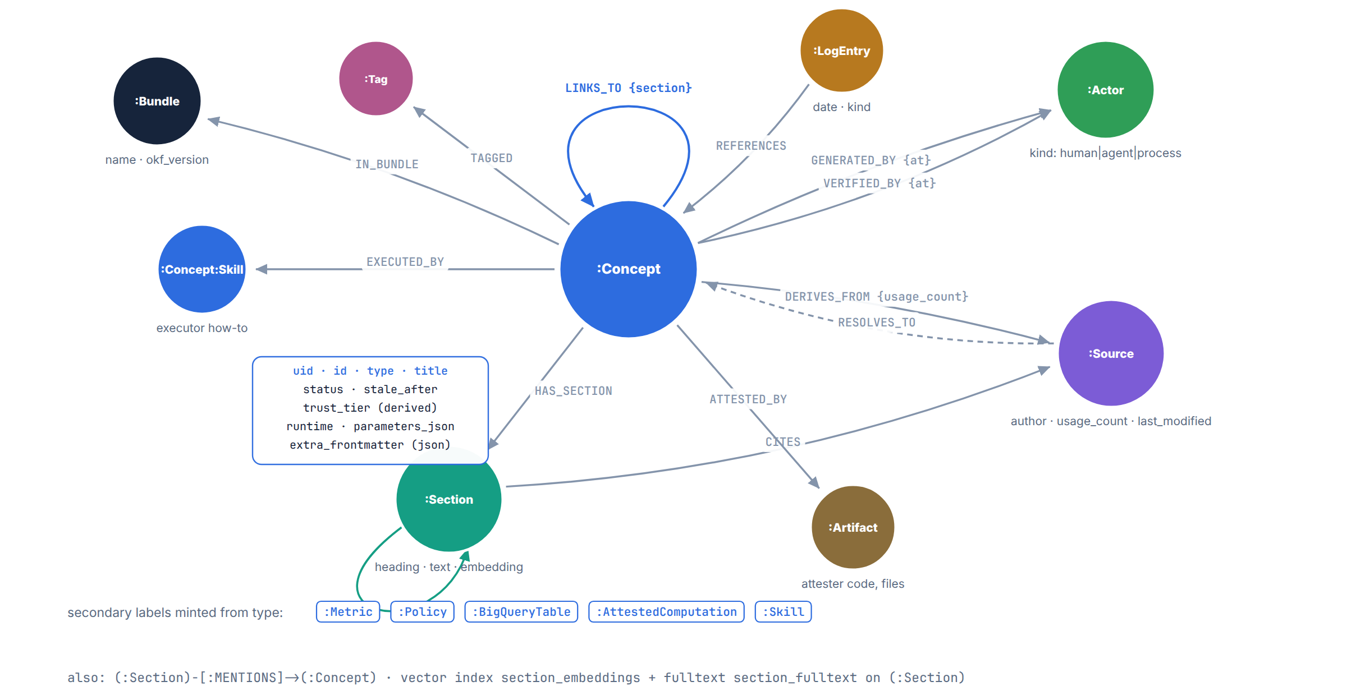
PART II · INTO NEO4J
The graph model
structural + provenance + lexical layers in one property graph — plain Cypher (APOC only in the optional extraction appendix)
OKF × Neo4j
10
Notes:
90s: The center is :Concept, one per file, uid = bundle + path. Around it: Bundle; Actor with GENERATED_BY/VERIFIED_BY carrying timestamps on the edges; Source with the DERIVES_FROM/RESOLVES_TO pair — RESOLVES_TO is what turns 'this source is actually another concept in the bundle' into a traversable provenance chain; Section is the lexical layer — OKF's conventional headings hand us retrieval units so chunking is free; CITES gives claim-level citations from footnotes. LINKS_TO keeps the section it came from as an edge property — the spec says relationship meaning lives in surrounding prose, so we preserve exactly where each link appeared. Attested computations get EXECUTED_BY to the skill concept and ATTESTED_BY to the checker artifact.

Slide 11
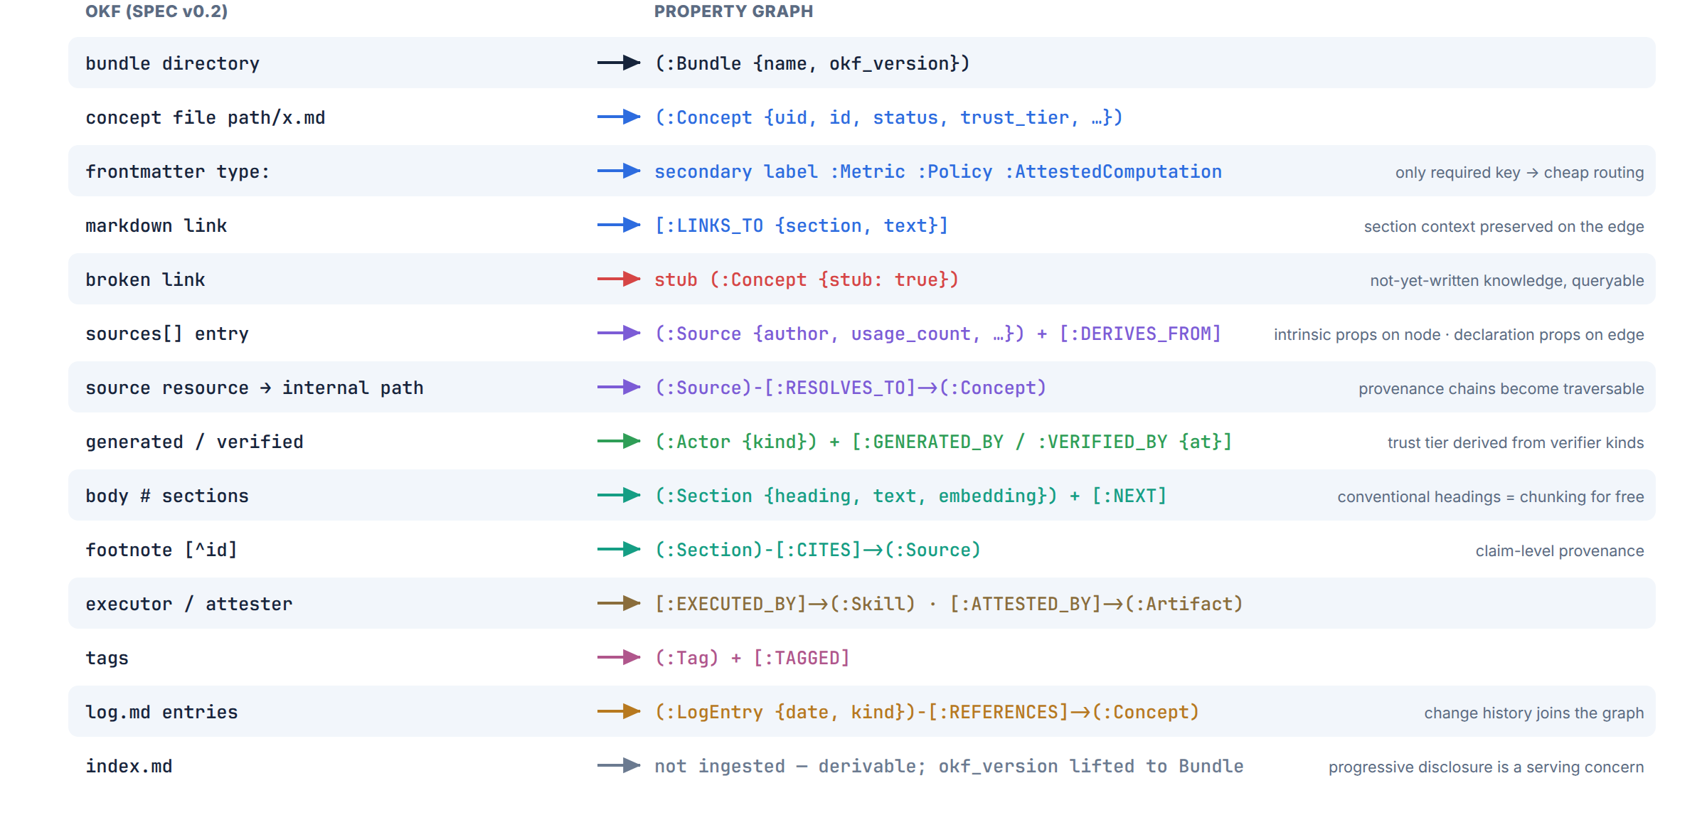
PART II · INTO NEO4J
The mapping, construct by construct
OKF × Neo4j
11
Notes:
75s: This is the reference card — it's in the repo README too. Call out three rows. Broken links become stub nodes with stub:true — the spec's 'not-yet-written knowledge' becomes a queryable authoring backlog. Sources: intrinsic facts (author, last_modified) live on the Source node; declaration-scoped facts (usage_count over a window, declared by the citing concept) live on the DERIVES_FROM edge — a clean node-vs-edge property decision the spec hands you if you read it carefully. And index.md is deliberately NOT ingested: it's derivable, progressive disclosure is a serving concern — we can regenerate indexes FROM the graph.

Slide 12
PART II · INTO NEO4J
Five decisions that earn their keep later
1
Sections, not fixed-size chunks
— trust tier, derived live (SPEC §5.3) MATCH (c:Concept)
OPTIONAL MATCH (c)-[v:VERIFIED_BY]->(a:Actor)
WITH c, collect(a.kind) AS kinds
RETURN CASE
WHEN size(kinds) = 0 THEN 'unverified'
WHEN 'human' IN kinds THEN 'human-reviewed'
ELSE 'machine-confirmed'
END AS trust_tier, count(*) AS n
h1 headings are semantic retrieval units (fence-aware splitting; long sections split at paragraphs).
2
Type strings → secondary labels
“BigQuery Table” → :BigQueryTable — label-scoped Cypher + index locality, original kept in c.type.
3
Trust tier: derived AND materialized
The CASE derivation is the living definition; the property is the cheap filter. Both shown right.
4
Unknown frontmatter survives
— staleness is a date comparison (§5.5) WHERE c.stale_after IS NOT NULL
AND date() >= c.stale_after
// absolute date — no TTL arithmetic
Spec: consumers MUST NOT reject; SHOULD round-trip. Extra keys → extra_frontmatter JSON (acme ships a not: field!).
5
Ingestion is idempotent
MERGE on uid everywhere; re-running a bundle is a sync, not a duplicate. reset(bundle) scopes deletes.
OKF × Neo4j
12
Notes:
75s: These five are where OKF-specific modeling pays off. #1 matters for RAG quality — OKF documents are already written in semantically coherent sections, so we chunk on author intent, not on 512 tokens. #3 is a pattern worth stealing generally: derive in a query you can show and audit, materialize for filter performance, keep both in the repo so they can't drift apart silently. #4: acme_retail actually ships a producer extension field ('not:' — anti-definitions for the margin metric); we keep it queryable JSON instead of dropping it.

Slide 13
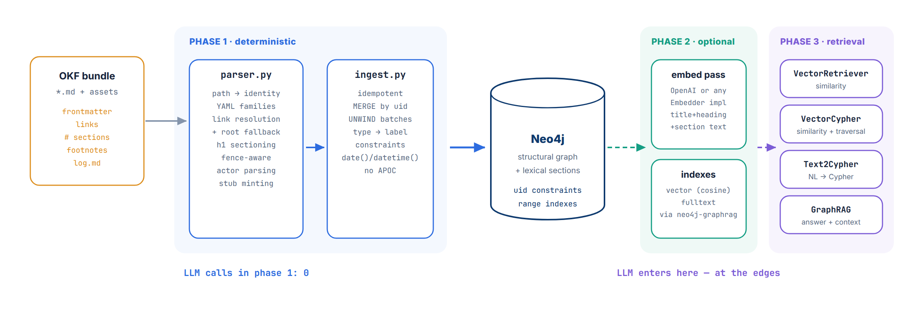
PART II · INTO NEO4J
Ingestion architecture
phase 1 is pure structure — an LLM never touches it; embeddings are a separate, optional pass
OKF × Neo4j
13
Notes:
60s: Three phases with a hard boundary. Phase 1 is deterministic — frontmatter families, link resolution with a root-relative fallback (real bundles use bare root paths in executor fields; conformance-in-practice means resolve generously), fence-aware sectioning, actor parsing, stub minting. Batched UNWIND MERGEs; typed date()/datetime() properties. Phase 2 is optional and separable: embed sections, build vector + fulltext indexes via neo4j-graphrag's helpers — you can build and query the whole structural graph with zero API keys. Phase 3 is where LLMs finally appear, at the edges. LLM calls in phase 1: zero.

Slide 14
PART II · INTO NEO4J
The graph pays rent before any AI shows up
— can we serve it? one query, whole estate MATCH (c:Concept) WHERE NOT c.stub
RETURN c.id, c.trust_tier,
CASE WHEN c.status = 'deprecated'
THEN 'do not serve'
WHEN date() >= c.stale_after
THEN 're-verify first'
ELSE 'servable' END AS verdict
metrics/gross-margin-legacy → do not serve
skills/run-on-bq (unverified) → servable
— blast radius: what breaks if tables/orders changes? MATCH p = (up:Concept)-[:LINKS_TO|EXECUTED_BY|
DERIVES_FROM|RESOLVES_TO|HAS_SECTION|MENTIONS
*1..6]->(t:Concept {id:'tables/orders'})
RETURN up.id, min(length(p)) AS hops // via :Source too
h1 policies/revenue-recognition
h2 computations/revenue-ytd (provenance chain)
h3 metrics/revenue · gross-margin · gm-period
h4 gross-margin-legacy · margin-standard
co-citation concepts whose CLAIMS share a source — footnote-level, via (:Section)-[:CITES]->(:Source)
authoring backlog MATCH (ghost:Concept {stub:true})<-[:LINKS_TO]-(c) — every not-yet-written doc, with who wants it
load-bearing knowledge incoming-degree ranking (or PageRank via GDS) — what to re-verify first when the quarter turns
OKF × Neo4j
14
Notes:
75s: Governance as one-liners. Left: the serve/no-serve verdict across the whole estate — deprecated beats stale beats servable; this is the query a serving layer should run before handing ANY doc to an agent. Right: impact analysis — one variable-length traversal over every forward dependency edge, INCLUDING provenance chains that pass through Source nodes (that's the RESOLVES_TO hop) and section-level mentions. Wikis fundamentally cannot answer this and it's the first thing a data platform team asks for. Below: three more that fall out for free. All of these are in okf_graph/queries.py — steal them.

Slide 15
LIVE DEMO · PART 1
Ingest and interrogate
notebooks/okf_graphrag_demo.ipynb — sections 1–4 (no API key needed)
1
docker compose up -d && uv sync
Neo4j 2025.x community · uv installs deps + the okf-graph CLI
2
uv run okf-graph ingest bundles/acme_retail --reset
parse → 9 concepts · 22 sections · 15 links · 4 log entries
3
trust tiers · staleness · impact · co-citation
the four governance queries, live on the real bundle
4
neo4j-viz — color by status, spot the deprecated island
interactive graph inside the notebook
OKF × Neo4j
15
Notes:
Demo beats (5 min): (1) Show the raw bundle first — cat gross-margin.md so the frontmatter families are fresh. (2) Run the ingest CLI (uv run okf-graph); point at the stats dict — 9 concepts, 22 sections, and importantly 0 LLM calls. (3) Governance queries: trust-tier distribution (8 human-reviewed, 1 unverified — the skill doc), staleness verdicts (legacy → do-not-serve), impact of the revenue-recognition policy. (4) neo4j-viz colored by status — the red deprecated node visually isolated with its two LINKS_TO edges to/from gross-margin. If time allows, run the §4.6 cell: a second tiny bundle (demo_extras) lands in the same graph — broken links become a queryable authoring backlog (stubs) and all three trust tiers appear. Fallback if live Neo4j misbehaves: the executed notebook copy has all outputs cached.

Slide 16
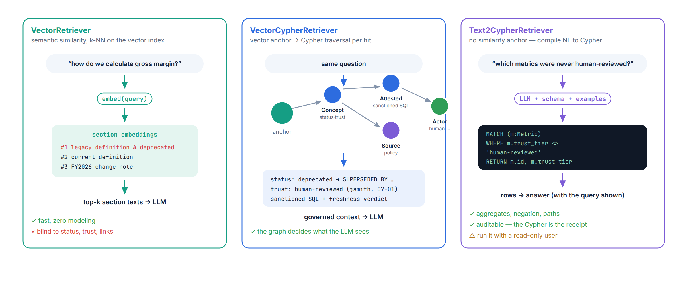
PART III · GRAPHRAG
Three retrieval patterns, one graph
pick per question, compose freely — GraphRAG wraps any retriever with any LLM
OKF × Neo4j
16
Notes:
75s: All three retrievers come from the neo4j-graphrag package against the same store — this is the payoff of doing the modeling work. Left: plain vector — fast, zero modeling, and blind to everything we just built; note the retrieval list — the legacy definition outranks the current one. Middle: VectorCypherRetriever — the ANN hit is just an ANCHOR; a Cypher retrieval_query walks out from it and ASSEMBLES the context. Right: Text2Cypher for questions that have no similarity anchor at all — negations, aggregates. GraphRAG wraps any of them with any LLM. Rule of thumb: vector for 'what does X mean', vector+cypher for 'answer with governance', text2cypher for 'report over the estate'.

Slide 17
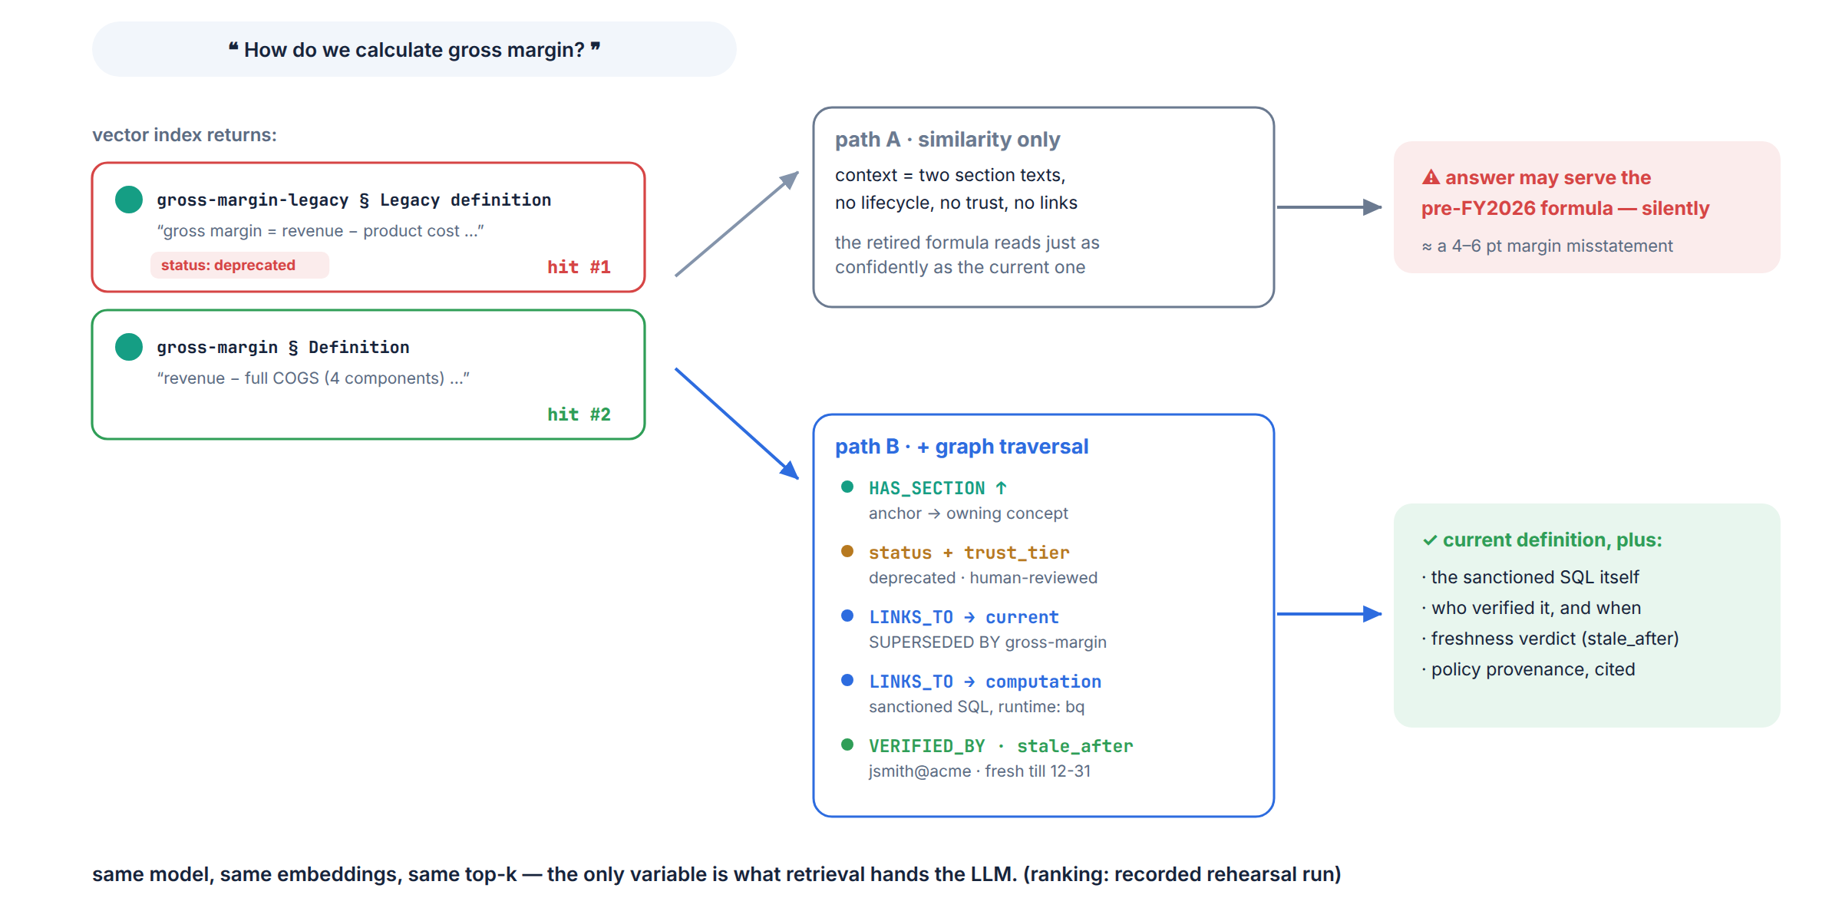
PART III · GRAPHRAG
The governance trap, step by step
the deprecated definition is the best-written text about the question — similarity is doing its job
OKF × Neo4j
17
Notes:
90s — the money slide: In recorded runs the deprecated definition lands at or near the TOP of the ranking — and fairly so: it's a well-written paragraph about exactly this topic; cosine similarity is doing its job perfectly. (Exact order can vary by embedder — the point is that NOTHING in a similarity score encodes deprecation.) The failure is asking similarity to also do governance. Path A hands the LLM two confident texts with zero signals — the answer can silently serve a formula retired in February, a 4-6 point margin misstatement. Path B, same anchors: HAS_SECTION up to the concept, read status/trust, follow LINKS_TO to the replacement AND to the sanctioned computation, VERIFIED_BY + stale_after for the verdict. Same model, same embeddings, same top-k. The only variable is what retrieval hands the LLM.

Slide 18
PART III · GRAPHRAG
The governed retrieval_query
okf_graph/queries.py · GOVERNED_RETRIEVAL_QUERY — runs after the ANN lookup, per anchor
— python: swap ONE argument from neo4j_graphrag.retrievers import \
VectorRetriever, VectorCypherRetriever
from neo4j_graphrag.generation import GraphRAG
from neo4j_graphrag.llm import OpenAILLM
baseline = VectorRetriever(driver,
'section_embeddings', embedder)
governed = VectorCypherRetriever(
driver, 'section_embeddings',
retrieval_query=GOVERNED_RETRIEVAL_QUERY,
embedder=embedder)
rag = GraphRAG(retriever=governed,
llm=OpenAILLM('gpt-4o'))
rag.search('how do we calculate
gross margin?', return_context=True)
— cypher: what each anchor pulls in WITH node, score // ANN anchor
MATCH (c)-[:HAS_SECTION]->(node)
// lifecycle + who verified
OPTIONAL MATCH (c)-[v:VERIFIED_BY]->(va)
// sanctioned SQL, ≤2 link-hops away
OPTIONAL MATCH p=(c)-[:LINKS_TO*1..2]->
(ac:AttestedComputation) …
// provenance + the current replacement
OPTIONAL MATCH (c)-[:DERIVES_FROM]->(src)
OPTIONAL MATCH (c)-[:LINKS_TO]->(current)
WHERE c.status = 'deprecated' …
RETURN '=== '+c.title+' ===\n'+
'status: … SUPERSEDED BY …'+
'trust/freshness verdicts'+node.text+
'sanctioned SQL…' AS info, score
The 2-hop LINKS_TO is what lets a deprecated anchor still reach the sanctioned SQL — through its replacement.
OKF × Neo4j
18
Notes:
60s: Mechanics slide. Left: the application diff between ungoverned and governed RAG is ONE constructor argument — that's the neo4j-graphrag package earning its keep. Right: the retrieval query's shape — node and score arrive from the index; everything else is ordinary Cypher you own. Formatting the return as a readable block matters: the LLM sees status verdicts stated in words, next to the text. Result formatters keep content clean (metadata separate). Point out the 1..2 hop bound and the ORDER BY hops so the directly-linked computation wins.

Slide 19
PART III · GRAPHRAG
Text2Cypher: questions with no similarity anchor
❝ Which concepts are stale or deprecated, and what replaces them? ❞
MATCH (c:Concept) WHERE c.status='deprecated' OR date() >= c.stale_after
OPTIONAL MATCH (c)-[:LINKS_TO]->(r {status:'stable'}) RETURN c.id, r.id
❝ Which metrics were never reviewed by a human? ❞
MATCH (m:Metric) WHERE m.trust_tier <> 'human-reviewed'
RETURN m.id, m.trust_tier
❝ Who verified revenue, and which sources back it? ❞
MATCH (c {id:'metrics/revenue'})-[v:VERIFIED_BY]->(a)
OPTIONAL MATCH (c)-[:DERIVES_FROM]->(s) RETURN a.id, v.at, collect(s.title)
Guardrails: hand-written schema string + few-shot examples (in queries.py) beat a dumped SHOW SCHEMA · run with a read-only user · generated Cypher explores, canned Cypher ships to dashboards
OKF × Neo4j
19
Notes:
60s: These are governance REPORTS phrased in natural language — negation ('never reviewed'), date math, multi-entity joins. No embedding will find you 'the set of metrics lacking human review'; there is no paragraph to be similar to. Text2CypherRetriever compiles the question against our hand-written schema — keep that schema SMALL and curated, it out-performs dumping the full introspected schema. The generated Cypher comes back in metadata, so every answer is auditable — the query IS the receipt. Production posture: read-only role, and promote recurring questions to canned parameterized queries.

Slide 20
LIVE DEMO · PART 2
GraphRAG on the bundle
notebook sections 5–8 — needs OPENAI_API_KEY (embeddings + gpt-4o)
1
embed 22 sections · create vector + fulltext indexes
okf_graph embed pass → neo4j-graphrag create_vector_index
2
ASK: “How do we calculate gross margin, exactly?”
baseline VectorRetriever — watch the deprecated section outrank the current one
3
same question, VectorCypherRetriever
governed context: SUPERSEDED BY · trust · freshness · sanctioned SQL — answer cites policy
4
Text2Cypher: “what breaks if orders changes?”
generated Cypher shown, rows returned — no embeddings involved
OKF × Neo4j
20
Notes:
Demo beats (7 min): (1) Embed + index — one cell. (2) Baseline: show the annotated hits table FIRST (concept, status, trust, score) so the audience sees deprecated at rank 1 before the answer generates; then the answer — sometimes right, sometimes the legacy formula, always UNGOVERNED context. (3) Governed: print items[0].content — the assembled block with SUPERSEDED BY, trust, freshness, sanctioned SQL — then the answer, which now names the policy and the verification. (4) Text2Cypher impact question; show r.metadata['cypher']. If time: hybrid retriever one-liner for exact-token queries like net_amount. Have the executed notebook open in a second tab as the no-network fallback.

Slide 21
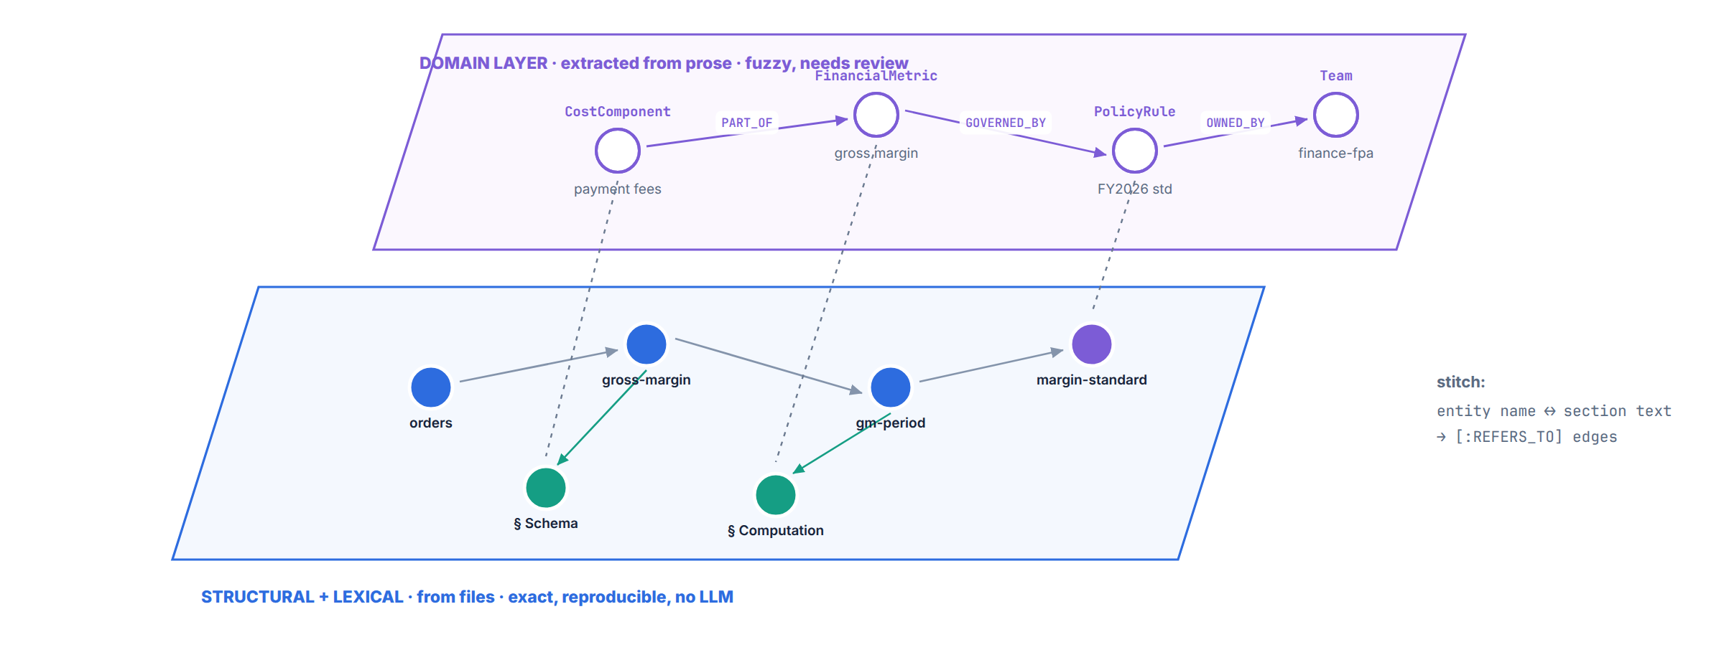
BEYOND · CONSTRUCTION MODES
Deterministic structure + LLM extraction, one graph
SimpleKGPipeline (same package) extracts CostComponent / PolicyRule / Team entities from the policy prose — connecting concepts that never explicitly link.
OKF × Neo4j
21
Notes:
60s: The structural graph is exact but only as connected as its explicit links. The neo4j-graphrag KG builder (SimpleKGPipeline) adds the complementary layer: schema-guided entity extraction over the policy PROSE — cost components, policy rules, teams — with FROM_CHUNK provenance back to the text. Then stitch: entity name ↔ section text matches become REFERS_TO edges. Now 'payment fees' connects the margin standard, the computation SQL, and the orders table even though no markdown link ties them. Notebook appendix runs it on two policies in ~a minute (server needs the APOC plugin — the repo compose installs it; okf_graph itself never calls APOC). Structural = trunk, extracted = foliage; keep them distinguishable — extracted facts are lower-trust by construction, which, fittingly, is exactly what OKF's tiers vocabulary lets you express.

Slide 22
CLOSING
What to take home
For your data estate
For your RAG stack
For your agents
OKF is a low-friction interchange: catalogs, wikis, agents all write files
Chunking on authored sections beats fixed windows — the format hands it to you
Trust tiers + stale_after become retrieval-time FILTERS, not documentation
One Cypher layer turns those files into serve/no-serve verdicts, impact analysis, provenance chains
Similarity ≠ governance: anchor with vectors, assemble context with the graph
Attested computations: agents bind parameters, never author SQL
Multi-bundle by construction — bundle is just a property
One package (neo4j-graphrag): indexes, 3 retriever families, GraphRAG, KG builder
The graph is the context service OKF says every org keeps rebuilding
OKF × Neo4j
22
Notes:
45s: Three audiences, three takeaways each. If they remember one sentence: an OKF bundle is a graph that happens to be stored as files — Neo4j makes it answer questions, and GraphRAG makes it govern what your LLM says. Everything demoed is plain Cypher plus one pip-installable package.

Slide 23
Thanks — go materialize your knowledge.
demo repo (this talk, runnable) github.com/johnymontana/neo4j-okf
OKF spec v0.2 + sample bundles github.com/GoogleCloudPlatform/knowledge-catalog
neo4j-graphrag package docs neo4j.com/docs/neo4j-graphrag-python
GraphRAG retriever patterns neo4j.com/developer/genai-ecosystem
Will Lyon · questions welcome
OKF × Neo4j
23
Notes:
Q&A prompts to keep in pocket: How would this handle multiple bundles with conflicting metric definitions? (bundle-scoped uids + cross-bundle same-title query — good discussion.) Why not put OKF straight into a vector DB? (slide 17 IS the answer — replay it.) What about writes — agents maintaining the bundle? (git is the write path; the graph is a read model; log.md entries already land as LogEntry nodes, and idempotent MERGE makes re-sync cheap.) GDS angle: PageRank for load-bearing concepts, community detection for topic clusters once bundles get big.

