Slide 1

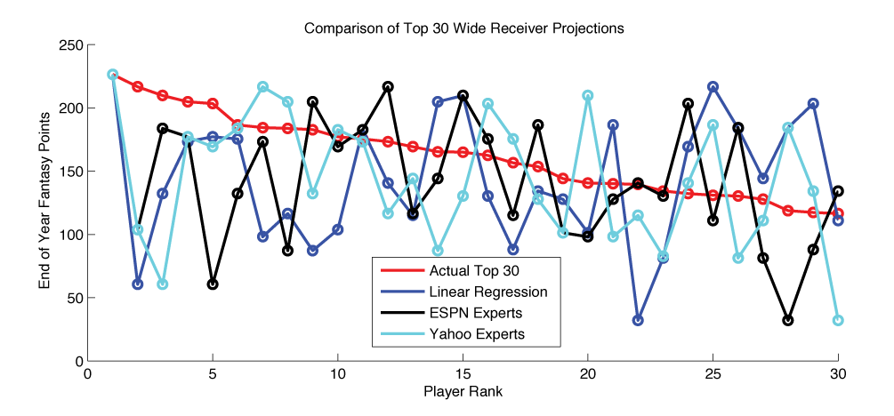
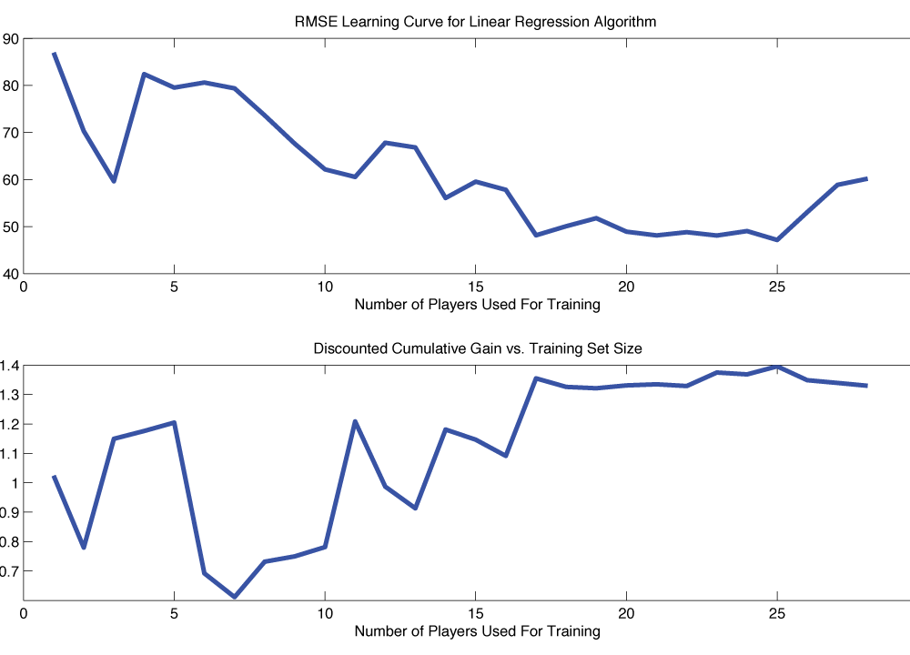
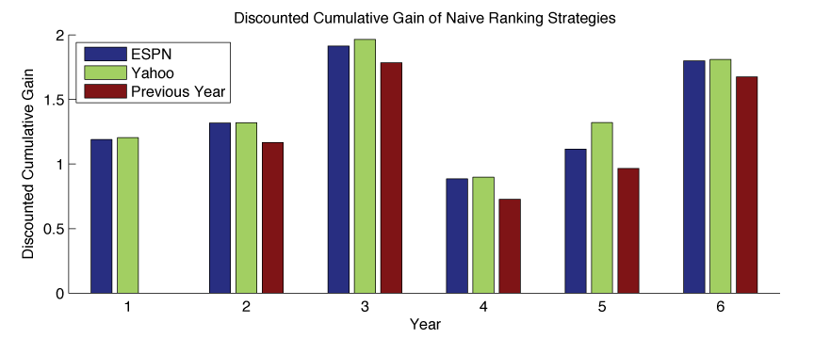
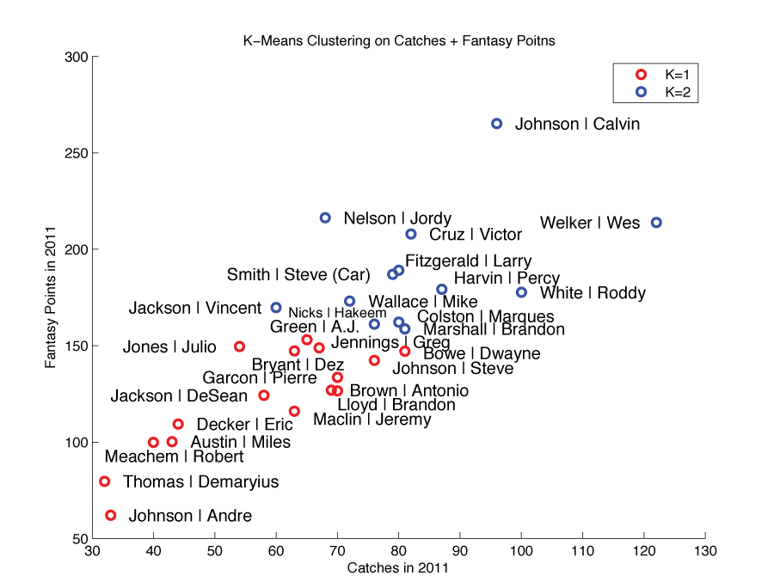
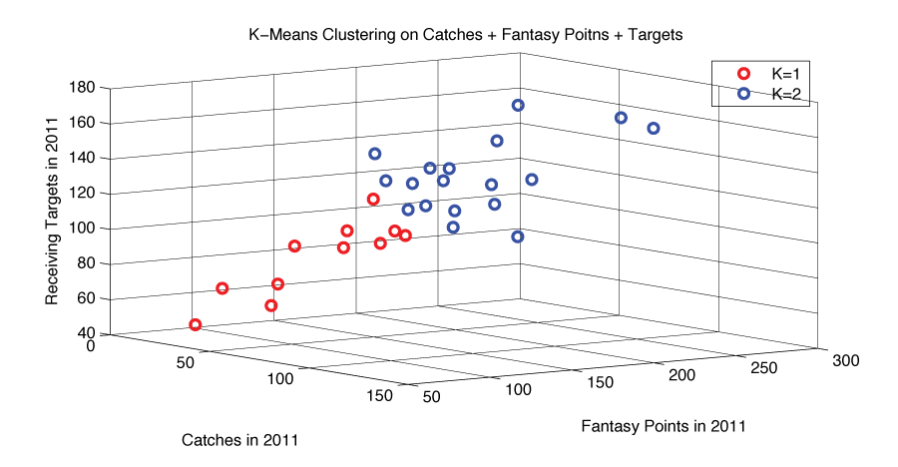
Predicting Fantasy Football Perfomances
John O’Hollaren (jpo4@duke.edu)
Department of Electrical and Computer Engineering
Duke University
Motivation
Methods
Linear Regression
K-Means Mixture Model
β = [ w_{FantasyPts} w_{RecYds} w_{RecTDs} w_{Targets} w_{Catches} w_{Δ1yrRecYds} w_{Δ1yrRecTDs} w_{Δ2yrRecYds} w_{Δ2yrRecYds} w_{Δ3yrRecYds} w_{Δ3yrRecYds} w_{ESPN} w_{Yahoo} ]
# Mixtures | K Means Features | DCG (6 Features) | DCG (2 Features)
2 | Catches Fantasy Points | 1.7601 | 1.8063
2 | Fantasy Points | 1.7601 | 1.7925
3 | Fantasy Points | 1.3621 | 1.7880
2 | Receiving Targets | 1.2053 | 1.7877
2 | Catches Fantasy Points Targets | 1.1887 | 1.7863
2 | Catches | 1.1811 | 1.7814
2 | Touchdowns | 1.1107 | 1.7747
2 | Receiving Yards | 1.0857 | 1.4428
β = [ w₁ … w_{L} ]
Data
Linear Regression
Something Else
K-Means Mixture Model
Conclusion
Expert | Discounted Cumulative Gain for 2012 Predictions
ESPN Expert (Matthew Berry) | 1.7991
Yahoo Team of Experts | 1.8100
Show ESPN, Yahoo, My best, Actual. Then color code it
Method | β | Discounted Cumulative Gain
13 Features | β = [ w_{FantasyPts} w_{RecYds} w_{RecTDs} w_{Targets} w_{Catches} w_{Δ1yrRecYds} w_{Δ1yrRecTDs} w_{Δ2yrRecYds} w_{Δ2yrRecYds} w_{Δ3yrRecYds} w_{Δ3yrRecYds} w_{ESPN} w_{Yahoo} ] | 1.7179
 | β = [0.17, 0.059, 12.91, -0.25, 0.18, -0.34, -4.82 -0.031, 0.61, 0.044, -3.36, -1.05, 1.03]
7 Features | β = [ w_{FantasyPts} w_{RecYds} w_{RecTDs} w_{Δ1yrRecYds} w_{Δ1yrRecTDs} w_{ESPN} w_{Yahoo} ] | 1.7722
 | β = [-0.18, 0.12, 11.10, -0.056, -3.35, -2.27, 1.67]
6 Features | β = [ w_{FantasyPts} w_{RecYds} w_{RecTDs} w_{Δ1yrRecYds} w_{Δ1yrRecTDs} w_{ESPN} ] | 1.7621
 | β = [0.10, 0.079, 10.23, -0.06, -3.09, -0.403]
3 Features | β = [ w_{FantasyPts} w_{RecYds} w_{RecTDs} ] | 1.7806
 | β = [1.72, -0.061, -5.08]
2 Features | β = [ w_{FantasyPts} w_{RecTDs} ] | 1.7896
 | β = [1.15, -2.031]
2 Features | β = [ w_{FantasyPts} w_{RecYds} ] | 1.7863
 | β = [0.92, 0.019]
References

