Slide 1

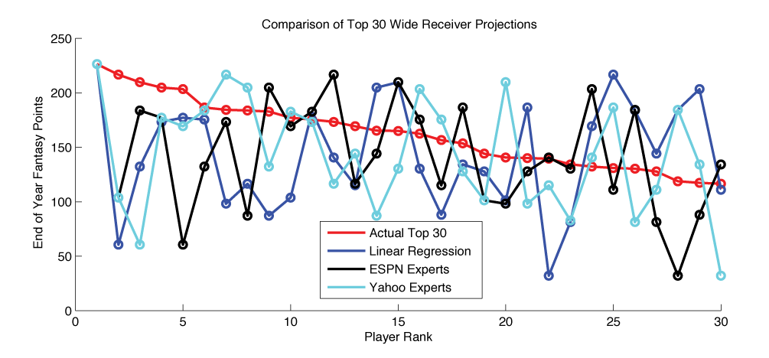
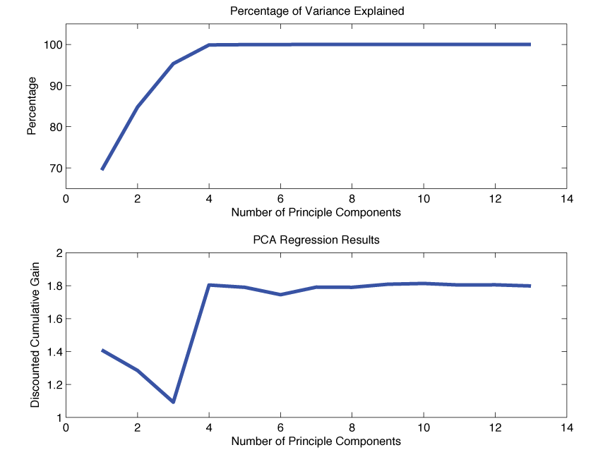
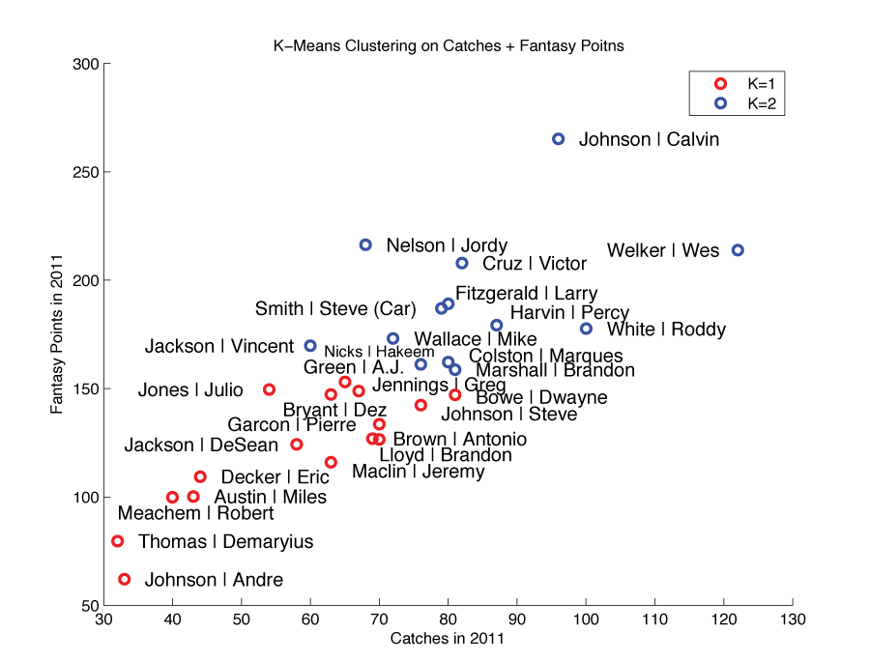
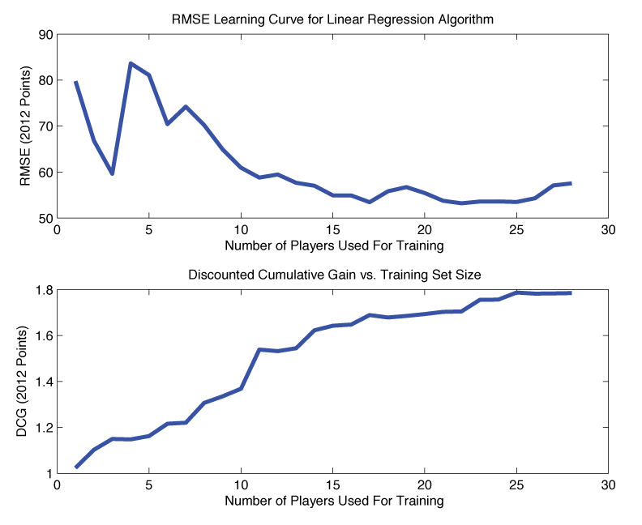
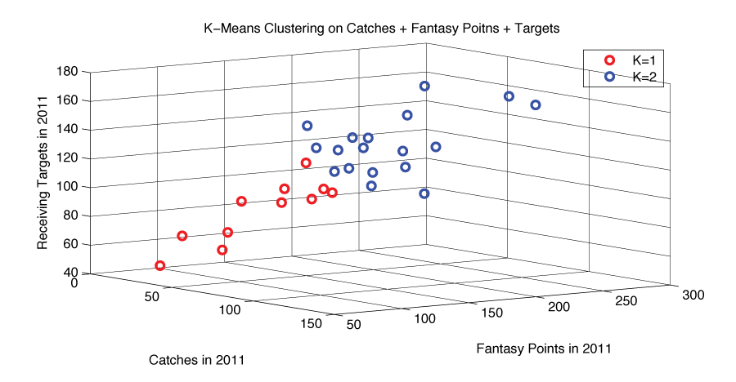
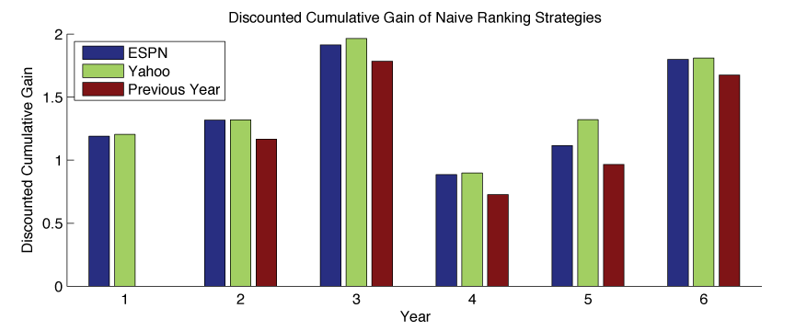
Optimizing Preseason Fantasy Football Rankings
John O’Hollaren (jpo4@duke.edu)
Department of Electrical and Computer Engineering
Duke University
Motivation
Methods
K-Means Mixture Model
PCA Regression
1) Linear Regression
β = [ w_{FantasyPts} w_{RecYds} w_{RecTDs} w_{Targets} w_{Catches} w_{Δ1yrRecYds} w_{Δ1yrRecTDs}
w_{Δ2yrRecYds} w_{Δ2yrRecYds} w_{Δ3yrRecYds} w_{Δ3yrRecYds} w_{ESPN} w_{Yahoo} ]
β = ( X^{T} • X )⁻¹ • X^{T} • Y
Y = β • X
2) Feature Reduction
Unimportant features, as determined by weight, will be removed to create an L-dimensional β for linear regression.
β = [ w₁ … w_{L} ]
3) K-Means Mixture Model
2 and 3 dimensional K-Means will be used to separate players, and linear regression will be run on each of the K mixtures individually.
β₁ = [ w₁ … w_{N} ]
⬇
β_{K} = [ w₁ … w_{N} ]
4) PCA Regression
PCA will be used to estimate the regression coefficients. Different numbers of principle components will be experimented with.
PCA(X) ➔ Λ_{p×p}, Ω_{n×p}
Ω_{n×p} = PC score. Representation of X in PC space
Λ_{p×p} = PC loadings. Each column contains loadings for one PC
β = (Ω^{T} • Ω )⁻¹ • Ω^{T} • ( Y – μ_{Y})
Transform to regression coefficients for uncentered variables
β = [ μ_{Y} – μ_{X} • Λ • β | Λ • β ]
Y = [ ones | X ] • β
There are many types of receivers in the NFL, including those who play in the slot and catch lots of short passes, those who play out wide and catch very few longer passes, and all-stars who do it all. This insight prompts clustering receivers by type prior to prediction.
K-Means Clustering
K-Means will be used to cluster receivers based on various groups of 2 and 3 features.
The results of PCA show that the majority of the variance in our data is explained by the first 4 principle components.
Figure 1: Total end-of-year fantasy points scored by ESPN / Yahoo’s preseason top 30, compared to the actual top 30 and the featured reduced linear regression algorithm. This shows that ranking is very difficult.
Why is predicting fantasy football stats important?
Profit: $15 billion per year is spent on fantasy football.
Popularity: According to the Fantasy Sports Trade Association, 10% of the US population plays fantasy football.
Difficulty: Ranking players is difficult, even the experts are rarely correct (see Figure 1). A small edge can therefore go a long ways.
How does fantasy football work?
Points are awarded when a player scores a touchdown or gains yards. Each owner picks their team at the beginning of the year. Correctly predicting which players will play well greatly improves your team's year-long performance. This paper focuses on an optimal strategy for predicting which NFL wide receivers will have the best fantasy football season using data available prior to the beginning of the season.
Goal
A top 30 list of NFL WRs ordered by predicted fantasy point output in the 2012 season, using only data available prior to the 2012 season.
Figure 9: PCA and PCA regression run with varying numbers of principle components. Note how the DCG goes up as we choose enough principle components to explain the majority of the variance.
Linear Regression
Using PCA regression with 10 principle components, we are able to out-perform the experts at both Yahoo and ESPN.
Using linear regression, predicted point totals are calculated for each player. Players are then ranked by predicted points for the final output.
Figure 6: 2D K-Means clustering by previous year catches and fantasy points. Note how this tends to separate high production, elite WRs in blue from role players and secondary receivers in red.
Number of Principle Components | Discounted Cumulative Gain
4 | 1.8040
10 | 1.8132
Data
Figure 10: The PCA results are better than standard linear regression and the mixture model approach.
The following key statistics were gathered for every single active wide receiver in the NFL from 2007 until 2012.
Conclusion
700+ Players Per Year ➔
Several machine learning approaches to ranking NFL receivers are shown. The best results come from PCA regression with 10 principle components. This method outperforms the experts at ESPN and Yahoo for the 2012 season.
Receiving Yards
Receiving Touchdowns
Receiving Targets
Receiving Catches
ESPN Preseason Ranking
Yahoo Preseason Ranking
Δ 1 year Receiving Yards: (Yards in year Y-1) – (Yards in year Y-2)
Δ 1 year Receiving TDs: (TDs in year Y-1) – (TDs in year Y-2)
Δ 2 year Receiving Yards: (Yards in year Y-1) – (Yards in year Y-3)
Δ 2 year Receiving TDs: (TDs in year Y-1) – (TDs in year Y-3)
Δ 3 year Receiving Yards: (Yards in year Y-1) – (Yards in year Y-4)
Δ 3 year Receiving TDs: (TDs in year Y-1) – (TDs in year Y-4)
Fantasy Points in Previous Year: 6 • TDs + 0.1 • Yards
⬅ 13 Features
Figure 7: 3D K-Means clustering by previous year catches, fantasy points, and targets.
Actual | PCA Regression | ESPN | Yahoo
Johnson | Calvin Marshall | Brandon Bryant | Dez Green | A.J. Thomas | Demaryius Jackson | Vincent Decker | Eric Johnson | Andre Jones | Julio White | Roddy Colston | Marques Welker | Wes Cruz | Victor Crabtree | Michael Wayne | Reggie Jones | James Cobb | Randall Williams | Mike (TB) Smith | Steve (Car) Johnson | Steve Moore | Lance Shorts | Cecil Smith | Torrey Wallace | Mike Hilton | T.Y. Austin | Miles Maclin | Jeremy Blackmon | Justin Rice | Sidney Nelson | Jordy | Johnson | Calvin Welker | Wes Johnson | Andre Jennings | Greg Fitzgerald | Larry White | Roddy Wallace | Mike Nicks | Hakeem Cruz | Victor Green | A.J. Jones | Julio Colston | Marques Nelson | Jordy Marshall | Brandon Smith | Steve (Car) Bryant | Dez Harvin | Percy Bowe | Dwayne Lloyd | Brandon Jackson | Vincent Maclin | Jeremy Johnson | Steve Austin | Miles Brown | Antonio Jackson | DeSean Garcon | Pierre Meachem | Robert Thomas | Demaryius Decker | Eric Smith | Torrey | Johnson | Calvin Fitzgerald | Larry Johnson | Andre White | Roddy Jennings | Greg Wallace | Mike Welker | Wes Nicks | Hakeem Green | A.J. Cruz | Victor Jones | Julio Marshall | Brandon Nelson | Jordy Smith | Steve (Car) Bryant | Dez Colston | Marques Lloyd | Brandon Jackson | Vincent Harvin | Percy Bowe | Dwayne Maclin | Jeremy Johnson | Steve Austin | Miles Thomas | Demaryius Brown | Antonio Decker | Eric Jackson | DeSean Meachem | Robert Garcon | Pierre Smith | Torrey | Johnson | Calvin Fitzgerald | Larry Jennings | Greg White | Roddy Cruz | Victor Johnson | Andre Marshall | Brandon Green | A.J. Wallace | Mike Jones | Julio Welker | Wes Nelson | Jordy Smith | Steve (Car) Nicks | Hakeem Austin | Miles Thomas | Demaryius Colston | Marques Maclin | Jeremy Harvin | Percy Bryant | Dez Bowe | Dwayne Lloyd | Brandon Britt | Kenny Johnson | Steve Jackson | Vincent Jackson | DeSean Brown | Antonio Decker | Eric Smith | Torrey Meachem | Robert
Mixture Model
Linear regression is performed on each K-Means grouping individually to produce each player’s projected fantasy points for 2012.
Feature Reduction
Using the results from the feature reduction section, the experiment is repeated for 2 and 6 features.
Combination
The players, regardless of mixture, are then recombined to be ranked by the DCG algorithm.
Performance Criteria
Discounted cumulative gain (DCG) will be used to reward ranking good players highly and penalize ranking good players low. A higher DCG is better.
Figure 4: Linear regression versus accuracy as a function of training set size. As the RMSE between point predictions and actual end-of-year points decreases, the DCG of the resultant ranking increases.
Feature Reduction
Below we can visually view our data, as well as the inconsistency of professional rankings. These will serve as our benchmarks.
The best results are obtained by using a subset of 13 total features. The DCG for this 2-feature case is 1.7896, still short of what is achieved by ESPN and Yahoo, but very close, and better than the naïve ranking method proposed previously.
# Mixtures | K Means Features | DCG (6 Features) | DCG (2 Features)
2 | Catches Fantasy Points | 1.7601 | 1.8063
2 | Fantasy Points | 1.7601 | 1.7925
3 | Fantasy Points | 1.3621 | 1.7880
2 | Receiving Targets | 1.2053 | 1.7877
2 | Catches Fantasy Points Targets | 1.1887 | 1.7863
2 | Catches | 1.1811 | 1.7814
2 | Touchdowns | 1.1107 | 1.7747
2 | Receiving Yards | 1.0857 | 1.4428
Method | β | DCG
13 Features | β = [ w_{FantasyPts} w_{RecYds} w_{RecTDs} w_{Targets} w_{Catches} w_{Δ1yrRecYds} w_{Δ1yrRecTDs} w_{Δ2yrRecYds} w_{Δ2yrRecYds} w_{Δ3yrRecYds} w_{Δ3yrRecYds} w_{ESPN} w_{Yahoo} ] | 1.7179
 | β = [0.17, 0.059, 12.91, -0.25, 0.18, -0.34, -4.82 -0.031, 0.61, 0.044, -3.36, -1.05, 1.03]
7 Features | β = [ w_{FantasyPts} w_{RecYds} w_{RecTDs} w_{Δ1yrRecYds} w_{Δ1yrRecTDs} w_{ESPN} w_{Yahoo} ] | 1.7722
 | β = [-0.18, 0.12, 11.10, -0.056, -3.35, -2.27, 1.67]
6 Features | β = [ w_{FantasyPts} w_{RecYds} w_{RecTDs} w_{Δ1yrRecYds} w_{Δ1yrRecTDs} w_{ESPN} ] | 1.7621
 | β = [0.10, 0.079, 10.23, -0.06, -3.09, -0.403]
3 Features | β = [ w_{FantasyPts} w_{RecYds} w_{RecTDs} ] | 1.7806
 | β = [1.72, -0.061, -5.08]
2 Features | β = [ w_{FantasyPts} w_{RecTDs} ] | 1.7896
 | β = [1.15, -2.031]
2 Features | β = [ w_{FantasyPts} w_{RecYds} ] | 1.7863
 | β = [0.92, 0.019]
Figure 11: Final outputs compared. Using PCA Regression would have beat ESPN and Yahoo in 2012.
References
“Fantasy Football Homepage.” ESPN.com. 2007 – 2012.
“Fantasy Football Homepage.” Yahoo.com. 2007 – 2012.
Kapina, Nitin. “Predicting Fantasy Football Performance With Machine Learning Techniques.” Final Project for Andrew Ng’s AI Course. December 14, 2012.
Mathews, Tim, et. al. “Competing with Humans at Fantasy Football: Team Formation in Large Partially-Observable Domain.” Association for the Advancement of Artificial Intelligence, 2012.
Farquhar, Lee, et. al. “Types of Fantasy Sports Users and Their Motivations.” Journal of Computer-Mediated Communication, 2007.
Wood, Frank. “Principle Component Analysis.” Tutorial PDF. December 2009.
Torres-Reyna, Oscar. “Linear Regression, version 6.0” Data and Statistical Services, Princeton University.
Rasmussen, Carl Edward. “The Infinite Gaussian Mixture Model.” Advances in Neural Information Processing Systems, 2012.
McLachlan, G. J., et. al. “A mixture model-based approach to the clustering of microarray expression data.” Bioinformatics, 2001.
Steinbach, Michael, et. al. “A Comparison of Document Clustering Techniques.” Technical Report, University of Minnesota. May 2000.
Figure 2: DCG of ESPN / Yahoo preseason rankings over the years, along with a naïve method of using the previous year’s final rankings as the next year’s preseason rankings.
Expert | Discounted Cumulative Gain for 2012 Predictions
ESPN Expert (Matthew Berry) | 1.7991
Yahoo Team of Experts | 1.8100
Figure 8: K-Means mixture model results through several types of runs.
The best results are obtained by using 2D K-means on catches and previous year fantasy points to define our mixture model, and then using 2 features, points and TDs, for regression. The DCG is 1.8063, better than ESPN but not quite as good as Yahoo.
Figure 3: The numeric DCG of ESPN and Yahoo in 2012. This is the benchmark used for this research.
Figure 5: Results of feature reduction on linear regression.

