Slide 1

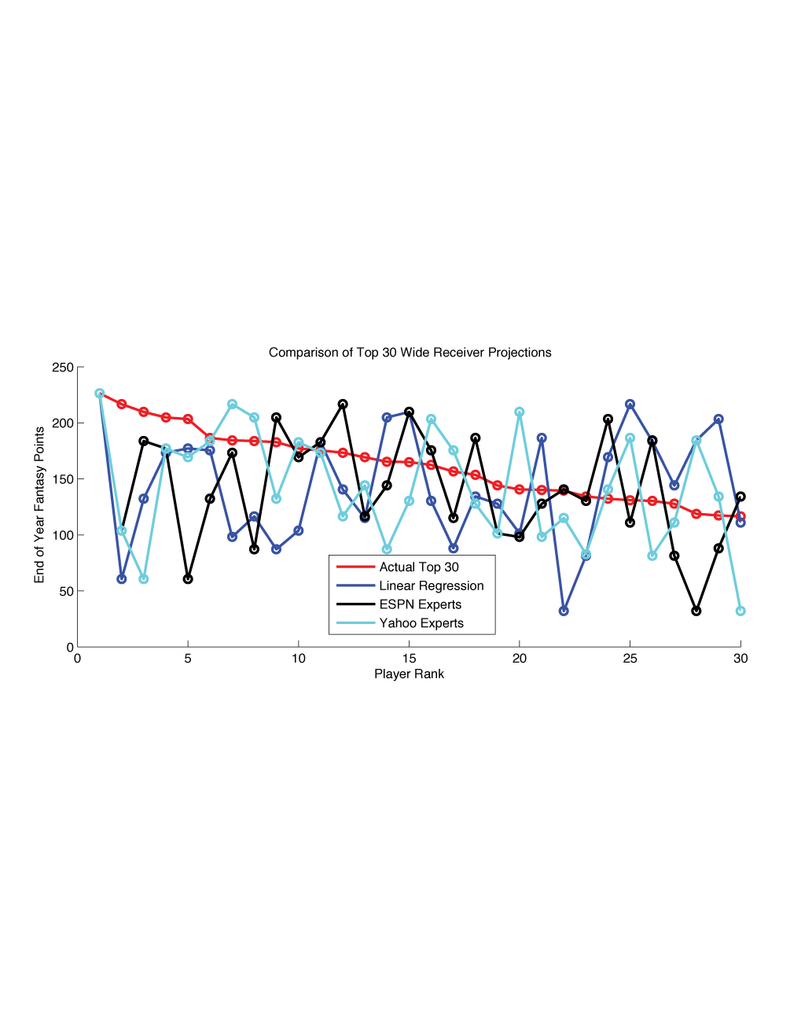
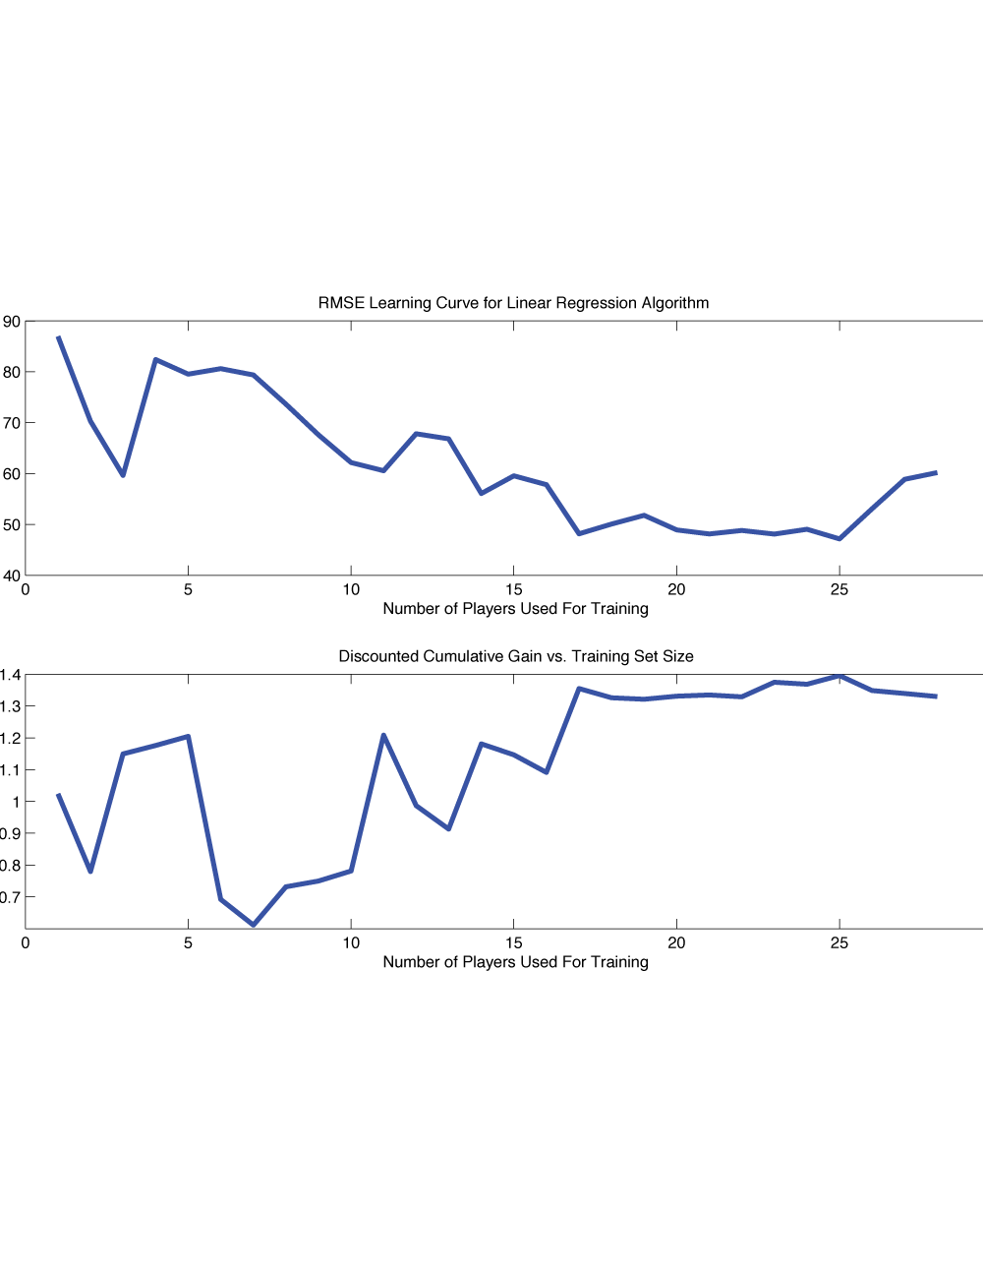
Predicting Fantasy Football Perfomances
John O’Hollaren (jpo4@duke.edu)
Department of Electrical and Computer Engineering
Duke University
Motivation
Data
Results
Results
Methods
Data
References

