Slide 1

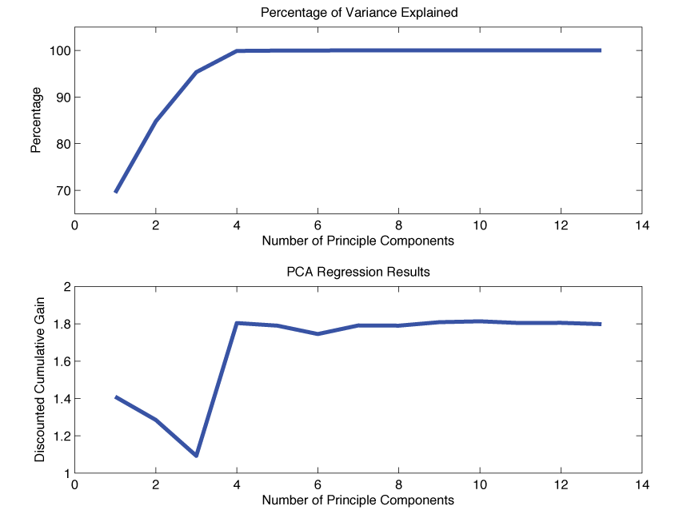
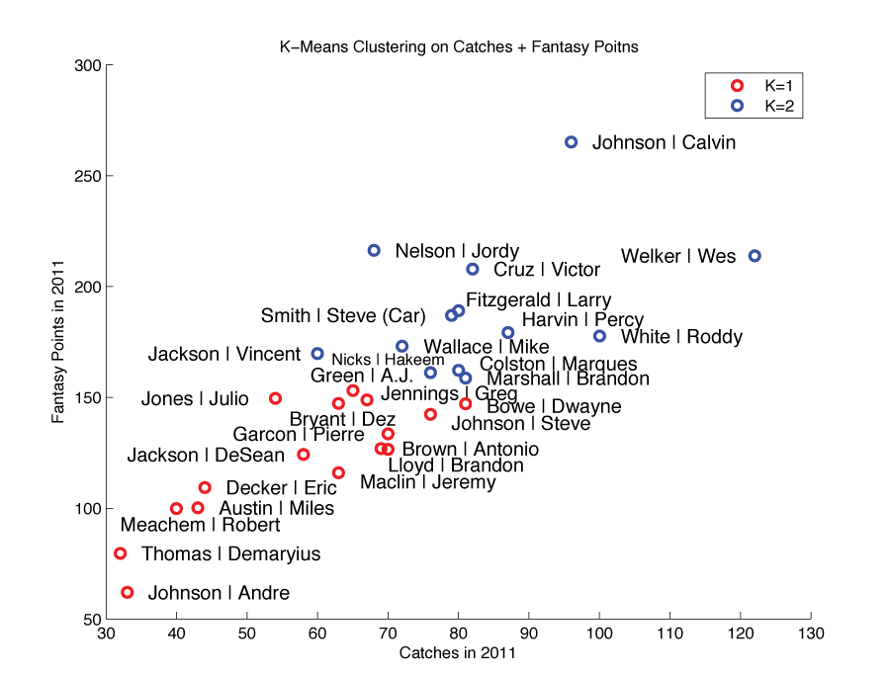
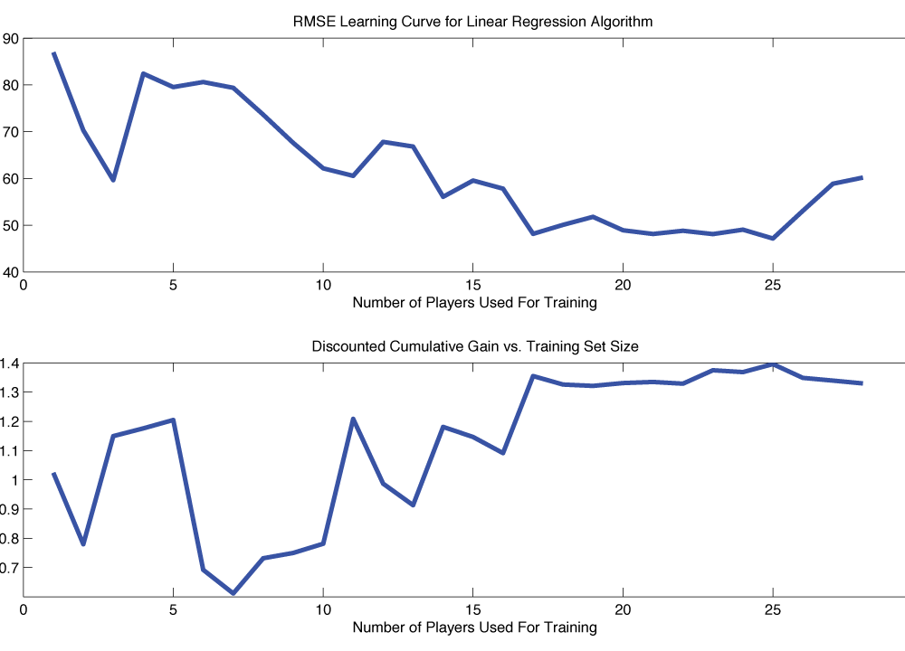
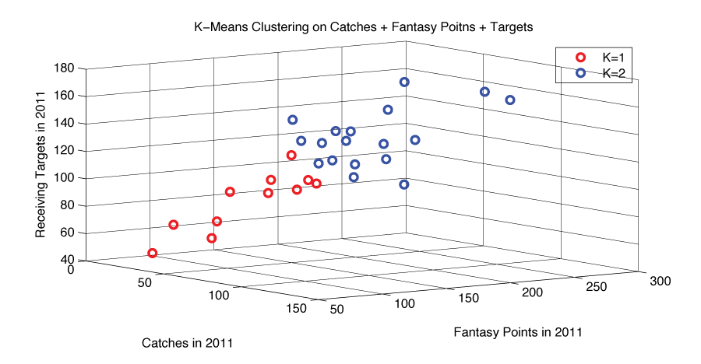
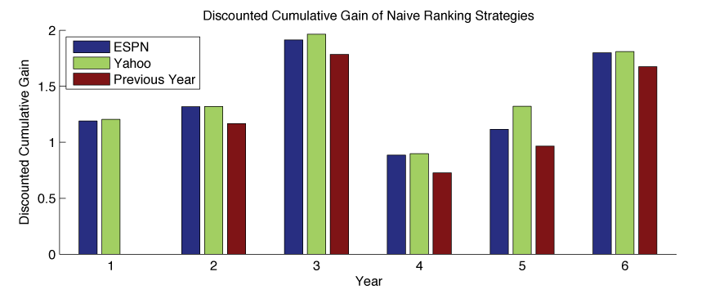
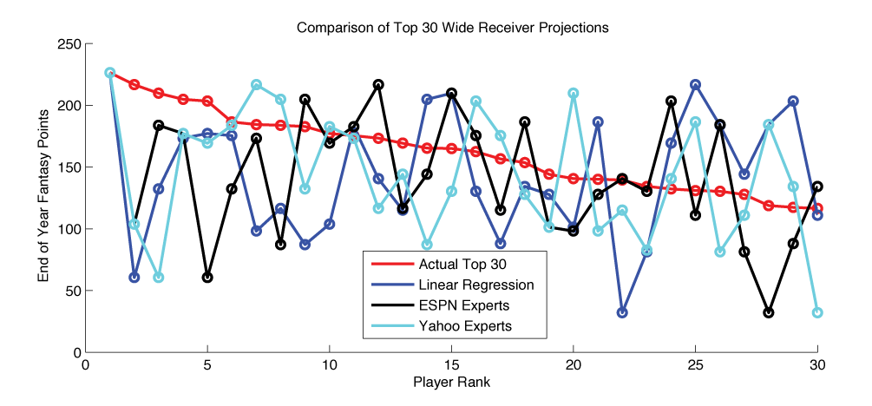
Predicting Fantasy Football Perfomances
John O’Hollaren (jpo4@duke.edu)
Department of Electrical and Computer Engineering
Duke University
Motivation
Methods
K-Means Mixture Model
PCA Regression
What is fantasy football?
Fantasy football is a fast growing, multi-billion dollar industry centered around projecting which players will perform well. Points are awarded when a player scores a touchdown, gains yards running, or catches a pass. Each owner (person playing fantasy football) picks their team at the beginning of the year, typically through a snake style draft where players are taken one after another. Correctly predicting which players will play well greatly improves your team's year-long performance, whereas wasting a high pick on a low achiever can ruin your season. This paper focuses on an optimal strategy for predicting which NFL wide receivers will have the best fantasy football season using data available prior to the beginning of the season.
Why is predicting fantasy football stats important?
Victory: There is no better way to help ensure victory in a fantasy league than to make good choices during the fantasy draft.
Popularity: According to the Fantasy Sports Trade Association (FSTA), 32 million Americans are playing fantasy football this year. That is over 10% of the US population.
The FSTA estimates that these 32 million Americans spend over 15 billion dollars on fantasy football.
Why predict wide receiver performances?
Wide receiver is the deepest position in fantasy football. Choosing quality wide receivers with confidence on draft day will allow more chances to be taken on the more injury prone or risky position picks such as running backs and quarterbacks.
β = [ w_{FantasyPts} w_{RecYds} w_{RecTDs} w_{Targets} w_{Catches} w_{Δ1yrRecYds} w_{Δ1yrRecTDs} w_{Δ2yrRecYds} w_{Δ2yrRecYds} w_{Δ3yrRecYds} w_{Δ3yrRecYds} w_{ESPN} w_{Yahoo} ]
β = [ w₁ … w_{L} ]
Linear Regression
Number of Principle Components | Discounted Cumulative Gain
4 | 1.8040
10 | 1.8132
Data
The dataset consists of key statistics for every single active wide receiver in the NFL from 2007 until 2012.
Fantasy Points: How many fantasy points they earned this year. Standard, non-PPR scoring is assumed.
Conclusion
Method | β | Discounted Cumulative Gain
13 Features | β = [ w_{FantasyPts} w_{RecYds} w_{RecTDs} w_{Targets} w_{Catches} w_{Δ1yrRecYds} w_{Δ1yrRecTDs} w_{Δ2yrRecYds} w_{Δ2yrRecYds} w_{Δ3yrRecYds} w_{Δ3yrRecYds} w_{ESPN} w_{Yahoo} ] | 1.7179
 | β = [0.17, 0.059, 12.91, -0.25, 0.18, -0.34, -4.82 -0.031, 0.61, 0.044, -3.36, -1.05, 1.03]
7 Features | β = [ w_{FantasyPts} w_{RecYds} w_{RecTDs} w_{Δ1yrRecYds} w_{Δ1yrRecTDs} w_{ESPN} w_{Yahoo} ] | 1.7722
 | β = [-0.18, 0.12, 11.10, -0.056, -3.35, -2.27, 1.67]
6 Features | β = [ w_{FantasyPts} w_{RecYds} w_{RecTDs} w_{Δ1yrRecYds} w_{Δ1yrRecTDs} w_{ESPN} ] | 1.7621
 | β = [0.10, 0.079, 10.23, -0.06, -3.09, -0.403]
3 Features | β = [ w_{FantasyPts} w_{RecYds} w_{RecTDs} ] | 1.7806
 | β = [1.72, -0.061, -5.08]
2 Features | β = [ w_{FantasyPts} w_{RecTDs} ] | 1.7896
 | β = [1.15, -2.031]
2 Features | β = [ w_{FantasyPts} w_{RecYds} ] | 1.7863
 | β = [0.92, 0.019]
# Mixtures | K Means Features | DCG (6 Features) | DCG (2 Features)
2 | Catches Fantasy Points | 1.7601 | 1.8063
2 | Fantasy Points | 1.7601 | 1.7925
3 | Fantasy Points | 1.3621 | 1.7880
2 | Receiving Targets | 1.2053 | 1.7877
2 | Catches Fantasy Points Targets | 1.1887 | 1.7863
2 | Catches | 1.1811 | 1.7814
2 | Touchdowns | 1.1107 | 1.7747
2 | Receiving Yards | 1.0857 | 1.4428
Show ESPN, Yahoo, My best, Actual. Then color code it
References
Expert | Discounted Cumulative Gain for 2012 Predictions
ESPN Expert (Matthew Berry) | 1.7991
Yahoo Team of Experts | 1.8100

