Slide 1

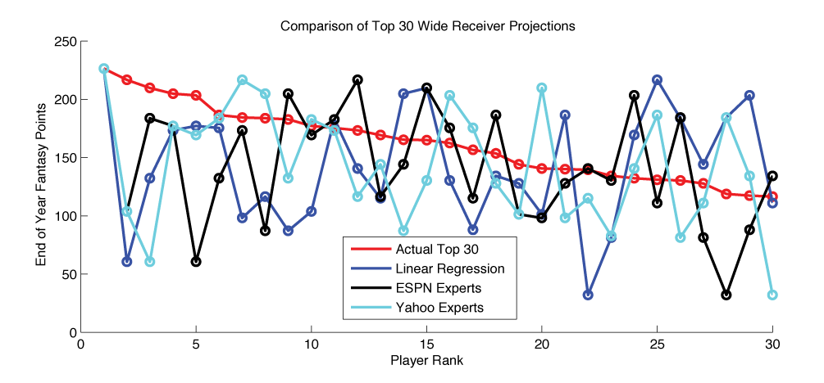
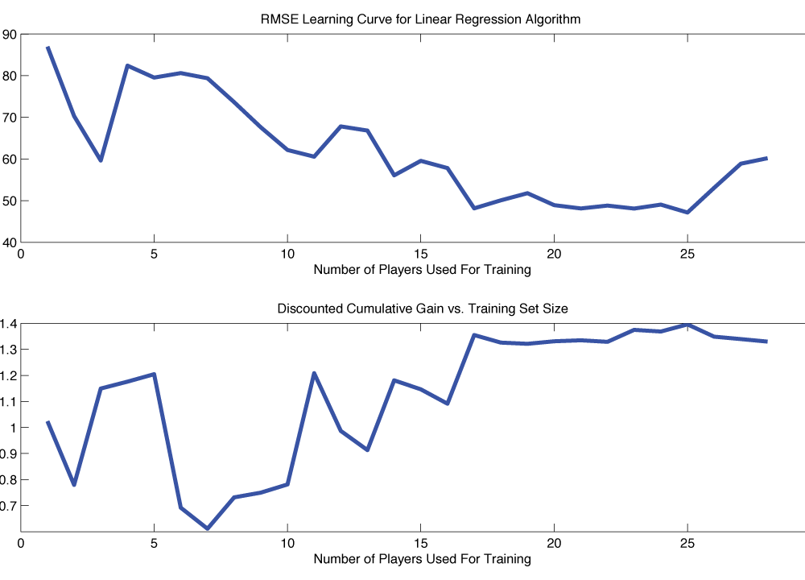
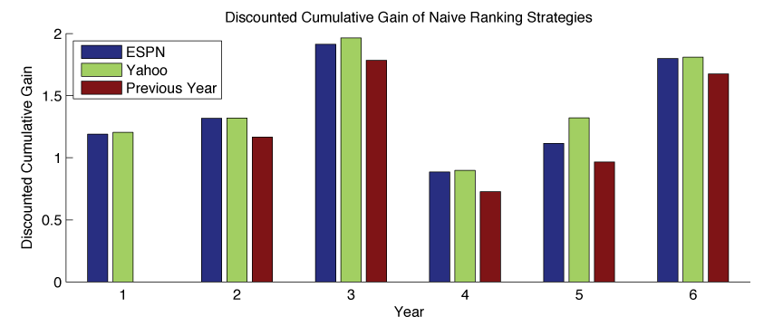
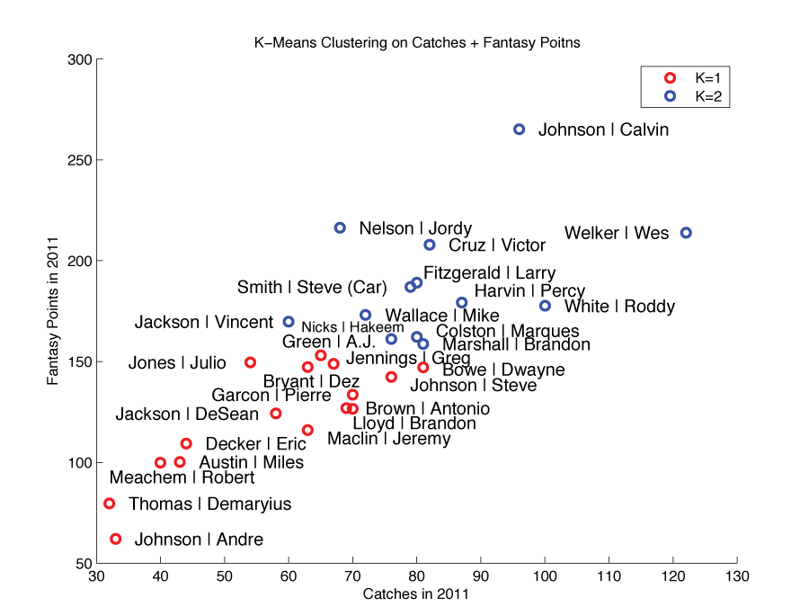
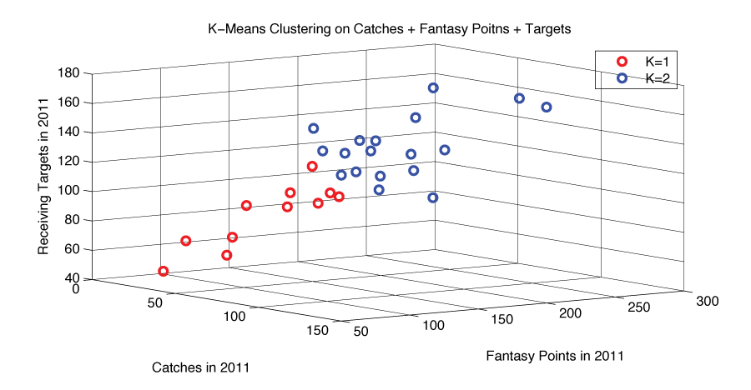
Predicting Fantasy Football Perfomances
John O’Hollaren (jpo4@duke.edu)
Department of Electrical and Computer Engineering
Duke University
Motivation
Methods
Linear Regression
Results
β = [ w_{FantasyPts} w_{RecYds} w_{RecTDs} w_{Targets} w_{Catches} w_{Δ1yrRecYds} w_{Δ1yrRecTDs} w_{Δ2yrRecYds} w_{Δ2yrRecYds} w_{Δ3yrRecYds} w_{Δ3yrRecYds} w_{ESPN} w_{Yahoo} ]
# Mixtures | K Means Features | β₁ … β_{K} | Discounted Cumulative Gain
2 | Catches Fantasy Points | β₁ = [-3.57, 0.46, 26.96, -0.025, 1.91, 8.75] β₂ = [-7.38, 0.92, 41.55, -0.094, 1.61, 6.85] | 1.7601
2 | Fantasy Points | β₁ = [-3.57, 0.46, 26.97, -0.025, 1.91, 8.75] β₂ = [-7.38, 0.92, 41.55, -0.094, 1.61, 6.85] | 1.7601
3 | Fantasy Points | β₁ = [-1.71, 0.37, 23.83, -0.01, 2.24, 71.3] β₂ = [-0.14, 0.12, 10.48, -0.04, -7.11, 1.5] β₃ = [-3.78, 0.61, 12.37, -0.12, 10.2, 13.7] | 1.3621
2 | Receiving Targets | β₁ = [-8.45, 1.17, 27.46, -0.12, 11.5, 13.35] β₂ = [-0.54, 0.2, 4.82, -0.085, -0.089, 4.20] | 1.2053
2 | Catches Fantasy Points Targets | β₁ = [2.71, -0.42, 0.61, -0.89, 45.02, 42.26] β₂ = [-0.70, 0.23, 4.00, -0.084, 0.83, 2.64] | 1.1887
2 | Catches | β₁ = [-1.04, 0.27, 6.02, -0.083, 0.16, 3.02] β₂ = [4.98, -0.99, 68.03, -0.32, 56.68, 24.8] | 1.1811
2 | Touchdowns | β₁ = [-4.09, 0.56, 24.85, -0.02, -4.31, 3.59] β₂ = [44.5, -4.44, -288, 0.11, 48.39, 52.04] | 1.1107
2 | Receiving Yards | β₁ = [-3.48, 0.48, 25.5, -0.06, -0.51, 5.64] β₂ = [17.87, -1.5, -115.9, -0.06, 3.82, 6.90] | 1.0857
β = [ w₁ … w_{L} ]
Data
Linear Regression
K-Means Mixture Model
# Mixtures | K Means Features | β₁ … β_{K} | Discounted Cumulative Gain
2 | Catches Fantasy Points Targets | β₁ =[1.51, -2.99] β₂ = [1.87, -13.66] | 1.8063
2 | Fantasy Points | β₁ =[1.81, -11.58] β₂ = [1.59, -5.52] | 1.7925
2 | Catches Fantasy Points | β₁ =[1.74, -7.77] β₂ = [1.82, -12.13] | 1.7880
2 | Catches | β₁ =[1.91, -13.53] β₂ = [1.58, -6.30] | 1.7877
2 | Receiving Targets | β₁ =[1.24, 0.69] β₂ = [2.04, -16.12] | 1.7863
2 | Receiving Yards | β₁ =[1.64, -10.13] β₂ = [1.49, 1.46] | 1.7814
2 | Touchdowns | β₁ =[4.41, -46.74] β₂ = [1.67, -11.34] | 1.7747
3 | Fantasy Points | β₁ =[2.03, -15.99] β₂ = [1.74, -7.77] β₃ =[4.12, -42.5] | 1.4428
Conclusion
Method | β | Discounted Cumulative Gain
13 Features | β = [ w_{FantasyPts} w_{RecYds} w_{RecTDs} w_{Targets} w_{Catches} w_{Δ1yrRecYds} w_{Δ1yrRecTDs} w_{Δ2yrRecYds} w_{Δ2yrRecYds} w_{Δ3yrRecYds} w_{Δ3yrRecYds} w_{ESPN} w_{Yahoo} ] | 1.7179
 | β = [0.17, 0.059, 12.91, -0.25, 0.18, -0.34, -4.82 -0.031, 0.61, 0.044, -3.36, -1.05, 1.03]
7 Features | β = [ w_{FantasyPts} w_{RecYds} w_{RecTDs} w_{Δ1yrRecYds} w_{Δ1yrRecTDs} w_{ESPN} w_{Yahoo} ] | 1.7722
 | β = [-0.18, 0.12, 11.10, -0.056, -3.35, -2.27, 1.67]
6 Features | β = [ w_{FantasyPts} w_{RecYds} w_{RecTDs} w_{Δ1yrRecYds} w_{Δ1yrRecTDs} w_{ESPN} ] | 1.7621
 | β = [0.10, 0.079, 10.23, -0.06, -3.09, -0.403]
3 Features | β = [ w_{FantasyPts} w_{RecYds} w_{RecTDs} ] | 1.7806
 | β = [1.72, -0.061, -5.08]
2 Features | β = [ w_{FantasyPts} w_{RecTDs} ] | 1.7896
 | β = [1.15, -2.031]
2 Features | β = [ w_{FantasyPts} w_{RecYds} ] | 1.7863
 | β = [0.92, 0.019]
References

