Slide 1
Application Mapper
John Yoakum

Slide 2
Disclaimers
I am a beginner programmer
My code is in infancy
The prep work is all manual right now, but hope to create a smooth way of creating the mappings later

Slide 3
Scope and Challenges
Windows 7 to Windows 10 Upgrade
Using UMST with local hardlinks and a wipe and load
130 models of computers
Seamless user experience from one OS to another (Applications)
No budget for a third-party tool
All apps to reinstall have to be set for dynamic install and have a step in task sequence for installing apps based on your task variable you want to use

Slide 4
Get all apps from that are installed in your environment
The first step is to get all the apps that are installed in your environment
I created the following query to get all of them and then selected them all and copied and pasted into an excel sheet
“select distinct SMS_G_System_INSTALLED_SOFTWARE.ProductName from SMS_R_System inner join SMS_G_System_INSTALLED_SOFTWARE on SMS_G_System_INSTALLED_SOFTWARE.ResourceId = SMS_R_System.ResourceId”

Slide 5
Get all apps available for mapping
Ran the following commands to get a CSV file of all the application names available to be mapped
“$Apps = Get-CMApplication | Select –Property LocalizedDisplayName”
“$Apps | Export-Csv -Path ‘Pathtosaveto/filename.csv’ -NoTypeInformation -Encoding UTF8”

Slide 6
Map Applications
Clean out both files of applications that make no sense to map
Create file with two columns, 1st column with existing installed app and 2nd column with the new app to install
I name both columns display name, but can be modified

Slide 7
Script and usage

Slide 8
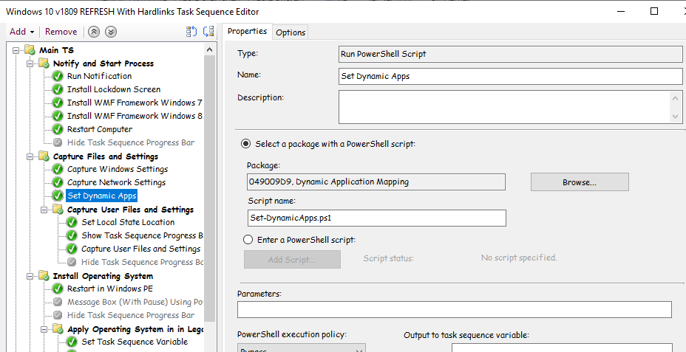
Task Sequence Step

Slide 9
Repo
https://github.com/johnyoakum/ApplicationMapping

