Slide 1
Introduction
Inter-IC Sound(I2S) or Integrated Inter chip Sound is a digital audio serial bus interface transmission standard defined by Philips in February 1986 (revised June 1996).
It aims to transmit digital audio data between the internal devices of the system, such as CODEC, DSP, digital input/output interface, DAC, ADC and digital filter.
The difference between I2C bus is used to connect the microcontroller and its peripheral devices while the I2S bus focuses on the audio data transmission between digital audio devices.

Slide 2
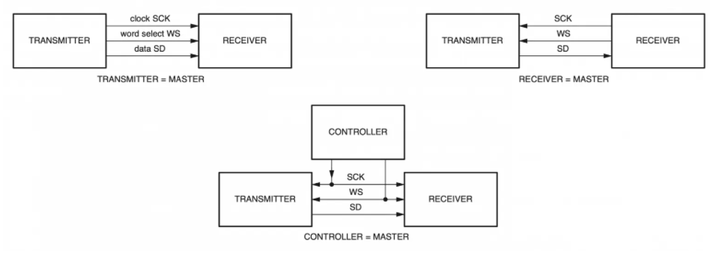
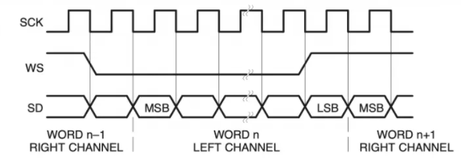
I2s configuration

Slide 3
The bus has only to handle the audio signal, while the other signals, such as sub-coding and control, are transferred separately. To minimize the number of pins, there are three lines defined in the I2S bus:
word select line (WS):
-A word select line is the channel selection signal,indicating the channel selected by the transmitter.
WS = 0, channel 1 (left)
WS = 1, channel 2 (right)
-WS may change either on a trailing or leading edge of the serial clock, but it doesn’t need to be symmetrical.
In the slave, the signal is latched on the leading edge of the clock signal. The WS line changes one clock period before the MSB is transmitted allows the slave transmitter to derive synchronous timing of the serial data that will be set up for transmission. Furthermore, it enables the receiver to store the previous word and clear the input for the next word.

Slide 4
Clock Line:
Officially “continuous serial clock (SCK)”, typically written “bit clock (BCLK)”, is the synchronization signal in the module which is provided externally in slave mode and internally generated in master mode.
SCK = Sampling frequency (e.g. 48kHz, 44.1kHz, etc) * word length (16bit, 24bit, 32bit) * 2 (left and right channels)
Take propagation delays between the master clock and the data and/or word select signals into account, the total delay is the sum of:
the delay between the external(master) clock and the slave’s internal clock;
the delay between the internal clock and the data and/or WS signals.

Slide 5
Data Line:
The serial data is transmitted in two’s complement with the MSB first. The MSB is transmitted because of different word lengths between transmitter and receiver.
If the system word length is greater than the transmitter word length, the word is truncated (LSBs are set to ‘0’) for data transmission.
If the receiver is sent more bits than its word length, the bits after the LSB are ignored.
If the receiver is sent fewer bits than its word length, the missing bits are set to zero internally.
The MSB has a fixed position, whereas the position of the LSB depends on the word length. The sender always sends the MSB of the next word one clock period after the WS changes.
Serial data sent by the transmitter may be synchronized with either falling or rising edge of the clock signal.

Slide 6
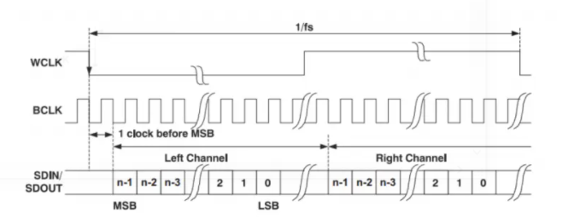
I2S Operation Mode
Based on the position of SD relative to SCK and WS, I2S is divided into three different operation modes: Phillips Standard, Left Justified Standard, Right Justified Standard.
Phillips standard:
Phillips Standard is a special case of left-justified, which is delayed by a change of one clock bit from the standard left justified standard. The data MSB of both left and right channels are valid after the second SCK / BCLK rising edge after WS changes.

Slide 7
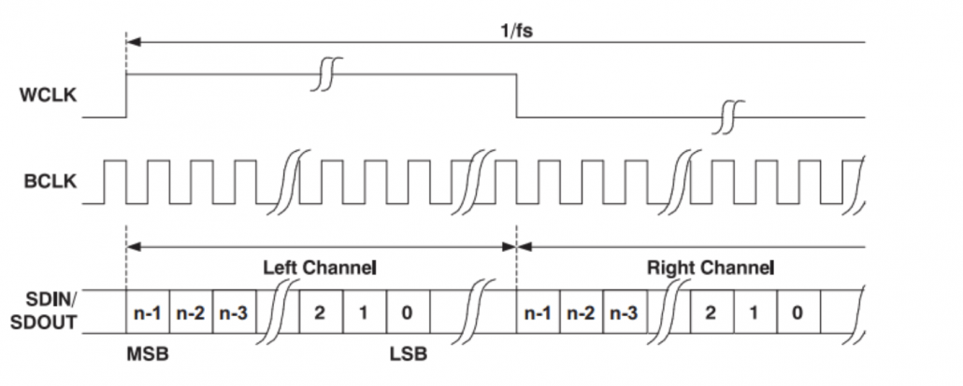
2. Left justified standard :
Left Justified Standard is not widely used, it is not delayed by one clock relative to BCLK. The MSB of both channels is valid after the first rising edge of SCK / BCLK after WS changes.
3. Right justified standard:
The LSB of the left channel is valid at the rising edge of SCK / BCLK before the falling edge of WS, while the LSB of the right channel is valid at the rising edge of SCK / BCLK before the rising edge of WS.
Compared to Left Justified Standard, the disadvantage of Right Justified Standard is that the receiving device must know the word length of the data to be transmitted in advance.
Please be careful, for Right Justified Standard and Left Justified Standard:
WS = 1, channel 1 (left)
WS = 0, channel 2 (right)
It is opposite to the Phillips Standard!

