Slide 1
AudioTrack to AudioFlinger code walk through upto creating mixer thread
Android’s Audio system is divided into two parts, one is the audio policy management, namely the Audio Policy module; the other is the AudioFlinger module, which is responsible for direct interaction with the Audio Hardware Module.
1.Framework or Java layer through JNI, new AudioTrack (); 2.According to StreamType and other parameters, through a series of calls to getOutput (); 3.If necessary, AudioFlinger opens different hardware devices according to StreamType; 4.AudioFlinger creates a mixing thread for the output device: MixerThread (), and returns the id of the thread to AudioTrack as the return value of getOutput ();

Slide 2
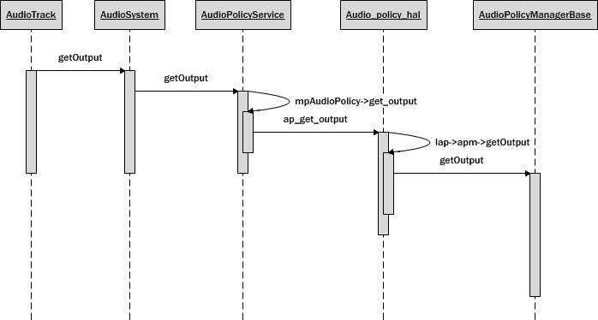

Slide 3
The implementation of getOutput() is divided into three steps :
AudioPolicyManagerBase::getOutput()
{
1. Obtain the strategy according to the incoming stream type.
routing_strategy strategy = getStrategy((AudioSystem::stream_type)stream);
2. Obtain the output device according to the strategy
audio_devices_t device = getDeviceForStrategy(strategy, false /*fromCache*/);
3. Turn on the output device
mpClientInterface->openOutput( device, …….);
}
AudioFlinger::openOutput( audio_module_handle_t module, audio_devices_t *pDevices,
uint32_t *pSamplingRate,
audio_format_t *pFormat,
audio_channel_mask_t *pChannelMask,
uint32_t *pLatencyMs,
audio_output_flags_t flags )

Slide 4
audio_io_handle_t AudioFlinger::openOutput(…)
{
outHwDev = findSuitableHwDev_l(…); // Find the corresponding audio interface.
2. hwDevHal = outHwDev->hwDevice(); // Load the corresponding Hal for the interface.
3. hwDevHal->open_output_stream(…); // Open an output stream for the device.
adev_open_output_stream(…)
4. Create PlaybackThread/Mixer/Offload thread depending on the audio_output_flags_t.
if ((flags & AUDIO_OUTPUT_FLAG_DIRECT)
thread = new DirectOutputThread(this, output, id, *pDevices);
else
thread = new MixerThread(this, output, id, *pDevices);
}

Slide 5
AudioFlinger:: findSuitableHwDev_l(audio_module_handle_t module, uint32_t devices)
{
1. if module is 0, the request comes from an old policy manager and we should load well known modules
if (module == 0)
{
for (size_t i = 0; i < ARRAY_SIZE(audio_interfaces); i++)
loadHwModule_l(audio_interfaces[i]);
}
else
{
// check a match for the requested module handle AudioHwDevice *audioHwdevice = mAudioHwDevs.valueFor(module);
then try to find a module supporting the requested device.
for (size_t i = 0; i < mAudioHwDevs.size(); i++)
audio_hw_device_t *dev = mAudioHwDevs.valueAt(i)->hwDevice;
return dev;
}

Slide 6
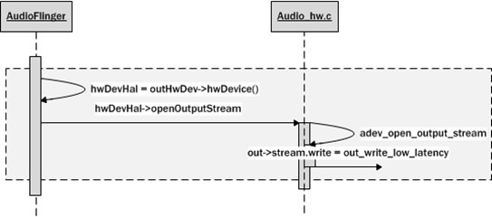

Slide 7
loadHwModule_l() loads the specified audiointerface, such as "primary", "a2dp" or "usb".
AudioFlinger::loadHwModule_l(const char *name)//
{
1. load the library file needed by the device
int rc = load_audio_interface(name, &dev);
2. determine whether the audio interface has been successfully initialized
rc = dev->init_check(dev);
3. if this device supports the master volume, set it
dev->set_master_volume(dev, mMasterVolume)
4. Add the loaded device to the mAudioHwDevs key-value pair, where the key value is generated by nextUniqueId. This ensures that the audiointerface has a globally unique id number.
audio_module_handle_t handle = nextUniqueId();
mAudioHwDevs.add(handle, new AudioHwDevice(name, dev, flags));
return handle;
}

Slide 8
static int load_audio_interface(const char *if_name, audio_hw_device_t **dev)
{
1. hw_get_module_by_class(AUDIO_HARDWARE_MODULE_ID, if_name, &mod);
2.audio_hw_device_open(mod, dev);
}
open(module, AUDIO_HARDWARE_INTERFACE, (struct hw_device_t**)device);
adev_open(const hw_module_t* module, const char* name,
hw_device_t** device)
}

Slide 9
