Slide 1
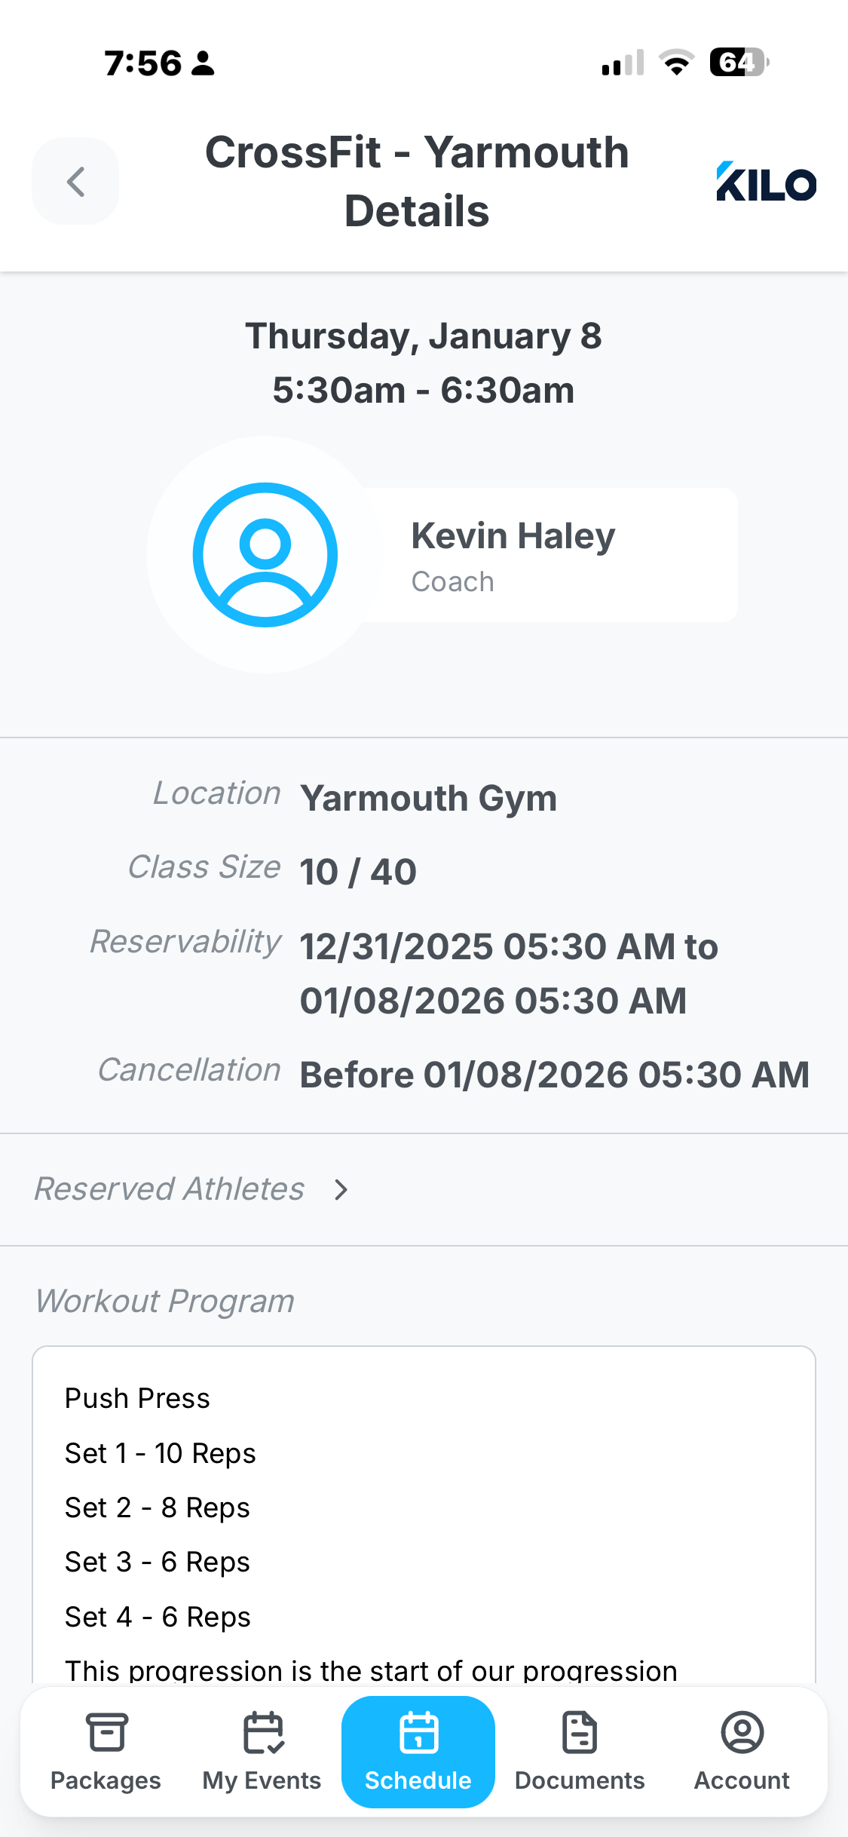
Gym name
Class date and time window
Coach name
Reservation starting and ending date and time (window)
Location Name. Lookup associated with Gym
Registered users / Max class size
Cancellation window (before a no-show is registered by the system if a coach see user not attending)
List of reserved users with full name and avatar
Workout description with Markdown formatting

Slide 2
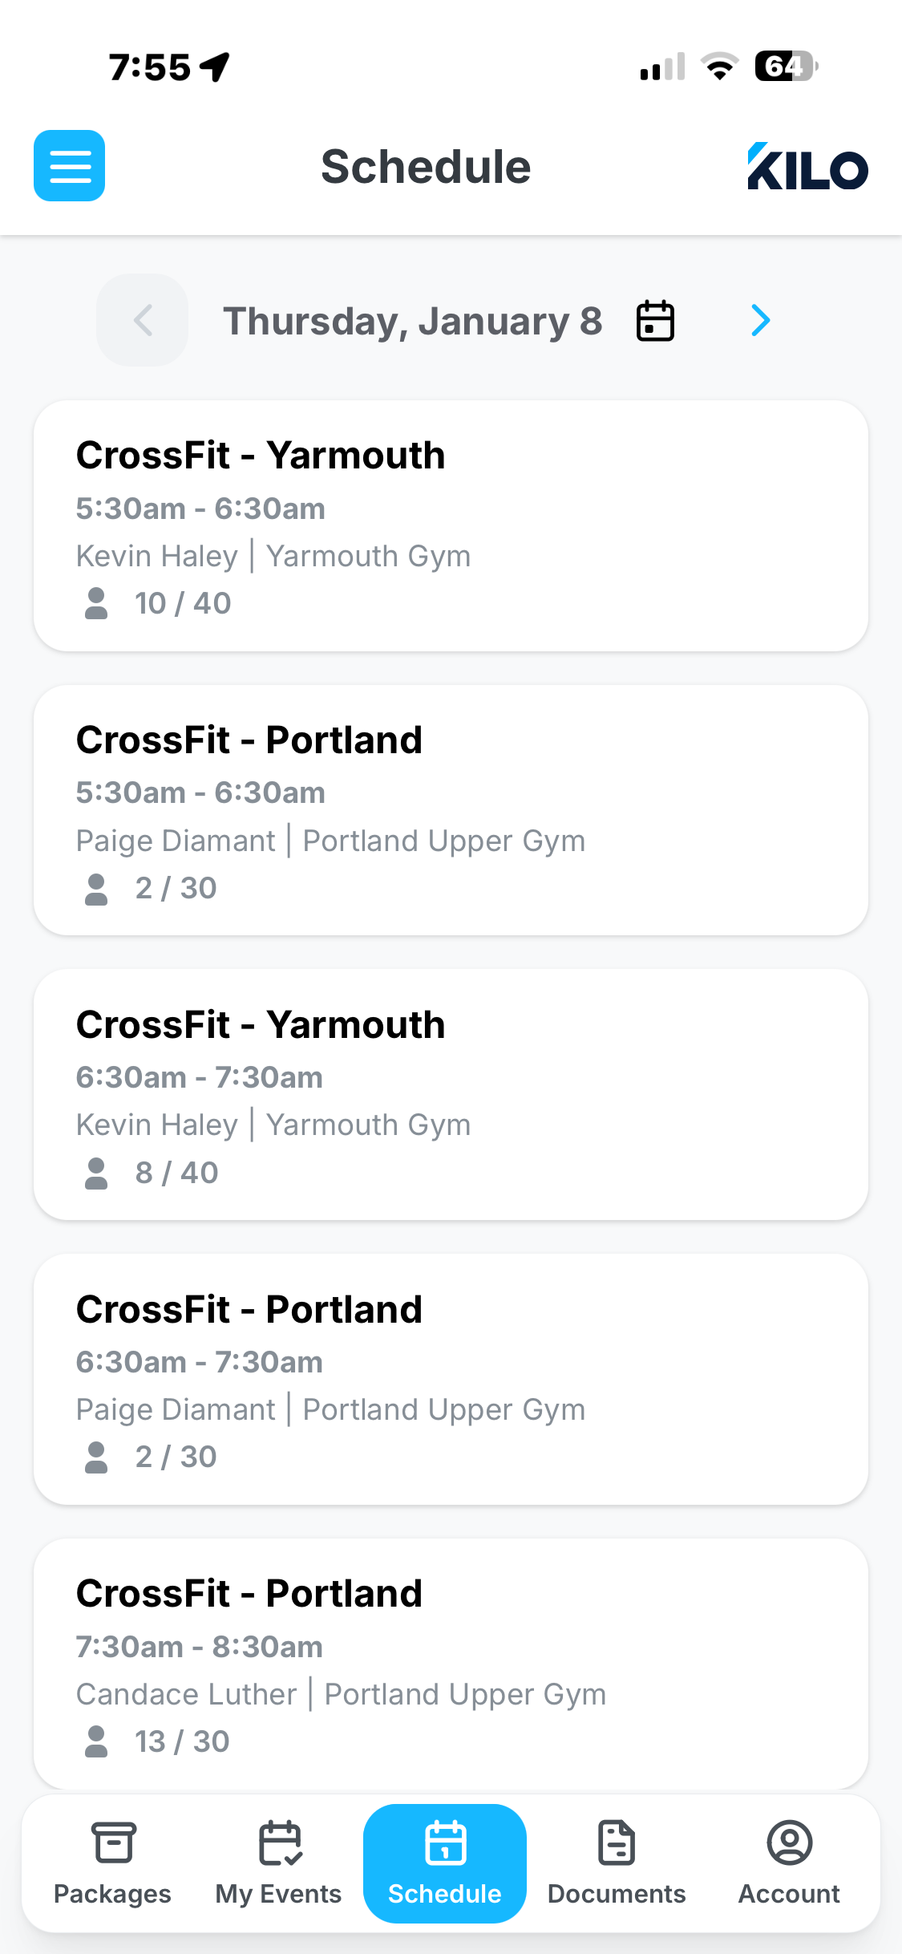
Date pager. Allows users to go forward or backwards as far as records extend.
Class details cards showing all classes from all gyms for the member.
Reserve
Workout event title
Cancel
Reserve or Cancel reservation toggle button
Reserve
Clicking the card takes user to full details of workout, including another Reserve/Cancel toggle button
Reserve
Details are Gym, Time, Coach, Location, Time window, Reserved / Class limit

Slide 3
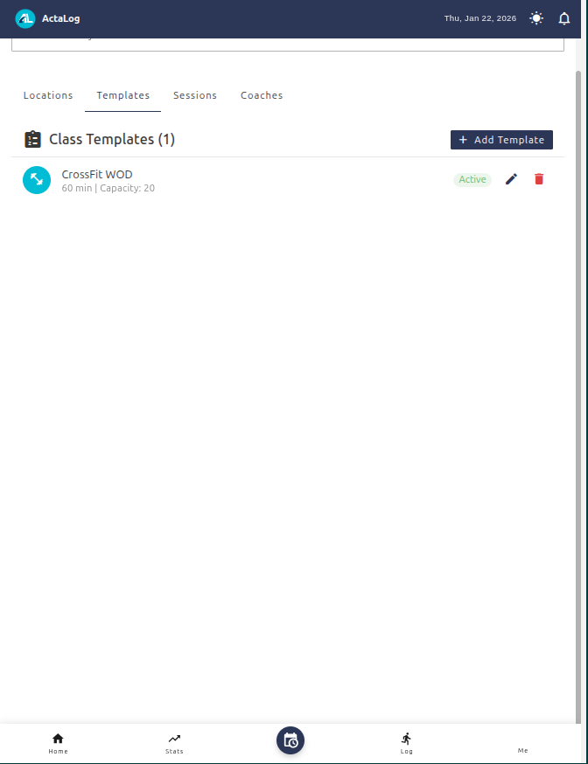
Explain how a templates works and how it is used here.

Slide 4
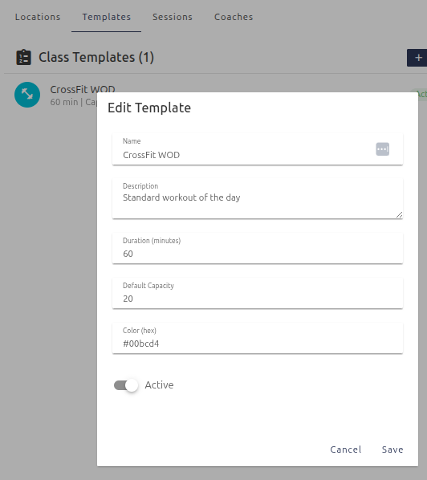

Slide 5
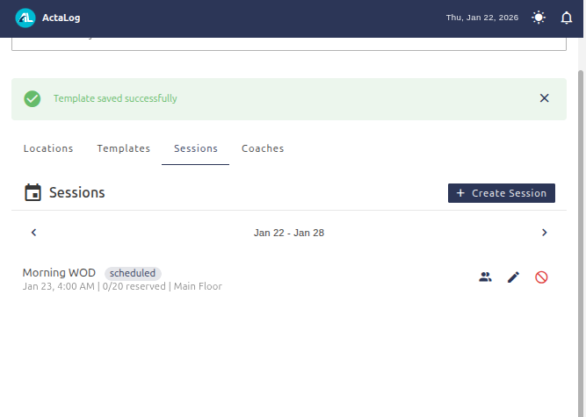

Slide 6
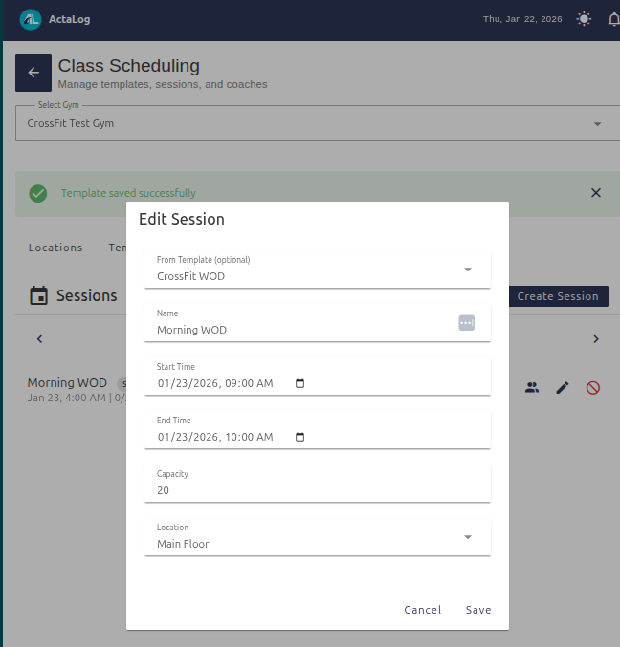

Slide 7
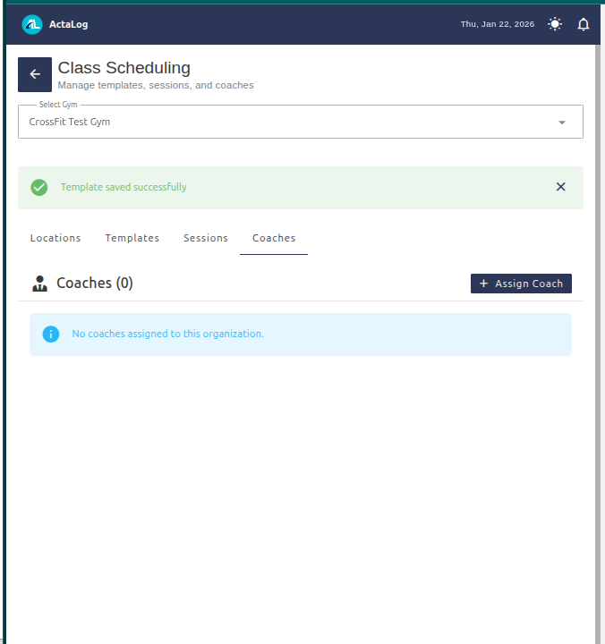

Slide 8
