Slide 1



Leads to Recurrence Pattern

Slide 2
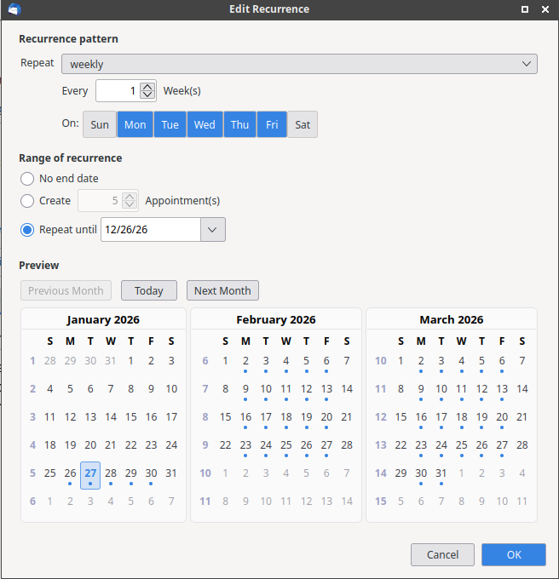
Back button. Start adding breadcrumbs to all screens
Recurrence Pattern
Recurrence dates and end date
3 month view
Dots on days when the class would occur. Clicking the day would open the screen to edit the coaches, assign a workout, and other details.

