Slide 1
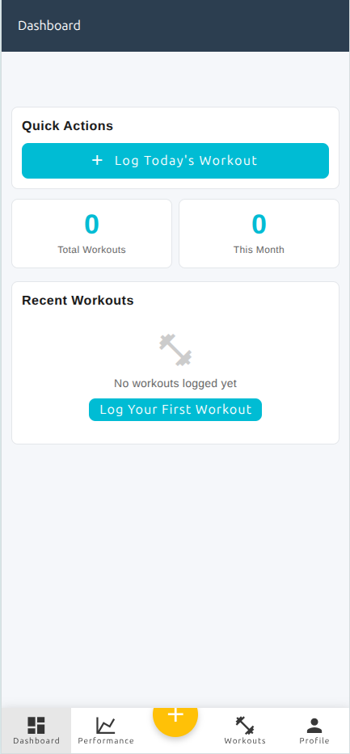

ActaLog
design/logo.svg. Link to Dashboard
Saturday, November 13, 2025
Today’s date
M | T | W | T | F | S | S
1
1
2
3
4
5
6
7
Cards showing workouts in the last 7 days. Clicking a card for the day shows a detailed screen of the workout. A workout with a Personal Record gets badge next to the element.
This month. Colored circles had workouts. Gray circle did not. Circle include today and previous days. Add a button on the left of the calendar to see previous month
8
9
10
11
12
13
Workouts in last 7 Days
Tue Nov 2
Named WOD 1
Named WOD 2
Strength 1
Change the Profile icon to be an avatar, which could be an image if uploaded by the user on the Profile screen. This the link to lead to a new screen called Settings. One setting will be Profile
Make this button smaller
Thu Nov 4
Named WOD 3
Named WOD 4
Strength 2
+
JZ

