Slide 1

Readable geoprocessing for everyone
Spatial analysis that a non-programmer can write, reproduce, and share.
Easy wins every time
Decision-maker & analyst briefing

Slide 2
THE OPPORTUNITY
Spatial questions are everywhere.
The people who need the answers — analysts, scientists, planners — mostly aren't programmers.
Yet to automate the work — to make it repeatable and shareable — today's tools demand that they write code. So the work waits, or doesn't happen.
niva · Easy wins every time
2

Slide 3
THE PROBLEM
Automating QGIS means writing PyQGIS
To script even simple geoprocessing in QGIS today, you must:
Initialize a QgsApplication boilerplate before any work begins
Memorize algorithm IDs like native:buffer, native:dissolve, native:clip
Build ALL_CAPS parameter dicts and juggle TEMPORARY_OUTPUT between steps
Thread each tool's output into the next by hand, step after step
That's a programming task — out of reach for the GUI-first analysts who need it most, and tedious even for those who can.
niva · Easy wins every time
3

Slide 4
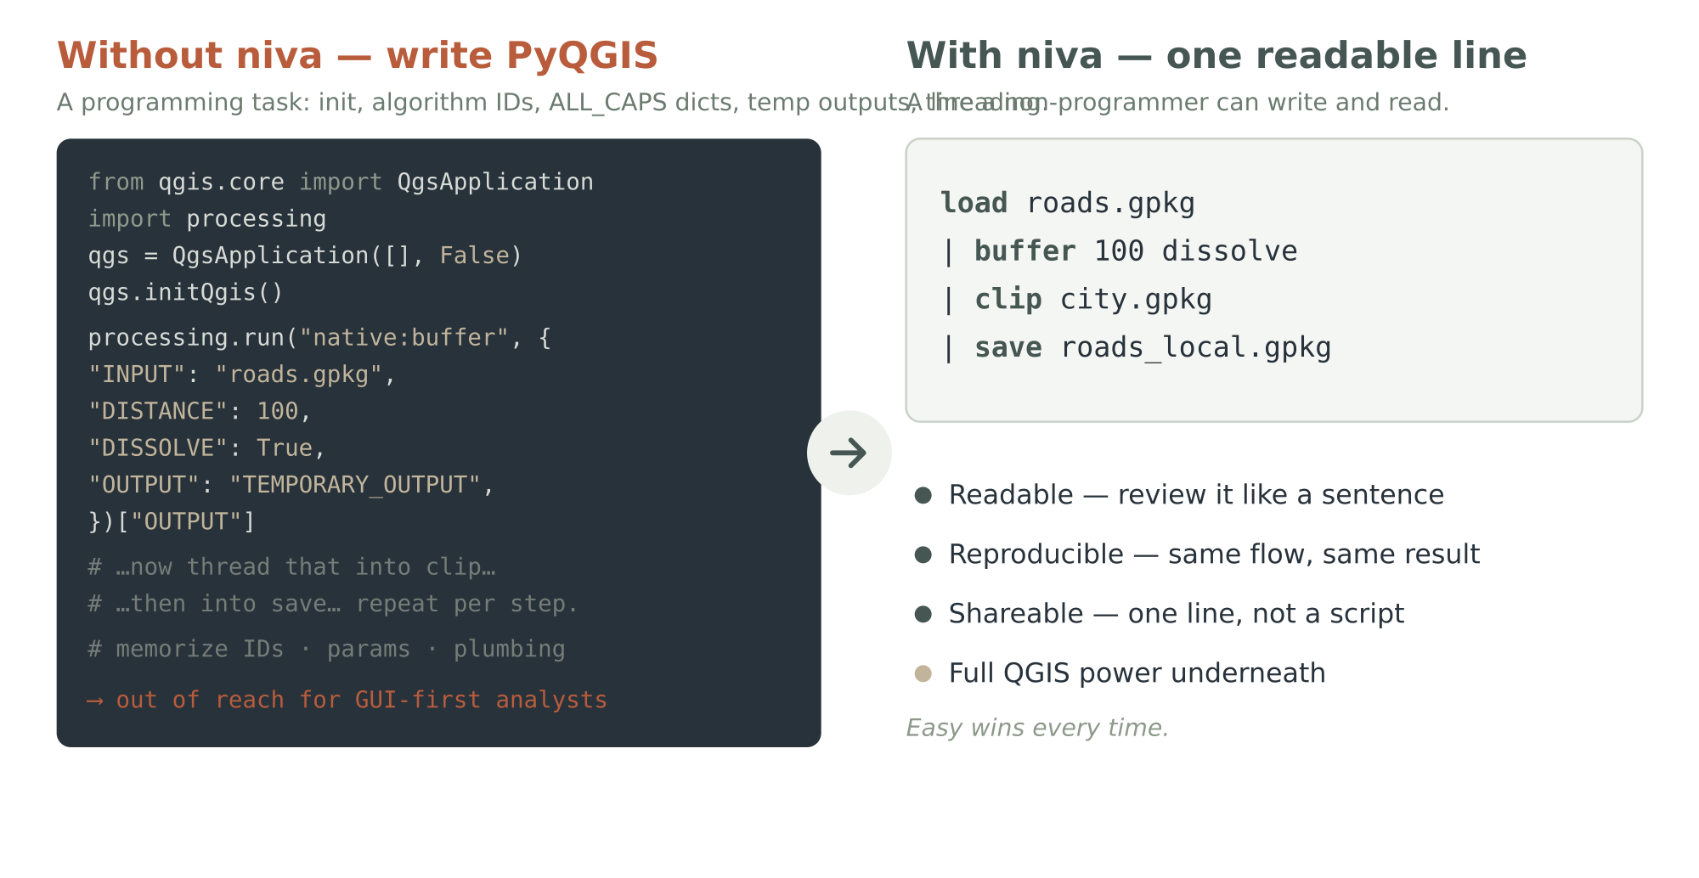
THE SHIFT
Automation shouldn't require a programmer
niva · Easy wins every time
4

Slide 5
THE PRODUCT
Meet niva
A concise, readable text-pipeline grammar for QGIS geoprocessing — for people who don't want to write PyQGIS.
load roads.gpkg | buffer 100 dissolve | clip city.gpkg | save roads_local.gpkg
A whole pipeline on one line — that a non-programmer can write and read — running on QGIS's own Processing algorithms underneath.
Easy wins every time.
niva · Easy wins every time
5

Slide 6
AUDIENCE
Who niva is for
Decision-makers
Data scientists (non-programmers)
Downstream consumers
Faster answers without hiring scarce GIS programmers. Work that's auditable, reproducible, and shareable across the org.
Already use Marimo for repeatable, shareable analysis. Now add geoprocessing — in the same readable, reactive workflow.
Explore the results in QGIS, in Marimo, or as static files — whichever fits, no GIS expertise required.
niva · Easy wins every time
6

Slide 7
MARIMO-NATIVE
It fits the workflow you already have
Marimo is how your team makes analysis repeatable and shareable. niva runs right inside it:
Write niva in a Marimo cell a readable pipeline beside your Python and charts
Reactive results change an input, the map and tables update — live
Repeatable the notebook is the analysis; re-run it any time, same result
Shareable hand someone the notebook, or export it — no setup ritual
No new tool to adopt — niva meets your people where they already work.
niva · Easy wins every time
7

Slide 8
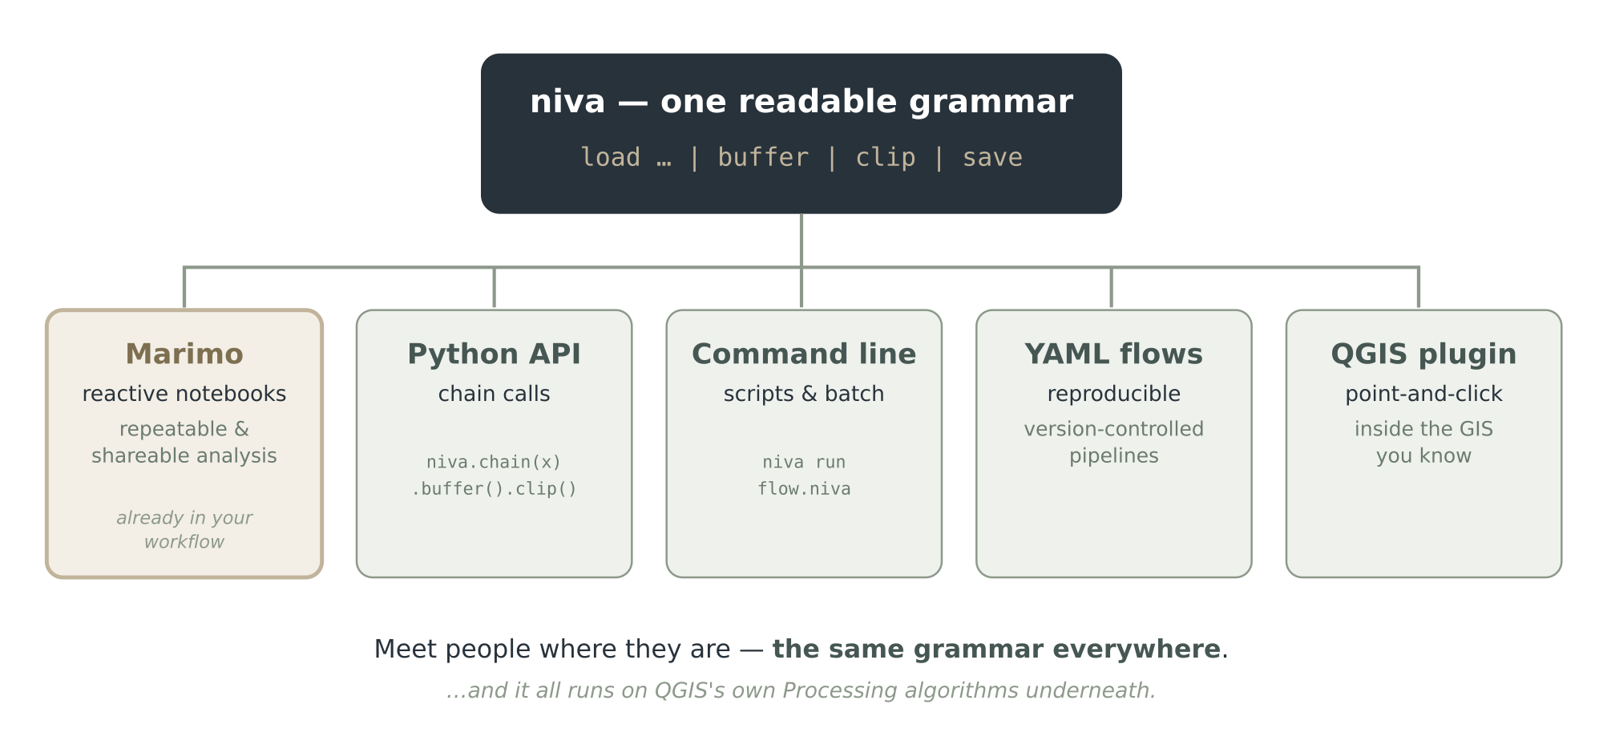
FLEXIBLE BY DESIGN
One grammar, many surfaces
niva · Easy wins every time
8

Slide 9
TRUST THE RESULT
Reproducible & shareable — by design
The value decision-makers care about most: results you can re-run, audit, and defend.
Pipelines are the record the one-line flow (or YAML) IS the documentation
Provenance as a byproduct every step auto-recorded as lineage metadata
Assess your inputs profile incoming data for quality before you trust it
Version-controlled flows diff and review analysis like any other text
niva · Easy wins every time
9

Slide 10
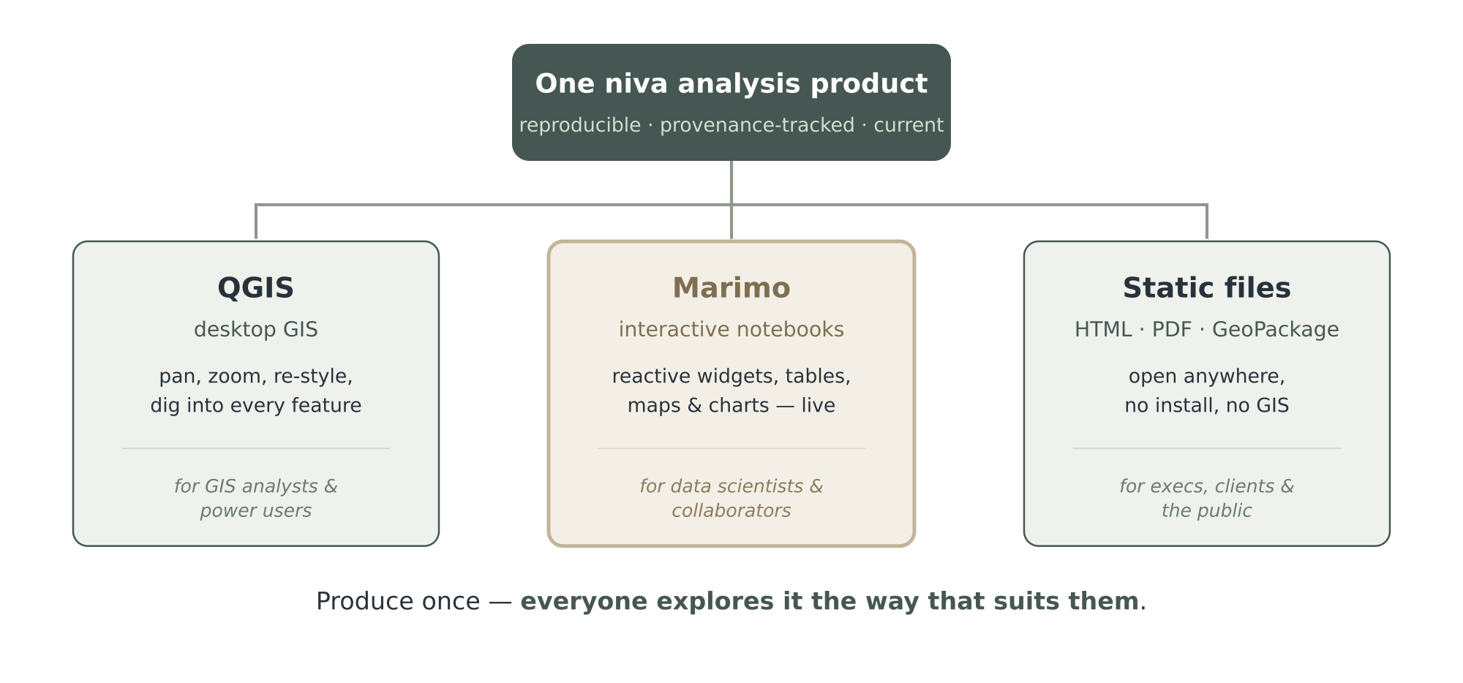
FOR EVERY STAKEHOLDER
Produce once — explore it anywhere
niva · Easy wins every time
10

Slide 11
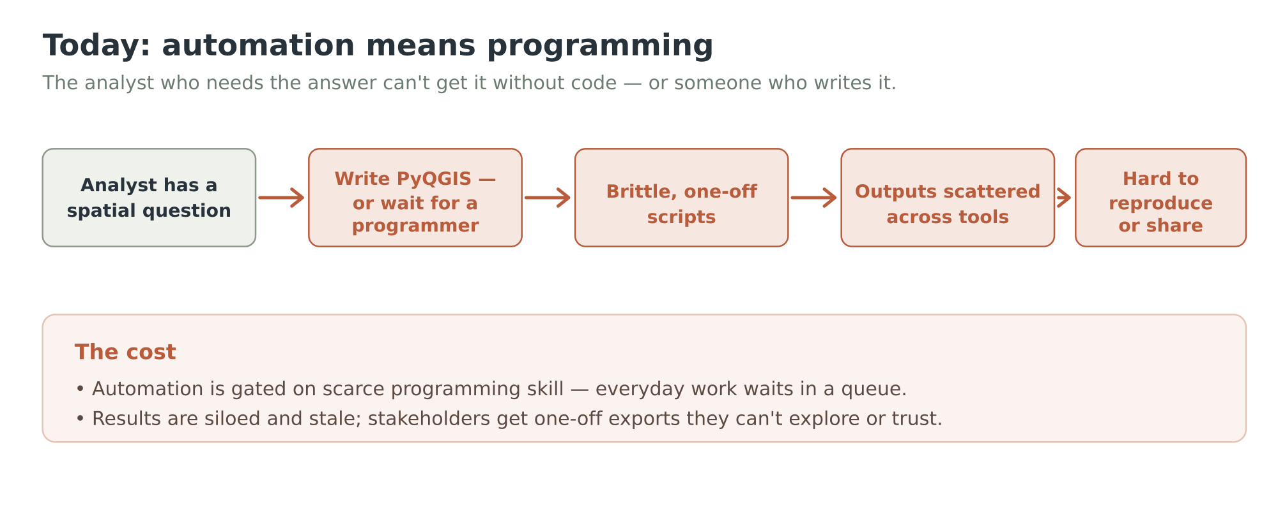
WITHOUT NIVA
The workflow today
niva · Easy wins every time
11

Slide 12
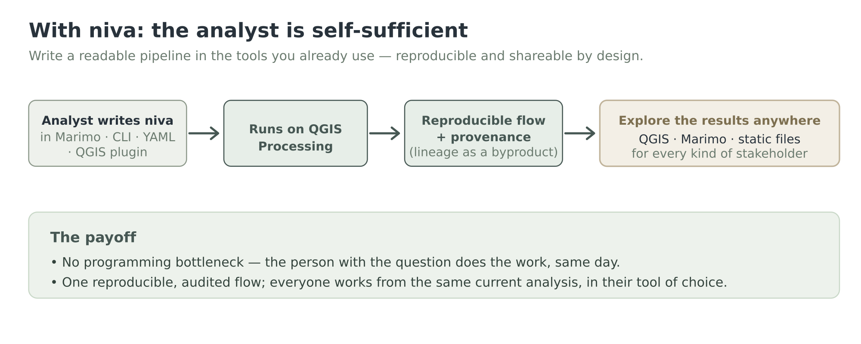
WITH NIVA
The workflow with niva
niva · Easy wins every time
12

Slide 13
THIN, NOT LIMITING
All of QGIS — in plain language
878
406
SQL
Processing algorithms
expression functions
SpatiaLite & PostGIS
niva is a thin wrapper — friendly verbs mapped onto QGIS's own algorithms, not a re-implementation of GIS. You get the full power of the world's leading open-source GIS, reachable in one readable line.
niva · Easy wins every time
13

Slide 14
THE TAILWINDS
Why niva, why now
QGIS is the de-facto open GIS ubiquitous, trusted, free — the foundation we build on
Reproducible analysis is the norm Marimo and notebooks are how modern teams work
The automation gap is real & unserved GUI analysts still can't automate without code
Open and clean-room GPLv3, built on PyQGIS; no proprietary lock-in to fear
niva · Easy wins every time
14

Slide 15
THE VALUE
What niva delivers
Speed
Capacity
answers the same day — no queue behind a programmer
your existing analysts automate their own work
Trust
Reach
reproducible, provenance-tracked, auditable results
share to QGIS, Marimo, or static files — for anyone
Lower cost
No lock-in
less custom scripting, less specialized hiring
open source, on open foundations
niva · Easy wins every time
15

Slide 16
STATUS · BUILT AND SHIPPING
What's working today
niva ships as a QGIS plugin (v0.62) and on PyPI, and runs real analysis end-to-end on QGIS's own algorithms:
Grammar & engine
Verbs & algorithms
✓ Readable lexer + parser → pipeline stages
✓ Pipe-chaining engine: layer handles, lineage
✓ PyQGIS backend — runs real geoprocessing
✓ 48 alias verbs + built-ins (vector · raster · point cloud)
✓ sql @conn — SELECT → layer, and server-side writes
✓ run — reach ANY of QGIS's 878 algorithms
Every data type
Data, cartography & delivery
✓ Vector · raster · point cloud · mesh discovery
✓ LiDAR: dtm / dsm / hag · GRASS + SAGA hydrology
✓ Landsat / Sentinel-2 / NAIP fusion → NDVI
✓ PostGIS & SpatiaLite — read · write · analyse
✓ project / style · figure / map · show / catalog
✓ Plugin · CLI · Python · LSP · 660+ tests · full docs
niva · Easy wins every time
16

Slide 17
ROADMAP · SHIPPED & NEXT
The road ahead
v0.62
Shipped — available now, on PyPI available now
48 verbs + raster · run → 878 · point clouds + mesh + all-types discovery · GRASS/SAGA hydrology · multispectral fusion · PostGIS read·write·analyse · project / style · figure / map · LSP · plugin · CLI / Python · full docs
v1.0
Stable release
Grammar freeze (SemVer) · worked Marimo–QGIS integration
v2.0
Power features
Named intermediates & variables · SQL-driven quality rules & constraints
v2.x
Service mode
Service / daemon mode · richer layout & symbology export
niva · Easy wins every time
17

Slide 18

Let your analysts do the analysis.
Bring readable, reproducible geoprocessing to the people who need it.
Easy wins every time.
github.com/johnzastrow/niva · Let's run a pilot.

