Slide 1
Teaching agent harness
How a small LLM and plain Python share the work
Lab meeting, October 2026
Notes:
Welcome. Twenty minutes: what the harness does, one tool up close, and what the evaluation showed.

Slide 2
What the harness does
Llama 3.2 3B plans each request and calls tools
  It only reads and writes text
  Tools make the images, sounds, videos and documents
Classifiers screen the request and pick the tools
Perception models turn every file back into text
  Captions for images, transcripts for speech, labels for music
Every stage is timed and color-coded in the trace
Each run writes report.html and trace.json
Notes:
The point: most of the work is plain Python, not AI.

Slide 3

One tool up close: how the harness makes pictures
SDXL-Turbo paints the picture in one step
BLIP writes a caption for the LLM
A safety classifier checks it first
Notes:
This fox came from the image tool: watercolor fox in a snowy forest.

Slide 4
Results
What the evaluation suite measured

Slide 5
Evaluation scores
Change | Score | What it fixed
First system prompt | 1/5 | nothing yet
One tool call per thing asked | 3/5 | speech read out four times
Router scores each clause | 6/6 | the robot's missing music
Document tools added | 11/11 | slides, Word, LaTeX and code
Notes:
Each change was measured with evaluate.py, not judged by eye.

Slide 6
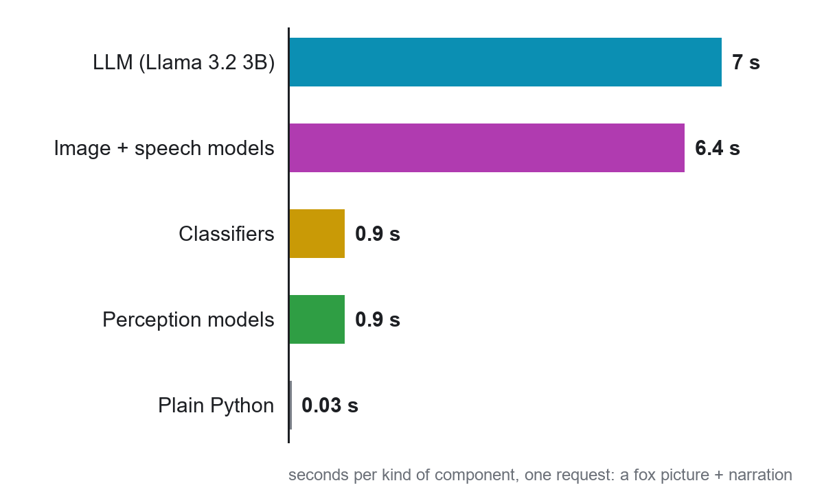
Where the time goes
Notes:
The LLM and the generators take almost all the time.

