Slide 1
Compartment fire tests
Briefing for the fire safety workshop
October 2026
Notes:
Welcome. Fifteen minutes on the test series: the set-up, what we saw, and what comes next.

Slide 2
Test programme
Six tests in a 3.6 m x 2.4 m x 2.4 m compartment
Fuel: wood cribs (tests 1-4) and a sofa mock-up (tests 5-6)
Door opening 0.8 m x 2.0 m, the only vent
Measured: heat release rate, gas temperatures and heat flux
Notes:
The compartment follows the ISO 9705 room geometry.

Slide 3
Instrumentation
Oxygen consumption calorimetry in the exhaust hood
Three thermocouple trees, ten heights each
Heat flux gauges on the floor, 1 m and 2 m from the door
Notes:
Slide 7 has the full table of peak values.

Slide 4
Results so far
We have completed 12 tests of the 16 planned
Flashover in every wood crib test, after 4 to 7 minutes
Peak heat release rate up to 2.4 MW
Notes:
Two tests were repeated after a leak in the hood.

Slide 5
Observations
The hot layer reached the floor of the doorway about 40 seconds before flashover in every crib test
Flames came out of the door 10 to 20 seconds after the gas temperature under the ceiling passed 600 °C
The sofa mock-up grew faster than any crib, close to the ultrafast t-squared curve for its first two minutes
Heat flux at the floor 1 m from the door was about twice the flux at 2 m throughout the growth phase
Smoke filled the room to the door soffit within a minute in the sofa tests, long before the cribs did
Repeat tests agreed within 10 % on peak heat release rate and within 30 seconds on the time to flashover
The exhaust hood captured all of the smoke at every stage, so the calorimetry needs no correction

Slide 6
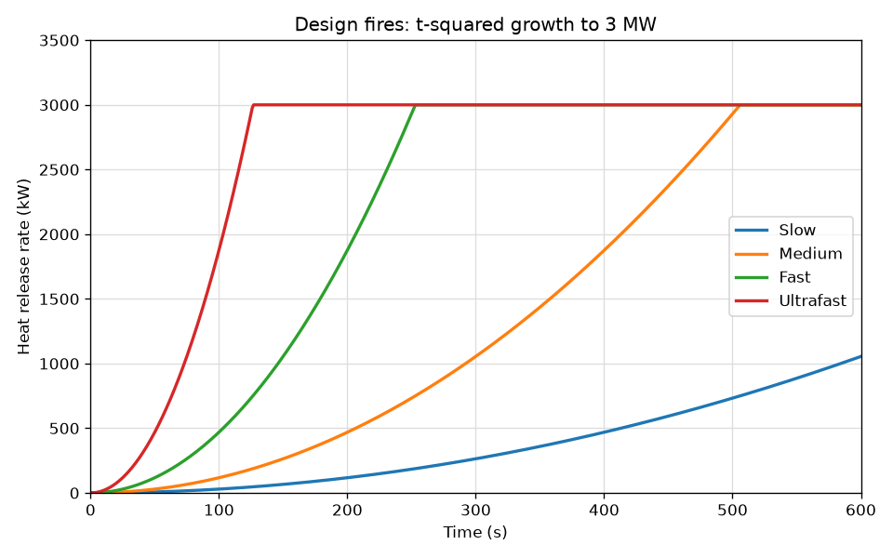
Design fire curves
Notes:
The ultrafast curve is closest to the sofa mock-up.

Slide 7
Peak values by test
Test | Fuel | Peak heat release rate (MW) | Time to flashover (s)
1 | Wood crib | 1.8 | 290
2 | Wood crib | 2.1 | 265
3 | Wood crib | 1.9 | 310
4 | Wood crib | 2.0 | 275
5 | Sofa mock-up | 2.4 | 150
6 | Sofa mock-up | 2.3 | 165
Notes:
Values are one-second averages.

Slide 8
Next steps
Four more tests with a 0.4 m door
Compare the results with FDS models of the room
Report to the workshop in December 2026
Notes:
Questions and discussion.

