Slide 1
Bay Area Bike Share Analysis

Slide 2
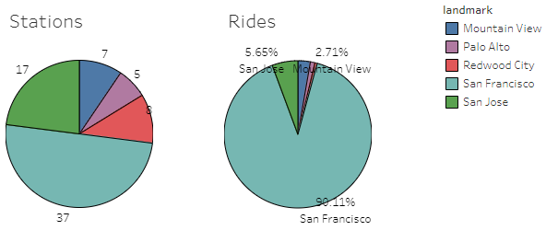
What is the Bay Area Bike Share?
The Bay Area Bike Share system allows users to rent bicycles for short journeys between stations throughout the city. Users can be annual members or short term (1 or 3 days). The system is completely automated for users.
There are 74 stations across 5 cities in the Bike Share system, with an average of 17 docks per station.
50% of the stations and docks are located in San Francisco, but it makes up 90% of the system use.
The data we analyze here came from rides between August 29, 2013 and August 31, 2015.

Slide 3
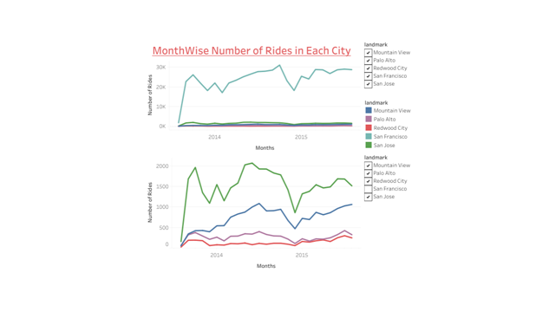
In the above graph, its very clear that Number of rides in San Francisco is much higher than all other cities. Average number of rides in 733 Days is 914 rides per day.

Slide 4
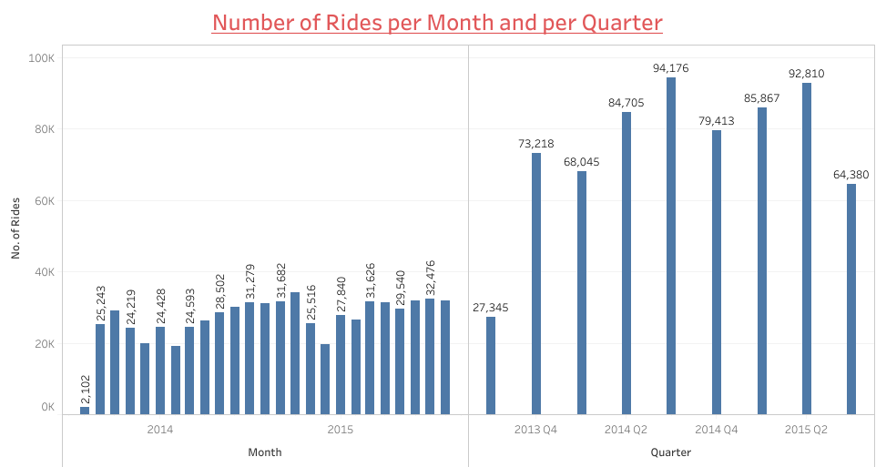
There were 6,69,959 total rides in 2 years and Average time per ride is 18 minutes and 28 seconds. In Palo Alto, average time per ride is 71 minutes and 19 seconds, which is the highest value in any city. Whereas in San Francisco, average time per ride is 17 minutes and 7 seconds, which is the lowest value in any city.

Slide 5
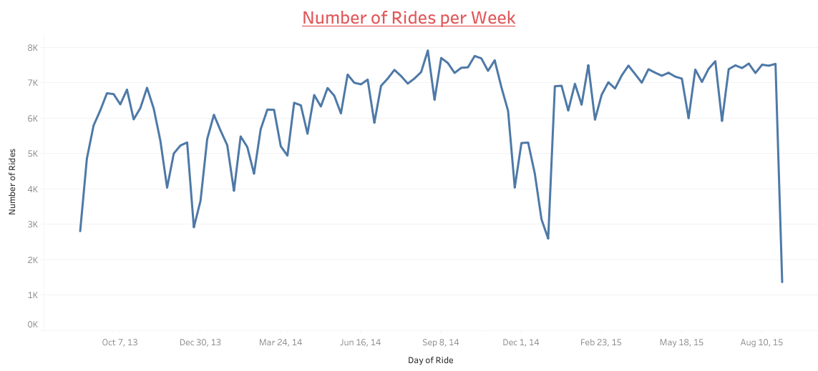
This chart is showing consumption of Bikes on a weekly basis. There is a huge difference in usage of bikes over weekend and in weekdays. Average number of rides in Weekday is 1122, whereas in Weekends average rides are 396.

Slide 6
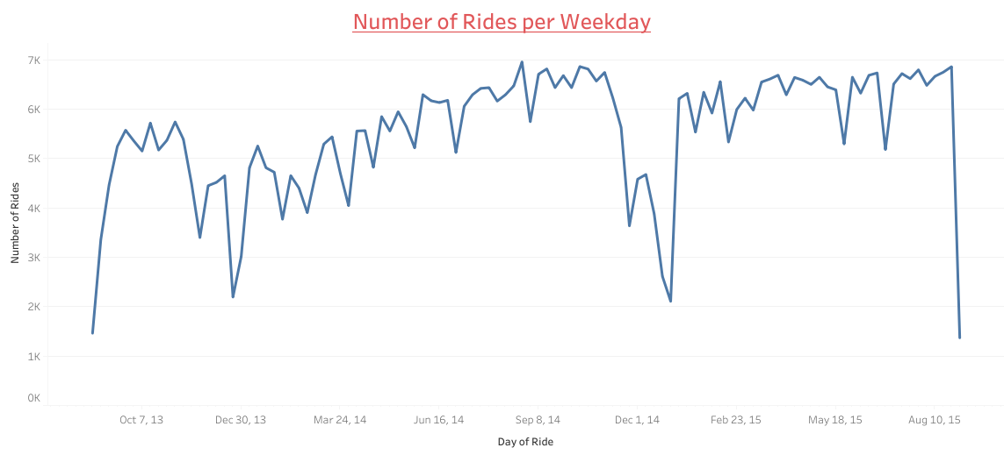
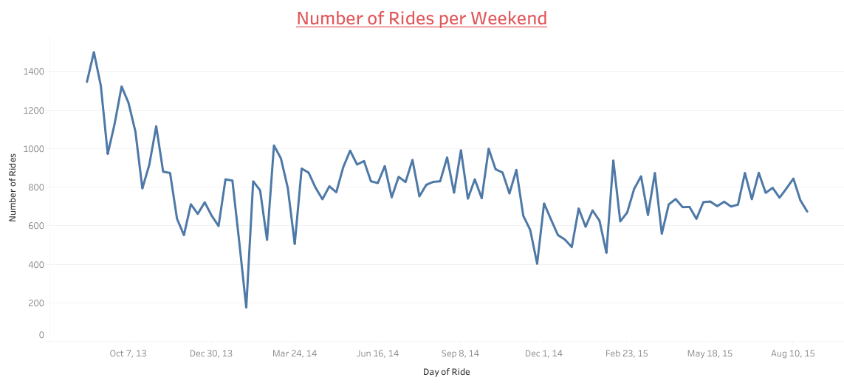

Slide 7
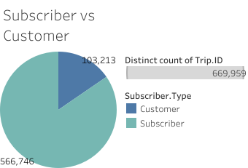
BAY AREA BIKE SHARE USERS???
Around 85% of the rides are availed by annual subscribers. Remaining 15% rides were taken by customers who purchased a daily pass or a 3-day pass.

Slide 8
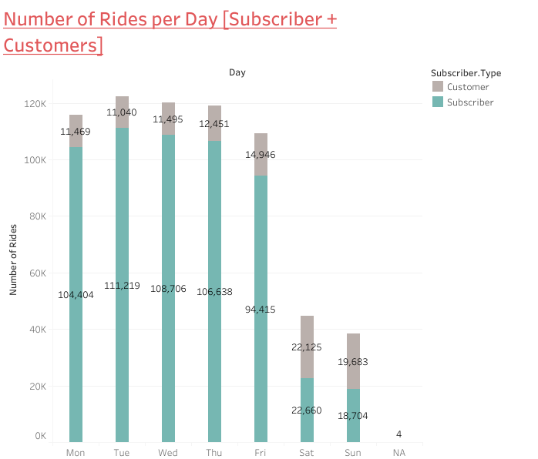
When is Bay Area Bike Share used?
We have already seen that most of the consumers are subscribers and consumption of bikes is marginally greater in weekdays in comparison with weekends.
But, here we can see that there is a huge difference in the ratio of Subscribers vs. Consumers in weekdays and in weekends.
In Weekends this ratio becomes 50:50.

Slide 9
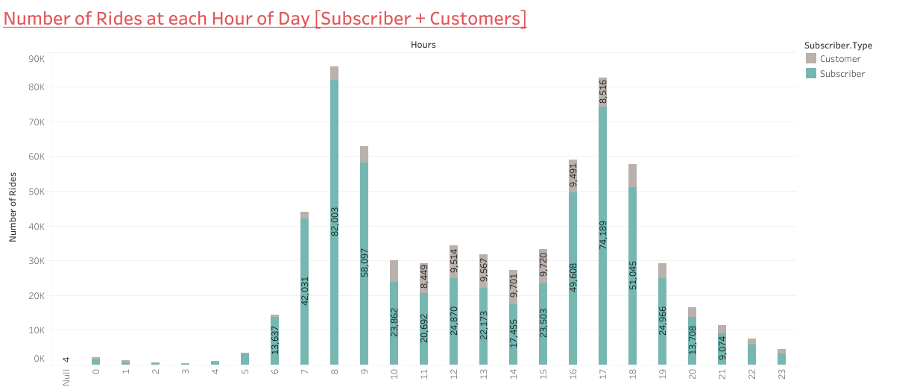
Among Subscribers we can see a spike in use at 7AM to 7PM (More than 15K rides). Consumption is good at office hours, and its clearly visible that its on peak at the login and logout timings of offices. Also, at 12:00 noon time there is a small spike.
Whereas usage consumers is in a good bell curve. Best usage at 11:00 AM to 5:00 PM.

Slide 10
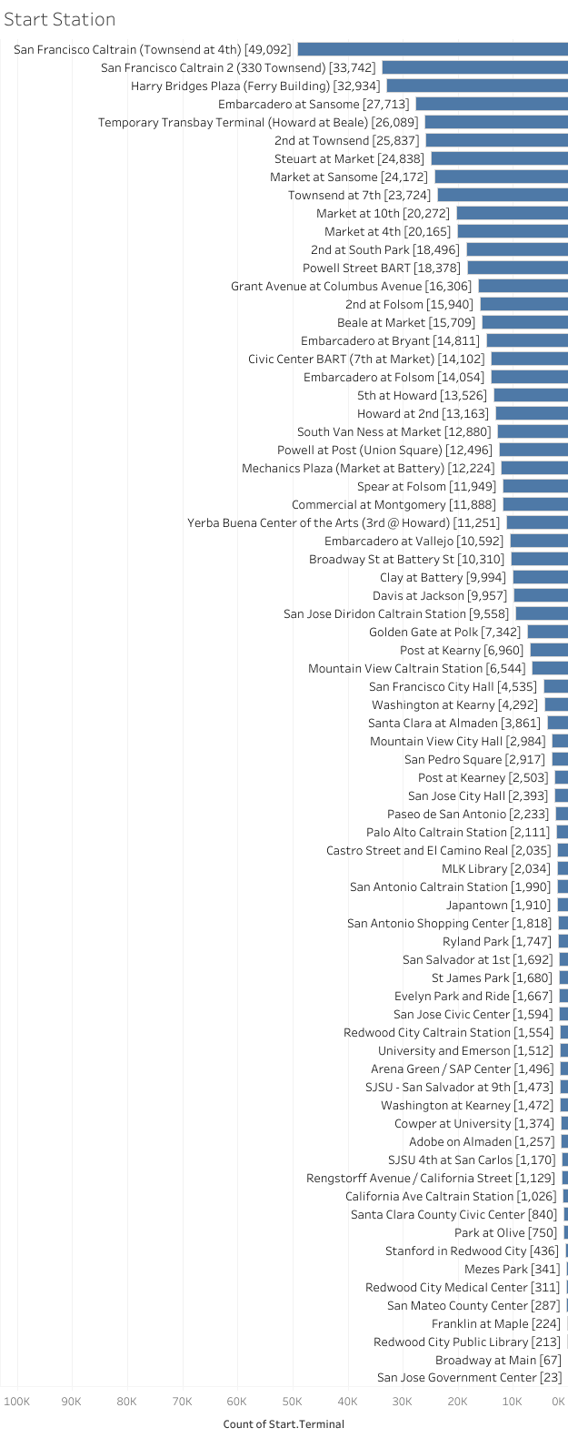
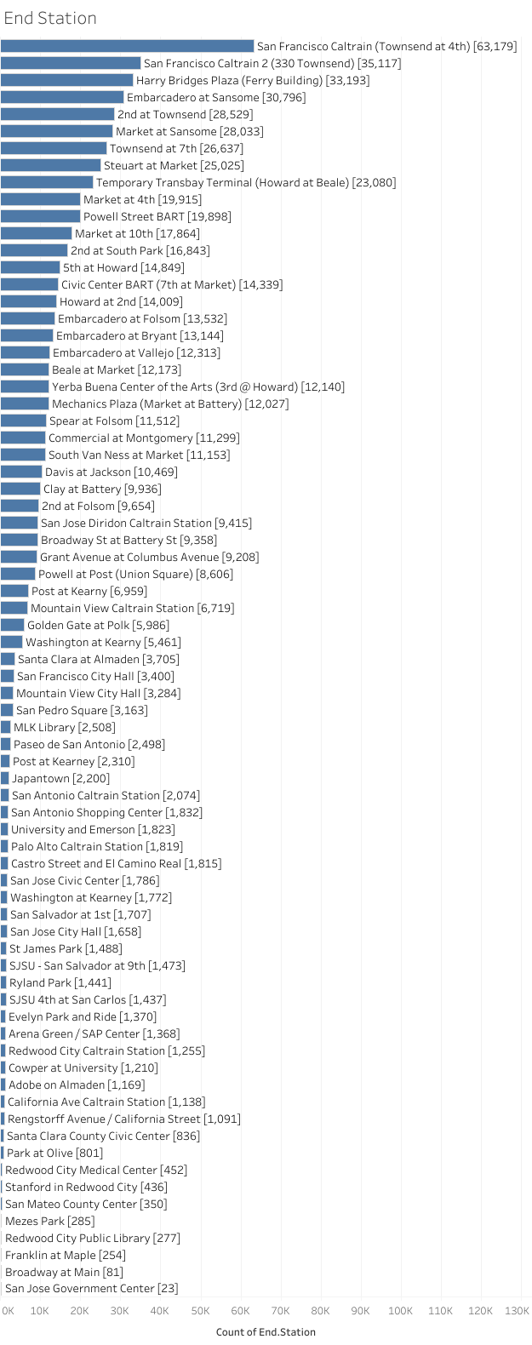
What are the most popular/busy stations ?
Its very clear that San Francisco Caltrain is the most busy station among all 74 stations. Number of rides starting from this station was 49,092, where as this station as a destination there are 63,179 rides.

Slide 11
Below are the most busy stations in each city as a starting point and as a destinations.
Starting Station
Mountain View | Palo Alto | Redwood City | San Francisco | San Jose
Mountain View Caltrain Station [6544] | Palo Alto Caltrain Station [2111] | Redwood City Caltrain Station [1554] | San Francisco Caltrain (Townsend at 4th) [49092] | San Jose Diridon Caltrain Station [9558]
Destination Station
Mountain View | Palo Alto | Redwood City | San Francisco | San Jose
Mountain View Caltrain Station [6654] | Palo Alto Caltrain Station [1720] | Redwood City Caltrain Station [1241] | San Francisco Caltrain (Townsend at 4th) [63167] | San Jose Diridon Caltrain Station [9410]

Slide 12
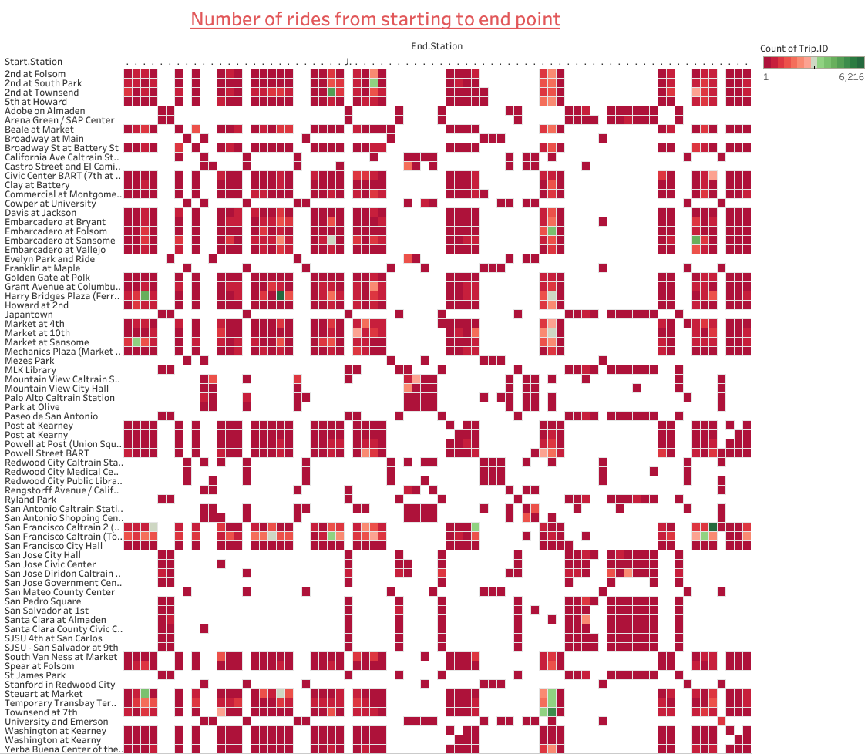

Slide 13
Most Busy Routes?
On the heatmap diagram in the previous slide, we can figure out which is the busiest route among all.
We can Also see with the help of this diagram that number of rides from one station to another station.
We note that riders leaving from most popular station, SF Caltrain, disperse throughout the system, Also riders heading to SF Caltrain similarly tend to come from throughout the system.
Most popular route is from San Francisco Caltrain 2 (330 Townsend) to Townsend at 7th.

Slide 14
Conclusion
Bike share is mostly used by Subscribers, in San Francisco.
Bike services is mostly used on Weekdays while going to or coming from offices.

